Slide 1

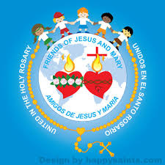
Ministry Friends of Jesus and Mary
Cycle B – III Sunday of Advent
St. John the Baptist, Witness to the Light
John 1, 6-8. 19-28
www.fcpeace.org

Slide 2
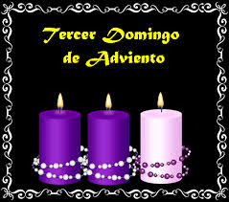
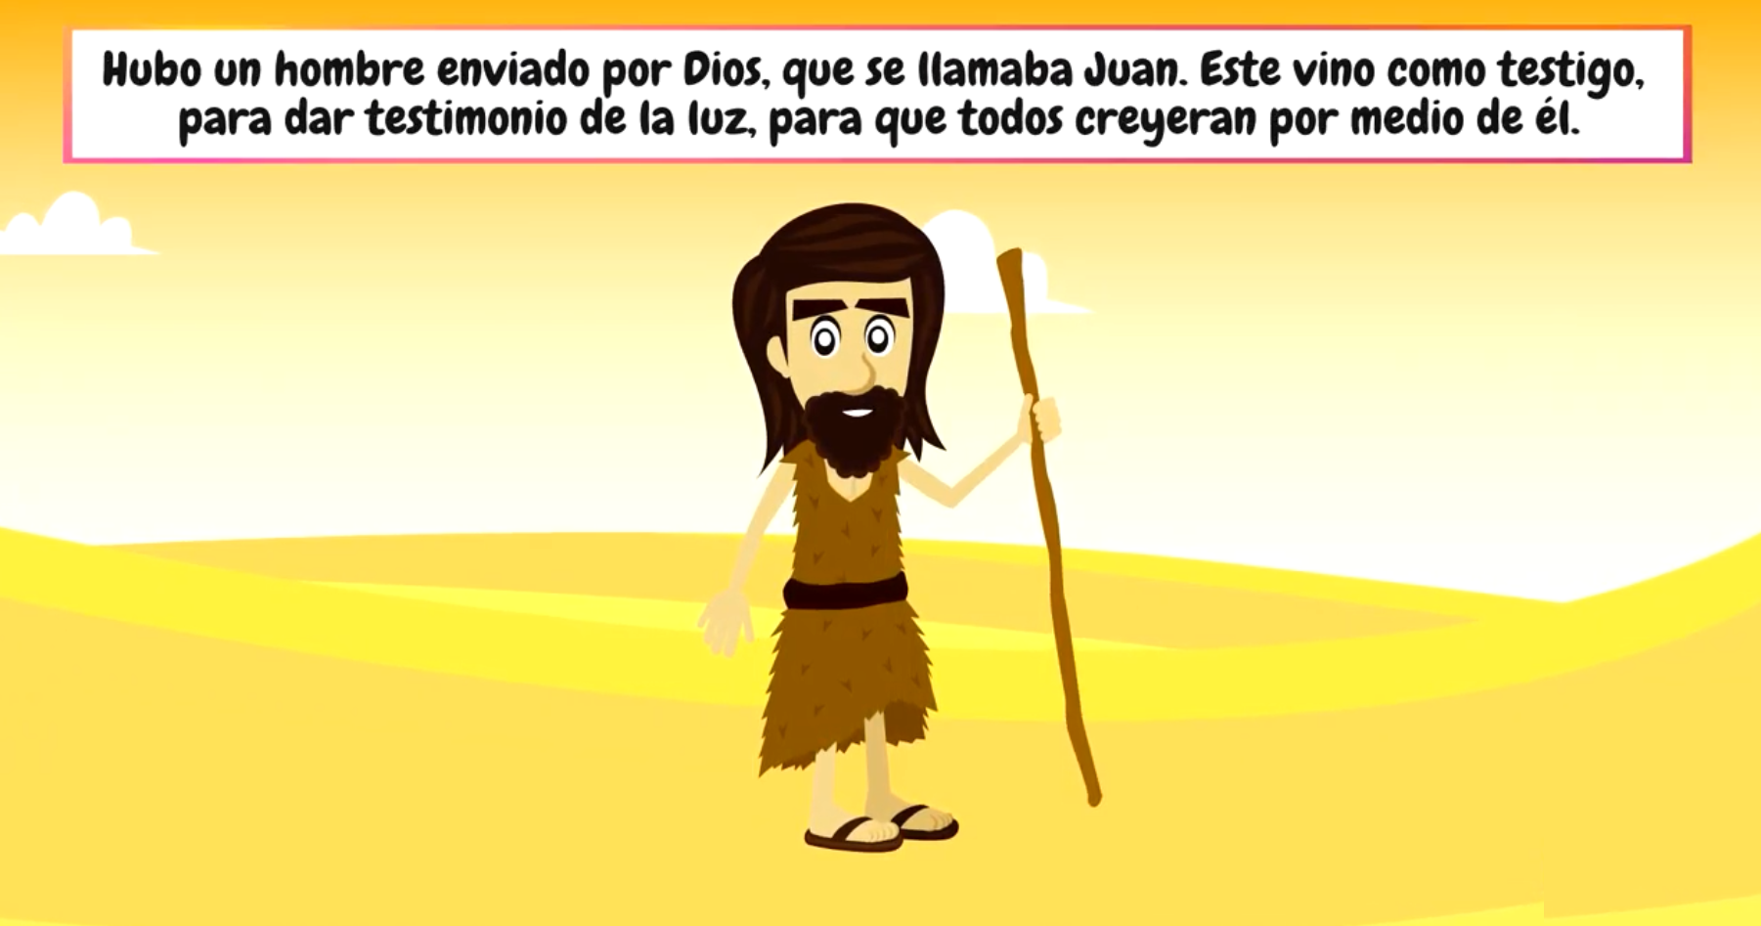
GOSPEL OF ST. JOHN 1, 6-8. 19-28
A man named John was sent from God. He came for testimony, to testify to the light, so that all might believe through him.

Slide 3
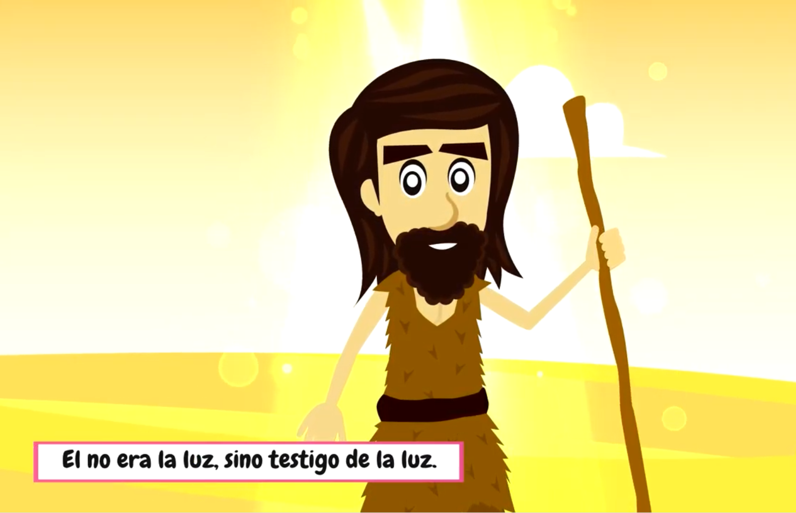
He was not the light, but came to witness to the light.

Slide 4
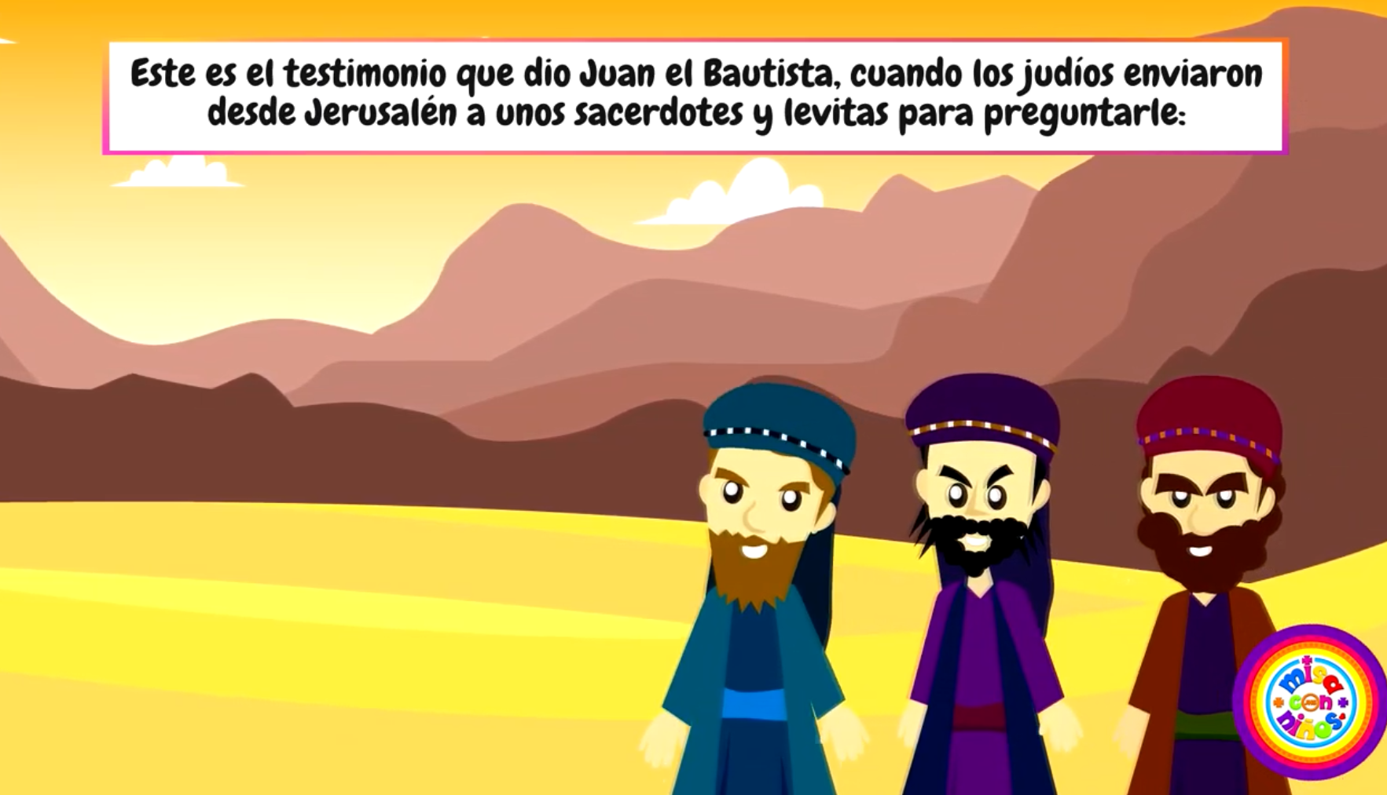
And this is the witness of John. When the Jews from Jerusalem sent priests and Levites to him to ask him, “Who are you?”

Slide 5
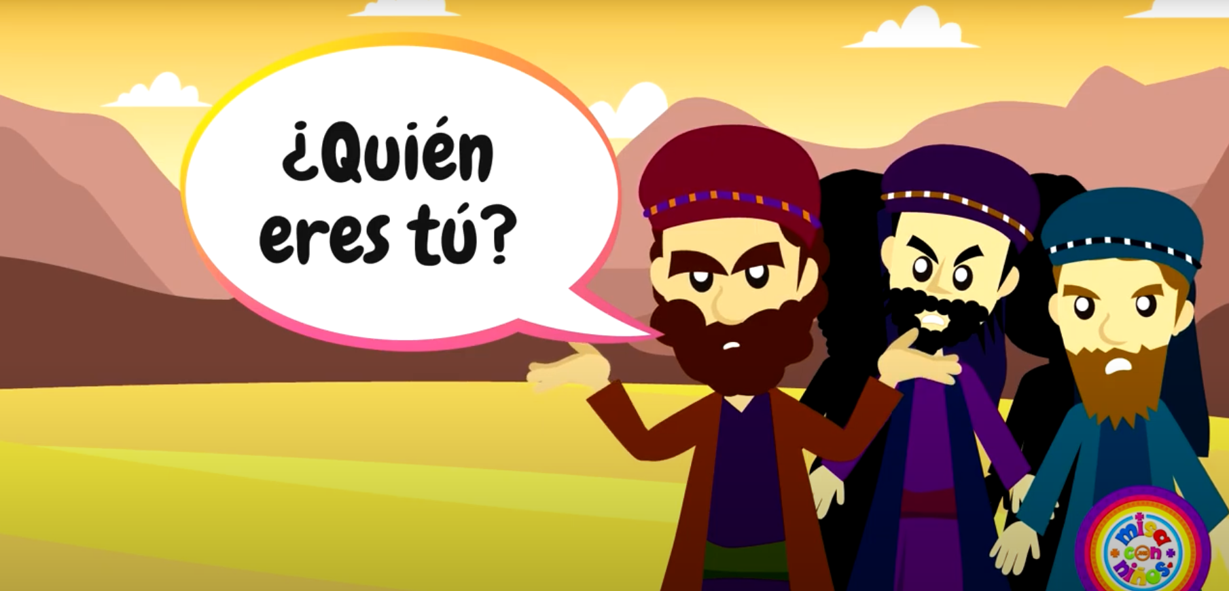
Who are you?

Slide 6
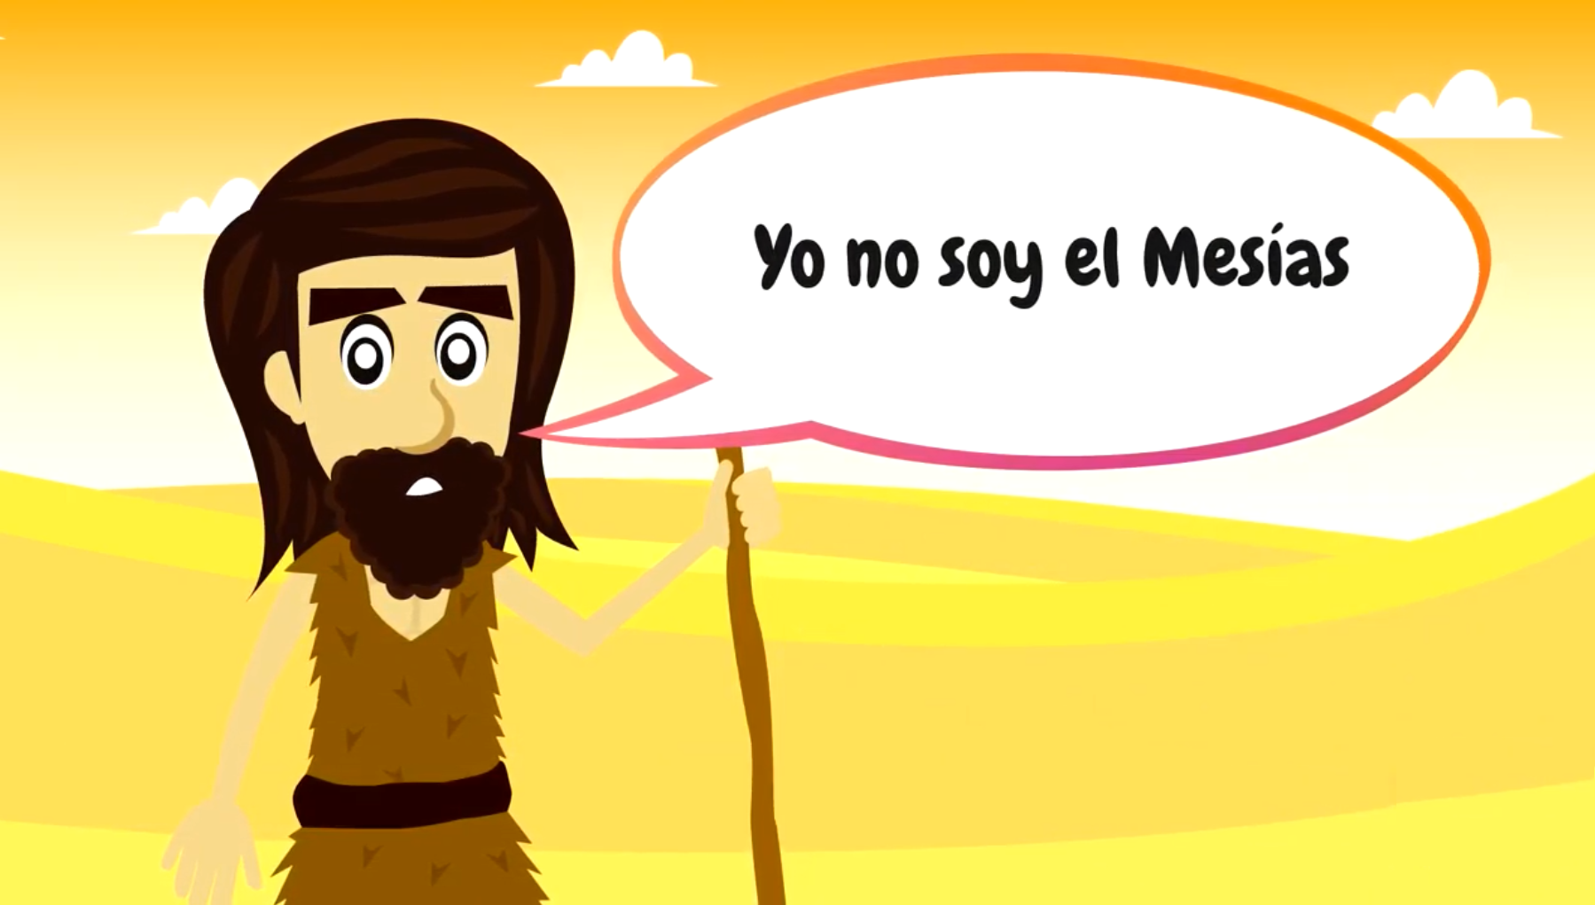
He admitted and did not deny it, saying,
I am not
the Christ.

Slide 7
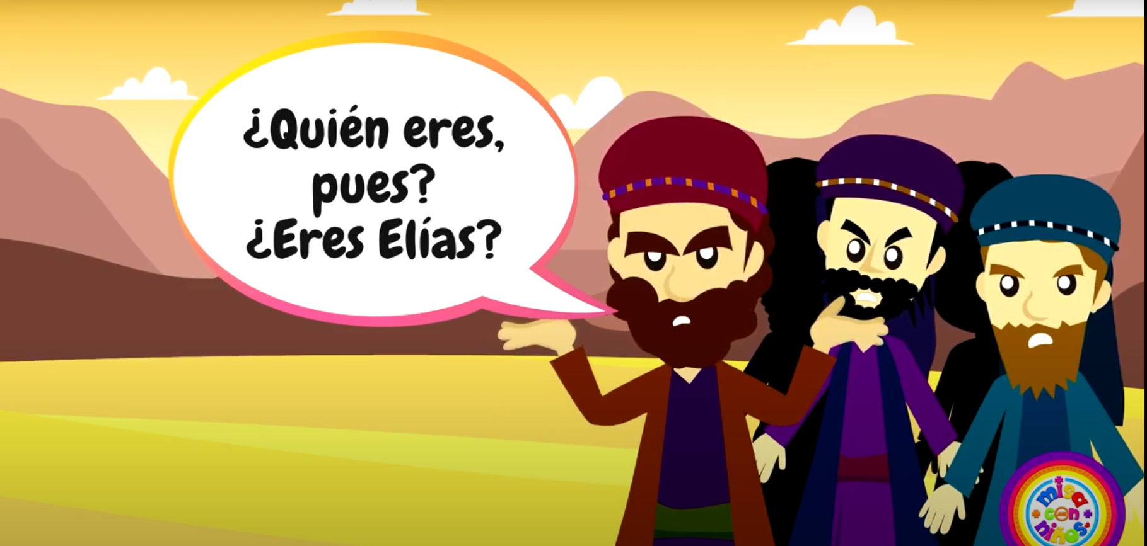
So they asked him,
Who are you then? Are you Elijah or the Prophet?

Slide 8
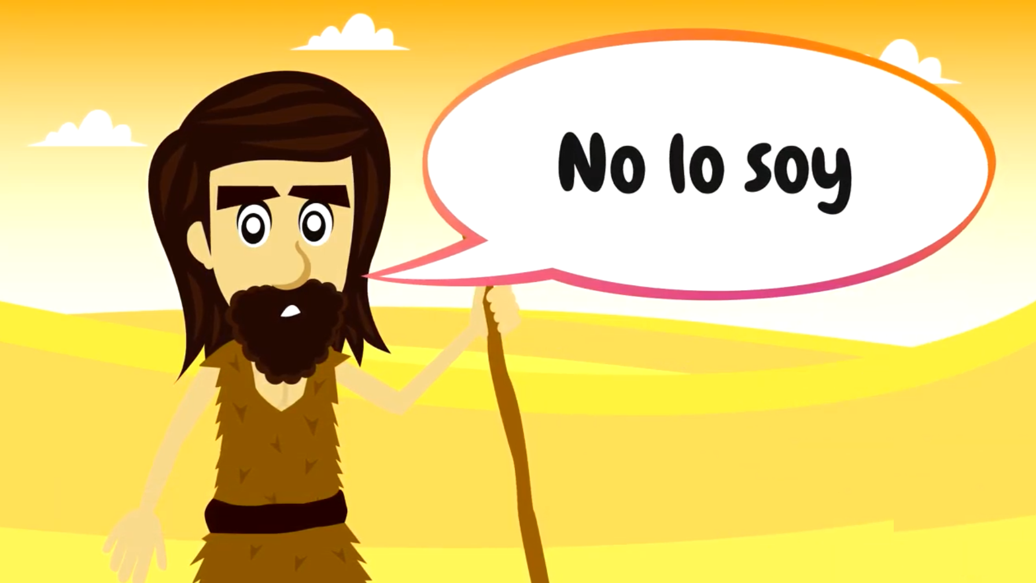
And he said,
I am not.

Slide 9
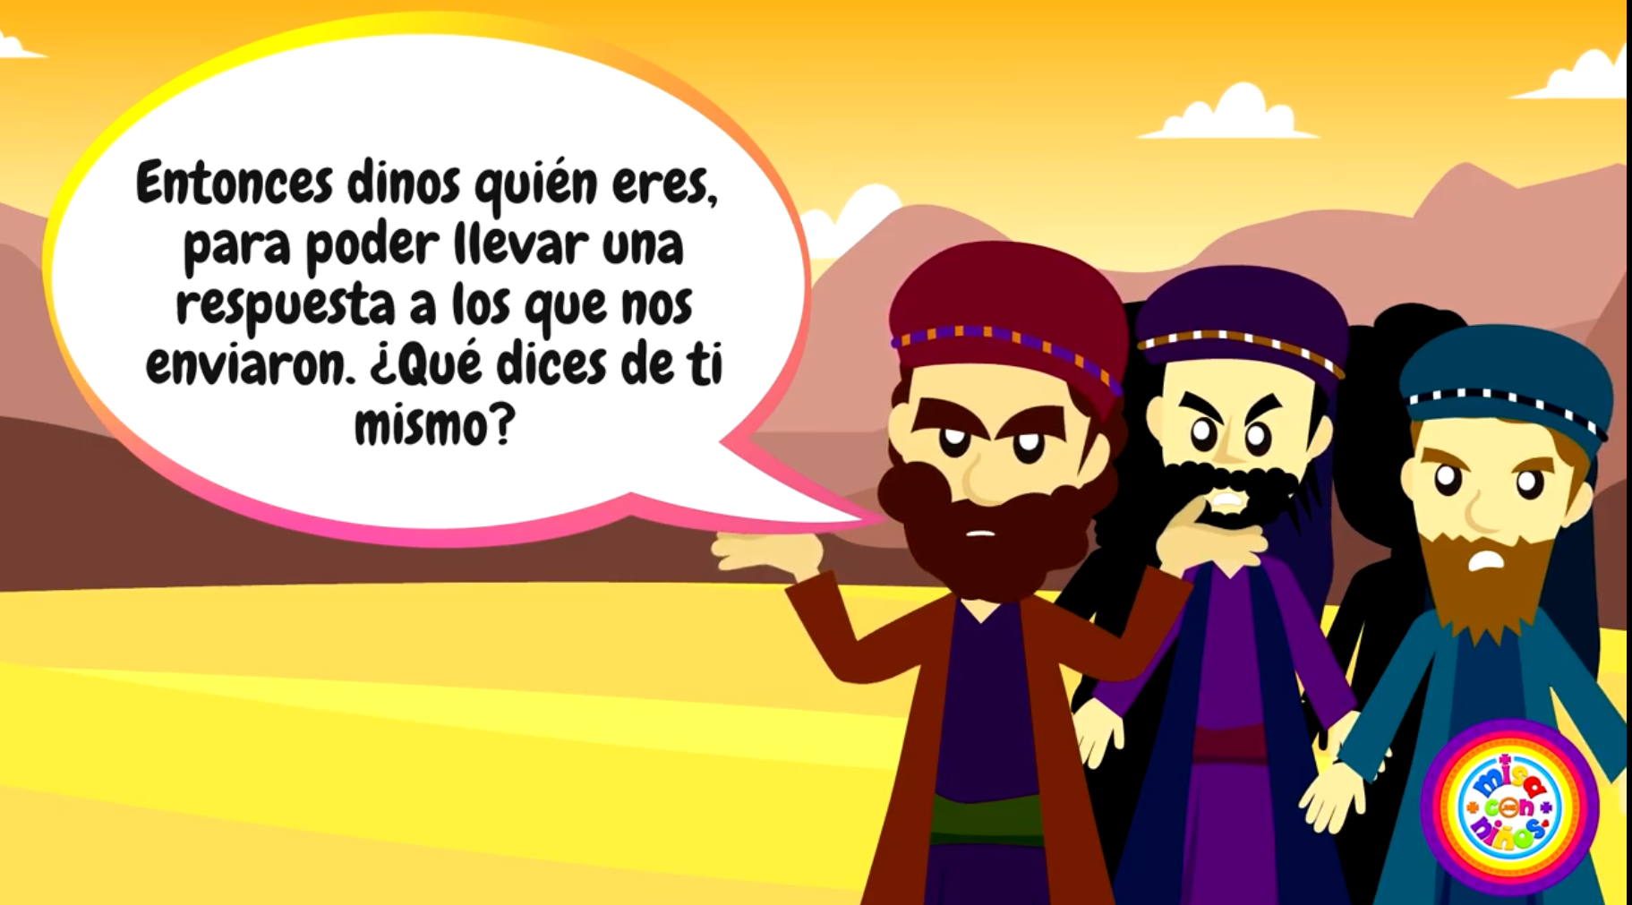
So they said to him,
Who are you, so we can give an answer to those who sent us?

Slide 10
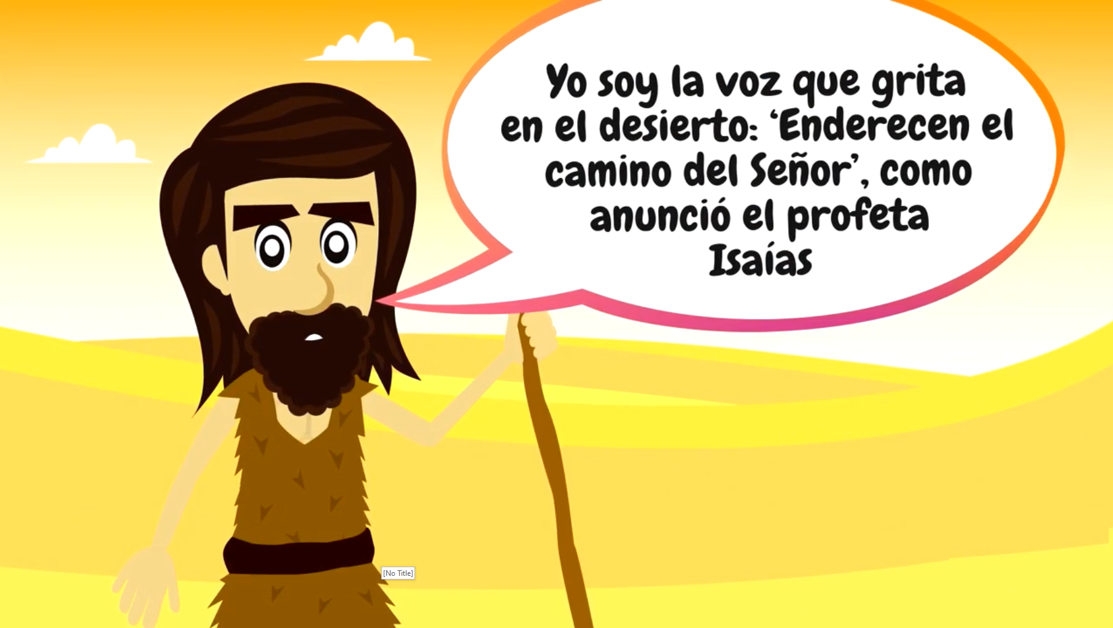
He said,
I am the voice of one crying out in the desert, ‘make straight the way of the Lord,’” as Isaiah the prophet said.”

Slide 11
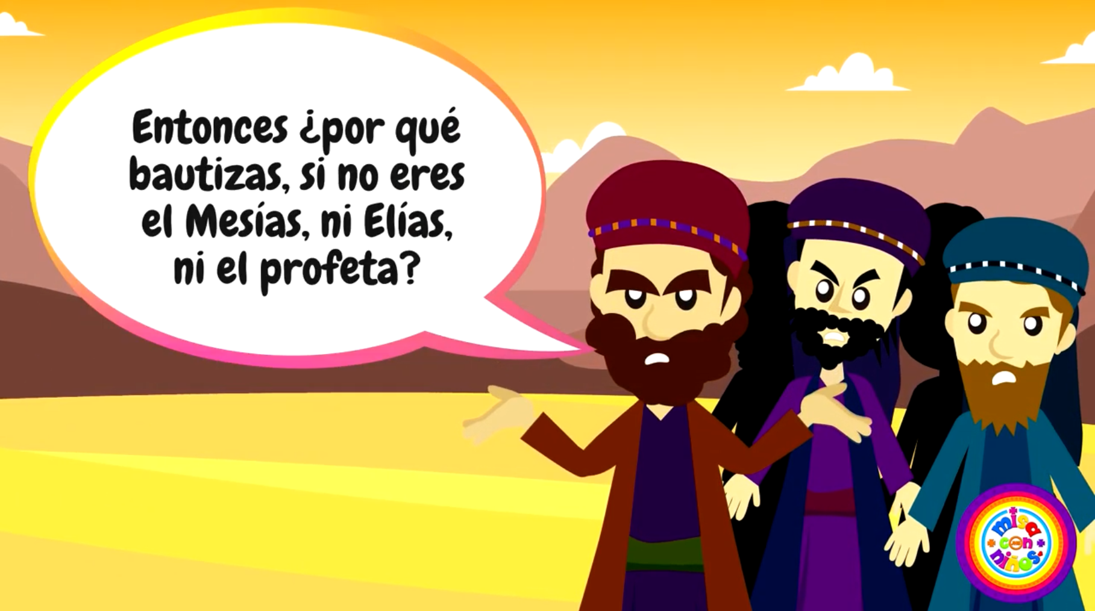
Some Pharisees were also sent. They asked him,
Why then do you baptize if you are not the Christ or Elijah or the Prophet?

Slide 12
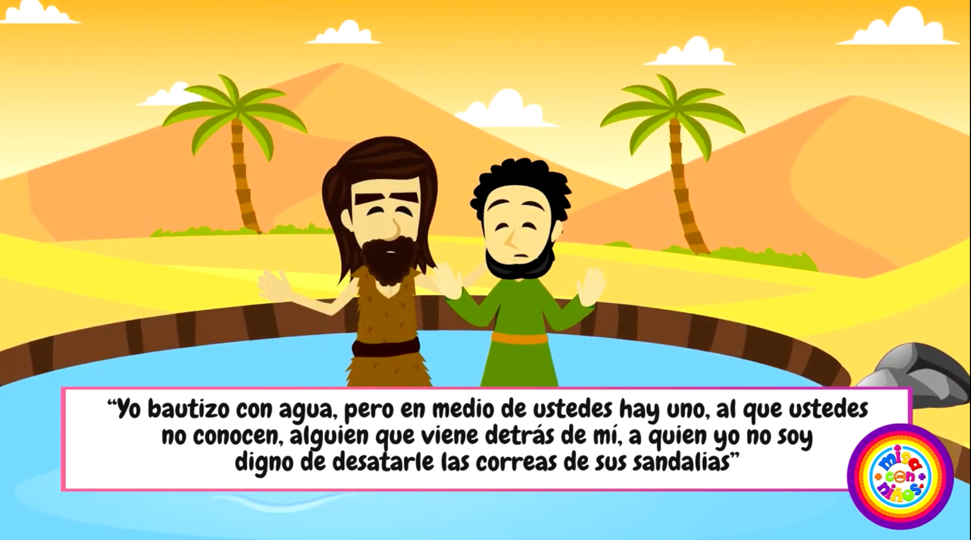
John answered them,
I baptize with water; but there is one among you whom you do not recognize, the one who is coming after me, whose sandal strap I am not worthy to untie.

Slide 13
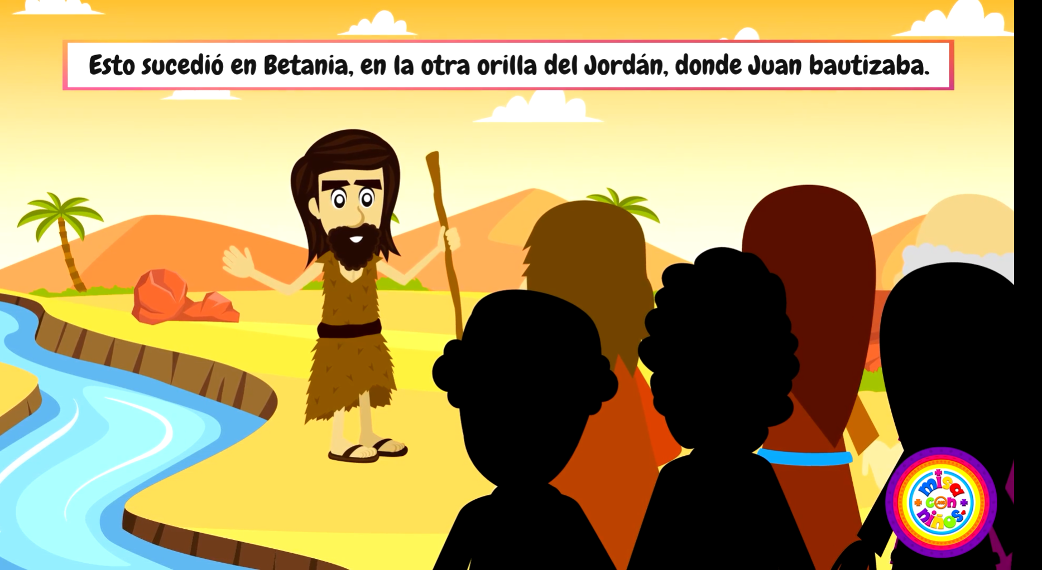
This happened in Bethany across the Jordan, where John was baptizing.
The Gospel of the Lord, Praise to You, Lord Jesus Christ

Slide 14
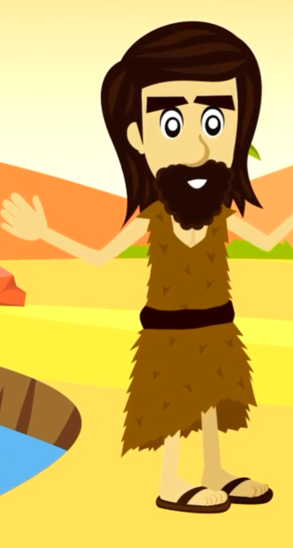
When you see your brother or sister break something and you tell your Mom, you are a witness to the event. What is a witness?
Someone who has observed a certain event or knows something and declares it.
John says he is not the light but witness to the light. Who is the light?
Jesus is the light of the world.
How does John witness to Jesus with his LIFE?
He lived in the desert dedicated completely to God by praying and fasting showing how important God was to him.
How is John witness to Jesus with his WORDS?
John asked God’s people to repent and be baptized to prepare for the coming of the Savior.
How did John baptize?
With water.
How does Jesus baptize?
With the Holy Spirit.

Slide 15
John said the words of the prophet Isaiah,
I am the voice of one crying out in the desert, ‘make straight the way of the Lord.
Why were these words important?
The Jews were waiting for the coming of the Messiah and recognized the words of the prophet Isaiah who foretold the Savior’s coming. They knew that John was proclaiming the coming of the Savior. His words were believable because of the way he lived his life.

Slide 16
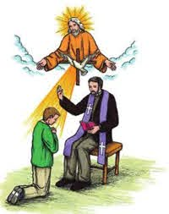
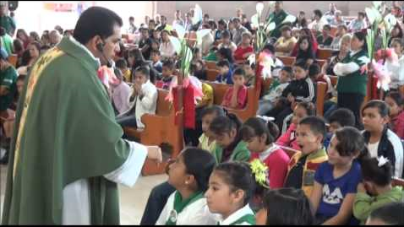
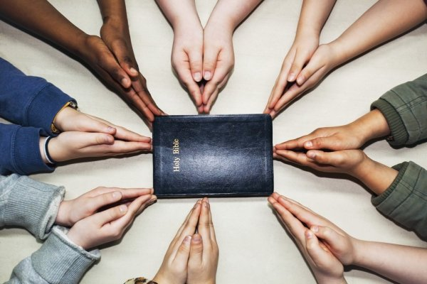




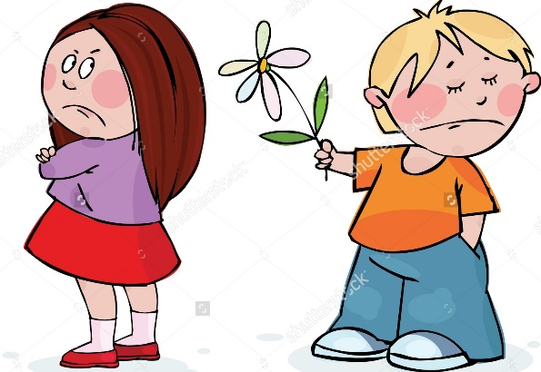
How can we be witnesses to Jesus with our LIVES?
Participate in the Sacraments
Pray Often
Do Small Sacrifices
Do Good Works
Forgive

Slide 17
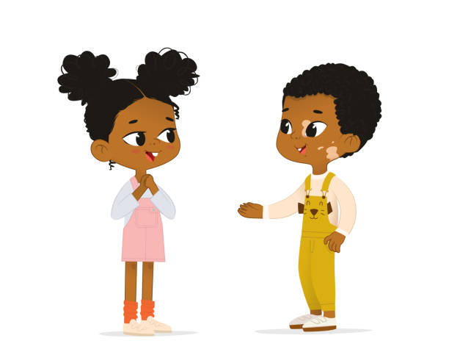
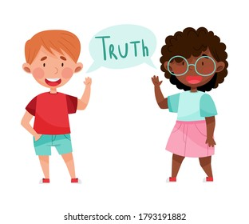

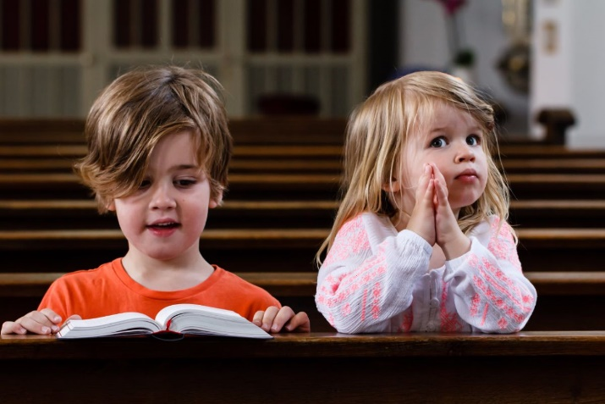
How can we be believable witnesses to Jesus with our WORDS?
Speak with kindness.
Say the truth.
Tell others about God’s great love for them.
Invite friends to mass.

Slide 18
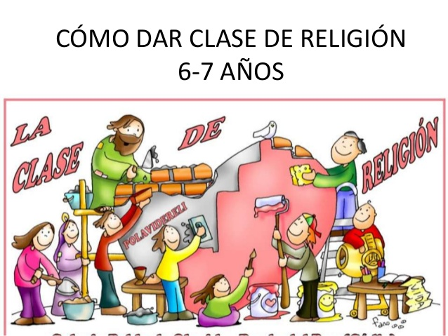


ACTIVITY

Slide 19
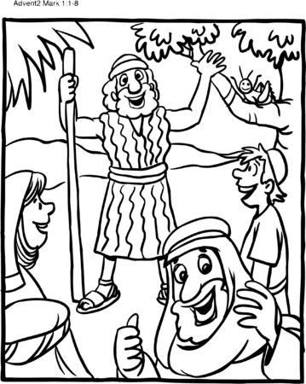
St. John the Baptist, Witness to the Light
How did John live?
He lived in the desert dressed with camel skin, eating locust and wild honey. He prayed and sacrificed often.
What did John ask of them?
Repent and be baptized.
For whom did John prepare the way?
For Jesus.

Slide 20
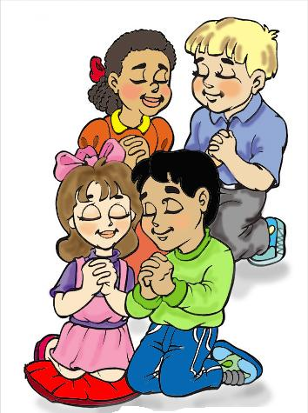
PRAYER
Lord,
Give me a humble heart so I may always seek you, always repent, and always love you, Help me to be a believable witness of your Light with my life and my words so I may help build Your Kingdom.
Amen.

Slide 21
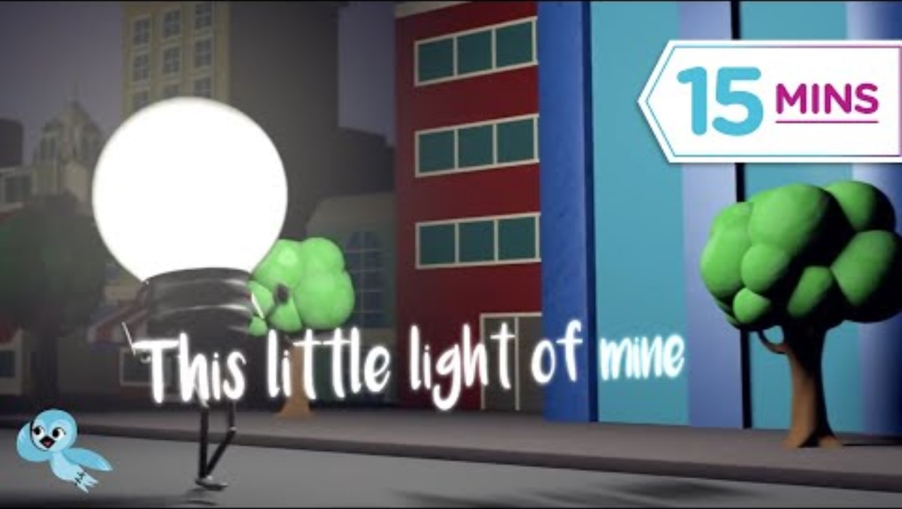
This Little Light of Mine, Listener Kids https://youtu.be/recdOYUmSRQ

Slide 22
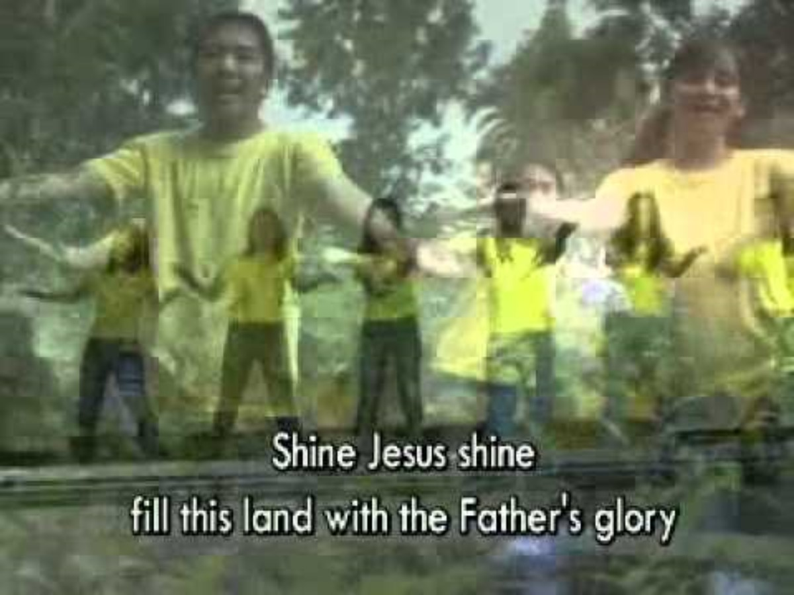
Shine Jesus Shine, eri63C, https://youtu.be/gURAcHTSsN4

