Slide 1
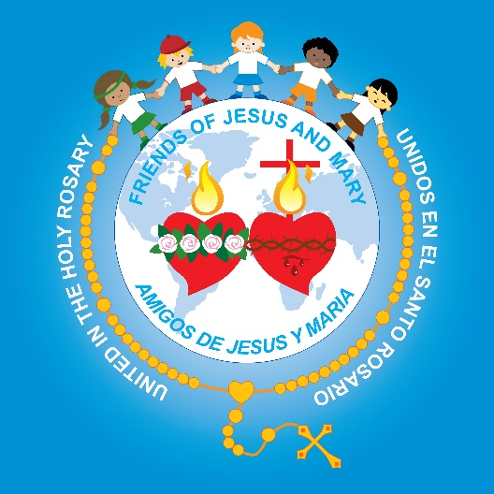
Friends of Jesus and Mary
Prayer Group for Children
Cycle B-III Sunday of Easter
Jesus is the Messiah – Luke 24:35-48
www.fcpeace.org

Slide 2
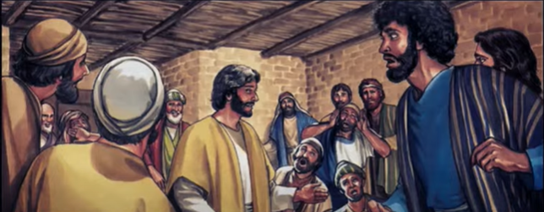
Gospel - Luke 24: 35-48 While the two were telling them this, suddenly the Lord himself stood among them and said to them,”
Peace be with you.

Slide 3
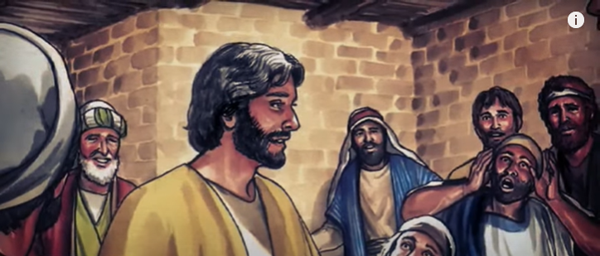
They were terrified, thinking that they were seeing a ghost. But he said to them,
Why are you alarmed? Why are these doubts coming up in your minds?

Slide 4
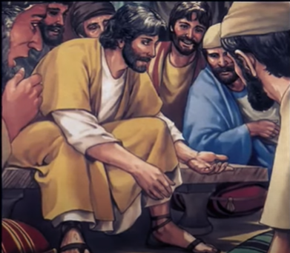
Look at my hands and my feet and see that it is I myself. Feel me, and you will know, for a ghost doesn’t have flesh and bones, as you can see, I have.
He said this and showed them his hands and his feet.

Slide 5
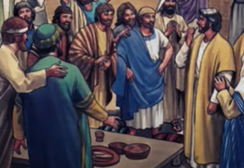
They still could not believe, they were so full of joy and wonder; so, he asked them,
Do you have anything here to eat?”
They gave him a piece of cooked fish, which he took and ate in their presence.

Slide 6
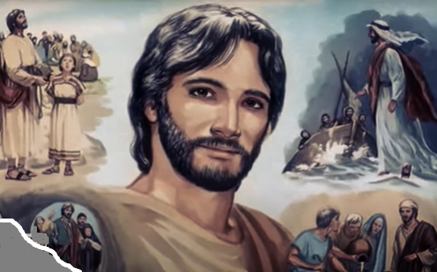
Then he said to them,
These are the very things I told you about while I was still with you:…
…everything written about me in the Law of Moses, the writings of the prophets, and the Psalms had to come true.
This is what is written: The Messiah must suffer and must rise from death three days later,
Then he opened their minds to understand the scriptures and said to them.

Slide 7
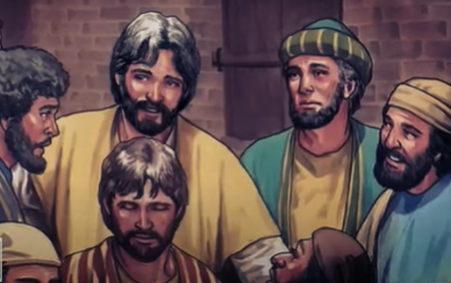
You are witnesses of these things.
…and in his name the message about repentance and the
forgiveness of sins must be preached to all nations, beginning in Jerusalem.
The Gospel of the Lord. Praise to you Lord Jesus Christ.

Slide 8
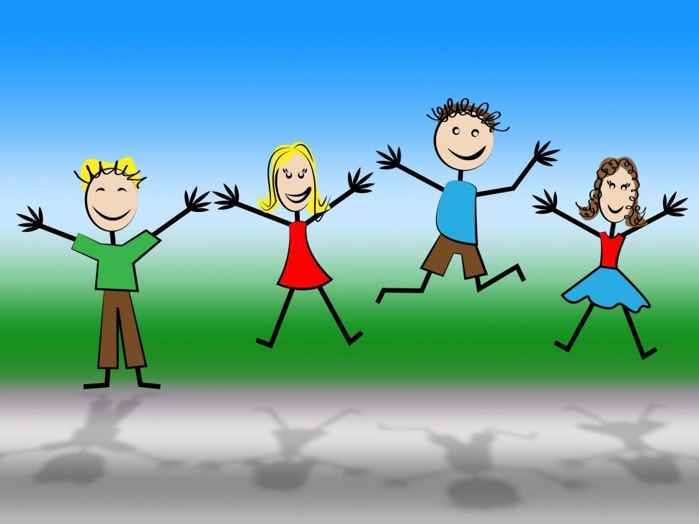
REFLECTION

Slide 9
How does Jesus greet them?
Jesus’ presence gives us peace in our hearts.
Peace be with you.

Slide 10
Jesus wanted them to know, that He was with them, not only in Spirit, but in body also.
What did He do to prove it?
He showed them the scars on His hands and feet and told them to touch them.
He also ate fish with them.

Slide 11
Why was it so important for them to believe this?
He wanted them to be completely sure that He was the Messiah that Moses, the prophets, and the psalms announced.
He explained to them what was written: “The Messiah must suffer and must rise from death three days later.”
Why?

Slide 12
He wanted them to be the witnesses of God’s love and mercy to the world.

Slide 13
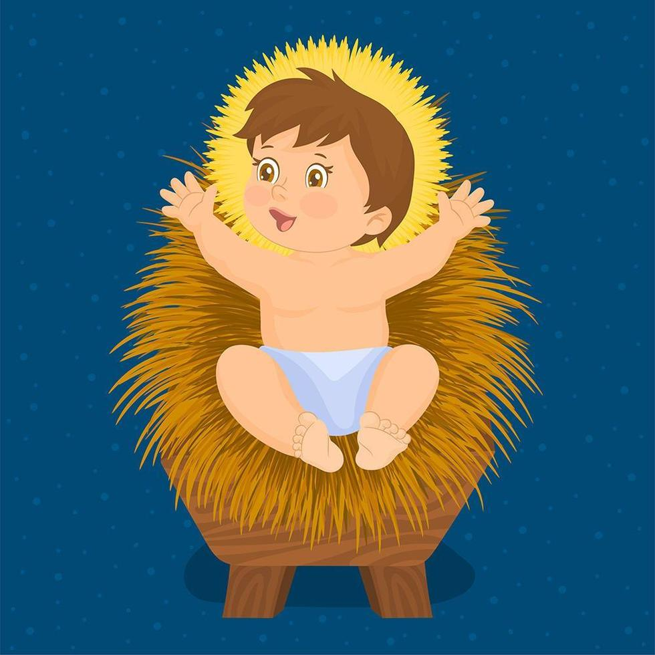
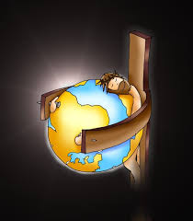
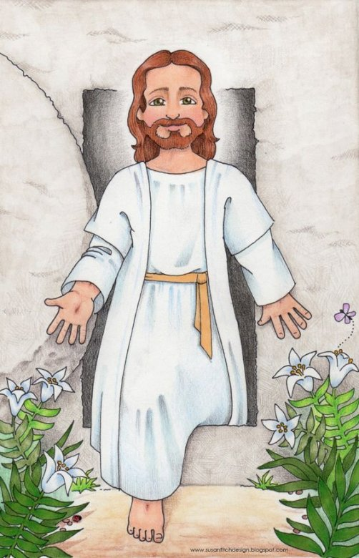
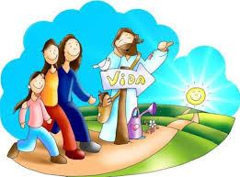
What did they need to announce to everyone?
He resurrected on the third day, victorious over death.
Return to God with a repentant heart and be saved.
God loves us so much, He sent His son, Jesus…
…to die on the cross for the forgiveness of our sins.

Slide 14
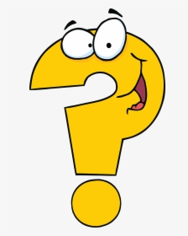
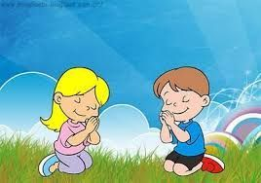
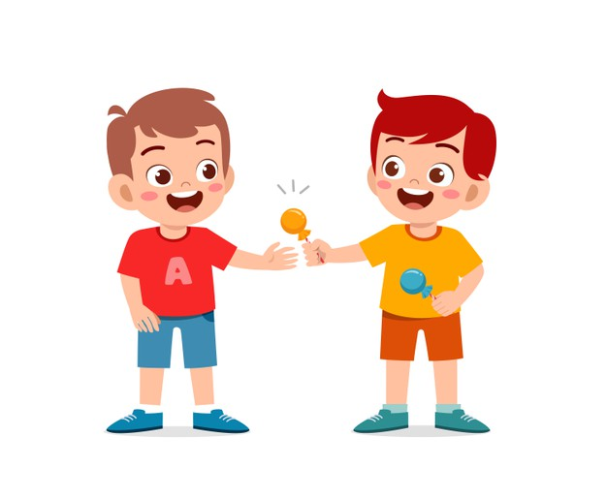
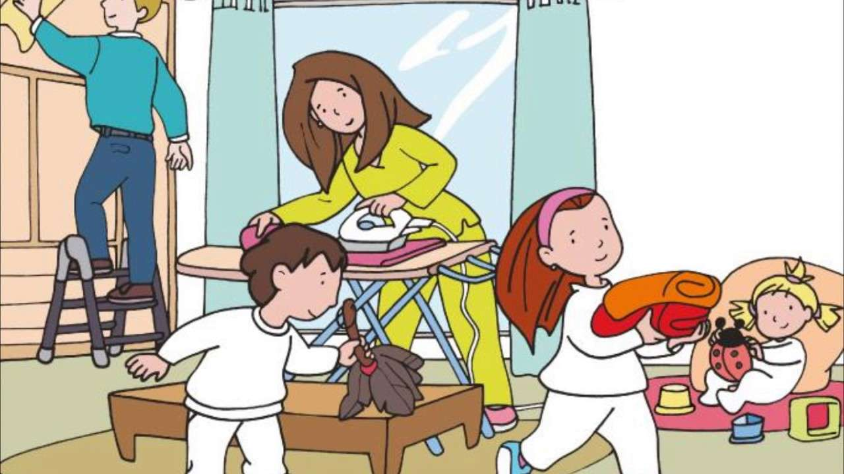
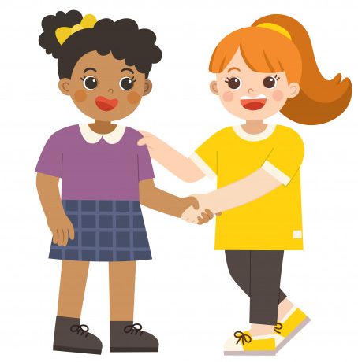
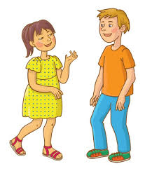
How can we be witnesses for Jesus?
Praying
Sharing
Helping
Forgiving
Announcing what God did for us.
Imitating Jesus by…

Slide 15
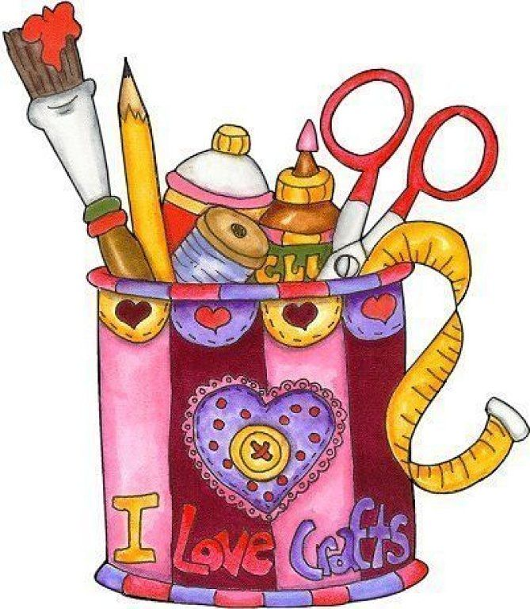
Activity

Slide 16
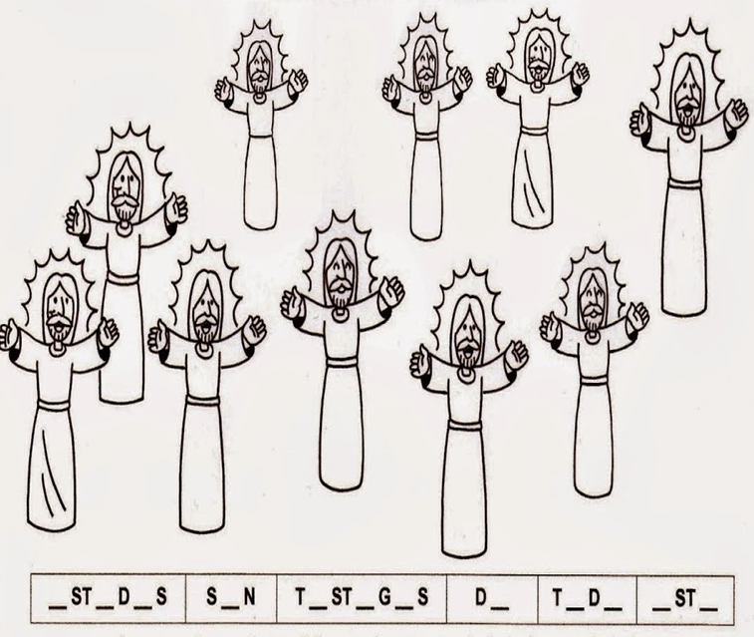
There are 3 drawings of Jesus that are the same. Which ones?
Add the missing vowels to read Jesus’ message.
_R_
I
E
E
_F
TH_S_
O
U
A
E
O
E
E
I

Slide 17
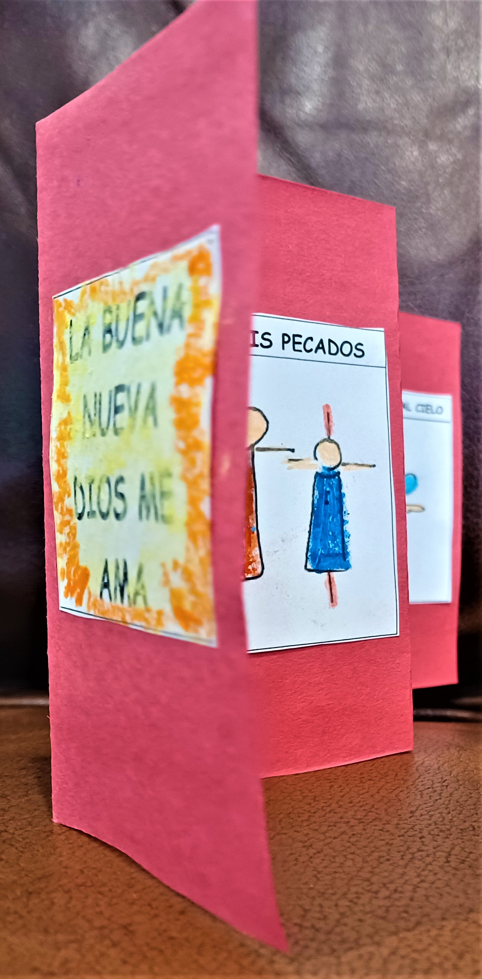
PROCLAIM THE GOSPEL ACCORDION BOOK
Instructions:
1-Color and cut each numbered picture and cover and end separately.
2-Fold a colored construction paper (8.5x11”) right side to left side; fold again.
3-Cut the 4 strips of paper and fold each strip in half 2 times.
4-Refold as an accordion, first in one direction, then in the other direction until you have 4 rectangles.
5-Glue the pictures, starting with the cover to the 4th rectangle on the right;
6-Turn the strip over and glue the numbered pages from left to right.
7-Turn over again, and glue the THANK YOU JESUS, on the far-left rectangle. Share the Gospel with your friends.

Slide 18
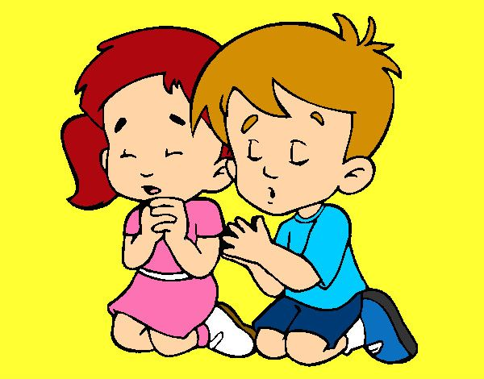
Prayer Lord, when you are with us, we have peace, joy and consolation. Help us to be witnesses of your love by always loving, forgiving, and helping others. Amen

Slide 19
Song: I Believe, Song Video

