Slide 1
Friends of Jesus and Mary
Cycle B – III Sunday of Lent
Jesus Purifies the Temple
John 2:13-25

Slide 2
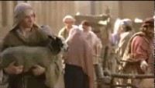
Jesus Purifies the Temple - John 2:13-25

Slide 3
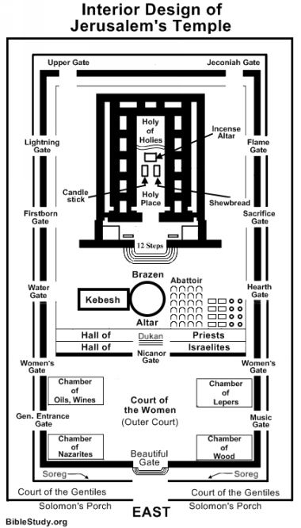
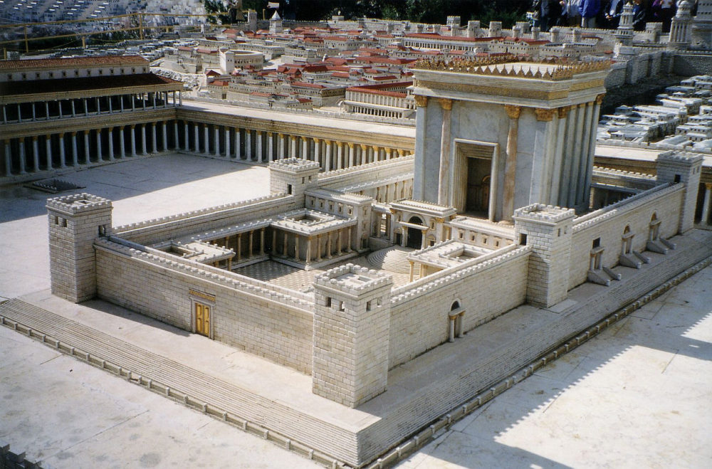
Reflection
In the Jewish temple, the people offered sacrifices of animals to God and they had to buy them there. Why does Jesus kick merchants and money changers out of the temple?
Jesus is enraged because He sees they only care about getting rich and have no devotion to God. Jesus’ only desire is that God gets the honor He deserves.

Slide 4
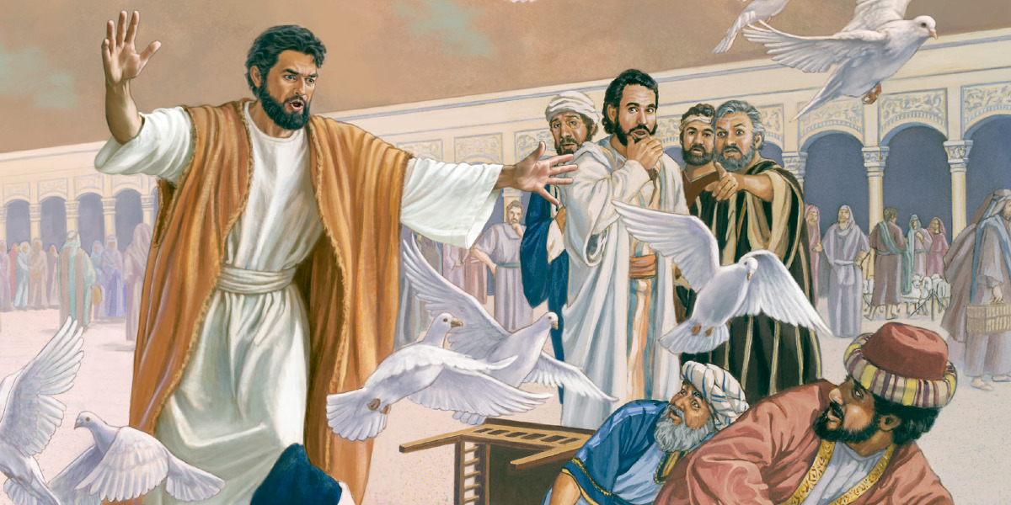
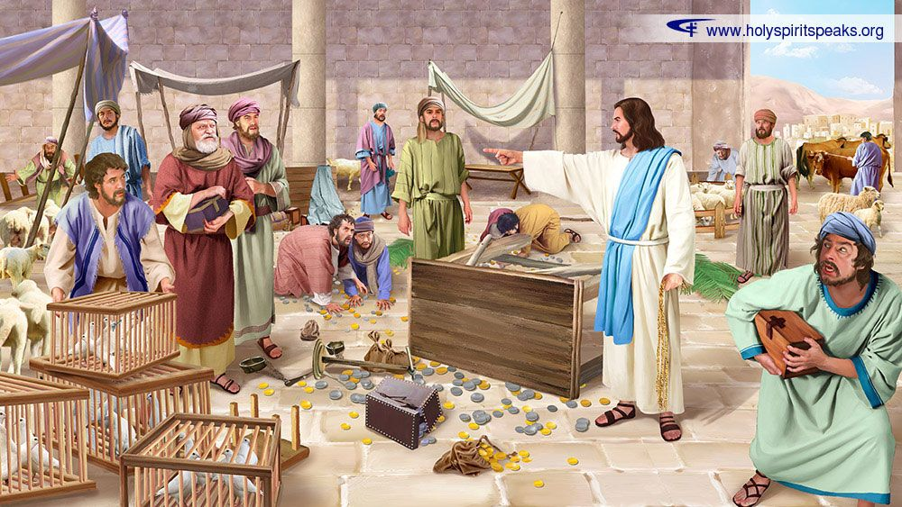
The Jews ask Jesus for a sign that He has authority to do this. What does Jesus answer?
“Destroy this temple and in three days I will raise it up.”

Slide 5
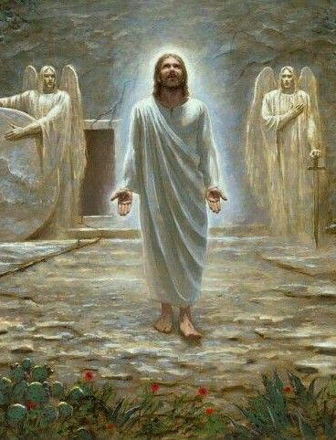
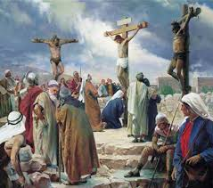
To what is Jesus referring?
The sign of His authority will be when the temple of His body dies on the cross and rises on the 3rd day, proving He is God.

Slide 6

Jesus knows what is in our heart.

Slide 7
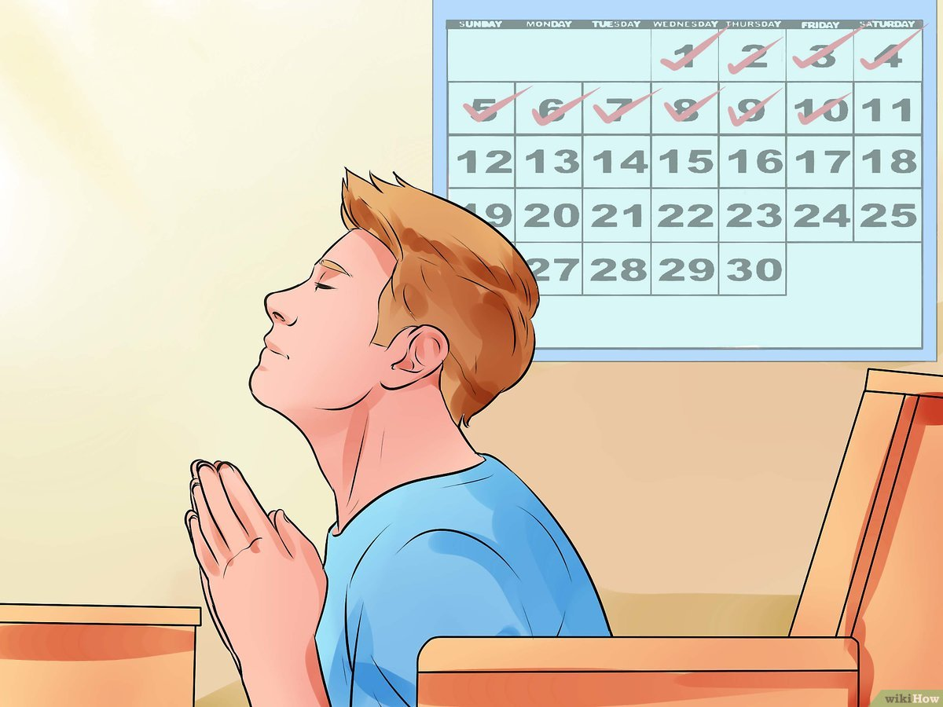
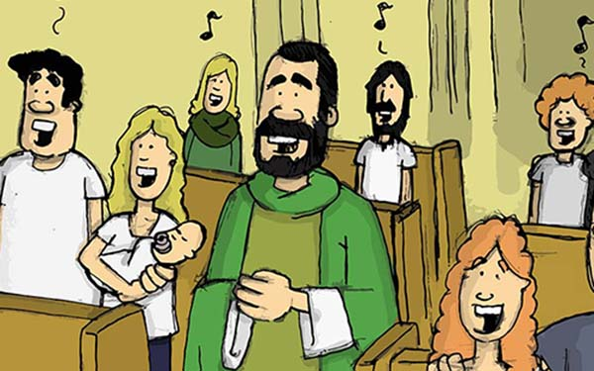
How can we clean our heart of distractions, hate, laziness, and all that does not give glory to God to adore Him as He deserves?
We can put God 1st and give Him enough time
in prayer daily;
we can participate in Mass
with our full attention;

Slide 8
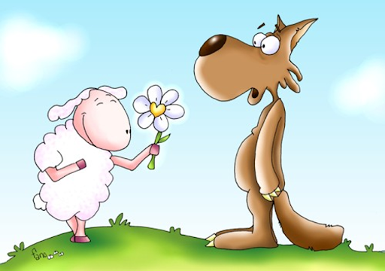
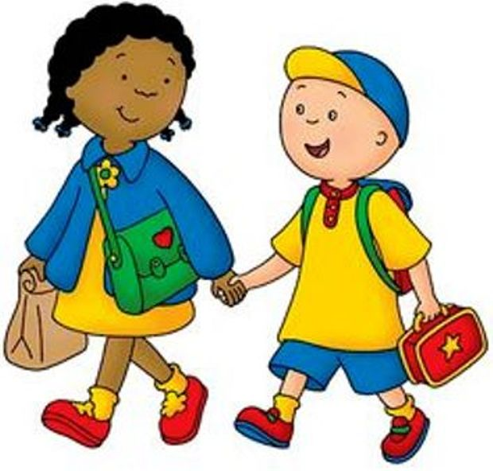
How can we clean our heart of distractions, hate, laziness, and all that does not give glory to God to adore Him as He deserves?
we can reconcile with enemies;
Be kind to everyone;

Slide 9

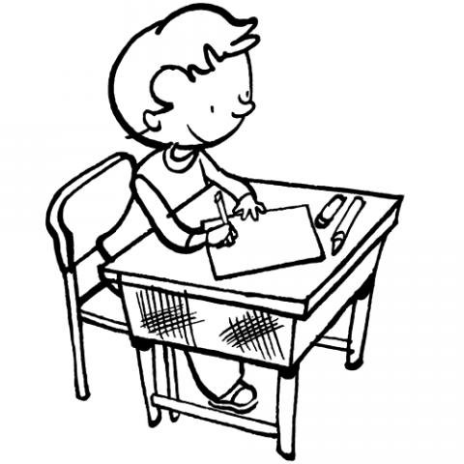
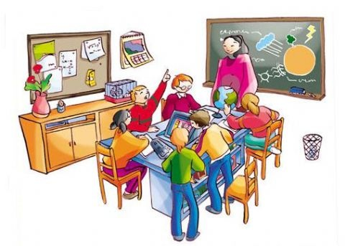
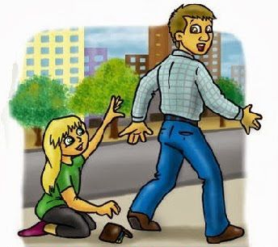

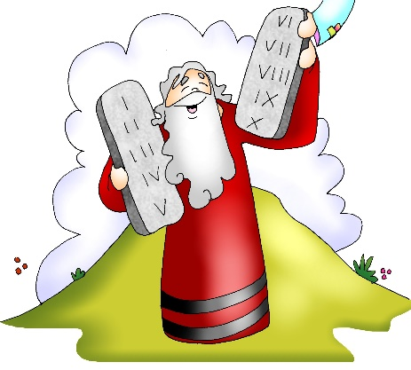
How can we clean our heart of distractions, hate, laziness, and all that does not give glory to God to adore Him as He deserves?
Help out at home and in school;
Do our homework;
Be honest;
Be obedient to our parents and teachers and to God’s Commandments…

Slide 10
Activities
Review the parts of a Church.
Circle the hearts which are most pleasing to Jesus when we come to adore Him?
Find the words used in the Gospel.

Slide 11
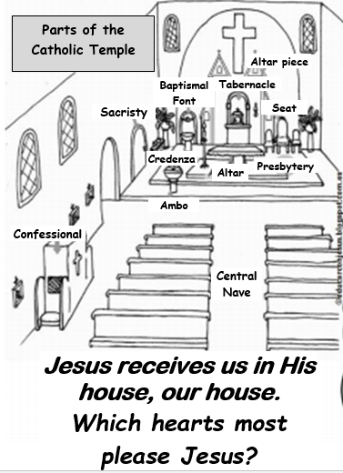
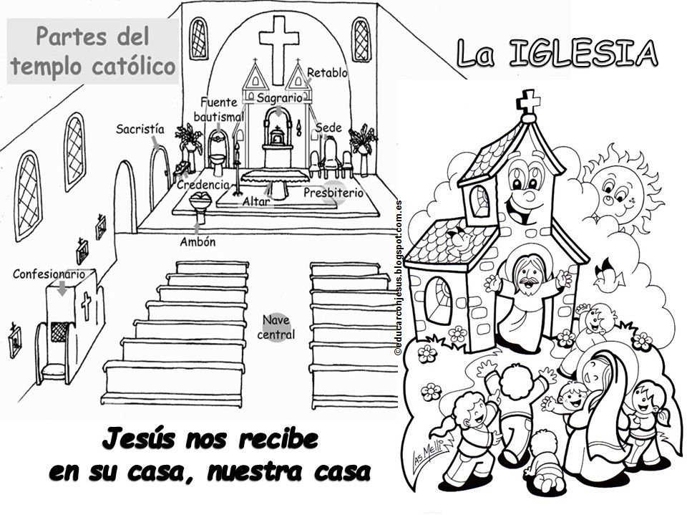






Jesus receives us into His home, our home.
The Church
With Love
With Anger
With Adoration
With Envy
Distracted

Slide 12
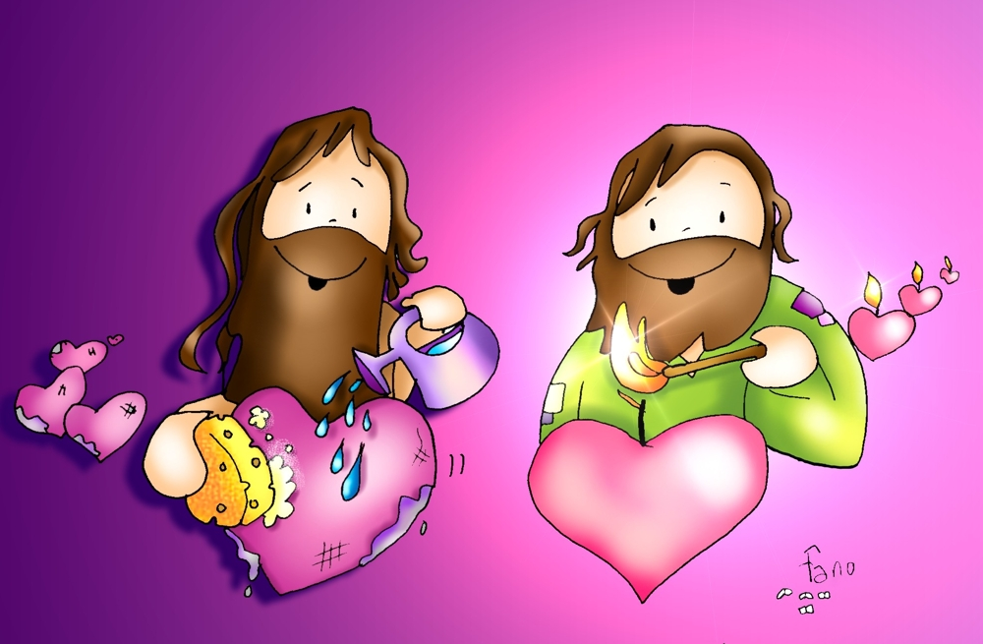
PRAYER
Lord,
You are the good and loving King of the Universe. Help me to clean my heart so you may feel happy there and so I may adore you as you deserve.
Amén

Slide 13
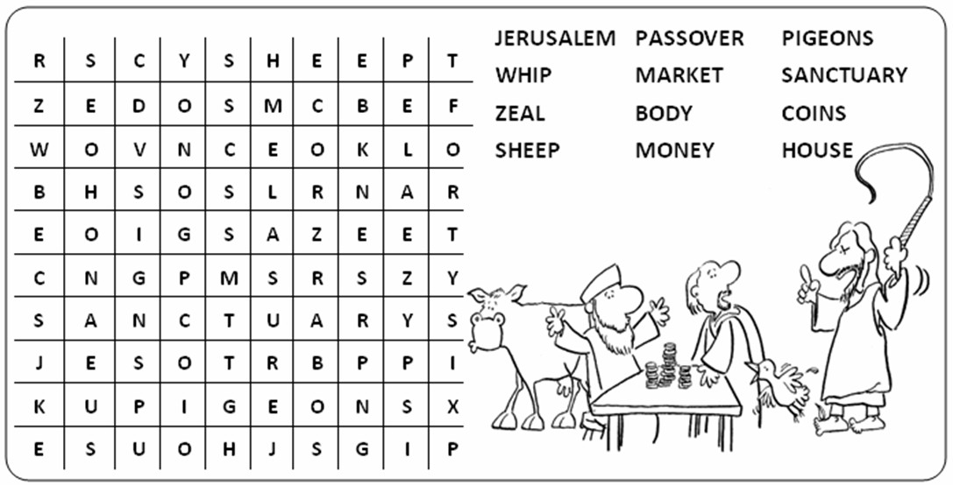

Slide 14

You are my King (Amazing Love), CEF Greenville-Ages 7+

Slide 15
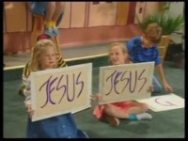
He is the King of Kings, TheRealDonutMan – Ages 2-6

