Slide 1
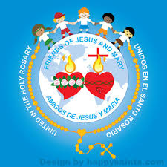
Ministry Friends of
Jesus and Mary
Cycle B-III Sunday in Ordinary Time
Jesus, Fisher of Men
Mark 1, 14-20
www.fcpeace.org

Slide 2
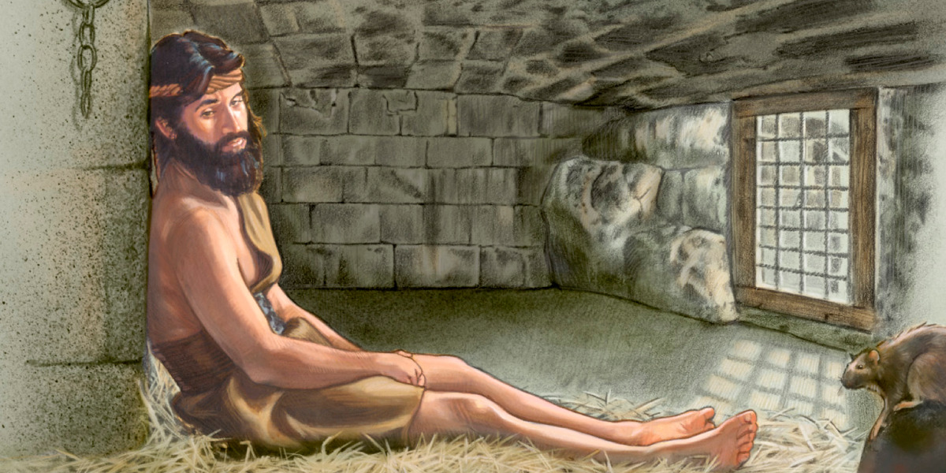
After John had been arrested,
Jesus came to Galilee
proclaiming the gospel of God.
Después de que arrestaron a Juan el Bautista, Jesús se fue a Galilea para predicar el Evangelio de Dios

Slide 3
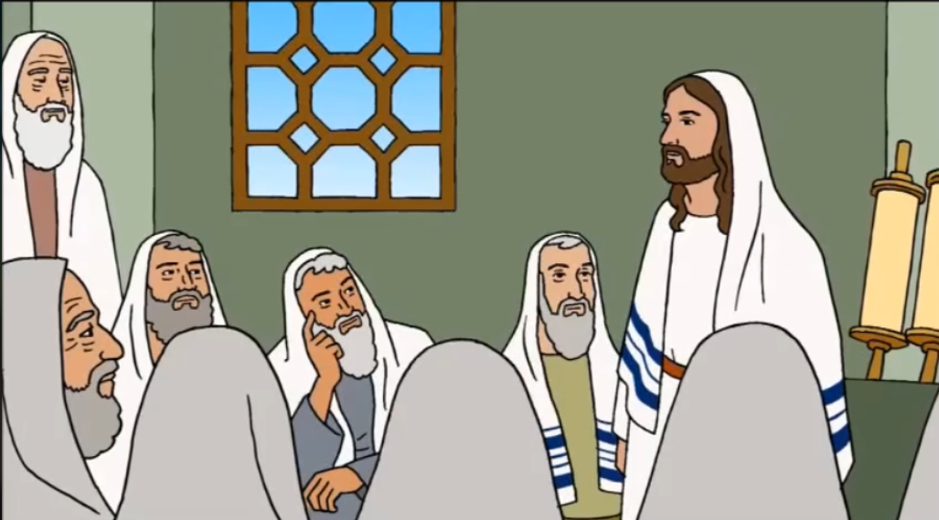
Y decía: “Se ha cumplido el plazo, está cerca el reino de Dios, convertíos y creed en el Evangelio”
He said, "This is the time of fulfillment.
The kingdom of God is at hand.
Repent, and believe in the gospel."

Slide 4
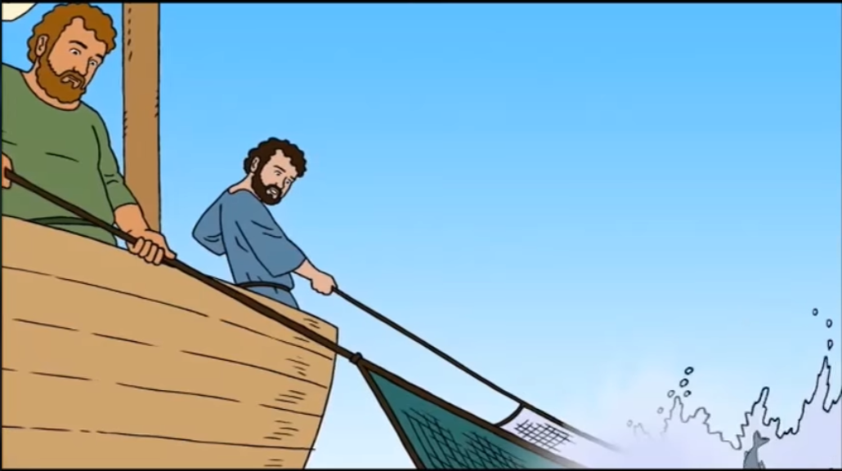
Pasaba Jesús por la orilla del lago de Galilea, cuando vio a Simón y a su hermano, Andrés, echando las redes en el lago
As he passed by the Sea of Galilee, he saw Simon and his brother Andrew casting their nets into the sea; they were fishermen.

Slide 5
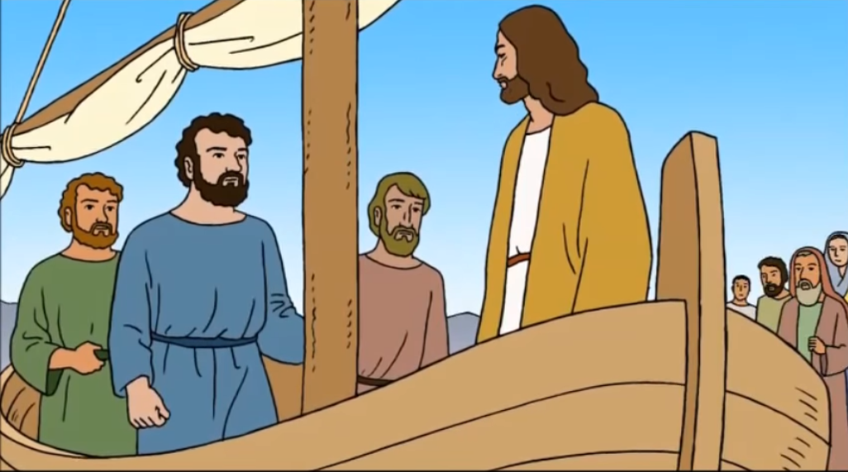
Jesus said to them, "Come after me, and I will make you fishers of men."

Slide 6
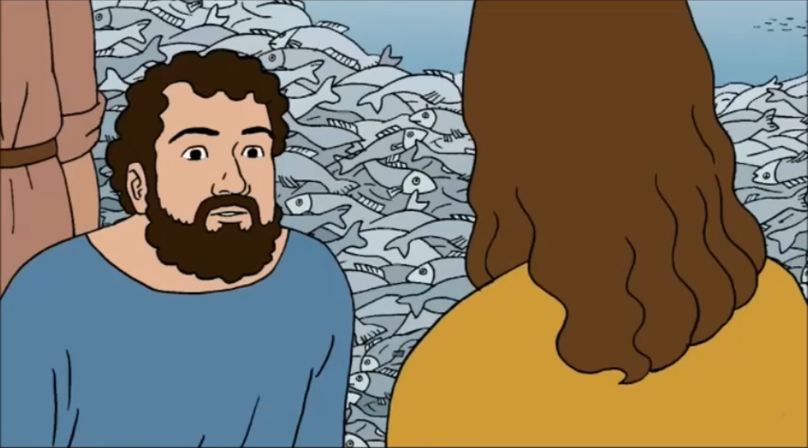
Then they abandoned their
nets and followed him.

Slide 7
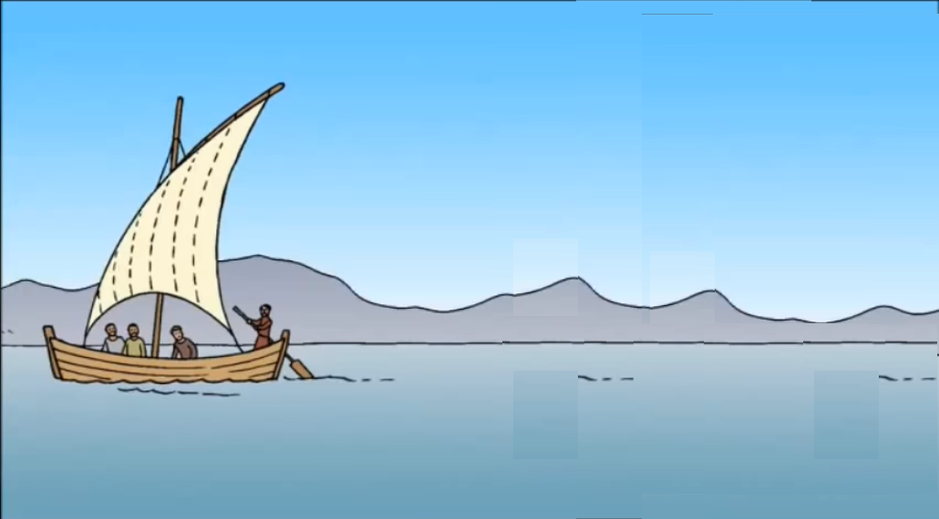
He walked along a little farther and saw James, the son of Zebedee, and his brother John. They too were in a boat mending their nets.

Slide 8
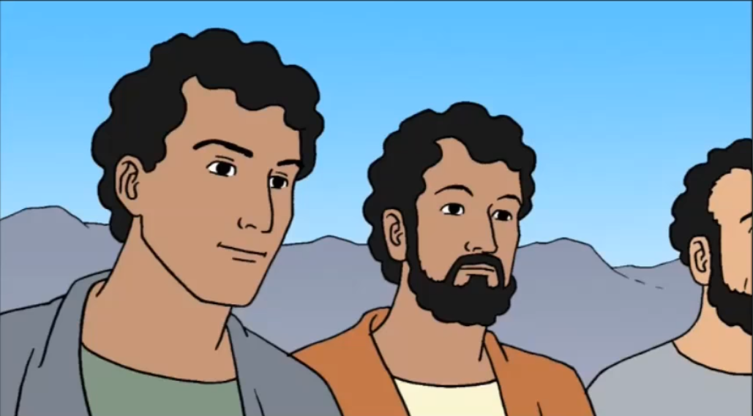
Then he called them. So they left their father Zebedee in the boat along with the hired men and followed him.
THE GOSPEL OF THE LORD. PRAISE TO YOU LORD JESUS CHRIST.

Slide 9
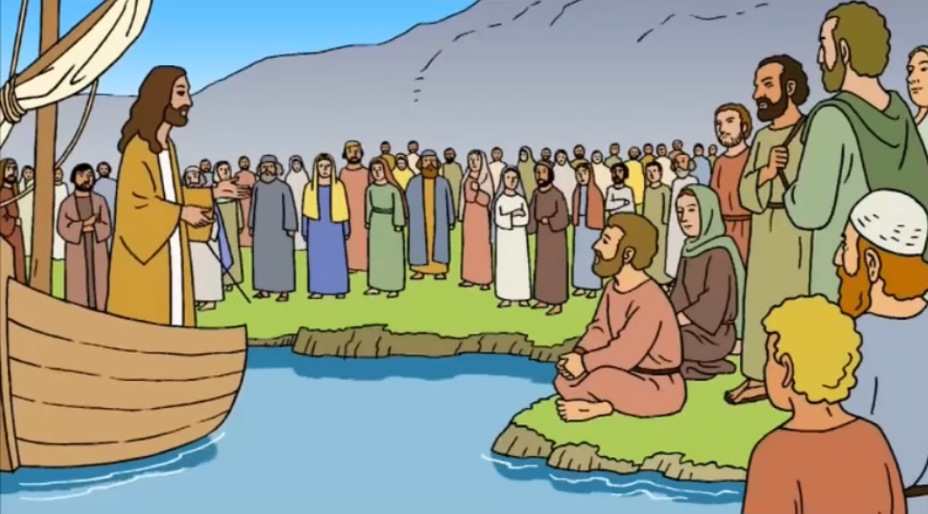
REFLECTION
John the Baptist, Jesus’ cousin, who had so often preached prepare the way for the Messiah, was arrested by Herod. But the prison did not scare Jesus!
Jesus goes to the north of Israel, to the region of Galilee where there is a large
lake called the Sea of Galilee. Many of the residents of that area work as fishermen.
Jesus strongly attracted those He encountered. His gaze was different, especially to the poor. They received the warmth of His love.

Slide 10
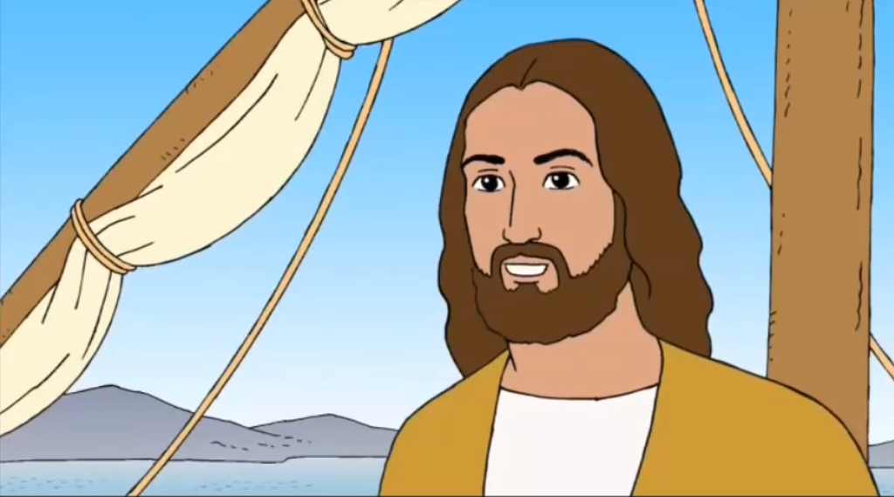
REFLECTION
Jesus begins to preach. What did He say?
“The kingdom of God is at hand. Repent, and believe in the gospel."
Jesus, our King, is amongst them. He has come so they may
open their hearts to God and they feel Him close.
The large crowds would gather to listen to His Word.
Jesus is compassionate to His people. Once, seeing that they did not catch any fish, he did a miracle so the nets were breaking from the number of fish they caught.
Jesus also cured the lepers, the sick, the paralyzed, the blind… They believed that Jesus was the Messiah.

Slide 11
Who were Simon and Andrew?
They were fishermen.
Jesus calls them to be fisher of men. How do they respond?
They immediately left everything and followed Him.
Jesus also finds James and his brother John who were fishing with their father.
How did they respond?
They also left everything and followed Him.

Slide 12
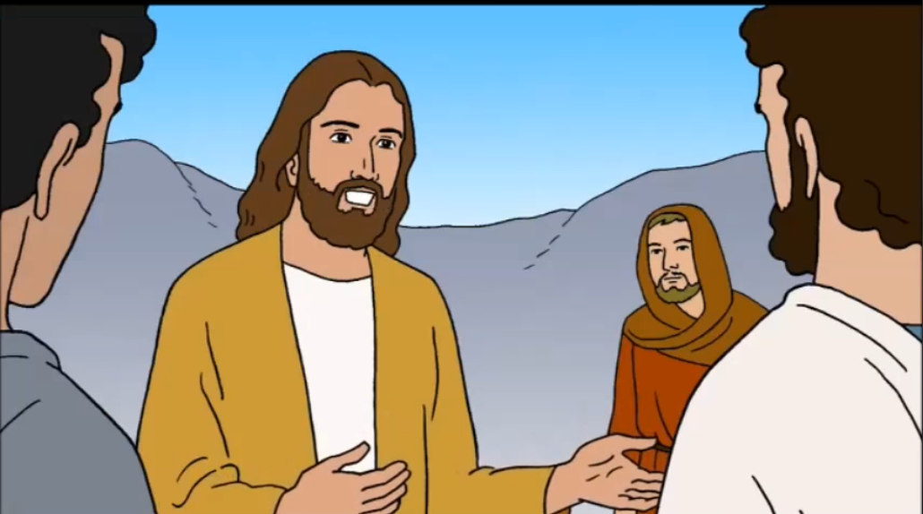
Jesus wants us to also be ready to follow Him faithfully.
Jesus passes by, sees us, and always calls us.
Jesus invites us to complete our daily responsibilities
with effort and dedication, even those things we don’t
like or don’t feel like doing. With our example, we too can fish souls for Jesus.
Do EVERYTHING FOR JESUS

Slide 13
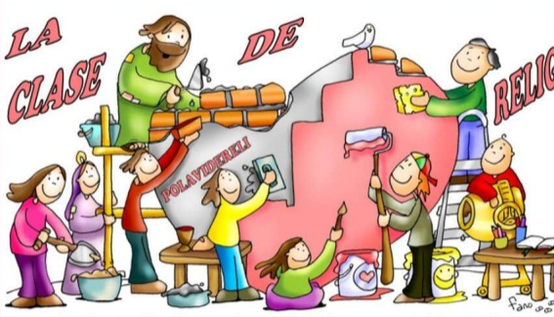
ACTIVITY

Slide 14
ACTIVITY
The first Christians recognized each other by drawing a fish. How? One would draw the ark of the symbol of the fish in the sand. If the stranger could draw the other half of the ark, he/she showed they were also Christian. On the following page, indicate who is interested in following Jesus!!!

Slide 15
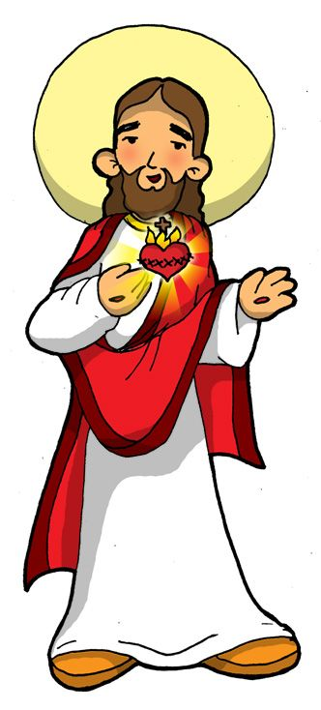
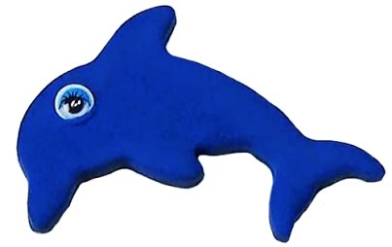
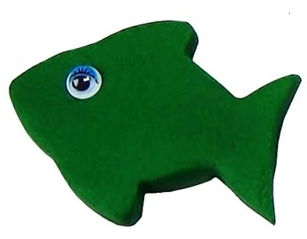
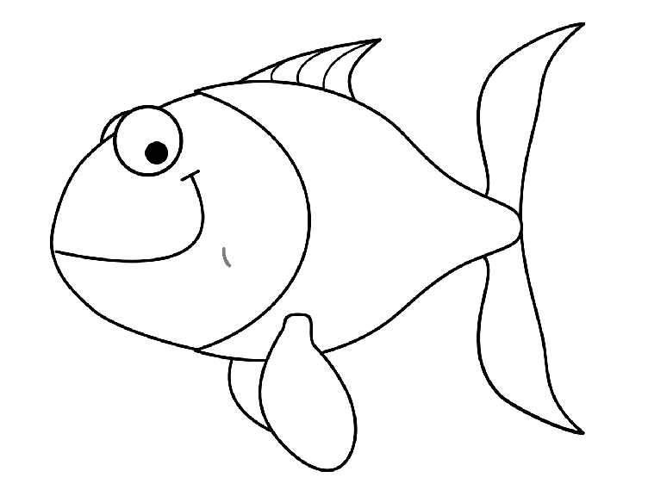
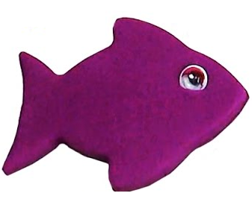
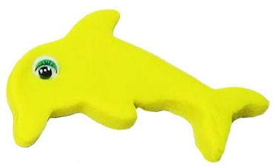
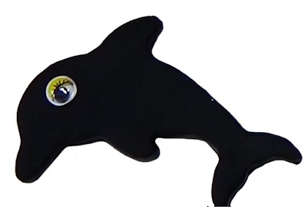
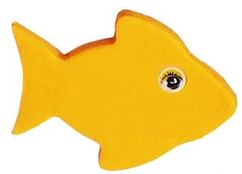
I always say the truth, even if I have to face the consequences.
I pray every night before going to sleep, thanking Jesus for everything.
I invent excuses so I don’t have to help with the work around the house.
I study and do my chores with
effort and dedication.
I go to Mass on Sundays and listen attentively to the Priest.
I share with my friends only if
they give me something in return.

Slide 16
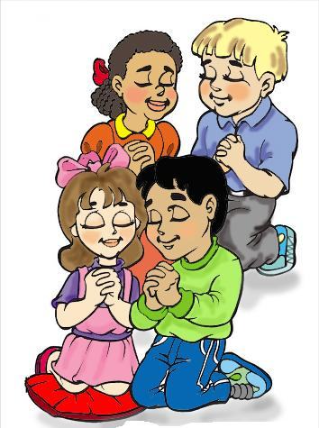
PRAYER
Jesus, many times we refuse to listen to you or are afraid to do what you ask of us. Give us a listening heart and the courage to follow in your footsteps knowing that you are always with us. Amen.

Slide 17
(3-7 yrs. old) I Want to Know You Lord, Apple Crisol, https://youtu.be/3UzW7wfn0L0

Slide 18
(8+ yrs) I Will Follow You, Roy RN, https://youtu.be/jpVuBcbZ24c

