Slide 1
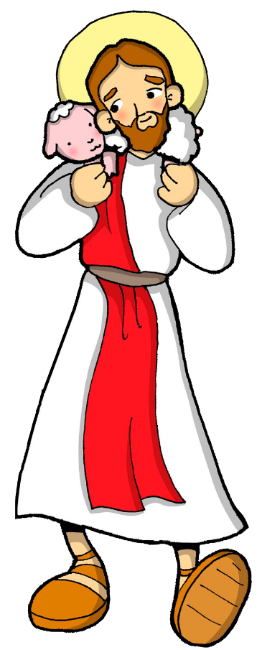
Friends of Jesus and Mary
Jesus, the Good Shepherd
Cycle B - IV Sunday of Easter
John 10:11-18
www.fcpeace.org

Slide 2
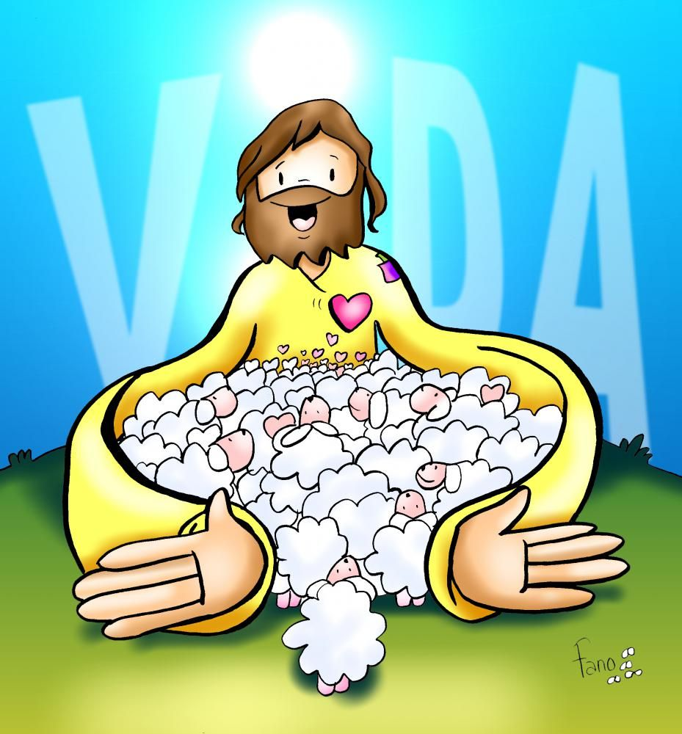
Jesus the Good Shepherd
I am the good shepherd, who is willing to die for the sheep. When the hired man, who is not a shepherd and does not own the sheep, sees a wolf coming, he leaves the sheep and runs away; so, the wolf snatches the sheep and scatters them. The hired man runs away because he is only a hired man and does not care about the sheep.

Slide 3
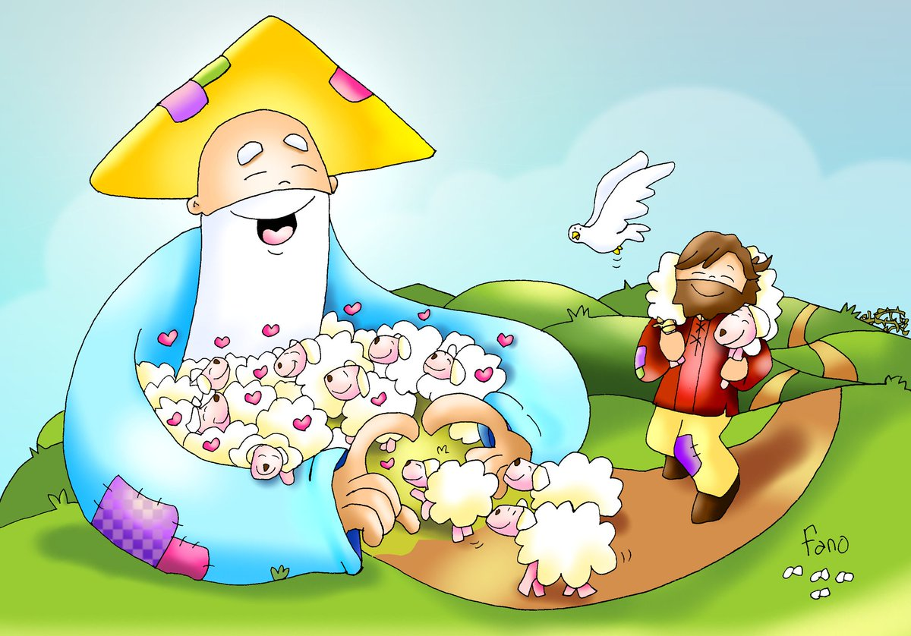
I am the good shepherd. As the Father knows me and I know the Father, in the same way I know my sheep and they know me. And I am willing to die for them. There are other sheep which belong to me that are not in this sheep pen. I must bring them, too; they will listen to my voice, and they will become one flock with one shepherd. The Father loves me because I am willing to give up my life, in order that I may receive it back again. No one takes my life away from me. I give it up of my own free will, I have the right to give it up, and I have the right to take it back. This is what my Father has commanded me to do.”

Slide 4
REFLECTION

Slide 5
What is the work of a Shepherd?

Slide 6
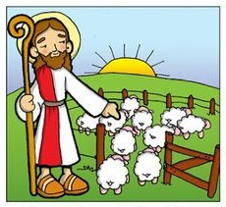
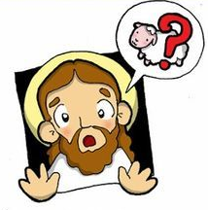
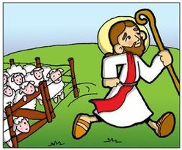
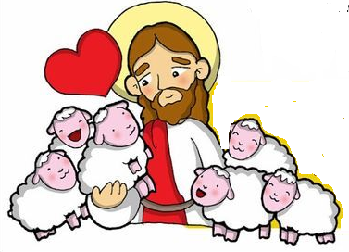
He protects the sheep from dangerous animals; he guides the sheep to eat in green pastures and to drink in streams, then take them back to their pen at night to sleep.
If they get lost, he goes out to find them.
The sheep know his voice and follow him.

Slide 7
How is Jesus the Good Shepherd?

Slide 8
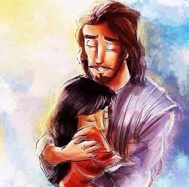
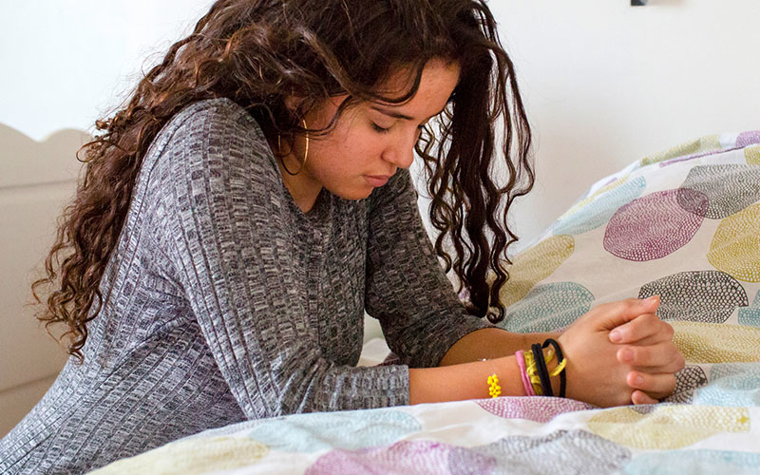
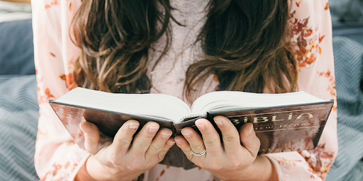
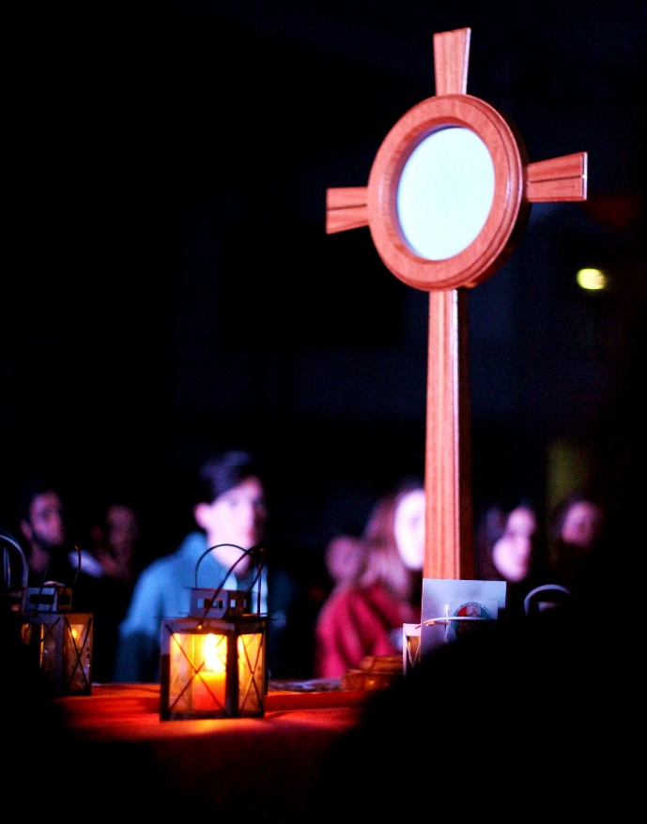
He is always with us.
When we listen to Him, He guides us away from danger.
He gives us His word in the Gospel so we may know Him and follow Him.
He gave us the Eucharist so He may share His life with us, and guide us to Heaven.
He protects and loves us.

Slide 9
Jesus says His sheep follow the Good Shepherd because they know His voice… How do we recognize the voice of Jesus in others?

Slide 10
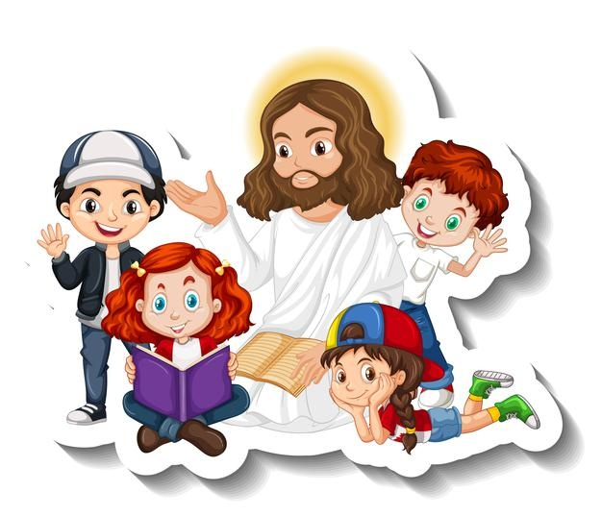
In prayer and in the Gospel, Jesus reveals himself and tells us what He wants from us.
If someone is telling us to disobey Jesus, we know they are not from God.

Slide 11
What does Jesus say we should do to follow Him?

Slide 12
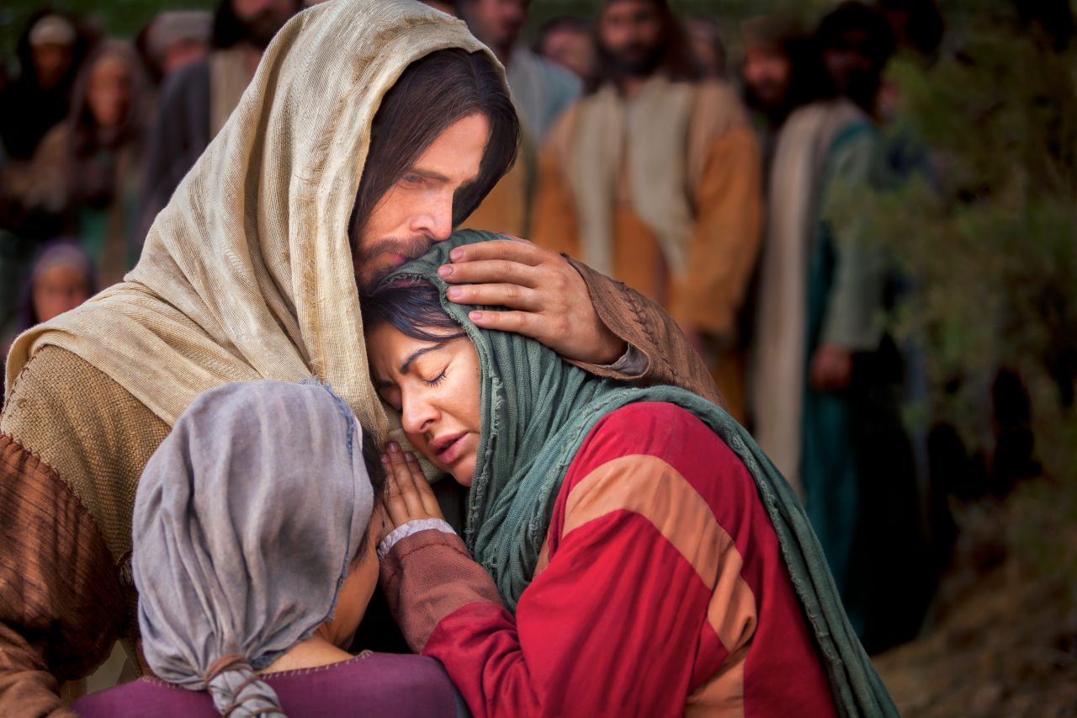
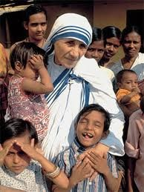
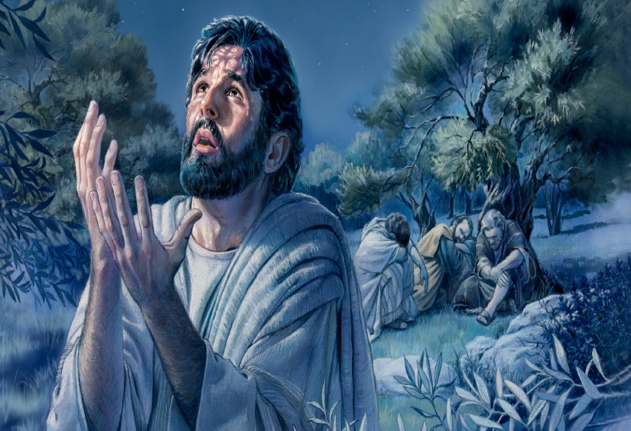
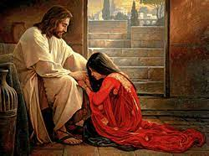
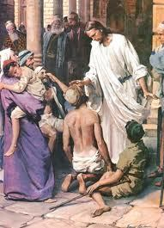
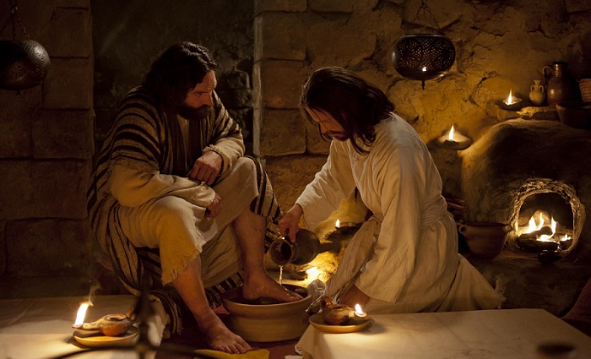
He tells us to love God and our neighbor with our whole heart.
He showed us with His life when:
He went out often to pray to His Father,
He cured the sick,
He fed the hungry,
He forgave sinners,
He washed the feet of His apostles…

Slide 13
How can we listen to and follow Him?
Share….

Slide 14
ACTIVITIES

Slide 15
S
T
R
A
N
G
E
R
G A T E
H
I
E
F
P
E
N
S
H
E
E
P
V O C
A M
S H E H R D

Slide 16
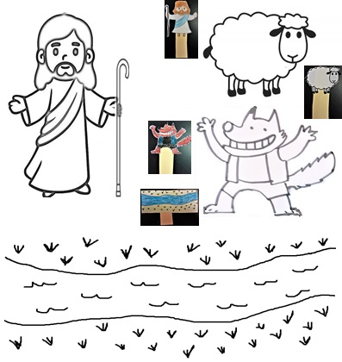
Instructions:
On the following page, color and cut the drawings and glue to sticks or pieces of cardboard. Glue cotton to the sheep. Act out how the Good Shepherd takes the sheep to drink water and eat grass, how he protects the sheep from the wolf, how he looks for the sheep when they are lost and how they take them to their pen at night to sleep. Emphasize how Jesus, the Good Shepherd loves His sheep and how the sheep follow Him and thus are saved.

Slide 17
We’re Following Jesus, riverspringbbc, (Ctrl Click) https://youtu.be/BcdxkZv9kDA 3-7 yrs.

Slide 18
I Have Decided to Follow Jesus, Lifetree Kids, https://youtu.be/sEL0WpeH088 8+Years

