Slide 1
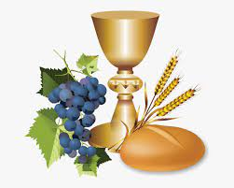
SOLEMNITY OF THE BODY AND BLOOD OF CHRIST
Ministry Friends of Jesus and Mary
IX Sunday in Ordinary Time
Corpus Christi
Mark 14, 12-16. 22-26
www.fcpeace.org

Slide 2
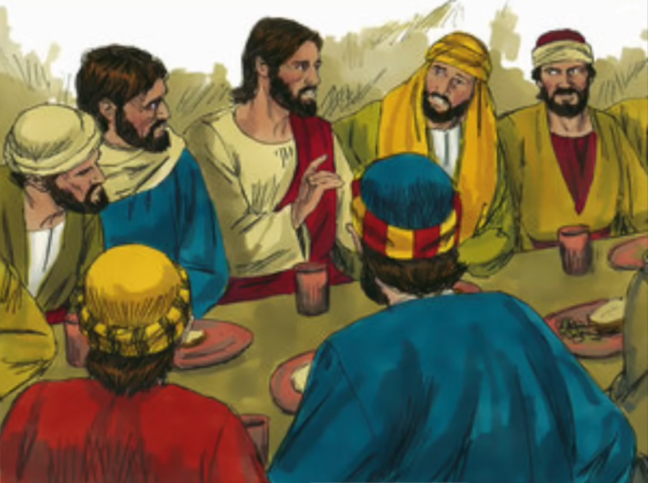
Gospel of Mark 14, 12-16. 22-26

Slide 3
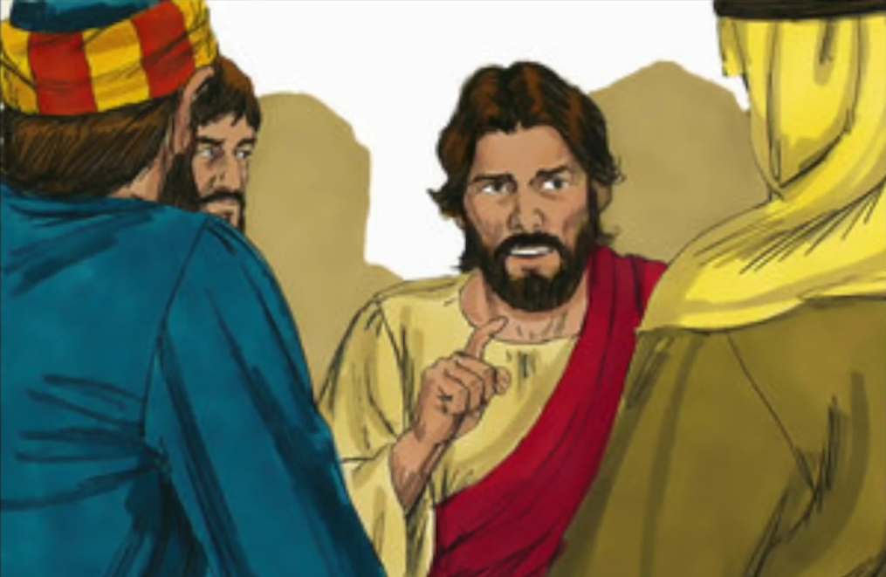
On the first day of the Feast of Unleavened Bread, when they sacrificed the Passover lamb, Jesus’ disciples said to him,

Slide 4
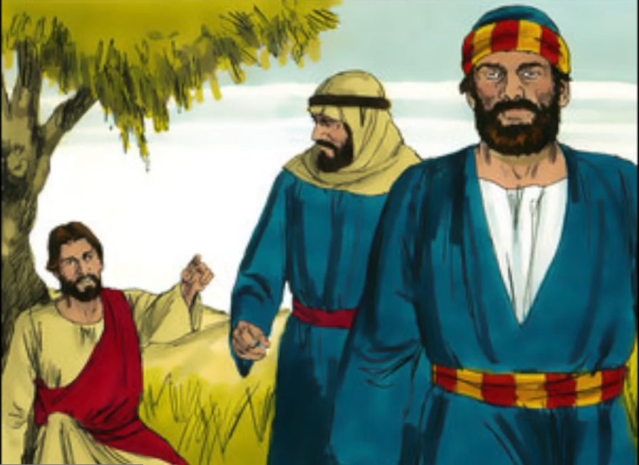
"Where do you want us to go and prepare for you to eat the Passover?" He sent two of his disciples and said to them, "Go into the city…

Slide 5
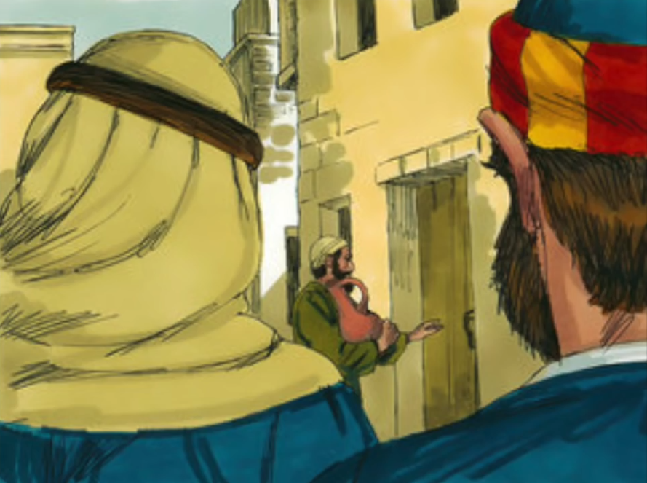
…and a man will meet you, carrying a jar of water. Follow him. Wherever he enters, say to the master of the house…

Slide 6
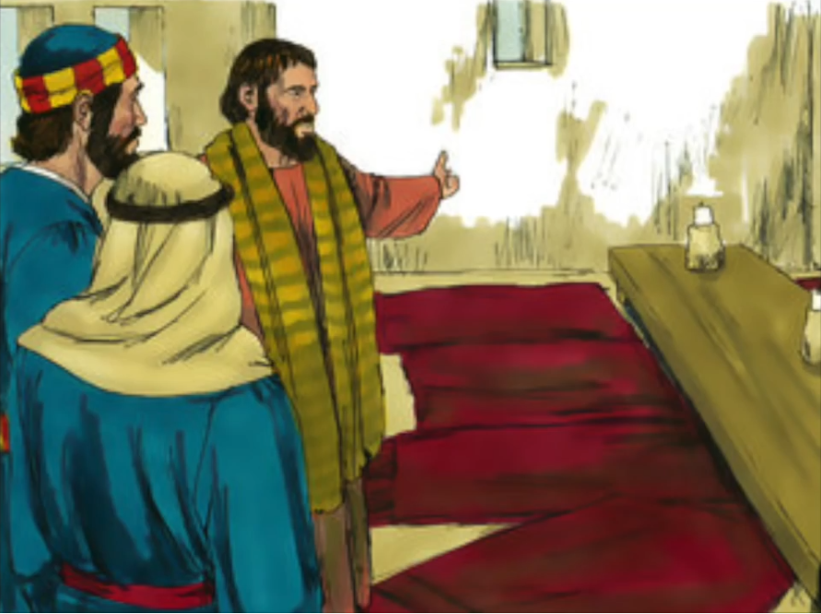
…'The Teacher says, "Where is my guest room where I may eat the Passover with my disciples?"' Then he will show you a large upper room…

Slide 7
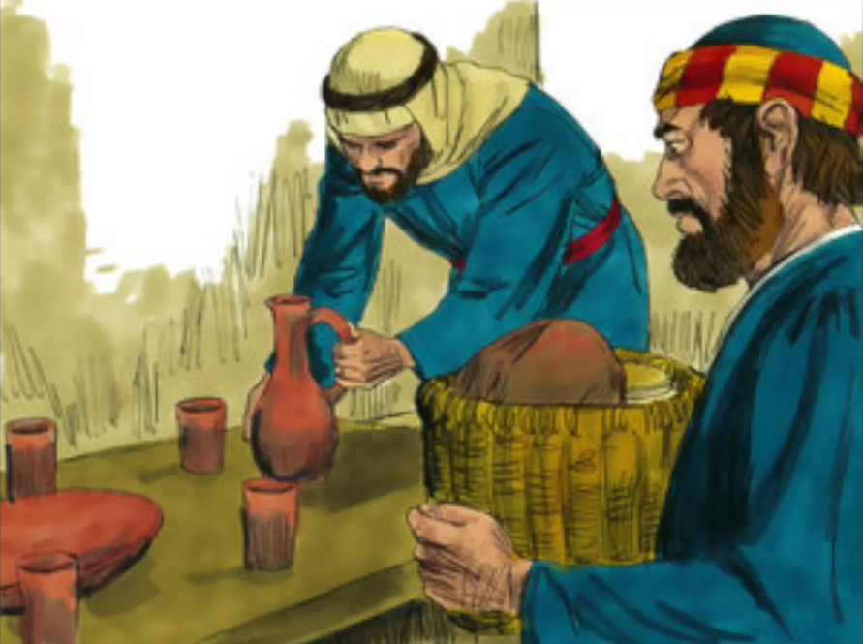
…furnished and ready. Make the preparations for us there." The disciples then went off, entered the city, and found it just as he had told them; and they prepared the Passover.

Slide 8
While they were eating, he took bread, said the blessing, broke it, gave it to them, and said,

Slide 9
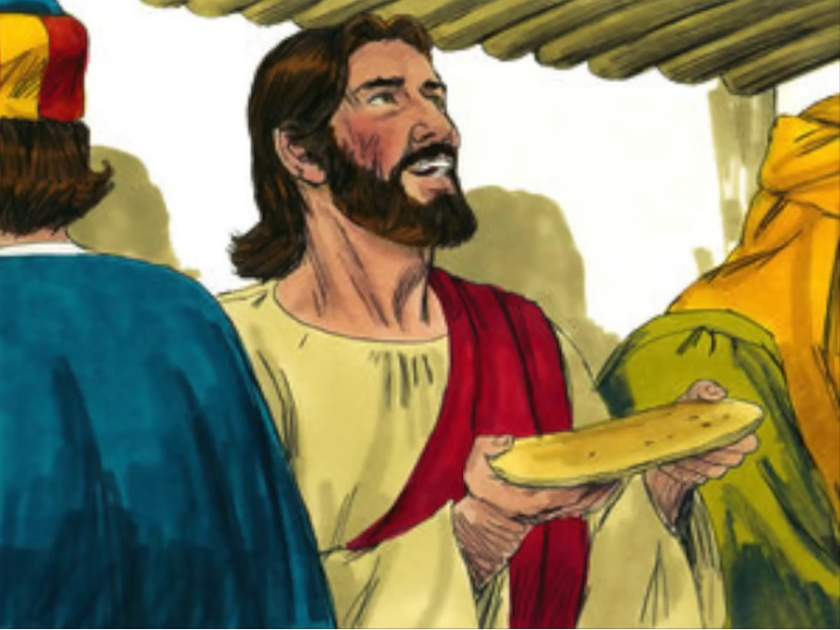
"Take it; this is my body."

Slide 10
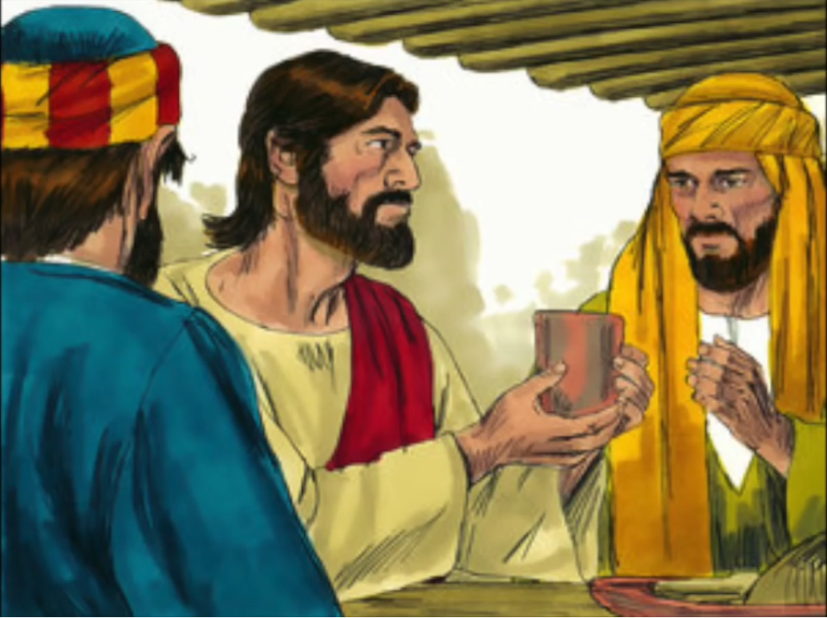
Then he took a cup, gave thanks, and gave it to them, and they all drank from it. He said to them, "This is my blood…”

Slide 11
…blood of the covenant, which will be shed for many. Amen, I say to you, I shall not drink again the fruit of the vine until the day when I drink it new in the kingdom of God."

Slide 12
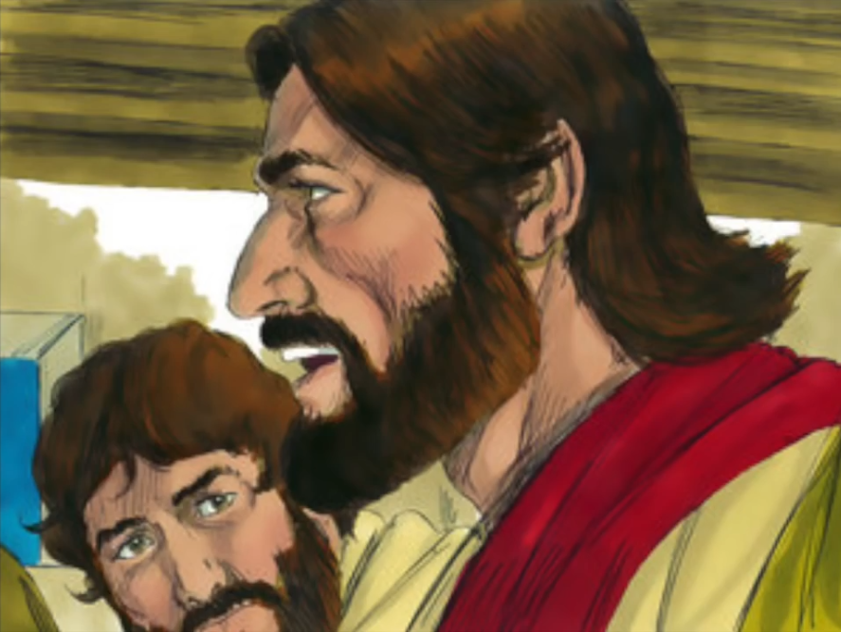
Then, after singing a hymn, they went out to the Mount of Olives.
THE GOSPEL OF THE LORD. PRAISE TO YOU LORD JESUS CHRIST.

Slide 13
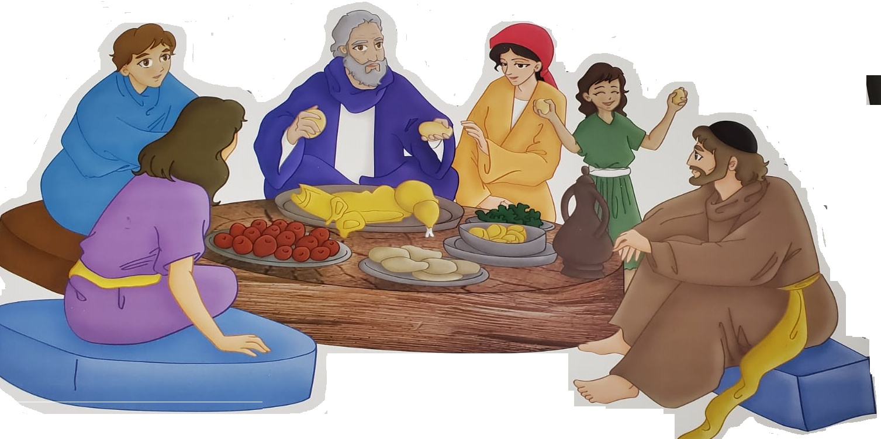
REFLECTION
Do you know since when Passover is celebrated?
…since the Old Testament, when God liberated His people from slavery in Egypt. The Feast of Unleavened Bread or Passover, lasted 7 days remembering when God asked them to prepare unleavened bread for their last meal because they had to leave Egypt quickly, leaving no time for the bread to rise.

Slide 14
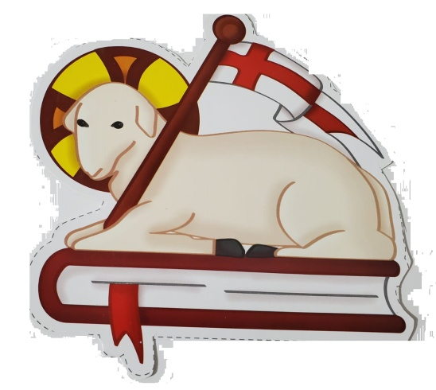
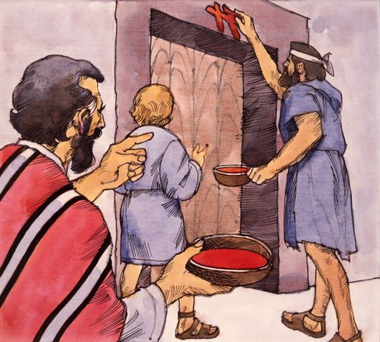
REFLECTION
The 1st day of Passover, they sacrificed a lamb
(a perfect, male, less than 1 year old).
They roasted, then ate the meat.
Its blood reminded them of how God had saved the first born of the Israelites in Egypt.
But Jesus celebrates His last Passover with His disciples without a lamb. Who is the lamb?
JESUS

Slide 15
REFLECTION
At dinner, Jesus blesses the bread and says, “Take it, this is my body.” How can bread be the body of Jesus?
Jesus is God, almighty; He does a miracle changing the substance of the bread to that of His body, although the appearance stays the same. Transubstantiation.
Jesus takes the cup and blesses it and says, “This is my blood of the covenant, which will be shed for many.”
Jesus is God, almighty; He does a miracle changing the substance of the wine to that of His blood, although the appearance stays the same. Transubstantiation.

Slide 16
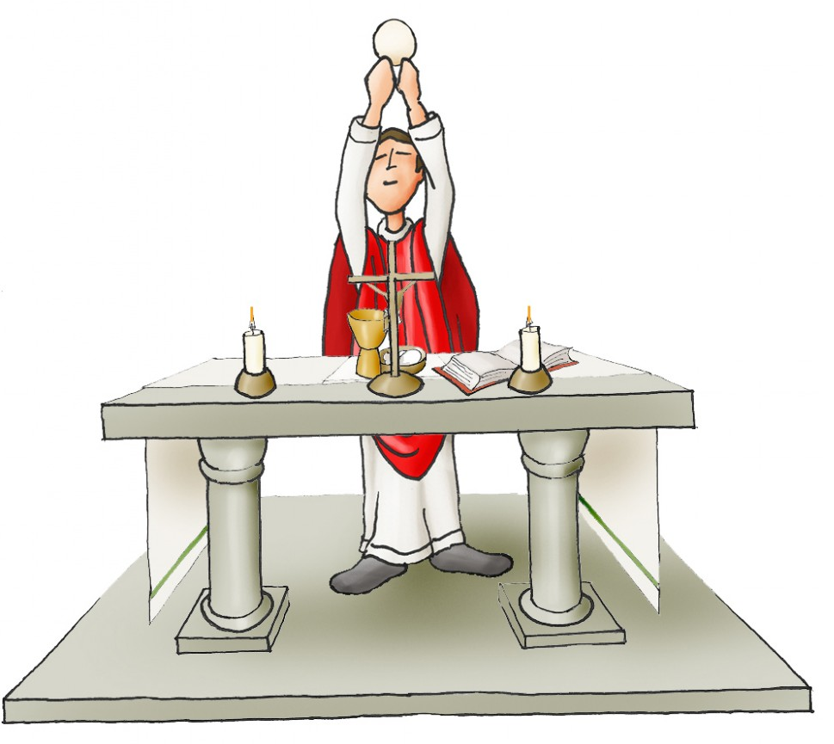
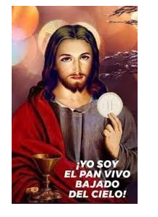
REFLECTION
CONSECRATION: Moment during the MASS in which Jesus, through the priest, changes the bread and wine to His Body and Blood.
Before the
CONSECRATION
After the
CONSECRATION
BREAD AND WINE
BODY AND BLOOD OF JESUS

Slide 17
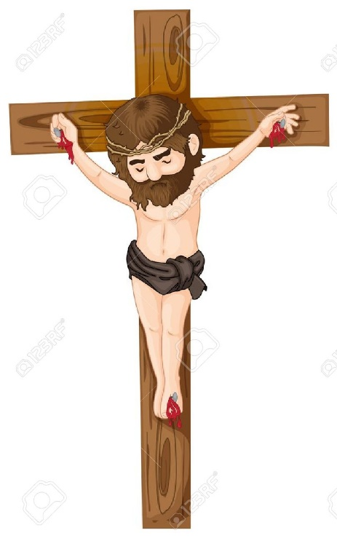
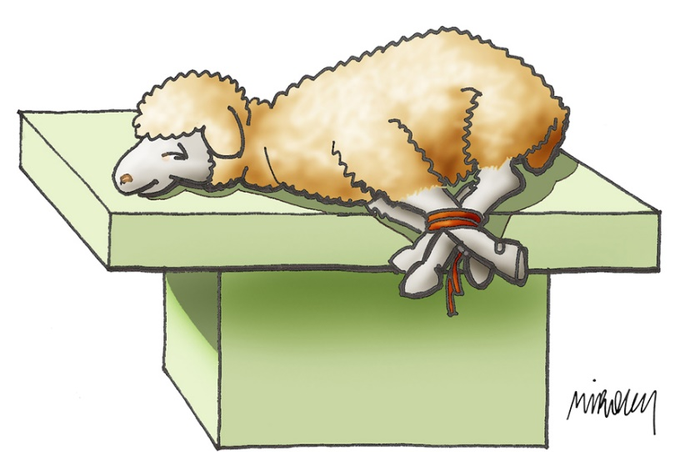
REFLECTION
Jesus is the LAMB OF GOD, who gave Himself as the perfect sacrifice, shedding His blood on the Cross for us, so we may be saved from our sins and live in communion with God.
God asked the Israelites to sacrifice a lamb to save them from the 10th plague in Egypt, death of the first born son. The 10th plague finally made Pharoah set them free.
Every time we go to Communion, we receive JESUS who helps us live holy lives, united with God. Jesus nourishes and strengthens our soul so we may be more like Jesus.

Slide 18
During the First Communion Ceremony, Caio Henrique Nagel Vieira was moved and cried when He received Jesus in the Eucharist for the 1st time. He remembered Jesus’ suffering and asked forgiveness for the sins of the world. Caio felt that Jesus hugged Him which caused him great emotion. Grateful, he said: “God could have started the world over from nothing, but preferred to sacrifice His Son for love of us”.
Source: Aciprensa May 2021

Slide 19
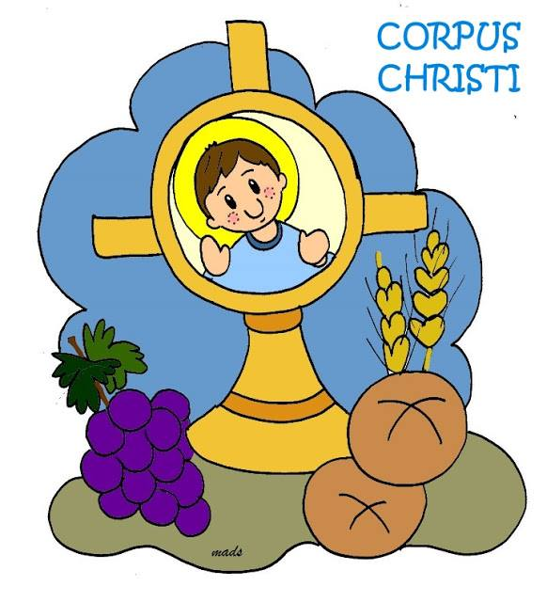
It’s the Feast of the Body and Blood of Christ, which is celebrated 60 days after the Resurrection of Christ.

Slide 20
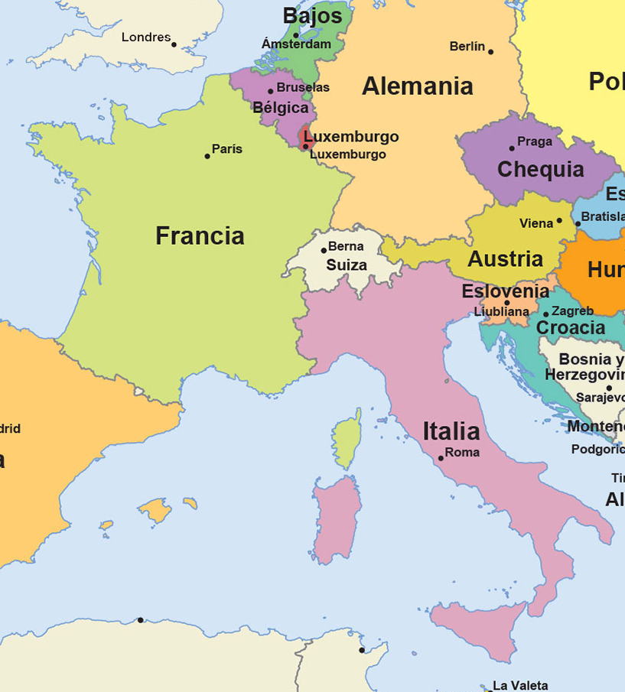
HISTORY OF CORPUS CHRISTI
This feast is born in Belgium thanks to a humble nun, St. Juliana of Mont Cornillon.
St. Juliana was born in 1193, orphaned very young and was educated by Augustinian nuns. She always had a strong devotion to the Blessed Sacrament.

Slide 21
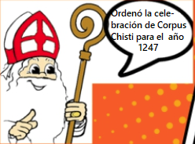
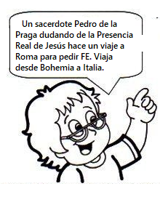
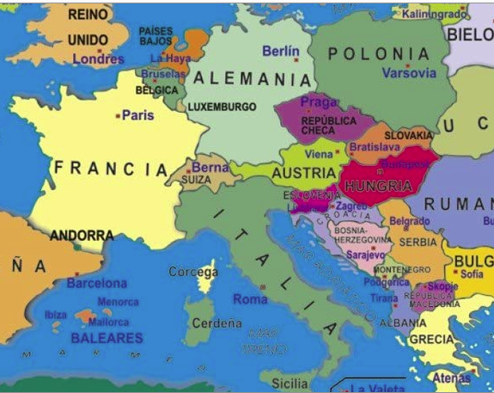
When she was 16 years old, she had a vision…
The Bishop, Robert of Thorete was greatly impressed, and although he doubted, he did what Juliana asked.
She saw a full moon (the Church) with a black stain which represented the absence of this feast.
He ordered the celebration of Corpus Christi for the year 1247.
Years later…in 1264…
A priest, Peter of Prague, doubting the Real Presence of Jesus, makes a trip to Rome to ask for faith. He travels from Bohemia to Italy.

Slide 22
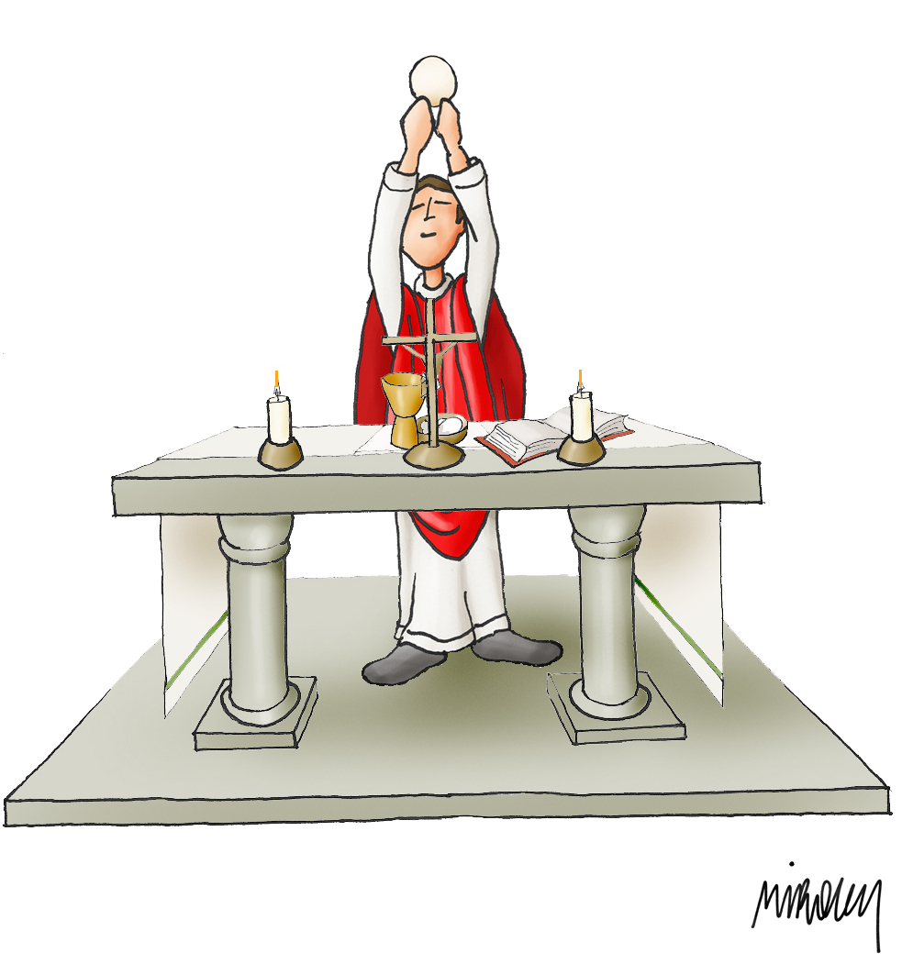
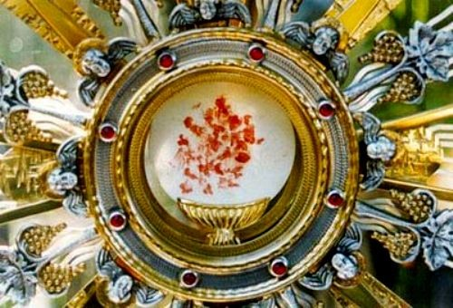
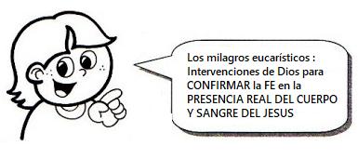
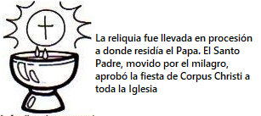
He visits a city close to Rome (Bolsena) where he celebrates Mass. Raising the Host, he saw it was bleeding staining the corporal (a special cloth where the chalice and host is placed).
MILAGRO EUCARISTICO
EUCHARISTIC MIRACLE
In Eucharistic miracles, God intervenes to CONFIRM the FAITH and the REAL PRESENCE OF THE BODY AND BLOOD OF JESUS.
The relic was raised in procession to where the Pope lived. The Holy Father, moved by the miracle, approved the feast of Corpus Christi for the whole Church.
Notes:
ESTE ES EL MILAGRO DE Bolzano

Slide 23
ACTIVITY

Slide 24
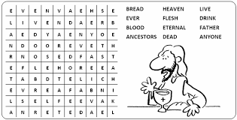

Slide 25
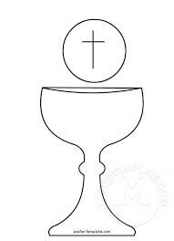
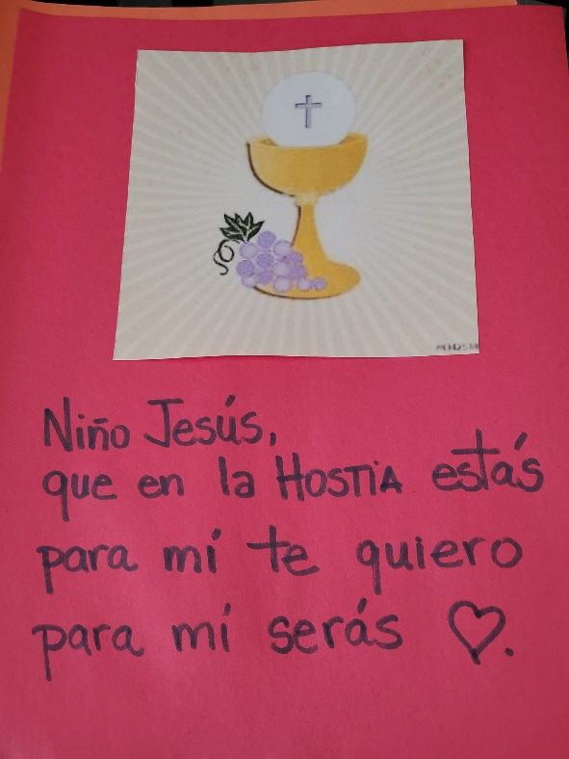
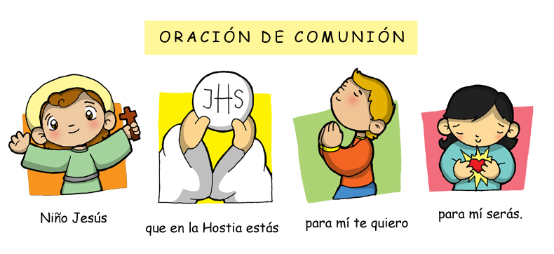
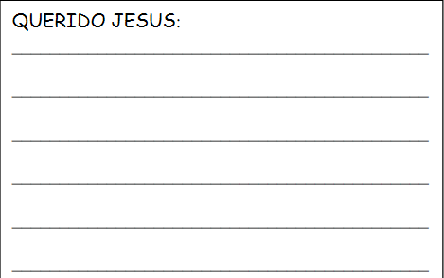
INSTRUCTIONS: Draw a chalice and a host. Cut, color and glue to a piece of colored construction paper. Write below the picture, the Communion Prayer. On the other side, write a letter to Jesus telling Him how you feel about all that He did for you.

Slide 26
PRAYER
Lord, you nourish us each day physically and spiritually with your own body and blood. Your communion teaches us to share everything with others. Help us to be generous with one another, giving ourselves in service and in love. Stay with us. Amen.

Slide 27
Song: Eucharist Song, CollinsSusan https://youtu.be/_GEqnKMN1zE (3-7 years)

Slide 28
Song: We Are One Body, Holy Spirit, https://youtu.be/N-3BO_PQbqY?si=pI5-La6fIgDCD9c5 (8+ years)

