Slide 1
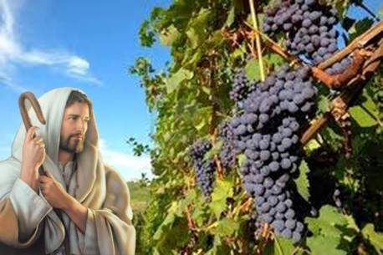
Ministry Friends of Jesus and Mary
Prayer Group for Children
The True Vine
Cycle B - V Sunday of Easter, John 15:1-8
www.fcpeace.org

Slide 2
Jesus the True Vine, https://youtu.be/BgWesdAHGMg?si=EPVp8_XnWDE5R_UN

Slide 3
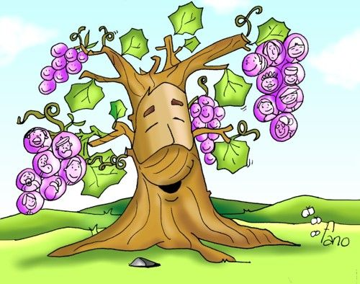
Reflection

Slide 4
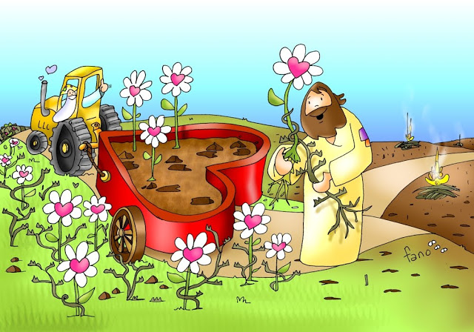
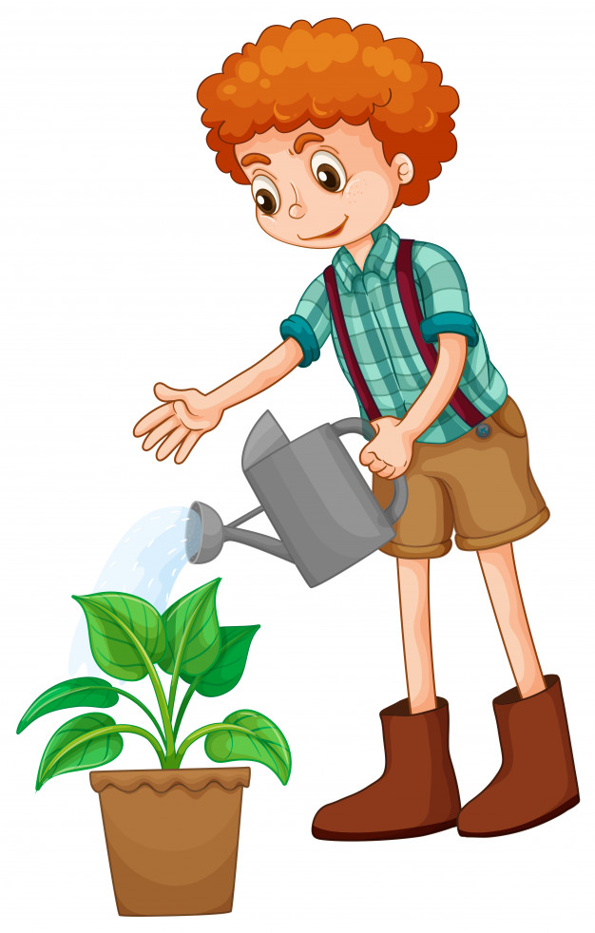
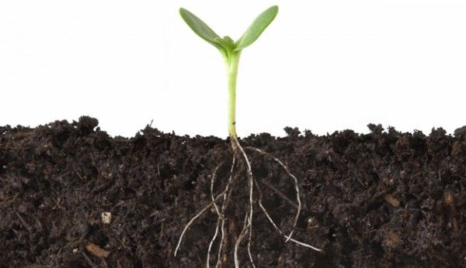
What does a tree or a vine need to give much fruit?
Pruning and cleaning
Water
Sun
Good soil

Slide 5
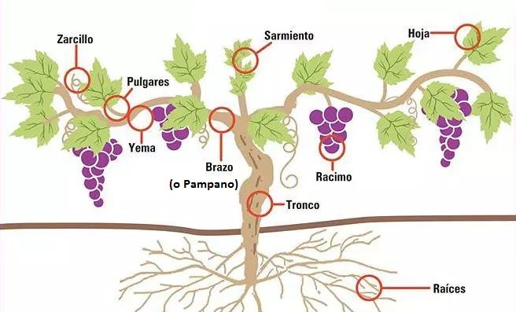
Do you know what a vine is?
leaves
Branch
Fruit cluster
Trunk
Roots
A vine is a tree that grows grapes
and grows in great vineyards.

Slide 6
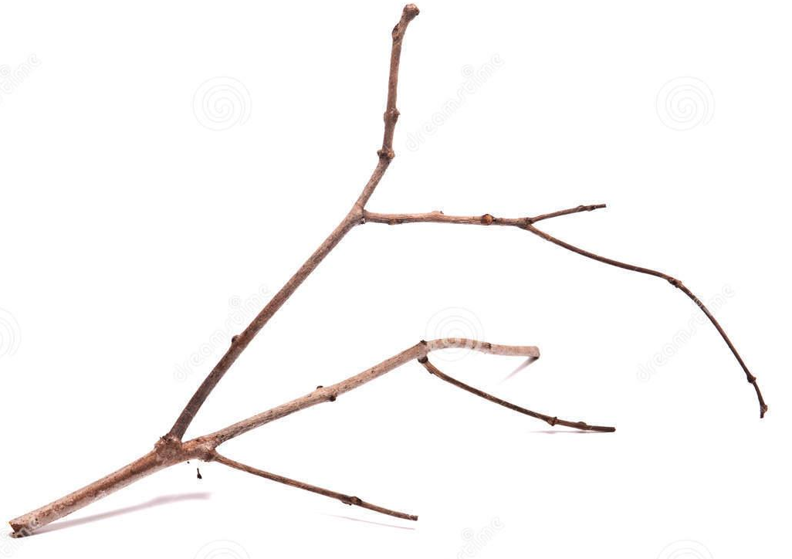
What happens if a branch separates from the trunk or the vine?
The Branch and its fruits die because they don’t receive water and nutrients.

Slide 7
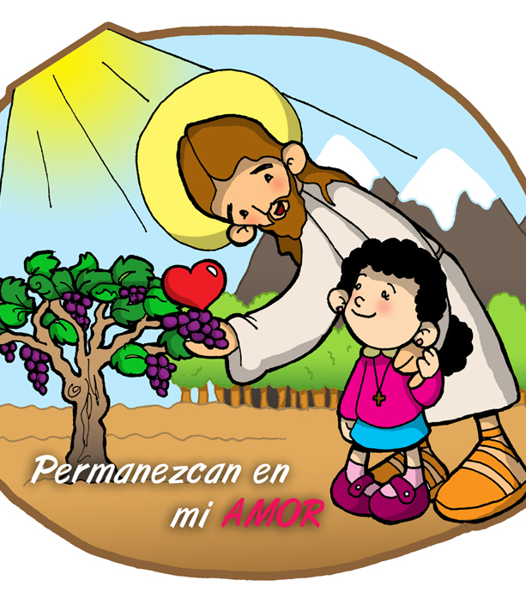
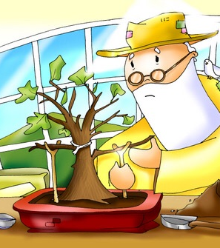
Jesus compares His Kingdom to a vine, where He is the vine, we are the branches and our Father in Heaven is the vine grower.
Remain in my
LOVE.

Slide 8
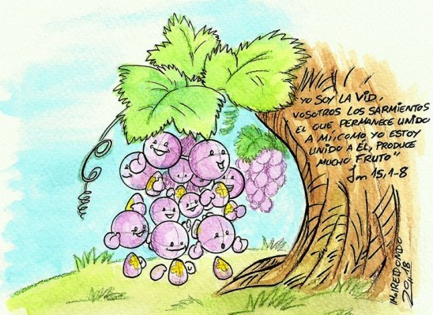
What do the fruits represent in this comparison?
The love we share to build God’s Kingdom

Slide 9
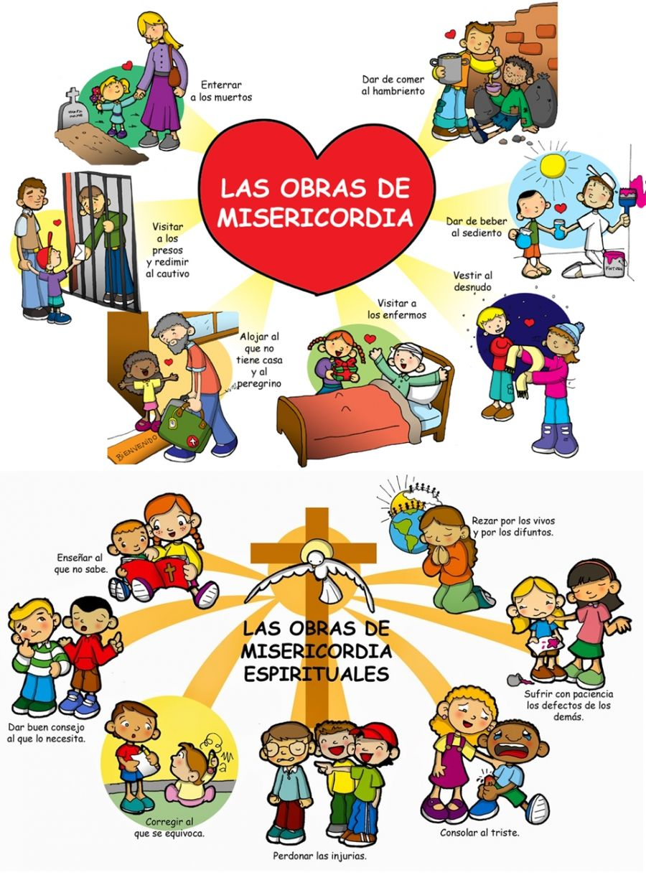
How do we share that love?
Bury the
dead
Feed the
hungry
The Corporal Works of Mercy
Visit the imprisoned
Give water to the thirsty
Visit the sick.
House the homeless
Pray for the living and the dead
Instruct the ignorant
The Spiritual Works of Mercy
Praying for others, doing works of mercy to help our neighbors…
Have patience with other’s faults
Give good advice
Correct the sinner
Console the sorrowful
Bear with insults

Slide 10
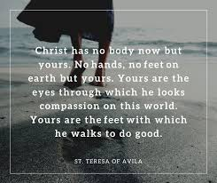
Jesus depends on us to be His voice and hands on earth.

Slide 11
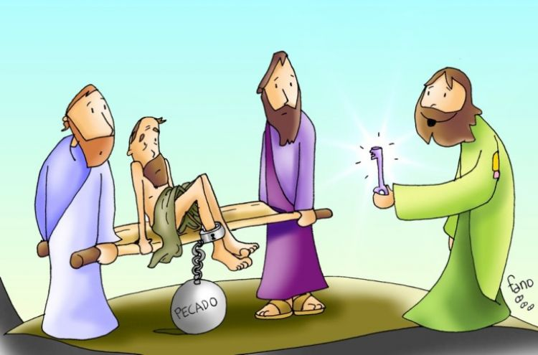
How does God prune us so we give more fruit and stay on the path to Heaven?
God takes away obstacles that stop our spiritual growth, or lets us experience the negative consequences of our bad decisions to teach us to follow the right path that leads to Him.

Slide 12
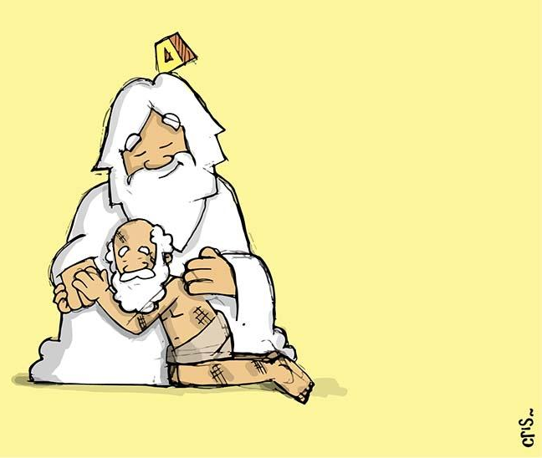
Have you ever experienced God’s pruning?
Share
How?

Slide 13
Jesus asks that we stay close to Him so we give fruit and so we receive all that we want from the Father.
Remain in my
LOVE

Slide 14
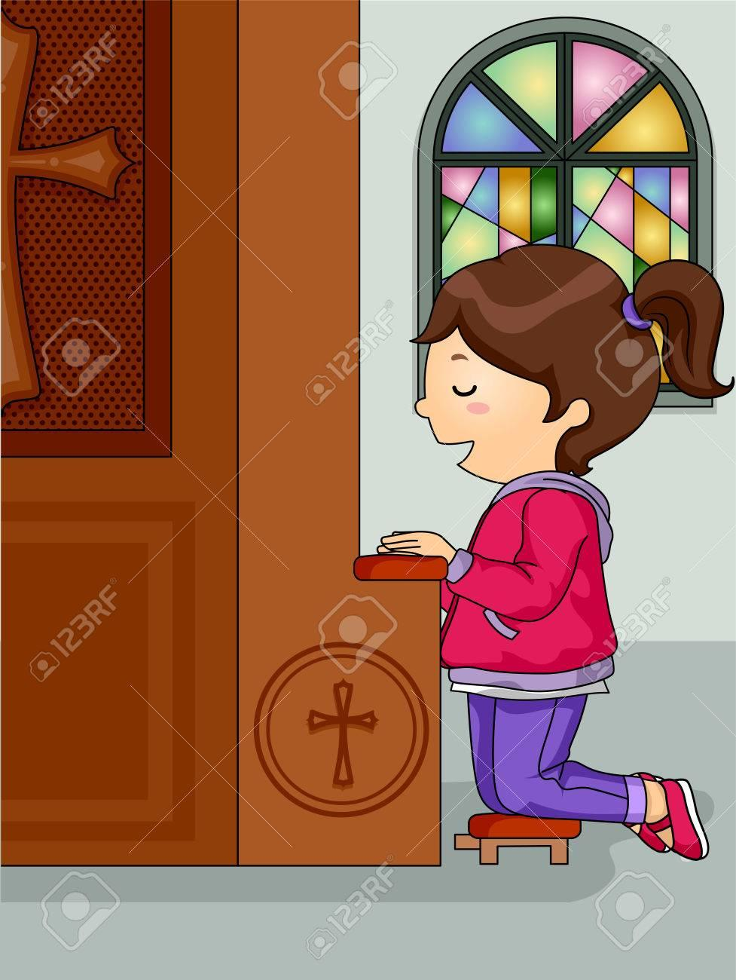
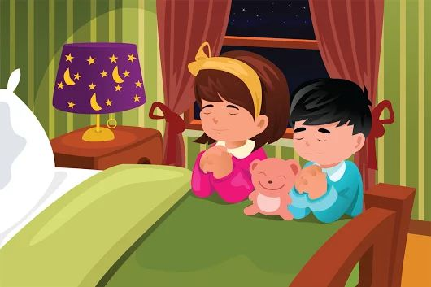
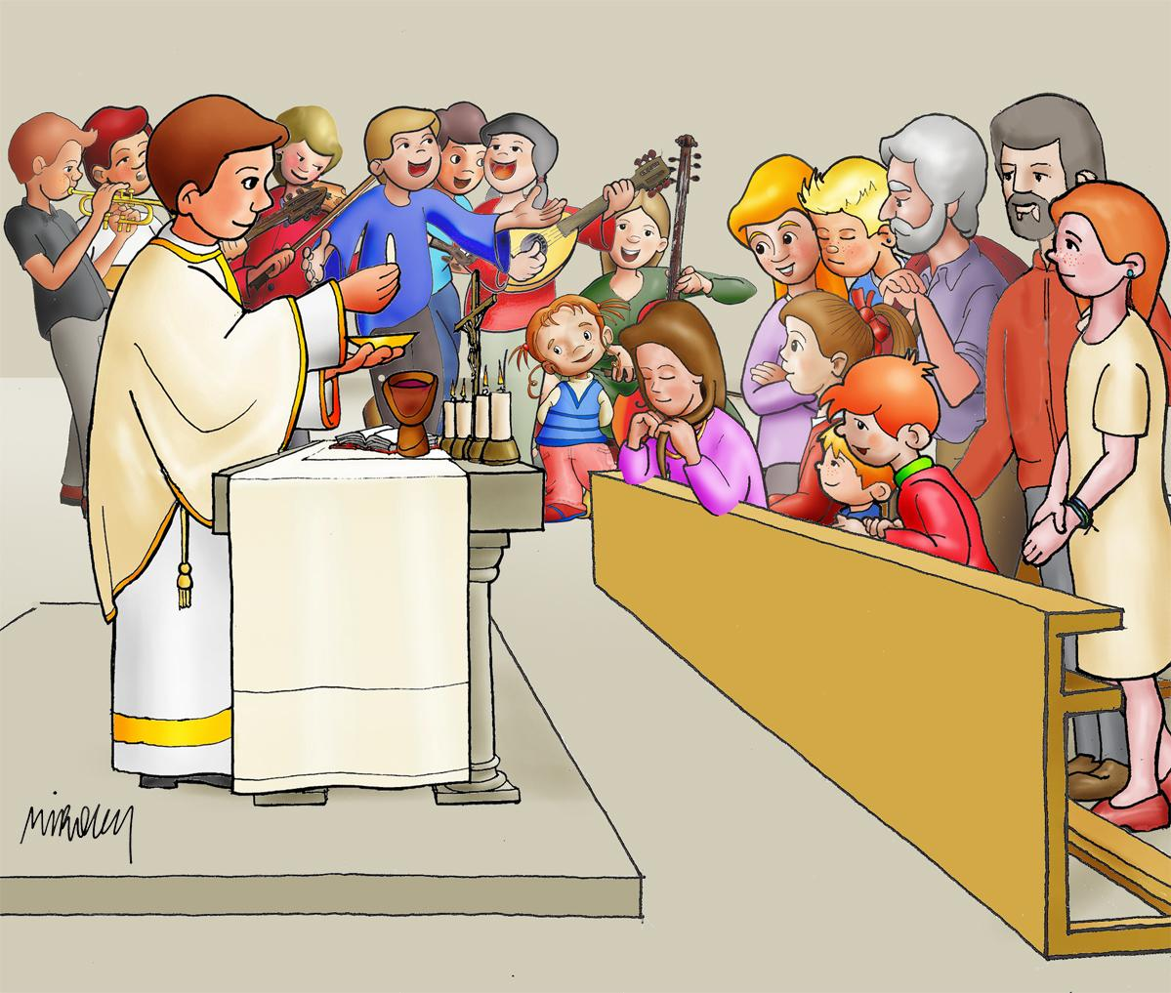
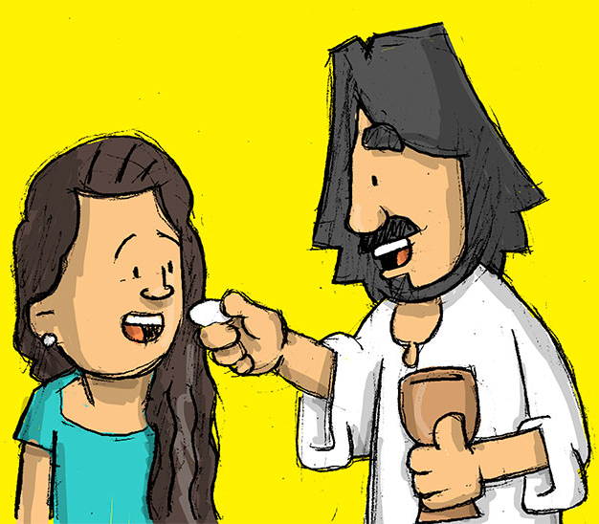
How do we stay close to Him?
Praying,
And in the other Sacraments; obeying His commandments of Love…
Participating in the Mass,

Slide 15
Activity
Instructions: Write in some of the grapes, how you can give fruit for Jesus. Draw your face in the square on the Branch. On the dry fruits on the floor, write or draw how a soul feels without Jesus: sad, angry, selfish, proud… Color.

Slide 16
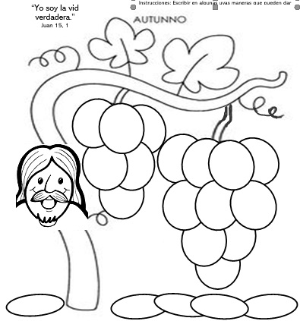
“I am the true vine”
(Jn 15:1)
advise
pray
help
love
obey
console
serve
forgive
give
Go to Mass
selfishness
anger
dissatisfied
pride
sadness

Slide 17
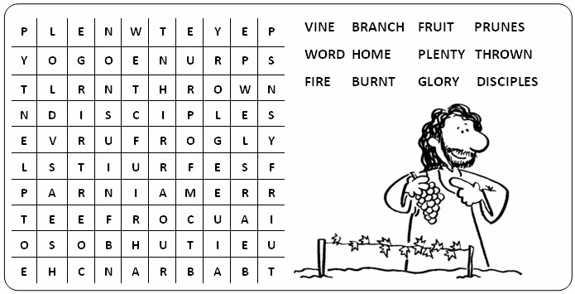

Slide 18
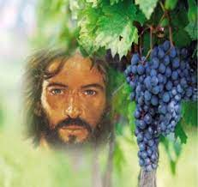
Prayer
Lord, sometimes we separate ourselves from your presence. Then we feel like life has no meaning or happiness. Remind us always that to live and bear fruit, we need to be united to you and to each other, like branches on a vine.
Amen

Slide 19
Song: I am the Vine, I Believe, https://youtu.be/sa1QmrfQ6q8?si=Dw5RSW0wxZUG8K37 (3-7 yrs.)

Slide 20
Song: You are the Vine Vineyard Worship, J. Priday, https://youtu.be/Mhq6Wse6sqY?si=3u20WkkMQCLT6d (8+ yrs.)

