Slide 1
Friends of Jesus and Mary
Prayer Group for Children
Cycle B-V Sunday of Lent
Jesus is the Good Seed – John 12: 20-33
www.fcpeace.org

Slide 2
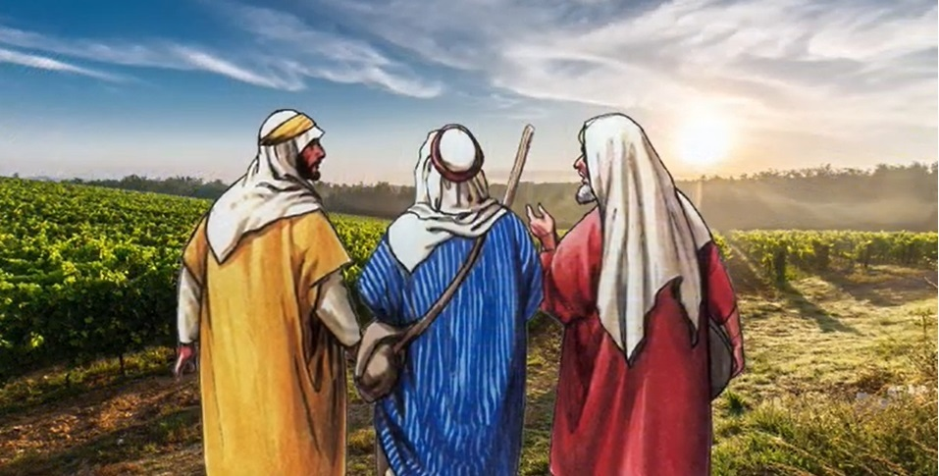
Some Greeks who had come to worship at the Passover Feast came to Philip, who was from Bethsaida in Galilee, and asked him, “Sir, we would like to see Jesus.”

Slide 3
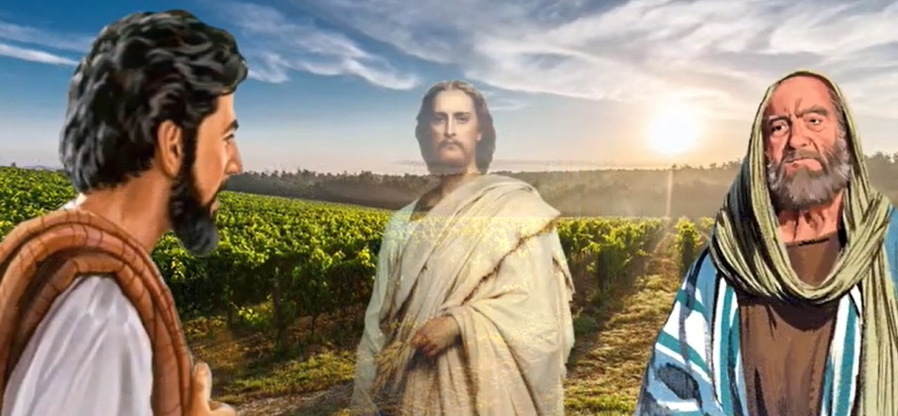
Phillip went and told Andrew; then Andrew and Phillip went and told Jesus.
Jesus answered them, “The hour has come for the Son of Man to be glorified.”

Slide 4
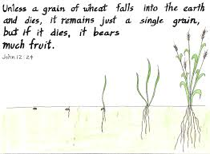

Slide 5
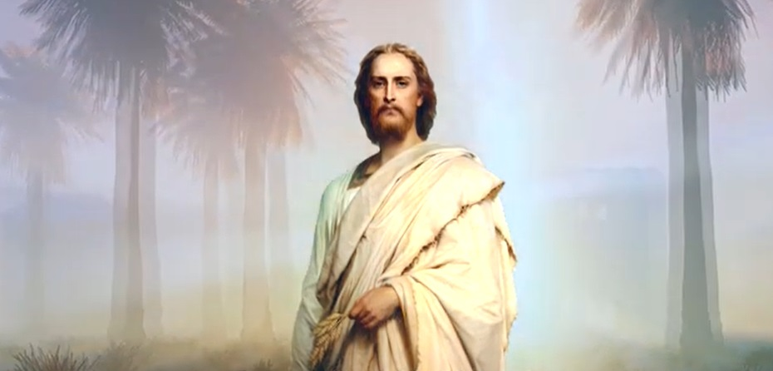
Whoever loves his life loses it and whoever hates his life
in this world will preserve it for eternal life.

Slide 6
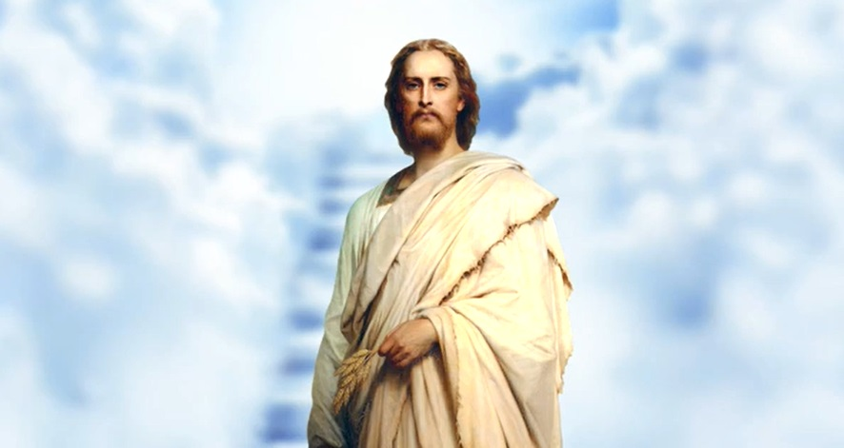
Whoever serves me must follow me, and where I am, there also will my servant be. The Father will honor whoever serves me.

Slide 7
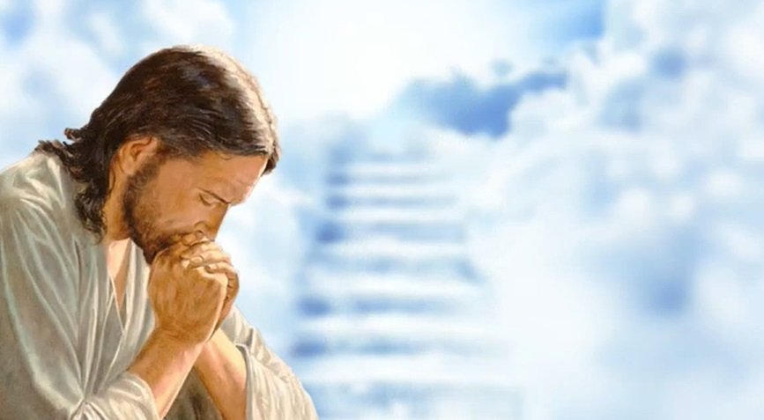
I am troubled now. Yet what should I say? Father save me from this hour? But it was for this purpose that I came to this hour. Father, glorify your name.

Slide 8
Then a voice came from heaven, “I have glorified it and will glorify it again.” The crowd there heard it and said it was thunder; but others said, “An angel has spoken to him.”
Jesus answered and said, “This voice did not come for my sake but for yours. Now is the time of judgment on this world; now the ruler of this world will be driven out.

Slide 9
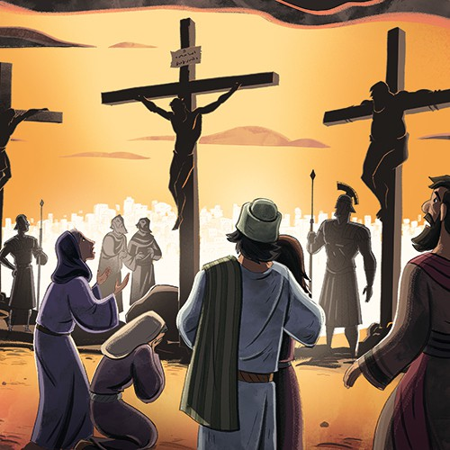
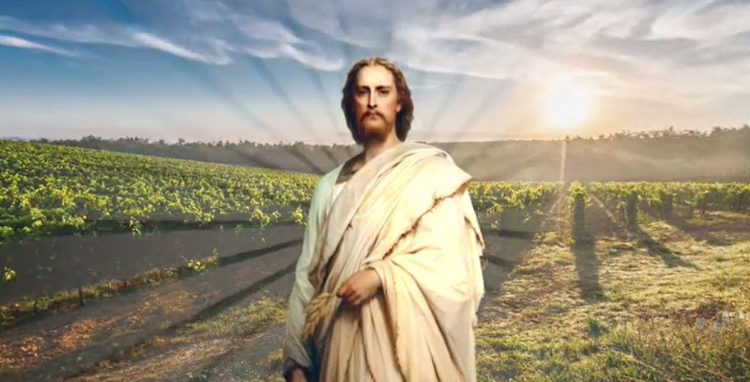
And when I am lifted up from earth, I will draw everyone to myself.”
He said this indicating the kind of death he would die.
THE GOSPEL OF THE LORD PRAISE TO YOUR LORD JESUS CHRIST

Slide 10
REFLECTION

Slide 11
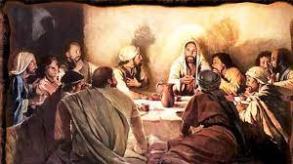
What feast were they going to celebrate in Jerusalem?
The Feast of Passover

Slide 12
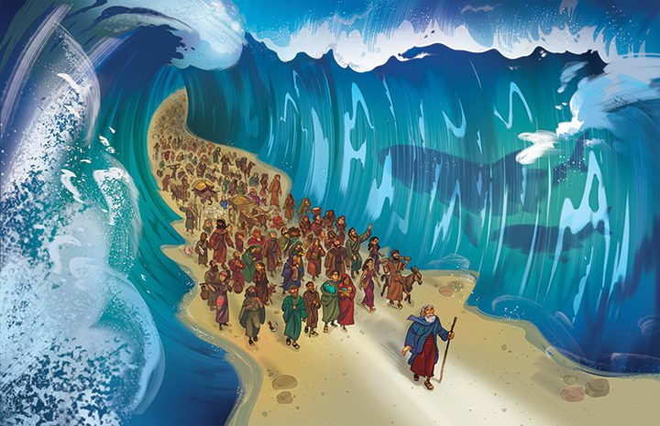
What do they celebrate at Passover?
When God saved His people from slavery in Egypt.

Slide 13
What does Jesus say to the apostles Andrew and Phillip?
“The hour has come for the Son of Man to be glorified.”

Slide 14
To what hour is Jesus referring?
To the hour of his suffering and dying on the cross.

Slide 15
Jesus then says,

Slide 16
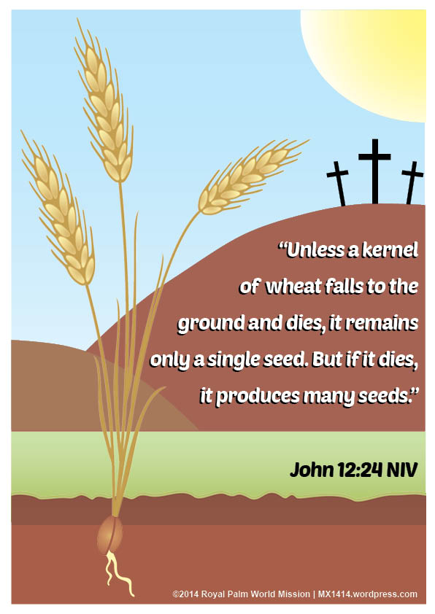
What comparison is Jesus making?
Like the death of the grain of wheat gives us bread to eat.
Jesus’ death gives us Eternal Life.
His death is not the end of the story,
but the beginning of abundant fruit for the good of the world.

Slide 17
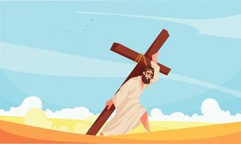
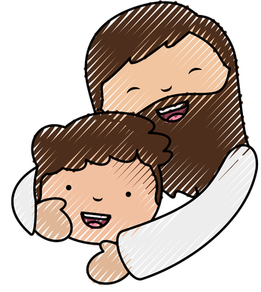
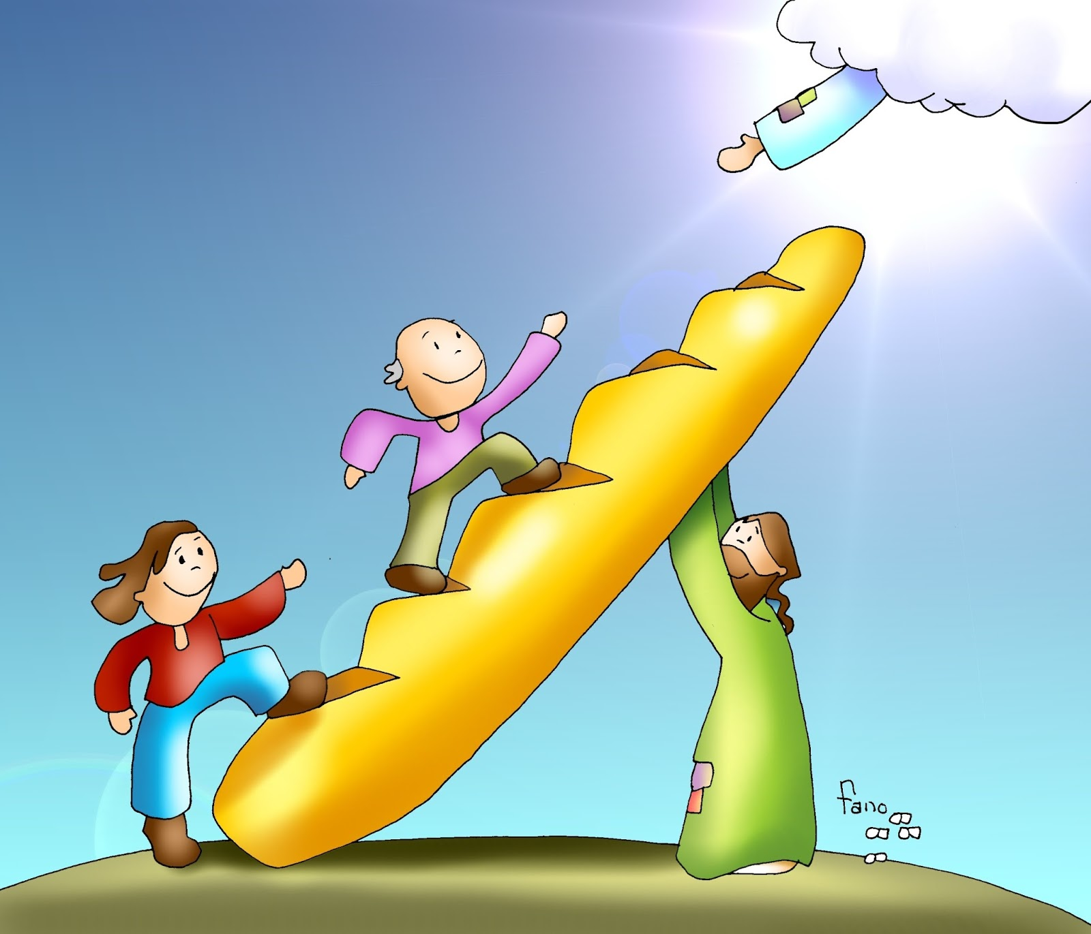
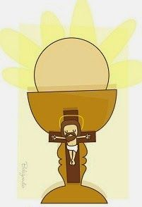
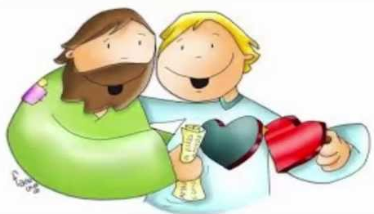
What are the fruits of Jesus’ sacrifice on the cross?
Forgiveness for our sins
Union with God eternally in Heaven.
Union with God in the Eucharist
God’s Grace
in us

Slide 18
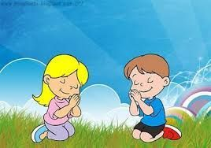
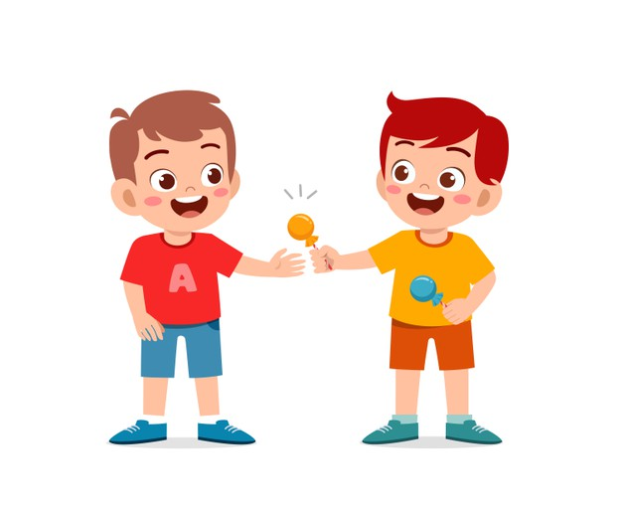
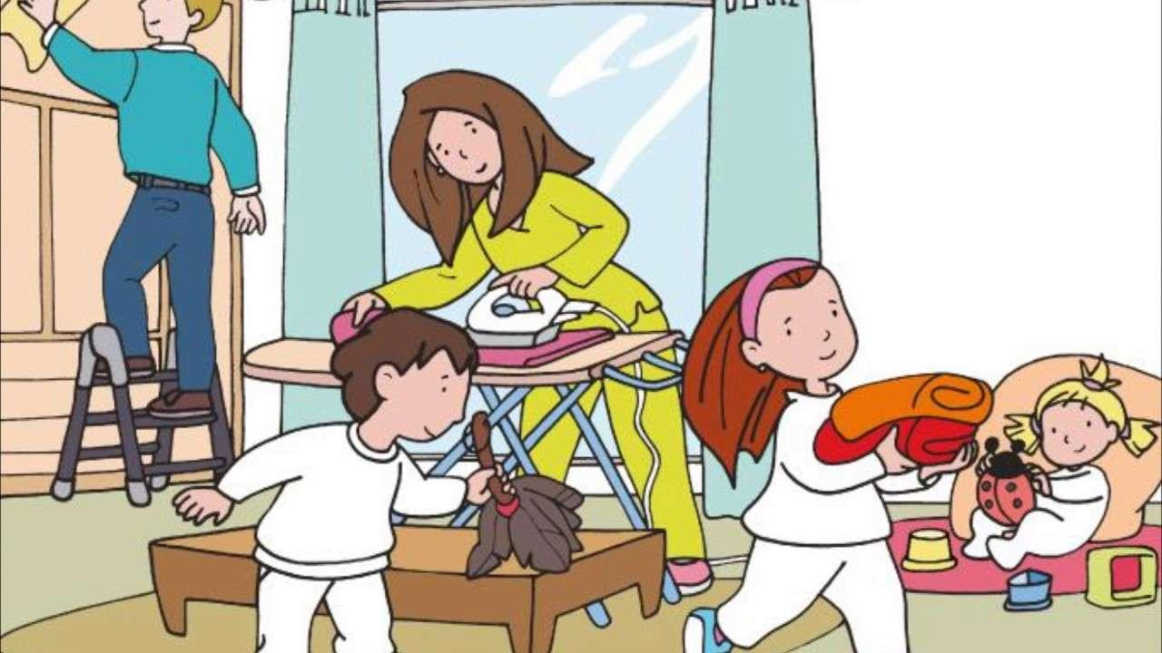
How can we give fruit for Jesus?
Sharing
Praying
Serving or Helping
Forgiving
Imitating Jesus, by sacrificing for love of God and others by…

Slide 19
Who sacrifices for us?
What sacrifice can you do this week to help someone?

Slide 20
Activity

Slide 21
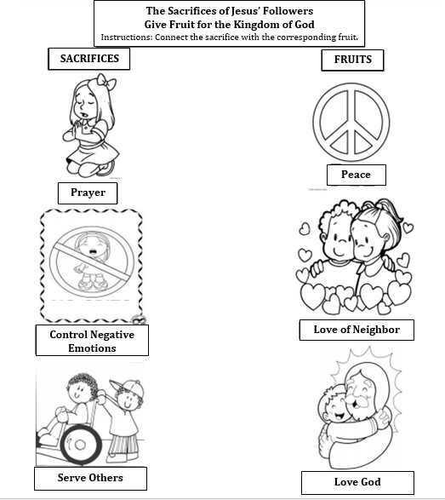

Slide 22
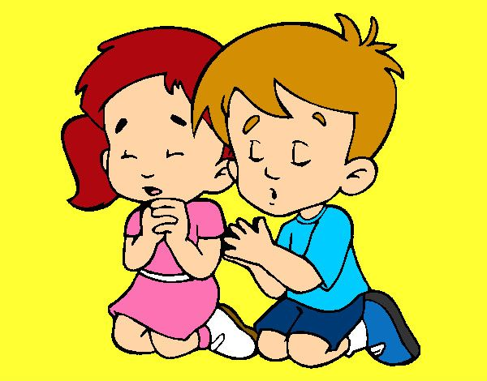
Prayer Jesus you are always attentive to the Father. Your love for our Father gave you the strength and courage to carry out your mission. Give us your Holy Spirit so that we may always work for the good of others. Help us to produce fruits of life. Amen

Slide 23
Song: Make me a Servant, Asidor kids, https://youtu.be/zw_FNbF1LrU?si=y3U31v-ztzHvfd_X (3-7 yrs)

Slide 24
The Servant Song, servantofthelion, https://youtu.be/kdmgpMfnjdU?si=hT5zoo0Waq0mkgzx (8+ yrs.)

