Slide 1
Ministry Friends of Jesus and Mary
Cycle B - V Sunday in Ordinary Time
Jesus Heals Peter’s Mother-in-Law
Instructions on using the PowerPoint:
Click Enable Editing and Enable Content
Click Slide Show in the menu
Click From the Beginning on the left of the submenu
Click the Mouse to advance the PowerPoint

Slide 2
Jesus Heals Peter’s Mother-in-Law
On leaving the synagogue Jesus entered the house of Simon and Andrew with James and John.

Slide 3
Simon’s mother-in-law lay sick with a fever.
They immediately told
him about her.

Slide 4
He approached, grasped her hand, and helped her up.
Then the fever left her and she waited on them.

Slide 5
When it was evening, after sunset, they brought to him all who were ill or possessed by demons. The whole town was gathered at the door.
He cured many, who were sick with various diseases, and he drove out many demons, not permitting then to speak because they knew him.

Slide 6
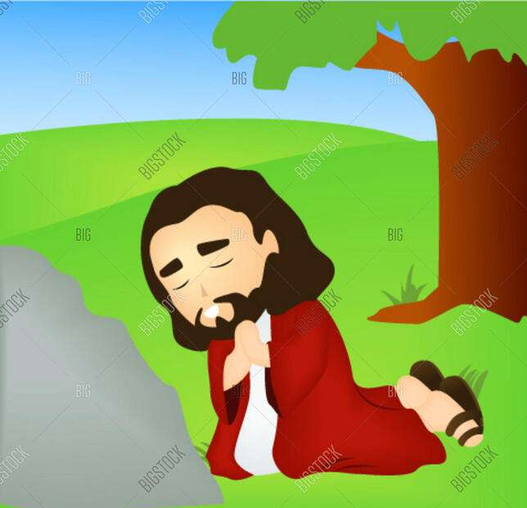
Rising very early before dawn, he left and went off to a deserted place, where he prayed.
Simon and those who were with him pursued him and on finding him said, “Everyone is looking for you.” He told them, “Let us go on the nearby villages that I may preach there also. For this purpose I have come.”

Slide 7
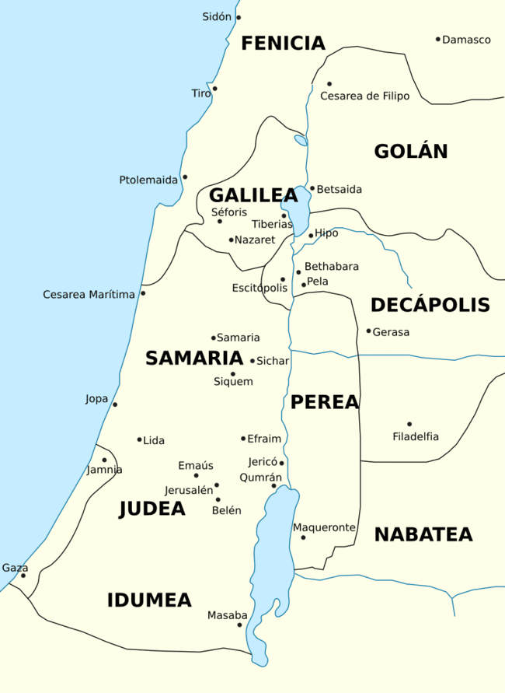
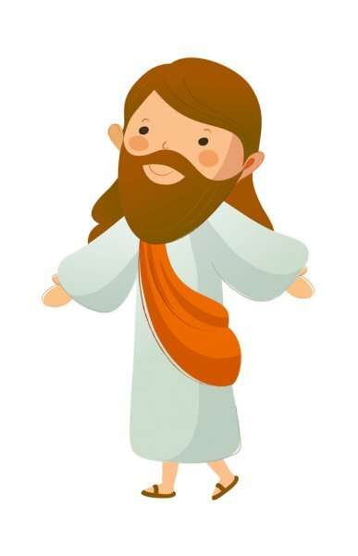
So he went into their synagogues, preaching and driving out demons throughout the whole of Galilee.
The Gospel of the Lord…
Praise to You Lord Jesus Christ

Slide 8
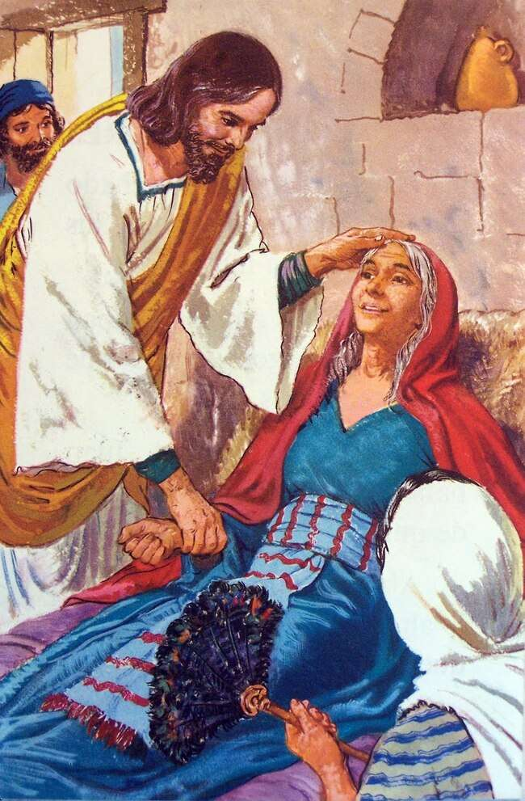
RefleCTIOn
Jesus leaves the synagogue and goes to Simon and Andrew’s house. What does he do there?
He heals Simon Peter’s mother-in-law who was sick with a fever.

Slide 9
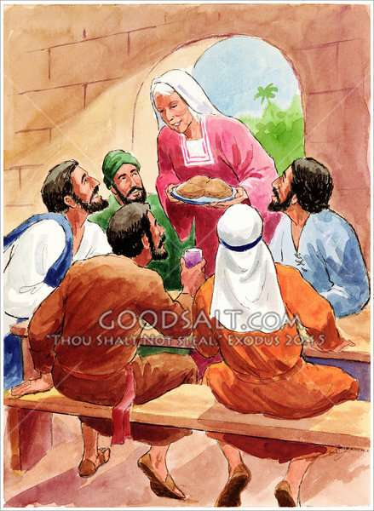
What does she do after she is healed?
She serves Jesus.

Slide 10
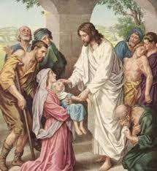
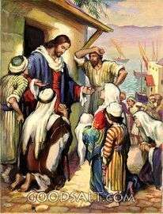
When it was evening, after sunset, they brought to him all who were ill or possessed by demons or healing.
Why does Jesus heal them?
Jesus loves them very much and has compassion on them.
Also, these miracles, in the future, will confirm that He is God.

Slide 11
But Jesus does not permit the demons to speak
so they don’t reveal who He is.
Why doesn’t Jesus want anyone to know who He really is?
Possibly because:
The Jews awaited the Messiah to liberate them from the oppressive Roman regime. They expected Him to be another King David, lifting his people politically. He still had to show them with His life why the Son of God became man.
Those that were announcing Jesus were not Friends of Heaven and did not want to build God’s kingdom.
At those moments, revealing His true identity as God’s Son would prevent Him from completing His mission.

Slide 12
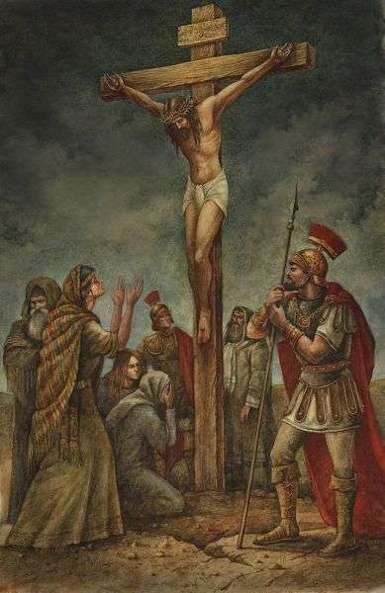
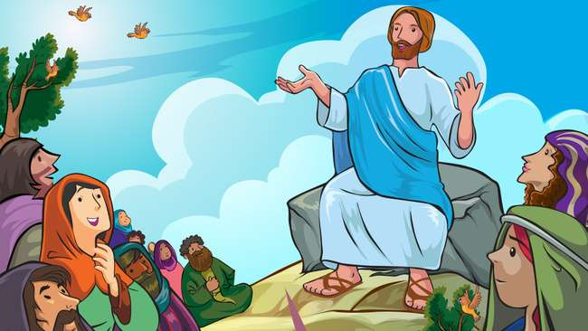
Why did Jesus, the Christ, come?
He came to preach the gospel, to serve, and to show us God’s love by dying on the Cross to pay for our sins and to open for us the gates of Heaven.

Slide 13
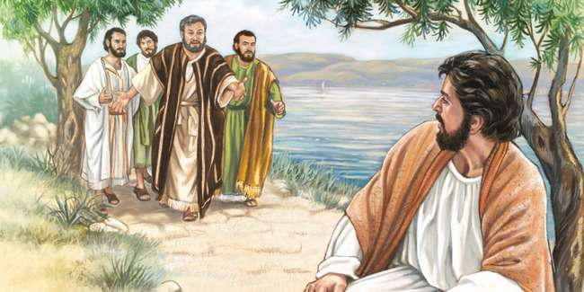
When the apostles found him praying, they hurried him because the sick were waiting for Him; but Jesus wanted to continue preaching the Gospel to other towns.
Why?
He preached that the Kingdom of Heaven was near, convert and turn to God.
Jesus came to save souls and to teach us to love and to serve.

Slide 14
How can we serve Jesus like
Peter’s mother-in-law did?
We can help others,
sharing our talents and love.
We can pray always.

Slide 15
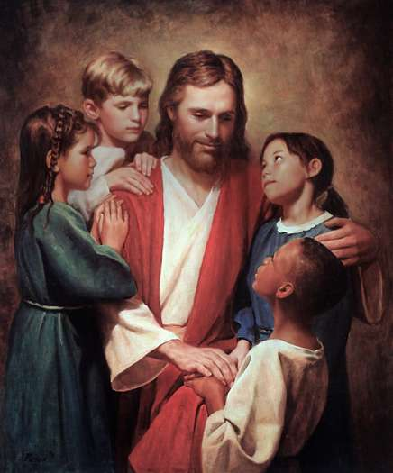
How does Jesus heal us daily?
He gives us Purpose when we don’t know what to do,
Hope when things are going badly,
Healing when we have been hurt by others,
Peace when we are worried and afraid,
Joy when we are sad,
Friends and family when we need someone to be there for us.
Love when no one seems to care,

Slide 16
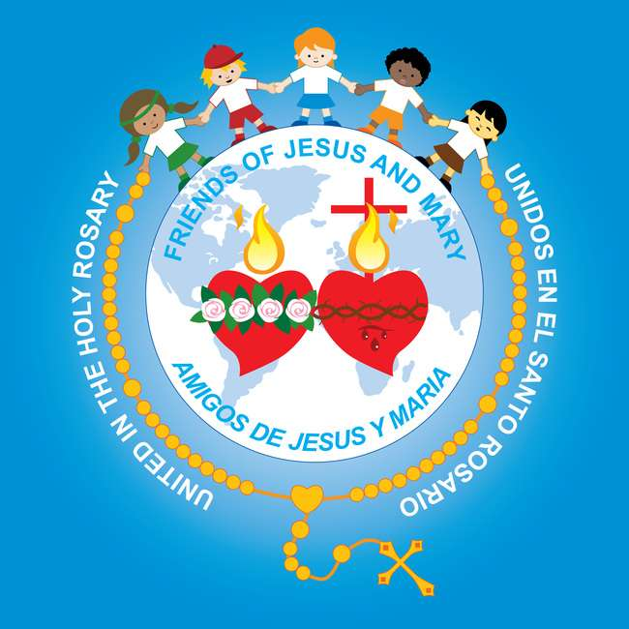
activiTY

Slide 17
Put the Story in Order:
Put the numbers in the box in the correct order.
2
3
1

Slide 18
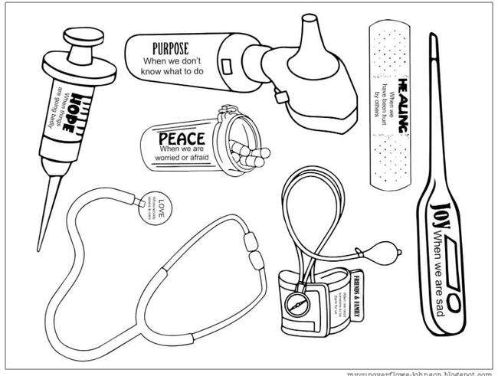
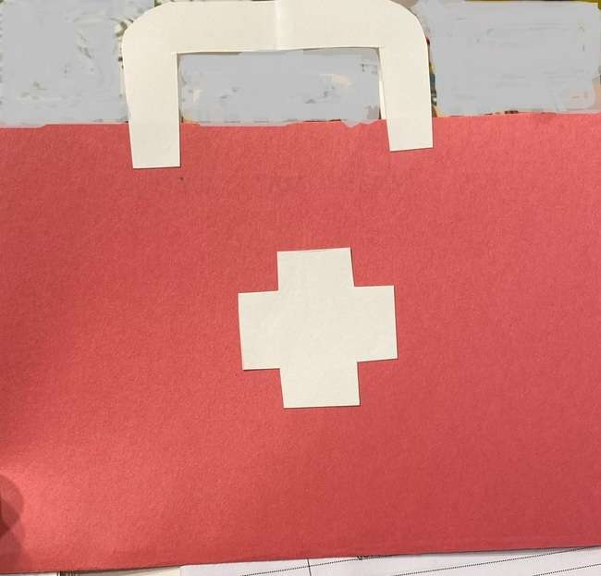
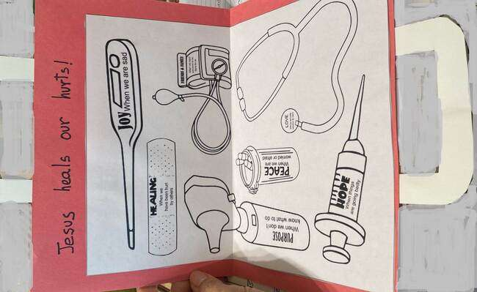
Instructions: Doctor’s bag: Fold a red construction paper in half. Cut a white cross, 2”x2”; glue to front with sign JESUS CURES ME. Cut 2 white handles (4”x 2”x 0.5”) and glue to outside, middle edge. Cut and color picture and glue to inside of red paper. Talk about how Jesus heals.
See www.fcpeace.org
Cycle B, Ordinary Time 1st,
V Sunday in Ordinary Time
JESUS CURES ME

Slide 19
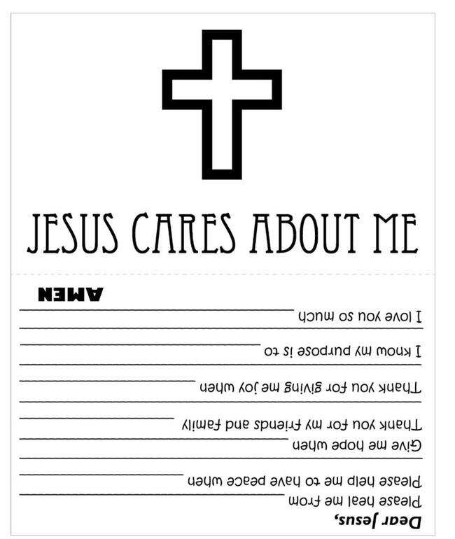
Make a card to remember how much Jesus cares for you.

Slide 20
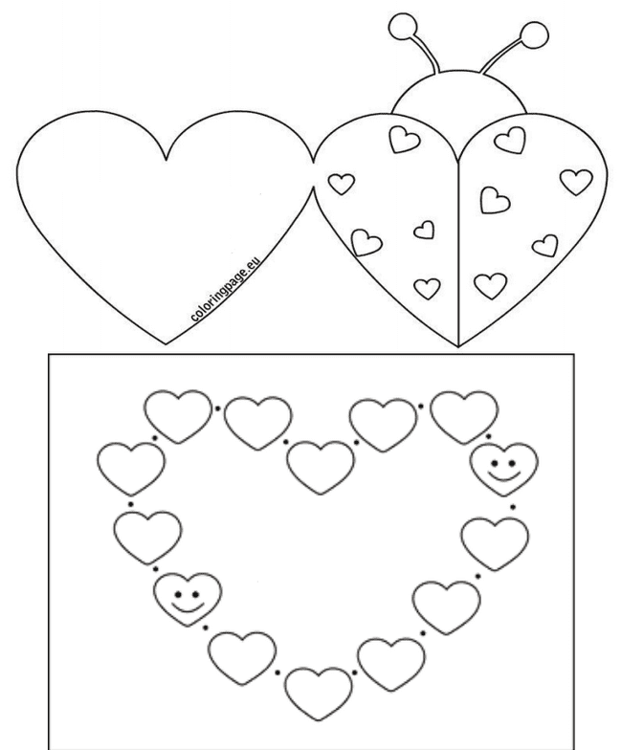
Dear Jesus,
Please heal _______
I love you,
Materials:
Paper
Pencils
Crayons
Scissors
Make a card for someone who needs healing.
Dear Jesus,
Please heal _______
I love you,

Slide 21
Prayer
Lord, you came to earth to show us how to serve and love our neighbor. You also healed those sick of body or spirit. Give us the strength we need to endure all and the generosity to serve others. Amen.

Slide 22
Jesus is the Healer, IDMC Kids, https://youtu.be/yjmTLwKE3GY?si=kVW-UPnao0ip9I7N (3-7 yrs.)

Slide 23
Healer, Casting Crowns, https://youtu.be/57S_NBOmyx0?si=OKbVNjJRdu2OBsoA (8+ yrs.)

