Slide 1
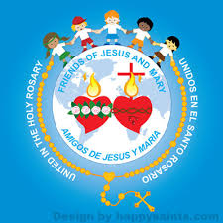
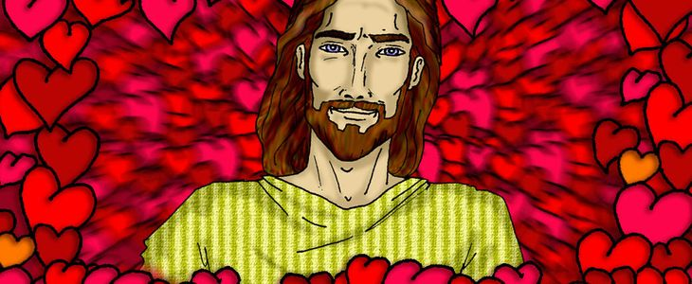
Ministry Friends of Jesus and Mary
Cycle B - VI Sunday of Easter
The Greatest Love
John 15, 9-17

Slide 2
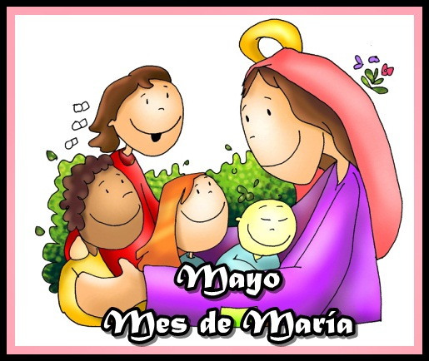
MAY begins
The Month dedicated to the Virgin Mary
MAY
The month of mary

Slide 3
Pope Francis: In the month of May, let’s raise our gaze towards the Mother of God, sign of consolation and sure hope; and let’s pray together the Rosary to face together the trials of our times and remain even closer as a spiritual family.
Pope

Slide 4
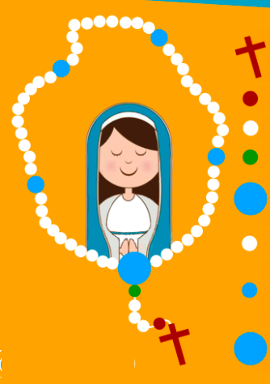
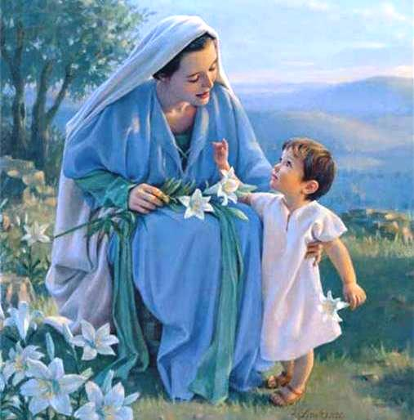
Mother in Heaven, I want to shower you with roses, with many Hail Mary’s which I will pray.

Slide 5
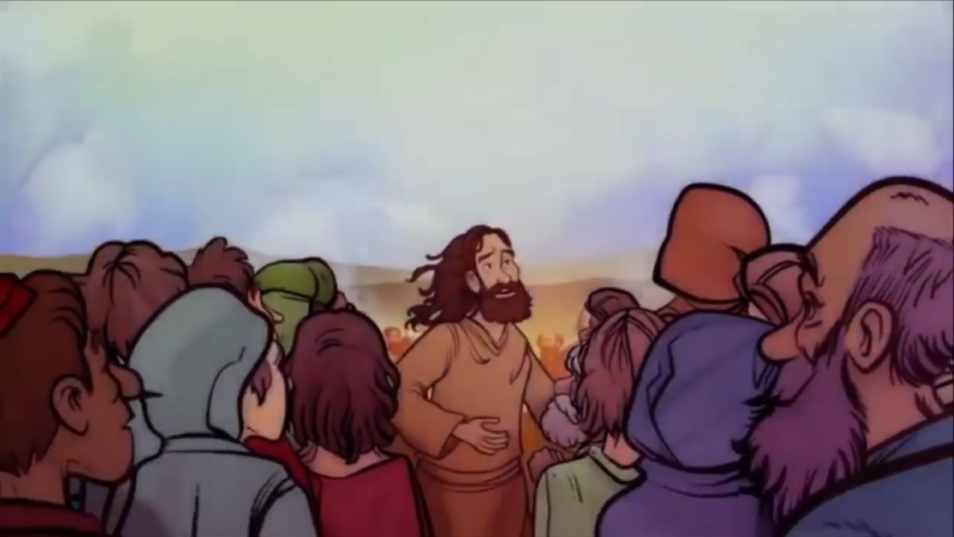
Gospel according to St. John 15, 9-17
Jesus said to his disciples: As the Father loves me, so I also love you. Remain in my love.

Slide 6
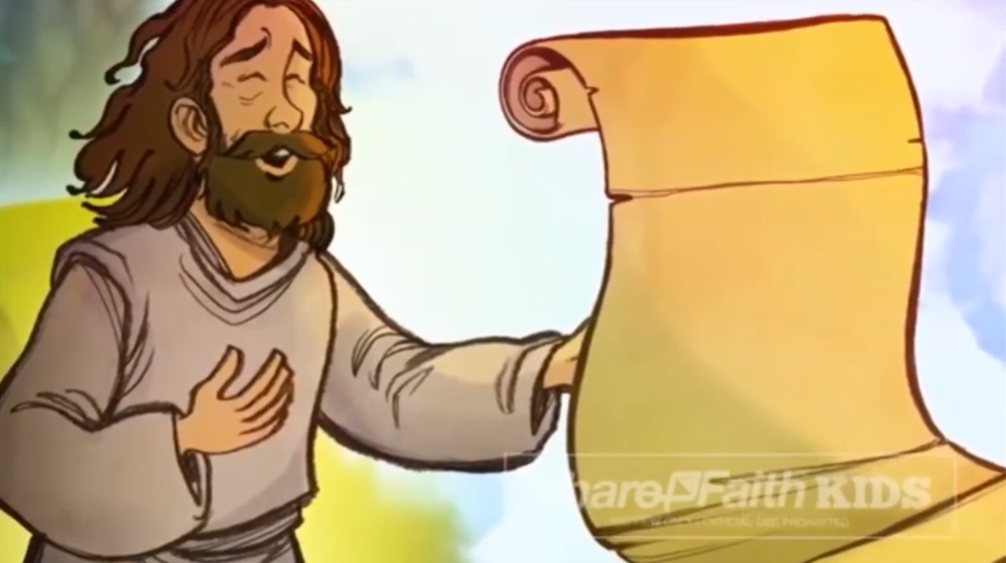
If you keep my commandments, you will remain in my love, just as I have kept my Father’s commandments and remain in his love.

Slide 7
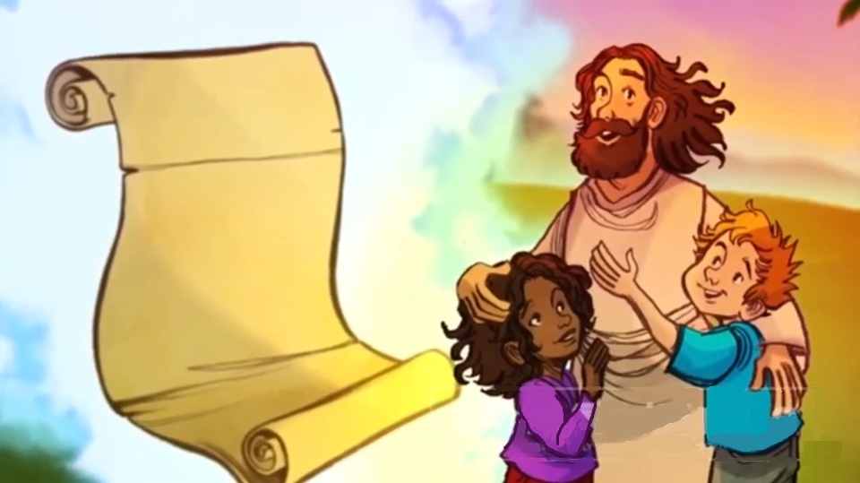
I have told you this so that my joy may be in you and your joy might be complete. This is my commandment: love one another as I love you.

Slide 8
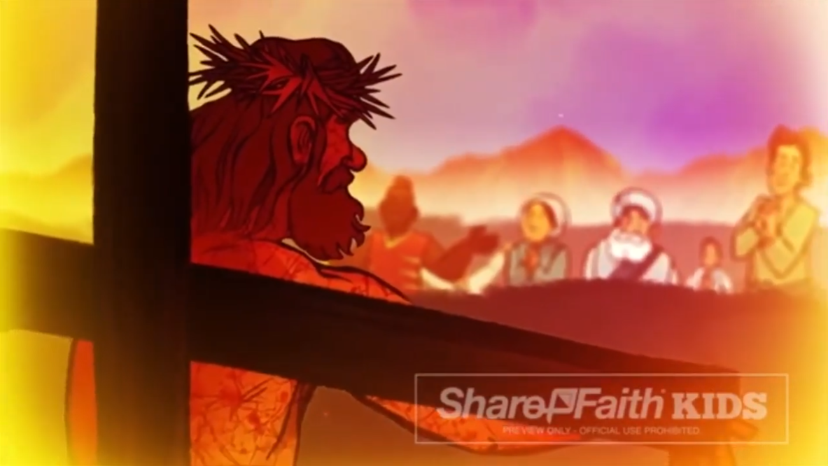
No one has greater love than this, to lay down one's life for one's friends. You are my friends if you do what I command you.

Slide 9
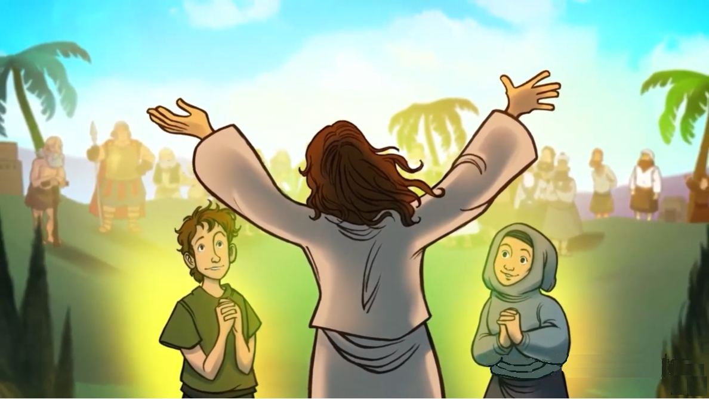
I no longer call you slaves, because a slave does not know what his master is doing. I have called you friends, because I have told you everything I have heard from my Father.

Slide 10
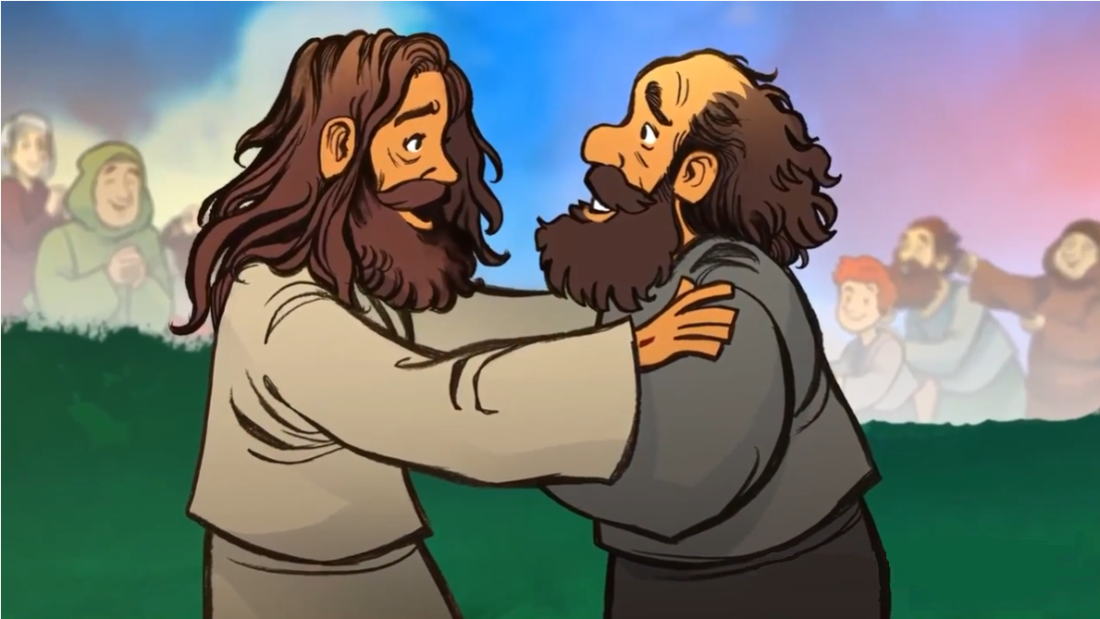
It was not you who chose me, but I who chose you and appointed you to go and bear fruit that will remain,

Slide 11
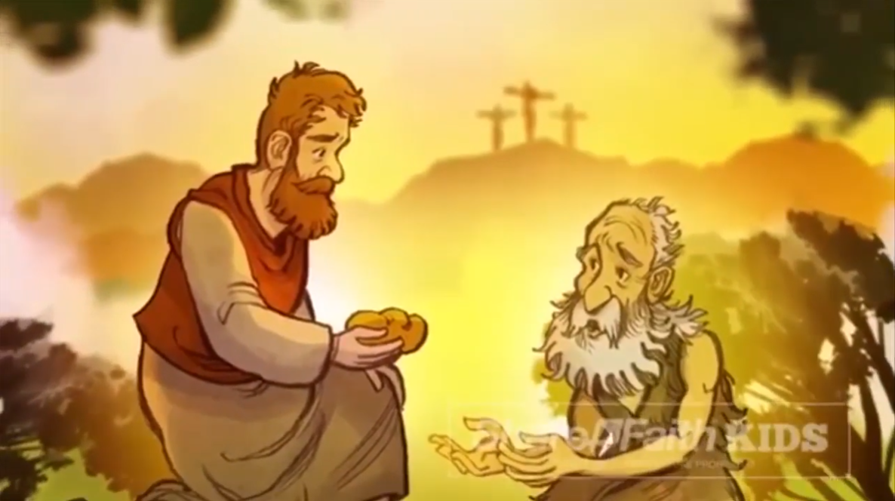
…so that whatever you ask the Father in my name he may give you.

Slide 12
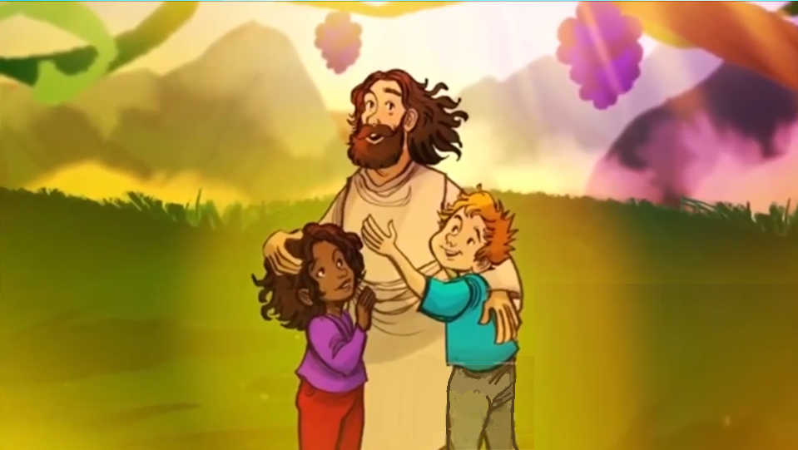
This I command you: love one another.
THE GOSPEL OF THE LORD. PRAISE TO YOU LORD JESUS CHRIST

Slide 13
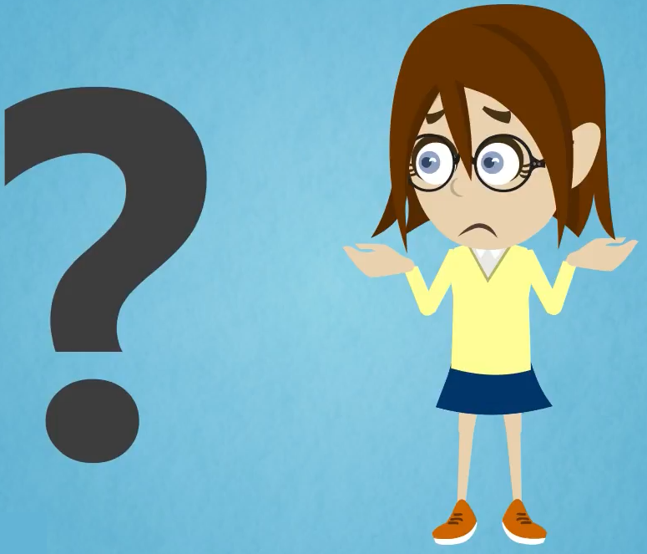
How does Jesus say that we may remain in his LOVE ?
Keeping His Commandments. Jesus said: : If you keep my Commandments, you remain in my love.”
What happens when we remain in Jesus’ love?
The joy of Jesus will be with us and our joy will be complete.

Slide 14
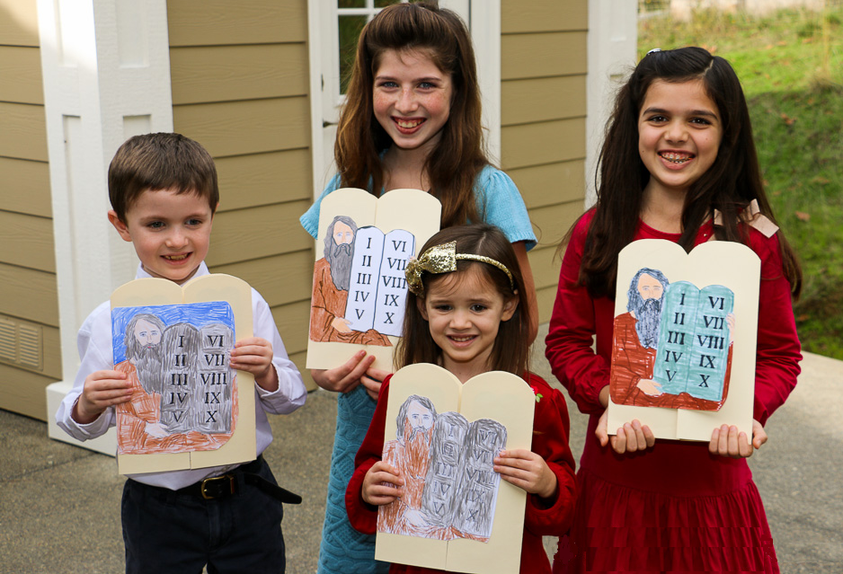
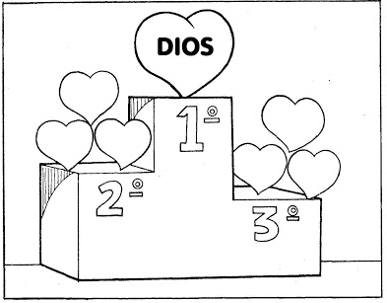
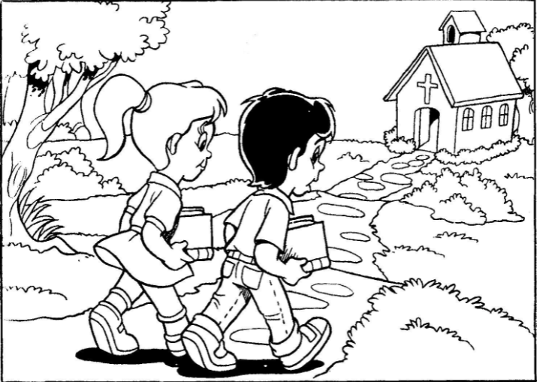
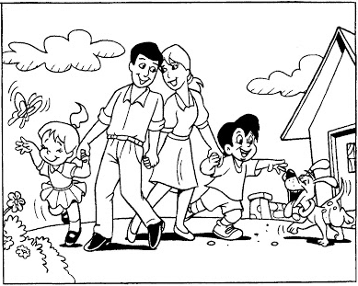
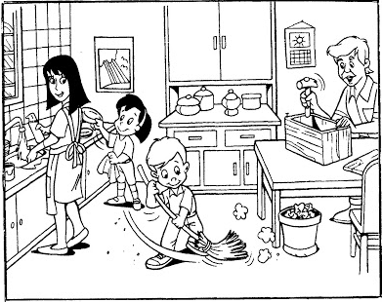
When we keep His Commandments:
For example,
Love God above everything
Keep Holy the Sabbath and the Feasts days
Honor your parents
Our Joy will be COMPLETE, because we become another Jesus on earth.

Slide 15
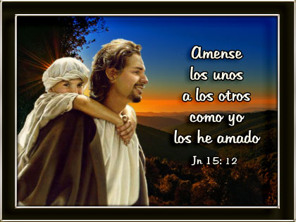
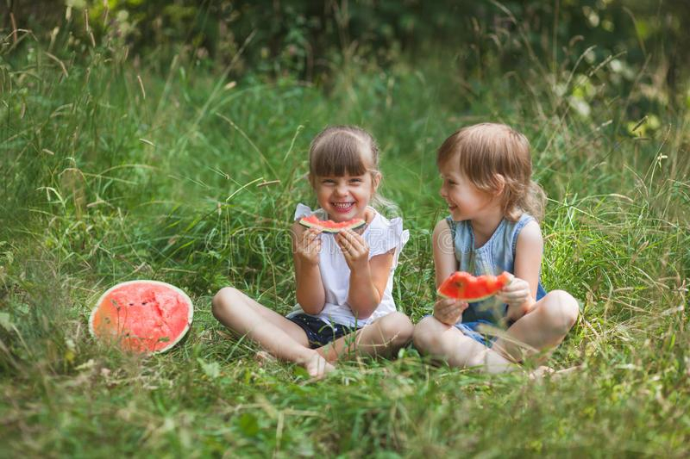
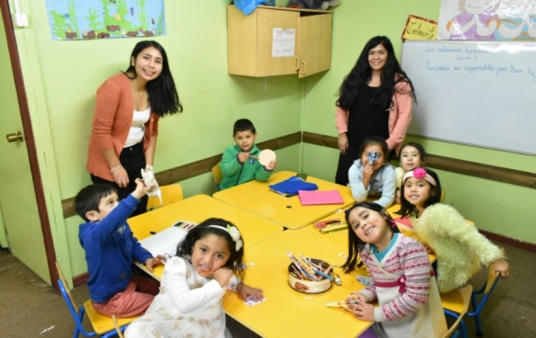
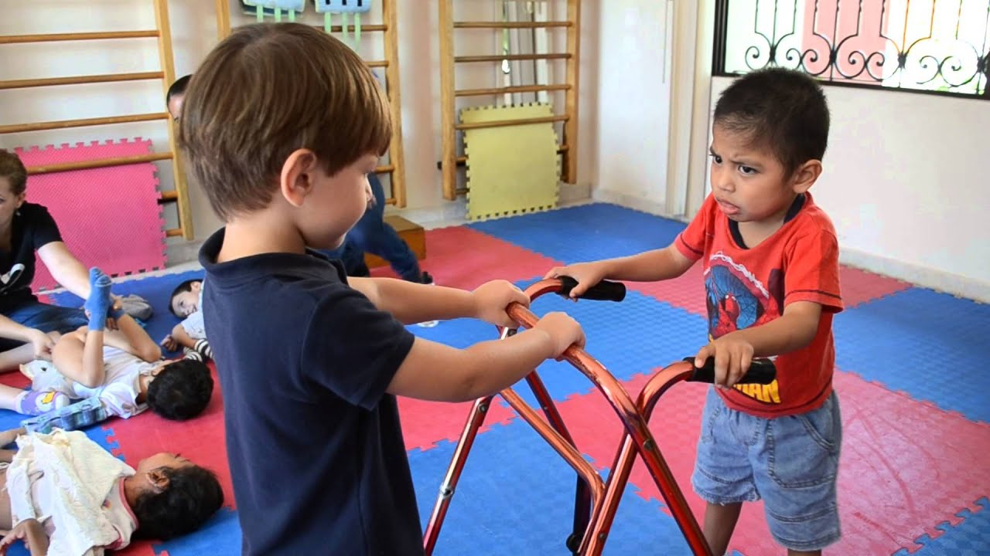
Jesus left us a commandment,
Do you remember it?
Love one another as I have loved you.
John 15:12
How can we show our love to others?
Sharing
Respecting our teachers and peers.
Helping those in need.

Slide 16
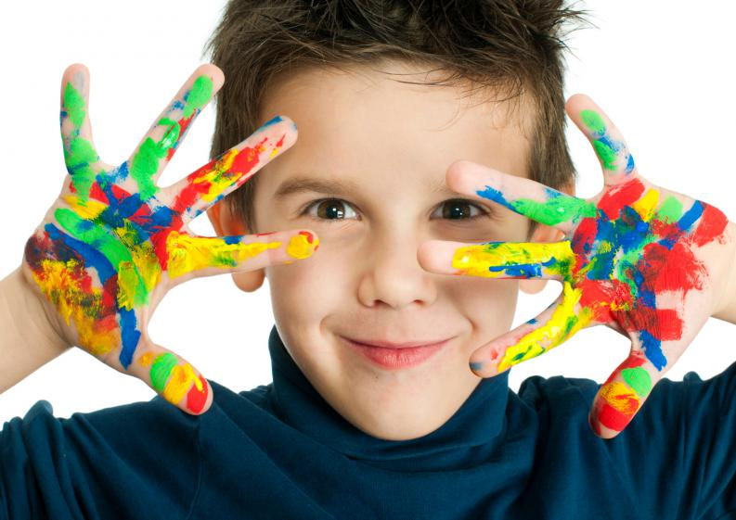
ACTIVITY

Slide 17
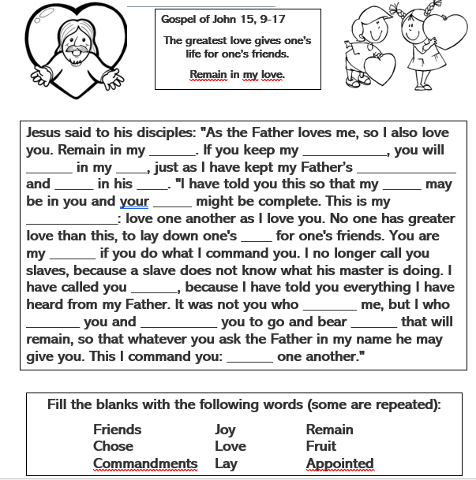
love
commandments
remain
love
commandments
remain
love
joy
joy
commandment
life
friends
friends
chose
chose
appointed
fruit
love
Fill the blanks with the following words (some are repeated):
Friends Joy Remain Commandment
Chose Love Fruit Life
Commandments Lay Appointed

Slide 18
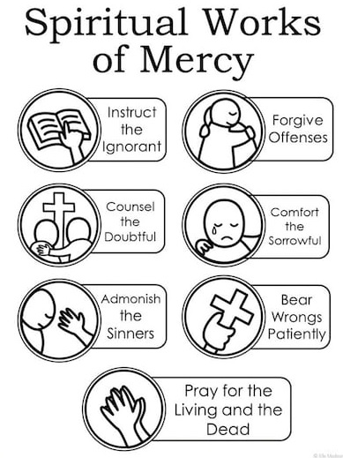
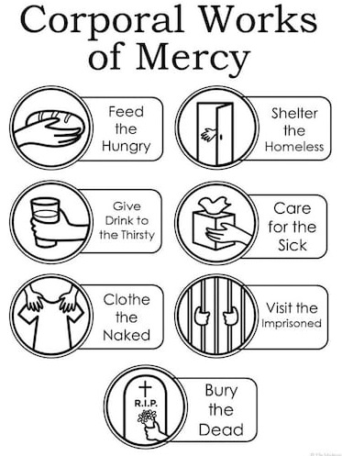

Slide 19
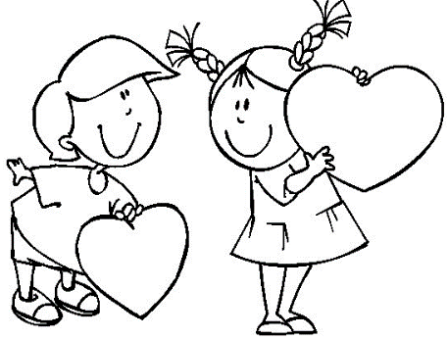
This I command you: love one another. (John 15:17)
Draw or write in the following hearts, how you will love others today.

Slide 20
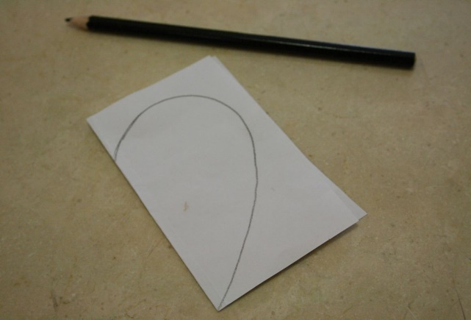
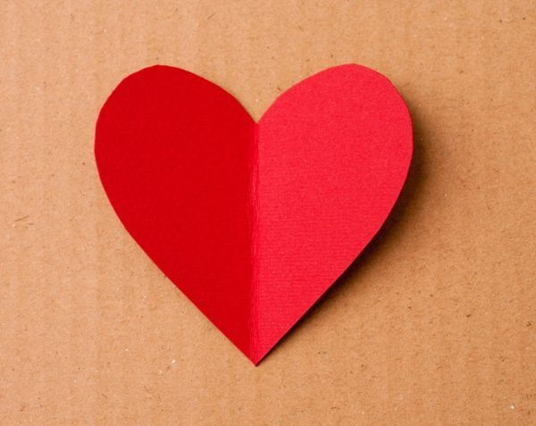
Fold a red poster paper in ½ and draw ½ a heart at the fold. (see picture). Cut.
Since it’s almost Mother’s Day, make a special heart for your Mom; write how much you love her!!

Slide 21
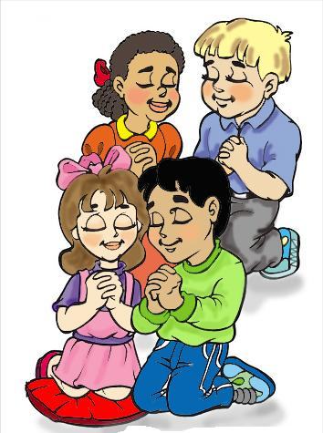
PRAYER
Jesús,
You love me with all of Your life and You chose me to be Your friend. You only ask that I share my love with everyone. Help me to never separate from you and to always choose love above all things. Jesus, I trust in You.
Amen.

Slide 22
Song: Love One Another, Dakota Pyle, https://youtu.be/LYlkcoAfLU4?si=K8EIOmMv1UOtz2ZW(3-7 yrs.)

Slide 23
Love One Another, Deer Run Kids, https://youtu.be/JysQNwalyIQ?si=WV92_17Yko683eC_ (8+ yrs.)

