Slide 1
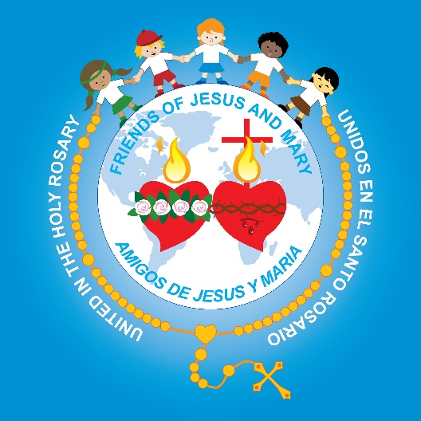
Friends of Jesus and Mary
Prayer Groups for Children
Cycle B-VII Sunday of Easter
Solemnity of the Ascension - Mark 16: 15-20

Slide 2
Gospel of Luke 16:15-20

Slide 3
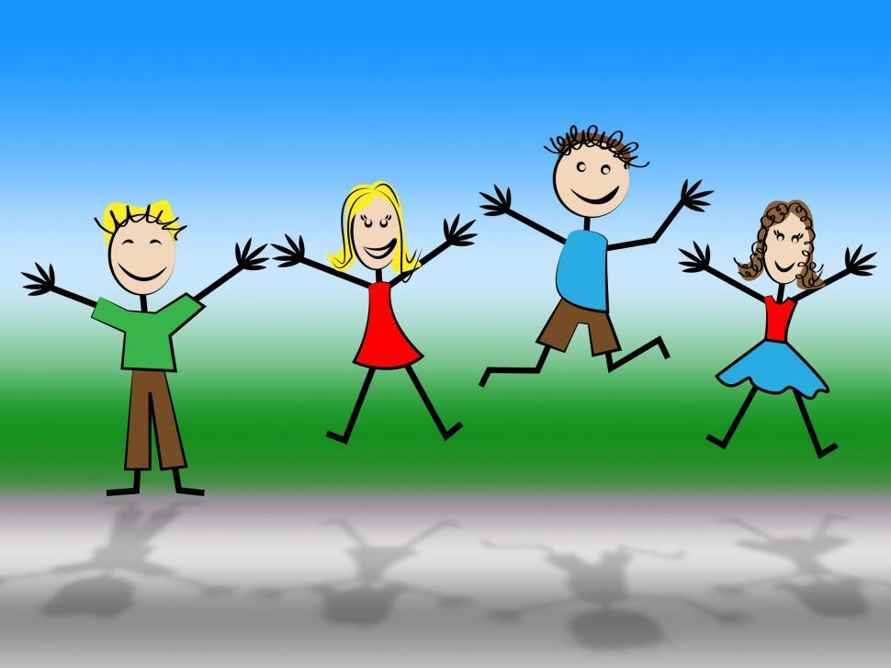
REFLECTION

Slide 4
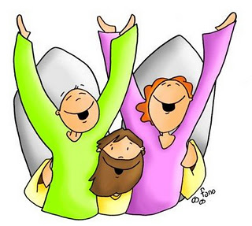
Jesus wants all the world to hear what God did for them, so He sends His Friends to preach the Gospel to everyone. What does Gospel mean?
The
Good
News

Slide 5
Some will believe and some won’t. Jesus makes promises to those who believe and are baptized. What promises?
They will be saved, and
Many miracles will accompany them.
Jesus gives you Wings!

Slide 6
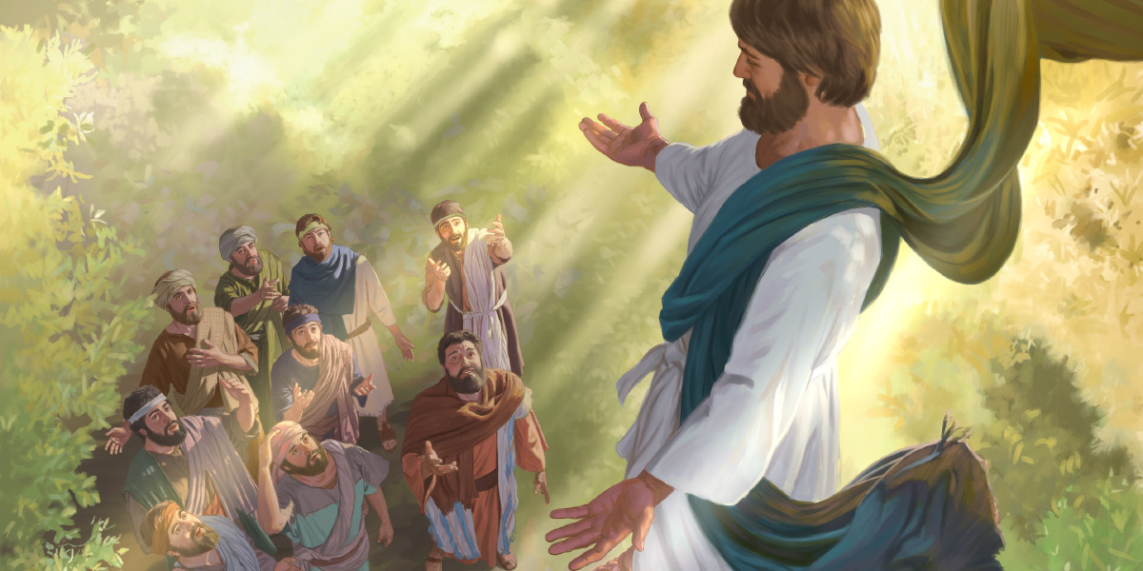
After, Jesus ascended into Heaven, body and soul, to sit at the right hand of His Father.
Did Jesus leave them alone?

Slide 7
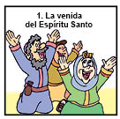
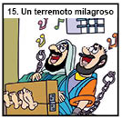
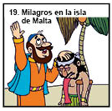
Jesus acted with them, performing miracles. Do you know of any?
NO!
The coming of the Holy Spirit.
A miraculous earthquake
Miracles in the Isle of Malta.
Jesus gave them the power to speak different languages so everyone could understand their message.
Jesus freed them from jail. Once he sent an earthquake to free them.
Jesus cured the sick.

Slide 8
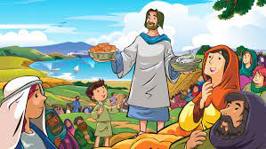
Why did Jesus perform miracles through them?
The miracles helped the people believe
in the disciple’s message.

Slide 9
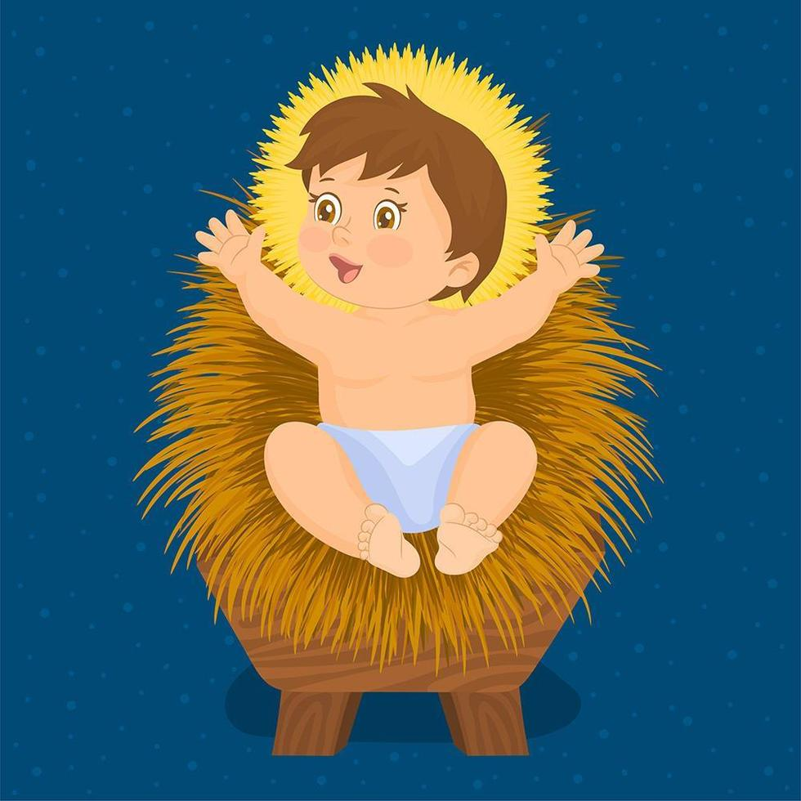
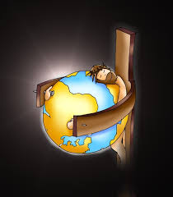
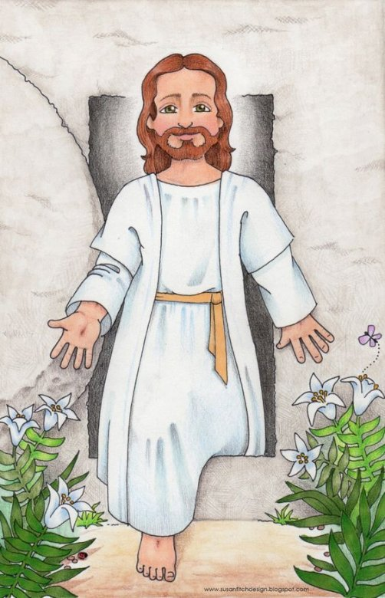
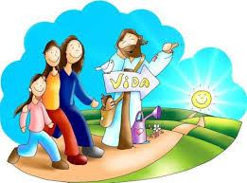
What is the Good News that Jesus wants the world to know?
God loved us so much, He sent His son Jesus…
…to die on the cross so our sins would be forgiven.
He resurrected on the 3rd day victorious over death.
Return to God and enter Eternal Life.

Slide 10
How will you help God spread the Good News?

Slide 11
Activity

Slide 12
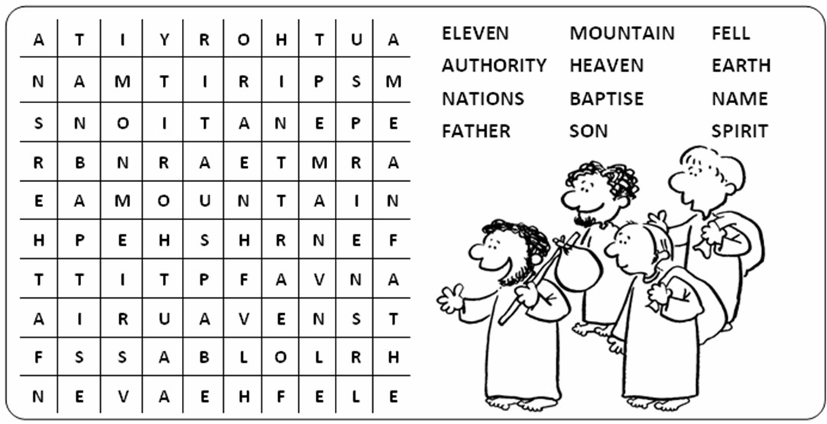

Slide 13
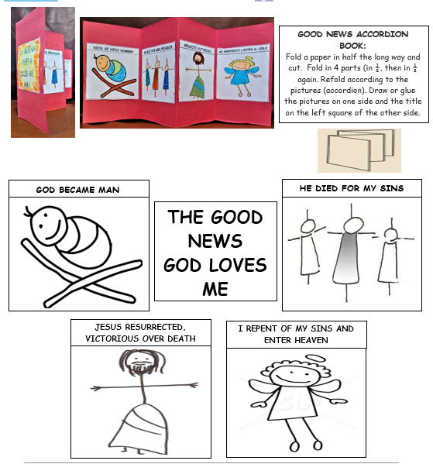

Slide 14
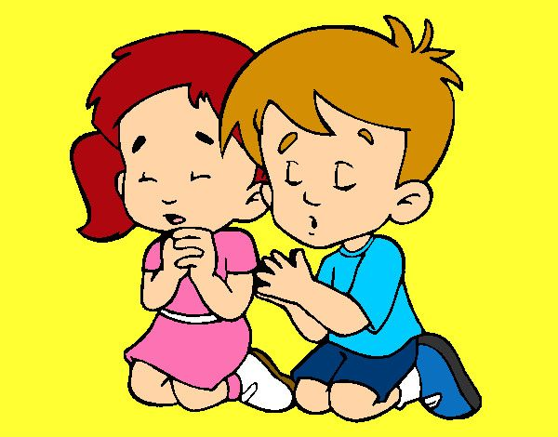
Prayer Lord, you send us to announce God’s love for all, and the salvation that comes from you. Sometimes we don’t even know how to start. Give us your light and wisdom to recognize each moment of the day in which we can be your witness through our actions of honesty, justice, love and service to all. Amen

Slide 15
Song: Lord I Lift Your Name on High, Church of Southland https://youtu.be/3tWSu9NAFIk

