Slide 1
Friends of Jesus and Mary
Solemnity of Pentecost
John 15,26-27; 16,12-15
www.fcpeace.org

Slide 2
Solemnity of Pentecost
Gospel: John 15,26-27; 16,12-15
Jesus said to his disciples:
When the Advocate comes whom I will send you from the Father, the Spirit of Truth that proceeds from the Father, he will testify to me. And you also testify, because you have been with me from the beginning.
I have much more to tell you, but you cannot bear it now.

Slide 3
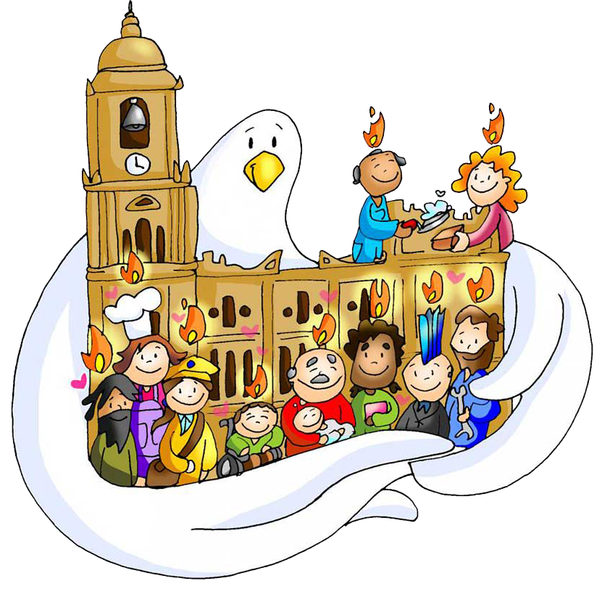
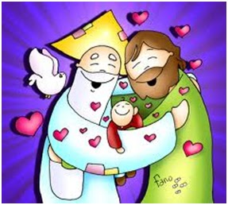
But when he comes, the Spirit of truth, he will guide you to all truth. He will not speak on his own, but he will speak what he hears, and will declare to you the things that are coming.
He will glorify me, because he will take from what is mine and declare it to you. Everything that the Father has is mine; for this reason, I told you that he will take from what is mine and declare it to you.”.
The Gospel of the Lord. Praise to you Lord Jesus Christ.

Slide 4
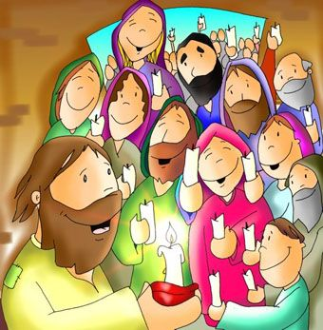
First Reading: Acts 2, 1-11
When the time for Pentecost was fulfilled, they were all in one place together. And suddenly there came from the sky a noise like a strong driving wind, and it filled the entire house in which they were.

Slide 5
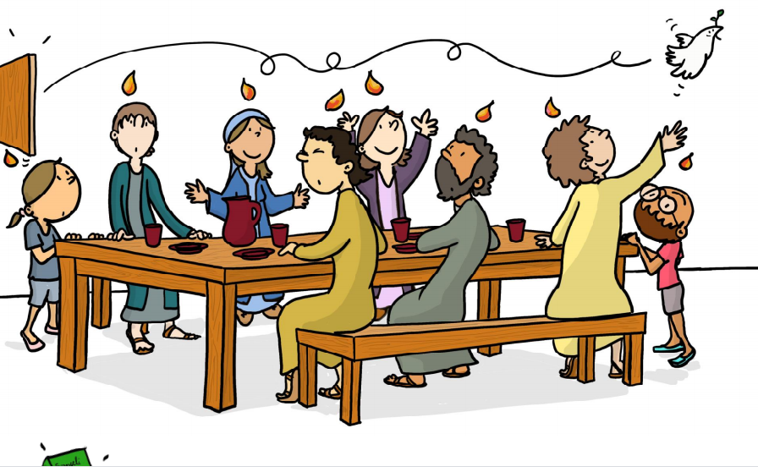
Then there appeared to them tongues as of fire, which parted and came to rest on each one of them. And they were all filled with the Holy Spirit and began to speak in different tongues, as the Spirit enabled them to proclaim.

Slide 6
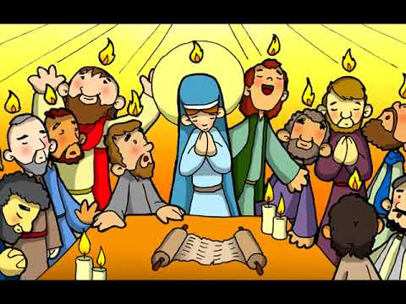
Now there were devout Jews from every nation under heaven staying in Jerusalem. At this sound, they gathered in a large crowd, but they were confused because each one heard them speaking in his own language.

Slide 7
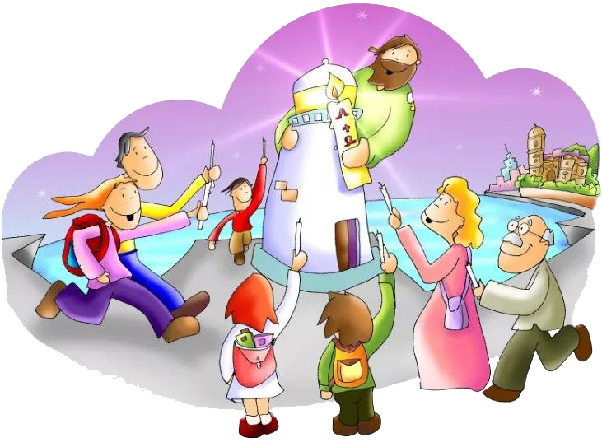
They were astounded, and in amazement they asked, “Are not all these people who are speaking Galileans? Then how does each of us hear them in his native language? We are Parthians, Medes, and Elamites, inhabitants of Mesopotamia, Judea and Cappadocia, Pontus and Asia, Phrygia and Pamphylia, Egypt and the districts of Libya near Cyrene, as well as travelers from Rome, both Jews and converts to Judaism, Cretans and Arabs, yet we hear them speaking in our own tongues of the mighty acts of God.”

Slide 8
REFLECTION

Slide 9
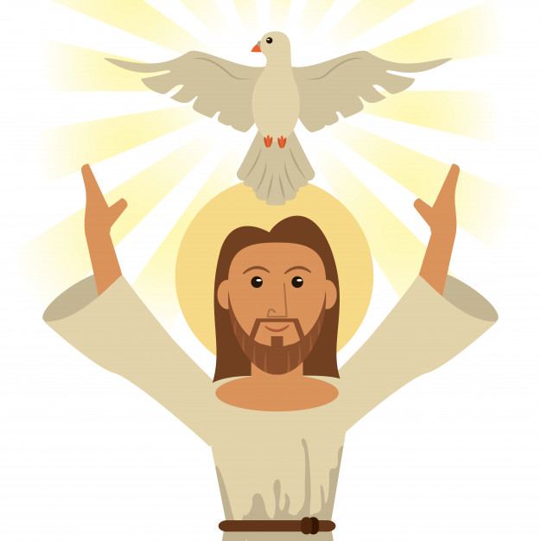
In the Gospel, Jesus announces that He will send the Holy Spirit.

Slide 10
What other names to they call the Holy Spirit?

Slide 11
The Advocate and
The Spirit of Truth

Slide 12
What does Jesus say the Holy Spirit will do when he comes?

Slide 13
Give witness to Jesus
Guide the disciples to the truth
Announce the things to come
Glorify Jesus by communicating all that Jesus says

Slide 14
10 days after Jesus ascended to Heaven, the disciples were together, hiding from those that persecuted them.
What happened?

Slide 15
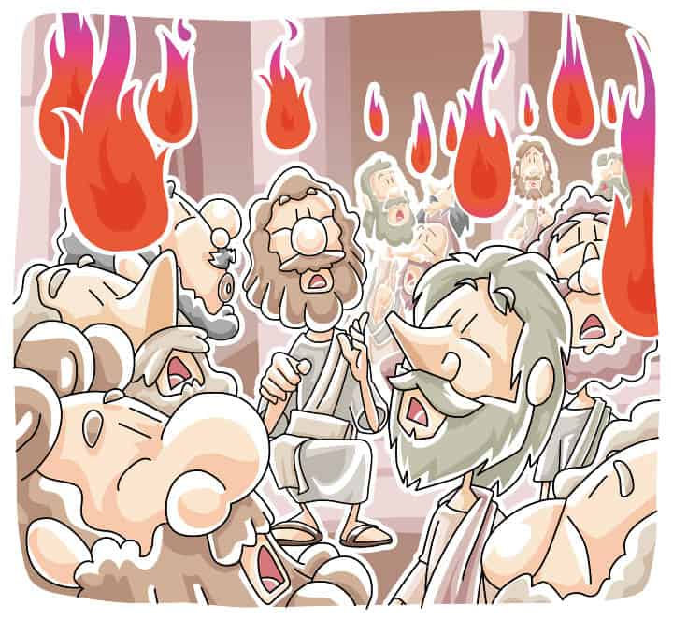
They heard a loud noise like of a strong wind;
Tongues of fire appeared above each of them;
They were filled with the Holy Spirit and they spoke in many languages so that all in Jerusalem who went to see what was happening, understood the marvels of God.

Slide 16
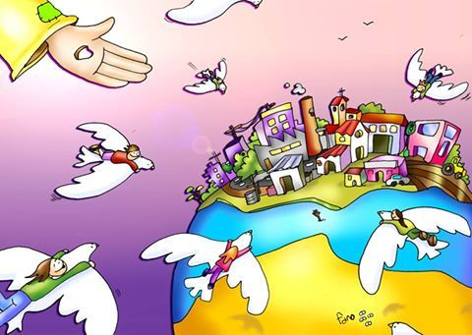
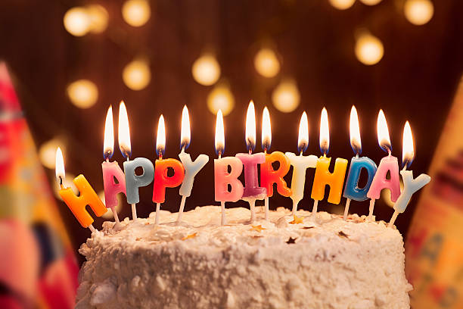
Jesus sent the Holy Spirit who dispersed all fear and converted the disciples in proclaimers of the Gospel.
Pentecost is the birth of the Catholic Church!
HAPPY BIRTHDAY!

Slide 17
The scripture explains that all the gifts and talents of each person are different, but all are called to serve God.
What talents do you have to put in God’s service?

Slide 18
ACTIVITIES

Slide 19
The Holy Spirit leaves gifts in our heart.
Let’s pray for these gifts.
Come Holy Spirit, Give me FEAR OF GOD, so I may never hurt you with my words or actions.
Come Holy Spirit, Give me PIETY, so God may always be first in my life.
Come Holy Spirit, Give me FORTITUDE, so I may always say the truth.
Come Holy Spirit, Give me COUNSEL, which I need to know right from wrong.
Come Holy Spirit, Give me WISDOM, so I may see my family and friends through your eyes.
Come Holy Spirit, Give me KNOWLEDGE, to better know how to do your Holy Will.
Come Holy Spirit, Give me UNDERSTANDING, of the wonderful gift of faith that I have.

Slide 20
When we have the Holy Spirit in our hearts, we give good fruits.
JOY
KINDNESS
PRAYER TO THE HOLY SPIRIT
Come, Holy Spirit,
Illuminate our hearts
And fill them with the fire of your love. Amen
LOVE
PEACE
PATIENCE
GOODNESS
GENTLENESS
FAITHFULNESS
SELF
CONTROL

Slide 21
The symbols of the Holy Spirit help us
to know the Holy Spirit better.
WIND
Initiates action
DOVE
Reflects peace and purity
WATER
Cleans and gives life
FIRE
Purifies, warms, and gives light

Slide 22
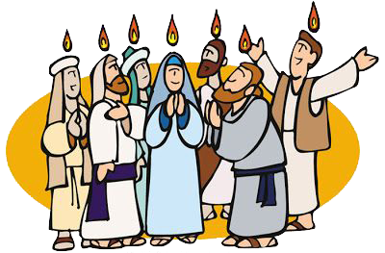
THE RESURRECTED CHRIST
SENDS US THE HOLY SPIRIT
Acts 2, 1-11
THE SYMBOLS OF
THE HOLY SPIRIT
D__V__
W__ND
W__T__ R
F __R__
O
E
I
A
E
I
E

Slide 23
Gift or Fruit of the Holy Spirit?
Say whether it is a gift or fruit of the Holy Spirit.
Love
Peace
Counsel
Love of God, Piety
Knowledge
Understanding
Fear of God
Wisdom
Goodness
Faithfulness
Patience
Gentleness
Joy
Courage

Slide 24
OTHER ACTIVITIES
Act out the coming of the Holy Spirits (Act 2,1-11)
Strong winds and tounges of fire: This is the way the Holy Spirit came!
Make a circle and start to pray. Prepare in advance a tonge of fire on a crown for each child.
(See the following page www.fcpeace.org, Cycle B, Easter, B-VIII – Solemnity of Pentecost)
Place on the head of each child a Crown with a flame. Say the prayer on the
flame asking for the gift of the Holy Spirit.
Put the fruits in a box and have each child pick a fruit and pray to receive it.
Craft: Cut and color the flames on the next page. You can make a mobile and hang the flames on a hanger or make a Crown by gluing the flames to a strip of paper 22” long. Place the Holy Spirit in the center.

Slide 25
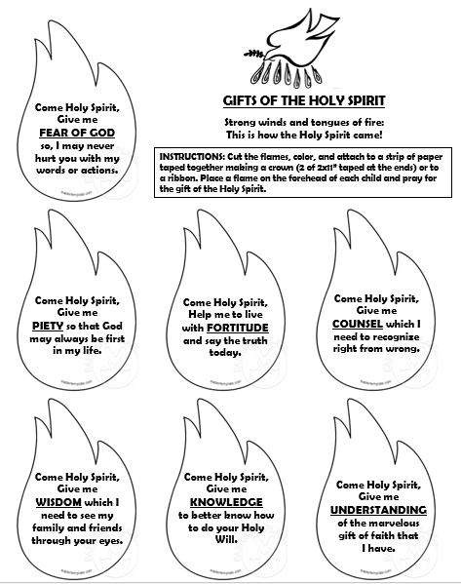
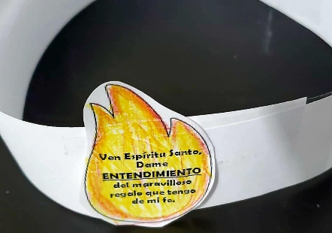

Slide 26
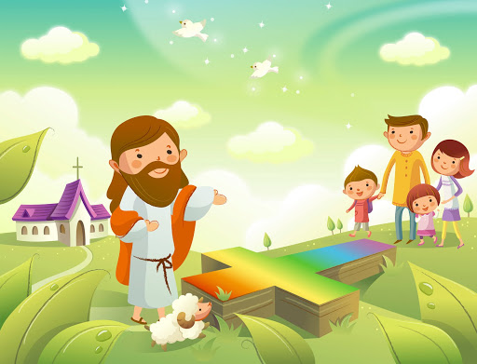
PRAYER
Lord, send us your Spirit who brings us peace and courage to face problems. Give us the fruits of generosity, kindness, love, joy, peace, and patience to lead our family and our group to harmony and to use them to serve others. Amen.

Slide 27
Song: Holy Spirit Fills Me Up, Brielle Lael https://youtu.be/ziCAU9B-5mU

Slide 28
Holy Spirit, B. & K. Torwalt, https://youtu.be/LaRHOItRfZg?si=kXr_FqdCnDVlk2CW (8+ yrs.)

