Slide 1
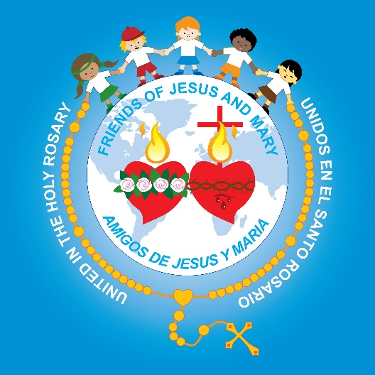
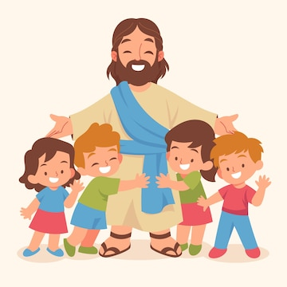
Friends of Jesus and Mary
Prayer Group for Children
Ciclo B-X Sunday in Ordinary Time
Whoever does the will of God is my Brethren... Mark 3, 20-35
and
The Solemnity of the Sacred Heart of Jesus and the Immaculate Heart of Mary
www.fcpeace.org

Slide 2
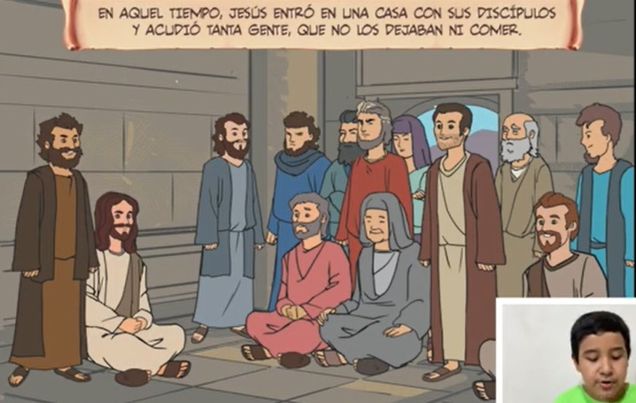
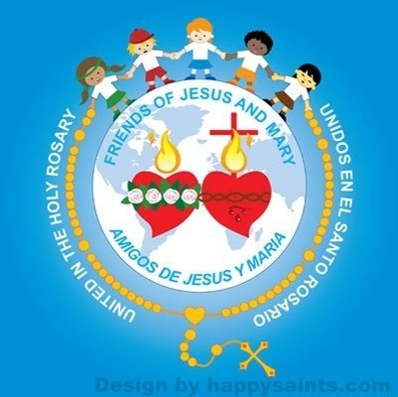
Jesus came home with his disciples. Again, the crowd gathered, making it impossible for them even to eat.

Slide 3
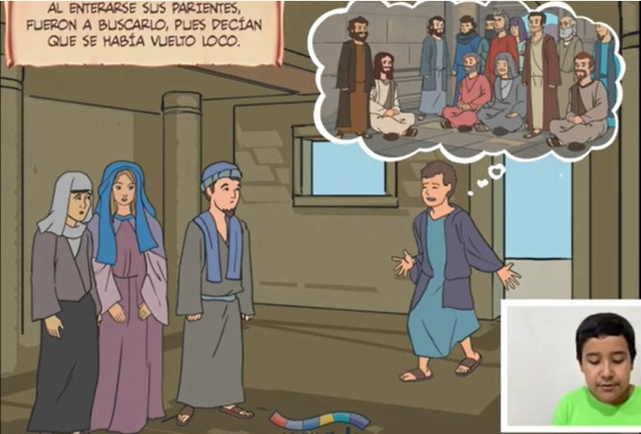
When his relatives heard of this they set out to seize him, for they said, "He is out of his mind."

Slide 4
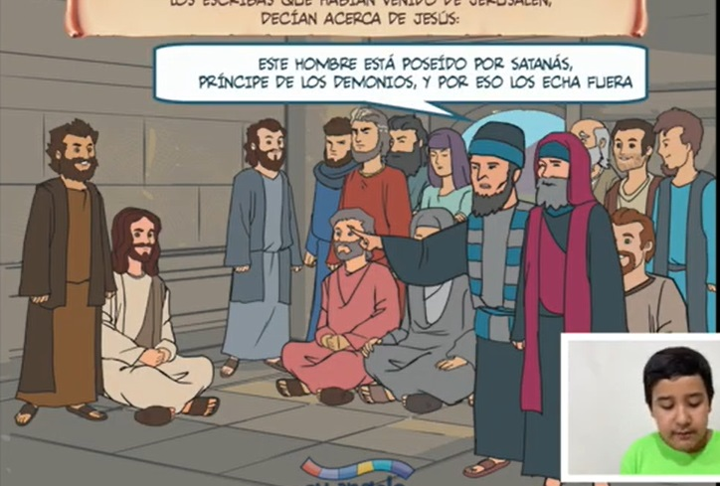
The scribes who had come from Jerusalem said of Jesus,
"He is possessed by Beelzebul," and "By the prince of demons he drives out demons."

Slide 5
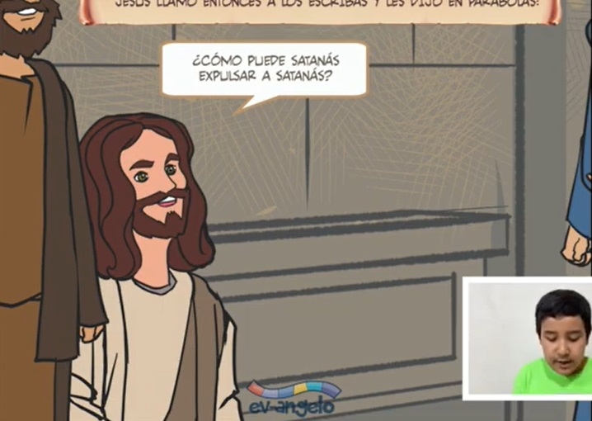
Summoning them, he began to speak to them in parables,
How can Satan drive out Satan?

Slide 6
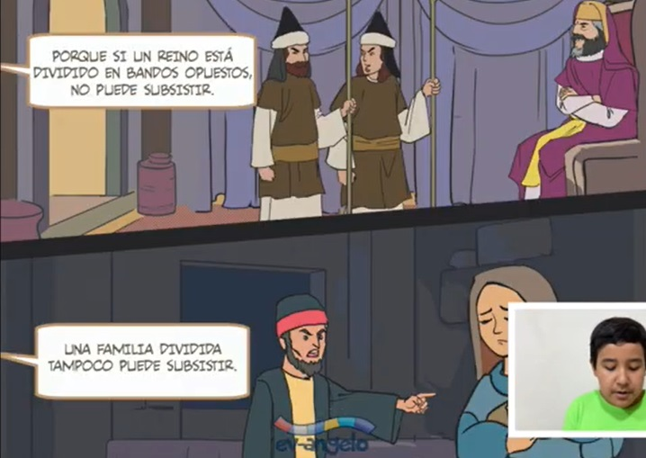
If a kingdom is divided against itself, that kingdom cannot stand.
And if a house is divided against itself, that house will not be able to stand.

Slide 7
And if Satan has risen up against himself and is divided, he cannot stand; that is the end of him.

Slide 8
But no one can enter a strong man's house to plunder his property unless he first ties up the strong man. Then he can plunder the house.

Slide 9
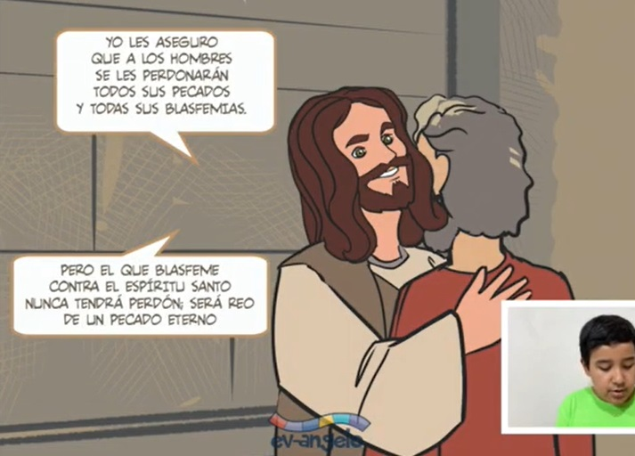
Amen, I say to you, all sins and all blasphemies that people utter will be forgiven them.
But whoever blasphemes against the Holy Spirit will never have forgiveness but is guilty of an everlasting sin.

Slide 10
For they had said, "He has an unclean spirit."

Slide 11
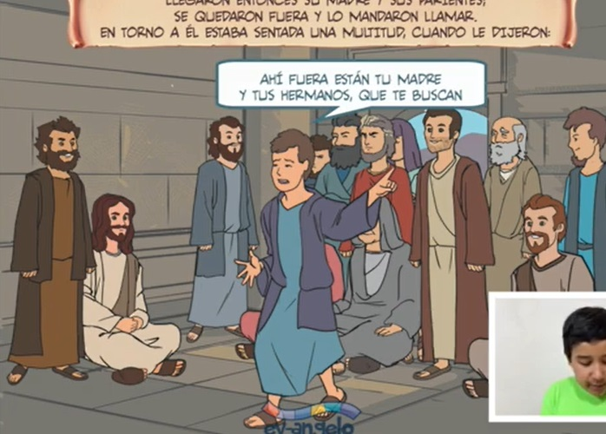
His mother and his brothers arrived. Standing outside they sent word to him and called him. A crowd seated around him told him,
Your mother and your brothers and your sisters are outside asking for you.

Slide 12
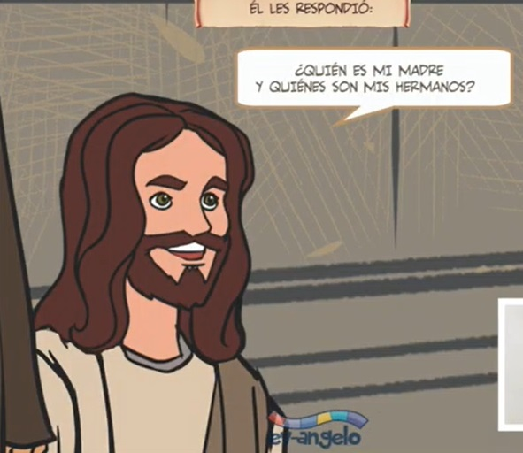
But he said to them in reply,
"Who are my mother and my brothers?"

Slide 13
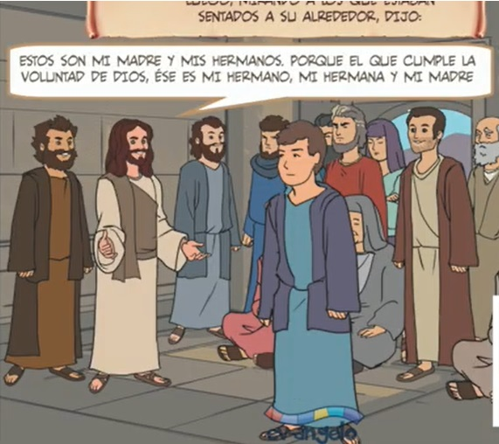
And looking around at those seated in the circle he said,
Here are my mother and my brothers. For whoever does the will of God is my brother and sister and mother.
THE GOSPEL OF THE LORD, PRAISE TO YOU LORD JESUS CHRIST

Slide 14
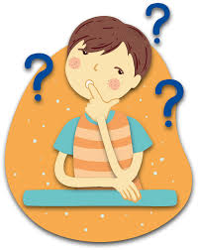
REFLECTION

Slide 15
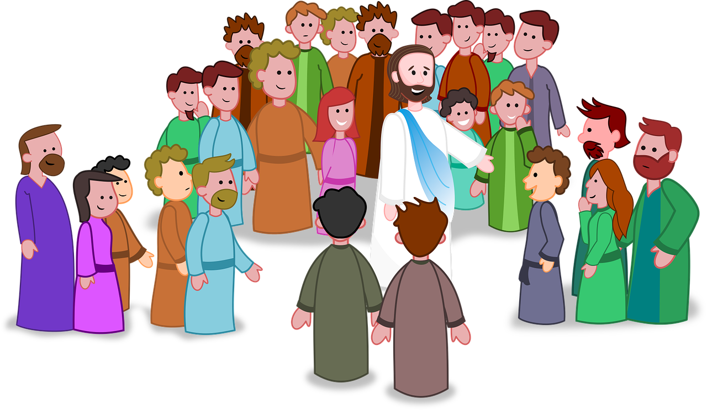
Many people followed Jesus. Why?
They felt the love of God in His words and wanted to hear more.

Slide 16
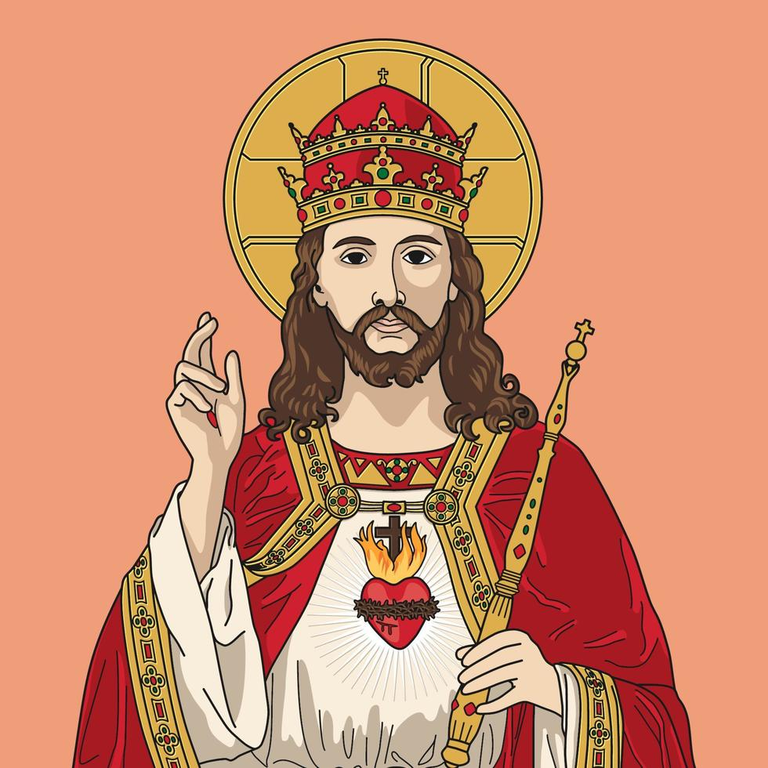
What did Jesus’ relatives say upon hearing of the crowds?
They did not know He was God!
He has lost His mind.

Slide 17
What did the scribes, the experts in the Law, say about Jesus?
He is possessed by Satan, prince of demons, and so He casts out the demons

Slide 18
What does Jesus reply?
A divided kingdom cannot stand.
In the same way, no one can rob a strong man unless they tie him up
. If Satan rises up against himself, he will end.

Slide 19
Jesus announces that God will not forgive sins against the Holy Spirit. What was the sin of the scribes?
They accused Jesus, the Holy Trinity, of being possessed by Satan.

Slide 20
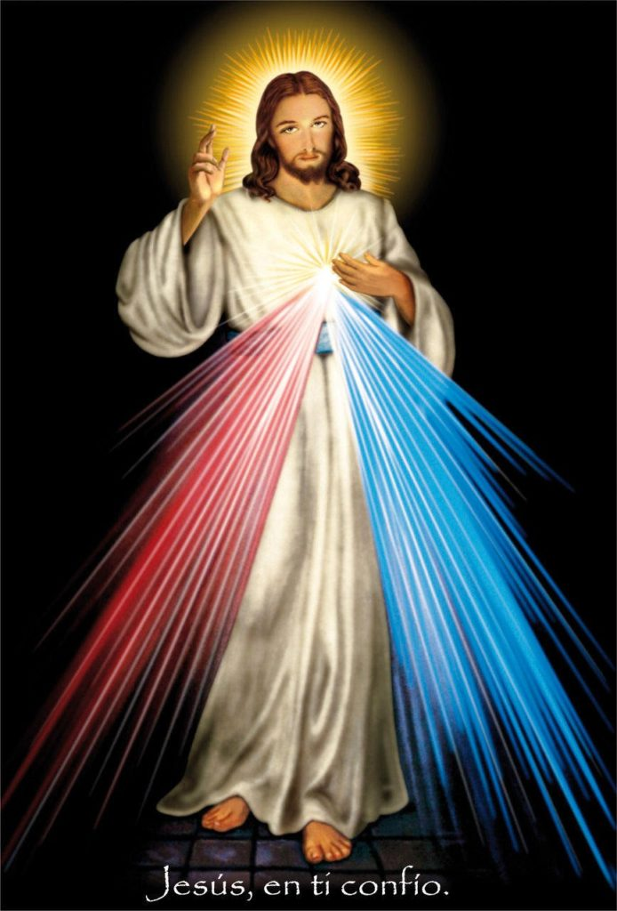
When we attribute evil to God, we sin against the Holy Spirit because God is pure Love, Mercy, and Goodness.

Slide 21
What did Jesus say when they announced the arrival of His Mother and brothers?
Whoever does the will of God is my brother and sister and mother.

Slide 22
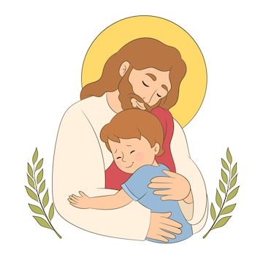
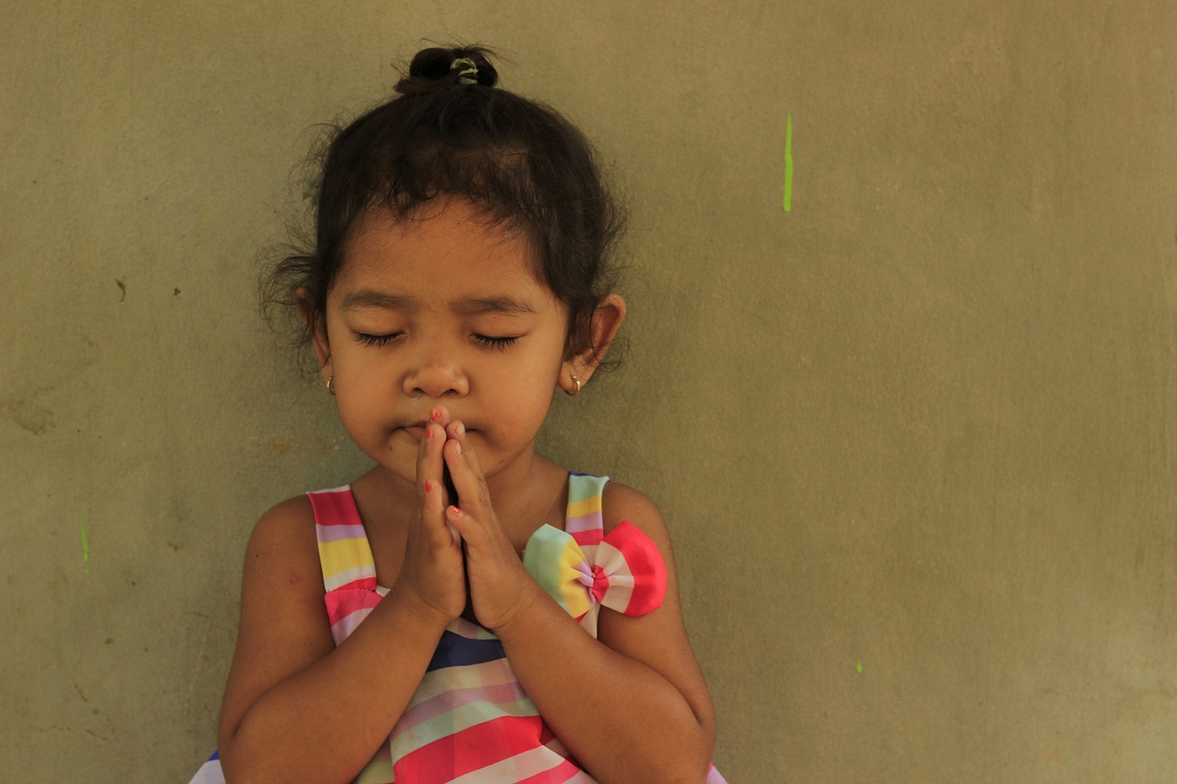
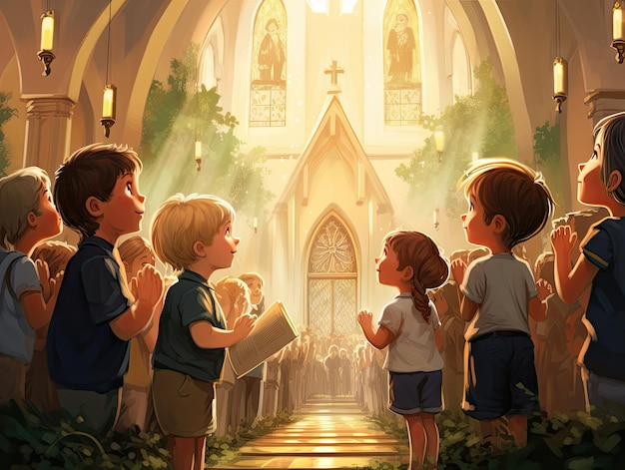
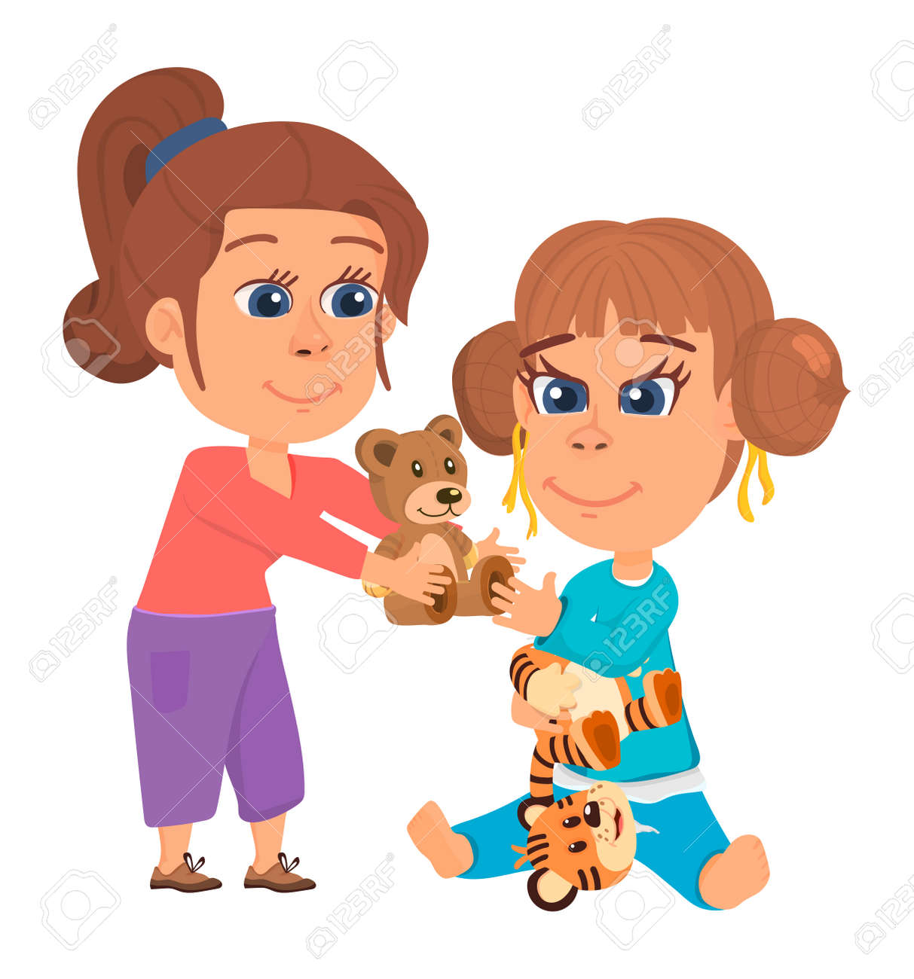
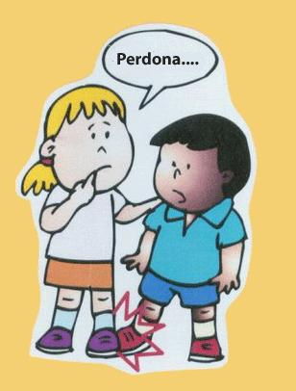
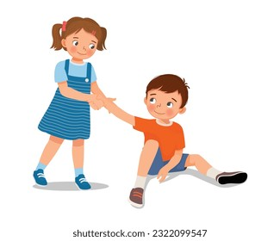
How can we do the will of God?
Loving God and trusting in Him,
Praying and listening to Him,
Going to Mass and to Reconciliation;
Loving our neighbor by helping,
Sharing,
Forgiving…

Slide 23
Activity

Slide 24
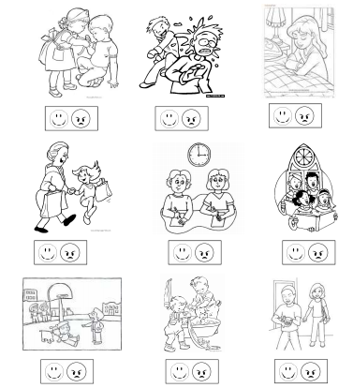
Who is doing God’s will?

Slide 25
Holy Kids the Sacred Heart Image, https://youtu.be/AKVMKfIm7HU?si=Apt7Sn8NAk_34jEa

Slide 26
The Immaculate Conception,Twinkl https://youtu.be/AfTuZeUQ8lw?si=sWHcVwD8j29aTPZy

Slide 27
How to Draw Sacred Heart Jesus and Immaculate Heart of Mary, https://youtu.be/iX9V_nUVUAk?si=jWKSUPOrwGjeh7wo

Slide 28
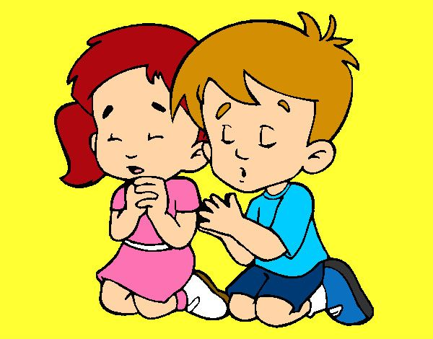
Jesus, you are Love. Teach me to love as you love. Help me to always do your will. Help me to be a good witness and take your message of love to those who do not know you. Send your Holy Spirit and fill the hearts of those that don’t know your Love. Amen
Prayer

Slide 29
I Love You Jesus, Kids Prayer, MAPI, https://youtu.be/-THWU6hSCdE?si=hkuVcO7SeaM0-Gir (3-7 years)

Slide 30
I Will Go and Do, David Archuleta, https://youtu.be/zeGC8lS20d8?si=htC9oROlrKlOT6AF (7+ years)

