Slide 1
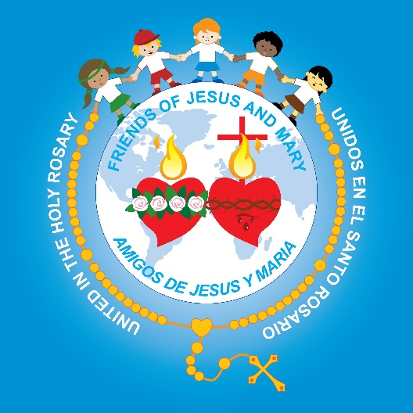
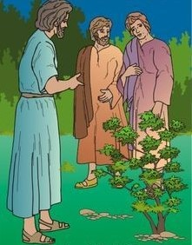
Friends of Jesus and Mary
Children’s Prayer Group
Cycle B-XI Sunday in Ordinary Time
The Seed that Grew, Mark 4: 26-34
and
The Solemnity of the Sacred Heart of Jesus (June 11)
and the Immaculate Heart of Mary (June 12)

Slide 2
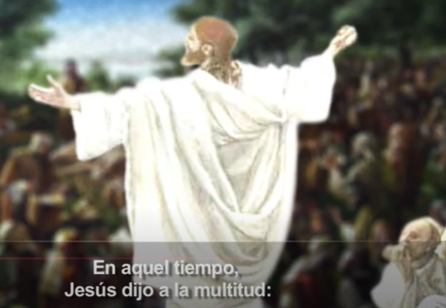
The Seed that Grew, Mark 4: 26-34
Jesus said to the crowds:

Slide 3
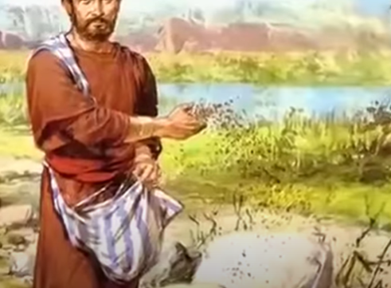
This is how it is with the kingdom of God; it is as if a man were to scatter seed on the land and would sleep and rise night and day and through it all the seed would sprout and grow, he knows not how.

Slide 4
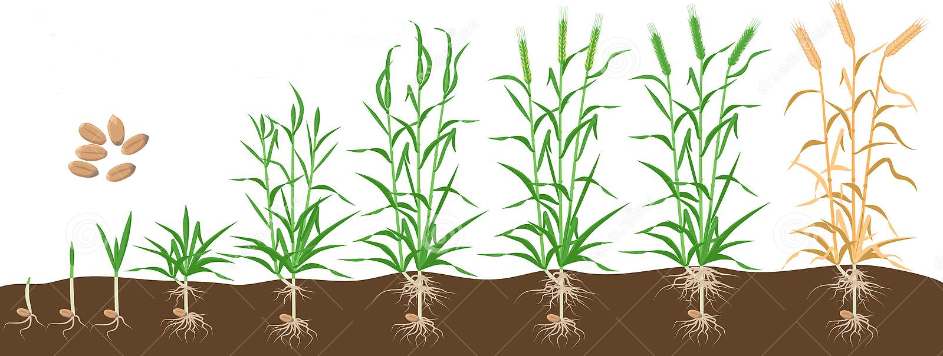
Of its own accord the land yields fruit, first the blade, then the ear, then the full grain in the ear.

Slide 5
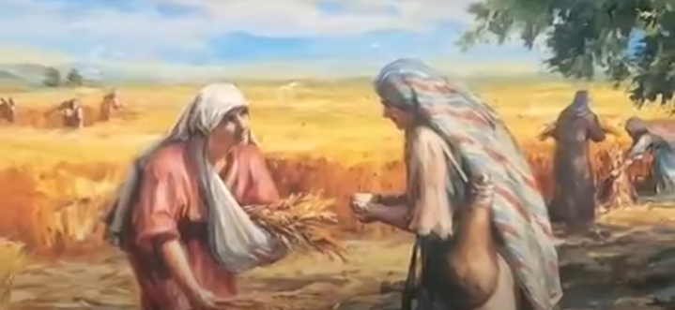
And when the grain is ripe, he wields the sickle at once, for the harvest has come.

Slide 6
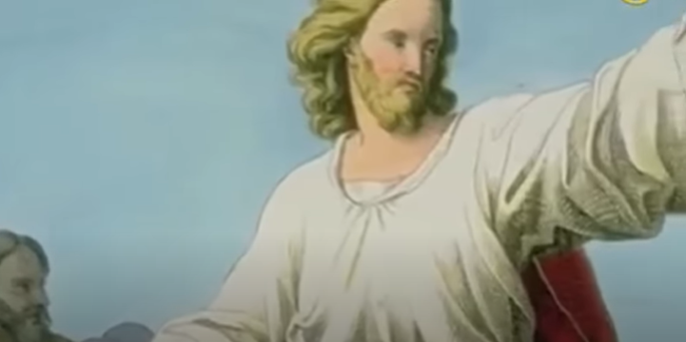
He said, “To what shall we compare the kingdom of God, or what parable can we use for it?

Slide 7
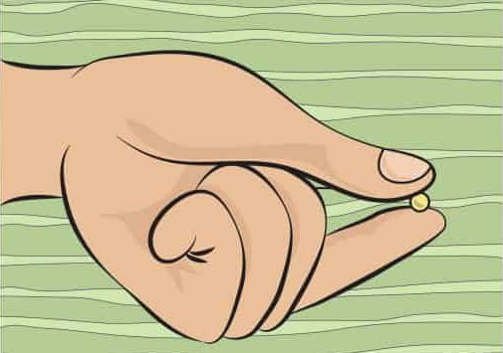
It is like a mustard seed that, when it is sown in the ground, is the smallest of all the seeds on the earth.

Slide 8
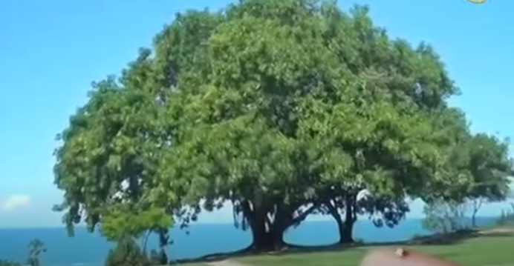
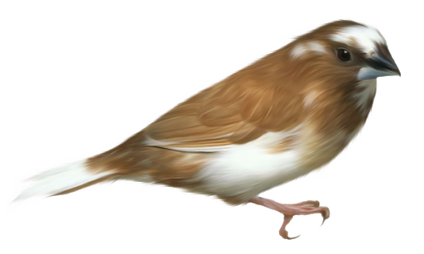
But once it is sown, it springs up and becomes the largest of plants and puts forth large branches, so that the birds of the sky can dwell in its shade.

Slide 9
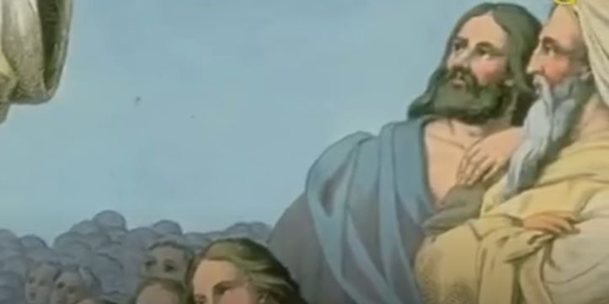
With many such parables he spoke the word to them as they were able to understand it. Without parables he did not speak to them, but to his own disciples he explained everything in private.
THE GOSPEL OF THE LORD. PRAISE TO YOU LORD JESUS CHRIST.

Slide 10
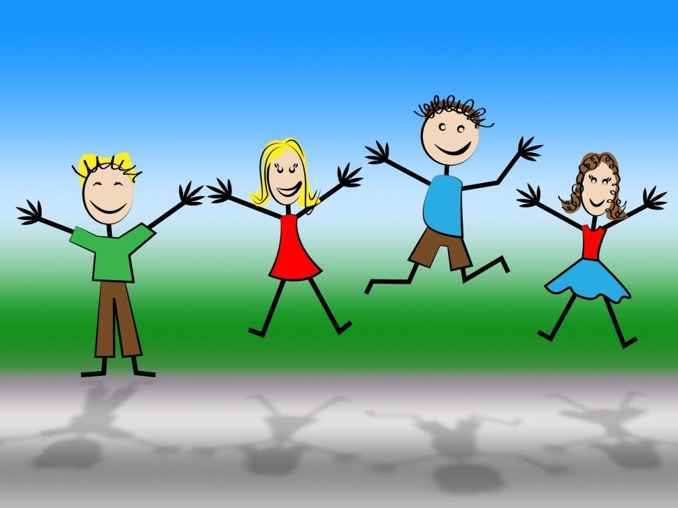
REFLECTION

Slide 11
Jesus tells 2 parables to explain the Kingdom of God. What is the Kingdom of God?

Slide 12
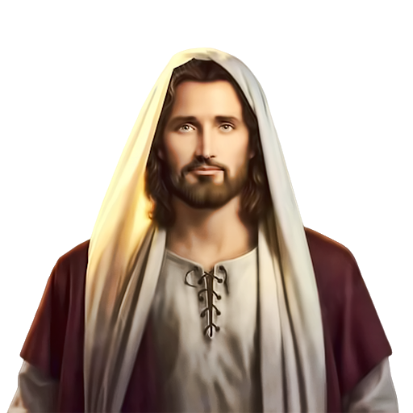
It is Jesus living and acting in the hearts of His friends.

Slide 13
First, Jesus compares the Kingdom of God to what?

Slide 14
Jesus compares the Kingdom of God to the process of planting a seed of wheat: the stems, stalks and grains grow, followed by the harvest.
How are they the same?

Slide 15
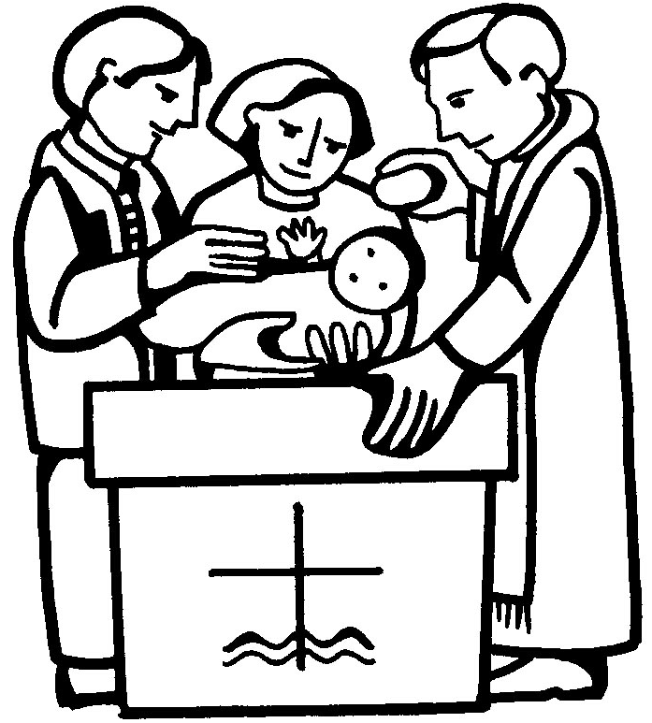
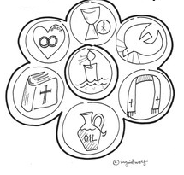
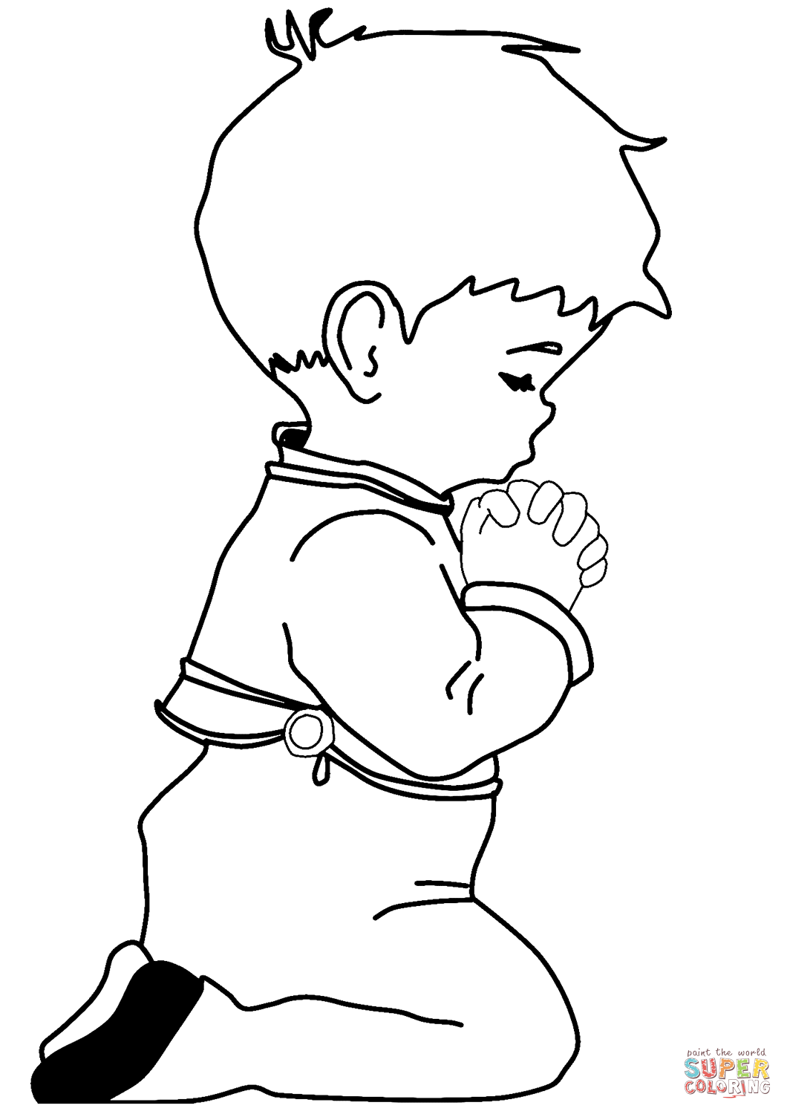
We plant the seed of the Kingdom of God when we baptize a child, teach them to pray and love God and others, and they receive the Sacraments.

Slide 16
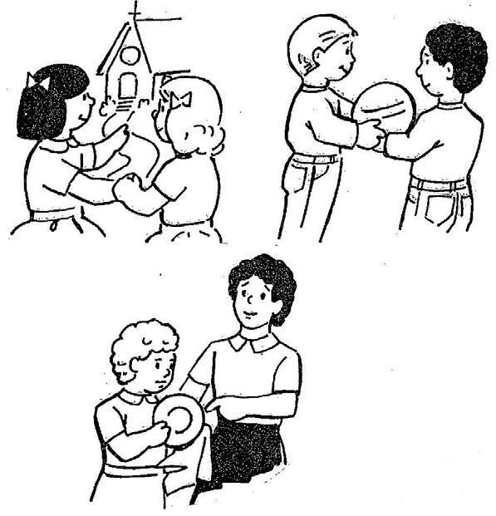
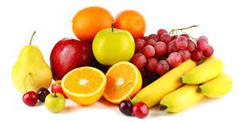
The harvest is their Good fruits.
Going to Church,
Sharing,
Helping others…

Slide 17
Just as a seed needs sun, water, and good soil to grow, what does a person need to grow in faith and love?

Slide 18
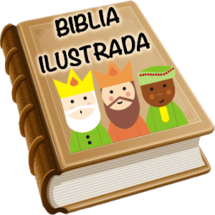
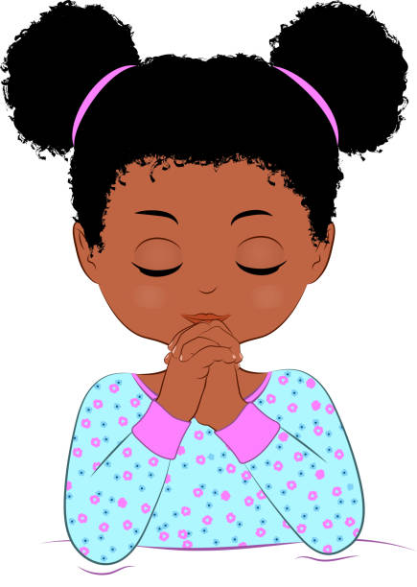
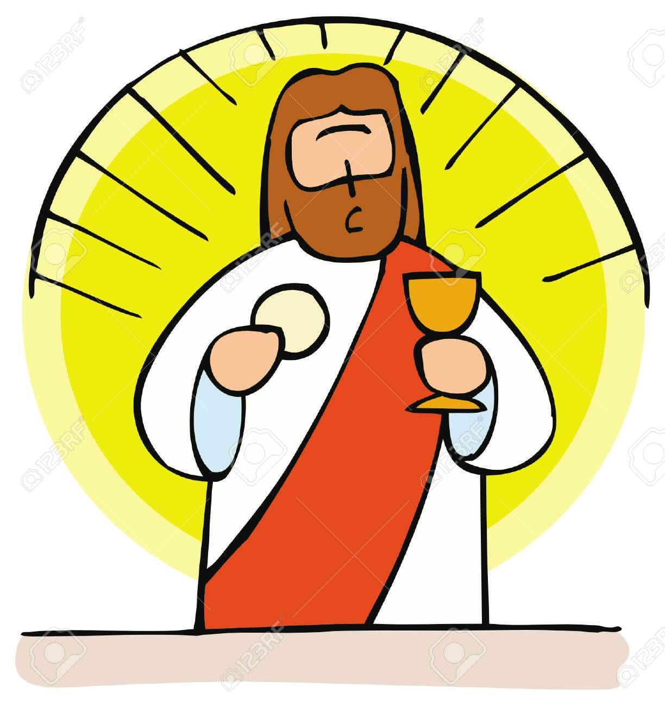
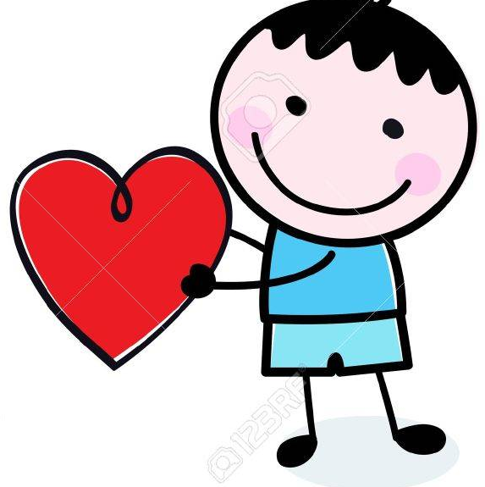
To talk to God in Prayer,
To listen to the Word of God,
To share God’s Love with others,
To share with Jesus in the Eucharist,

Slide 19
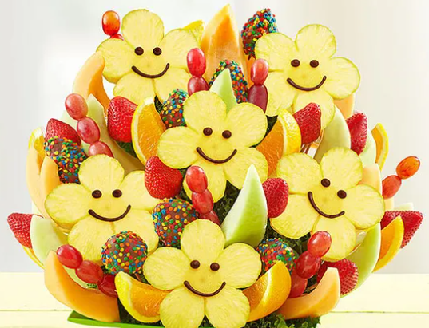
Although we don’t see it, the Holy Spirit makes the seed of faith grow into good works to help build God’s Kingdom.

Slide 20
Jesus also compares the Kingdom of God to a mustard seed. How?

Slide 21
Although the mustard seed is tiny, the tree grows to be the largest, with abundant branches for many birds to build their nests.

Slide 22
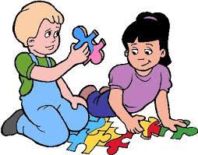
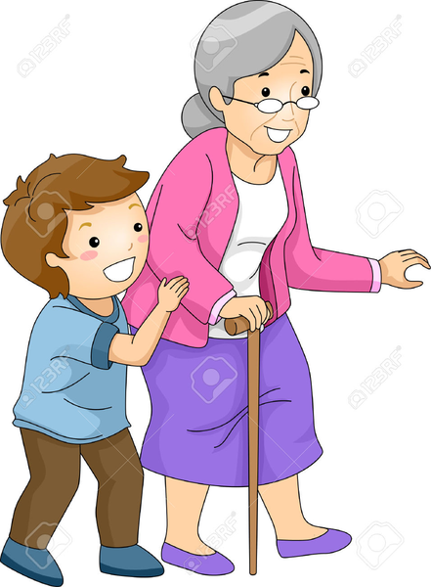
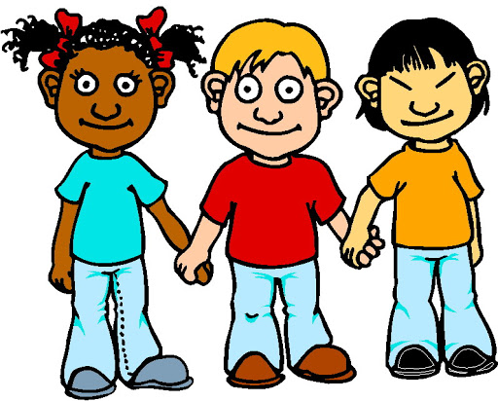
In the same way, when the seed of the Kingdom of God is planted in a fertile heart, faith, hope, and love grows and extends to others helping build God’s Kingdom.

Slide 23
Activity

Slide 24
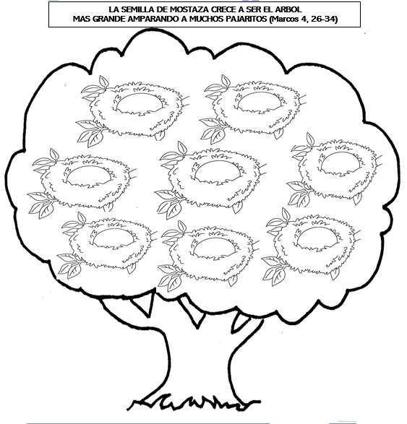
THE TINY MUSTARD SEED GROWS TO BE THE LARGEST TREE
HOUSING MANY BIRD’S NESTS (Mark 4, 26-34)
The Kingdom of God needs our help.
Choose the words that help build the Kingdom of God.
LOVE,
SELFISHNESS, PRAYER, DISOBEDIENCE,
SERVICE, FORGIVENESS,
FIGHT,
THE EUCHARIST, LIES,
THE HOLY SPIRIT,
HUMILITY,
READING
THE BIBLE
Love
Prayer
The Eucharist
Service
Forgiveness
The Holy Spirit
Reading
the Bible
Humility

Slide 25
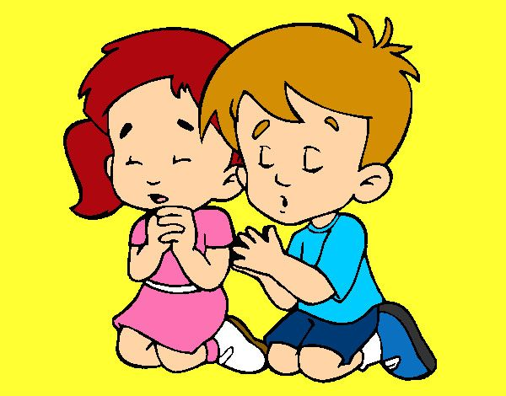
Jesus, you are the best Sower and you plant in your friends the seed of your Word and your immense Love. Help me to share this love with my good works, and help build Your Kingdom. Thank you, Jesus, for making me grow without me realizing it. Amen
Prayer

Slide 26
Song: Enable Me to Grow, Nabil and Nasreen, https://youtu.be/yMkYxv-jQvw

