Slide 1
Friends of Jesus and Mary
Cycle B - XII Sunday in Ordinary Time
Jesus Calms the Storm
Mark 4, 35-41

Slide 2
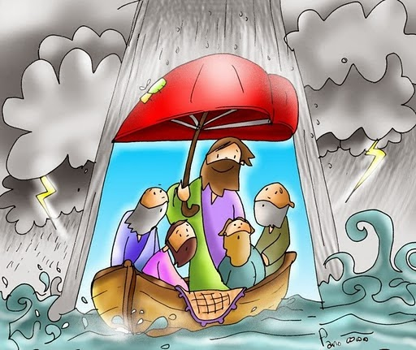
Jesus Calms the Storm
Gospel: Mark 4: 35-41
On that day, as evening drew on, Jesus said to his disciples: “Let us cross to the other side.” Leaving the crowd, they took Jesus with them in the boat just as he was. And other boats were with him. A violent squall came up and waves were breaking over the boat, so that it was already filling up. Jesus was in the stern, asleep on a cushion.

Slide 3
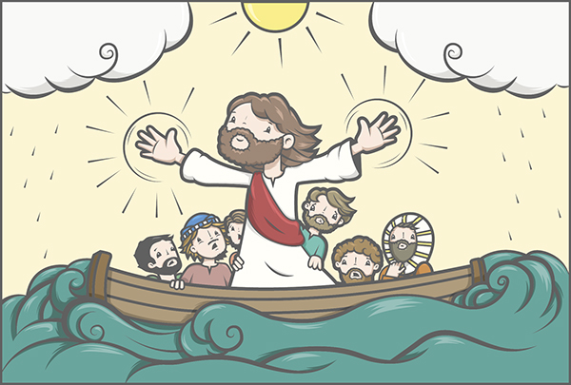
They woke him and said to him, “Teacher, do you not care that we are perishing?” He woke up, scolded the wind, and said to the sea, “Quiet! Be still!” The wind ceased and there was great calm.
Then he asked them, “Why are you terrified? Do you not yet have faith?” They were filled with great awe and said to one another, “Who then is this whom even wind and sea obey?”
The Gospel of the Lord. Praise to You Lord Jesus Christ.

Slide 4
REFLECTION

Slide 5
Jesus asks his disciples to go to the other side of the lake.
What happened on the way?

Slide 6
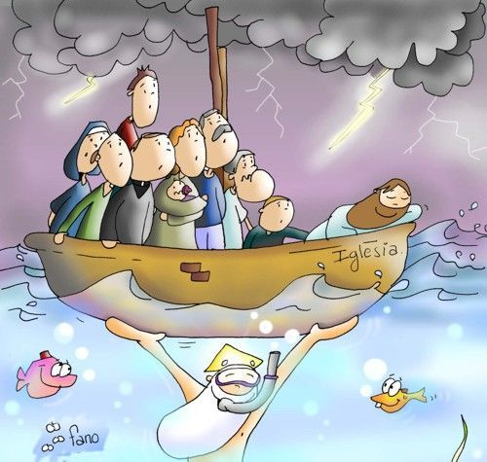
A storm suddenly hit which almost sunk the boat.

Slide 7
What do the disciples do ?

Slide 8
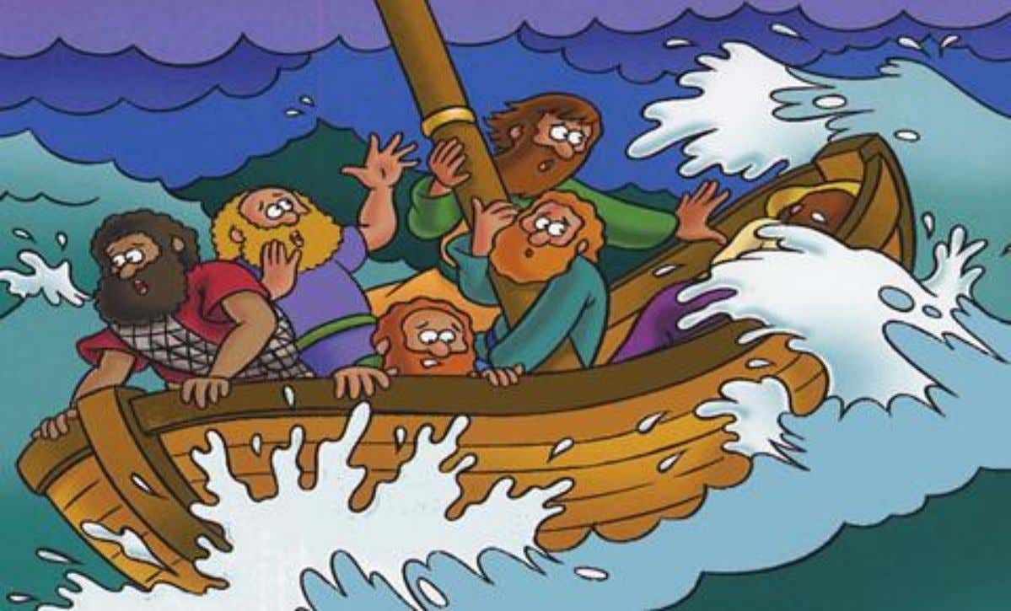
Terrified, they wake up Jesus and ask Him,
“Do you not care that we are perishing?”

Slide 9
What does Jesus do?

Slide 10
He scolded the wind and commanded the sea to be quiet!

Slide 11
What happened next?

Slide 12
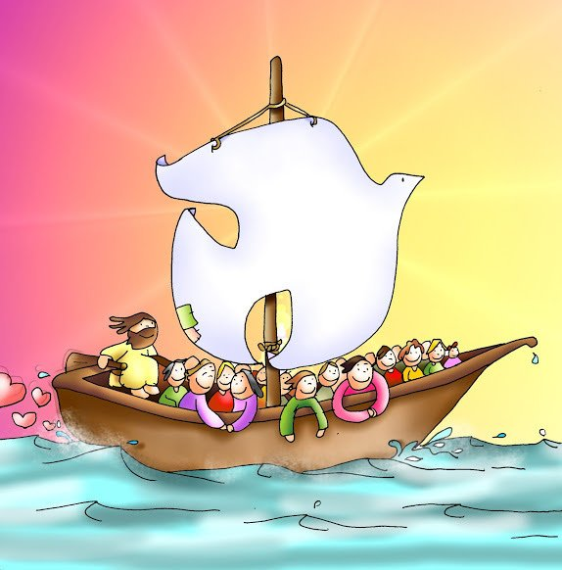
The wind and the sea obeyed and calmed down.

Slide 13
What does Jesus ask them?

Slide 14
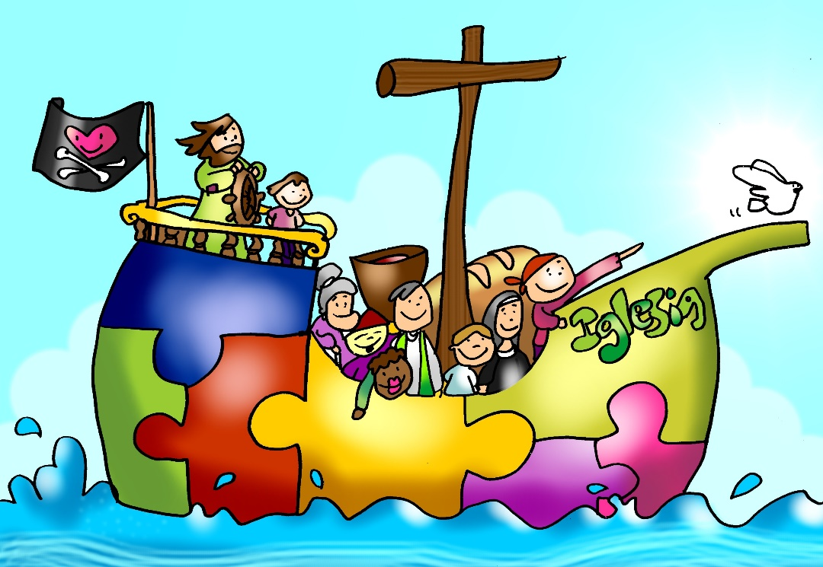
Why were you so scared? Do you not yet have faith?

Slide 15
What does Jesus want to teach us?

Slide 16
With Jesus in our boat (our heart), we should not be afraid. He is God and can calm all the storms in our lives.

Slide 17
What are some of the storms in our lives?

Slide 18
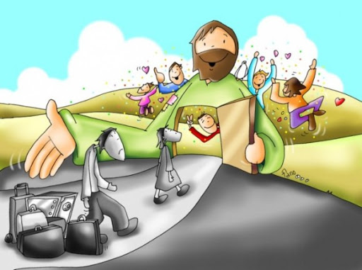
Family problems, fights with friends, sickness or death of a loved one, financial problems, difficulty in school…

Slide 19
How can Jesus help us?

Slide 20
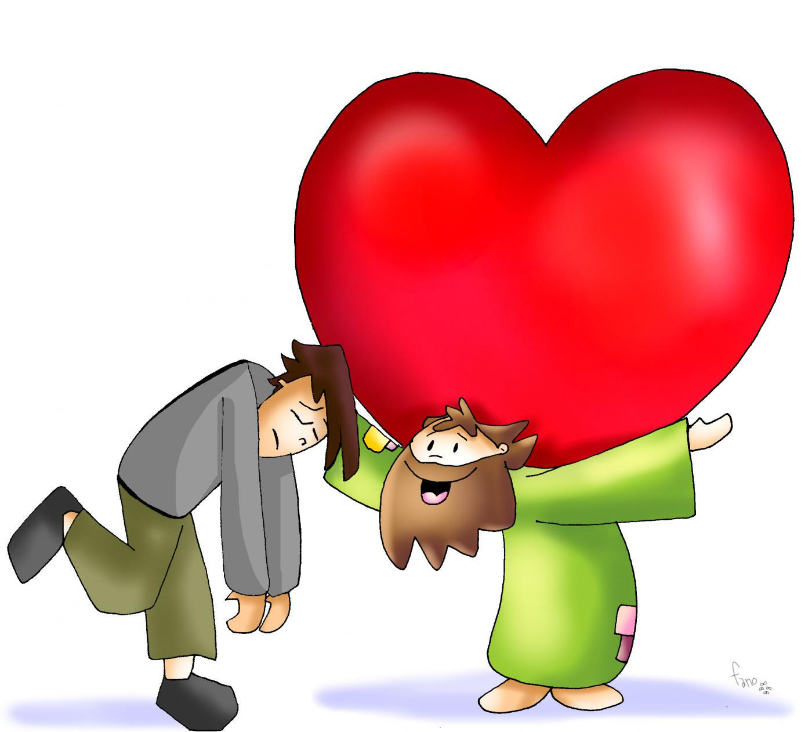
When we pray with our heart, Jesus gives us strength, peace, and wisdom to face our problems. He never leaves us alone. He can do anything. He wants us to trust Him always.

Slide 21
How did the disciples react when he calmed the storm?

Slide 22
Filled with awe they asked, “Who is this whom even wind and sea obey?” They did not understand that He was God.

Slide 23
Do you believe that Jesus is God, almighty,
full of love for you and who will never abandon you?

Slide 24
ACTIVITIES

Slide 25
On the following page, print or draw and color Jesus in a boat calming the storm, and five round lifesavers in the water. Choose or draw the emojis in the lifesavers that describe the words listed that apply to God. Praise Jesus using these and other words,
“Jesus you are Love…”
On the other page, fill in the blanks with words from the Gospel.

Slide 26
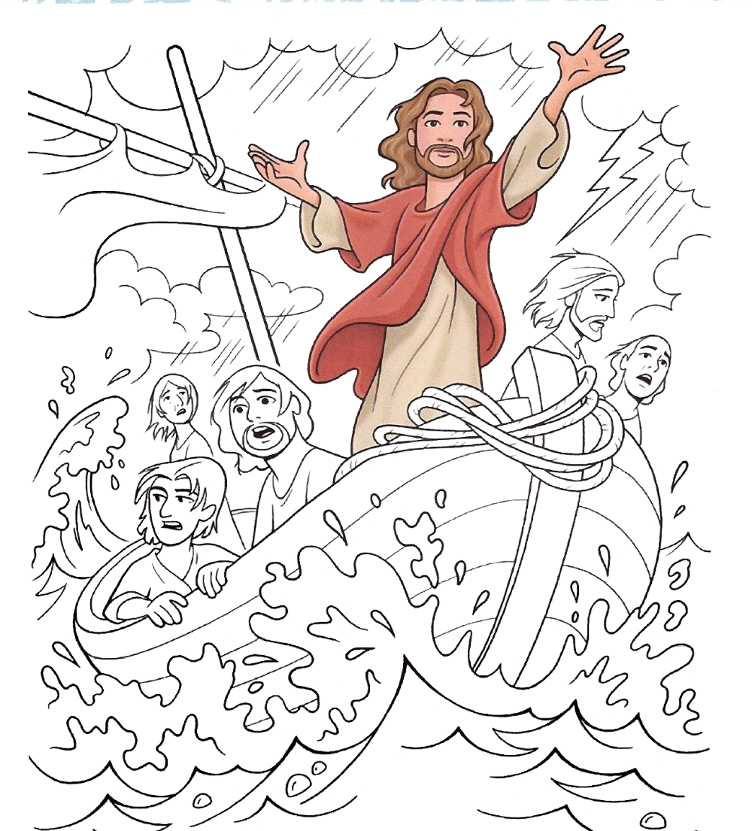
JESUS CALMS THE STORM
Mark 4, 35-41
“Why are you terrified? Do you not yet have faith?”
Instructions
Choose the emojis that describe God and place them or draw them in the life savers. Choose the words that describe the emojis:
Wise, Love, Almighty, Holy, King
Praise Him: “Jesus you are love…”
Love
Almighty
My King
Holy
Wise

Slide 27
JESUS CALMS THE STORM Mark 4, 35-41
Fill the blank spaces with the words from the Gospel: be still,
waves, boat, faith, perishing, obey, water, calm, terrified, scolded, sleeping, awe.
On that day, as evening drew on, Jesus said to his disciples: “Let us cross to the other side.” Leaving the crowd, they took Jesus with them in the __________ just as he was. And other boats were with him. A violent squall came up and __________ were breaking over the boat, so that it was already filling up with _________. Jesus was in the stern, __________ on a cushion. They woke him and said to him, “Teacher, do you not care that we are ______________?” He woke up, __________ the storm, and said to the sea, _____________!” The wind ceased and there was great ___________. Then he asked them, “Why are you ____________? Do you not yet have ________?” They were filled with great ________ and said to one another, “Who then is this whom even wind and sea ____________?”
waves
perishing
water
Be still
terrified
obey
boat
scolded
awe
calm
sleeping
faith

Slide 28
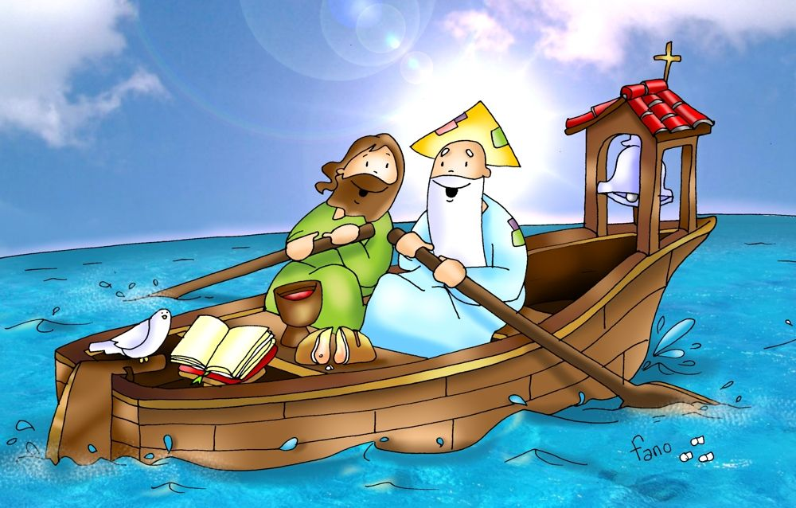
PRAYER
Jesus, I believe that you are God, almighty, filled with love and mercy for me. Help me to have faith in your great power and love in my life. Jesus, I trust in you.
Amen.

Slide 29
Jesus Calms the Storm, kids church, (Ctrl Click) https://youtu.be/zCuHjbz13X4

