Slide 1
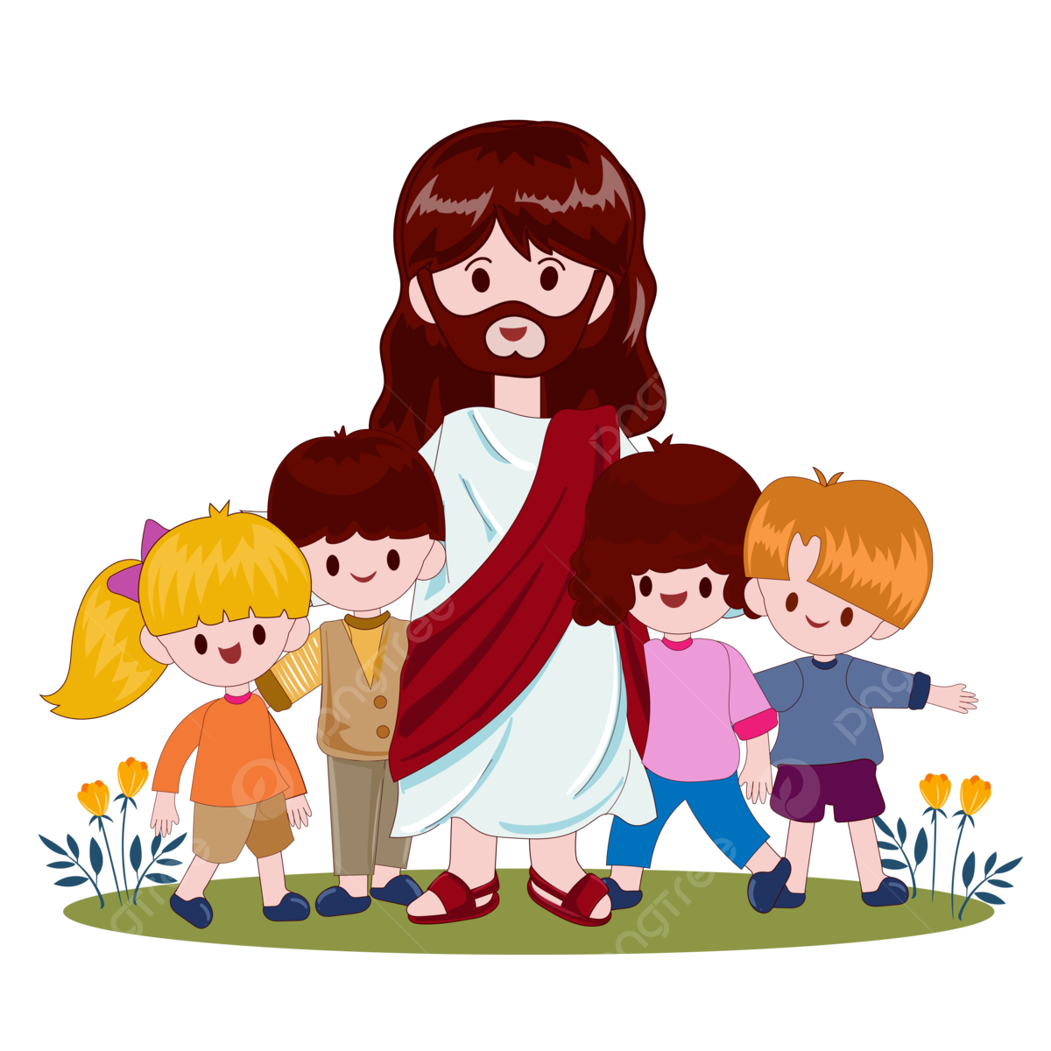
Ministry Friends of Jesus and Mary
Prayer Group for Children
Jesus Cures Jairus’ Daughter
Cycle B - XIII Sunday in Ordinary Time
Mark 5: 21-24. 35-43
www.fcpeace.org

Slide 2
When Jesus had crossed again in the boat to the other side...

Slide 3
… a large crowd gathered around him, and he stayed close to the sea.

Slide 4
One of the synagogue officials, named Jairus, came forward.

Slide 5
Seeing him he fell at his feet and pleaded earnestly with him, saying, “My daughter is at the point of death. Please, come lay your hands on her that she may get well and live.”

Slide 6
He went off with him, and a large crowd followed him and pressed upon him. While he was still speaking, people from the synagogue official’s house arrived and said, “Your daughter has died; why trouble the teacher any longer?”

Slide 7
Disregarding the message that was reported, Jesus said to the synagogue official, “Do not be afraid; just have faith.”

Slide 8
He did not allow anyone to accompany him inside except Peter, James, and John, the brother of James. When they arrived at the house of the synagogue official, he caught sight of a commotion, people weeping and wailing loudly.

Slide 9
Why this commotion and weeping?
The child is not dead but asleep.
And they ridiculed him. Then he put them all out. He took along the child’s father and mother and those who were with him and entered the room where the child was. He took the child by the hand and said to her, “Talitha koum,” which means, “Little girl, I say to you, arise!”

Slide 10
The girl, a child of twelve, arose immediately and walked around.
At that they were utterly astounded.

Slide 11
He gave strict orders that no one should know this and said that she should be given something to eat.
THE GOSPEL OF THE LORD
PRAISE TO YOU LORD JESUS CHRIST

Slide 12
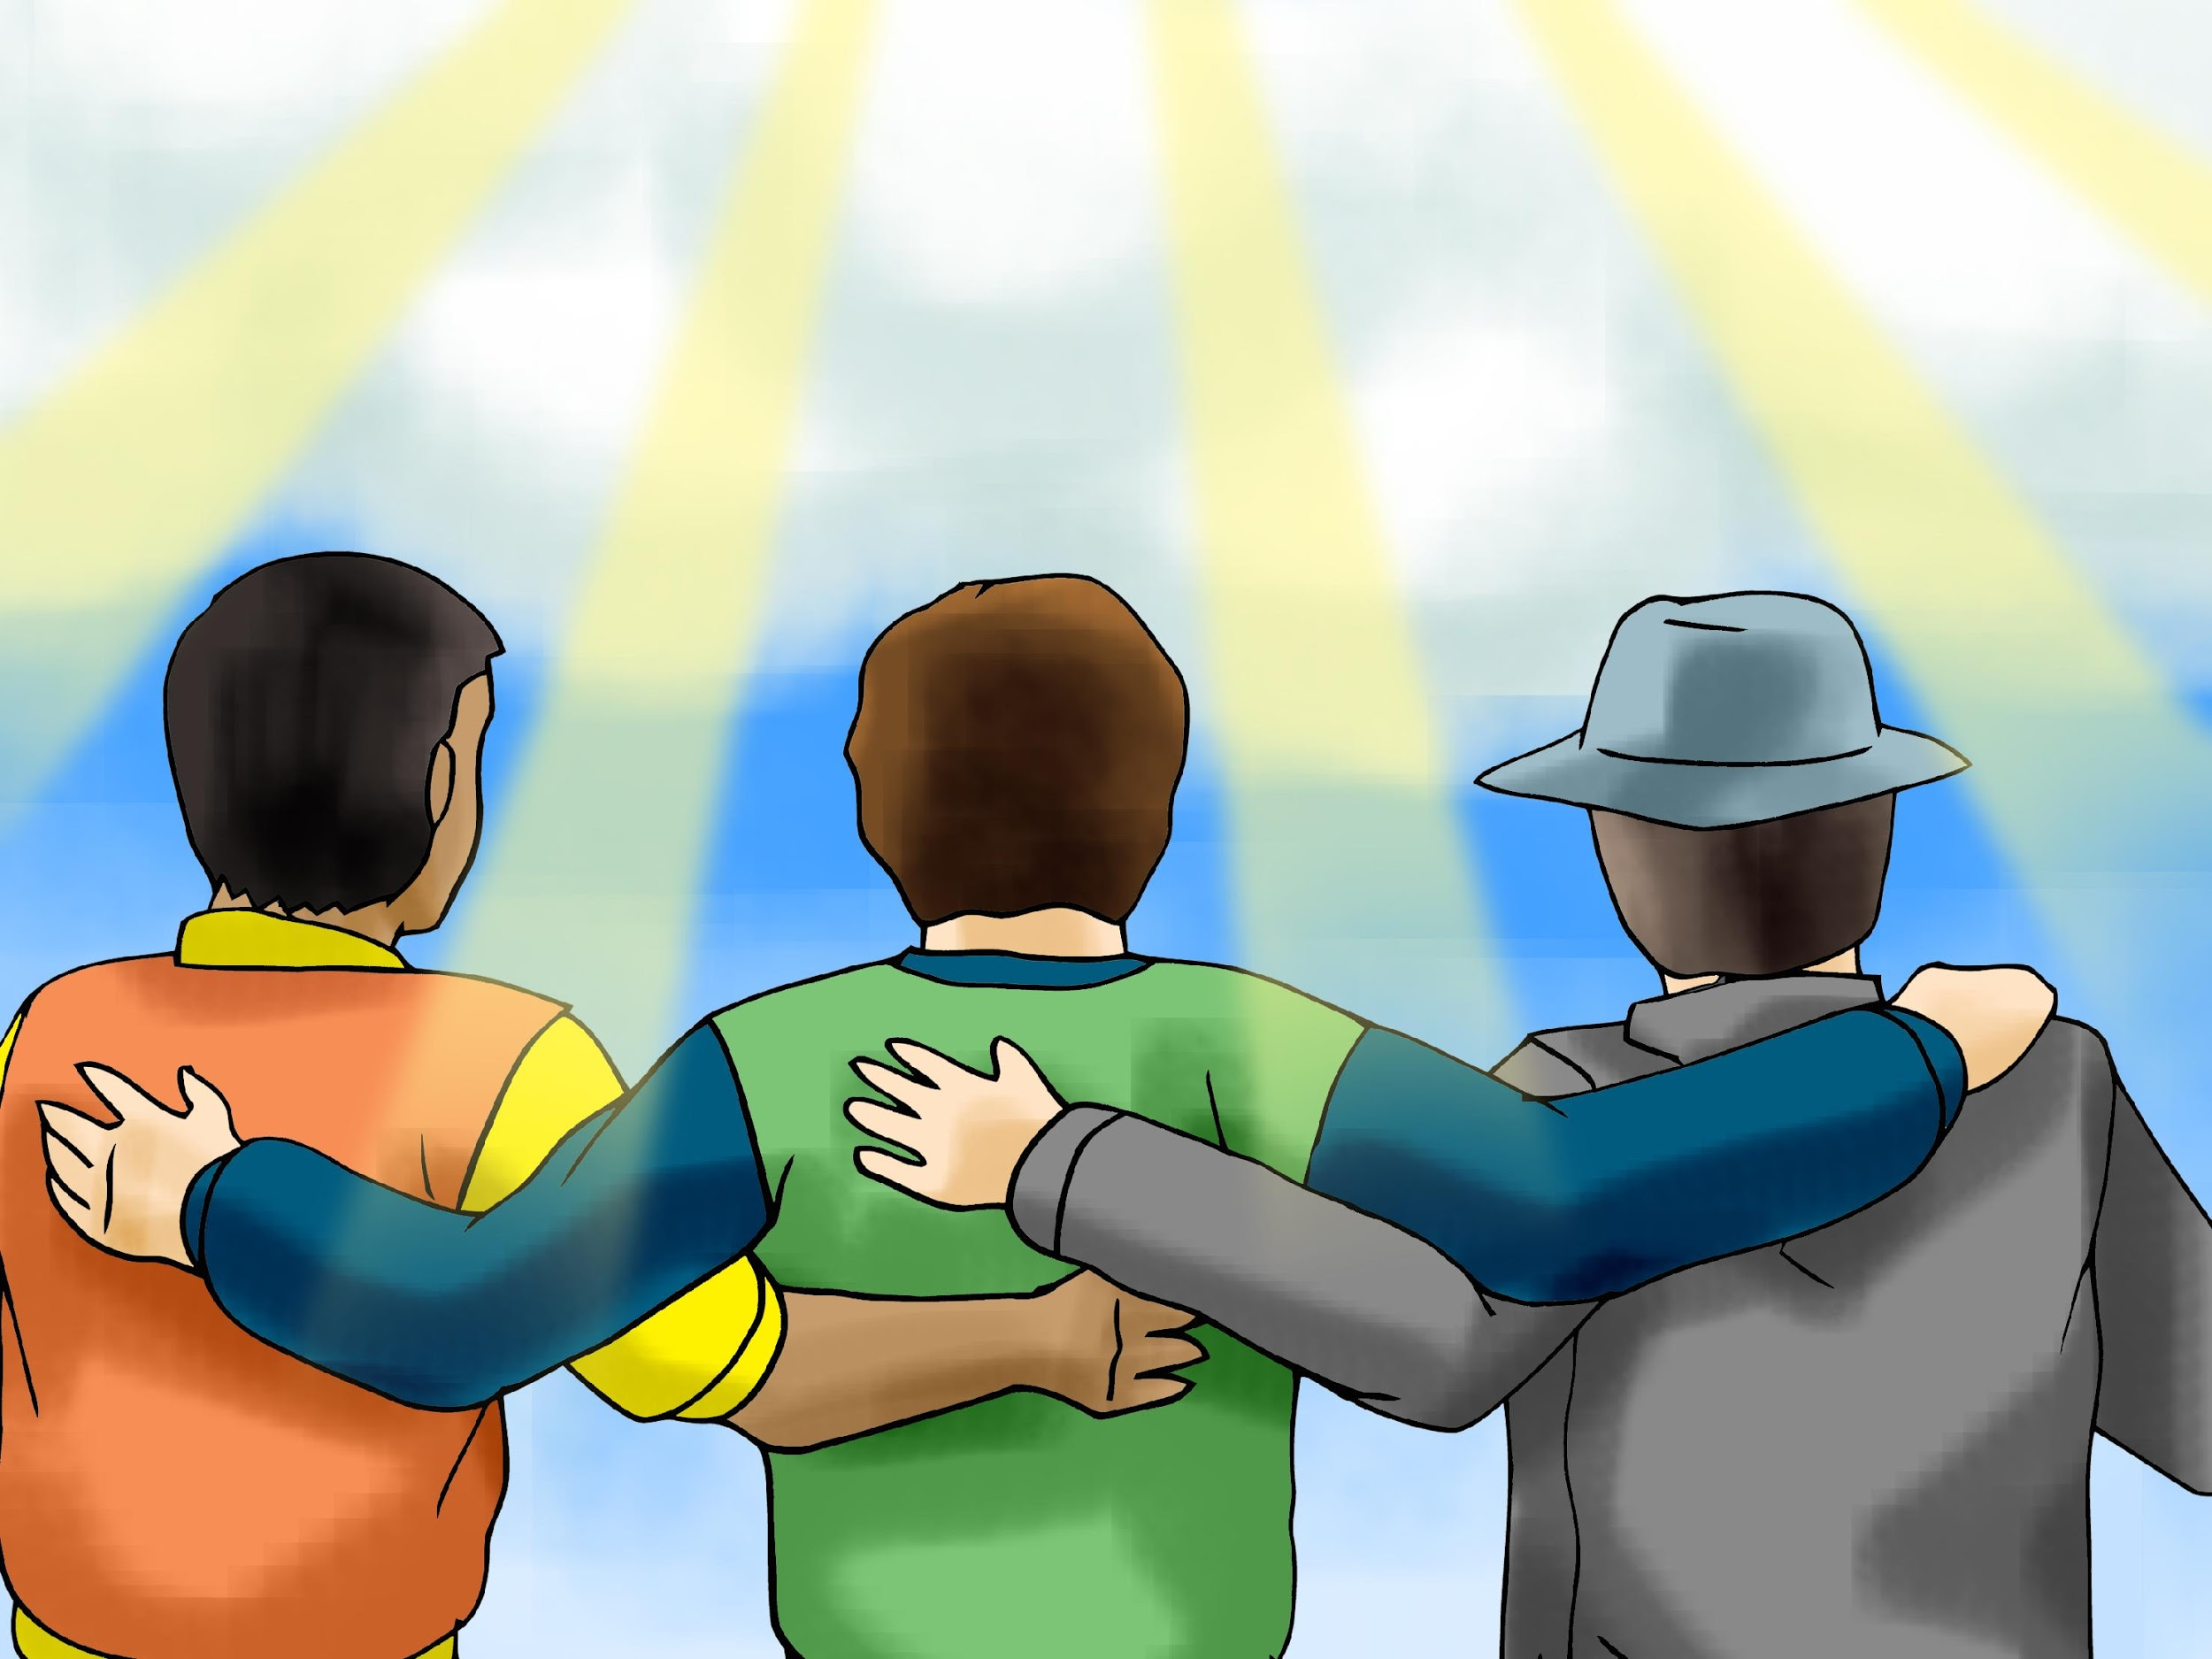
REFLECTION

Slide 13
Who was Jairus?
One of the officials of the synagogue, where the Jews meet to discuss scripture.
What did Jairus do when he saw Jesus?
He threw himself at his feet and pleaded for Jesus to heal his dying daughter.
Jesus left with him, but some of his servants arrived to tell him something. What did they tell him?
His daughter had died.

Slide 14
What did Jesus tell him?
Do not be afraid; just have faith.
Jairus continued with Jesus to his home, despite his servant’s message.
What does this show about Jairus’ faith?
Jairus had great faith in the Word and Power of Jesus.
He took the girl’s hand and said: “Little girl, I say to you, arise!”
What did Jesus do when he arrived at his home?

Slide 15
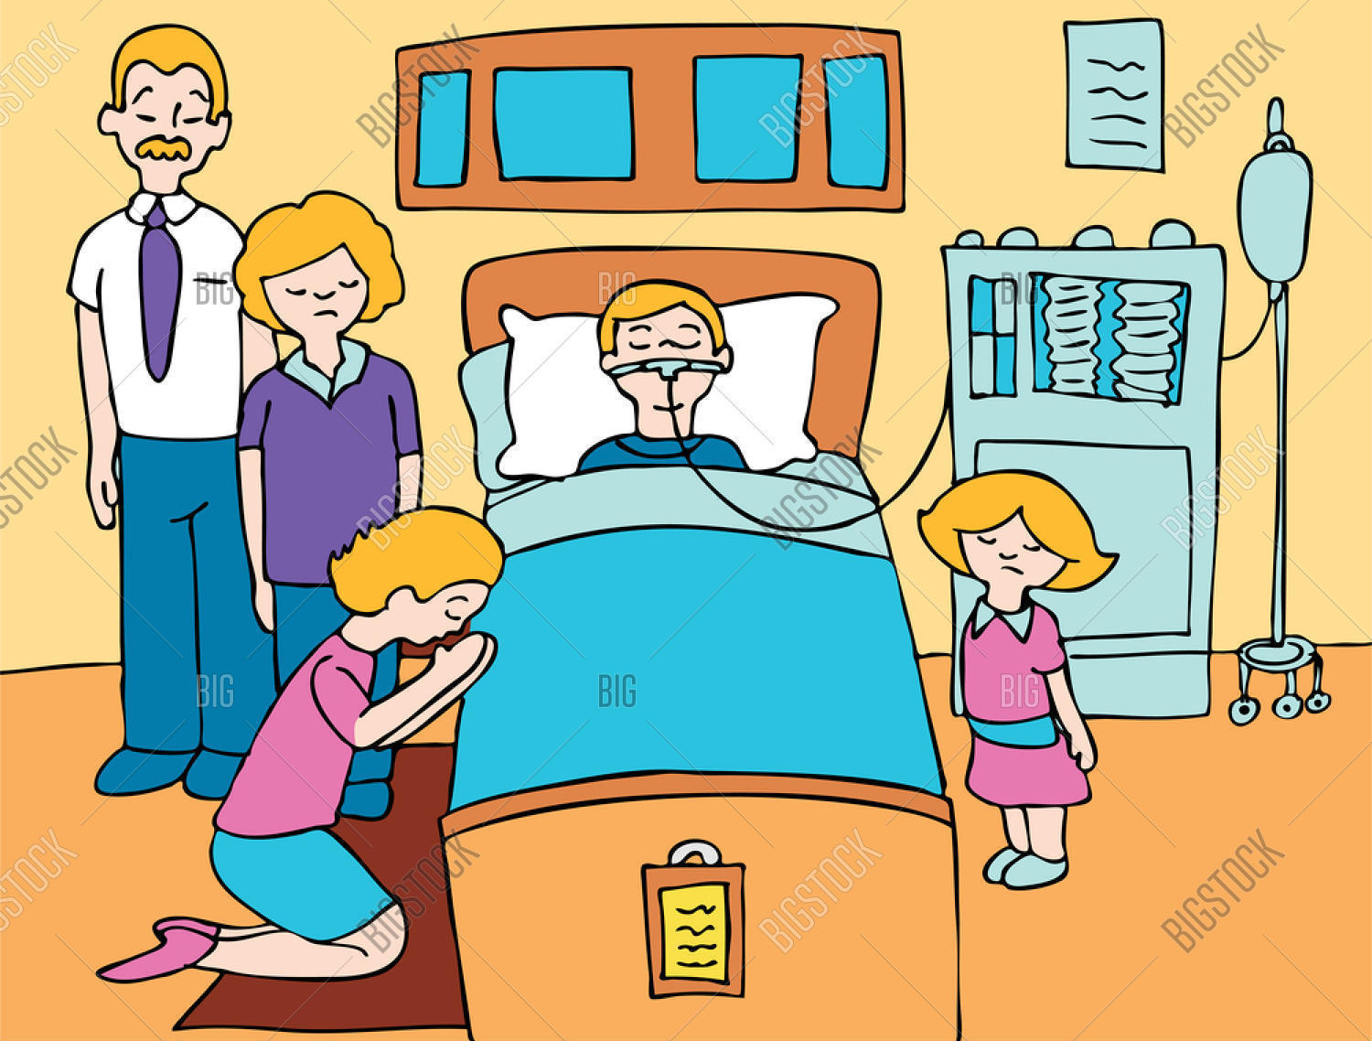
And then what happened?
The girl rose and walked.
Do you pray to Jesus when a loved one is sick?
Sometimes, they are not healed, but we should never lose faith in Jesus. We do not always understand God’s will because we do not see what He sees. We should always pray with the condition that it is God’s will and always accept His will. Jesus is always with us and helps us. He can change problems into good things. Let us always trust Him.

Slide 16
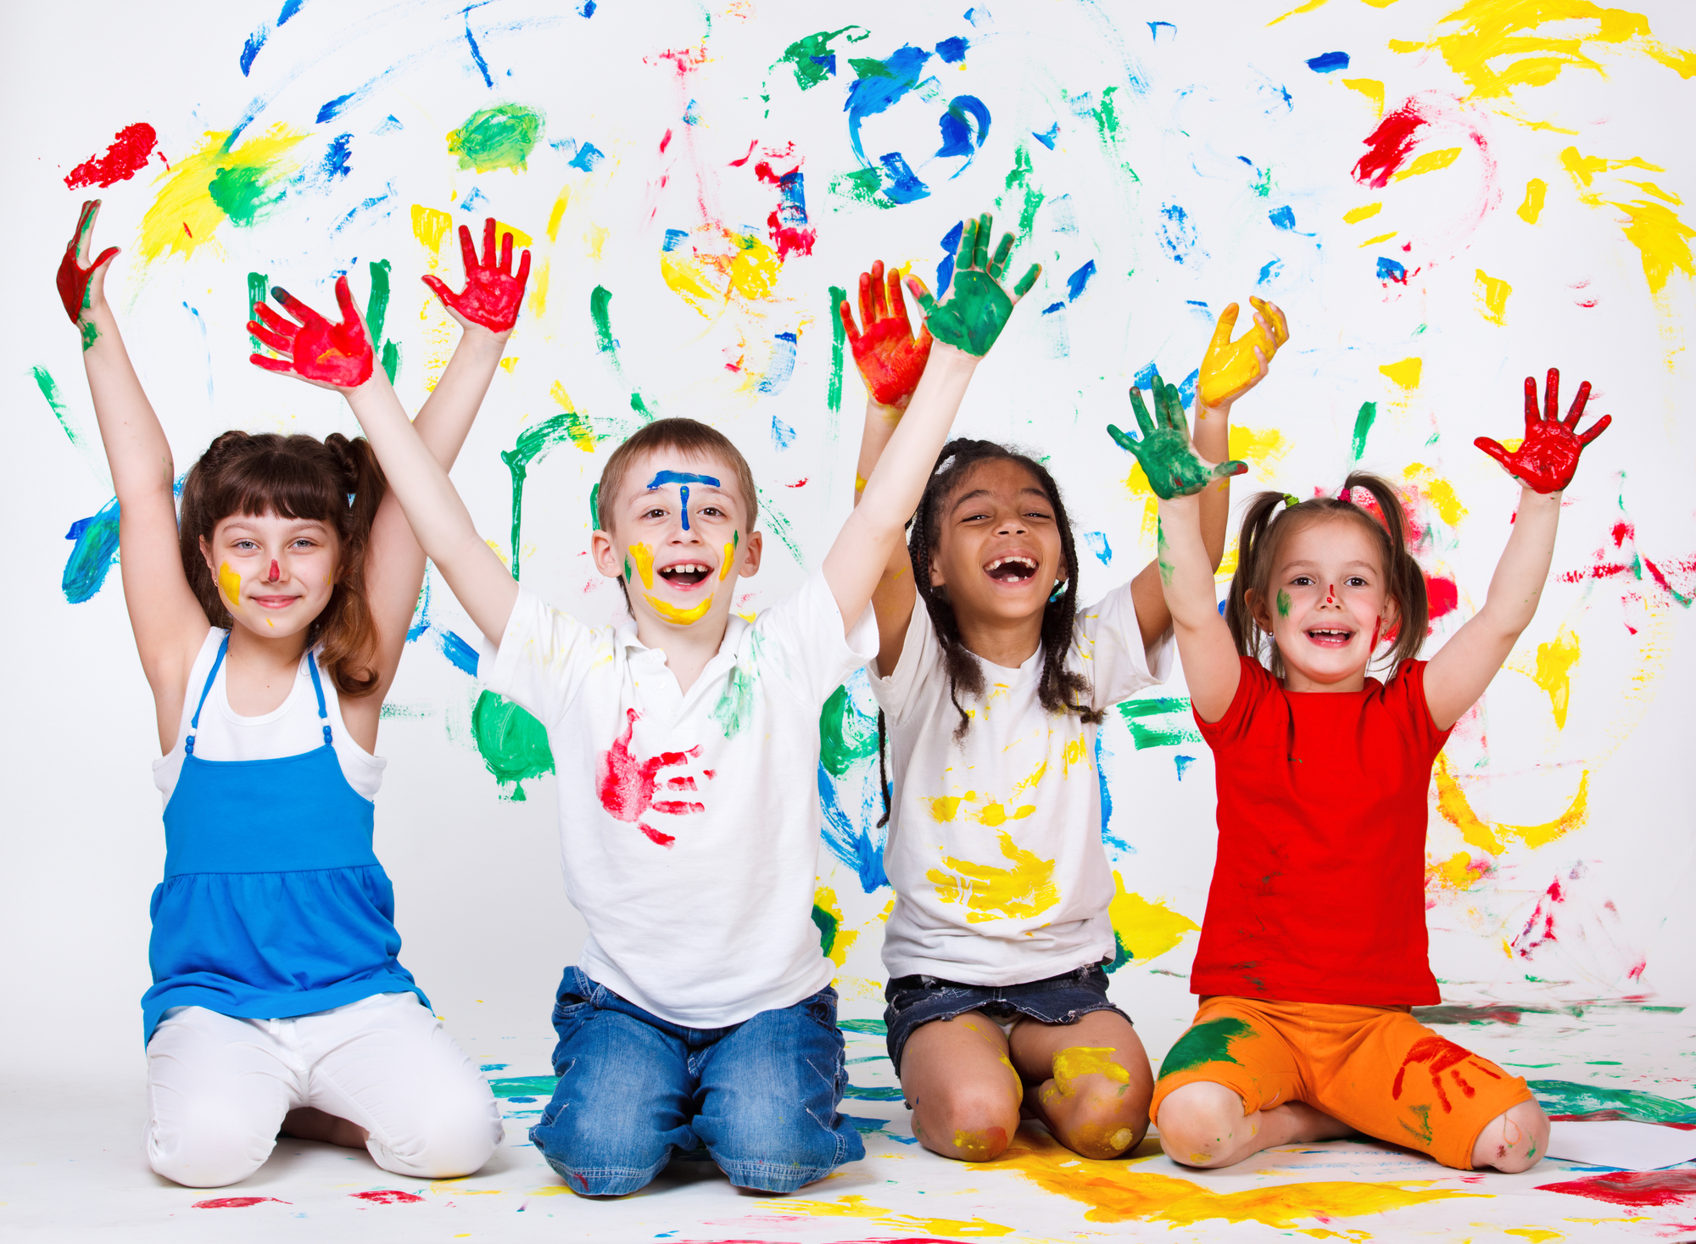
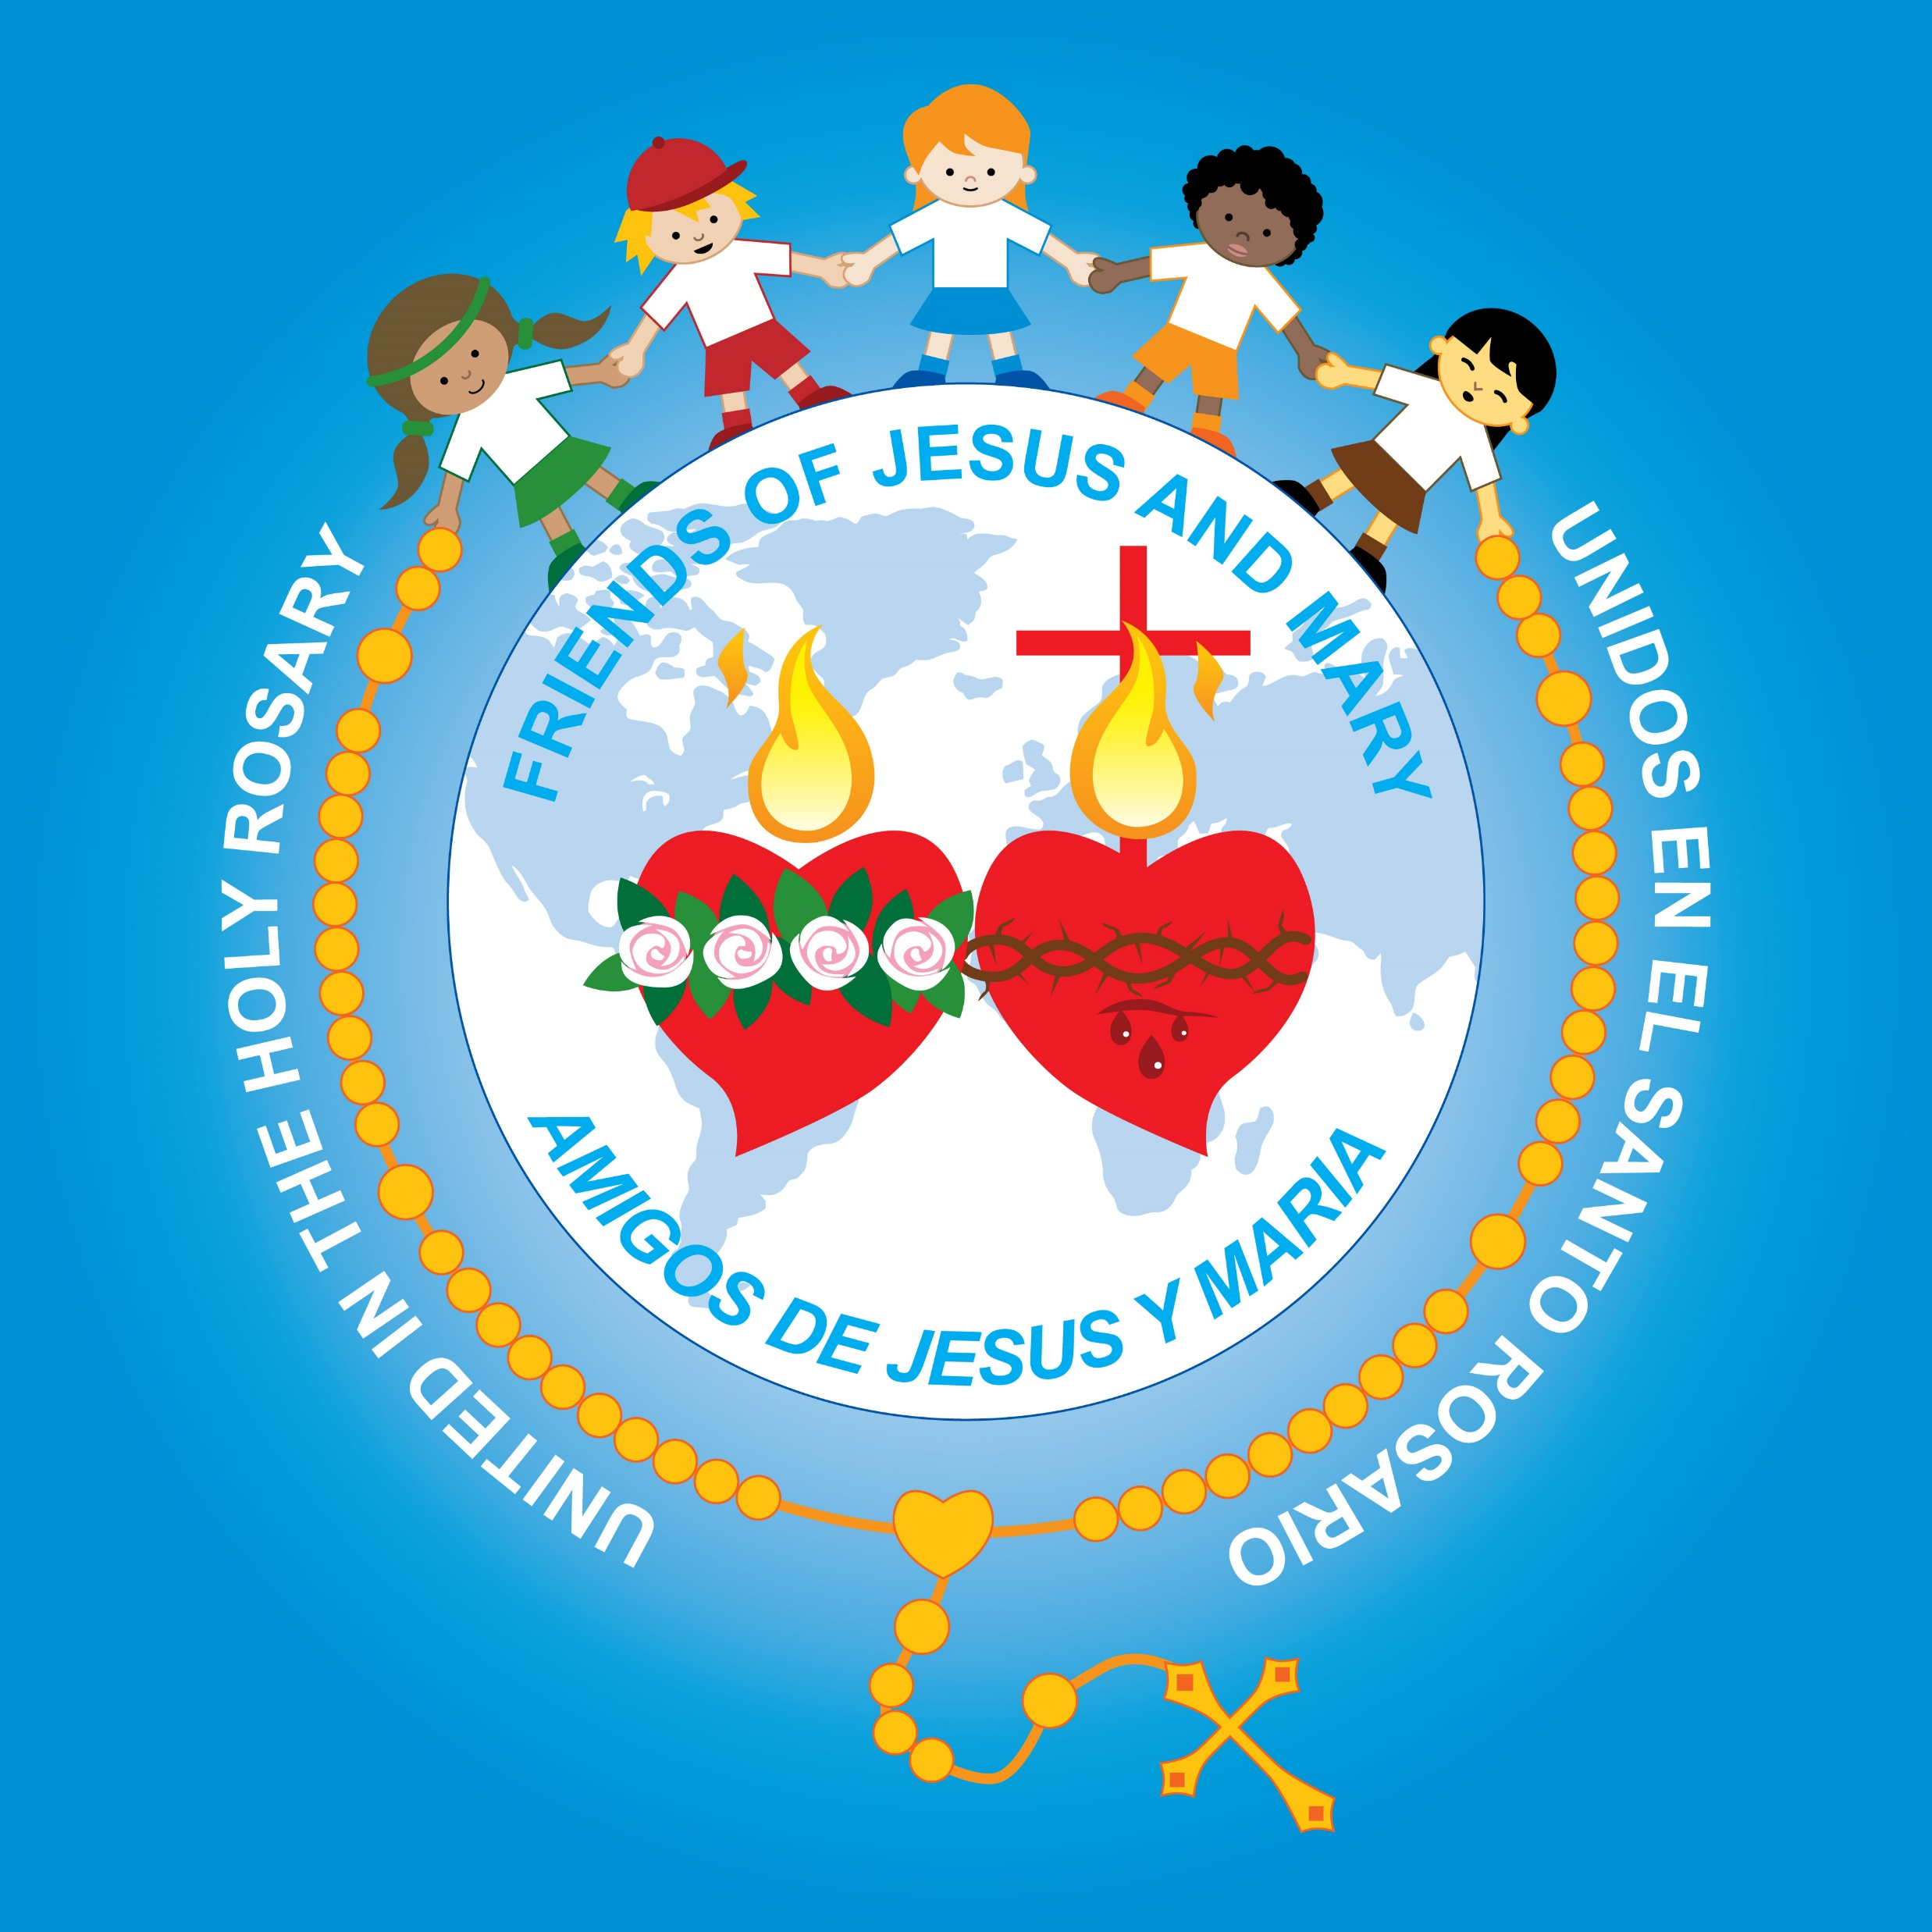
ACTIVITY

Slide 17
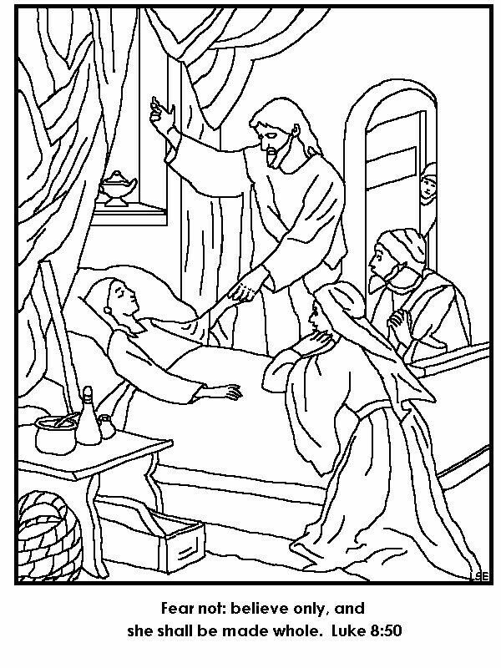
Color
Talk about how we can increase our faith: Pray often, participate in the Sacraments, read the bible, love and obey God, love our neighbor…
“Do not be afraid; just have faith.”

Slide 18
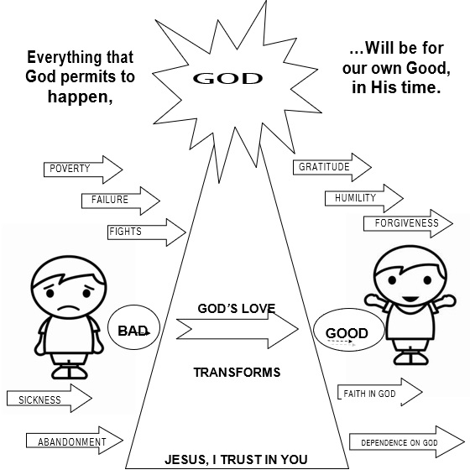
Talk about how God can change difficult events into goodness for our soul that helps us get to Heaven.

Slide 19
Instructions: Match the phrase on the left with the phrase that follows on the right.

Slide 20
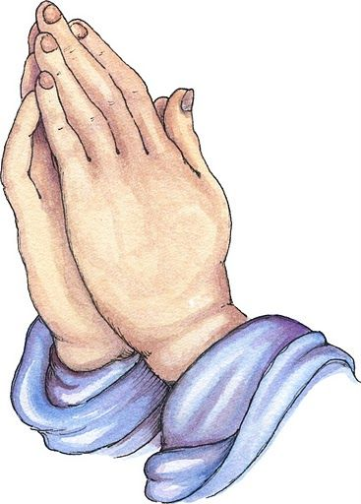
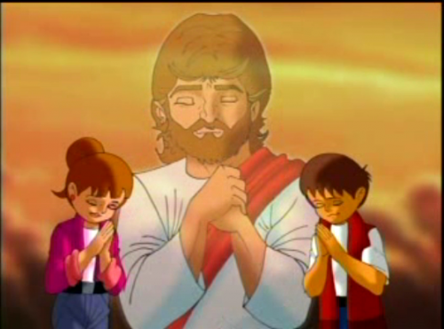
PRAYER
Lord of life, help me to recognize all the blessings you give me every day. Give me more faith and confidence in you, especially during difficult times. Jesus I trust in You. Amen.

Slide 21
Song: I Sing the Mighty Power of God, Heirs, https://youtu.be/1Zy6FYXrmiI?si=o0aCmfsmP6Bk37ga (3-7 years)

Slide 22
My God Can, Katy Nichole, https://youtu.be/zQATwkAklYw?si=3PfEqyEPIw-KVnwr (8+ years)

