Slide 1
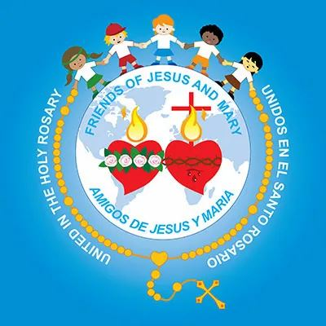
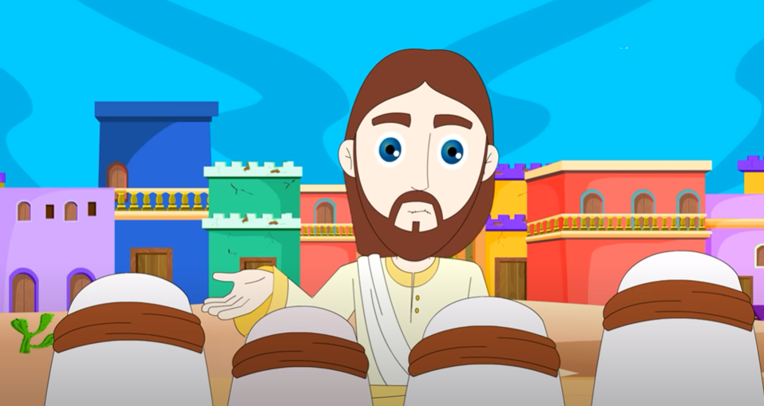
Cycle B - XIV Sunday in Ordinary Time No one is a prophet in his home. (Mk 6, 1-6)
Ministry Friends of Jesus and Mary
www.fcpeace.org

Slide 2
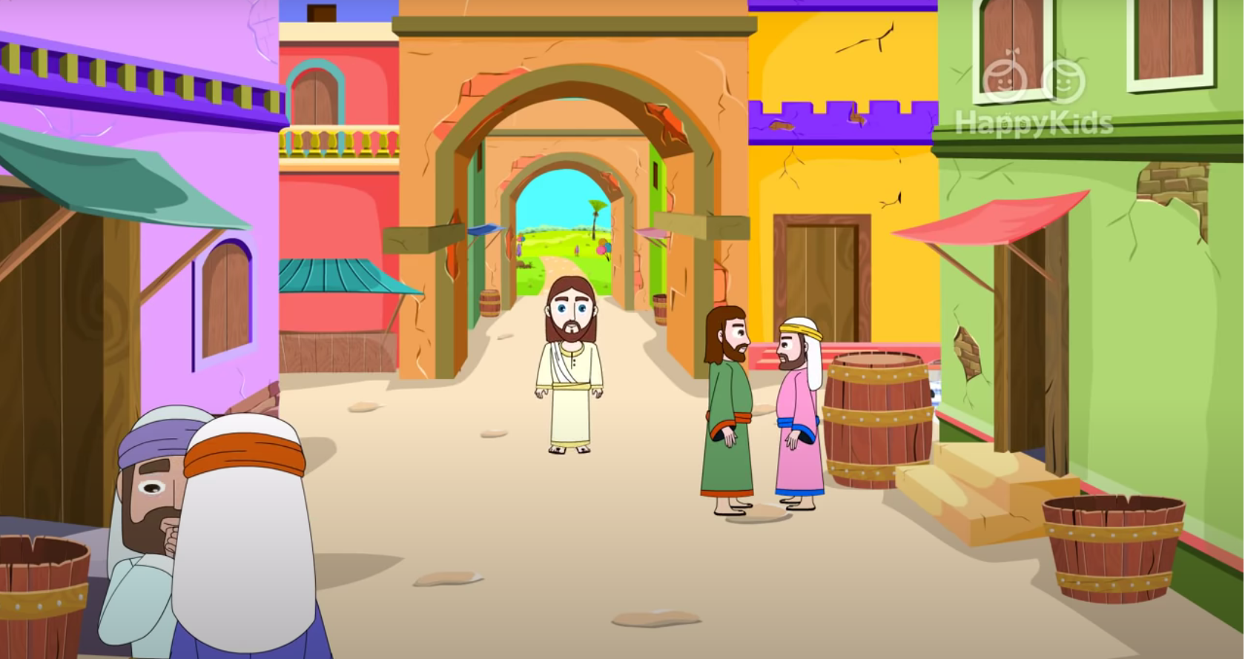
The Gospel according to Mark 6: 1-6
No one is a prophet in his own home.

Slide 3
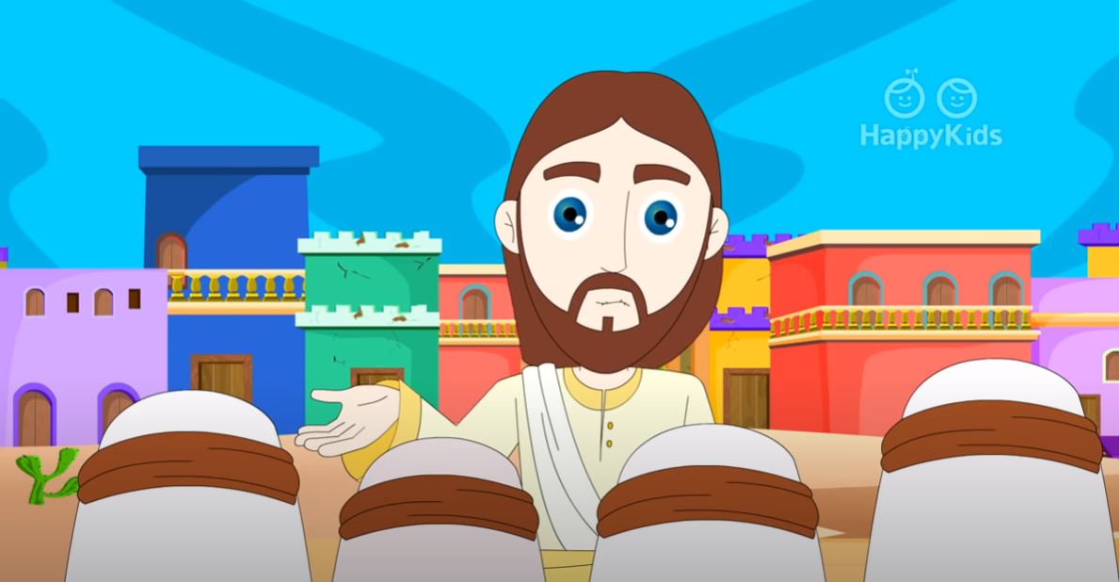
Jesus departed from there and came to his native place, accompanied by his disciples. When the sabbath came he began to teach in the synagogue…

Slide 4
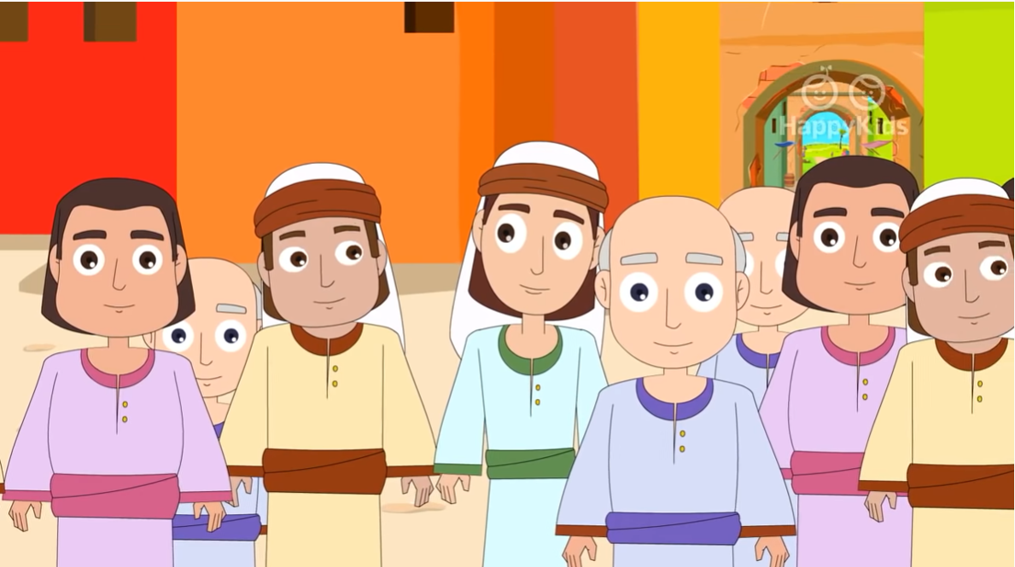
…and many who heard him were astonished. They said, “Where did this man get all this? What kind of wisdom has been given him?”

Slide 5
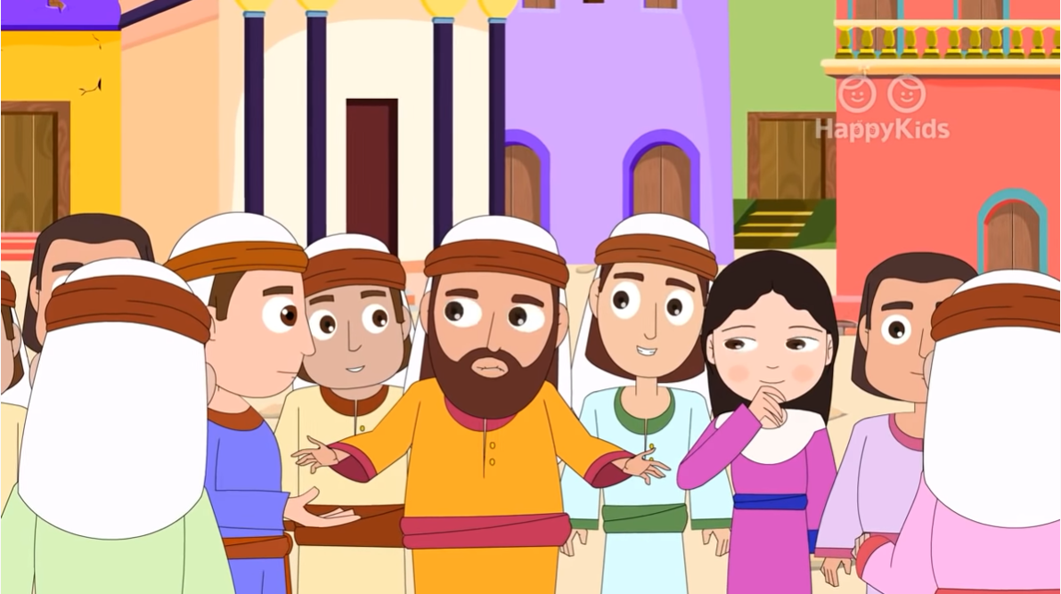
“What mighty deeds are wrought by his hands! Is he not the carpenter, the son of Mary, and the brother of James and John and Judas and Simon?”

Slide 6
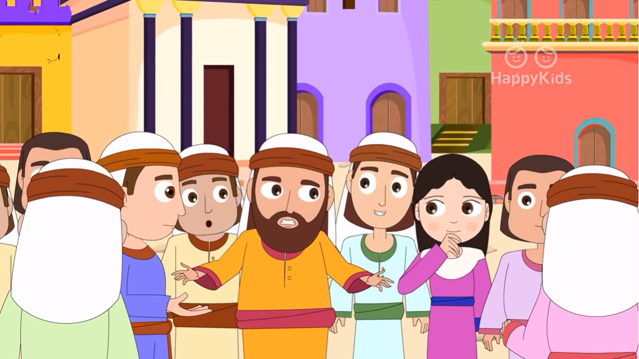
“And are not his sisters here with us?” And they took offense at him.

Slide 7
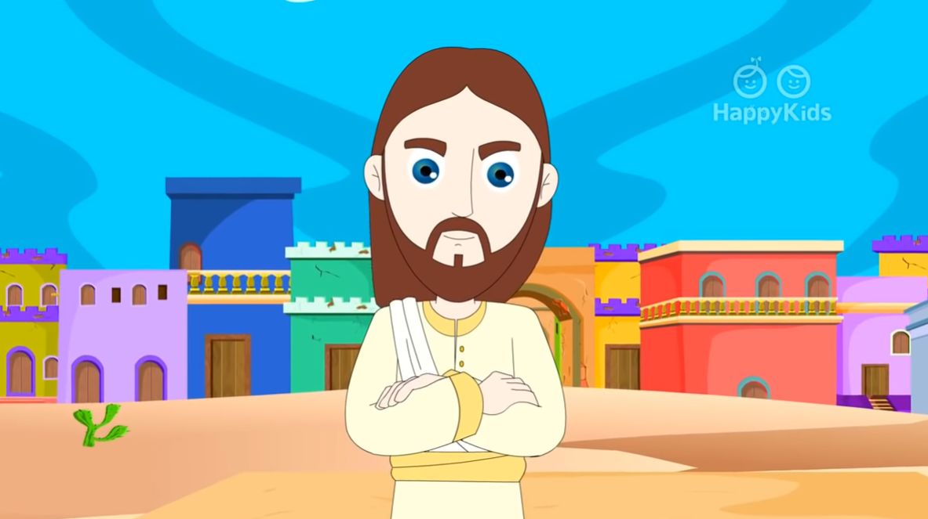
Jesus said to them, “A prophet is not without honor except in his native place and among his own kin and in his own house.”

Slide 8
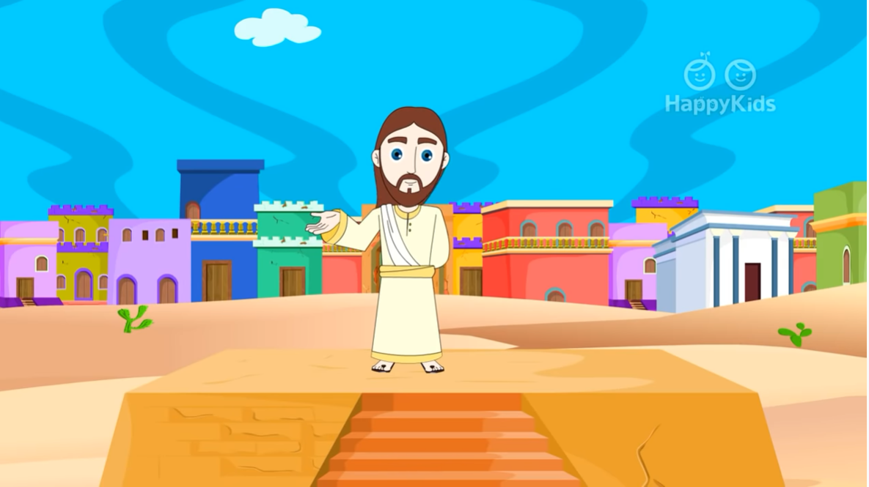
So, he was not able to perform any mighty deed there, apart from curing a few sick people by laying his hands on them. He was amazed at their lack of faith.
The Gospel of the Lord,
Praise to you Lord Jesus Christ.

Slide 9
REFLECTION

Slide 10
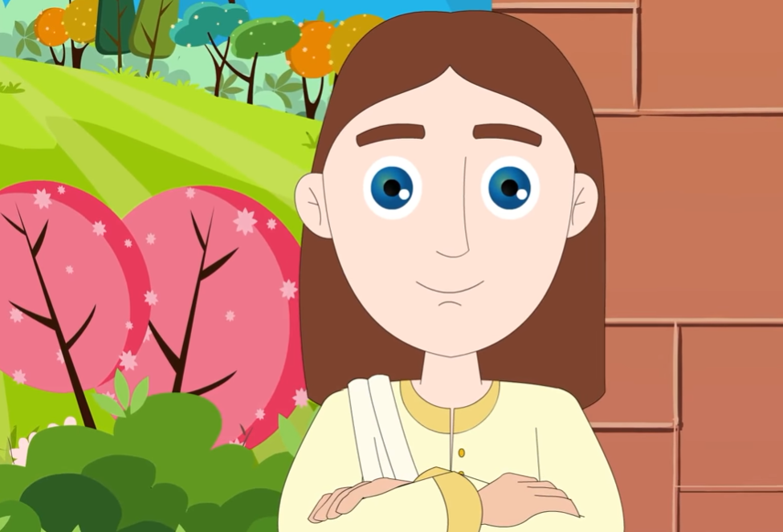
REFLECTION
Jesus went to his home town with his disciples to teach in the synagogue. Where was Jesus raised?
He was raised in Nazareth, a city in Galilee.
Why were they astonished at His wisdom and His power to do miracles?
They knew Him since He was a child as the son of Joseph, the carpenter, and Mary, a humble and loved family like their own.

Slide 11
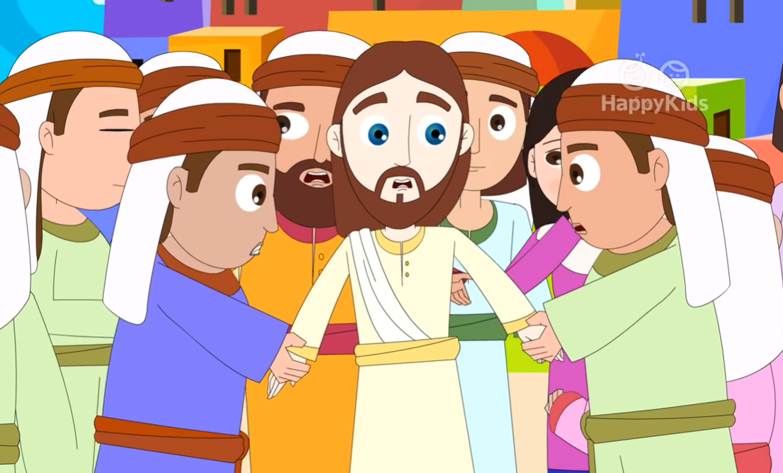
REFLECTION
Do you think that when Jesus was speaking, they were opening their hearts to what he said?
Their hearts were closed. They thought He was lying.
How do you think Jesus felt?
He was very sad. That is why He said, “A prophet is not without honor except in his native place…”.

Slide 12
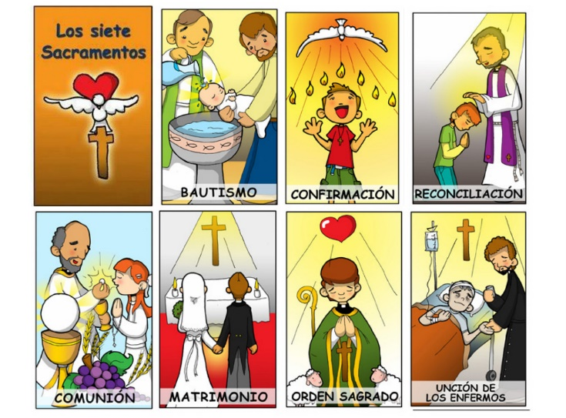
REFLECTION
What is a prophet?
A Messenger from God.
Even though we cannot hear or see Jesus like they did back then, we can feel His presence and love. Do you know how?
We receive His Grace (His Life and love) in the Sacraments.
He is in our heart and speaks to us when we pray.
He is in the beauty of Nature.

Slide 13
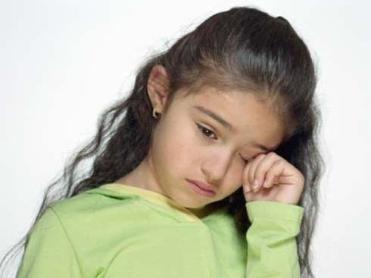
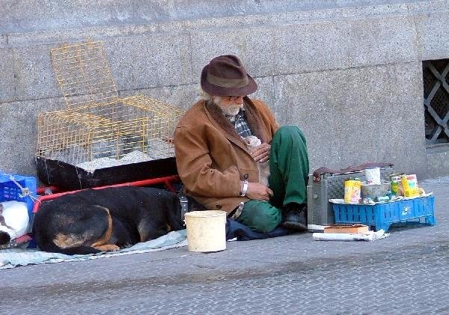
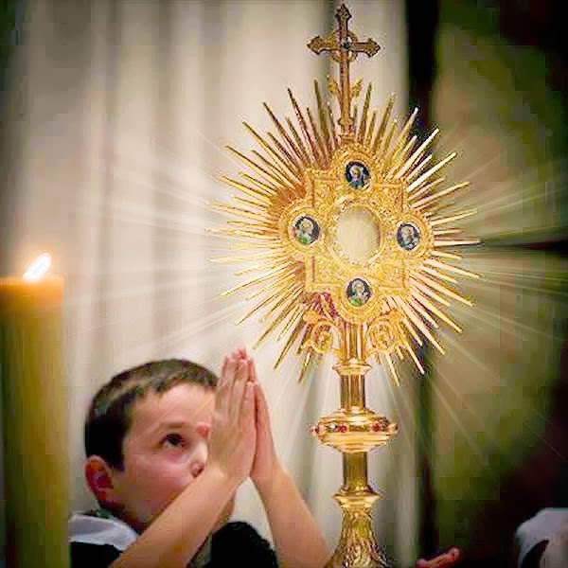
REFLECTION
Jesus is in the child at school who is sad because some make fun of him or her,
He is in the elderly man who begs in the street,
He is in the little piece of bread in the Church,
(the Eucharist).
Jesus is always close. You can see Him in the simplest things; you only have to believe that He is present and He can change your heart.

Slide 14
REFLECTION
Why was Jesus not able to perform miracles in Nazareth?
They did not believe He was God. They did not have faith in His power to do miracles and in His love.
When we open our hearts to Jesus, we grow in love and faith and then He can do miracles in our life.
Jesus only wants that you ALWAYS believe and trust Him.

Slide 15
ACTIVITY

Slide 16
INSTRUCTIONS: Match the question with the correct Sacrament.

Slide 17
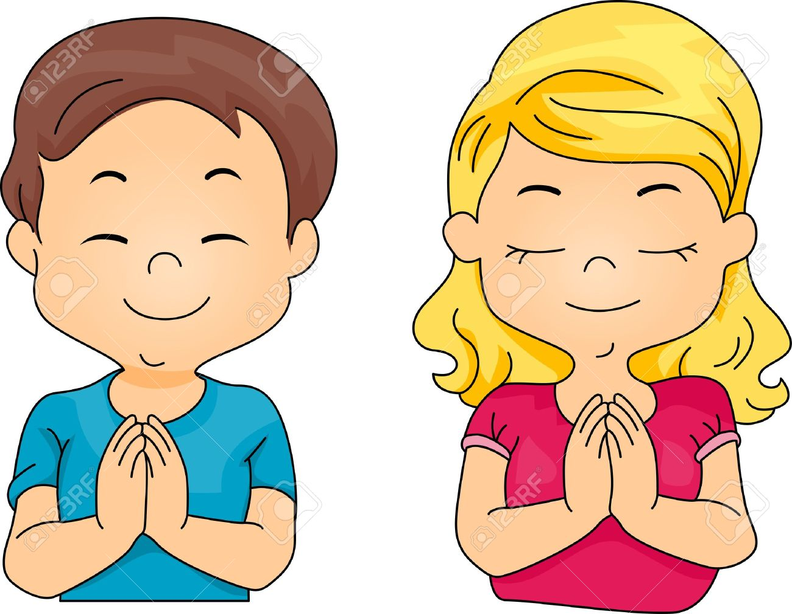
PRAYER
Lord, help to always seek you. Help me to grow in faith every day and to see the great Love you have for me in all the events of my life and in the Church’s Sacraments. Help me to trust you always. Amen

Slide 18
Song: The Seven Sacraments, Christine in Action, https://youtu.be/OCT_pZhGoaM?si=KoEy5PewJzpr5B_U (3-7 yrs.)

Slide 19
Song: Power Shuffle, https://youtu.be/r7cISC84Rls?si=t5juVq0g4TE_FnN2 (8+ yrs.)

