Slide 1
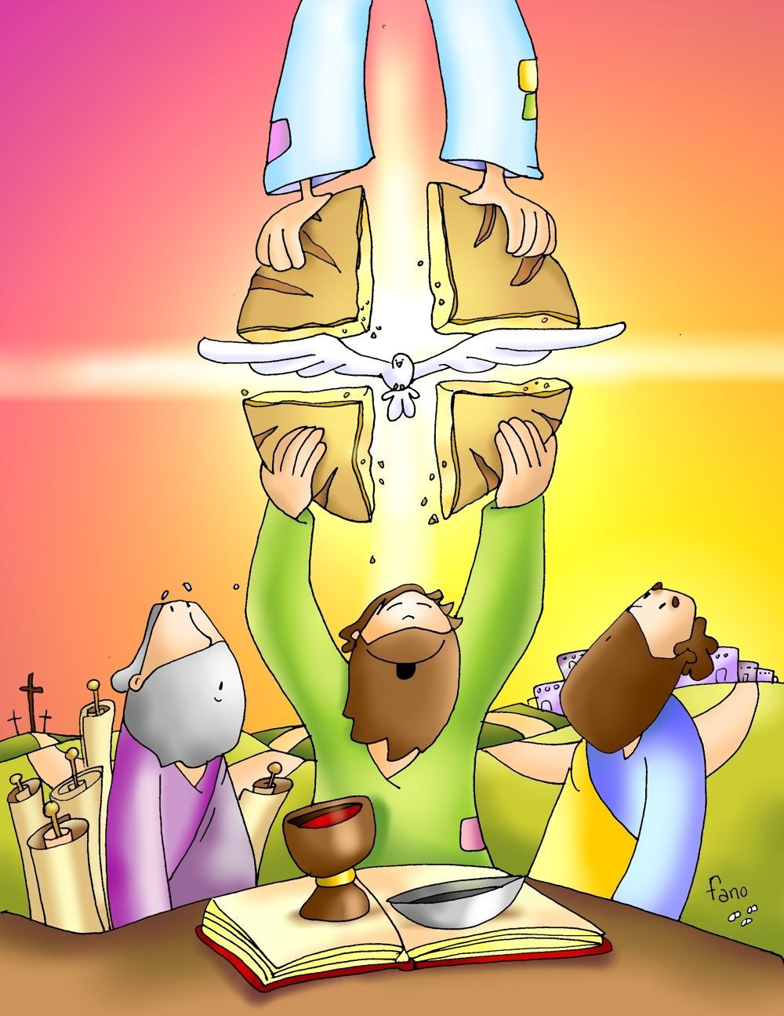
Friends of Jesus and Mary
XIX Sunday in Ordinary Time
Whoever has faith, has eternal life.
John 6:41-51

Slide 2
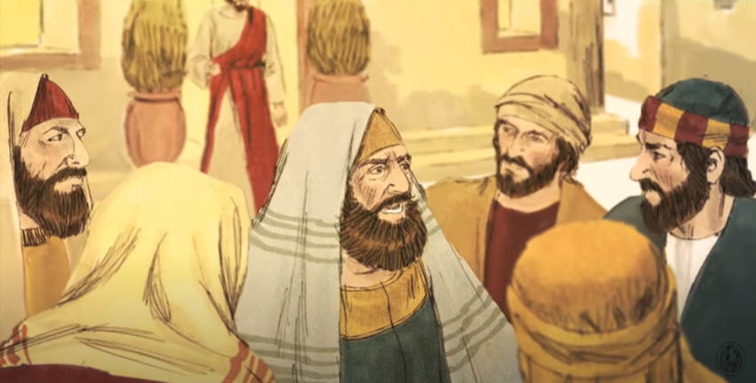
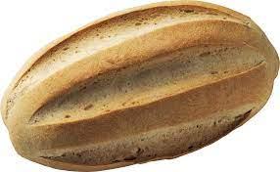
The Jews murmured about Jesus because he said,
“I am the bread that came down from heaven.”

Slide 3
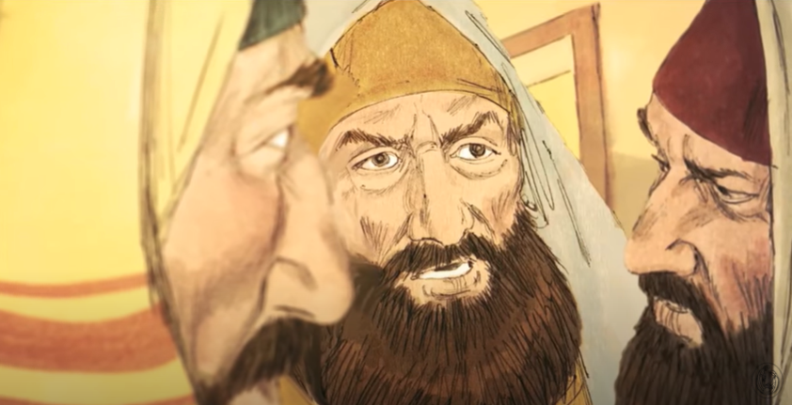
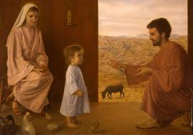
…and they said, “Is this not Jesus, the son of Joseph?
Do we not know his father and mother?
Then how can he say, ‘I have come down from heaven’?”

Slide 4
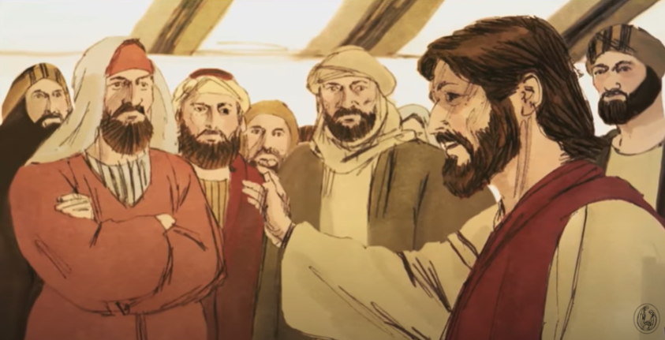
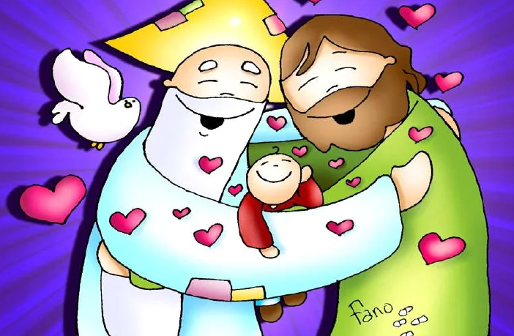
Jesus answered and said to them,
“Stop murmuring among yourselves.
No one can come to me unless the Father who sent me draw him, and I will raise him on the last day.

Slide 5
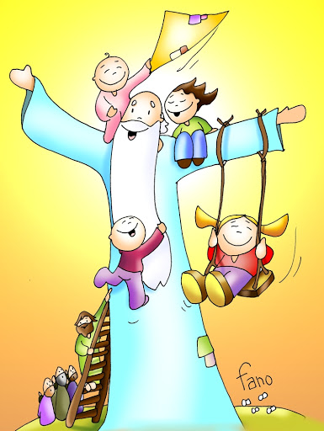
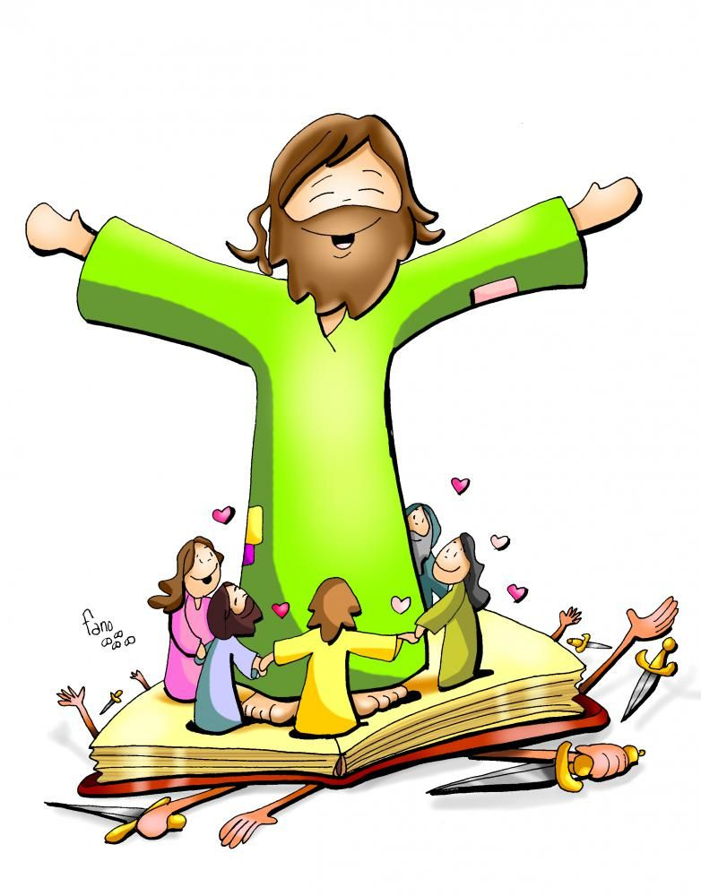
It is written in the prophets: They shall all be taught by God.
Everyone who listens to my Father and learns from him comes to me.

Slide 6
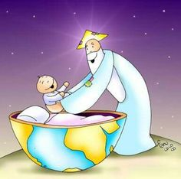
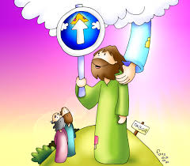
Not that anyone has seen the Father except the one who is from God; he has seen the Father.
Amen, amen, I say to you, whoever believes has eternal life.

Slide 7
I am the bread of life.

Slide 8
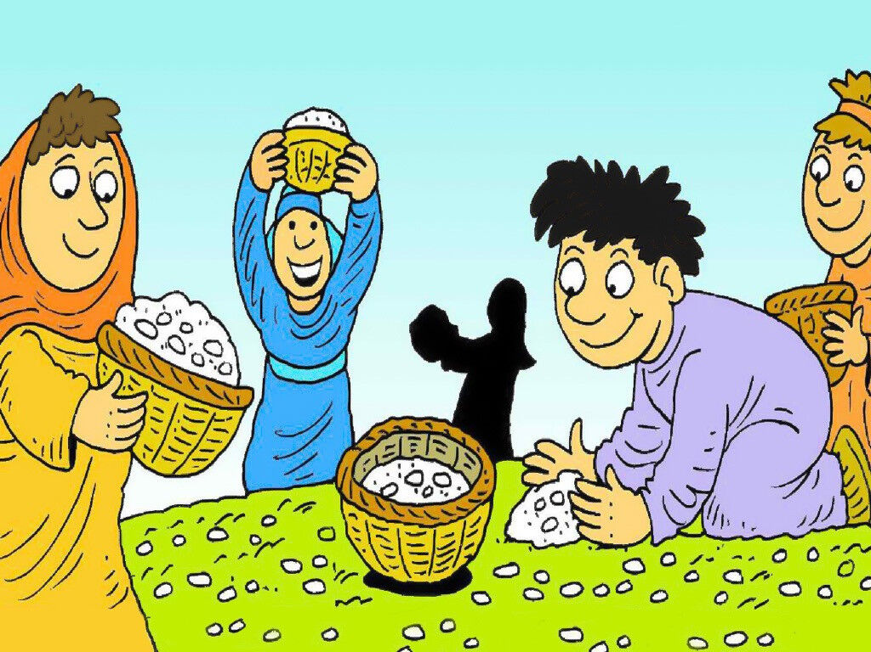
Your ancestors ate the manna in the desert, but they died;

Slide 9
…this is the bread that comes down from heaven;
so that one may eat it and not die.

Slide 10
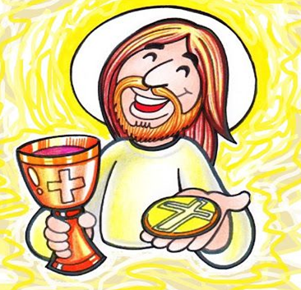
I am the living bread that came down from heaven; whoever eats this bread will live forever.

Slide 11
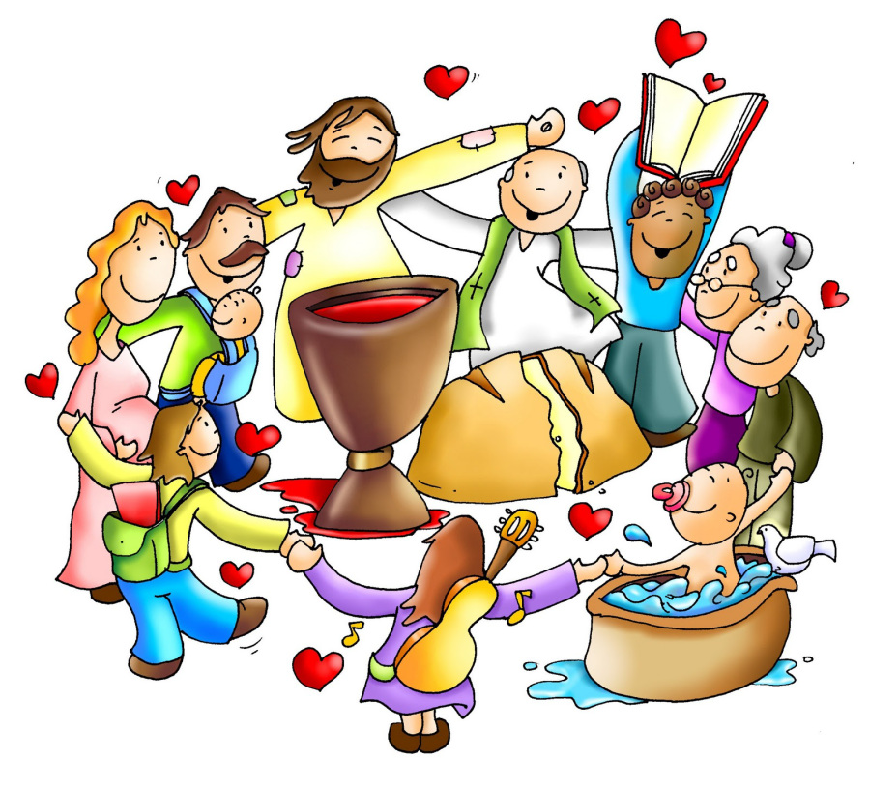
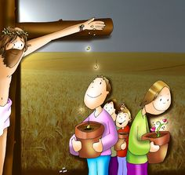
The bread is my flesh…
…that I will give for the life of the world.”
The Gospel of the Lord. PRAISE TO YOU LORD JESUS CHRIST

Slide 12
REFLECTION

Slide 13
Jesus said: “I am the bread of life came down from heaven”.
Did they believe Him?

Slide 14
No. They asked themselves, “How can this be?
We know His mother and father?”

Slide 15
Jesus responded that whoever listens to the Father and learns from Him, goes to Jesus.
What is He saying about those that don’t believe?

Slide 16
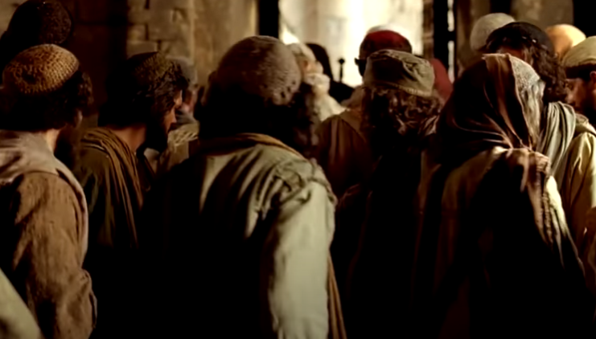
They do not listen to or learn from the Father.

Slide 17
Jesus tells them that no one has seen the Father except the One who is from God, Jesus himself.
To believe in the Father without seeing Him requires what?

Slide 19
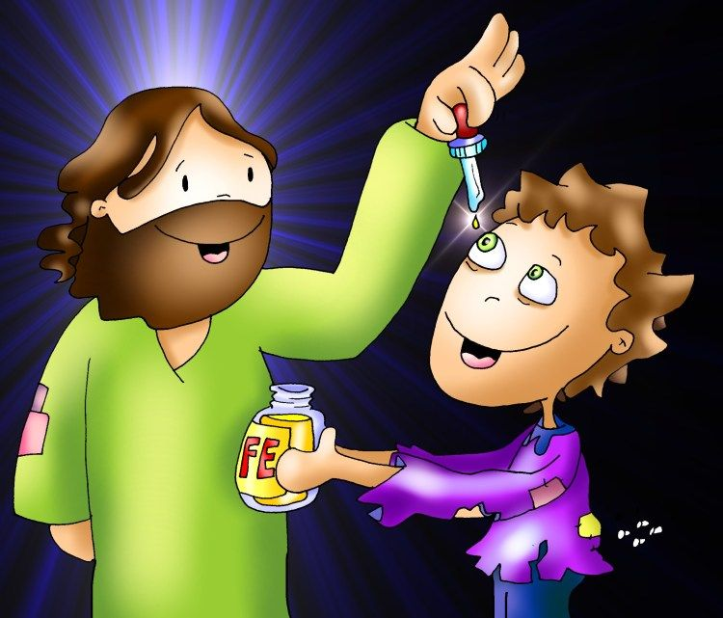
Faith is believing without seeing.
They did not have faith.

Slide 20
Jesus tells them that whoever has faith, has what?
ETERNAL LIFE

Slide 21
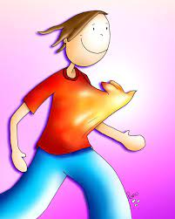
Jesus continues: I am the bread of life.
What life does Jesus give?
God’s life in our heart that helps us get to heaven.

Slide 22
Jesus says: “The bread that I give is my own body.”
What do we call the bread of life, the body of Jesus that we eat during mass?
THE EUCHARIST

Slide 23
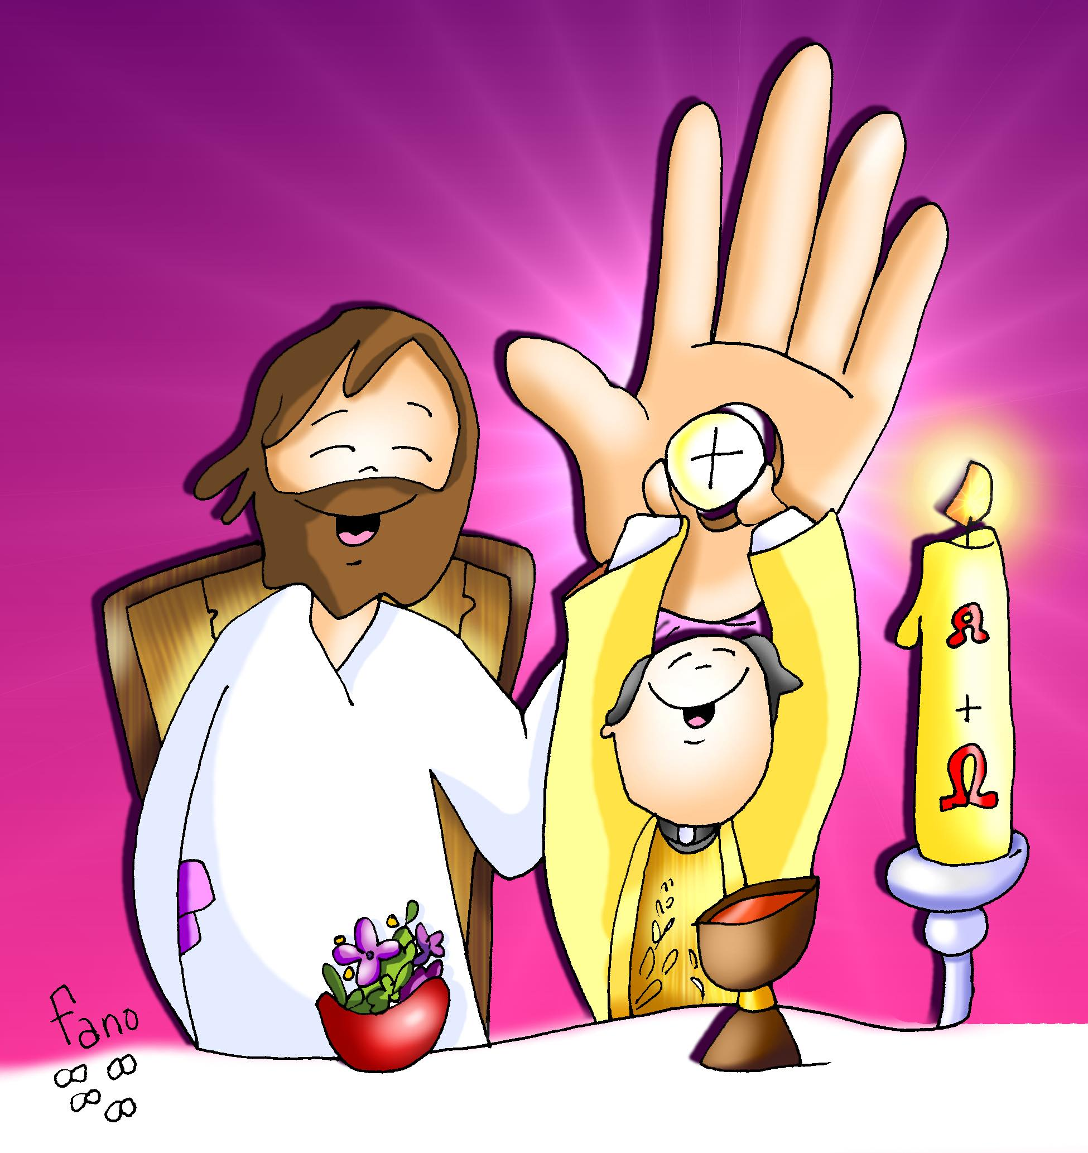
The Eucharist is the bread and wine that Jesus, through the priest, changes to His Body and Blood.
Jesus wants to be united with us to give us His life (Grace).
IT IS A MIRACLE!

Slide 24
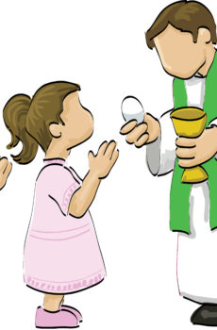
We need faith to believe Jesus is present in the Eucharist.
He wants to feed our spirit with faith, hope, love, peace, joy…to help us on our journey to eternal life.

Slide 25
ACTIVITIES

Slide 26
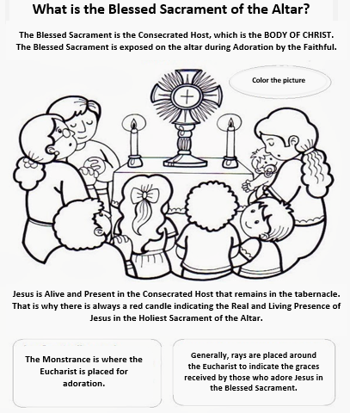
Jesus feeds our spirit when we eat the bread of life during Communion in the Mass;
or when we adore Him in the Blessed Sacrament.

Slide 27
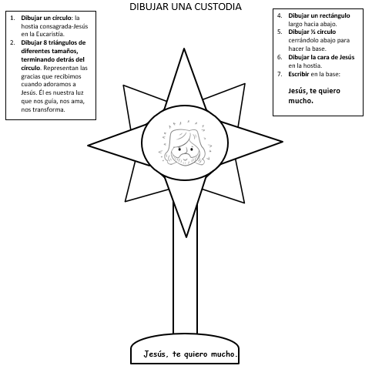
DRAW A MONSTRANCE
Draw a rectangle: long reaching down to the base.
Draw ½ a circle closing it at the bottom with a line: represents the base.
Draw the face of Jesus in the Host.
Write on the base:
Jesus, I love you.
Draw a circle: the consecrated host-Jesus in the Eucharist.
Draw 8 triangles of different sizes with the base behind the circle: They represent the graces we receive when we adore Jesus. He is or light that guides us, loves us, transforms us.
Jesus, I love you.

Slide 28
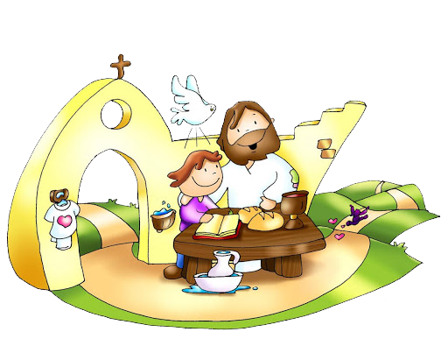
PRAYER
Jesus, give me faith to always believe and listen to you. You are my God that gave His life to stay with me in this little piece of bread, helping me on my journey to eternal life. Thank you for loving me and caring for me. I love you very much. Amen.

Slide 29
John 3:16 Eternal Life, Seeds Family Worship, https://youtu.be/nTc8Lv6SdJg

