Slide 1
Ministry Friends of Jesus and Mary
Mark 6: 7-13
Jesus Sends Them in Twos.
Cycle B - XV Sunday in Ordinary Time
www.fcpeace.org

Slide 2
Jesus Sends Them in Twos.

Slide 3
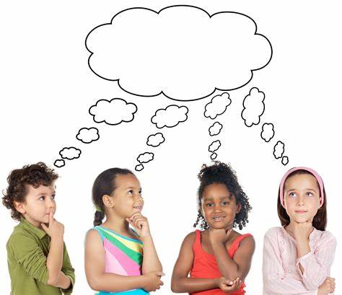
Reflection

Slide 4
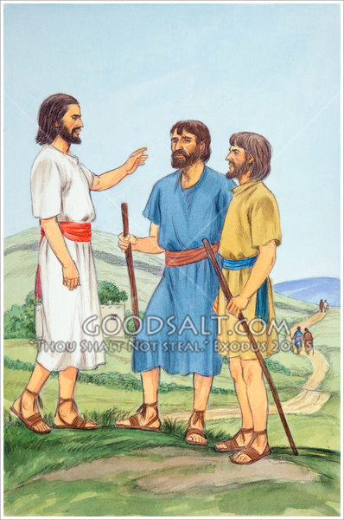
Jesus sent His disciples out to preach in pairs. What was their mission?
He sent them to tell everyone what Jesus said and did for us.

Slide 5
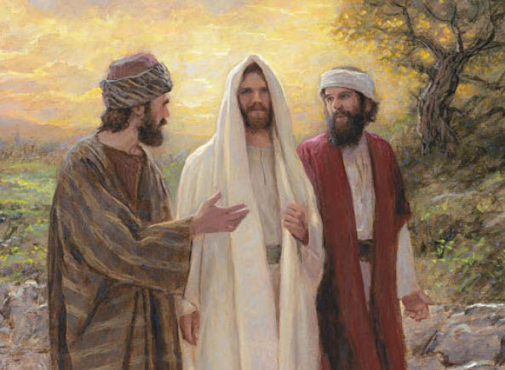
Why did He send them in twos?
People believe two people more than just one.
During that time, all testimonies in judgements required two people.

Slide 6
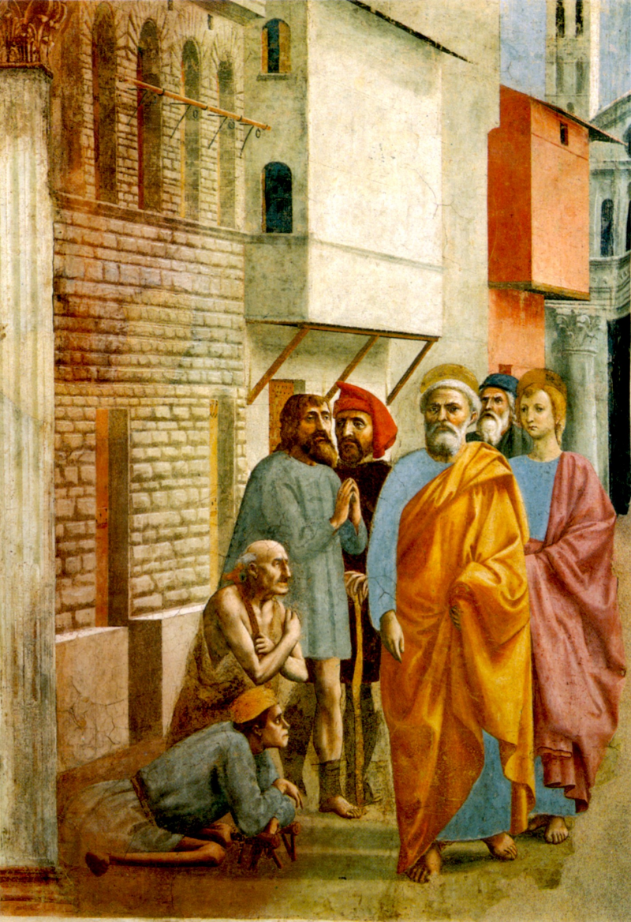
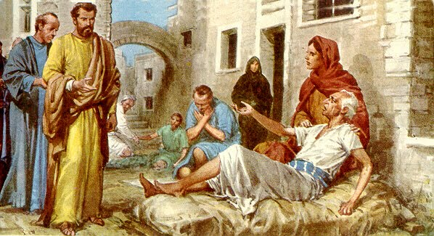
Why did Jesus give them authority over evil spirits and the power to cure the sick?
When people see these miracles, they know what the apostle’s say is true and is from God. Also, Jesus wanted the apostles to continue His work of healing…

Slide 7
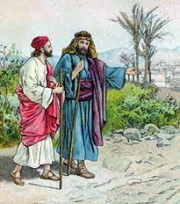
Why did Jesus order them to take only their clothes and sandals?
Jesus wants them to be completely focused on their mission and to trust that He Will provide for them through the community.

Slide 8
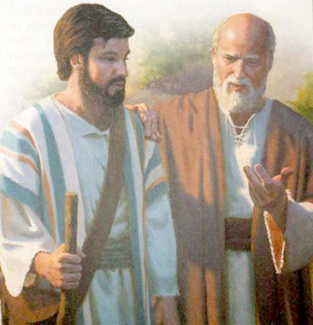
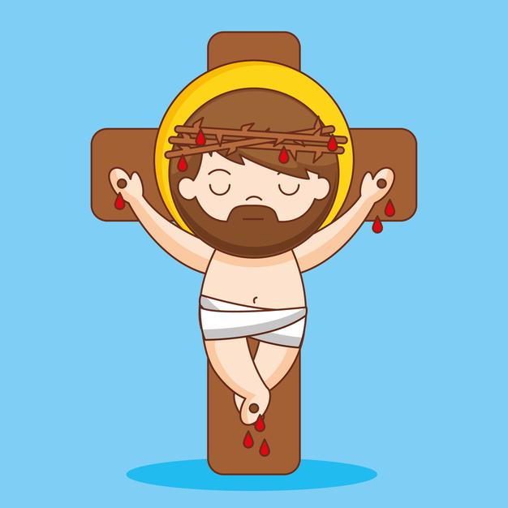
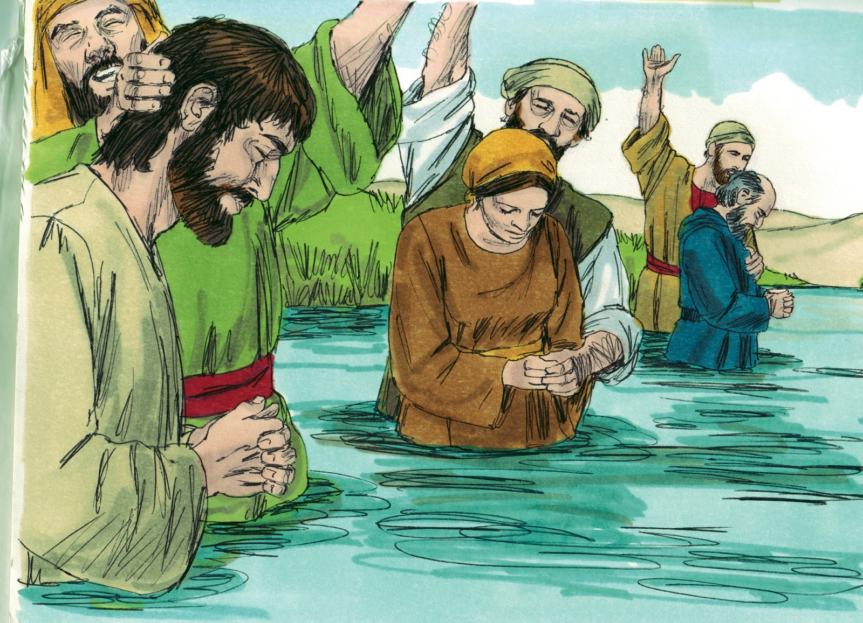
What did the disciples preach?
Repent, be baptized, believe in the Gospel and be saved;
God loved us so much that He sent His son, Jesus to die for us on the cross. He resurrected on the third day, then ascended to Heaven and opened the gates of Heaven for us.

Slide 9
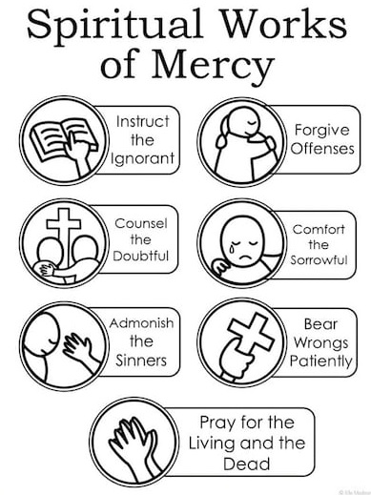
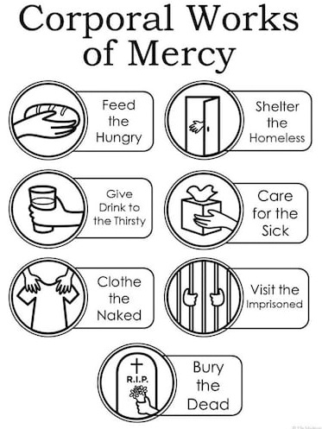
How can we help in this mission?
We can show them Jesus’ love with our lives by practicing the Works of Mercy.

Slide 10
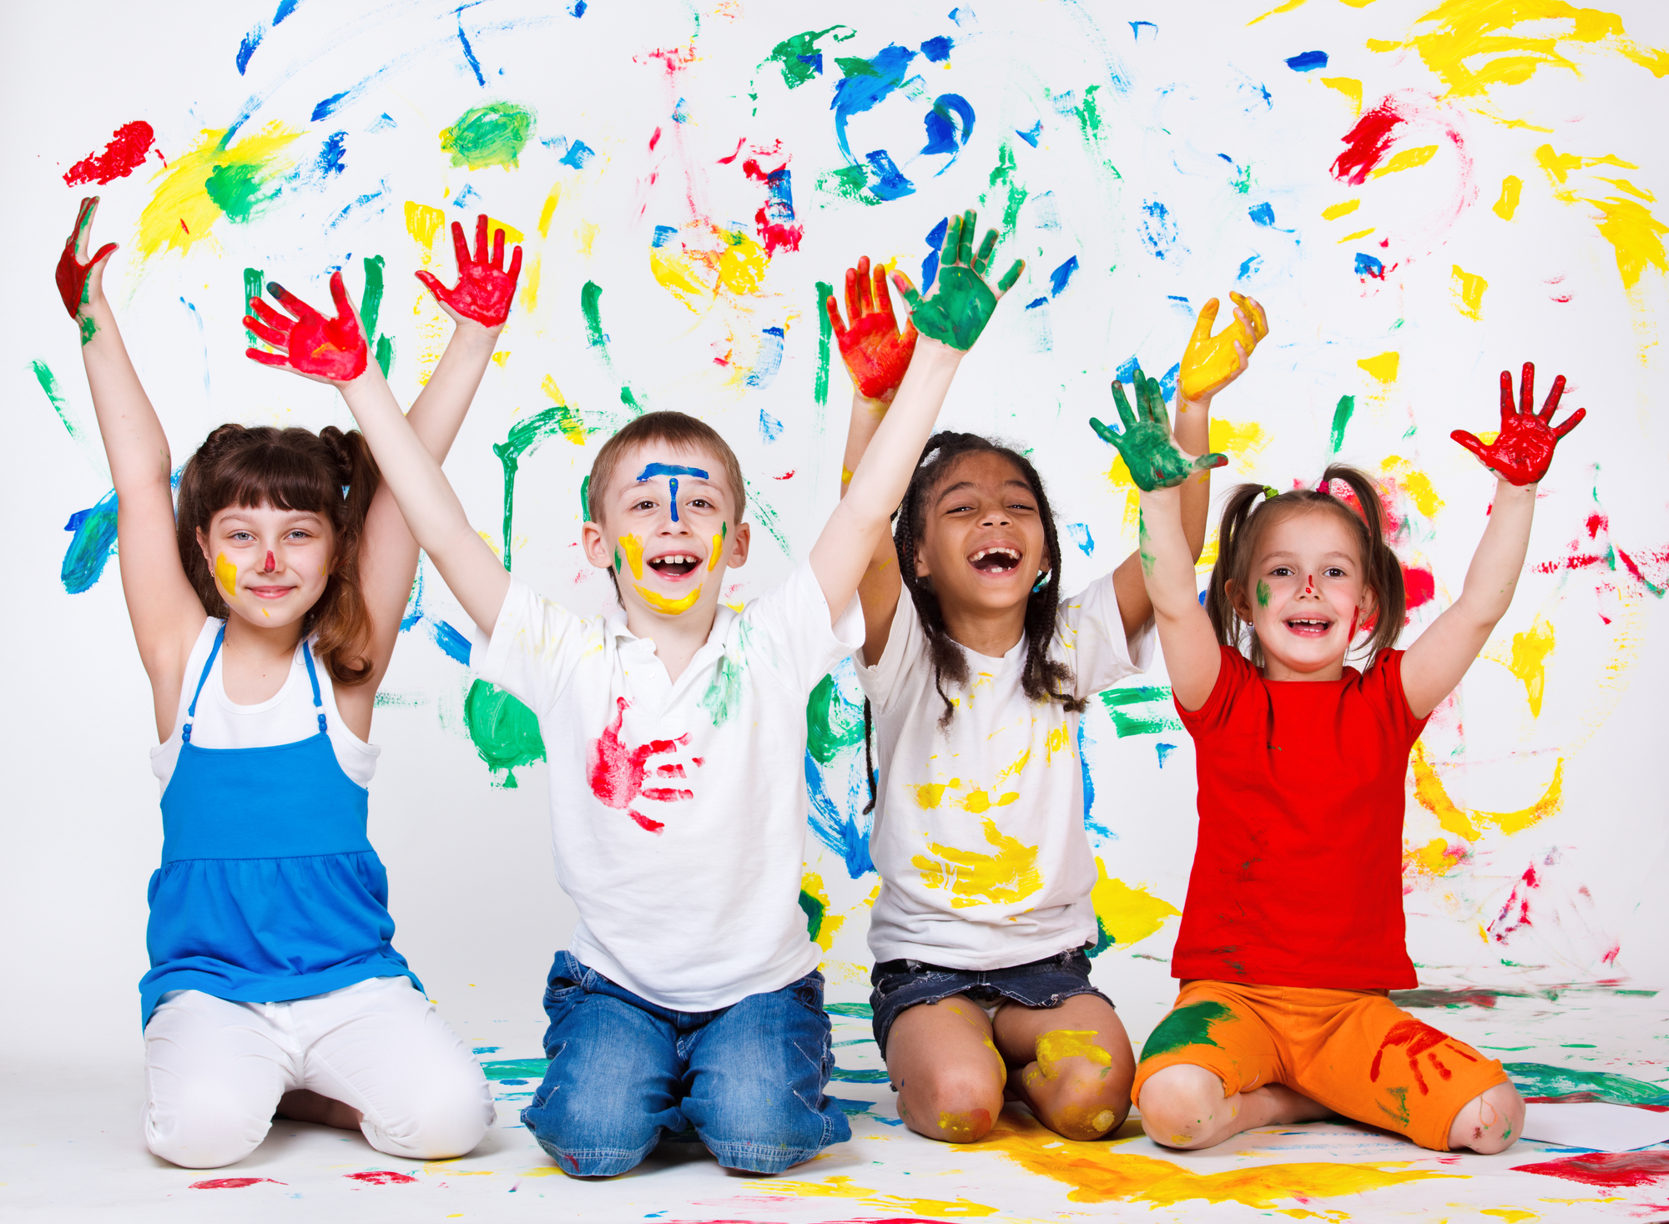
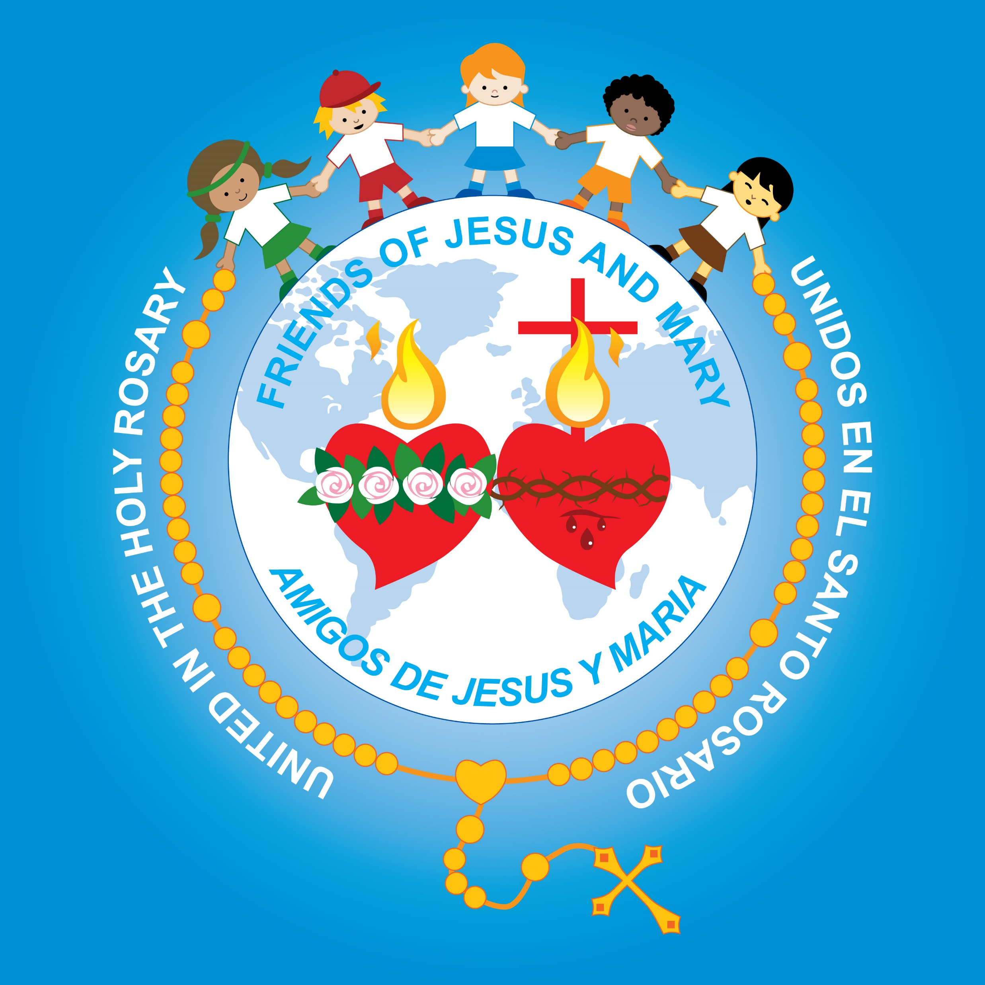
ACTIVITY

Slide 11
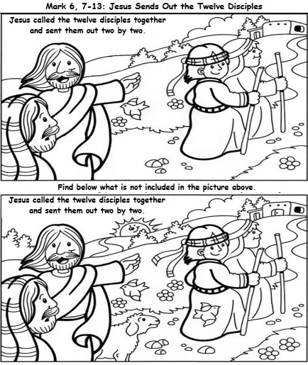
Find 10 ítems in the 2nd picture that is not in the 1st picture.

Slide 12
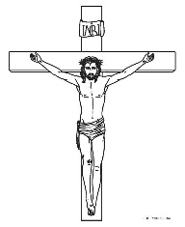
How else can we help in spreading the Gospel?
Telling others about Jesus’ great love. Try with a wordless book.
The Story
of
God’s Love
for Us
Adam & Eve disobeyed God and brought Original Sin into the world. This separated us from God.
God loved us so much He sent His Son to die to pay for our sins so we could unite with Him again. He resurrected, victorious over death.
Through Baptism we are cleansed of Original Sin and receive the Holy Spirit. We become part of God’s family.
Our souls are purified through Jesus’ sacrifice. Jesus gave us the Sacrament of Reconciliation where God forgives our other sins.
Jesus opened the gates of Heaven for us so we may live with God forever.
We grow in God’s love by praying, sharing His life in the Sacraments, reading scripture, loving, obeying…

Slide 13
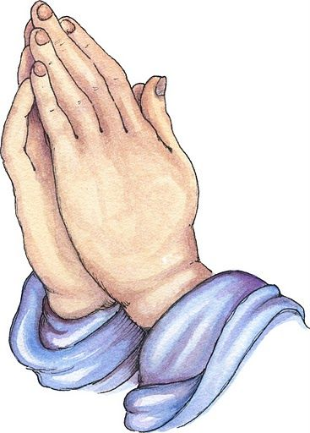
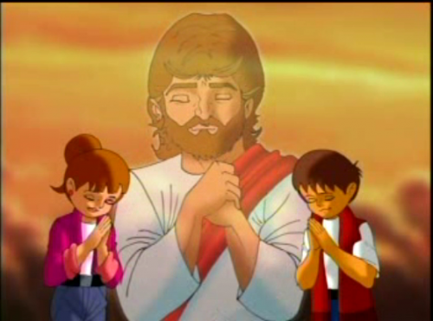
Prayer
Lord, make me a witness of your message of love. Help me to love as you love so I may lead more souls to you.
Amen.

Slide 14
I’m in the Lord’s Army, Heritage Kids (Ctrl Click) https://youtu.be/9FqmiGwTqh4 (3-7 yrs. old)

Slide 15
I will Follow You, Roy Rantung (Ctrl Click) https://youtu.be/jpVuBcbZ24c (8+ yrs. old)

