Slide 1
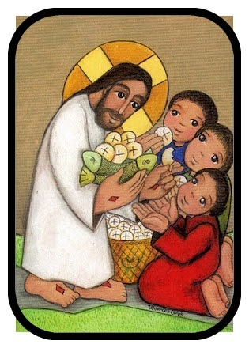
Ministry Friends of Jesus and Mary
Cycle B - XVII Sunday in Ordinary Tinme
John 6, 1-15
Jesus feeds the crowd
www.fcpeace.org

Slide 2
Jesus feeds the crowd

Slide 3
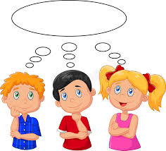
REFLECTION

Slide 4
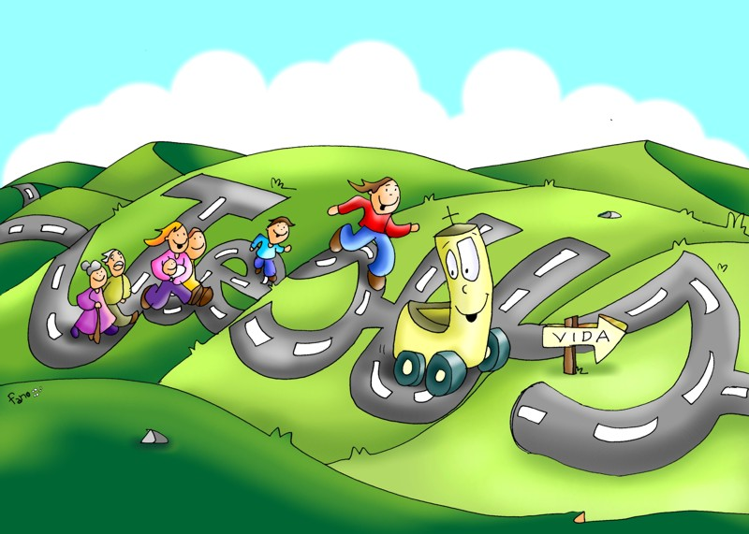
Why were the people following Jesus?
They had seen or heard about His healing miracles and wanted to hear His words that filled their hearts with love.

Slide 5
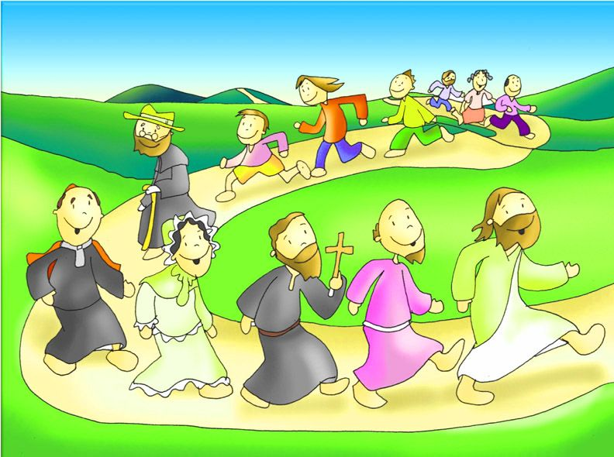
Why does Jesus want us to follow Him?
He wants us to love Him with all our hearts.

Slide 6
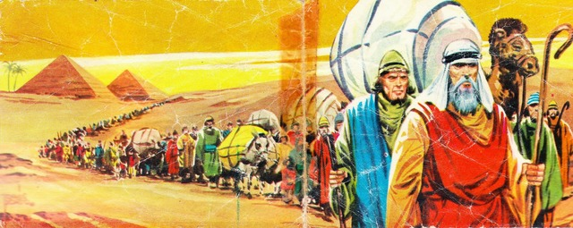
What Jewish feast day was near?
The Passover Festival, when God liberated His people from slavery in Egypt.

Slide 7
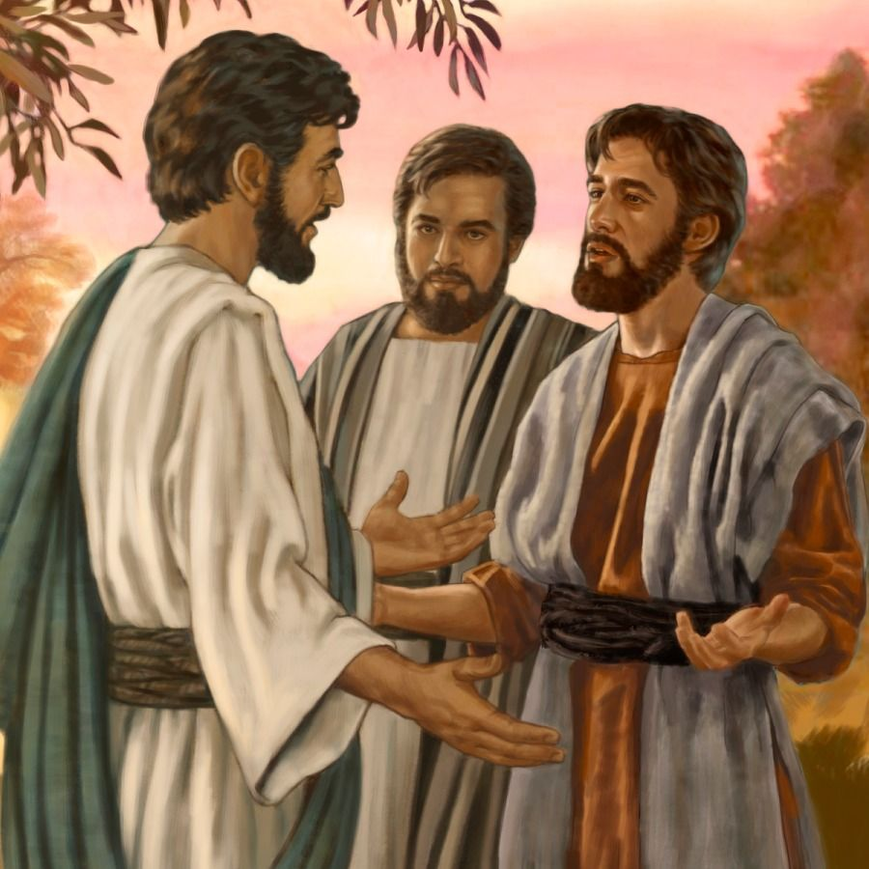
At dinner time, what did Jesus ask Phillip?
Where can we buy enough food to feed all these people?

Slide 8
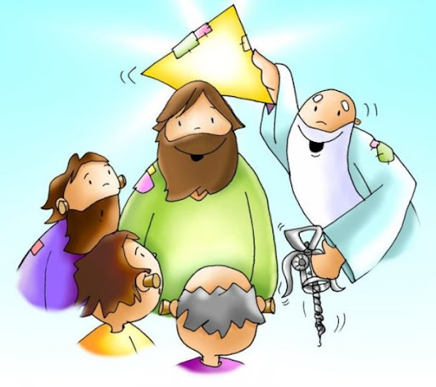
Why did He ask this?
Jesus was testing his faith in His power as Almighty God.

Slide 9
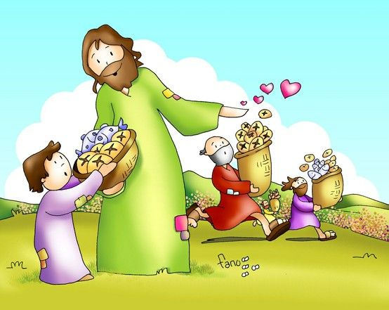
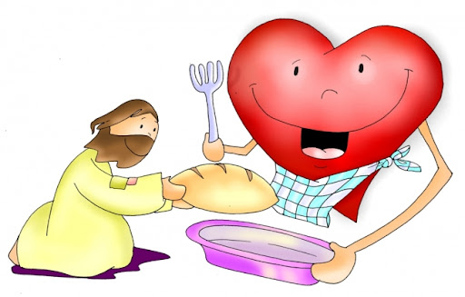
Another disciple, Andrew, tells Jesus there is a boy with 5 loaves and 2 fish. Do you think Jesus could feed the people without this donation?
Yes, Jesus is God and can do anything.

Slide 10
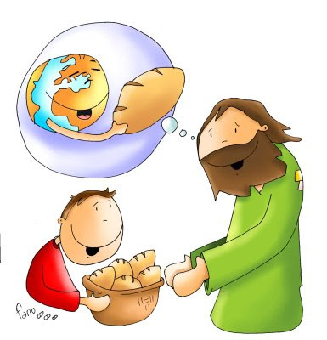
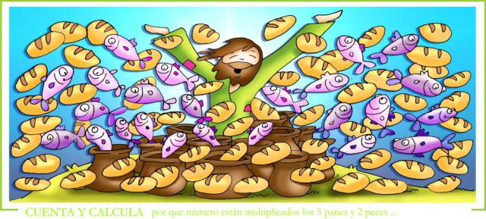
Why does He take the fish and loaves?
Jesus wants us to be generous with our gifts. When we share what we have and are, Jesus multiplies it for the good of all.

Slide 11
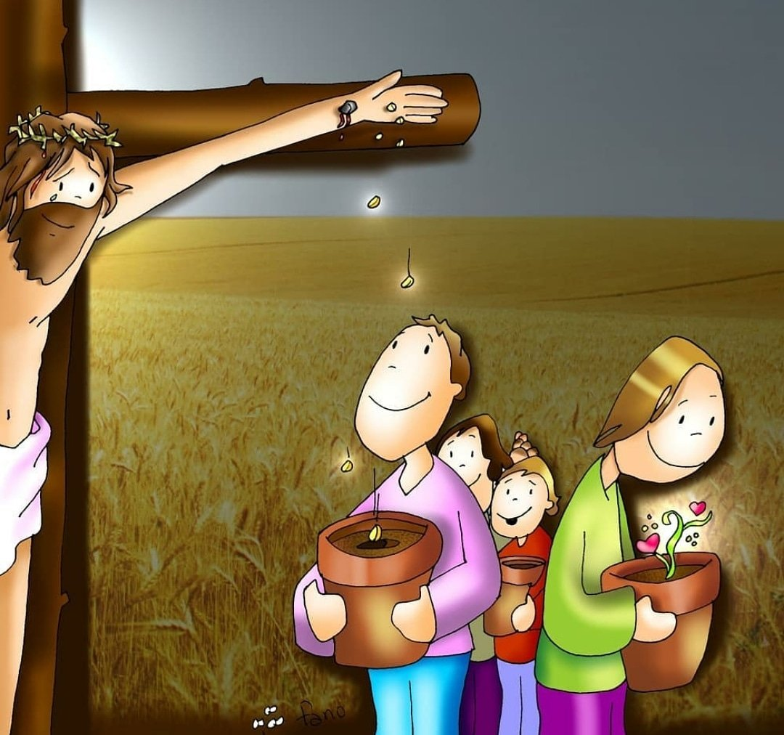
What did Jesus give for our good ?
His life for the forgiveness of our sins.

Slide 12
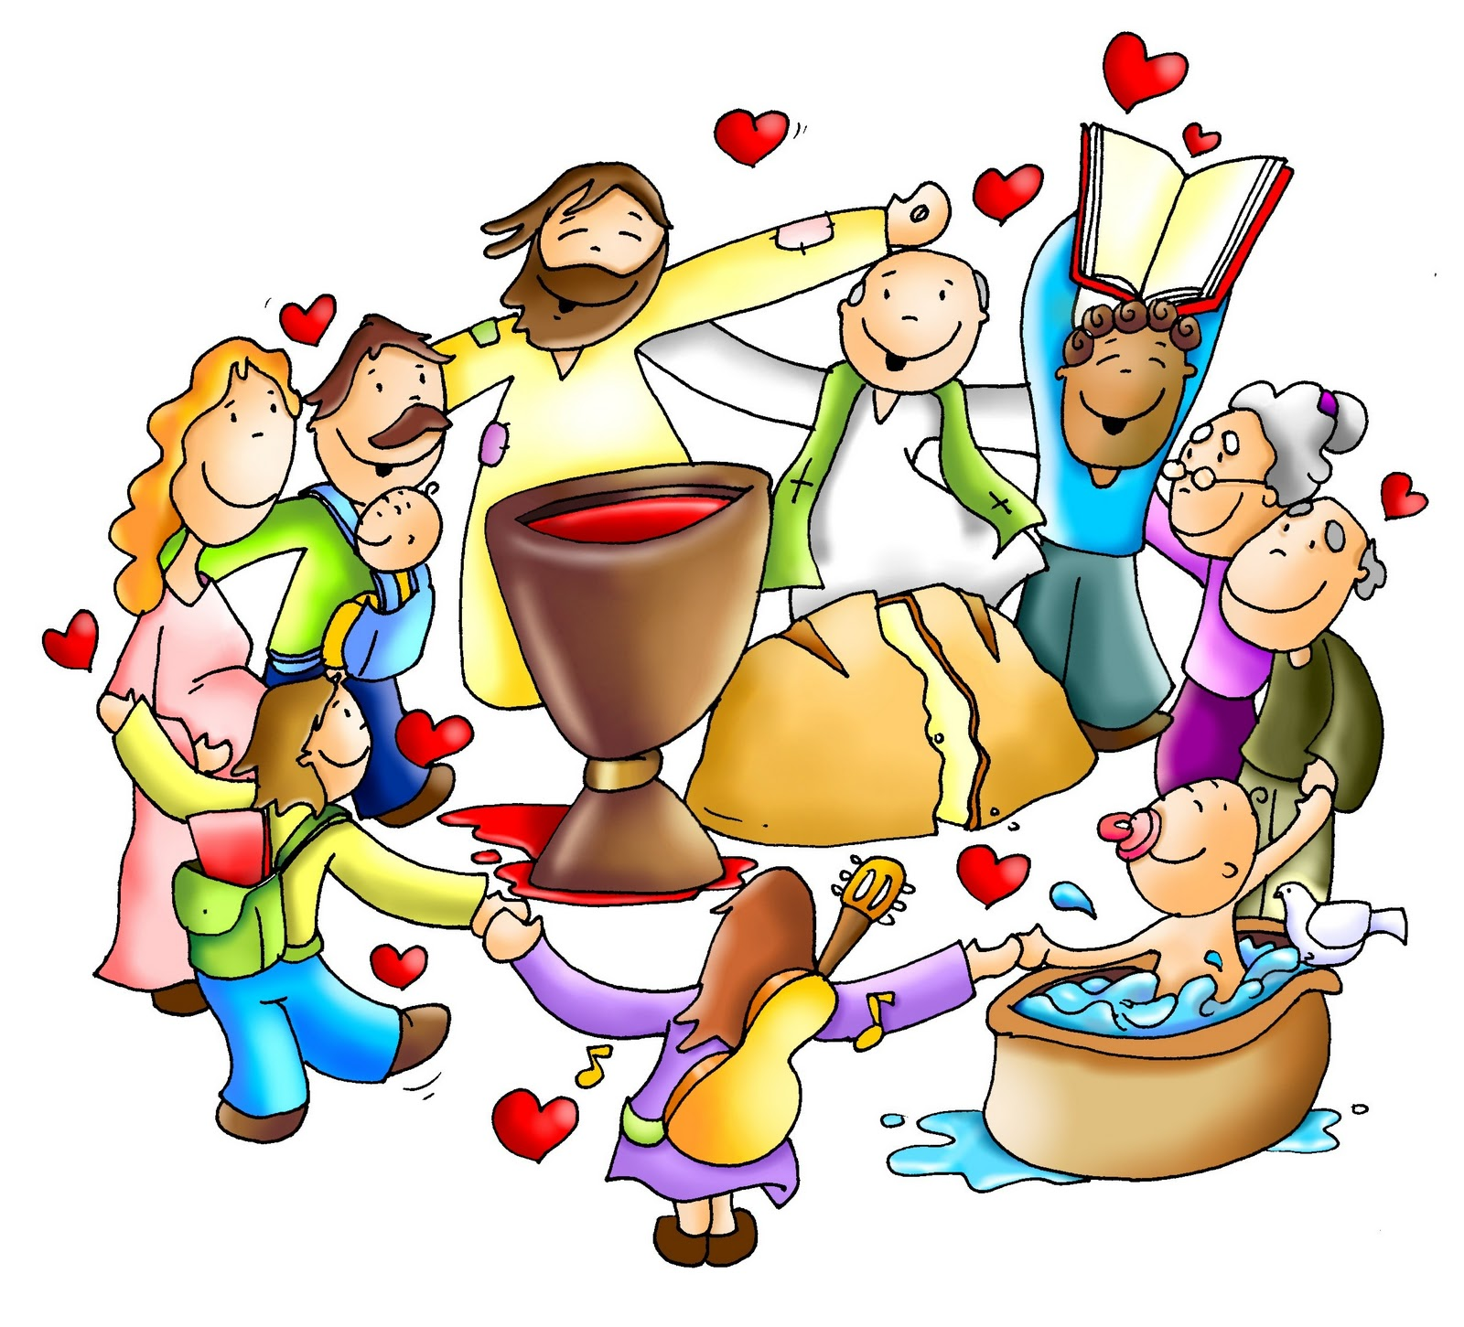
What did He leave with us to help us?
And His Grace in the 7 Sacraments of the Catholic Church.
His presence in the Eucharist: the consecrated bread and wine that is multiplied during every Mass,

Slide 13
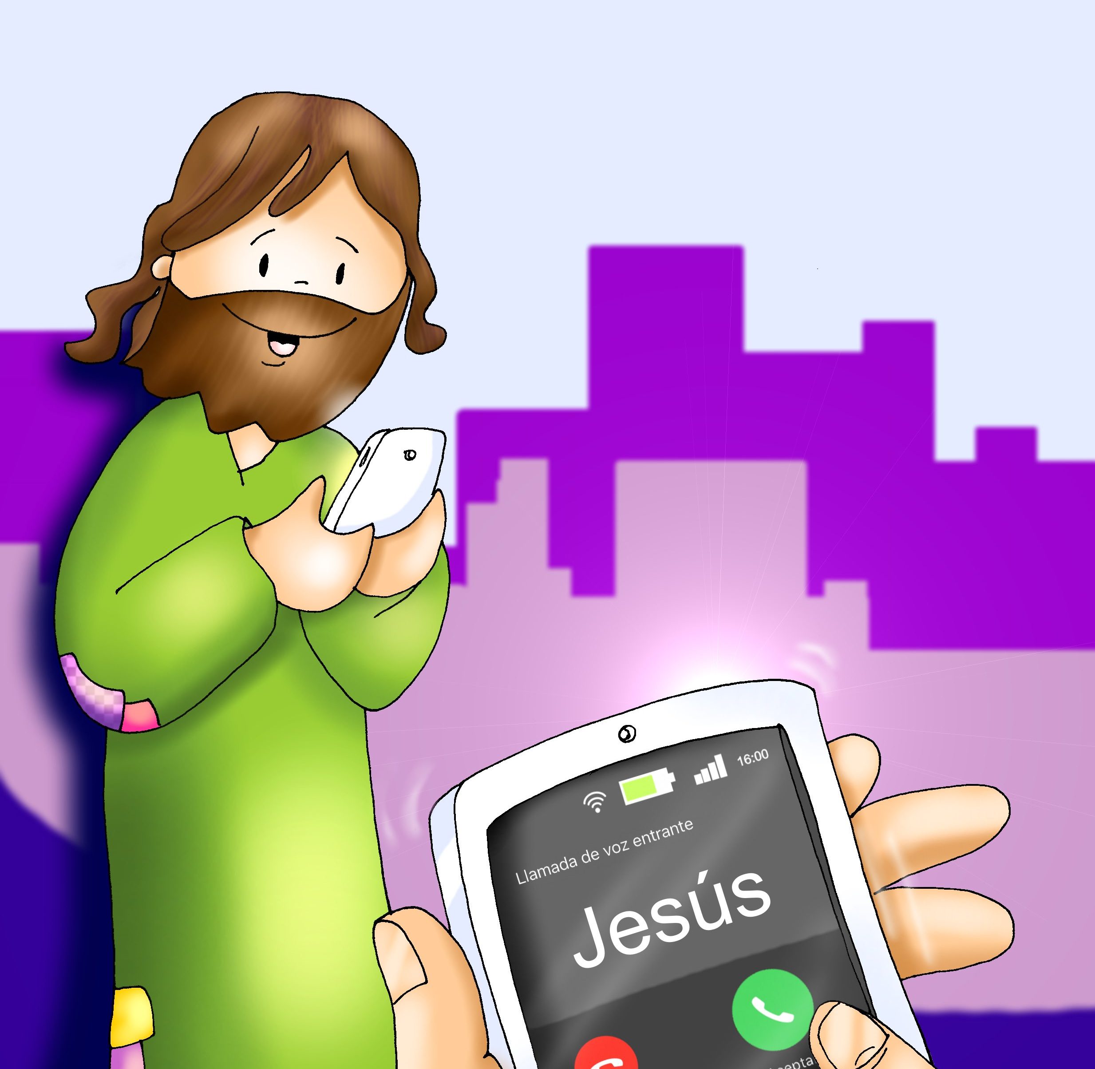
What can you donate to Jesus so He can multiply it for the good of many?

Slide 15
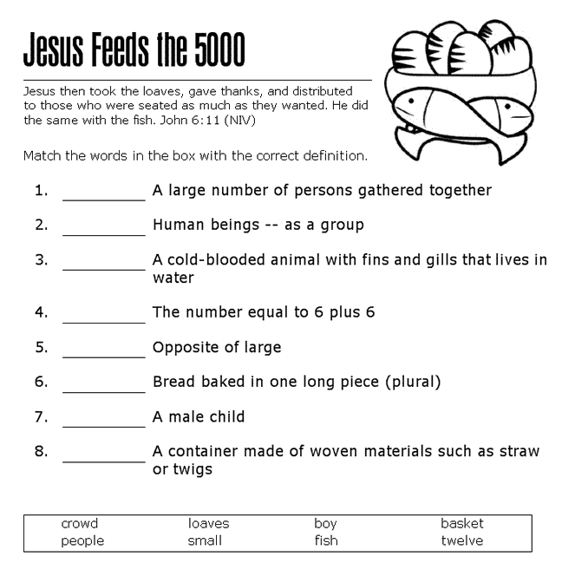
Crowd
People
Fish
Twelve
Small
Loaves
Boy
Basket

Slide 16
Jesus wants us to love Him very much and to be generous with our blessings. In one fish, write a note to Jesus letting Him know you love Him. On the other fish, write something you would like to share with Jesus so He can multiply it for the good of others.

Slide 17
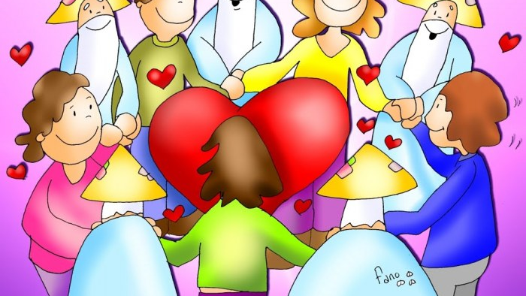
PRAYER
Lord, fill my heart with your love so I may love you more and love others more. Help me to be generous with the gifts you have given me. Thank you for giving your Life for me and for staying with me in the Eucharist. I love you very much. Amén

Slide 18
Loaves and Fishes, Jaqueline Hegarty (3-7 años)

Slide 19
Here I am Lord, Eric Tom, https://youtu.be/EcxOkht8w7c?si=ohR2gORjXjGJW3v6 (8+ yrs.)

