Slide 1
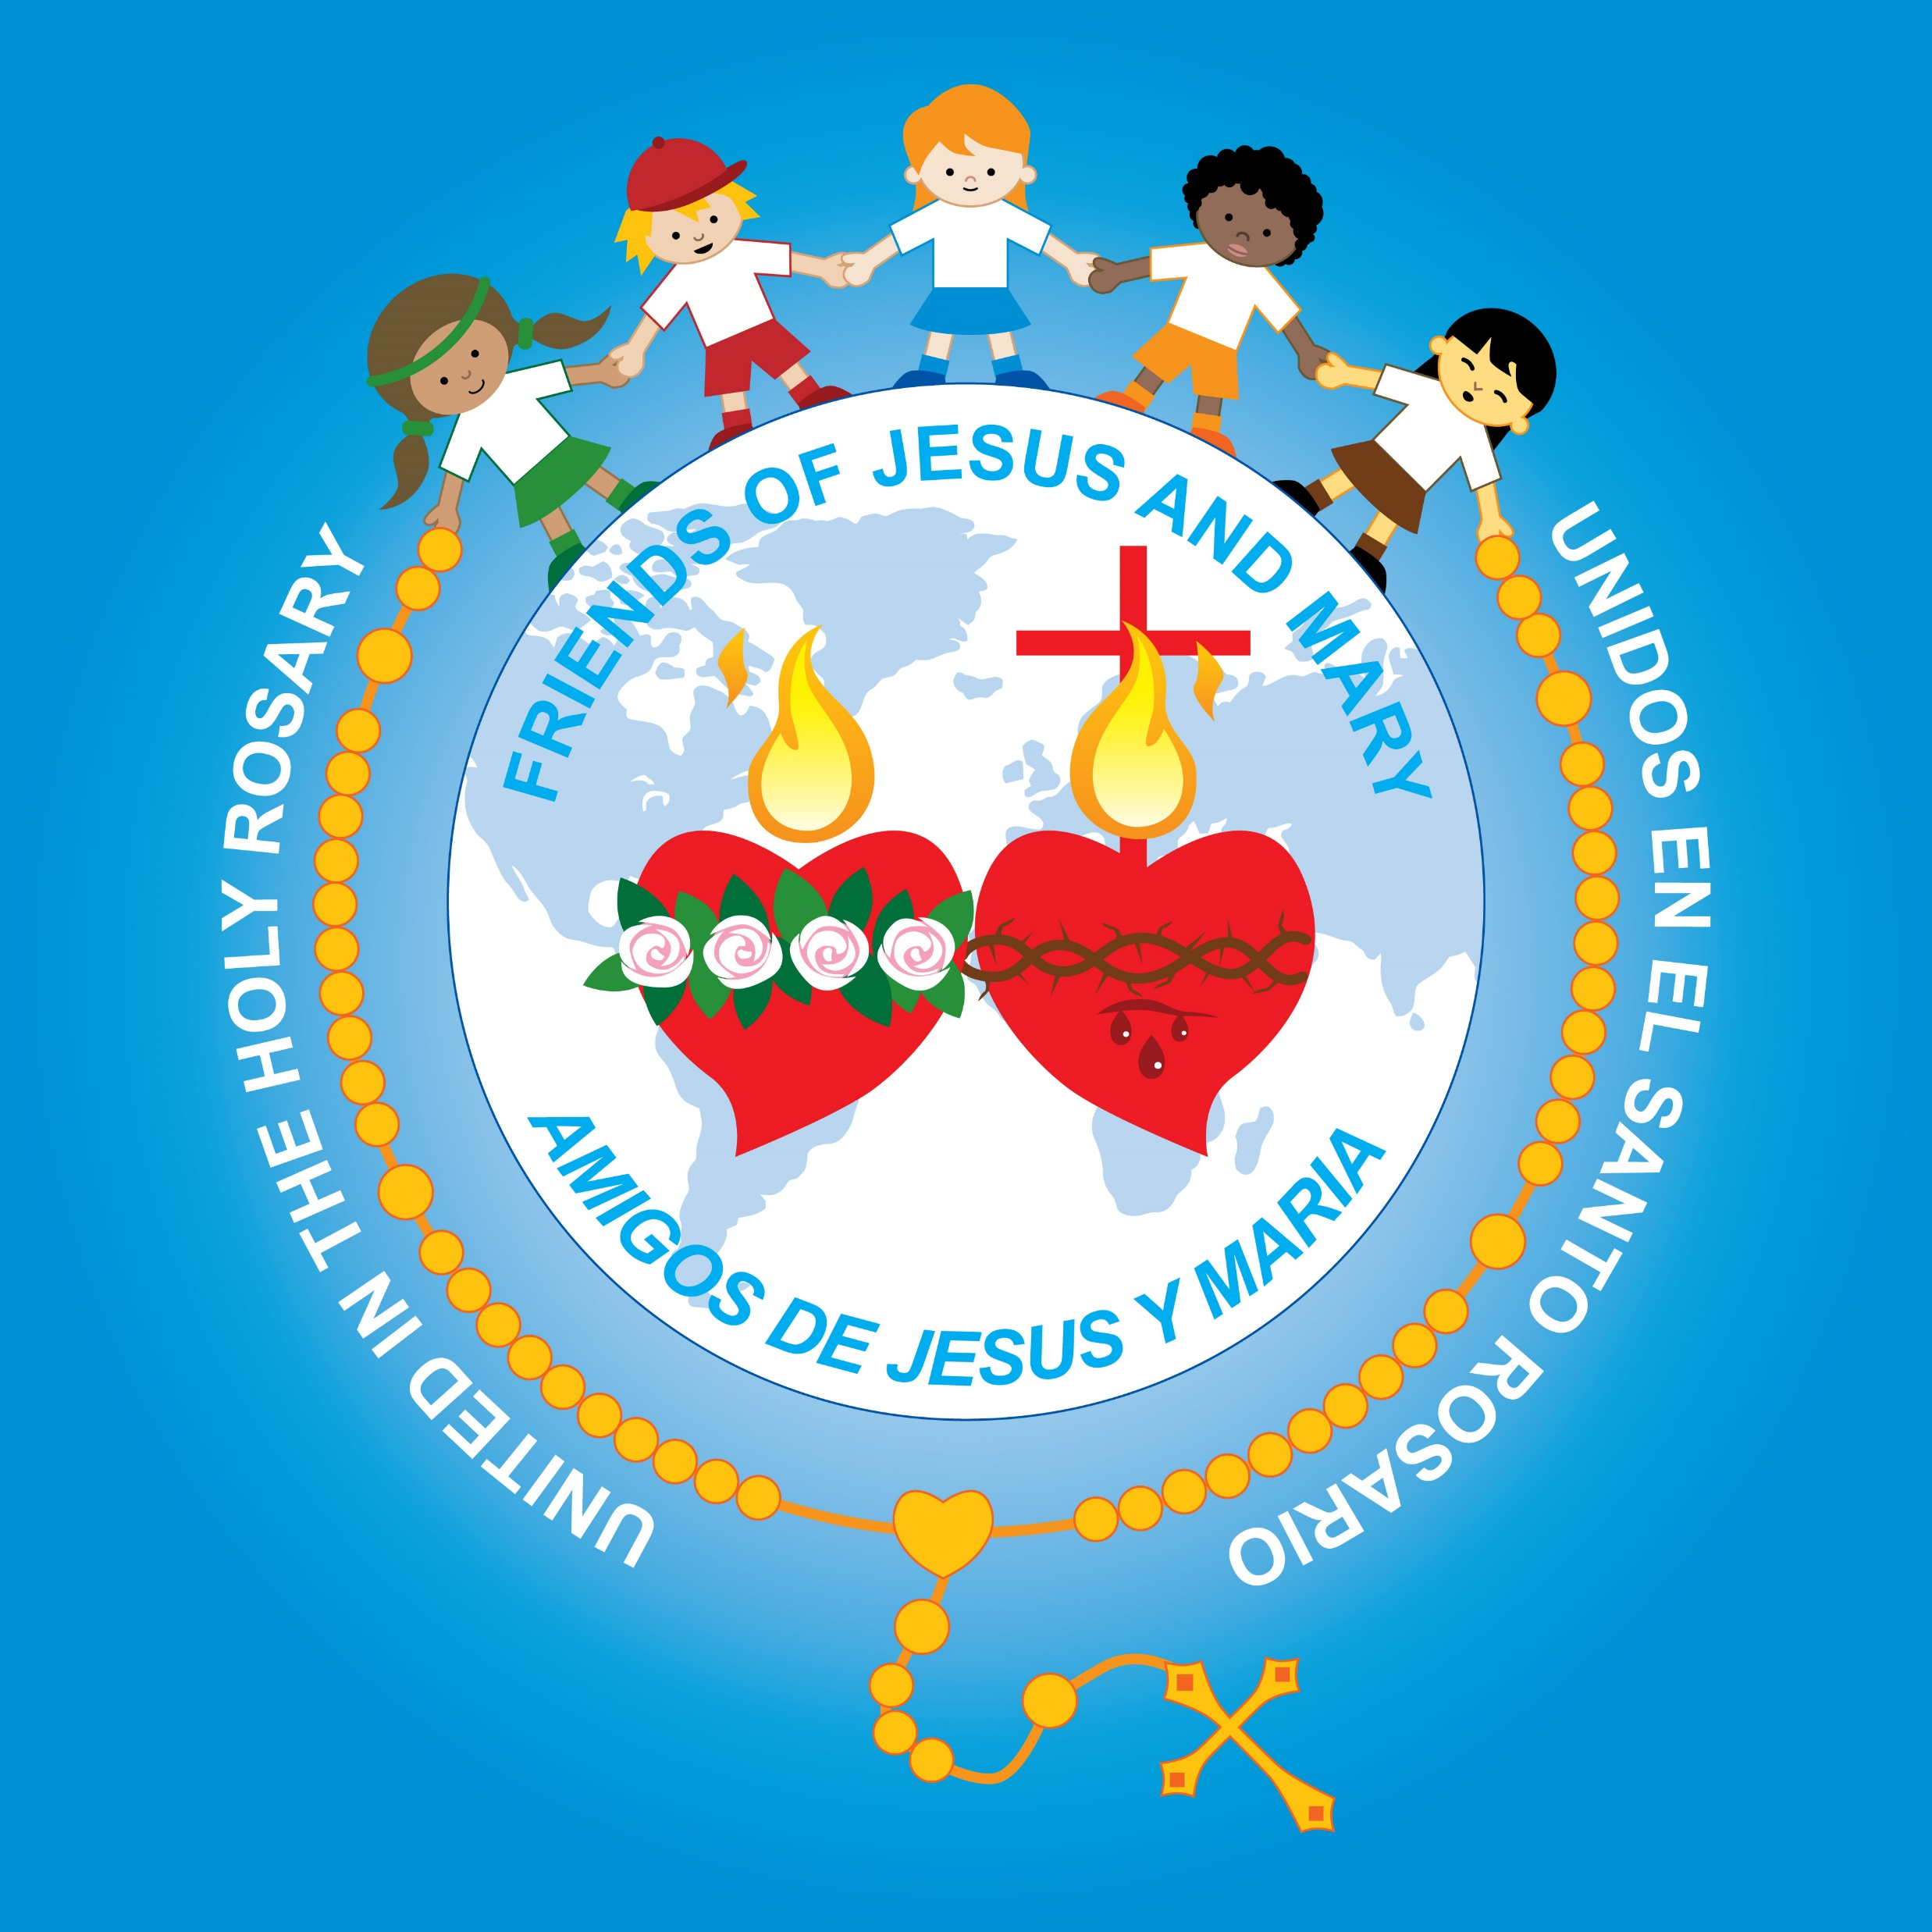
Ministry Friends of Jesus and Mary
XXI Sunday in Ordinary Time
John 6, 55. 60-69
You have words of eternal life.

Slide 2
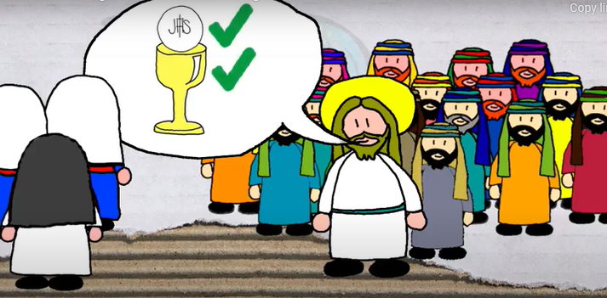
Jesus said, “For my flesh is real food and my blood is real drink.”

Slide 3
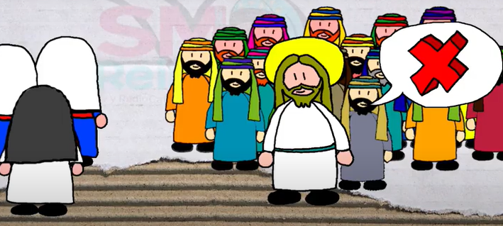
Many of Jesus’ disciples who were listening said, “This saying is hard; who can accept it?” .

Slide 4
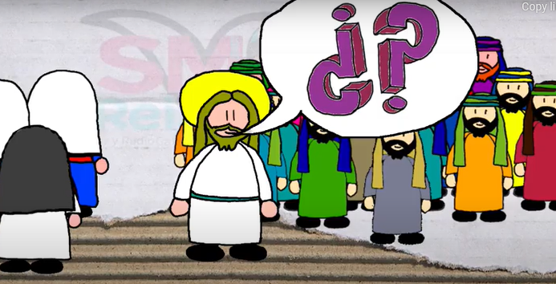
Since Jesus knew that his disciples were murmuring about this, he said to them, “Does this shock you?

Slide 5
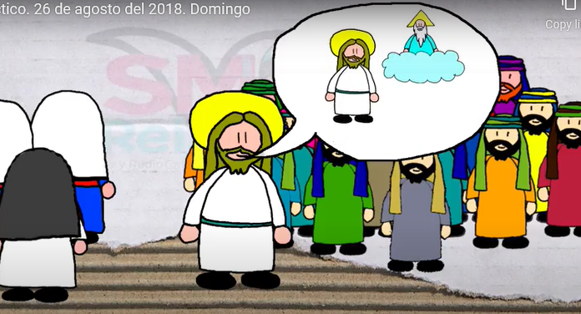
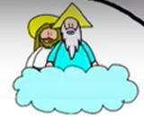
What if you were to see the Son of Man ascending to where he was before?

Slide 6
It is the spirit that gives life, while the flesh is of no avail.

Slide 7
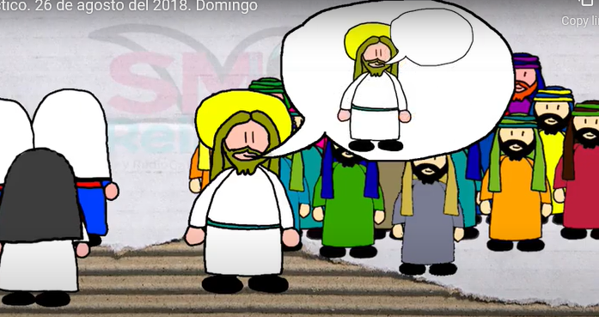
The words I have spoken to you are Spirit and life.

Slide 8
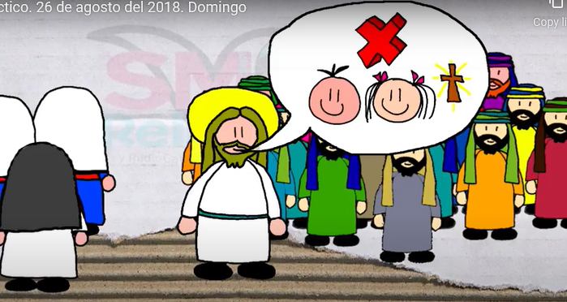
But there are some of you who do not believe.”

Slide 9
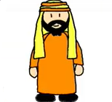
Jesus knew from the beginning the ones who would not believe and the one who would betray him.

Slide 10
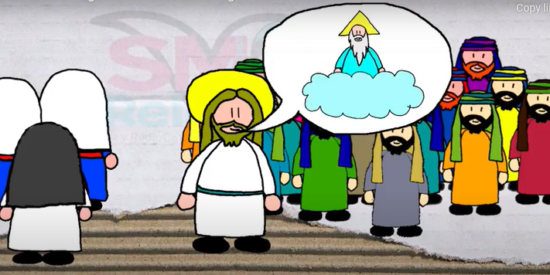
And he said, “For this reason I have told you that no one can come to me unless it is granted him by my Father.”

Slide 11
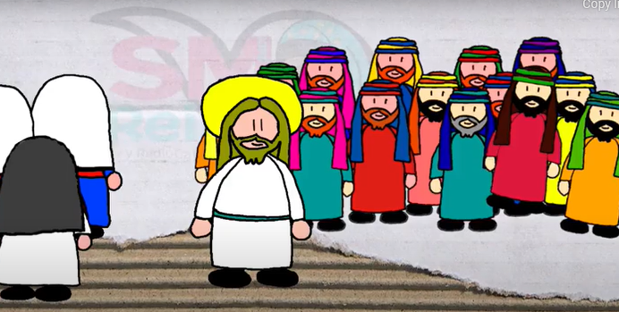
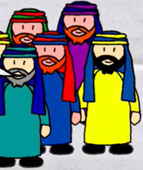
As a result of this, many of his disciples returned to their former way of life and no longer accompanied him.

Slide 12
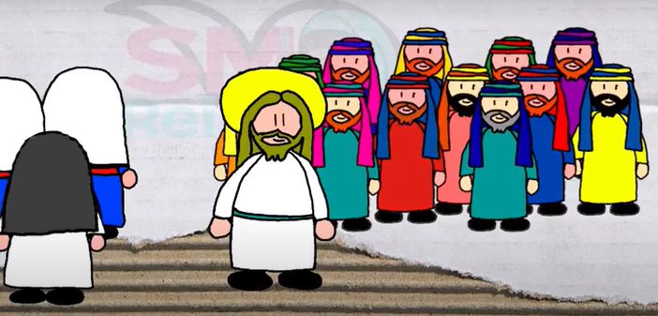
Jesus then said to the Twelve, “Do you also want to leave?”.

Slide 13
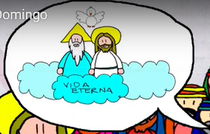
Simon Peter answered him, “Master, to whom shall we go? You have the words of eternal life.
Eternal Life

Slide 14
We have come to believe and are convinced that you are the Holy One of God.”
The Gospel of the Lord.
Praise to You Lord Jesus Christ.

Slide 15
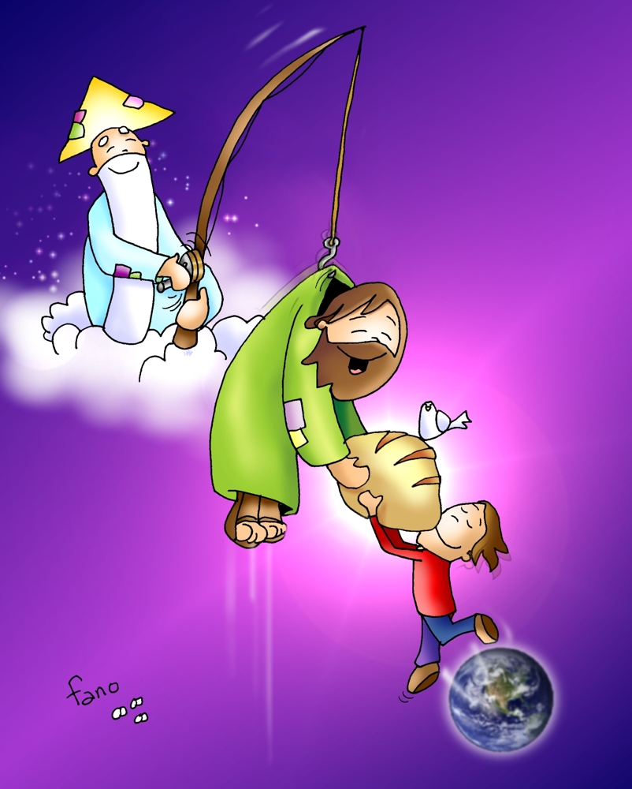
Reflection

Slide 16
Jesus told the people something they had a hard time accepting.
“For my flesh is real food and my blood is real drink.”
What did He tell them?

Slide 17
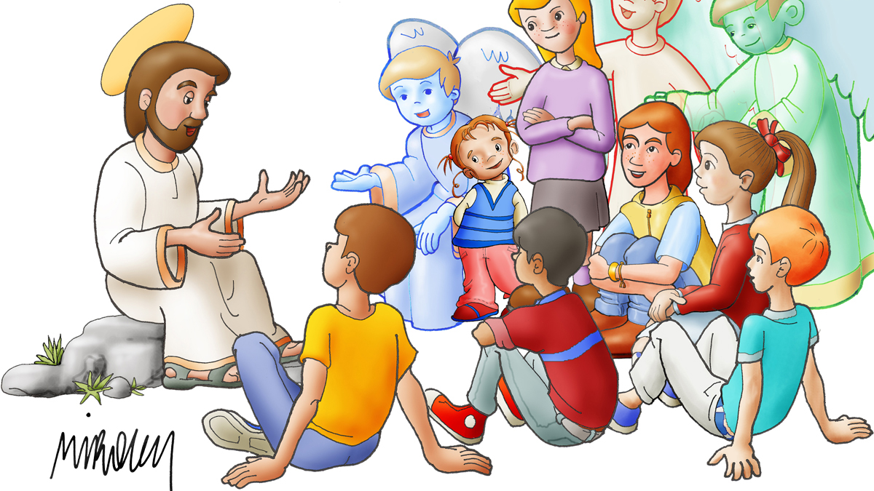
Why was this difficult to accept?
They did not understand what he was saying. They thought they actually had to eat pieces of his real body.

Slide 18
Jesus explains why they don’t accept His words. “It is the spirit that gives life, while the flesh is of no avail.”
What did He mean?
Without the Holy Spirit in your heart, you cannot accept God’s words.

Slide 19
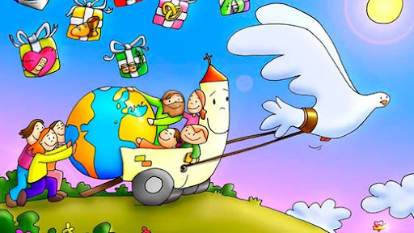
The Holy Spirit gives us love and trust to know God always speaks the truth. The Holy Spirit also gives us the patience to wait for Him to reveal to us the meaning of His words.

Slide 20
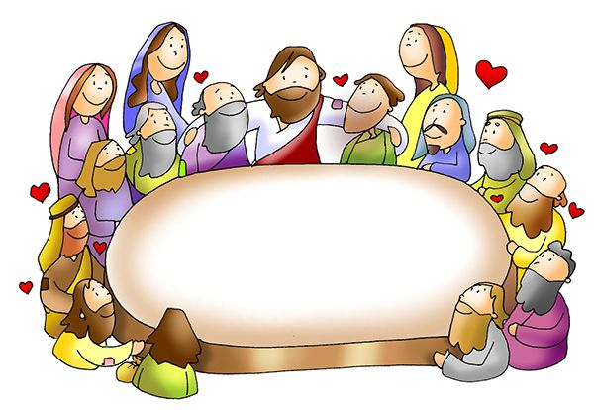
When did Jesus reveal the meaning of these words?
At the Last Supper, Jesus reveals the Eucharist, the Living Bread which is His Body and Blood given up so we may be united to Him and have eternal life.

Slide 21
Jesus also said: The words I have spoken to you are Spirit and life.
Life
What did He mean?
When we receive God’s words with the Holy Spirit in our hearts, our spirit is fed with love, faith, peace… because we receive God’s life (Grace).

Slide 22
Many of His followers did not understand and left. Jesus asks the 12 apostles:
Master, to whom shall we go? You have the words of eternal life. We have come to believe and are convinced that you are the Holy One of God
So you also want to leave?
What did Simon Peter respond?

Slide 23
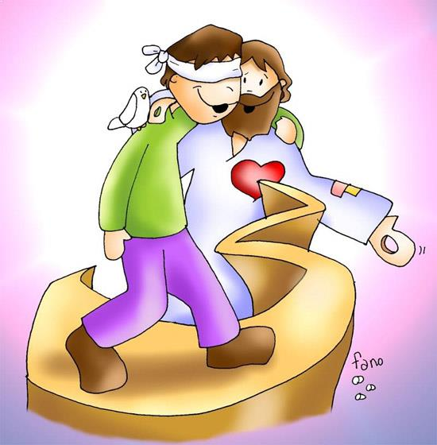
To accept the living Word of Jesus, we must have faith that He is God and that He loves us and wants our happiness.

Slide 24
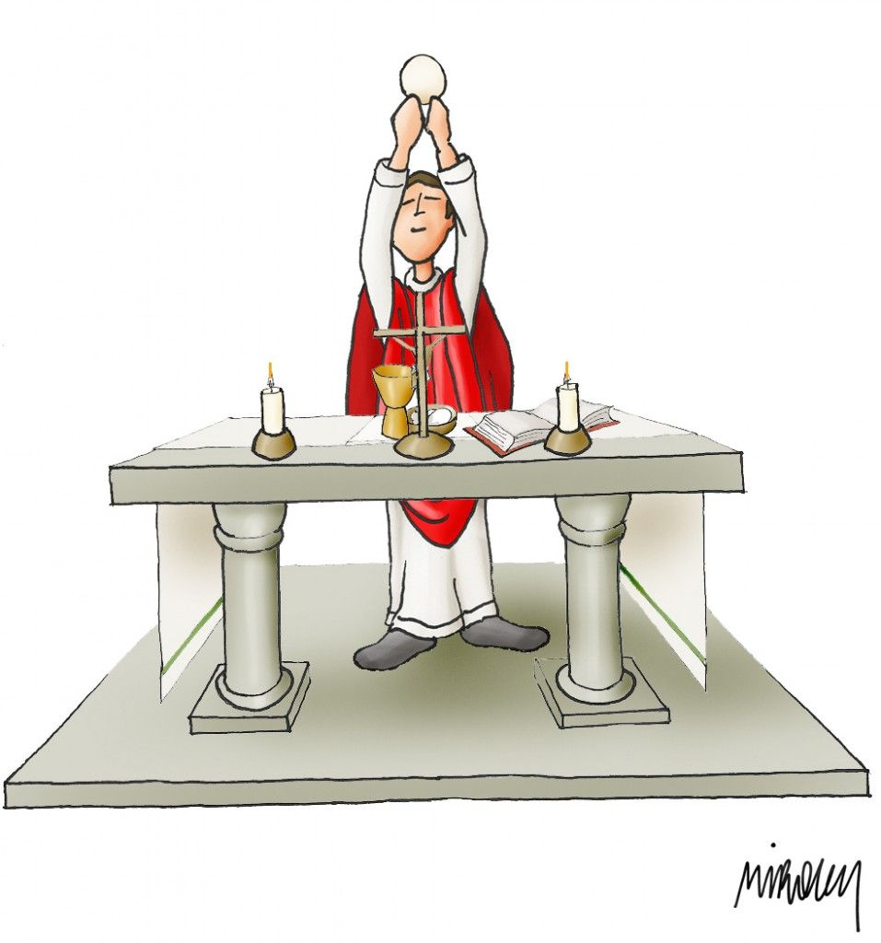
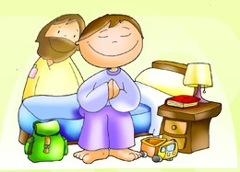
When and where do we hear the Word of God?
In the Bible
In Prayer
During Mass

Slide 25
ACTIVITY

Slide 26
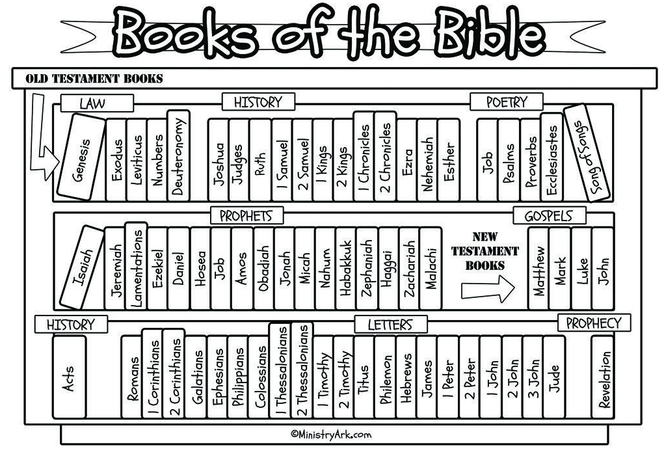

Slide 27
5
6
6
7
3
5
2
1
4

Slide 28
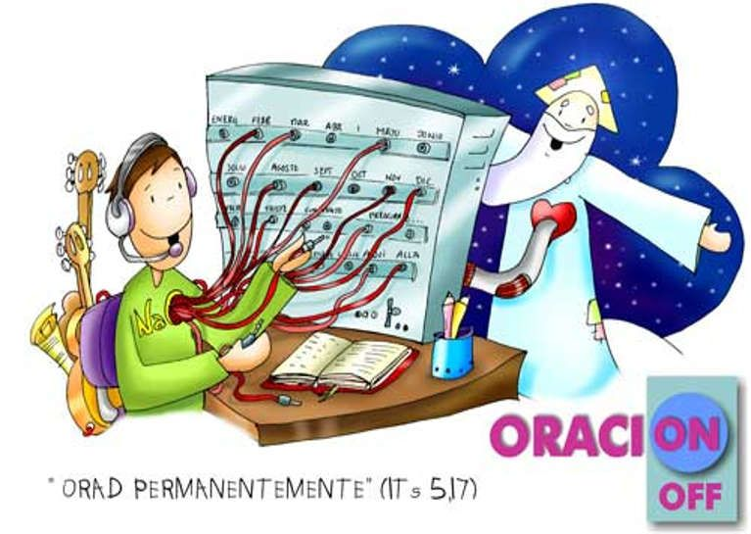
Prayer
Lord, send your Holy Spirit to my heart so I may always listen to your words with faith, hope, and love. Only you have words of eternal life that bring me true happiness. Help me to always seek you in prayer, in Mass, and in the Bible. I love you. Amen
PRAYER
Pray Always

Slide 29
God Speaks in Many Different Ways, KGCN VBS (Ctrl Clck) https://youtu.be/iYcKQWiqlb4

