Slide 1
Ministry Friends of Jesus and Mary
Prayer Group for Children
Cycle B-XXII Sunday in Ordinary Time
…What stains the heart comes from within… (Mark 7,1-8.14-15.21-23)
And Feast of St. Bartholomew,
the Apostle, August 24

Slide 2
Feast of St. Bartholomew , the Apostle, August 24 https://youtu.be/YLS225EfE1g

Slide 3
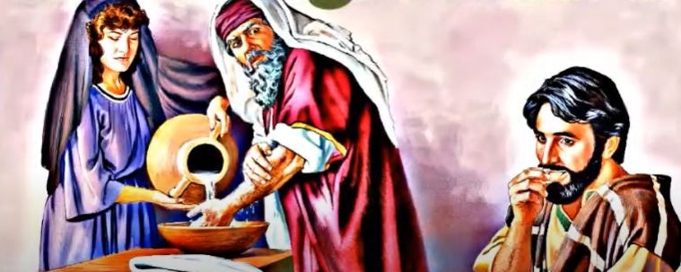
When the Pharisees with some scribes who had come from Jerusalem gathered around Jesus, they observed that some of his disciples ate their meals with unclean, that is, unwashed, hands.

Slide 4
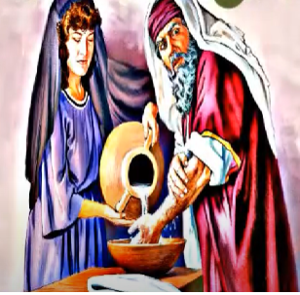
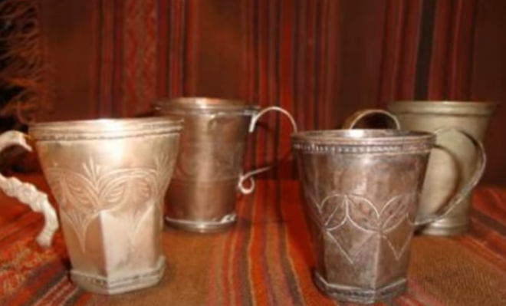
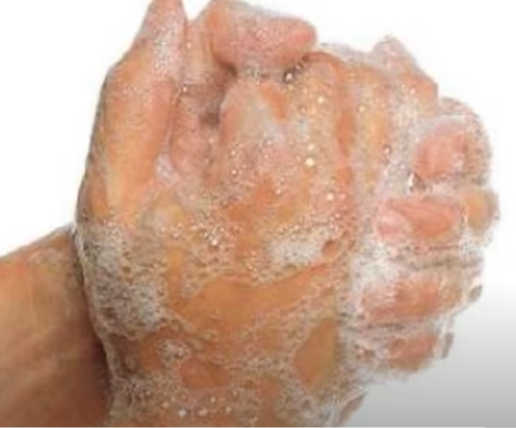
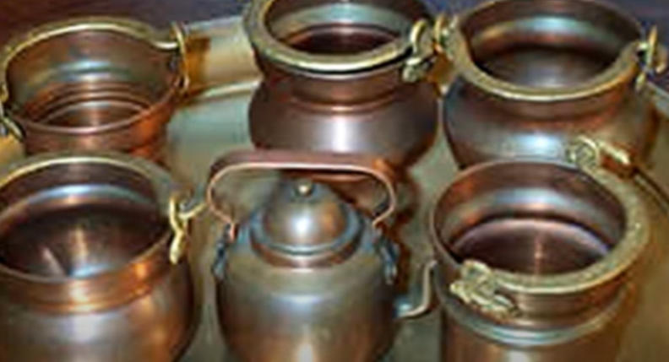
For the Pharisees and, in fact, all Jews, do not eat without carefully washing their hands, keeping the tradition of the elders. And on coming from the marketplace, they do not eat without purifying themselves.
And there are many other things that they have traditionally observed, the purification of cups and jugs and kettles and beds.

Slide 5
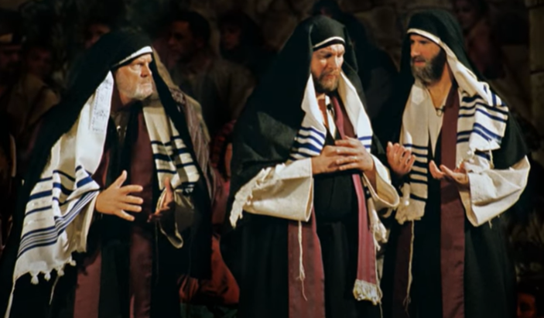
So, the Pharisees and scribes questioned him, “Why do your disciples not follow the tradition of the elders but instead eat a meal with unclean hands?”

Slide 6
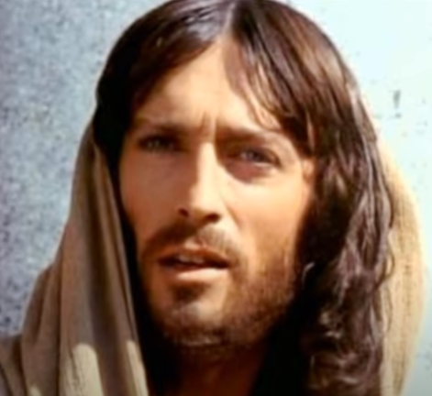
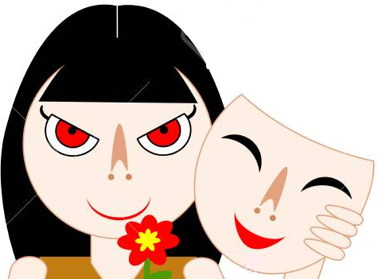
He responded, “Well did Isaiah prophesy about you hypocrites,

Slide 7
…as it is written: This people honor me with their lips, but their hearts are far from me;…

Slide 8
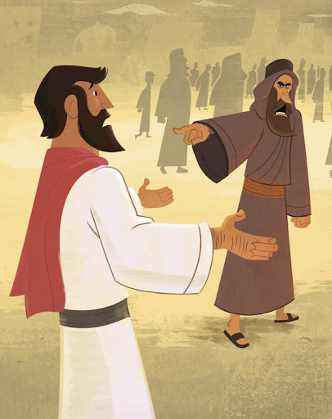
…in vain do they worship me, teaching as doctrines human laws. You disregard God’s commandment but cling to human tradition.”

Slide 9
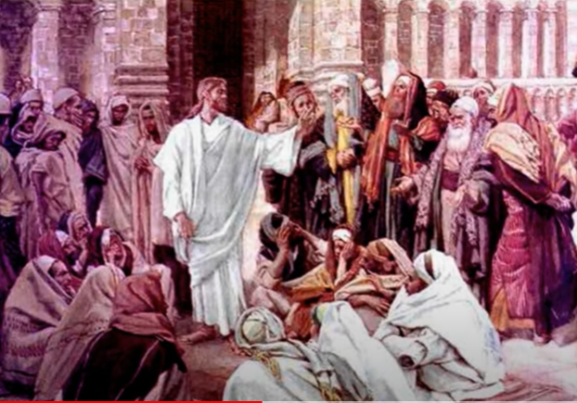
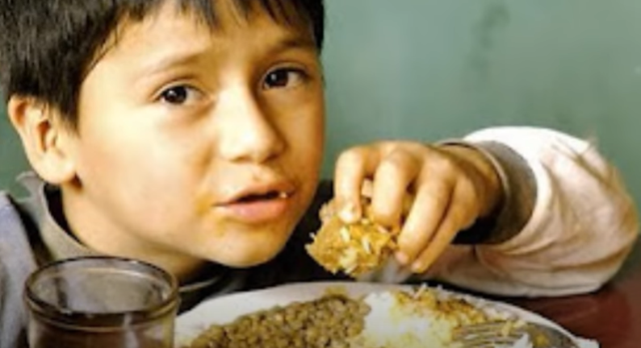
He summoned the crowd again and said to them, “Hear me, all of you, and understand…
…but the things that come out from within are what defile. “
…Nothing that enters one from outside can defile that person;

Slide 10
From within people, from their hearts, come evil thoughts, unchastity, theft, murder, adultery, greed, malice, deceit, licentiousness, envy, blasphemy, arrogance, folly. All these evils come from within and they defile.”
The Gospel of the Lord,
Praise to You Lord Jesus Christ.

Slide 11
REFLECTION

Slide 12
In this gospel, why were the Pharisees criticizing Jesus’ disciples?
The disciples were eating without purifying themselves, their plates and cups in the manner of the Jewish traditions.

Slide 13
But Jesus, who knew what was in their hearts, calls them hypocrites. What does this mean?
A person that appears good on the outside, but inside has bad thoughts and feelings toward others.

Slide 14
What do you think Jesus cares about more:…
…or what is on the inside of our heart?
…our appearance,…

Slide 15
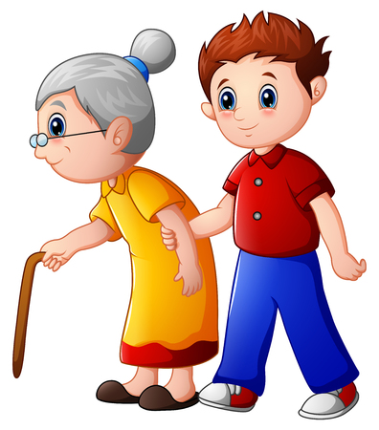
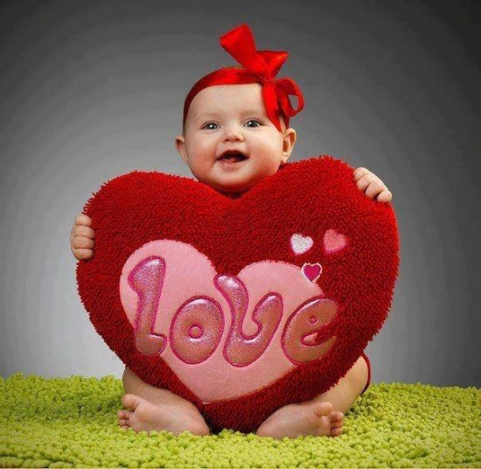
Jesus does not judge by appearances (dirty hands, clothes, etc.) but on how we think, what we do, what we have in our heart.

Slide 16
How does a heart get stained?

Slide 17
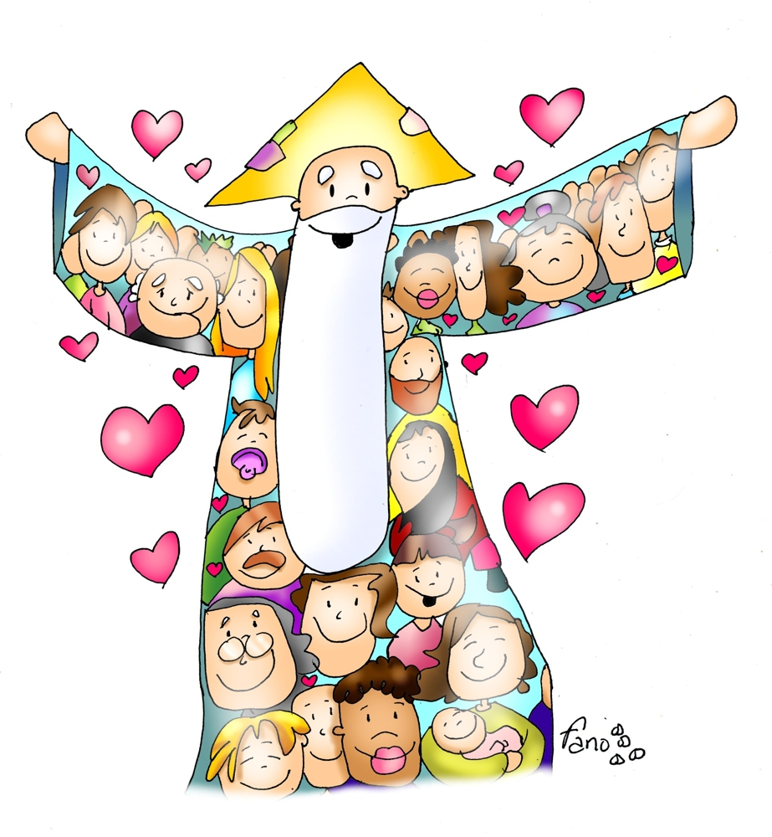
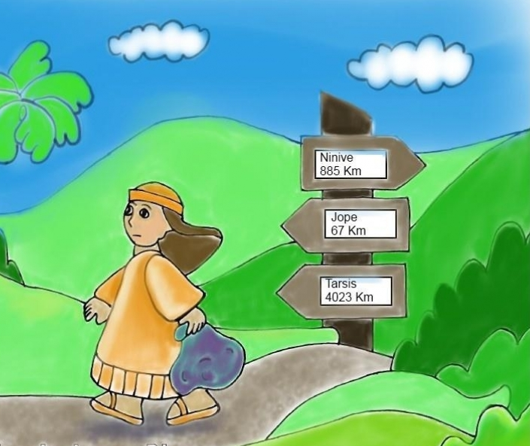
SIN
LOVE
HATE
BY DISOBEYING
GOD
DISOBEY

Slide 18
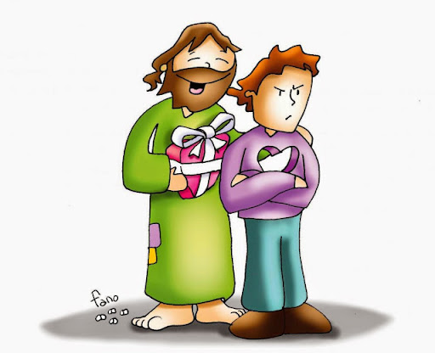
All sin weakens or breaks our friendship with God; it distances us from Him and darkens our heart.

Slide 19
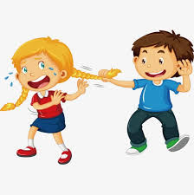
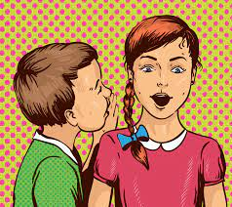
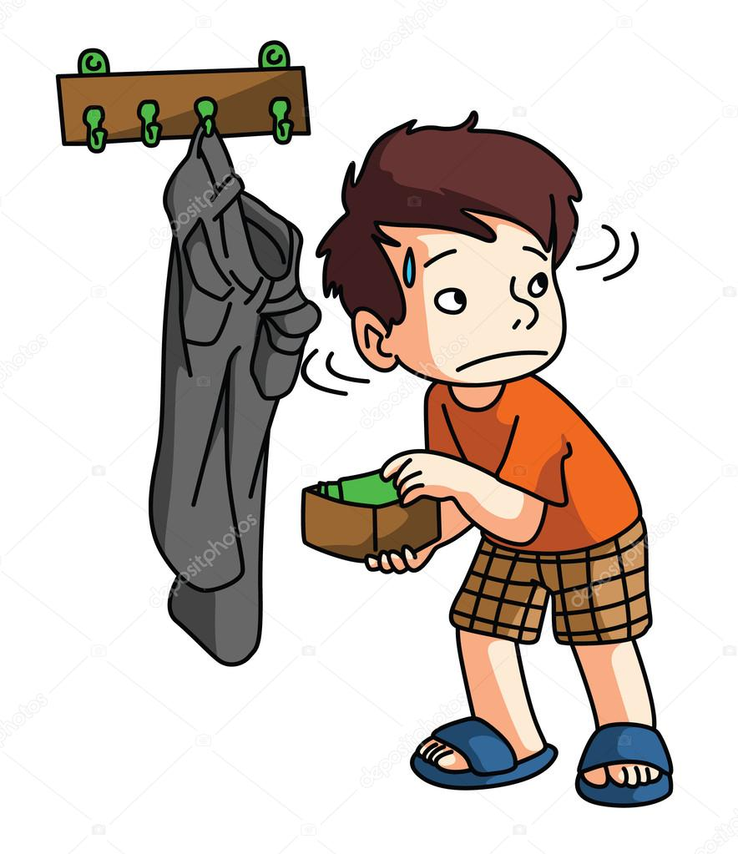
Share some examples of things you can do or think which stain your heart.
LIE
INSULT
FIGHT
GOSSIP
STEAL
DISRESPECT OUR ELDERS

Slide 20
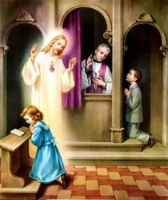
How can I clean my heart and start again?
With the Sacrament of Reconciliation.

Slide 21
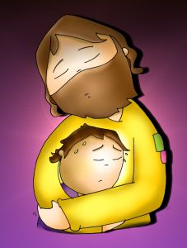
Jesus always forgives us if we are truly sorry for our bad behavior and our heart is willing to change.

Slide 22
Activity

Slide 23
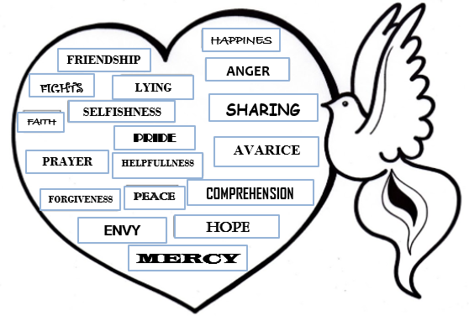
Choose the words that lighten our heart and the lives of others.

Slide 24
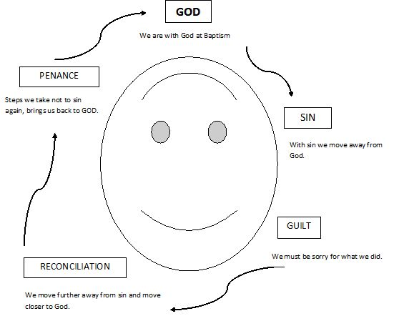
RECONCILIATION

Slide 25
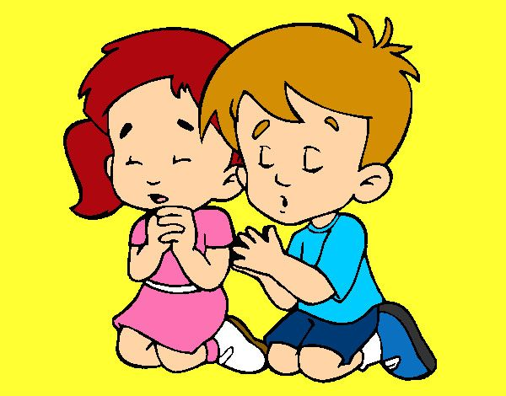
Lord, sometimes we do things mechanically, or for appearances because we are supposed to. Show us to follow you with our whole heart and to obey the Church with love. Help us to help those in need and to be faithful to our promises. Amen
Prayer

Slide 26
Song: Create in Me a Pure Heart Psalm 51 10, (Ctrl Click) https://youtu.be/XCNedO3PaBA

