Slide 1
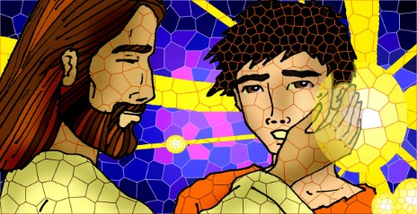
Friends of Jesus and Mary
Jesus cures a deaf mute man
XXIII Sunday in Ordinary Time
Mark 7, 31-37

Slide 2
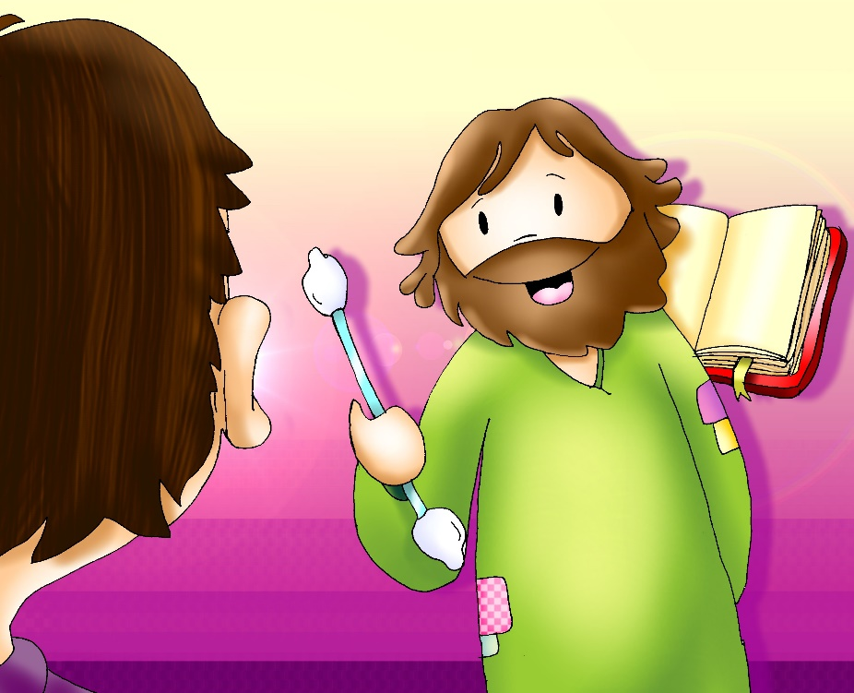
Jesus Cures a Deaf Mute Man
Again, Jesus left the district of Tyre and went by way of Sidon to the Sea of Galilee, into the district of the Decapolis. And people brought to him a deaf man who had a speech impediment and begged him to lay his hand on him. He took him off by himself away from the crowd. He put his finger into the man’s ears and, spitting, touched his tongue.

Slide 3
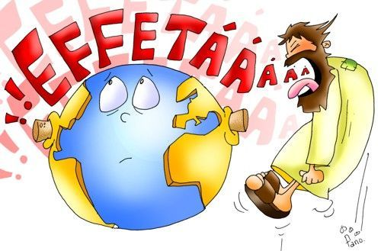
Then he looked up to heaven and sighed deeply, and said to him, “Ephphatha!”— that is, “Be opened!” — And immediately the man’s ears were opened, this speech impediment was removed, and he spoke plainly. He ordered them not to tell anyone. But the more he ordered them not to, the more they proclaimed it. They were exceedingly astonished, and they said, “He has done all things well. He makes the deaf hear and the mute speak.”

Slide 4
REFLECTION

Slide 5
People took a man who was deaf and had a speech impediment to Jesus to be cured. What problems did he have?

Slide 6
He could not hear or speak well.

Slide 7
How did Jesus cure him?

Slide 8
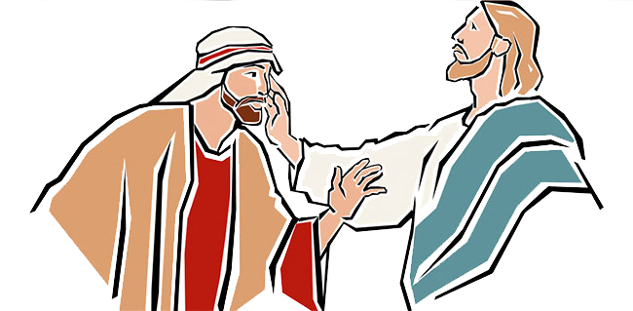
He took him away from the crowd, put His fingers into his ears, and touched his tongue with His saliva. Then, He looked up to heaven and said, “Ephphatha!”

Slide 9
What does Ephphatha mean?

Slide 10
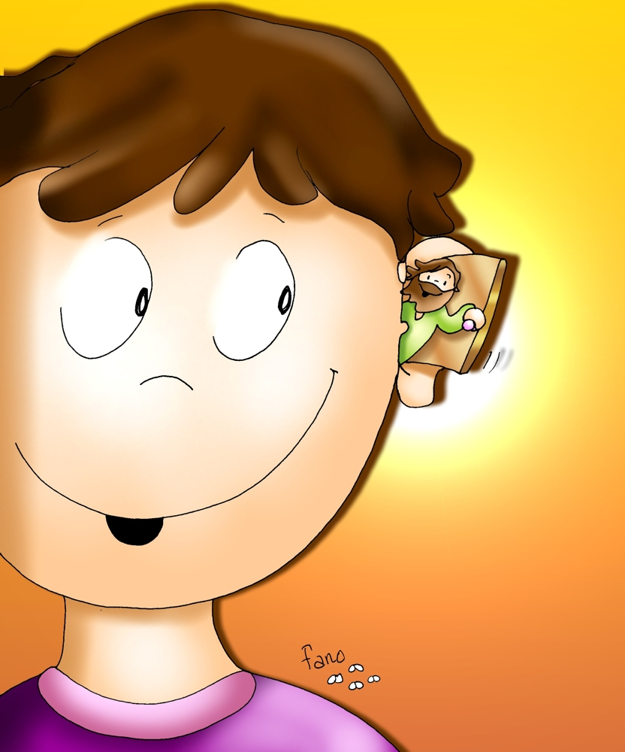
Be opened!

Slide 11
We hear people speak with our ears. How do we hear God speak?

Slide 12
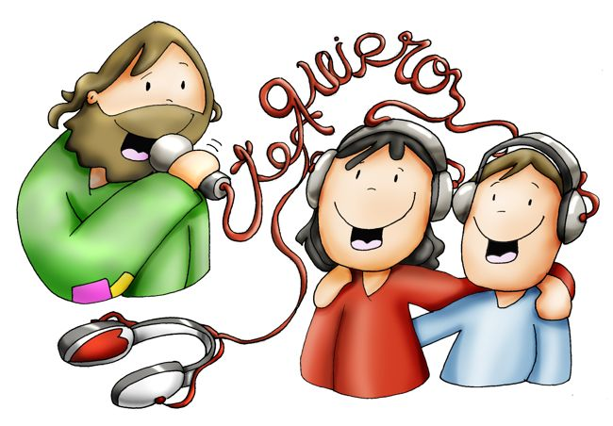
WITH OUR HEART
But our heart must be open to Jesus.

Slide 13
To heal the man, Jesus first took him away from the crowd. To listen to Jesus, we need silence from conversations, music, tv, videos, etc. Do we make time each day, in silence, to listen to Jesus?
Share….

Slide 14
Jesus then looked up to heaven and sighed deeply. What does this mean?

Slide 15
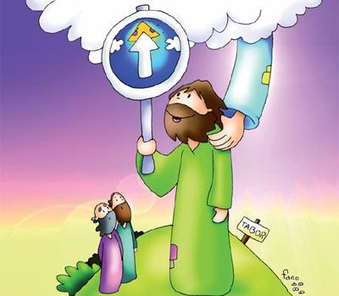
He looked up to His Father in Heaven.
Like in other gospels, a sigh or breath from Jesus represents the Holy Spirit. The Holy Trinity opens his ears and tongue to hear and speak well.

Slide 16
Did you know…?
In the ancient Baptism liturgy, the priest would touch the ears and mouth of the person being baptized signifying the opening of the Word of God, and the possibility of LISTENING and SPEAKING to Him.

Slide 17
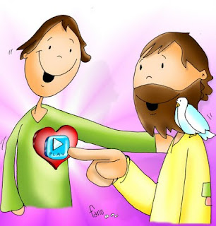
Jesus wants to open our heart and send the Holy Spirit so we may listen well and learn to love as He loves with good words and actions. We should try to give Jesus time in silence and ask Him to open our heart to receive the Holy Spirit and be His light in the world.

Slide 18
ACTIVITIES

Slide 19
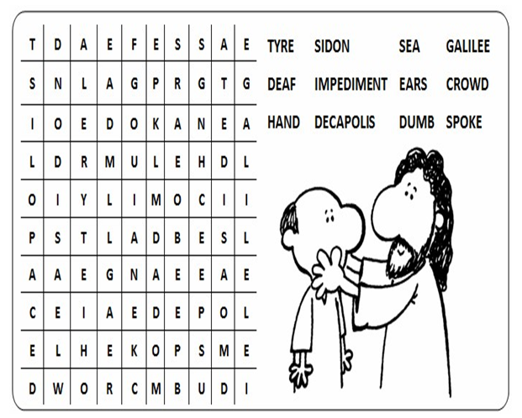
Complete the Word Search with words from the Gospel.

Slide 20
Draw a heart with some hands: 1-Praying (Listening to God) 2-Shaking someone’s hand (Forgiving) 3-Holding another’s wrist (Helping) 4-Hand up (Obeying God)

Slide 21
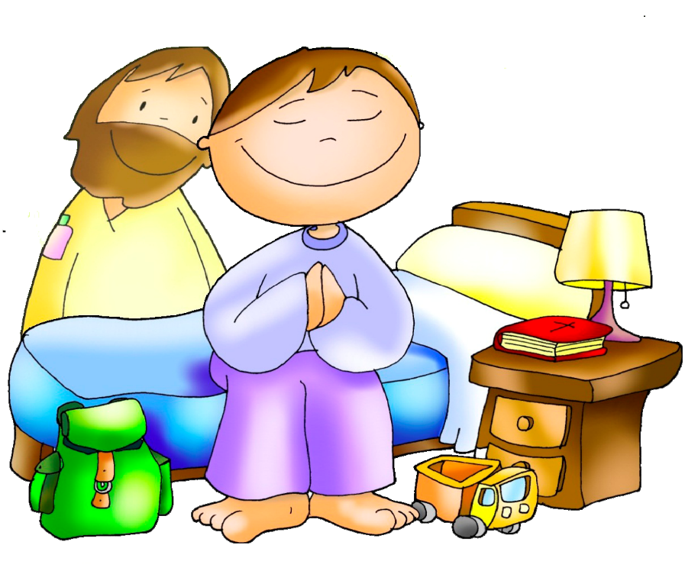
Prayer
Jesus, thank you for your presence in my life. Please open my heart and send your Holy Spirit so I may love as you love. Help me to be your light in this world. Amen.
Amen.

Slide 22
Help Me Listen to You Lord, m2e2linde1256 (Ctrl click) https://youtu.be/dKqiwc-0TvM

