Slide 1
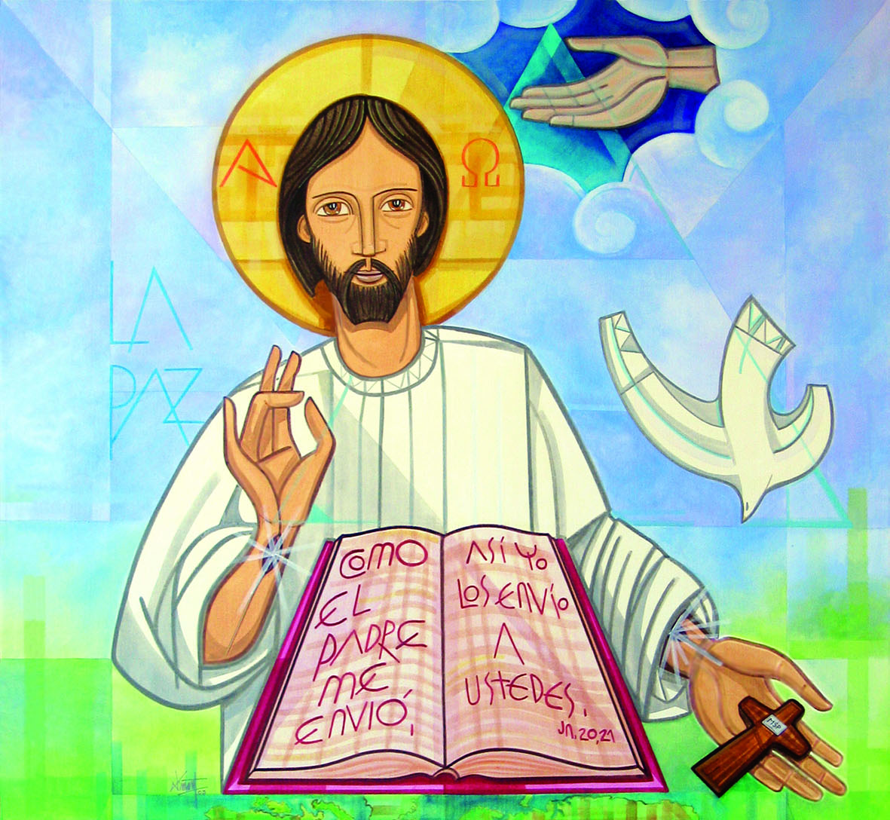
Ministry Friends of Jesus and Mary
XXIV Sunday in Ordinary Time
Mark 8, 27-35
Carry Your Cross and Follow Me

Slide 2
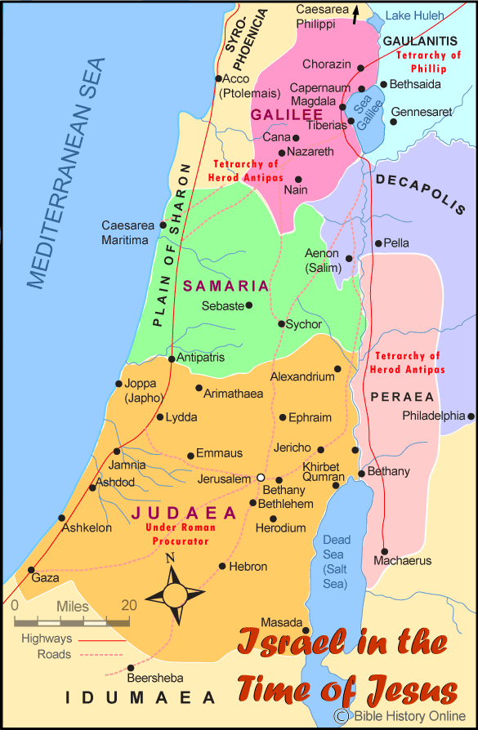
Jesus and his disciples set out for the villages of Caesarea Philippi.

Slide 3
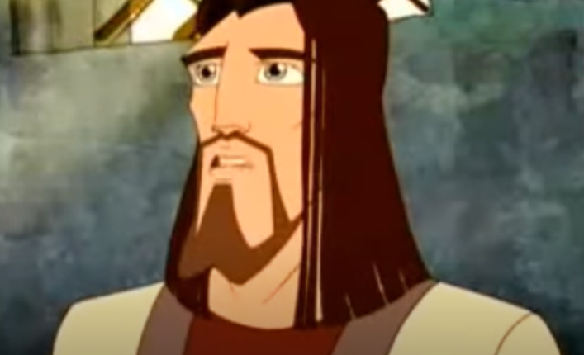
Along the way he asked his disciples, "Who do people say that I am?"

Slide 4
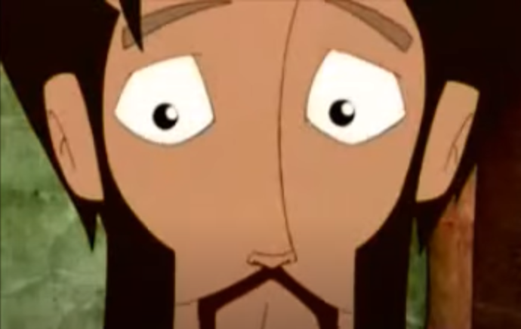
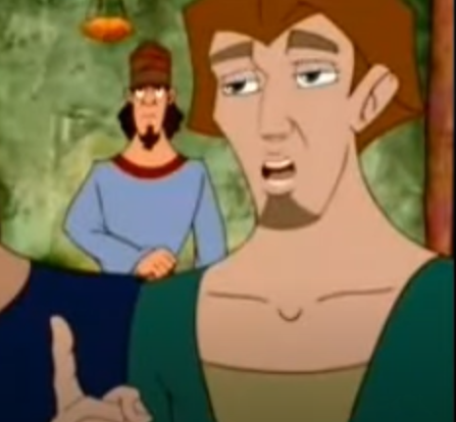
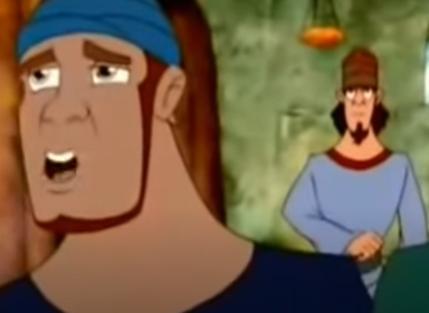
They said in reply,
John the Baptist,
still others one of the prophets.
others Elijah,

Slide 5
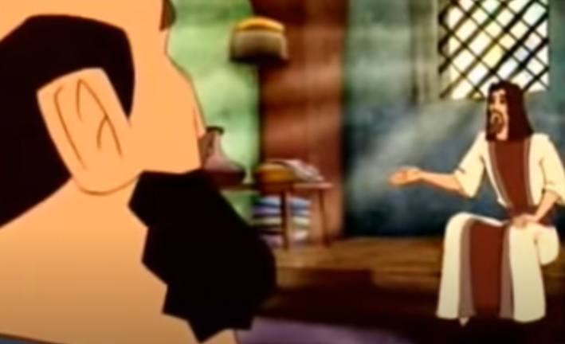
And he asked them, "But who do you say that I am?”

Slide 6
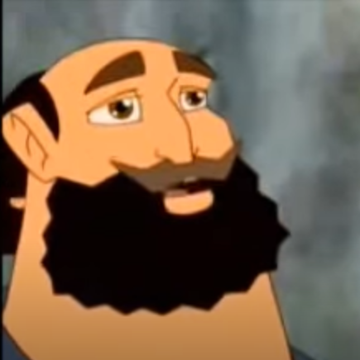
Peter said to him in reply,
You are the Christ.

Slide 7
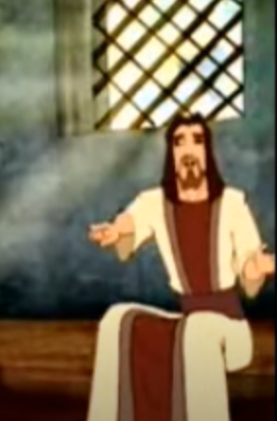
Then he warned them not to tell anyone about him.

Slide 8
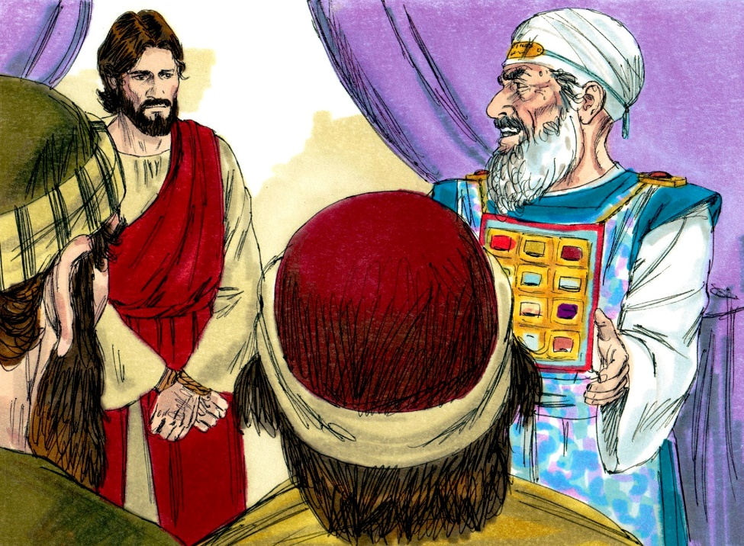
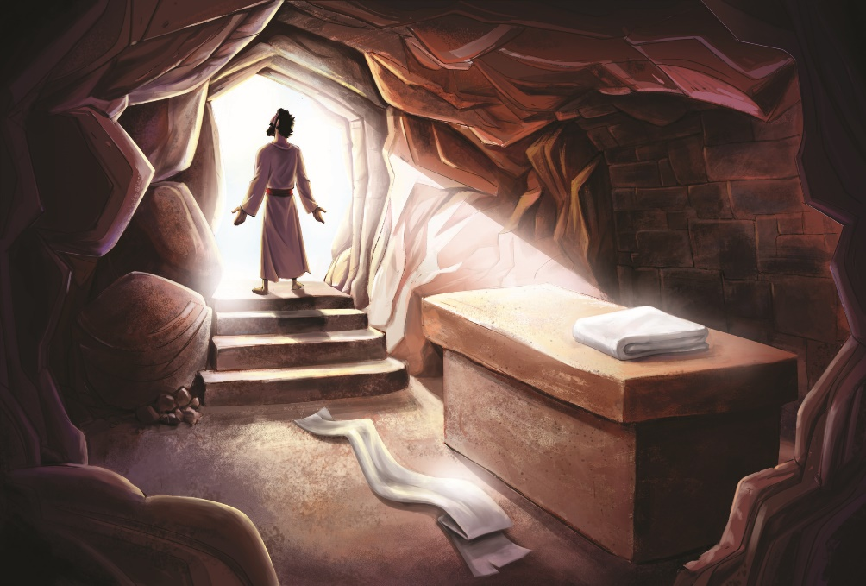
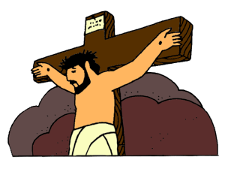
He began to teach them that the Son of Man must suffer greatly…
and rise after three days.
and be killed,
and be rejected by the elders, the chief priests, and the scribes,

Slide 9
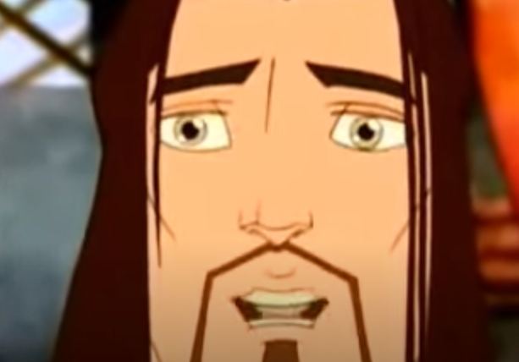
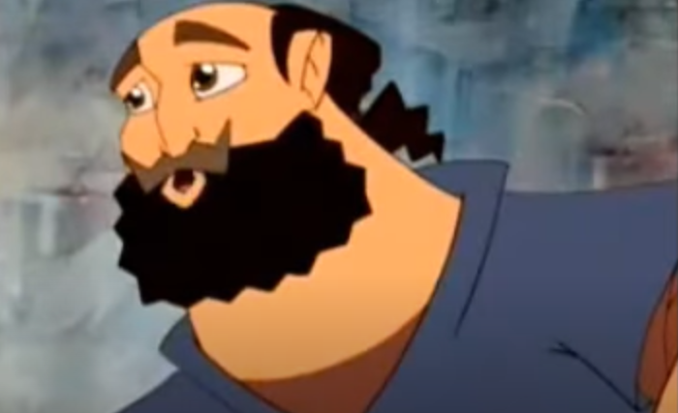
He spoke this openly.
Then Peter took him aside and began to rebuke him.

Slide 10
At this he turned around and, looking at his disciples, rebuked Peter and said,
Get behind me, Satan.

Slide 11
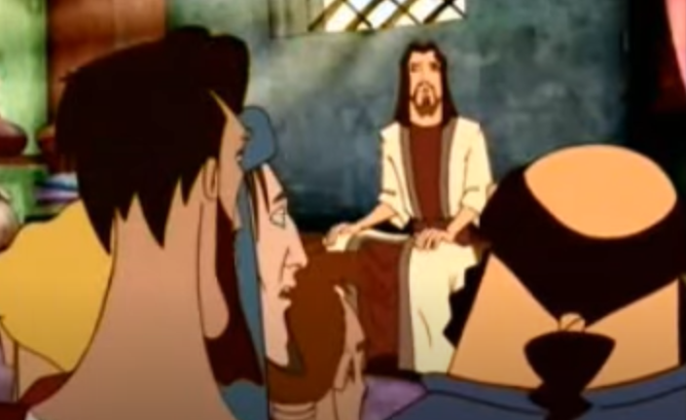
You are thinking not as God does, but as human beings do.

Slide 12
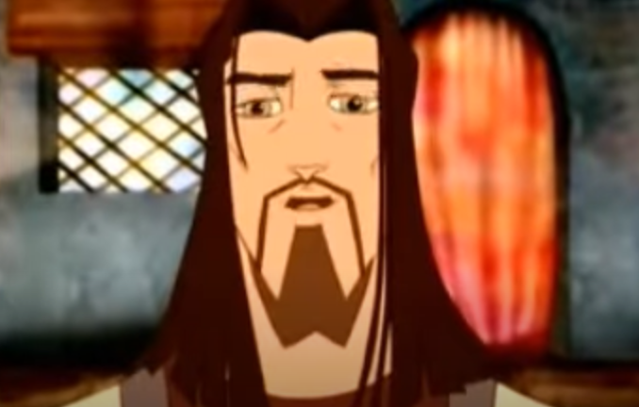
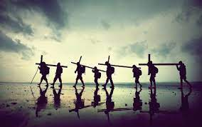
He summoned the crowd with his disciples and said to them,
Whoever wishes to come after me must deny himself, take up his cross, and follow me.
For whoever wishes to save his life will lose it.

Slide 13
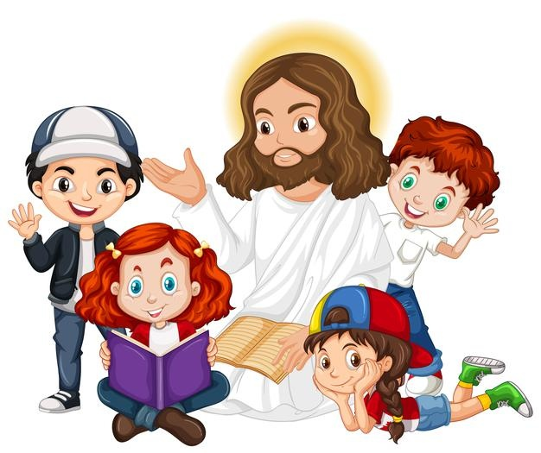
But whoever loses his life for my sake and that of the gospel will save it.
The Gospel of the Lord,
Praise to you Lord Jesus Christ.

Slide 14
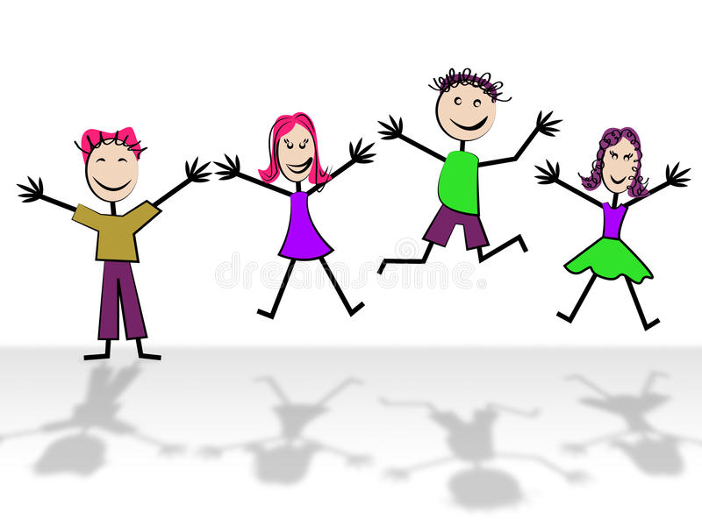
REFLECTION

Slide 15
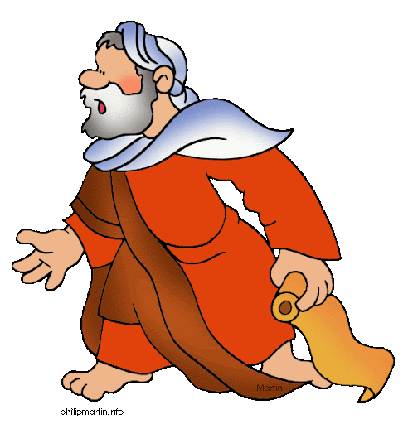
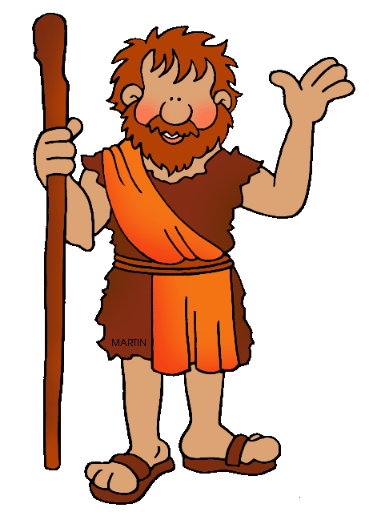
Jesus asks, "Who do people say that I am?"
What do they answer?
Some say
John the Baptist;
And others one of the prophets.
Others say Elijah;

Slide 16
Then Jesus asks, “Who do you say that I am?”
What did Peter respond?
Peter responded, You are the Christ.

Slide 17
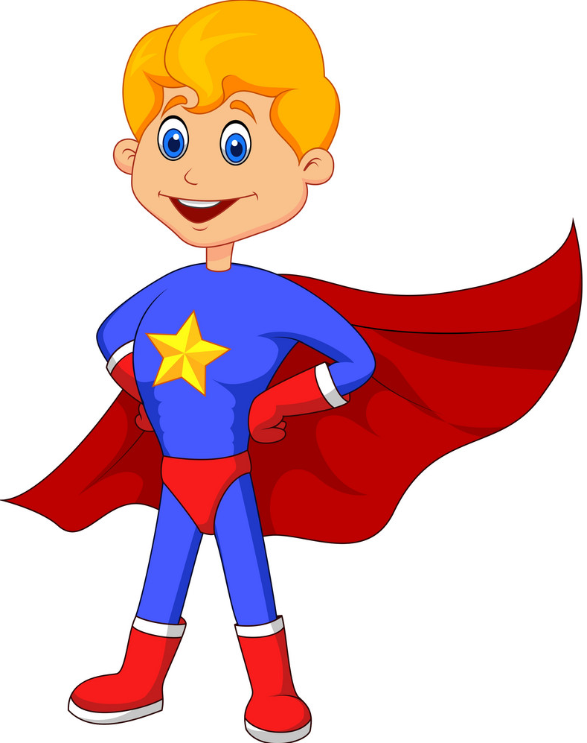
What does Christ mean?
Savior

Slide 18
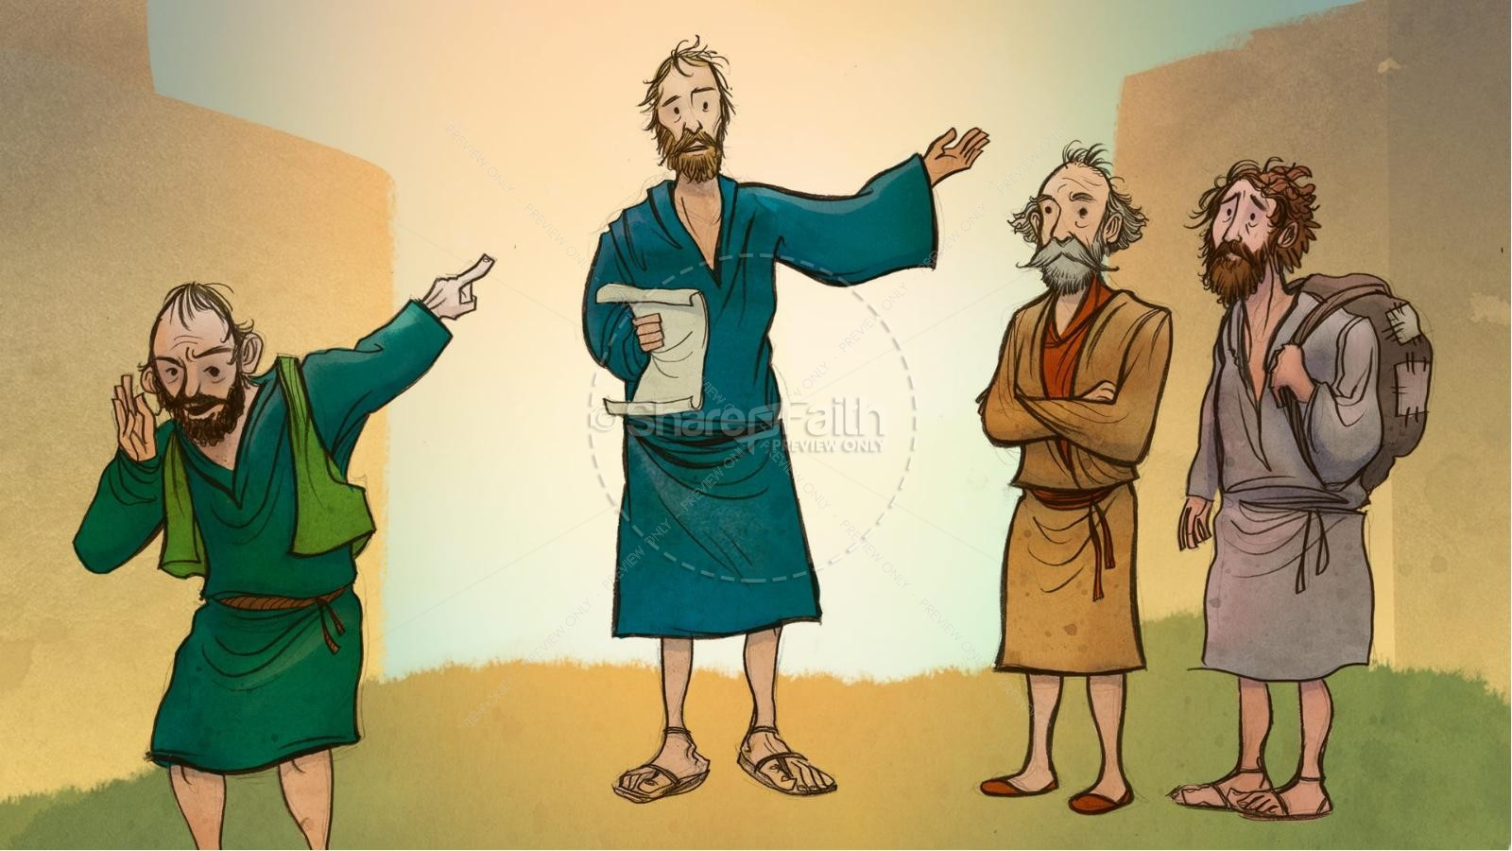
The Old Testament announced that God would send a Savior to His people.
How did they imagine the Savior would be?

Slide 19
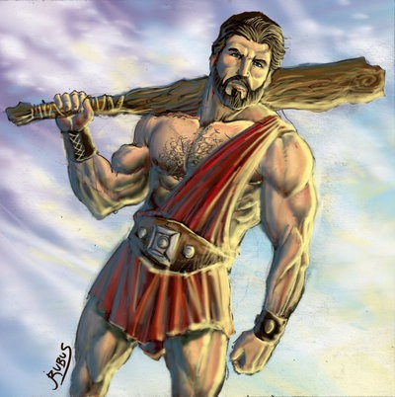
Many thought the Savior would be a military leader who would liberate the Jewish people from the Romans.

Slide 20
But Jesus tells them the Jewish High Priests would reject Him; He would suffer, die, and then resurrect on the 3rd day.
How did they respond to this?
Peter tries to convince Him to not do this because he didn’t want to see Him suffer or die.

Slide 21
What does Jesus say?
Get behind me, Satan.
You are thinking not as God does, but as human beings do.

Slide 22
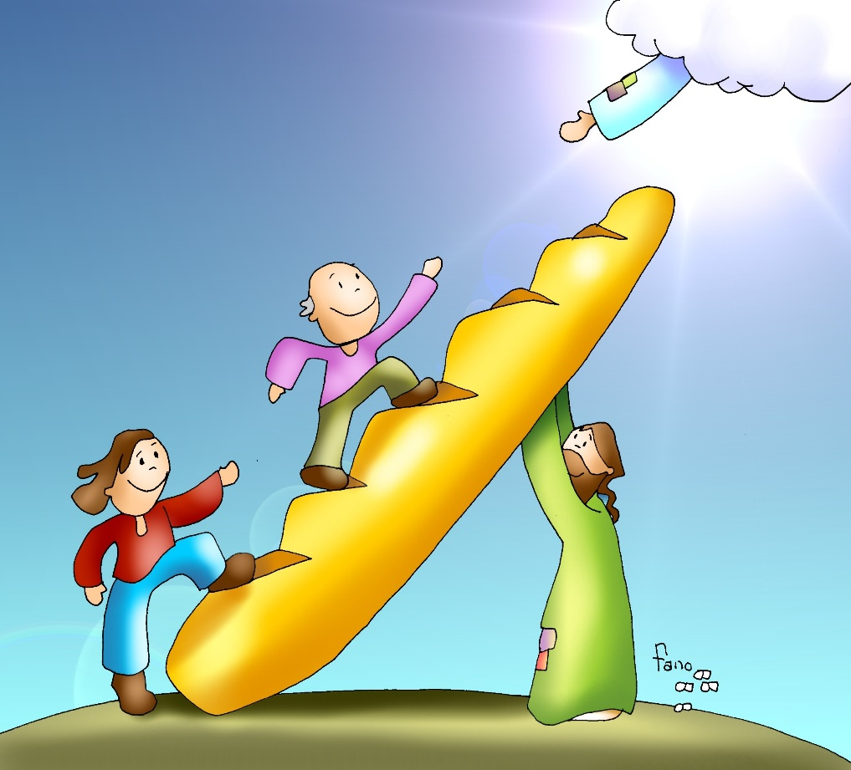
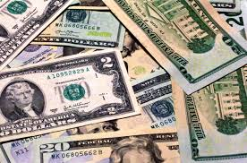
Jesus says the world thinks differently than God;
The world thinks about wealth, and power
God thinks about eternal life that never ends.

Slide 23
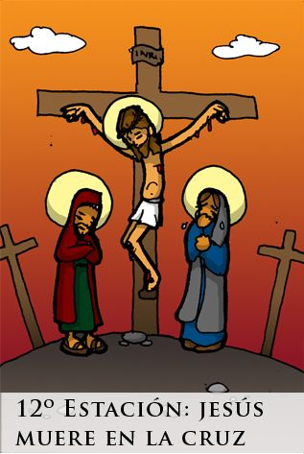
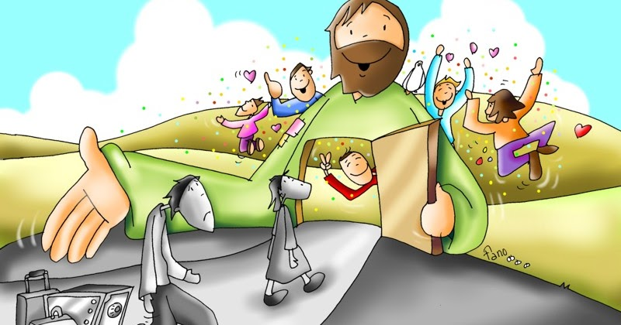
So Jesus is the promised Christ, the Savior.
From what does Jesus’ passion, death, and resurrection save us?
Jesus pays for the consequences of our sins which would be to lose eternal life.
He opens the gates of Heaven.
This requires a great sacrifice.

Slide 24
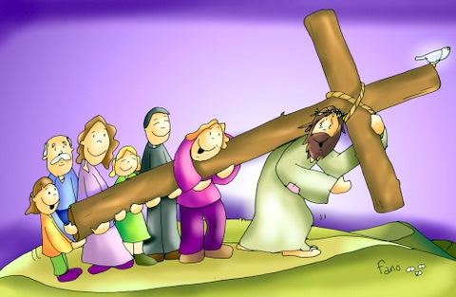
What does Jesus ask of us at the end of the Gospel?
Whoever wishes to come after me must deny himself, take up his cross, and follow me.

Slide 25
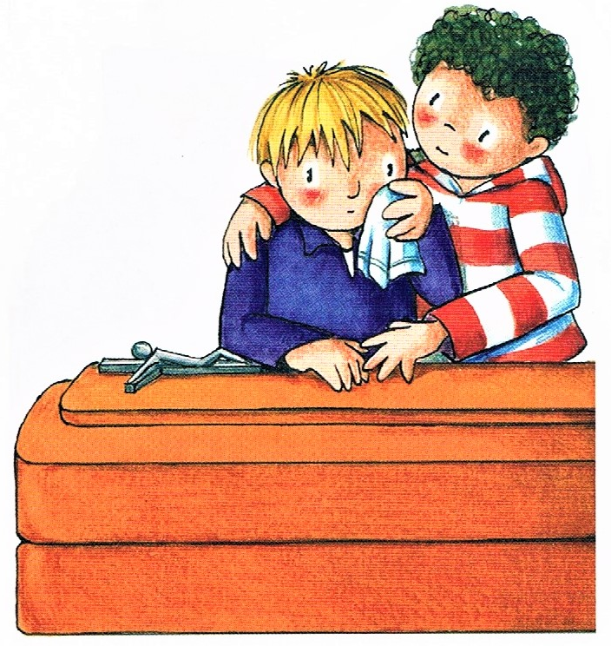
What does this mean?
Just as Jesus’ sacrifice opens the gates of Heaven for us, our sacrifices for Jesus help us get to Heaven and help others get to Heaven.

Slide 26
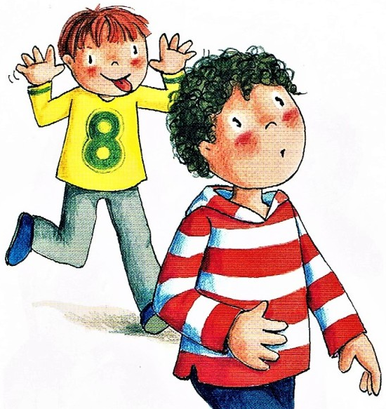
What does this mean?
When we decide to follow Jesus and His commandments and not a disobedient friend,
…when we stop doing something we love to help another or to help Jesus, we are carrying our cross and gaining Heaven.

Slide 27
Life on earth ends,
but our soul continues to Heaven if we follow Jesus.

Slide 28
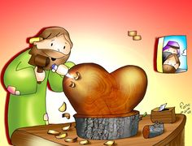
Activities

Slide 29
Mark 8: 27-35
Who do the people say that I am?
COLOR

Slide 30
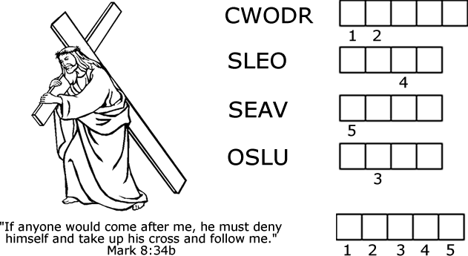
Instructions: Unscramble the words. Put the letters with a number underneath in the corresponding space at the bottom to reveal the word.
C R O W D
L O S E
S A V E
S O U L
C
R
O
S
S

Slide 31
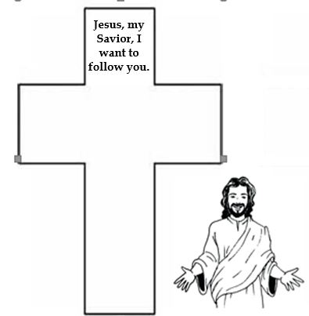

Slide 32
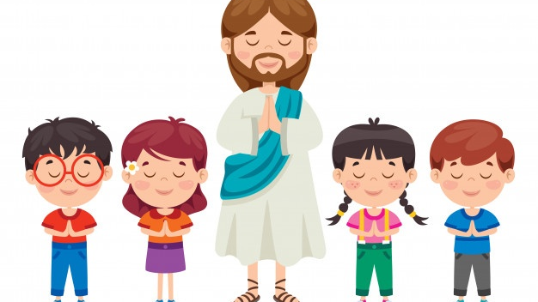
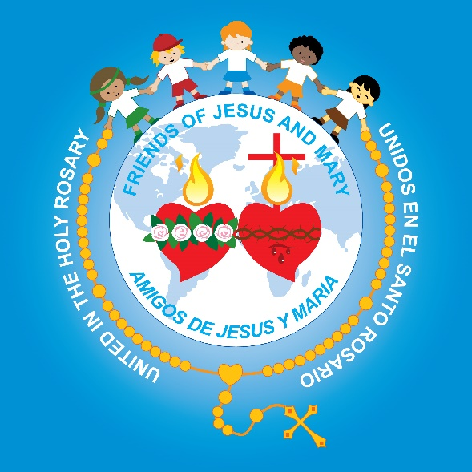
PRAYER
Lord, I want to follow you. Help me to carry my cross with love by obeying, helping those in need, forgiving, and offering sacrifices for the salvation of souls. Amen.

Slide 33
I will follow you. Roy Rantung https://youtu.be/jpVuBcbZ24c

