Slide 1
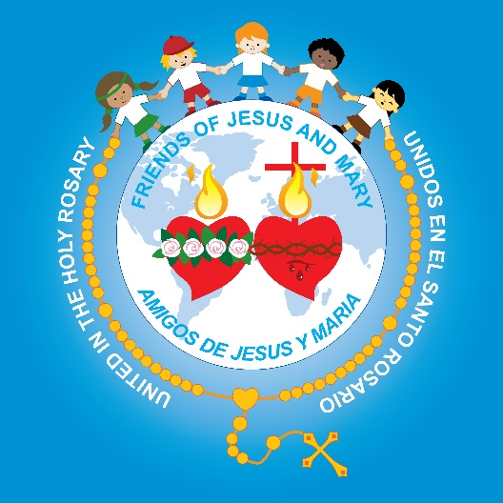
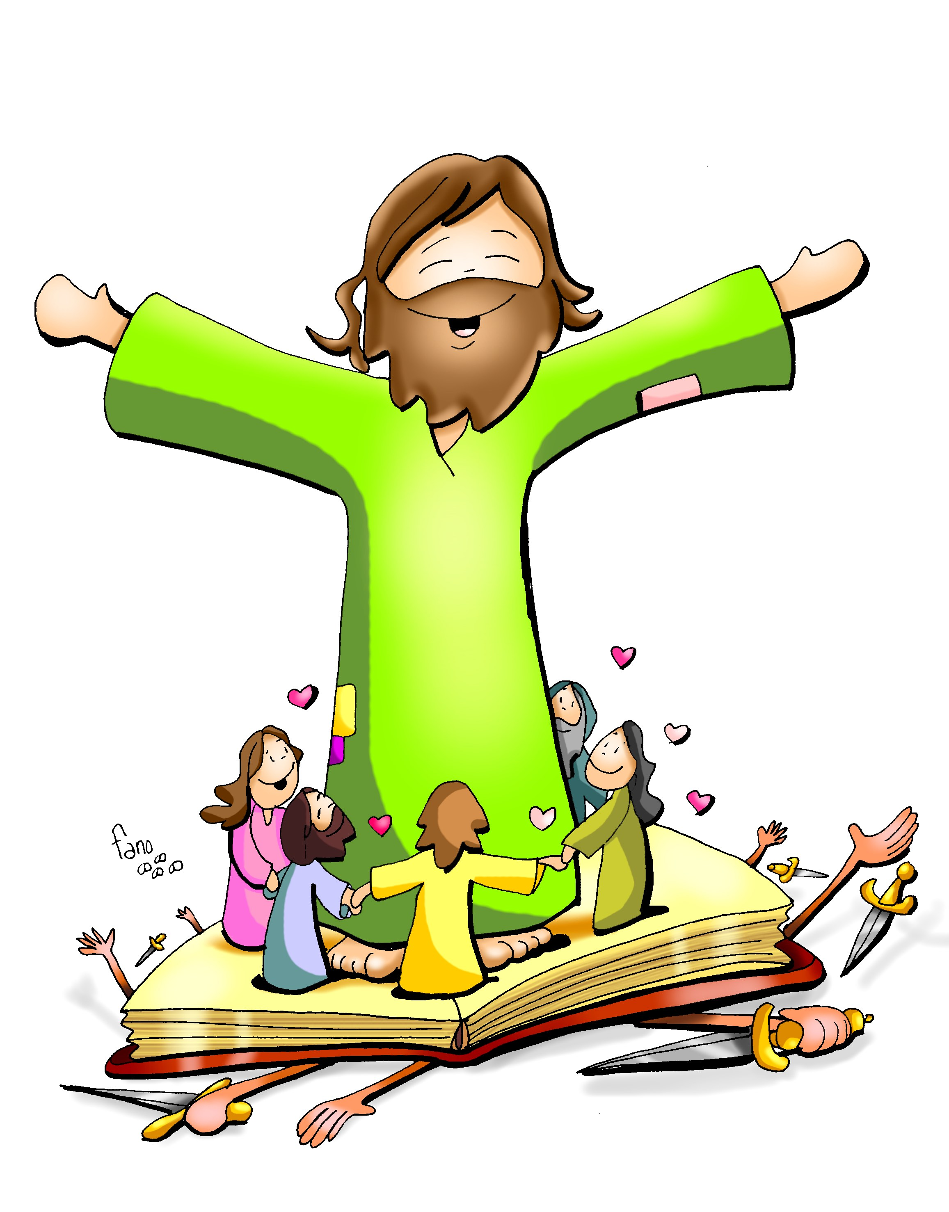
Friends of Jesus and Mary
Prayer Group for Children
Cycle B-XXX Sunday in Ordinary Time
Mark 10, 46-52
Jesus Heals a Blind Man

Slide 2
Blind Beggar Healed, The Global Gospel, https://youtu.be/T1NhVw3iN-Uel

Slide 3
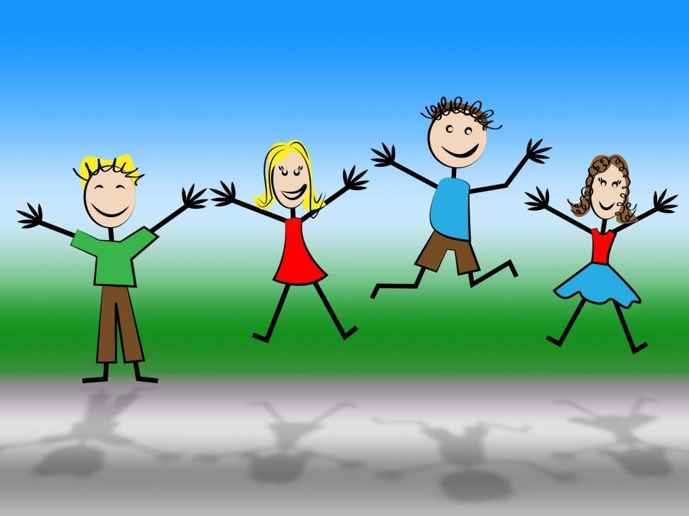
REFLECTION

Slide 4
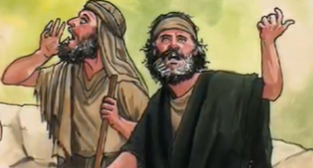
Bartimaeus, a blind beggar called out: “Jesus, son of David, have pity on me!”
Why did he call Him this?
He believed Jesus was the promised Messiah, descendant of King David.
Isaiah (11,1-9) prophesized years before that the Savior would be a descendent of David and he would bring reconciliation.

Slide 5
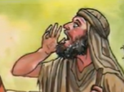
The prophets had foretold the Messiah would perform many miracles and healings and he wanted to see.
He insisted although many tried to silence him.
Why?

Slide 6
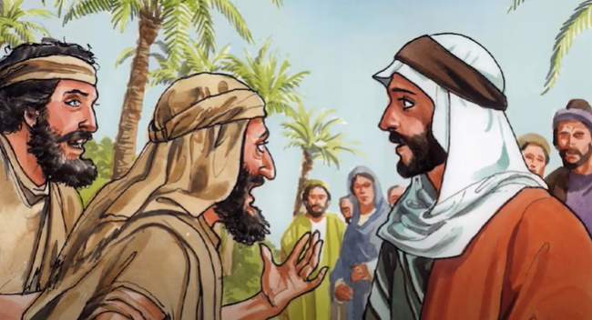
When Jesus called him, Bartimaeus immediately threw his cloak and sprang up. As a beggar, this was probably his only possession. Why did he throw it?
He had much faith in Jesus’ power and only wished to be near Him.
Jesus who is God, knew what He wanted.
Why did He ask him?

Slide 7
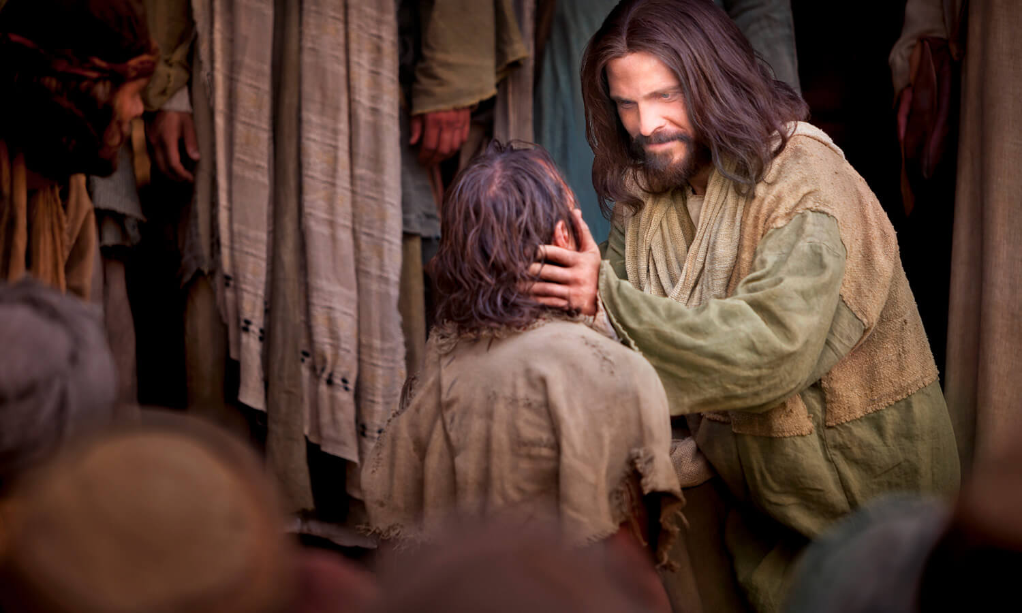
Jesus wanted him to ask for what he needed to show he trusted in Jesus’ love and power.
What does the blind man ask for?

Slide 8
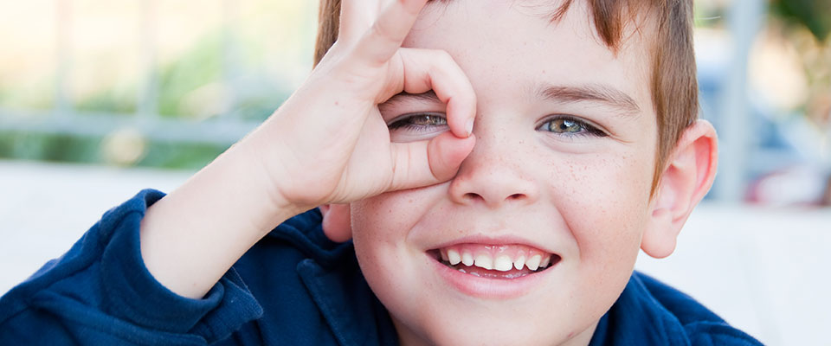
He wanted to see.
We see people and things with our eyes.
How do we see God?

Slide 9
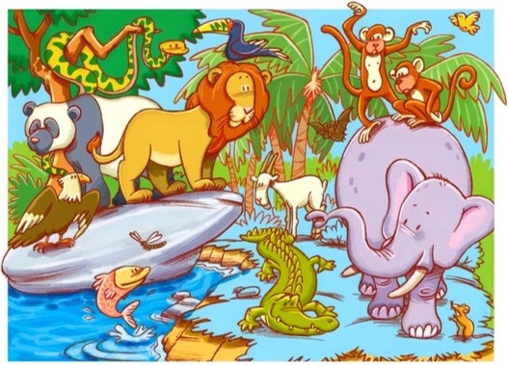
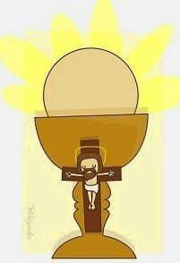
We see Him with our spiritual heart when we have faith...
In the Bible,
In nature,
In our brothers & sisters,
IN THE EUCHARIST

Slide 10
What is Jesus’ answer?
Your faith has saved you.
Bartimaeus saw Jesus with his heart, though not with his eyes.

Slide 11
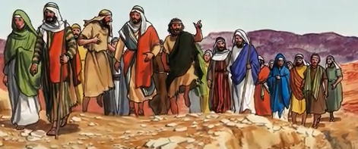
What did he do after he was healed?
He began to follow Jesus.
Do you ask Jesus for what you need trusting in His love for you?
Do you follow Him every day?

Slide 12
Activities

Slide 13
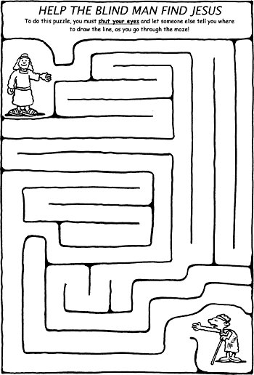

Slide 14
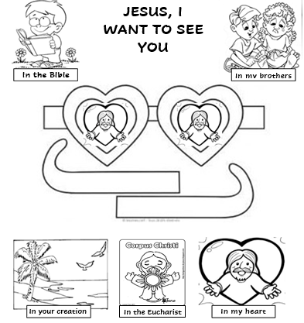

Slide 15
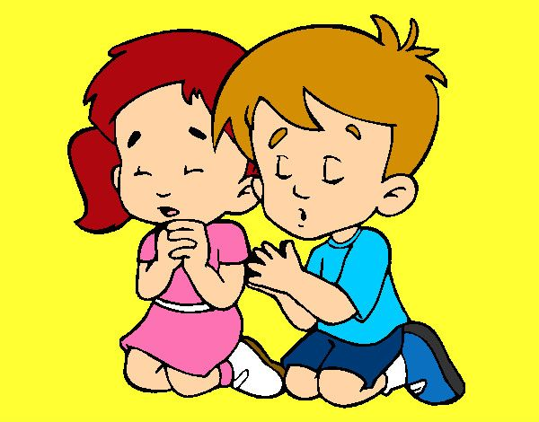
Jesus, give me more faith that I may believe completely in your great love for me. Help me to see you with my heart and always ask you for what I need, always accepting your Holy Will. Don’t let me ever separate from you. Amen
Prayer

Slide 16
Song: Open the Eyes of my Heart Lord, Ft. Paul Baloche, (Ctrl Clck) https://youtu.be/r_2xLdgkNKs

