Slide 1
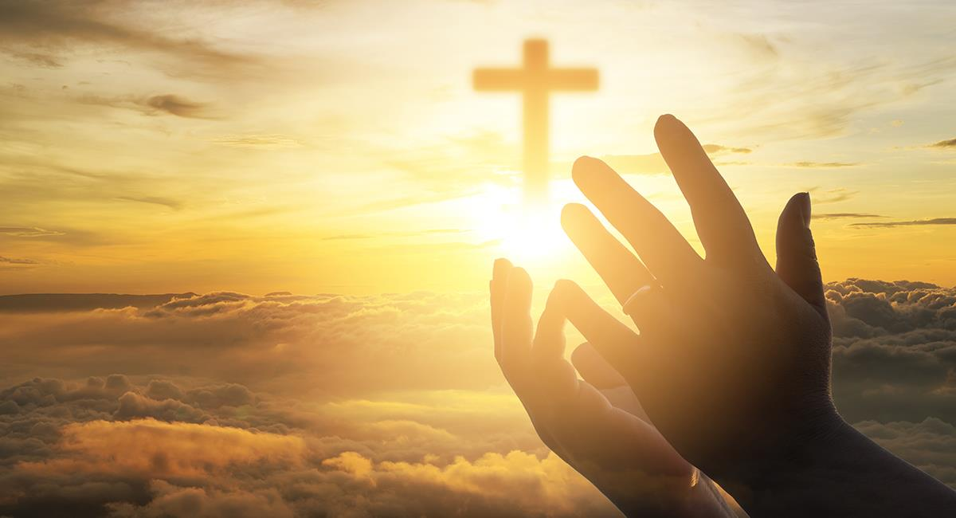
Friends of Jesus and Mary
XXXI Sunday in Ordinary Time
The First Commandment
Deuteronomy 6, 2-6; Psalm 17; Hebrews 7, 23-28; Mark 12, 28-34

Slide 2
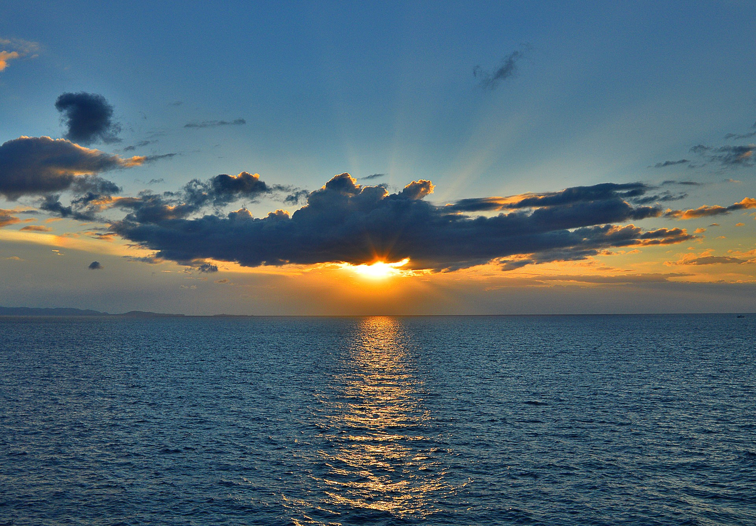

The First Commandment
Mark 12, 28-34
One of the scribes came to Jesus and asked him, "Which is the first of all the commandments?" Jesus replied, "The first is this:
Hear, O Israel! The Lord our God is Lord alone! You shall love the Lord your God with all your heart, with all your soul, with all your mind, and with all your strength.

Slide 3
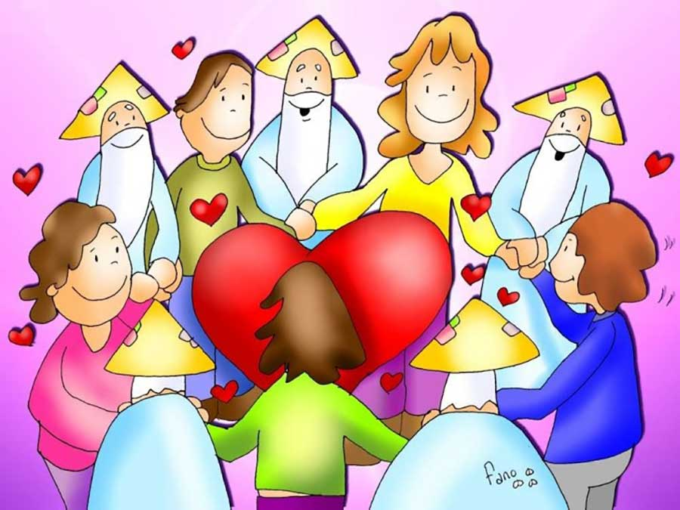
The second is this:
You shall love your neighbor as yourself.
There is no other commandment greater than these.”
The scribe said to him, "Well said, teacher. You are right in saying, 'He is One and there is no other than he.' And 'to love him with all your heart, with all your understanding, with all your strength, and to love your neighbor as yourself' is worth more than all burnt offerings and sacrifices."
And when Jesus saw that he answered with understanding, he said to him, "You are not far from the kingdom of God." And no one dared to ask him any more questions.
The Gospel of the Lord, Praise to You Lord Jesus Christ.

Slide 4
REFLECTION

Slide 5
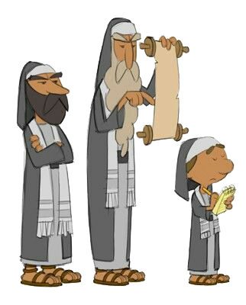
One of the scribes came to Jesus.
Who was a scribe?
A person that studied the Law of Moses.
What does he ask Jesus?

Slide 6
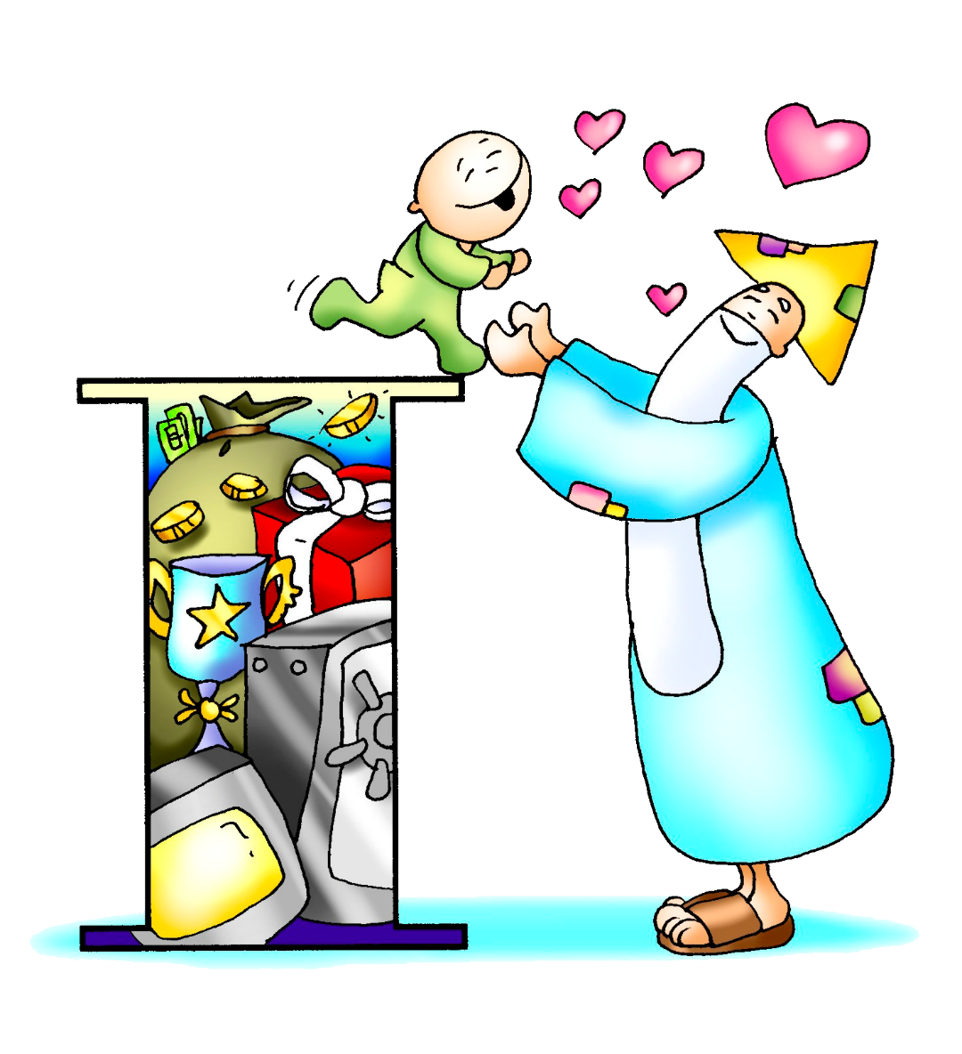
Which is the first of all the commandments?
What does Jesus respond ?

Slide 7
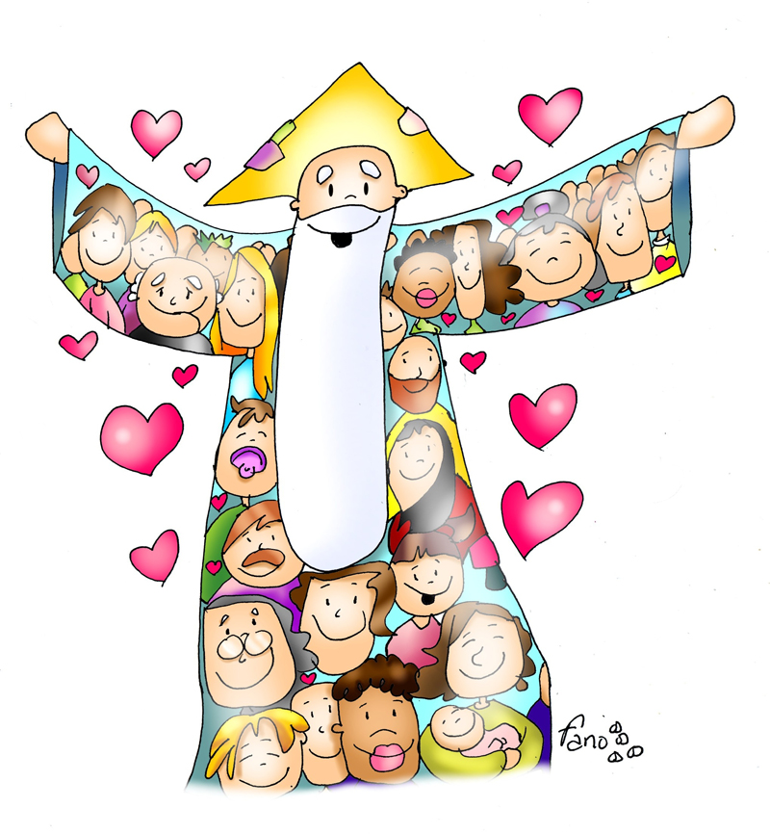
You shall love the Lord your God with all your heart, with all your soul, with all your mind, and with all your strength.
Jesus adds a second commandment.
What was it?

Slide 8
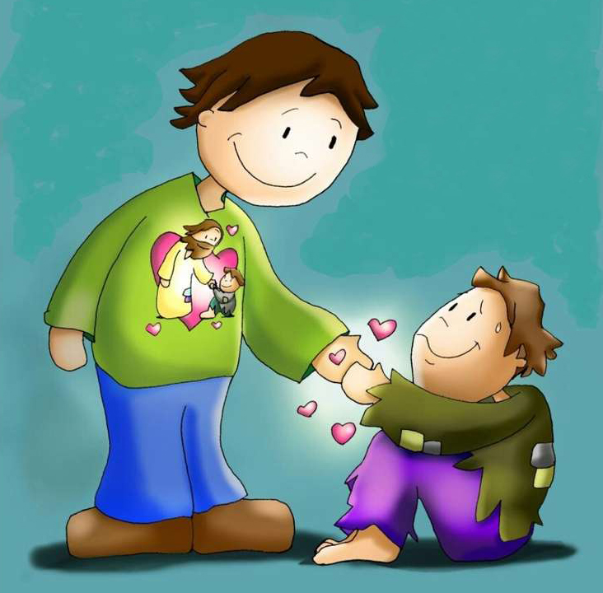
You shall love your neighbor as yourself.
What do they both have in common?

Slide 9
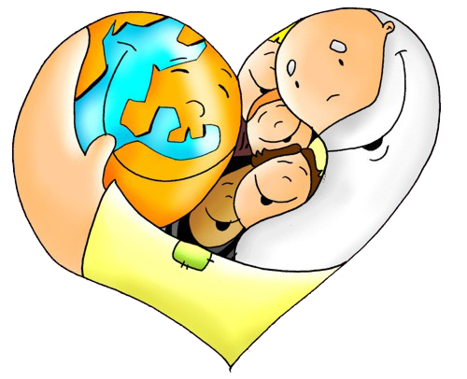
LOVE

Slide 10
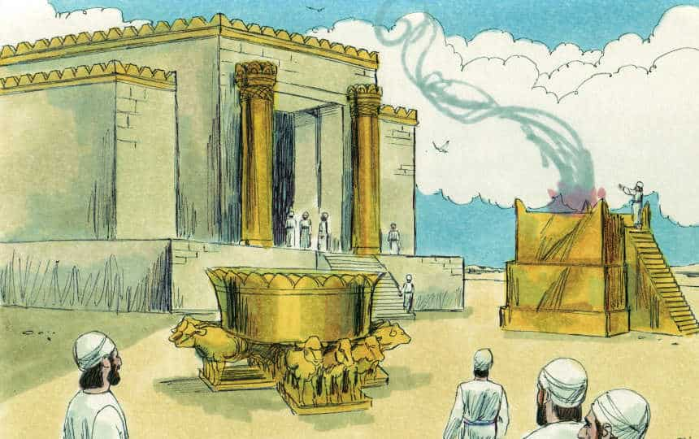
The Scribe agreed, adding that loving God and loving your neighbor is worth more than all burnt offerings and sacrifices.
During that time, the law required animal sacrifices or food offerings to God in thanksgiving for something, to ask for forgiveness, and for other reasons.
What the Scribe meant was that loving God and neighbor is more important than following the law of sacrifices mechanically, for appearance’s sake, but without love.
What does Jesus answer him?

Slide 11
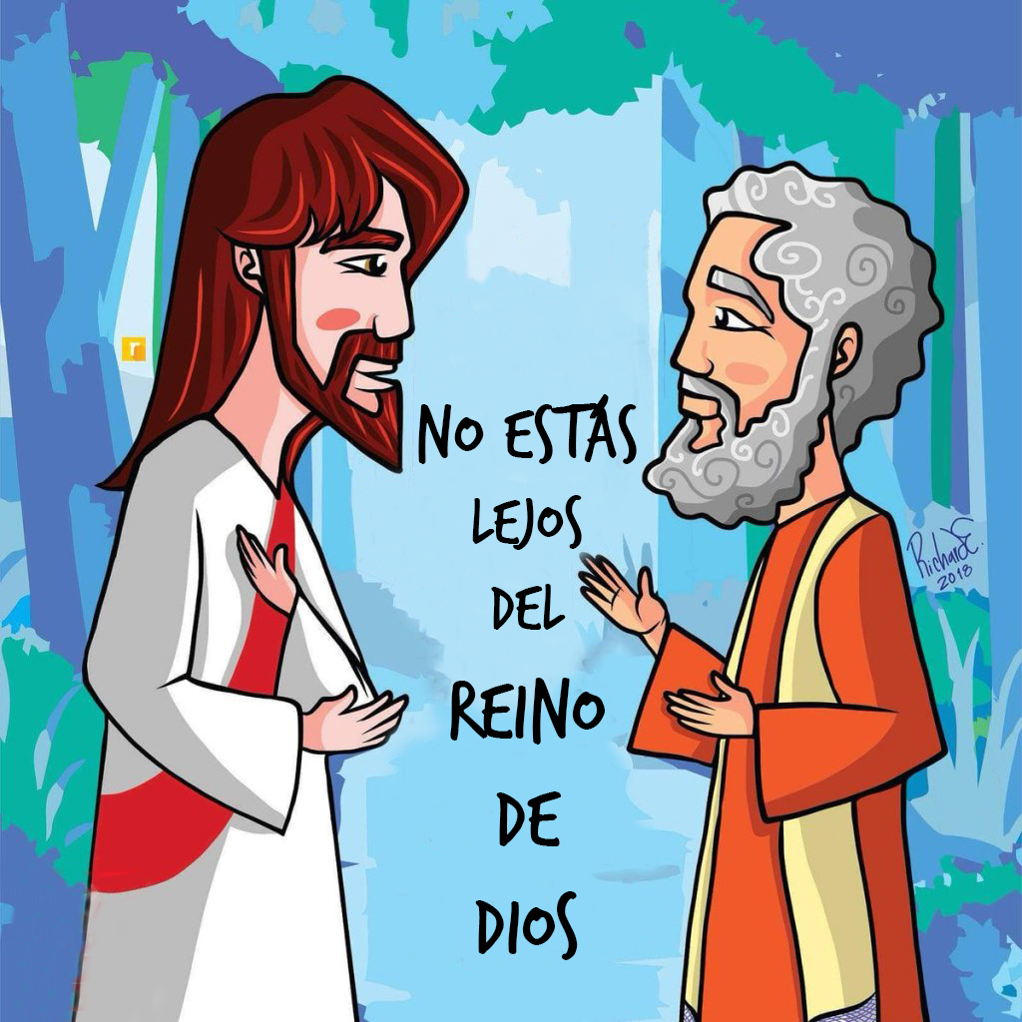
You are not far from the Kingdom of God.

Slide 12
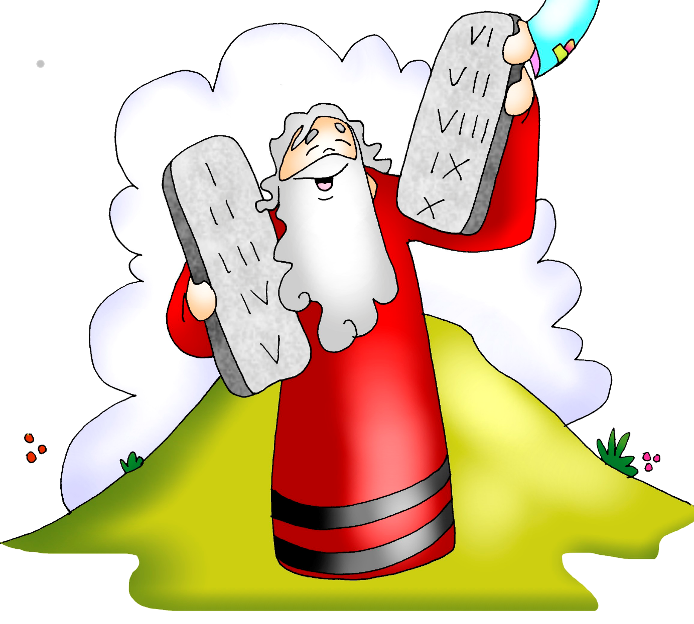
Why did God give us the commandments ?
He loves us and wants us to be happy.
He knows that if we don’t follow them, bad things can happen that cause us to be sad and even to lose eternal life.
If we follow them with love, we will have eternal life.

Slide 13
How are the 10 commandments related to these 2 commandments?
1
2
The Lord our God is Lord alone! You shall love the Lord your God with all your heart, with all your soul, with all your mind, and with all your strength.
You shall love your neighbor as yourself.
4) Love your parents.
5) Do not kill
1) Love God above all
6) Do not commit impure acts.
2) Do not say His name in vain.
7) Do not steal.
GOD
3) Keep Holy the Sabbath Day.
The first summarizes the first 3 commandments;
The second summarizes the last 7 commandments.
8) Do not lie
9) Do not covet another’s spouse.
10) Do not covet another’s things..

Slide 14
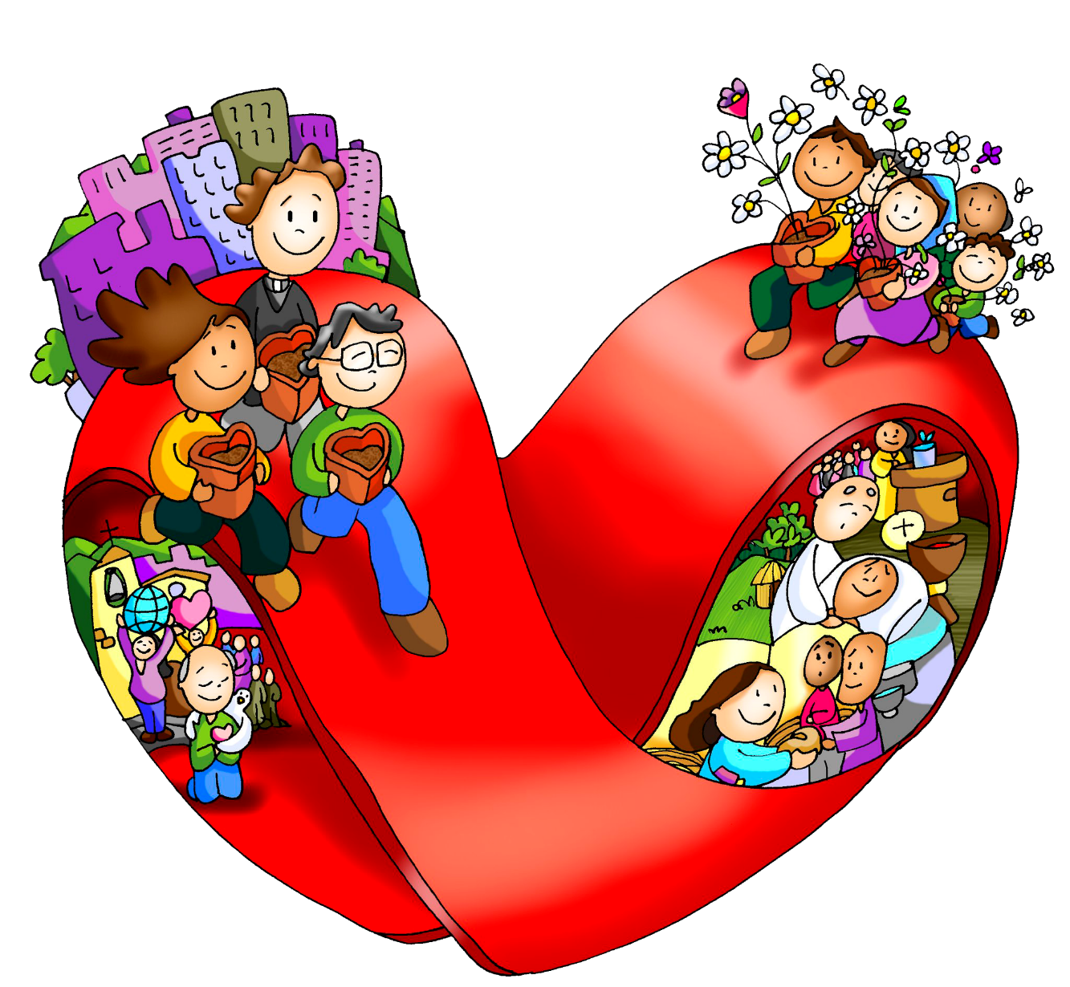
Loving God and loving neighbor is what God asks so we may obtain eternal life.

Slide 15
ACTIVITIES

Slide 16
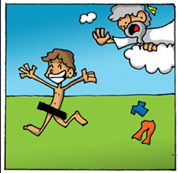
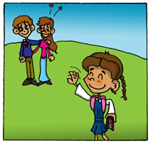
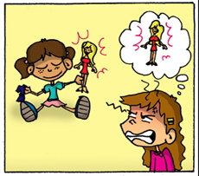
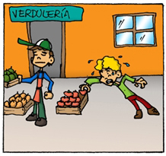
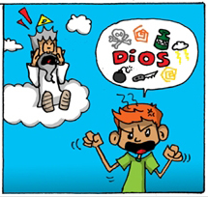
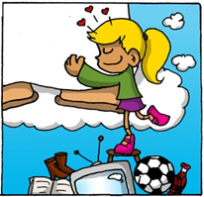
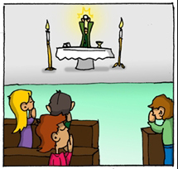
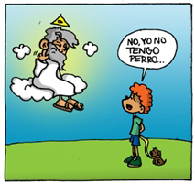
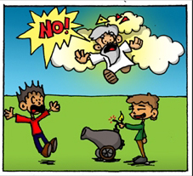
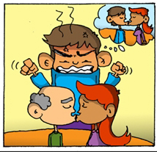
Place the commandment under the picture to which it corresponds.
VEGGIES
GOD
1) Love God above all.
2) Do not use His name in vain.
3) Keep Holy the Sabbath Day.
4) Love your parents.
5) Do not kill.
6) Do not commit impure acts.
It’s not my dog.
7) Do not steal.
8) Do not lie.
9) Do not covet another’s wife.
10) Do not covet another’s things.

Slide 17
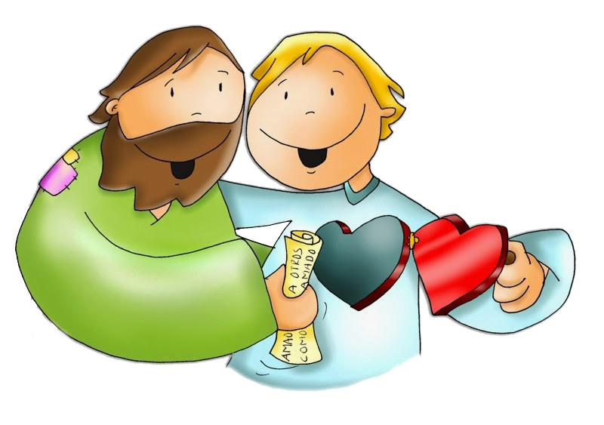
PRAYER
Lord, thank you for always caring about my happiness. Help me to love you with my whole heart so I may always want to obey you. Help me to love others more so I may be your light in the world.
Amen

Slide 18
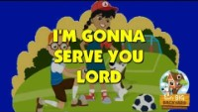
The Greatest Commandment, World of Joms (Ctrl Click) https://youtu.be/Y3DC9pBioQY

