Slide 1
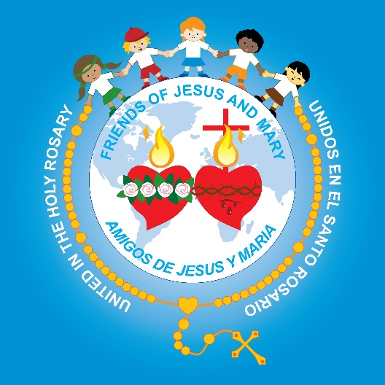
Friends of Jesus and Mary
Prayer Group for Children
Cycle B-XXXII Sunday in Ordinary Time
The Offering of the Poor Widow
Mark 12, 41-44

Slide 2
All Saints Day – November 1st – We pray that the Saints intercede for us so we too may become saints.

Slide 3
The Widow’s Offering, https://youtu.be/muXThu2MydM

Slide 4
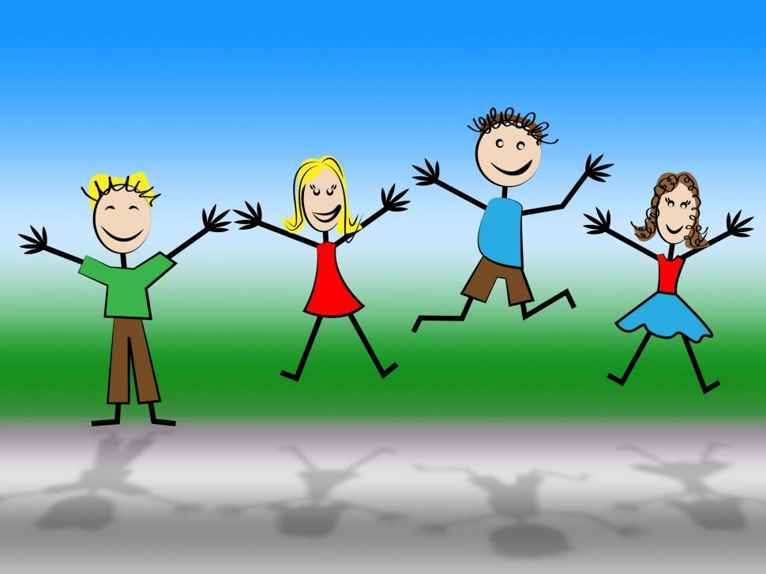
REFLECTION

Slide 5
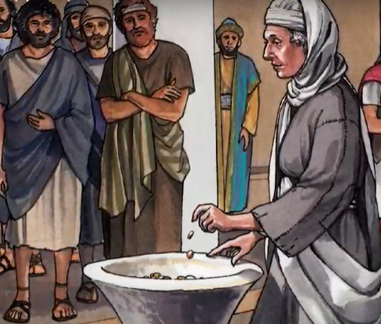
Jesus says with her two coins, the poor widow has given more than anyone.
Why does He say this when the rich gave so much more?

Slide 6
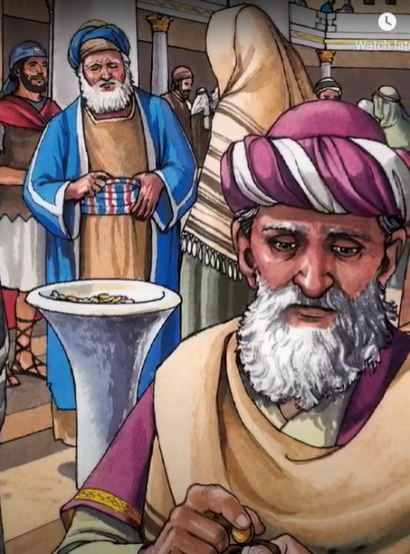
The rich had given from their surplus or extra and the widow gave what she needed to live.

Slide 7
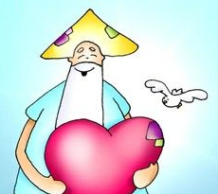
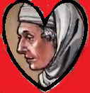
She loved God with her whole heart and wanted to show Him her gratitude for all He had done for her.
Why did the widow give so much?

Slide 8
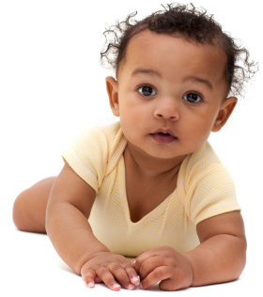
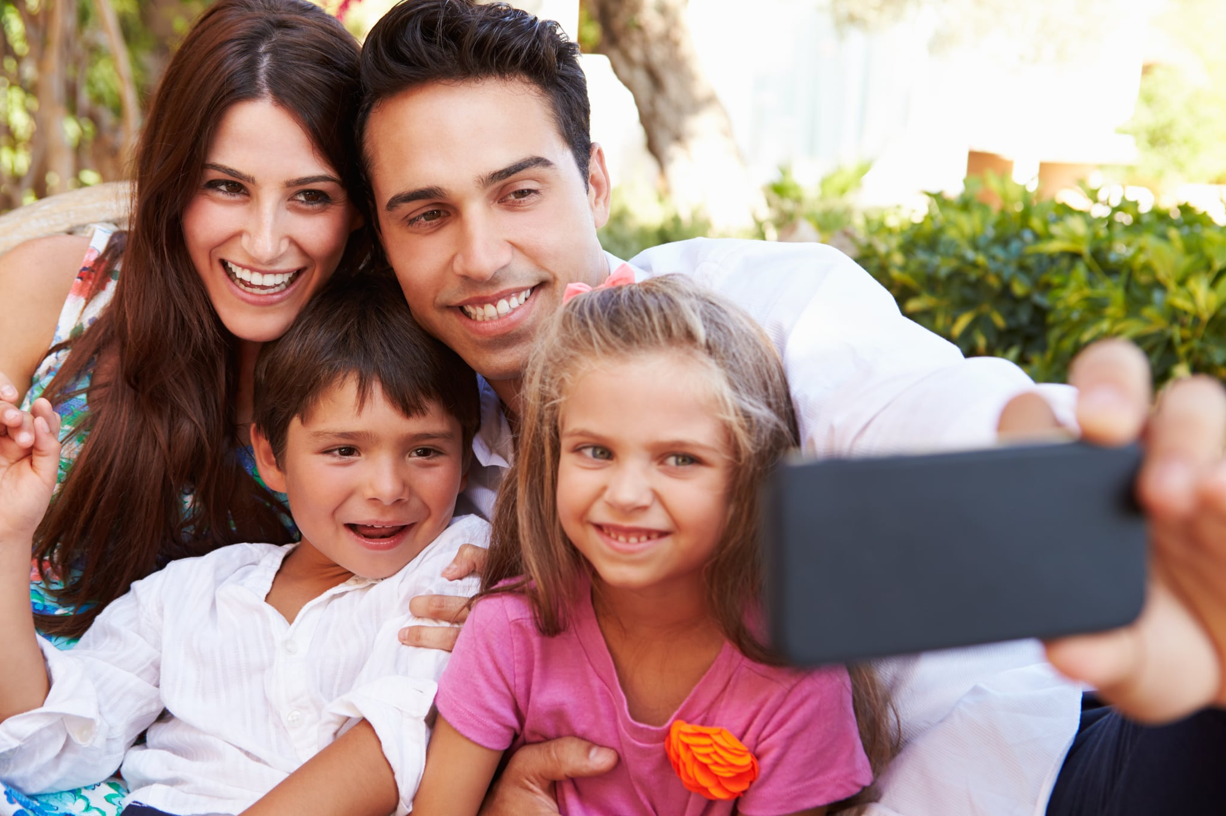
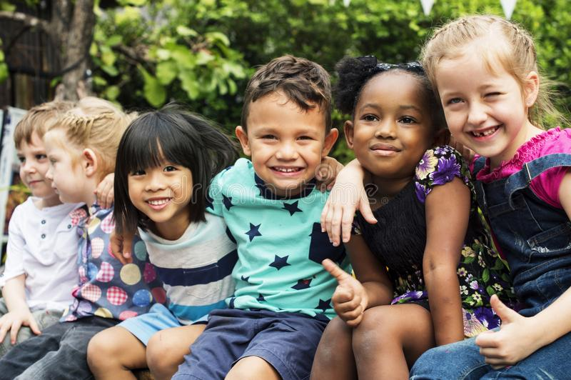
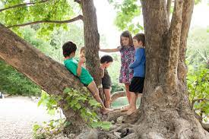
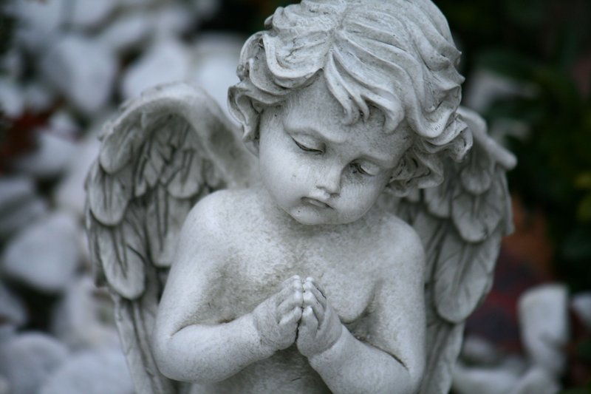
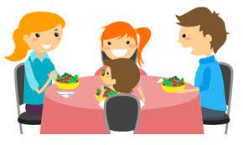
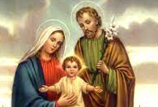
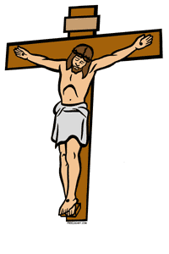
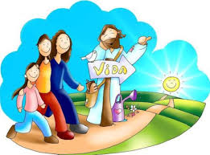
What has God done for us?
He gave us life,
Our families,
Our friends,
Our home and food,
The earth,
Our Guardian Angel,
He paid for our sins on the cross and gave us…
LIFE
Eternal
Life
Our family in Heaven,

Slide 9
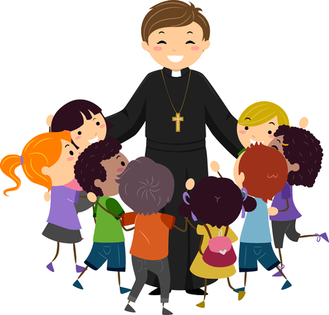
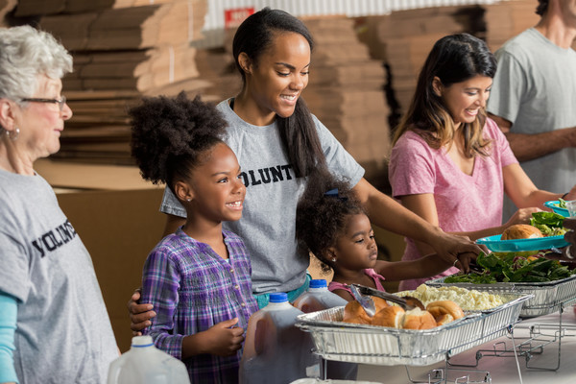
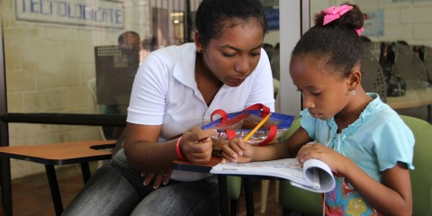
Why is it important to give to the Church and to the less fortunate?
The Church needs us to be able to communicate Jesus’ message of love so all may be saved,
To help the less fortunate,
To build schools that teach children about God…

Slide 10
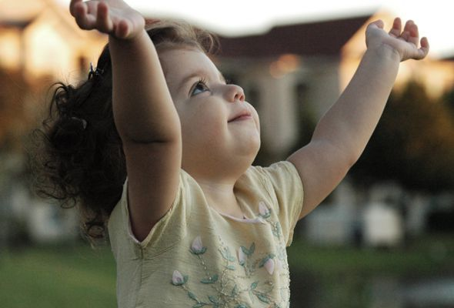
When we give, we are adoring God, letting Him know we love Him and are grateful for all He does for us.

Slide 11
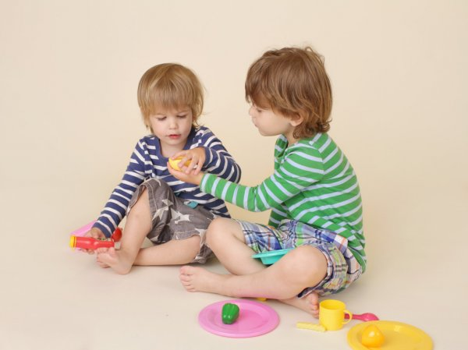
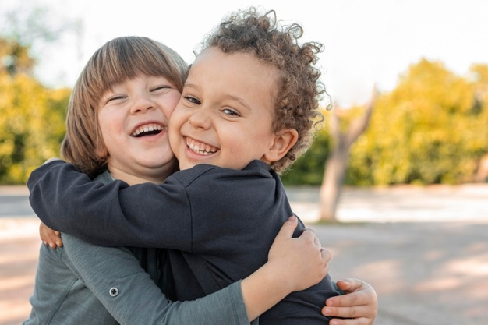
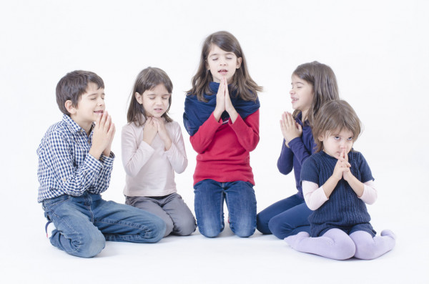
We make a valuable offering to God.
When we offer up to God with love…
Our work,
Our sharing with others,
Our time and talents,
Our forgiveness to those who hurt us,
Our prayer for others,

Slide 12
What talents, time, or treasures can you share to build God’s Kingdom? Share.

Slide 13
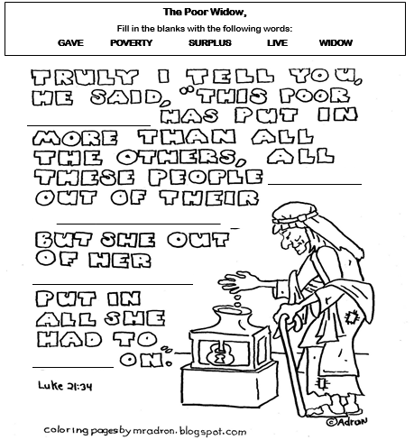
widow
gave
surplus
poverty
live

Slide 14
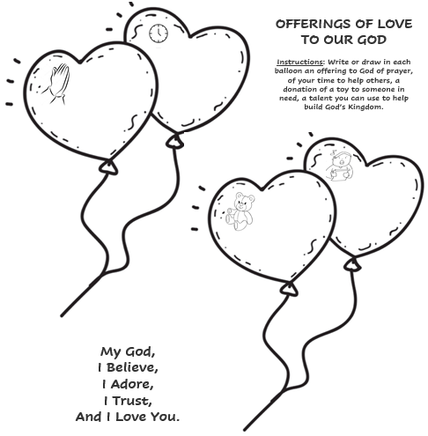

Slide 15
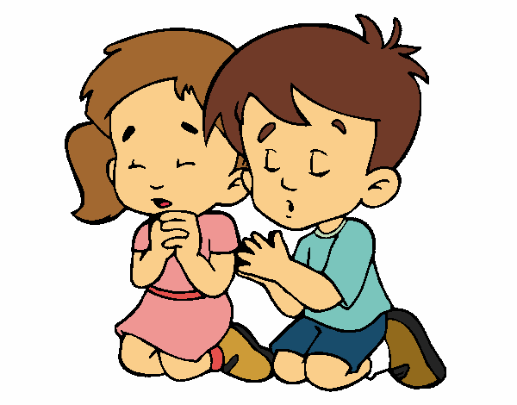
Prayer Lord, we have received life and all that we are and have from your generosity. Help me to put all Your gifts at the service of others to help build Your Kingdom. Amen.

Slide 16
A Gift to You, Angel911 (Ctrl Click) https://youtu.be/J_g76phMf5E (2-7 years)

Slide 17
All that I am, Lifetree Kids, (Ctrl Click) https://youtu.be/pP1SKYk11Ow (8+ years)

