Slide 1
Ministry Friends of Jesus and Mary
Cycle B - XXXIII Sunday in Ordinary Time
Mark 13, 24-32
The Return of the Son of Man

Slide 2
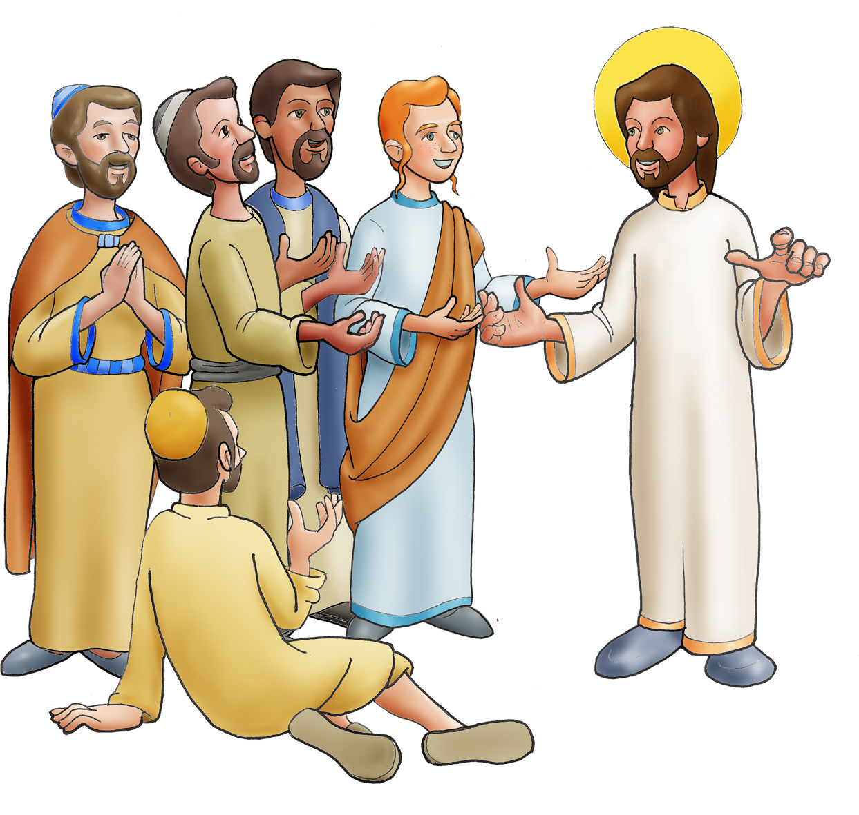
The Return of the Son of Man
Jesus said to his disciples:

Slide 3
In those days after that tribulation the sun will be darkened, and the moon will not give its light, and the stars will be falling from the sky, and the powers in the heavens will be shaken.

Slide 4
And then they will see 'the Son of Man coming in the clouds' with great power and glory,

Slide 5
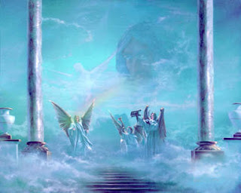
…and then he will send out the angels and gather his elect from the four winds, from the end of the earth to the end of the sky.

Slide 6
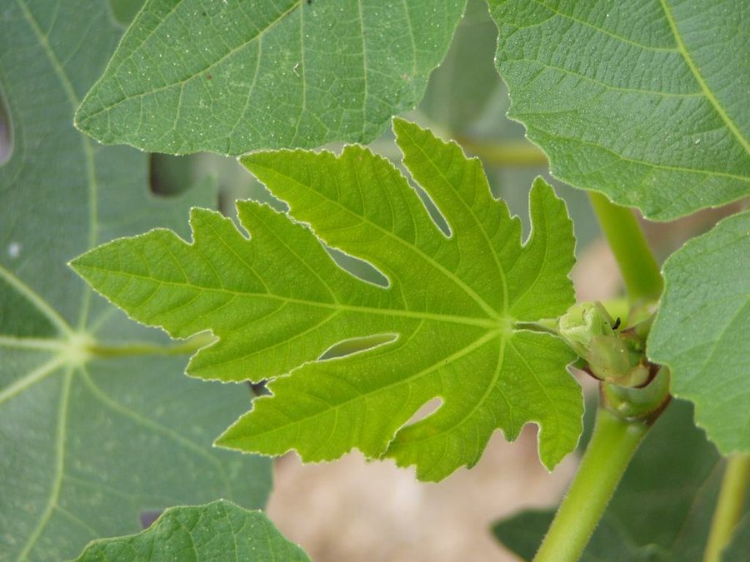
Learn a lesson from the fig tree. When its branch becomes tender and sprouts leaves, you know that summer is near.

Slide 7
In the same way, when you see these things happening, know that he is near, at the gates.

Slide 8
Amen, I say to you, this generation will not pass away until all these things have taken place.

Slide 9
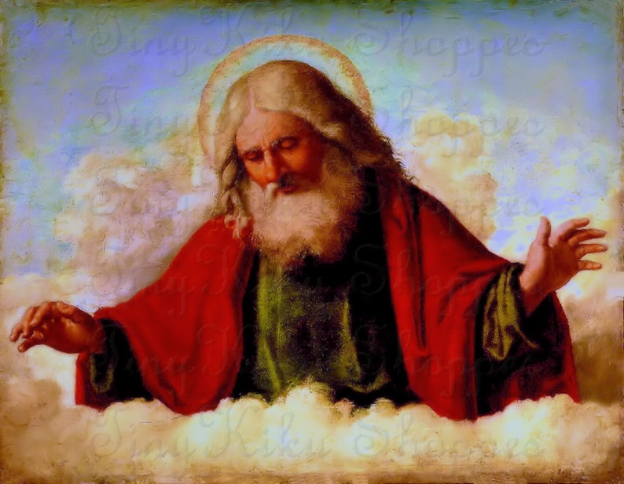
But of that day or hour, no one knows, neither the angels in heaven, nor the Son, but only the Father.

Slide 10
Reflection

Slide 11
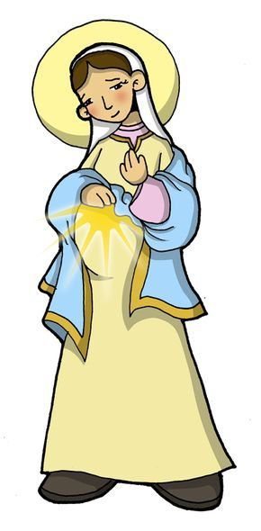
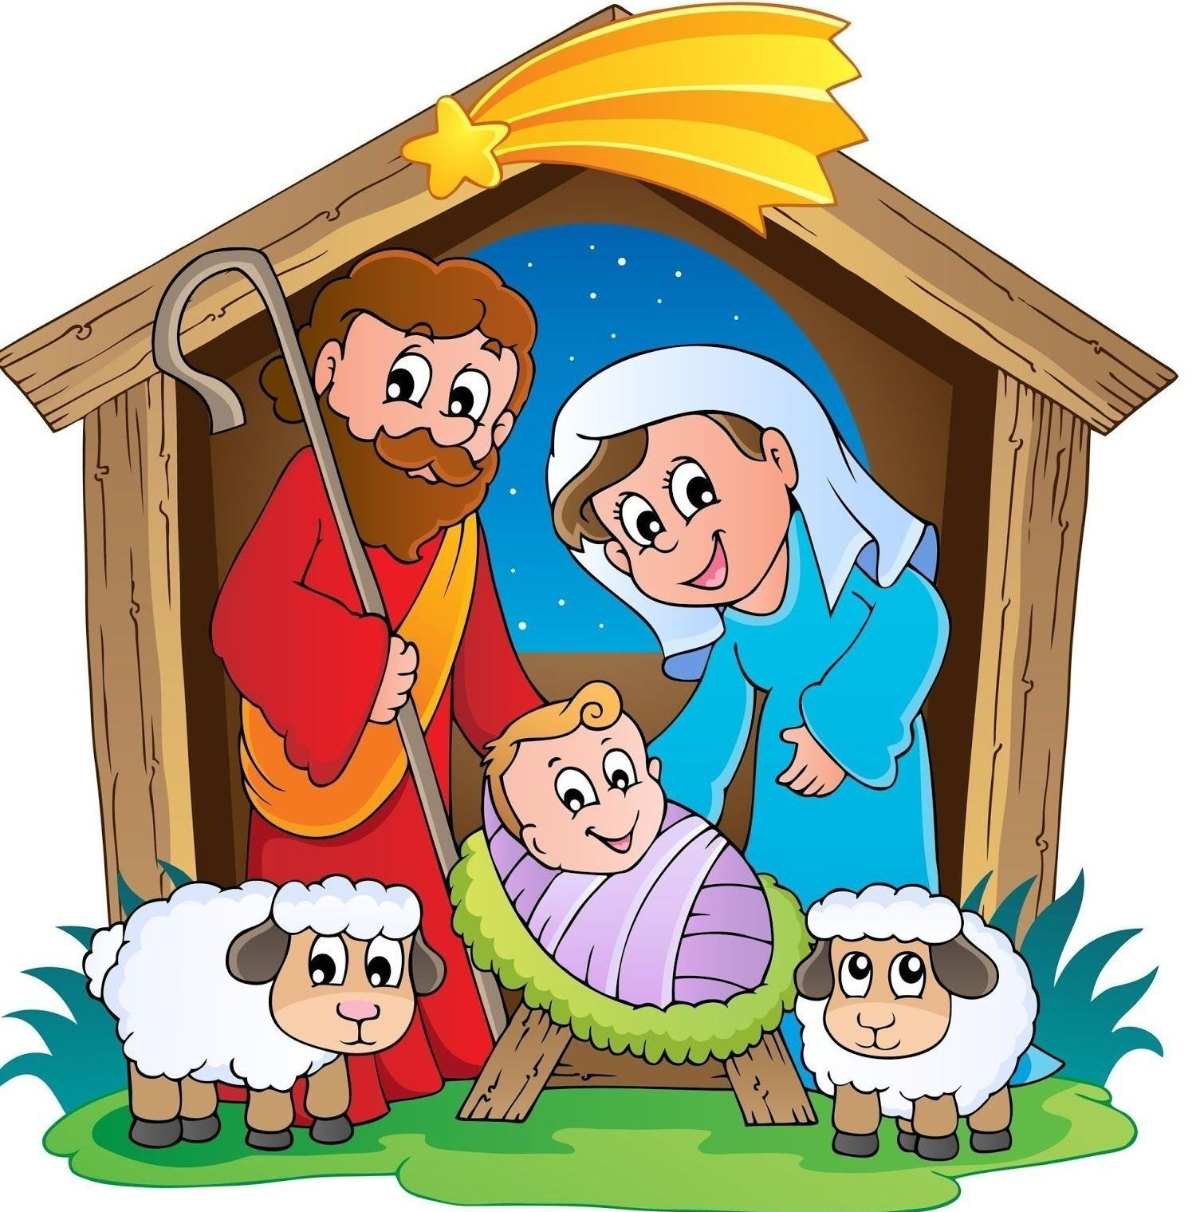
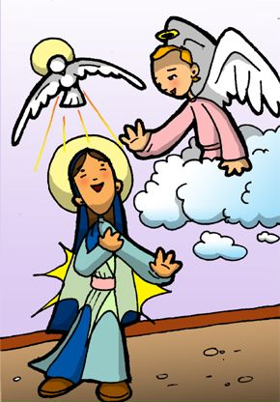
Jesus here promises to return for the second time to earth. How did He come the first time?
In the womb of the Virgin Mary

Slide 12
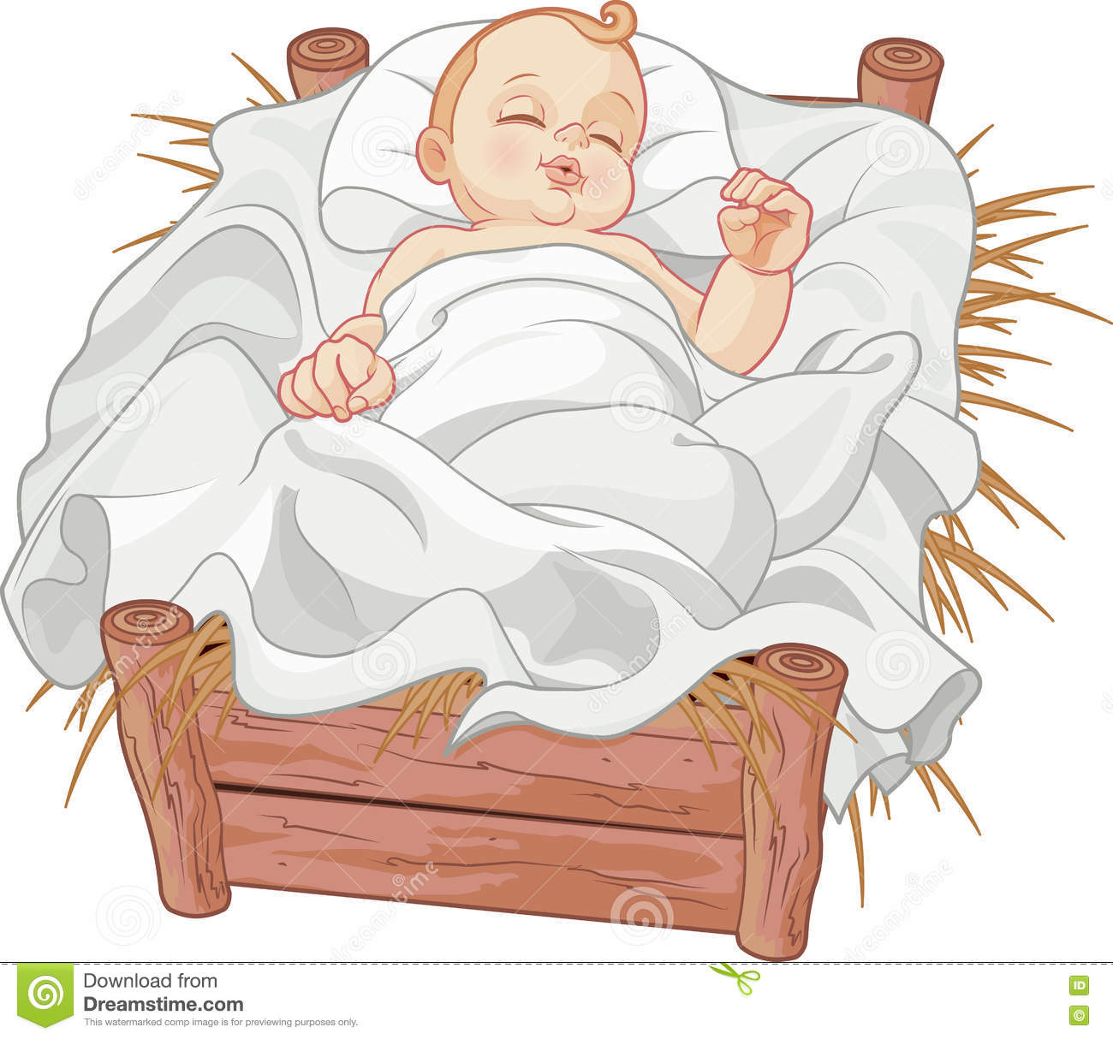
Why did He come small?
He wanted to share in our smallness and so only those with clean hearts can recognize Him.

Slide 13
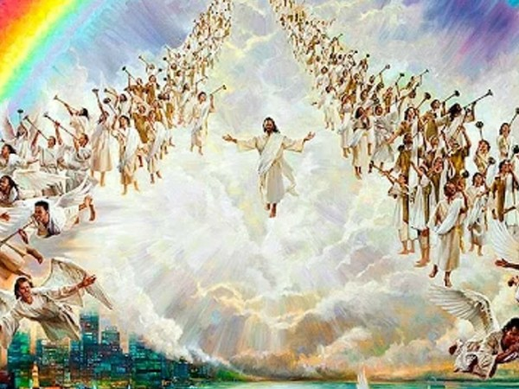
How will He come the second time?
Over the clouds with much power and majesty so all may recognize Him.

Slide 14
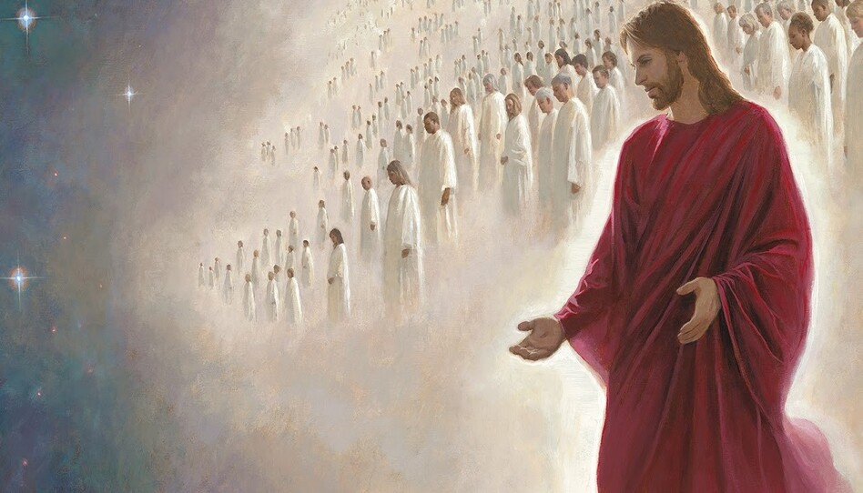
What will He do when He returns?
Everyone who has died will resurrect and
He will gather His elect to share in His glory in body and soul forever.

Slide 15
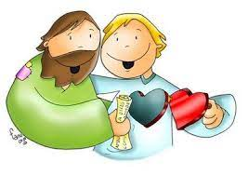
How do we prepare our hearts to recognize and follow Jesus so we may be one of His elect?
Obey His commandments.
Love God,
PRAY
READ THE BIBLE
Listen to Him in prayer and in the bible,

Slide 16
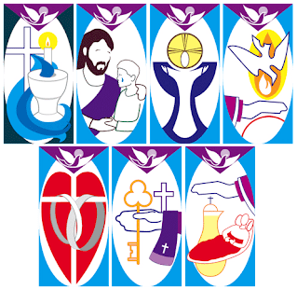
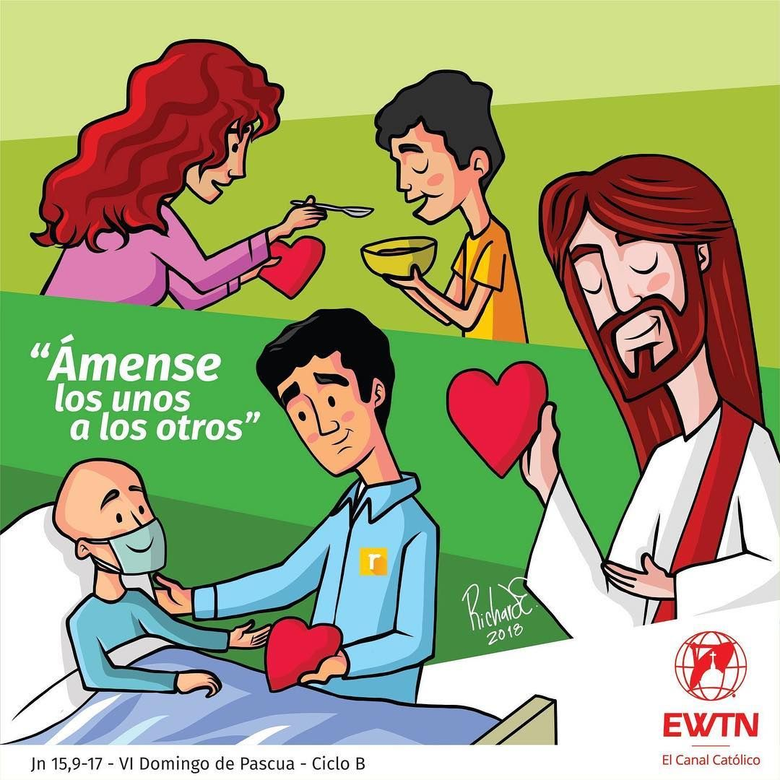
How do we prepare our hearts to recognize and follow Jesus so we may be one of His elect? (2)
LOVE ONE ANOTHER
Be humble
& obedient.
Participate in the Sacraments,
Love and serve your neighbor,

Slide 17
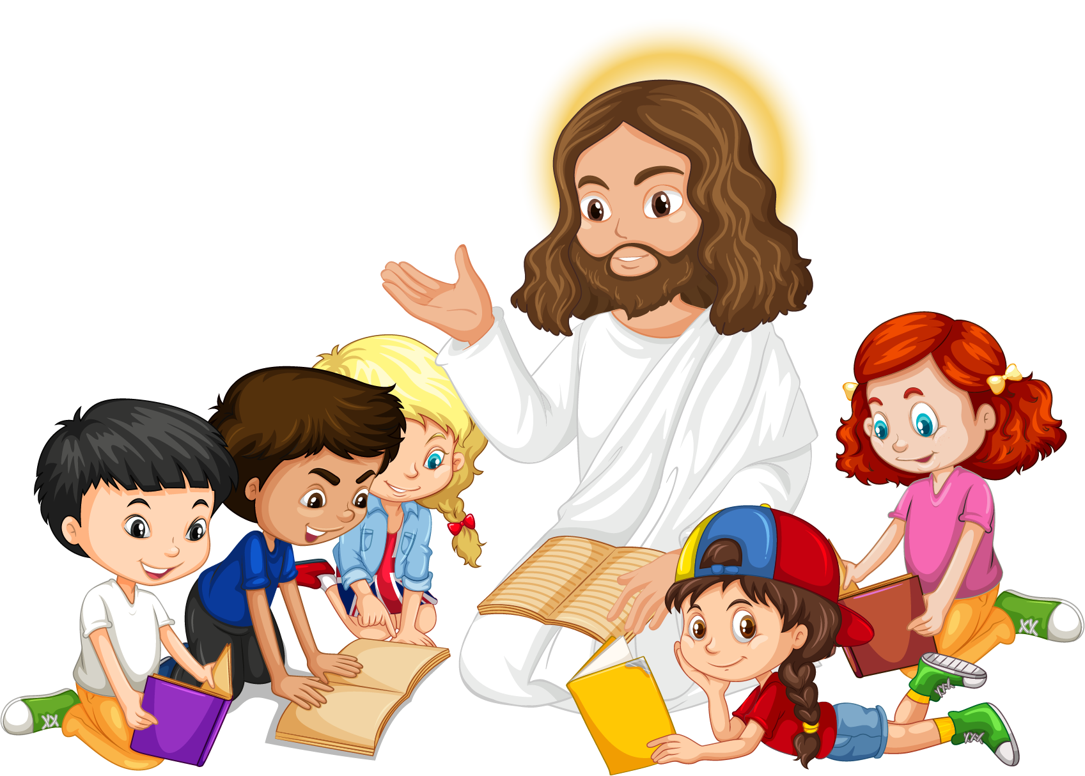
Activities

Slide 18
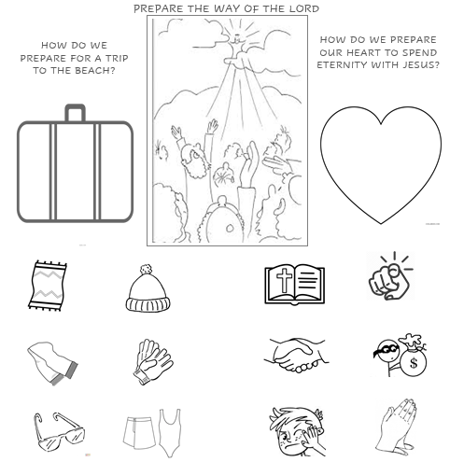
Mark an “X” over the items which are not useful.
Compare the preparation of a trip to the beach with the preparation for eternity. Choose the pictures that you need for each journey.

Slide 19
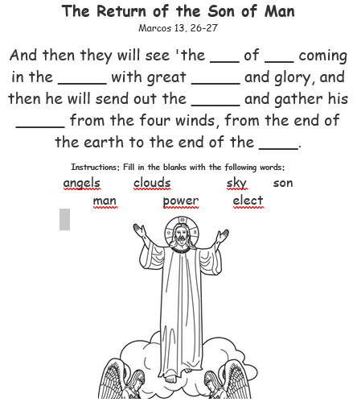
Son
Man
clouds
power
angels
elect
sky

Slide 20
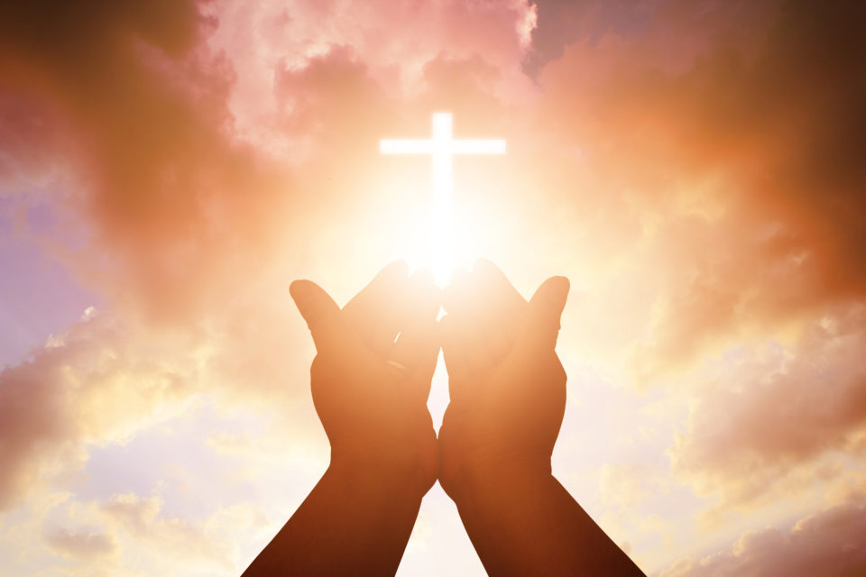
Prayer
Lord, help us to always be aware of your presence in our life. Teach us to trust in your Word above all else, since it never passes. Help us to never be afraid because You are always with us. Teach us to always love. Amen.

Slide 21
Song: I have decided to follow Jesus, Lifetree Kids (Ctrl Click) https://youtu.be/sEL0WpeH088

