Slide 1
Cycle B XXXIV Sunday in Ordinary Time Solemnity of Christ the King
MINISTRY FRIENDS OF JESUS AND MARY
Jesus Christ
King of the
Universe
John 18, 33-37

Slide 2
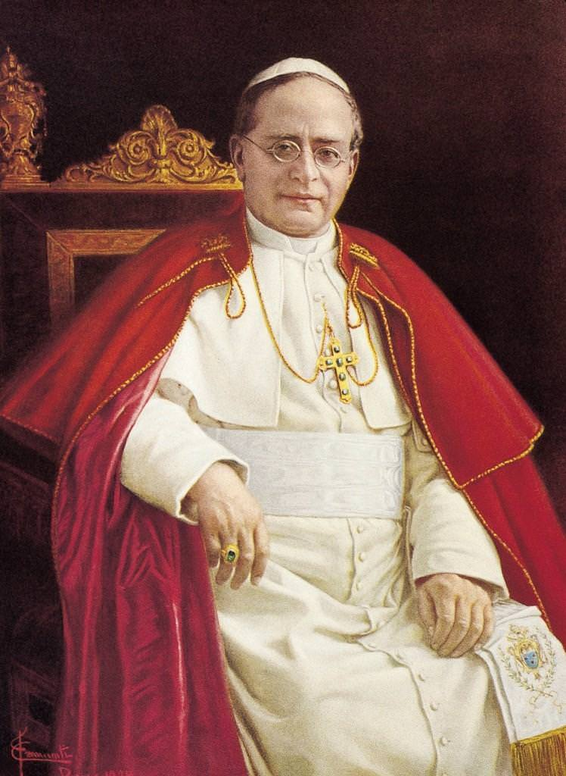
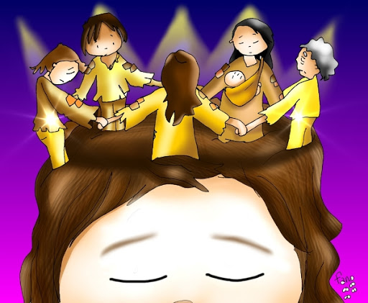
En aquel tiempo, preguntó Pilato a Jesús: “¿Eres tú el rey de los judíos?”
Who instituted the celebration of Christ the King and when?
Pope Pius XI instituted the feast on March 11, 1925.
The Pope wanted all Catholics to publicly recognize that the head of the Church is Christ the King.
Later, the Church transferred the feast to the last Sunday in Ordinary Time, the end of the Liturgical year, to emphasize the importance of Christ as the center of history. Christ is the Alfa and the Omega, the beginning and the end.

Slide 3
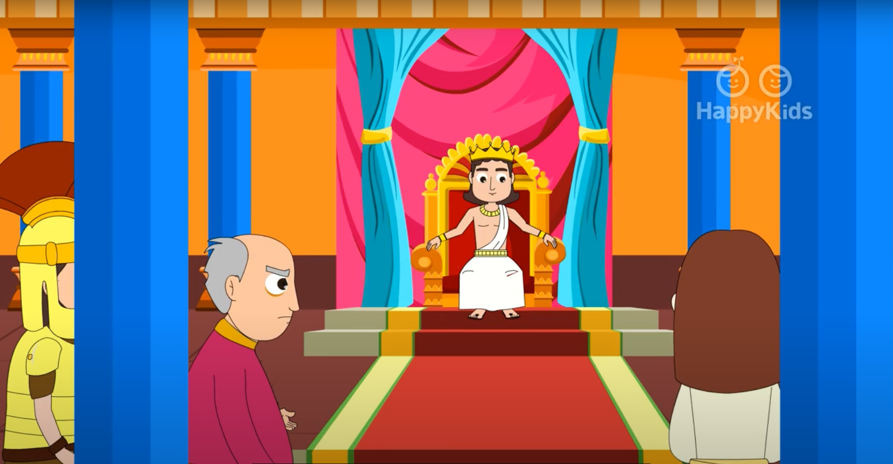
Pilate said to Jesus, "Are you the King of the Jews?"

Slide 4
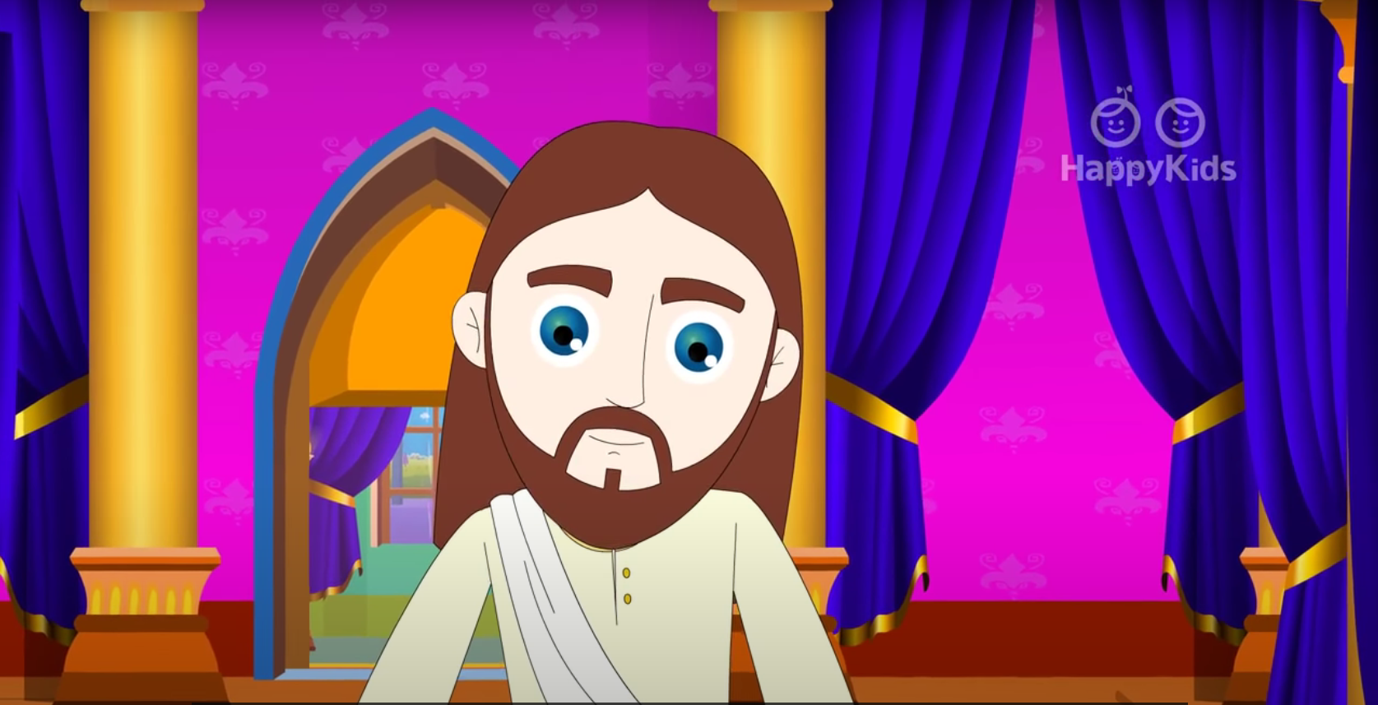
Jesus answered, "Do you say this on your own or have others told you about me?"

Slide 5
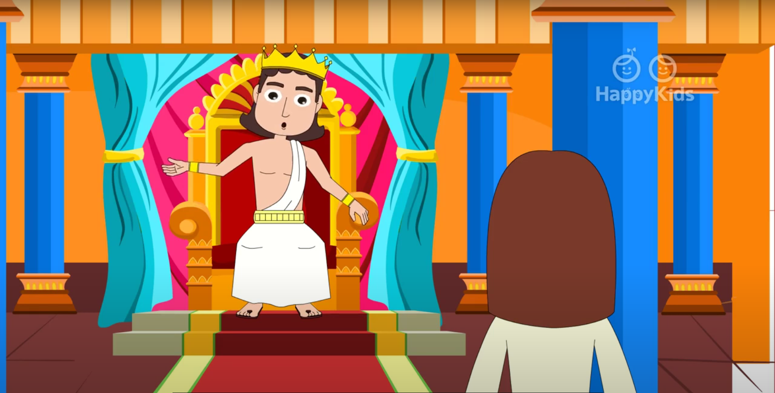
Pilate answered, "I am not a Jew, am I? Your own nation and the chief priests handed you over to me. What have you done?"

Slide 6
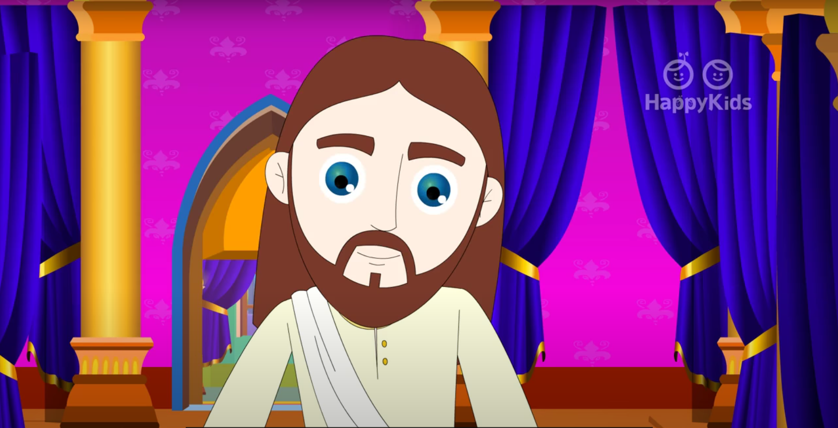
Jesus answered, "My kingdom does not belong to this world. If my kingdom did belong to this world, my attendants would be fighting to keep me from being handed over to the Jews. But as it is, my kingdom is not here."

Slide 7
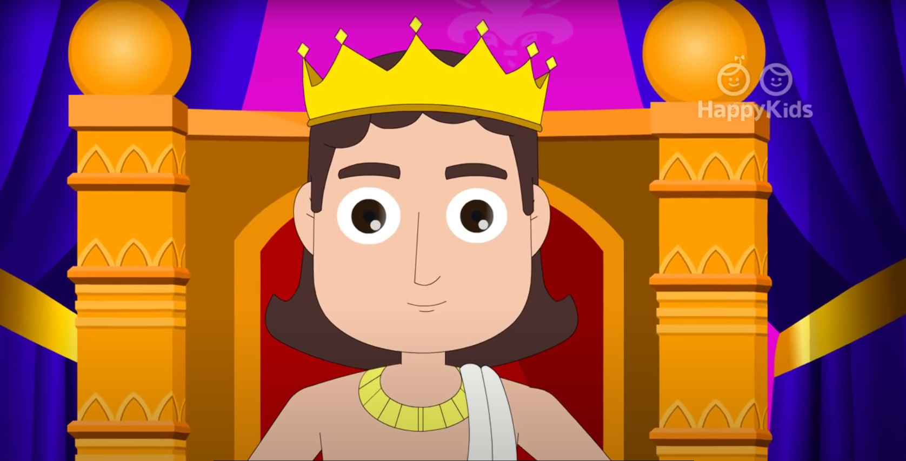
So Pilate said to him, "Then you are a king?"

Slide 8
Jesus answered, "You say I am a king. For this I was born and for this I came into the world, to testify to the truth. Everyone who belongs to the truth listens to my voice."
THE
GOSPEL
OF THE LORD.
PRAISE TO YOU
LORD JESUS CHRIST.

Slide 9
REFLECTION
Who was Pontius Pilate?
He was governor of Judea.
He had the power to be SUPREME JUDGE, which means that only he had the authority to order the execution of a criminal.
What is the 1st question that He asks Jesus?
Are you the King of the Jews?

Slide 10
Why does He ask this?
To say you were King of the Jews was a serious crime that required the death sentence.
The Jewish High Priests had paid the apostle Judas Iscariot to take them to Jesus so they could condemn Him to death.
How does Jesus describe His Kingdom?
Jesus says His Kingdom is NOT of this world.
How are Kings and Queens?
They live in castles;
They wear crowns;
They dress luxuriously.

Slide 11
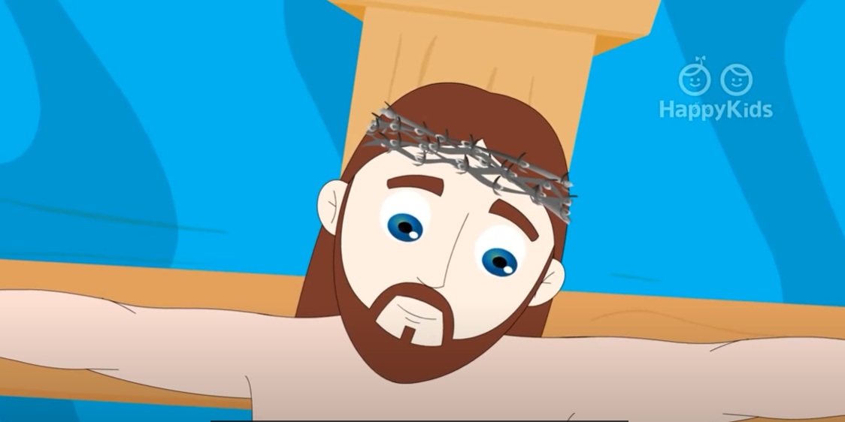
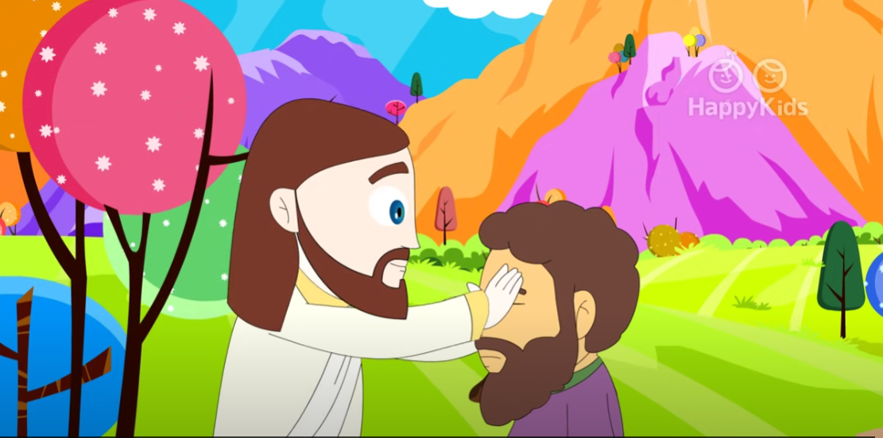
Do you think Jesus’ Kingdom is like that?
No. His Kingdom is different. It is not about earthly power (money, armies, servitude, etc).
He always said He didn’t come to be served, but to serve.
His Kingdom is of service and love for others. He gave to the point of giving His life for us.

Slide 12
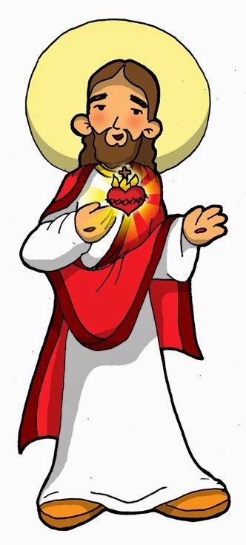
The Kingdom of Jesus started more than 2000 years ago when He came to this world.
He left us an example of His Kingdom of Love, Justice, Truth, and Service.
Christ will reign forever when He returns in Glory.
Do you want
Jesus to reign
in your heart?

Slide 13
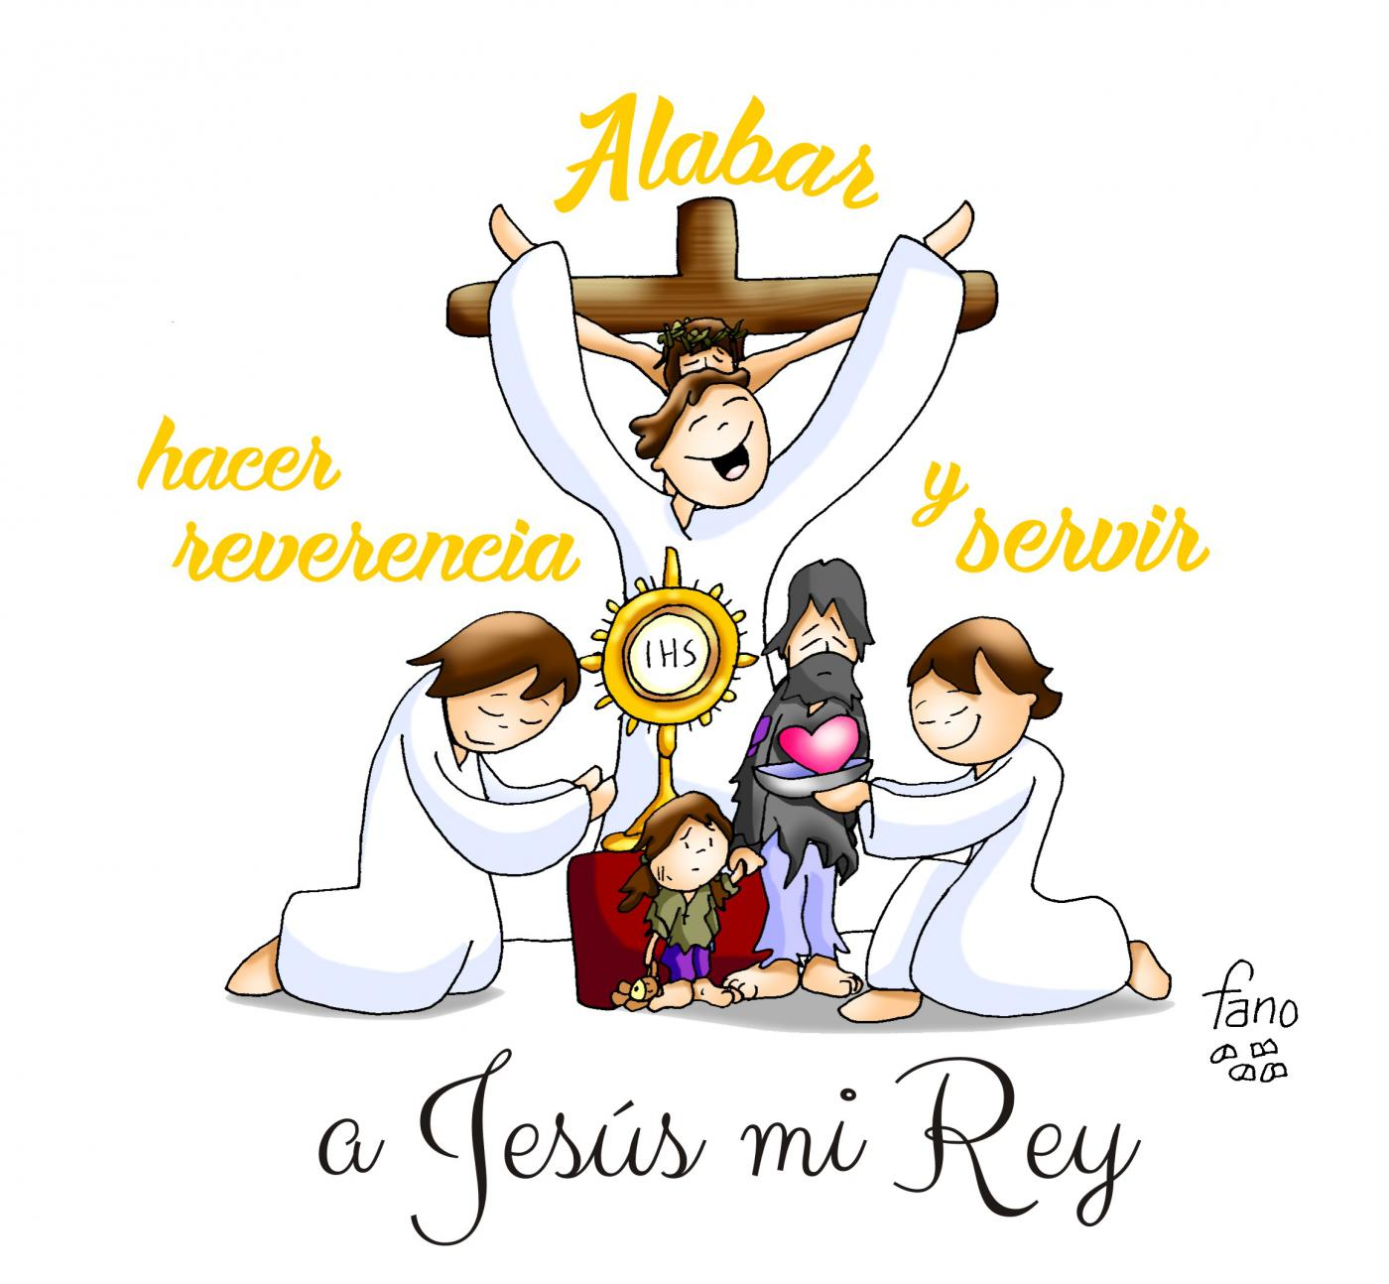
Jesus Christ can start to reign in your heart the moment you let Him in…
Open the door of your heart to Jesus.
PRAISE HIM
DO HIM
SERVE
HIM
REVERENCE
To Jesus my King

Slide 14
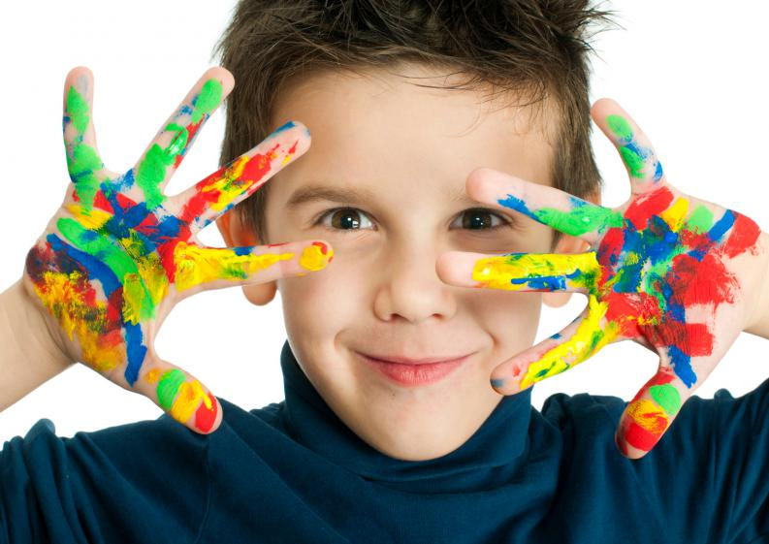
ACTIVITY

Slide 15
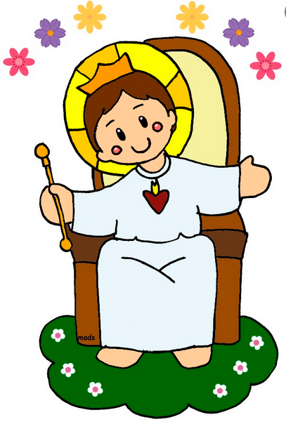
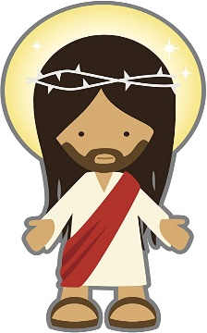
How do you think you can make Jesus “The King of your heart”?
If the action helps Jesus be the center of your heart, Jesus will appear crowned as King;
on the other hand, if the action condemns Jesus, He will appear with a crown of thorns.
1.- Praying upon waking up and going to sleep, giving thanks.
5.-Rejecting someone at school.
2.- Going to Mass.
6.-Staying in my room playing or resting, and not helping with chores.
3.- Asking my parents to give me presents, even if they can’t afford it.
7.-Being helpful with others, sharing my crayons, erasers, or even my lunch.
4.- Respecting and loving my parents.

Slide 16
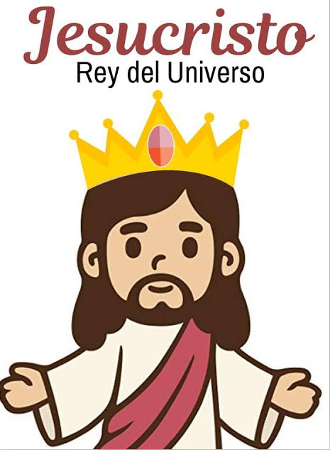
PRAYER
JESUS CHRIST
King of the Universe
Lord,
You are King of the Universe; but because of your great love, You came to serve and suffer on the cross to save us from our sins. You resurrected, victorious over death and You live among us. Help us to bring your Kingdom to earth by loving, serving, and forgiving each other; by treating each other with kindness, and by always doing your will.
Amen.

Slide 17
He is the King of Kings, Bible Time (Ctrl Click) https://youtu.be/gH8YzqQ7iHE (3-6 yrs.)

Slide 18
All Creatures of our God and King (Ctrl Click) https://youtu.be/8aeHBczYCA4 (7+)

