Slide 1
Title and Content Layout with List
Ministry Friends of Jesus and Mary
Add your first bullet point here
Add your second bullet point here
Add your third bullet point here
XX Sunday in Ordinary Time
Solemnity of the Assumption
of the Blessed Virgin Mary

Slide 2
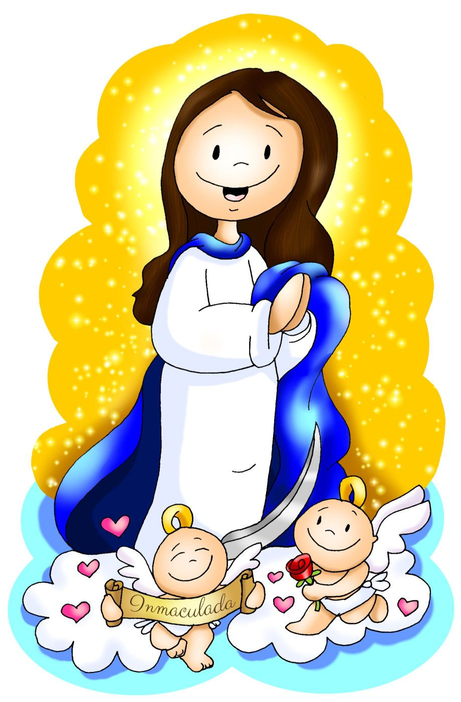
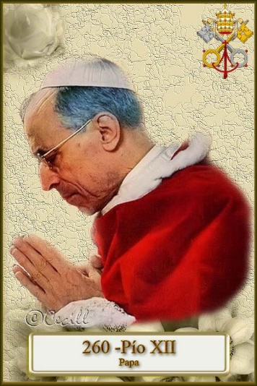
This week we celebrate a Great Feast!!!!
The Assumption of the Virgin Mary
We celebrate that, after her life on earth,
Mary was taken body and soul to Heaven.
She was taken by the angels to heaven;
she did not ascend by herself like Jesus did.
This feast is a DOGMA of the faith: It is a TRUTH which the Church closely studied before it was proclaimed.
POPE PIO XII proclaimed this DOGMA in 1950,

Slide 3
When do we celebrate this feast?
HOME, MOM!
WELCOME
August 15
The Virgin Mary always did what was pleasing to God and now she is HAPPY with Jesus in Heaven.
She wants us to go to Heaven; she guides us and invites us to always do what is pleasing to God loving and doing good to others.
THE ASSUMPTION OF THE VIRGIN MARY

Slide 4
GOSPEL FOR THE XX SUNDAY IN ORDINARY TIME
THE VISITATION
Luke 1, 39-56

Slide 5
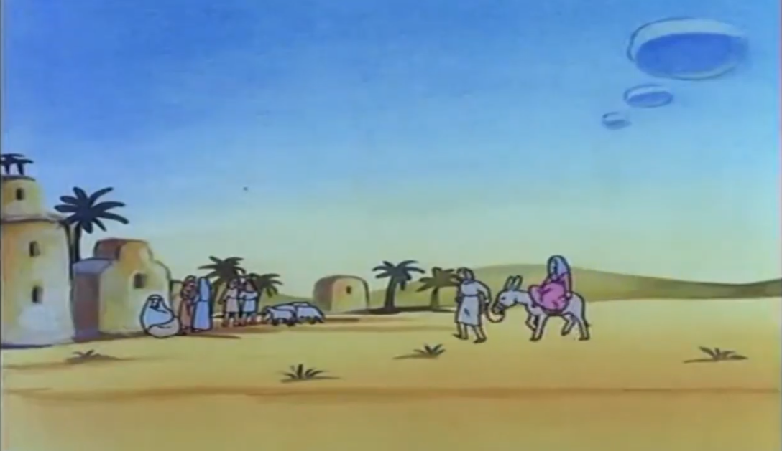
Mary set out and traveled to the hill country in haste to a town of Judah,

Slide 6
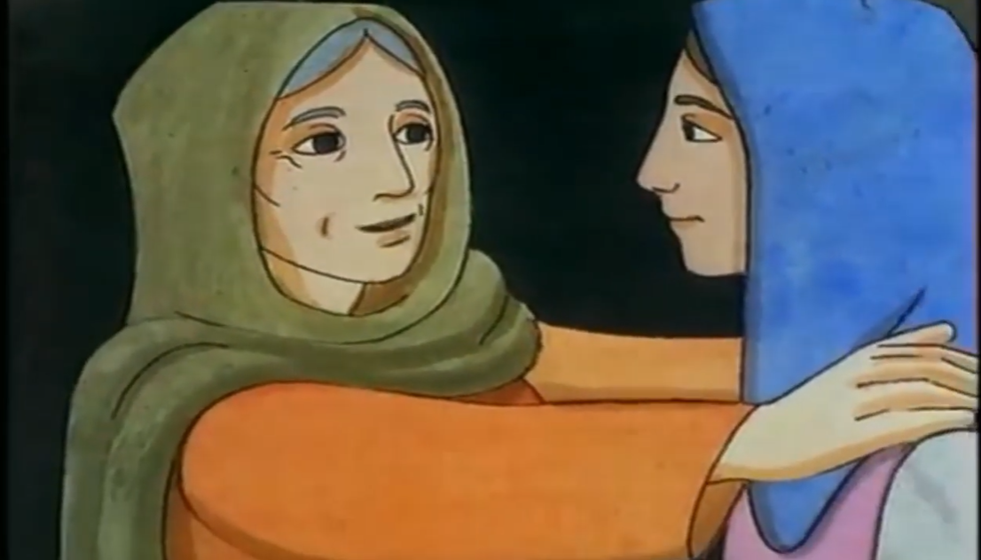
…where she entered the house of Zechariah and greeted Elizabeth. When Elizabeth heard Mary’s greeting, the infant leaped in her womb,

Slide 7
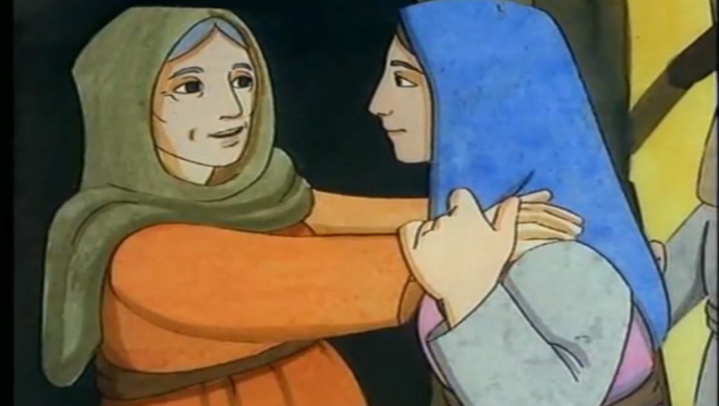
…and Elizabeth, filled with the Holy Spirit, cried out in a loud voice and said, “Blessed are you among women, and blessed is the fruit of your womb!

Slide 8
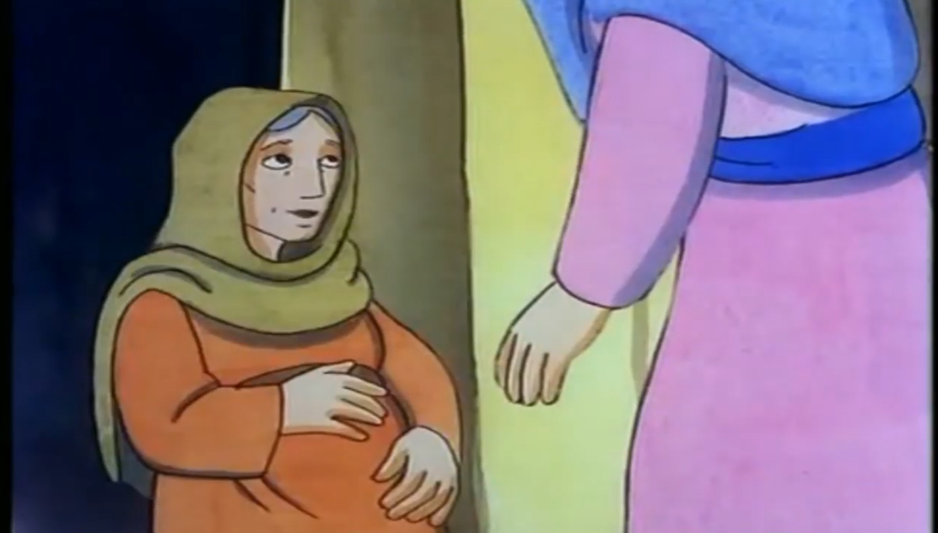
And how does this happen to me, that the mother of my Lord should come to me? For at the moment the sound of your greeting reached my ears, the infant in my womb leaped for joy.

Slide 9
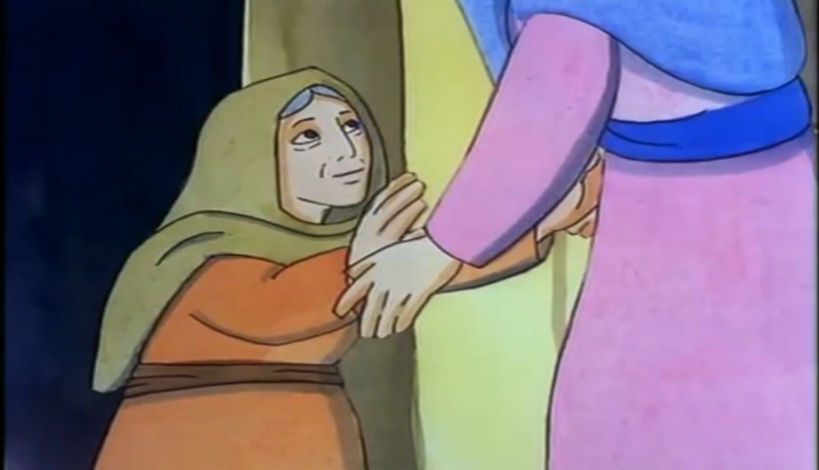
“Blessed are you who believed that what was spoken to you by the Lord would be fulfilled.”

Slide 10
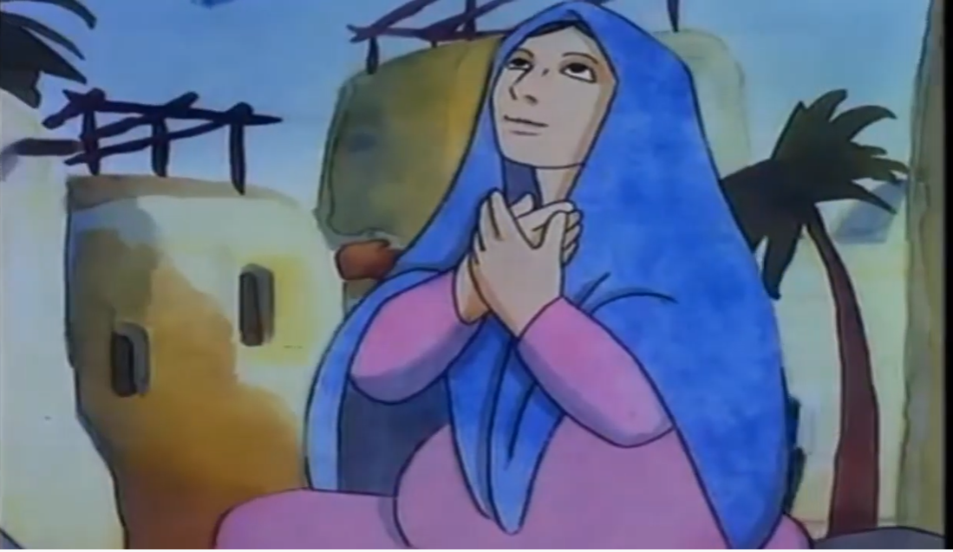
And Mary said: “My soul proclaims the greatness of the Lord; my spirit rejoices in God my Savior for he has looked with favor on his lowly servant.

Slide 11
From this day all generations will call me blessed: the Almighty has done great things for me and holy is his Name. He has mercy on those who fear him in every generation.

Slide 12
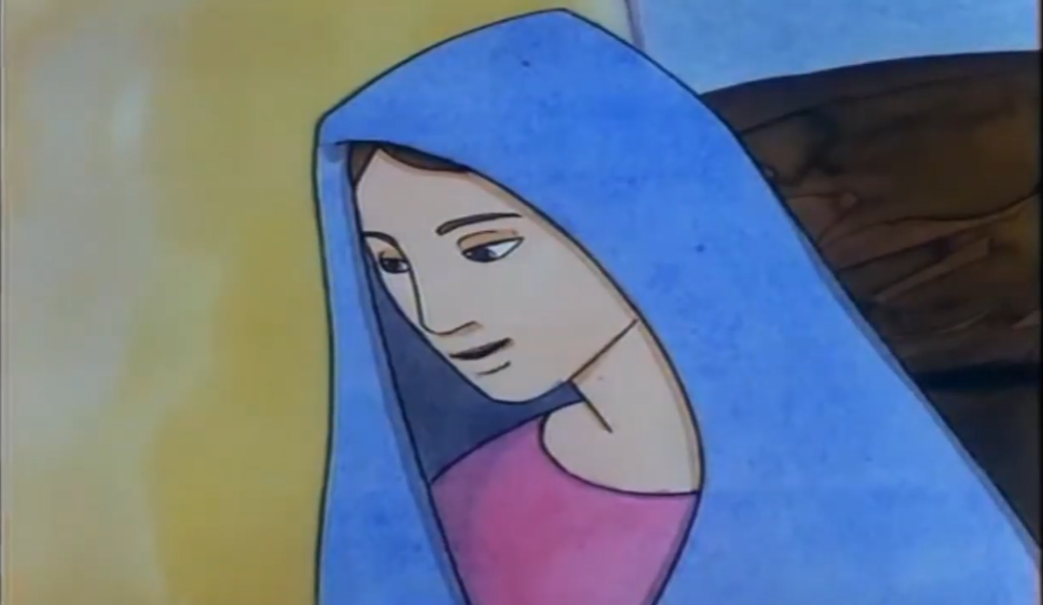
He has shown the strength of his arm, and has scattered the proud in their conceit. He has cast down the mighty from their thrones, and has lifted up the lowly. He has filled the hungry with good things, and the rich he has sent away empty.

Slide 13
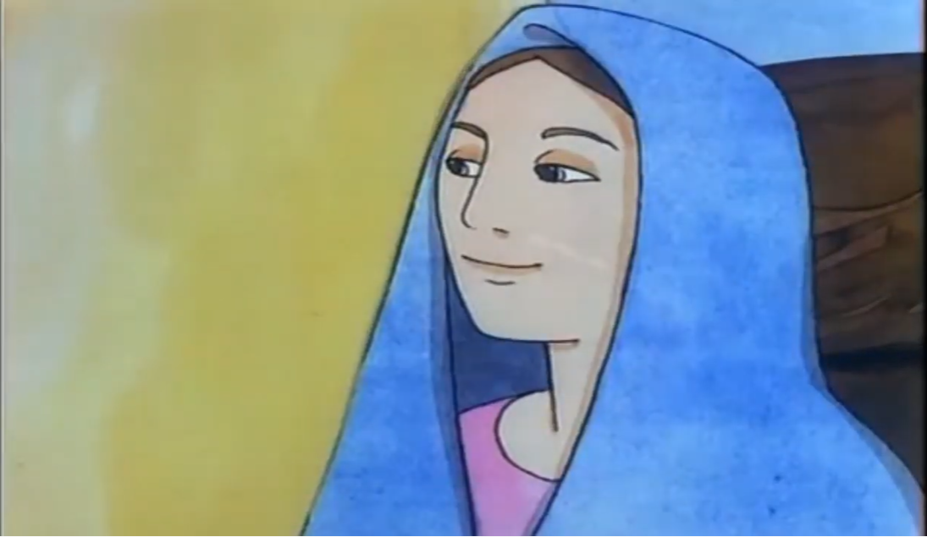
He has come to the help of his servant Israel for he has remembered his promise of mercy, the promise he made to our fathers, to Abraham and his children forever.” ’

Slide 14
Mary remained with her about three months and then returned to her home.
THE GOSPEL OF THE LORD. PRAISE TO YOU LORD JESUS CHRIST.

Slide 15
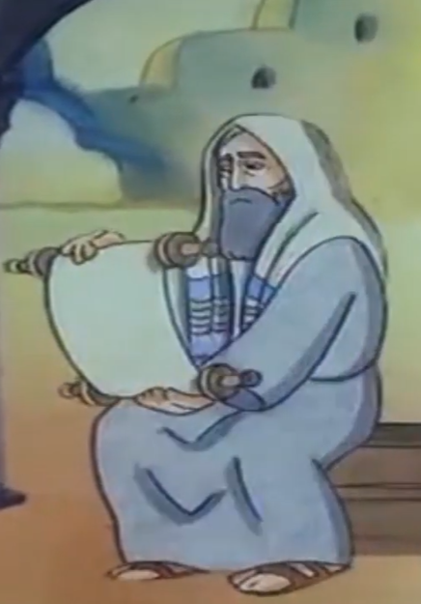
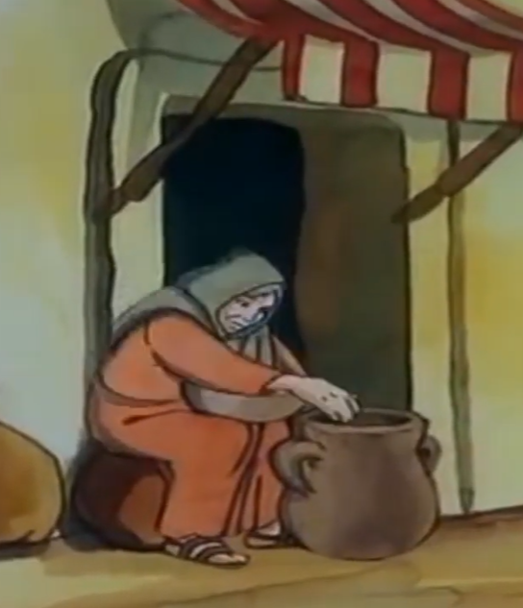
REFLECTION
This is Zechariah, an old jewish priest
who was married to…..
Elizabeth, Mary’s cousin.
Both were old and had never been able to have children.

Slide 16
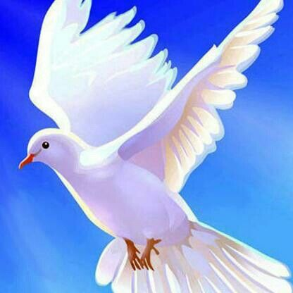
REFLECTION
After the ángel Gabriel appeared to Mary and told her that her cousin Elizabeth was pregnant, she set out immediately to help her.
Do you remember what Elizabeth felt when she first saw Mary?
Upon hearing Mary’s greeting, the infant leaped in her womb and Elizabeth was filled with the
HOLY SPIRIT

Slide 17
REFLECTION
What familiar words did Elizabeth exclaim to her cousin Mary?
Blessed are you among women, and blessed is the fruit of your womb!
Where else have you heard these words?
THE HAIL MARY

Slide 18
REFLECTION
Elizabeth felt so small when faced with the Mother of the Savior, she asked Mary a question about her visit. Do you remember?
Elizabeth asked, And how does this happen to me, that the mother of my Lord should come to me?

Slide 19
The Virgin Mary was always humble, even when she carried in her womb the SAVIOR OF THE WORLD. She answered, “God my Savior has looked with favor on his lowly servant.”
Why does she call herself a lowly servant?
The Virgin Mary was always open to doing God’s will in her life.

Slide 20
The Virgin Mary says: God has come to the help of his servant Israel for He remembered His promise of mercy…to our fathers, to Abraham and his children forever.”
Do you remember who Abraham was and the promise God made him?
Abraham and his wife Sarah were old and could not have children. Because of their faithfulness to Him, God promised them descendents as numerous as the stars in the sky.
FOR GOD, NOTHING IS IMPOSSIBLE.

Slide 21
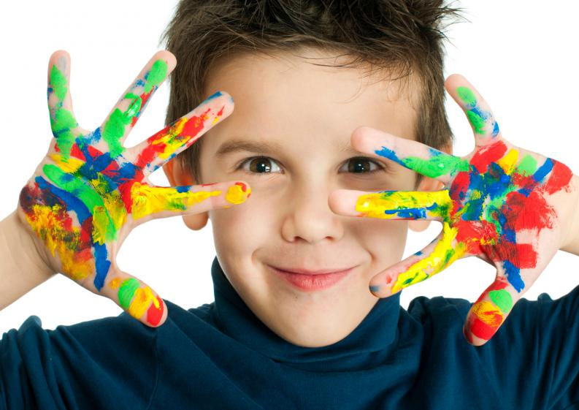
ACTIVITY

Slide 22
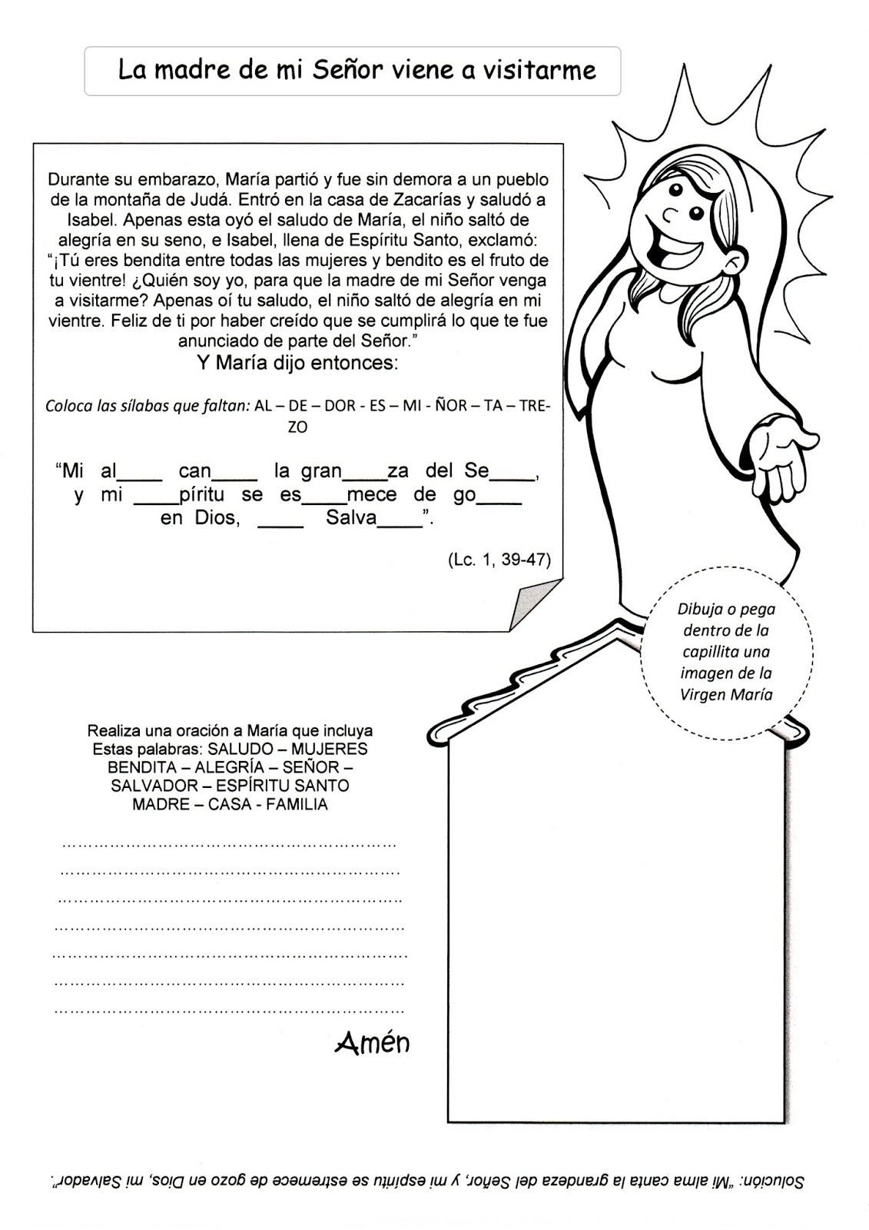
The Mother of the Lord comes to visit me.
Mary set out and traveled to the hill country in haste to a town of Judah, where she entered the house of Zechariah and greeted Elizabeth. When Elizabeth heard Mary’s greeting, the infant leaped in her womb, and Elizabeth, filled with the Holy Spirit, cried out in a loud voice and said, “Blessed are you among women, and blessed is the fruit of your womb. And how does this happen to me, that the mother of my Lord should come to me? For at the moment the sound of your greeting reached my ears, the infant in my womb leaped for joy. Blessed are you who believed that what was spoken to you by the Lord would be fulfilled.” And Mary said:
“My _____ pro______ the _______ness of the Lord; my spir___ ___joices in God ___ ___vior.”
Replace the blanks with the following syllables:
it – my - great – sa - claims – re - soul
soul
claims
great
it
re
my
sa
Draw or glue in the chapel an image of the Virgin Mary
How can I take Jesus to others?

Slide 23
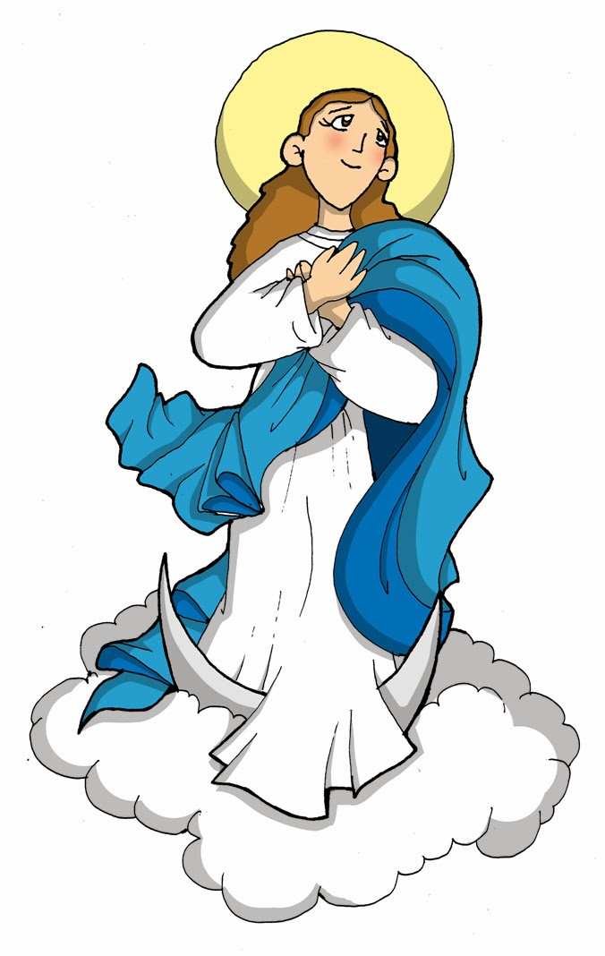
PRAYER
Lord, make me humble like my Mother Mary so Jesus may live in my heart. Send your Holy Spirit and fill me with love so I may love and serve you more and love and serve my neighbor more like Mary did. Amen.

Slide 24
Song: Mama Mary https://youtu.be/v0kcAWZ9qOA

