Slide 1
Ministry Friends of Jesus and Mary
Cycle B - XX Sunday in Ordinary Time
Whoever eats this bread will live forever.
John 6:51-58
www.fcpeace.org

Slide 2
https://youtu.be/rKKCLzwc7C4?si=T7yWn8yWc8hE6je6

Slide 3
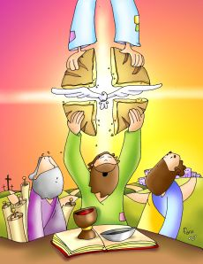
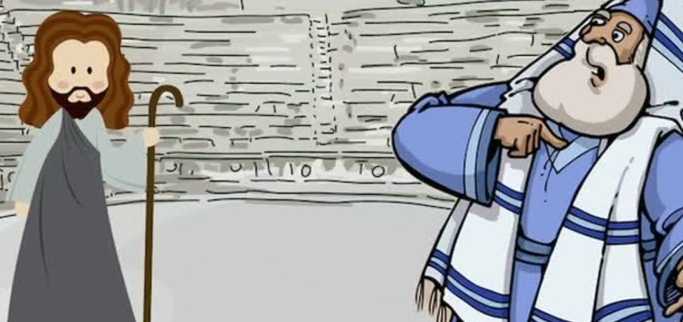
Whoever eats this bread will live forever.
John 6:51-58
I am the living bread that came down from heaven; whoever eats this bread will live forever; and the bread that I will give is my flesh for the life of the world.”
The Jews quarreled among themselves, saying, “How can this man give us [his] flesh to eat?”
Jesus said to them, “Amen, amen, I say to you, unless you eat the flesh of the Son of Man and drink his blood, you do not have life within you.

Slide 4
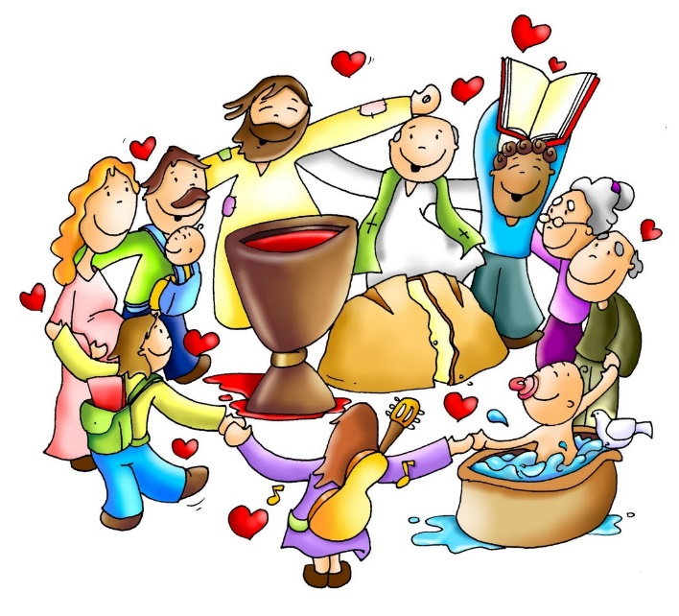
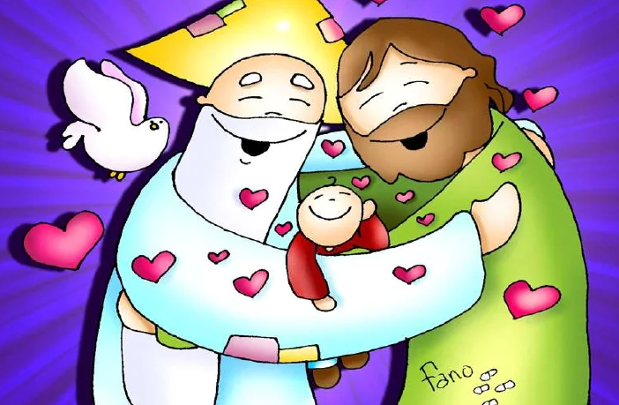
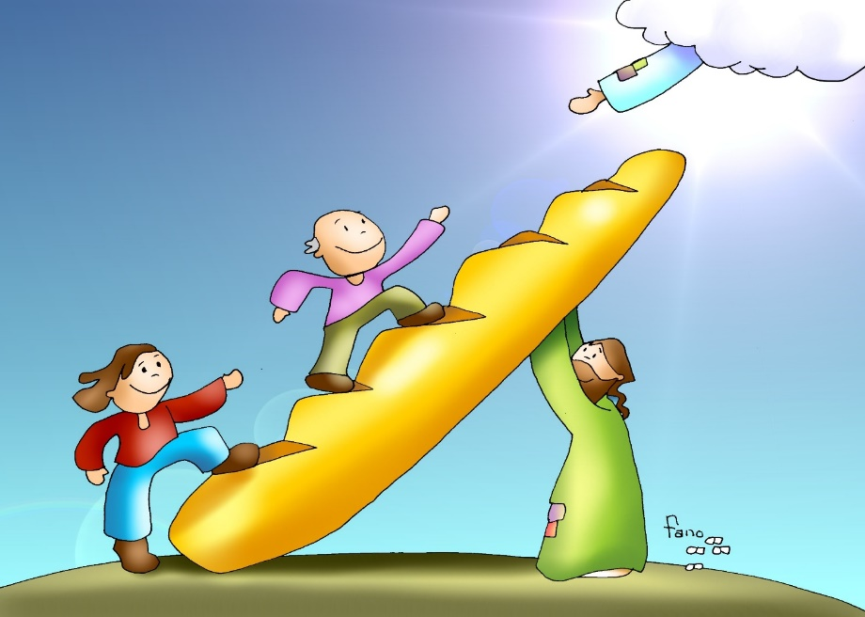
Whoever eats my flesh and drinks my blood has eternal life, and I will raise him on the last day. For my flesh is true food, and my blood is true drink.
Whoever eats my flesh and drinks my blood remains in me and I in him. Just as the living Father sent me and I have life because of the Father, so also the one who feeds on me will have life because of me.
This is the bread that came down from heaven. Unlike your ancestors who ate and still died, whoever eats this bread will live forever.”
The Gospel of the Lord, Praise to you Lord Jesus Christ.

Slide 5
REFLECTION

Slide 6
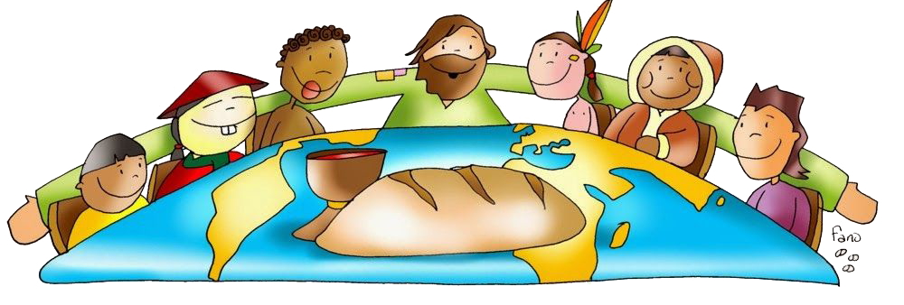
Jesus says, “I am the living bread that came down from heaven; … “Whoever eats my flesh and drinks my blood , _________________________.
has eternal life.

Slide 7
When the Jews heard this, they did not understand. What did they think He was saying?

Slide 8
They thought Jesus wanted them to literally eat His flesh and drink His blood like cannibals.

Slide 9
What did He really mean?

Slide 10
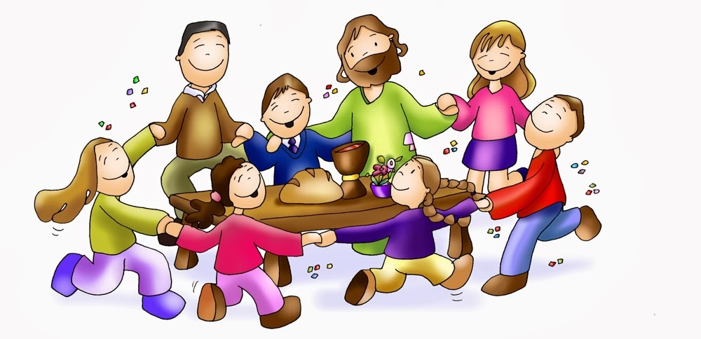
Those that eat the living bread, that is the same as His body, will have eternal life.

Slide 11
When did He give us this Living Bread?

Slide 12
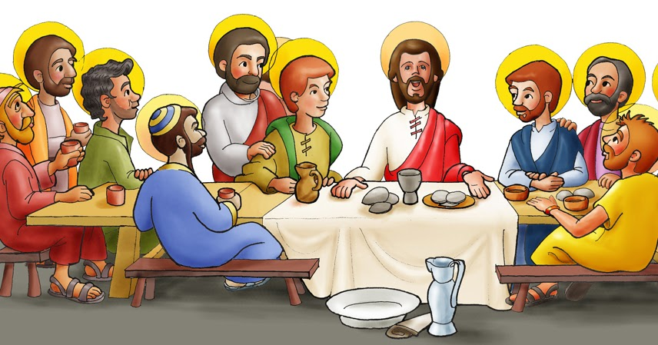
At the Last Supper with His apostles, Jesus took the bread and giving thanks, broke it and gave it to them saying,
“Take this bread and eat it. This is my body which will be given up for you.”
After the meal, He did the same with the cup saying,
“Take this wine and drink it. This is my blood, blood of the new covenant, which will be shed for you and for all so that sins may be forgiven.“
“Do this in memory of me.”

Slide 13
Where do we hear these words?

Slide 14
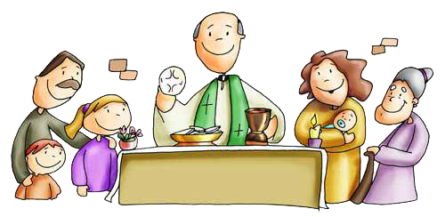
In Mass,
During the Consecration, when Jesus repeats the words of Jesus at the Last Supper,
the miracle of Transubstantiation takes place.
What is Transubstantiation?
God changes the bread and wine to the body and blood of Jesus leaving the appearance the same.

Slide 15
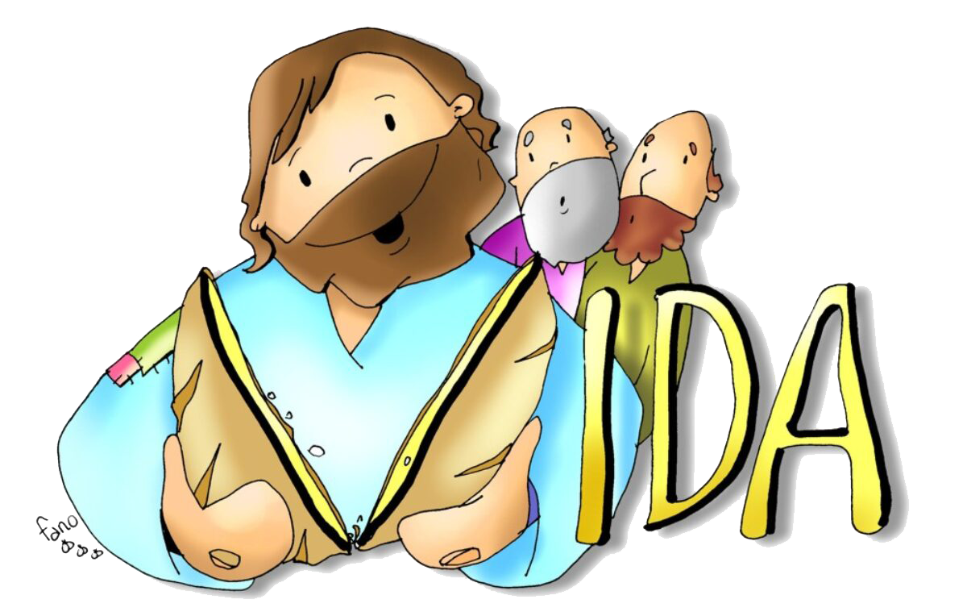
We do not always understand Jesus’ words, but we know He loves us and always tells the truth. We pray for faith to accept His words always.

Slide 16
ACTIVITIES

Slide 17
On the next page, unscramble the words on the left and place them in the correct order in the picture.
On the other page, draw an arrow from the picture to the correct box: loving God or loving our neighbor.

Slide 18
MY
WHOEVER
FLESH
EATS
WHOEVER
EATS
MY
FLESH
BLOOD
MY
DRINKS
AND
AND
DRINKS
MY
BLOOD
ME
HIM
AND
REMAINS
I
HIM
IN
REMAINS
IN
ME
AND
I
IN
HIM

Slide 19
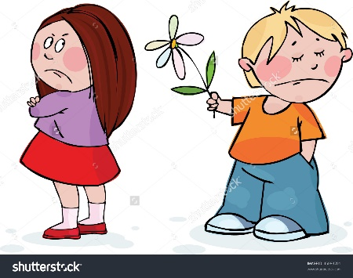
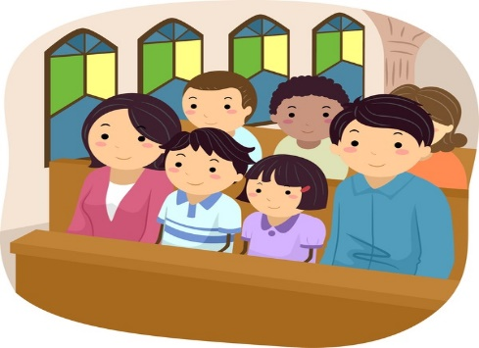
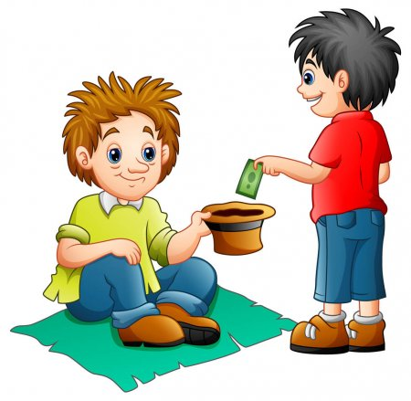
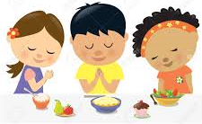
What do we need to get to Eternal Life?
We need Jesus in our heart to help us love God and our neighbor.
Love God | Love our neighbor

Slide 20
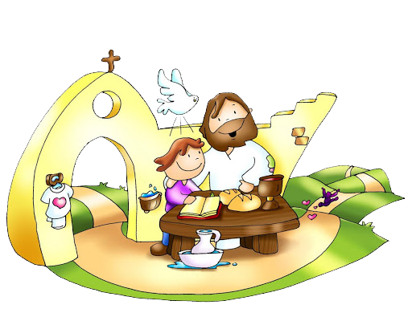
PRAYER
Lord, help me to understand the great gift of Your Presence in the Eucharist, the Living Bread. Your food gives me strength and guides me to eternal life. Help me to accept with faith all that you tell me. Thank you for loving me.
I love you.
Amen.

Slide 21
Bread of Life, Christ Kids… https://youtu.be/UQ8jc2psEd4?si=1-jk1mGWBjnqhfaP (3-6 yrs.)

Slide 22
This is my Body Broken for you, Restoration https://youtu.be/IHTvNJW7LPQ?si=wYDhlrGRPFyDkpIu (7+ yrs.)

