Slide 1
MINISTRY FRIENDS OF JESUS AND MARY
CYCLE “C”, II SUNDAY OF ADVENT
JOHN THE BAPTIST IN THE DESERT: PREPARE THE WAY OF THE LORD
LUKE 3, 1-6

Slide 2
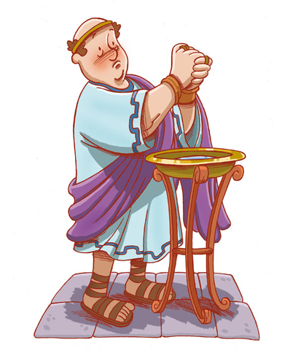
JOHN THE BAPTIST IN THE DESERT PREPARE THE WAY OF THE LORD
In the fifteenth year of the reign of Tiberius Caesar,
…when Pontius Pilate was governor of Judea,

Slide 3
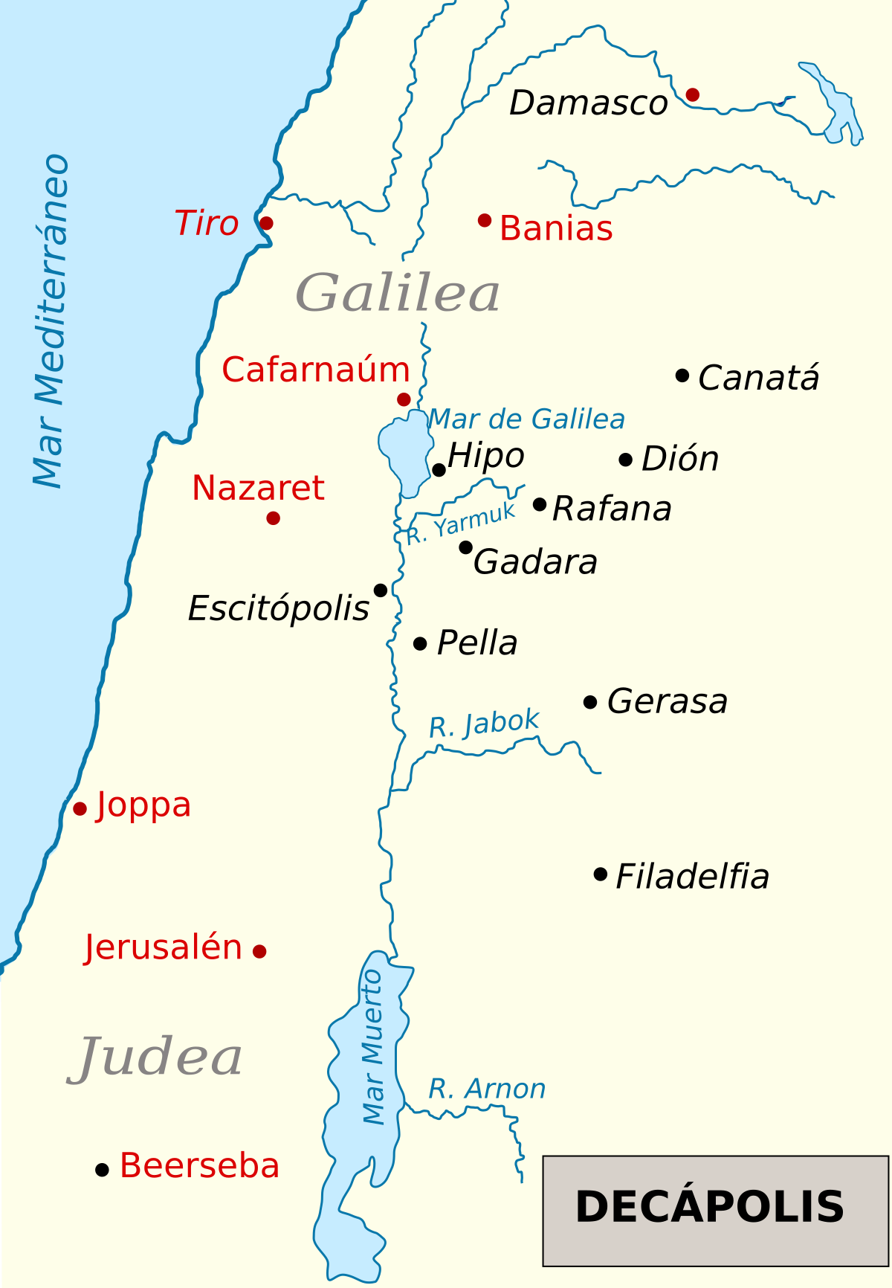
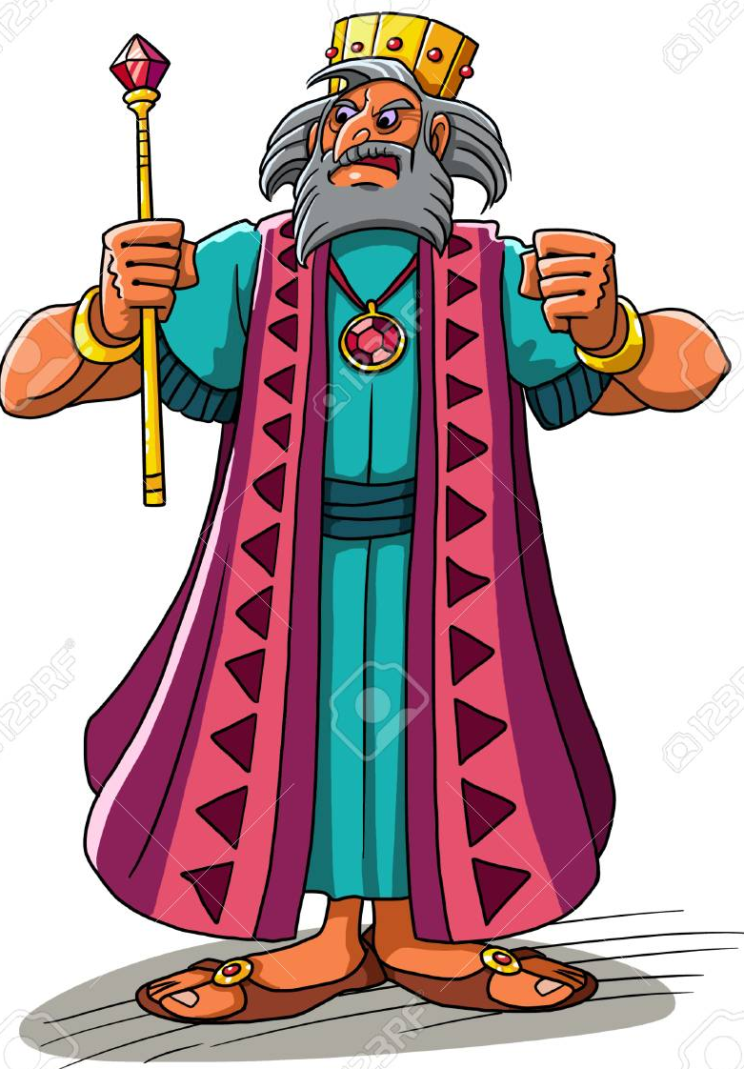
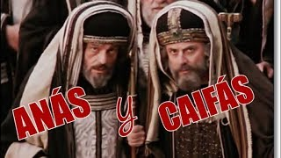
…and Herod was tetrarch of Galilee, and his brother Philip tetrarch of the region of Ituraea and Trachonitis, and Lysanias was tetrarch of Abilene,
…during the high priesthood of Annas and Caiaphas,

Slide 4
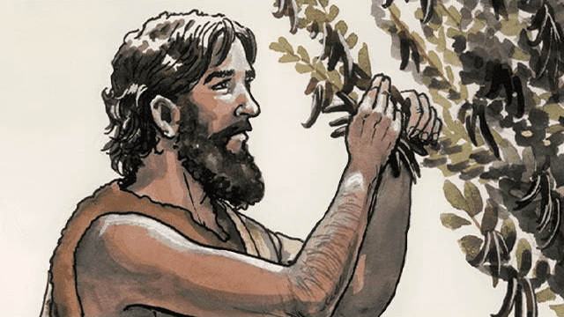
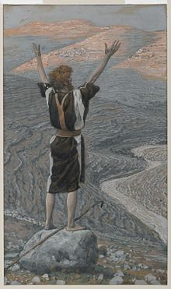
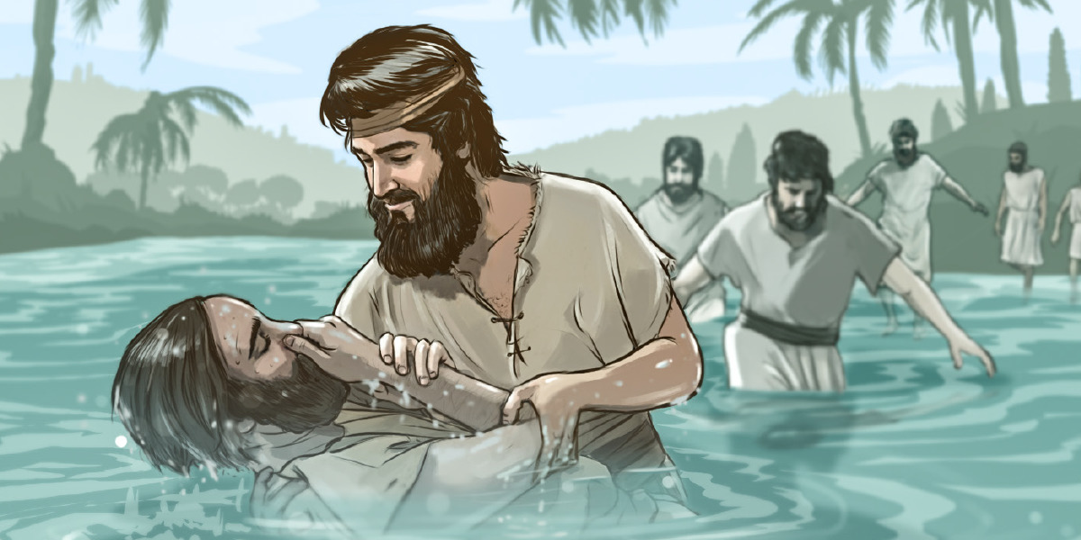
…the word of God came to John the son of Zechariah in the desert.
John went throughout the whole region of the Jordan, proclaiming a baptism of repentance for the forgiveness of sins, as it is written in the book of the words of the prophet Isaiah:

Slide 5
A voice of one crying out in the desert: “Prepare the way of the Lord, make straight his paths. Every valley shall be filled and every mountain and hill shall be made low. The winding roads shall be made straight, and the rough ways made smooth, and all flesh shall see the salvation of God.”
2nd Sunday of Advent
Prepare the Way
Luke
3: 1-6
Make straight His path…
The Gospel of the Lord,
Praise to you Lord, Jesus Christ.

Slide 6
REFLECTION

Slide 7
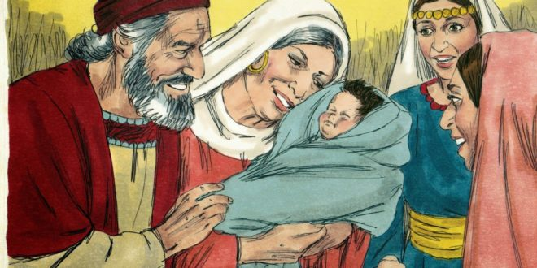
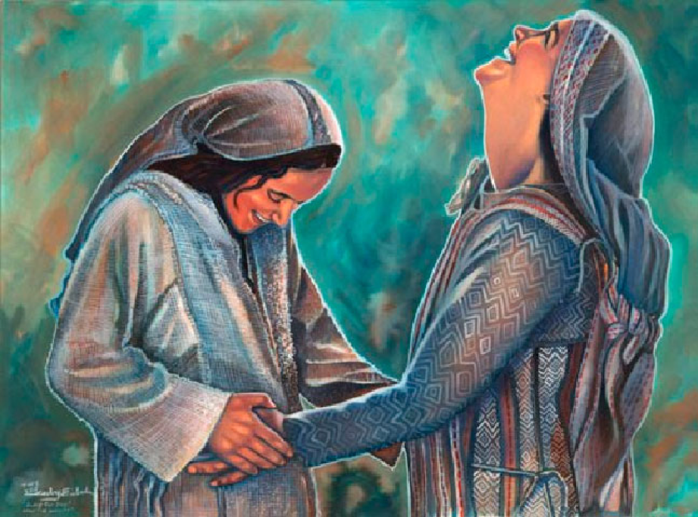
Who is john the baptist?
John is the son of the priest Zachariah and of Elizabeth, the Virgin Mary’s cousin. He is Jesus’ cousin.

Slide 8
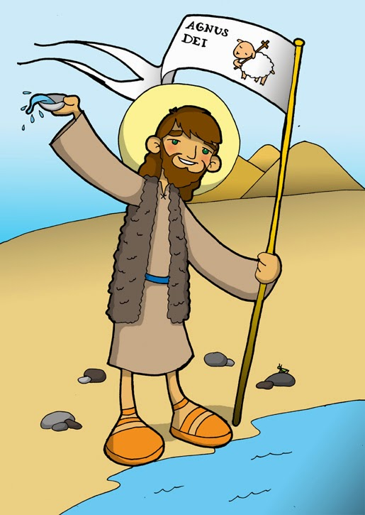
HOW DID JOHN LIVE?
He lived in the desert, dressed with a tunic of camel hair and a belt of leather. He ate locust and wild honey.

Slide 9
WHY DID HE LIVE LIKE THIS?
John only cared about getting close to God so he spent all his time praying and doing sacrifices.

Slide 10
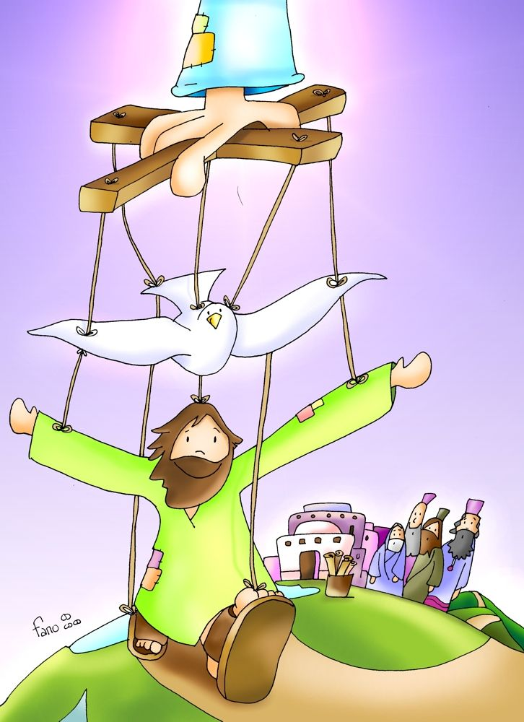
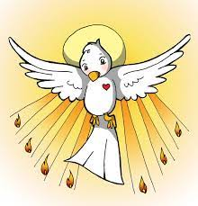
THE GOSPEL SAYS THAT THE WORD OF GOD CAME TO JOHN. WHAT DOES THIS MEAN?
The Holy Spirit spoke to his heart.

Slide 11
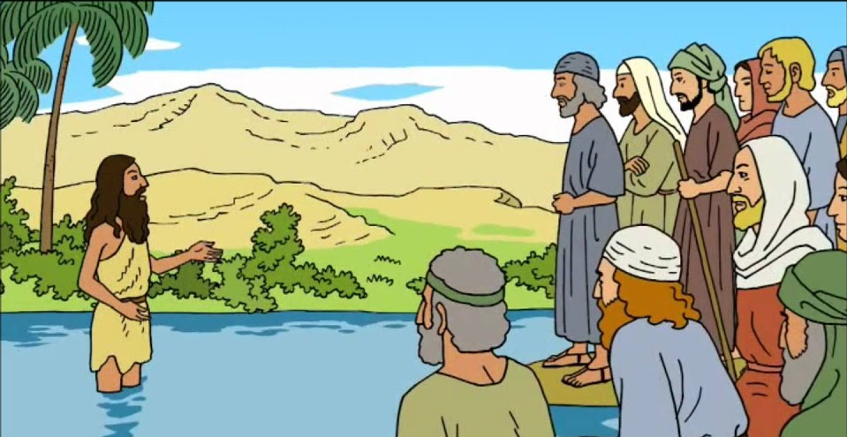
WHAT DID JOHN DO WHEN THE WORD OF GOD CAME TO HIM?
John went throughout the whole region of the Jordan,
proclaiming a baptism of repentance for the forgiveness of sins.

Slide 12
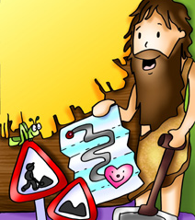
WHAT DOES THIS MEAN?
John preached that everyone should be sorry for their sins and do penance in order to be baptized with water.
This baptism represented a change of life, a CONVERSION, where God is at the center.
PENANCE is a sacrifice done to make-up for hurting God with sin.
This was to prepare their hearts for the coming of the Savior which was already here.

Slide 13
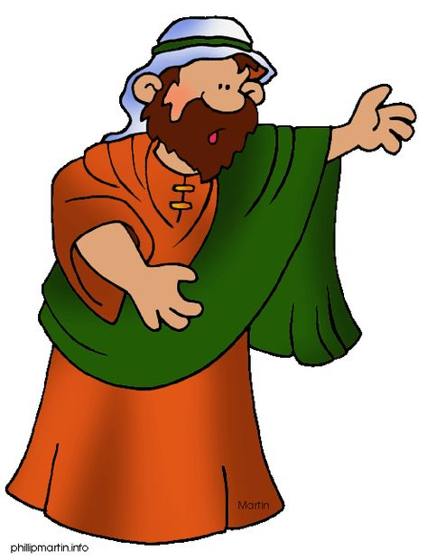
WHAT DID THE PROPHET ISAIAH SAY ALMOST 1000 YEARS BEFORE JESUS?
A voice of one crying out in the desert: “Prepare the way of the Lord.
Make straight his path.”

Slide 14
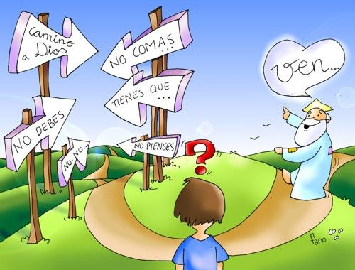
the gospel asks us to change our lives and prepare for the coming of jesus into our hearts.
What changes can we make to welcome Jesus on Christmas day? Share.

Slide 15
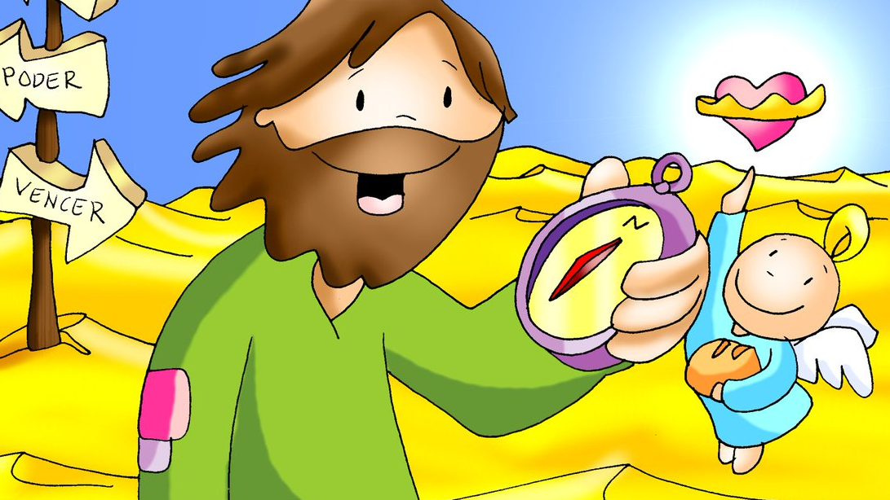
activities

Slide 16
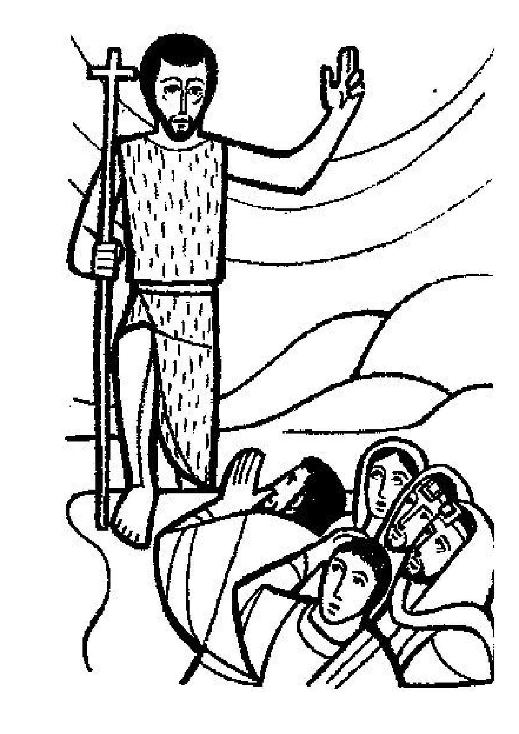
Prepare the Way of the Lord (Luke 3, 1-6)
A voice of one crying out in the _______: “Prepare the way of the _______, make ________ his ______. Every valley shall be filled and every mountain and hill shall be made low. The winding roads shall be made straight, and the rough ways made _______, and all flesh shall see the ___________ of God.”
Replace the spaces with the following words:
Lord straight salvation desert smooth paths
desert
Complete the
words of the Gospel
Lord
straight
paths
smooth
salvation

Slide 17
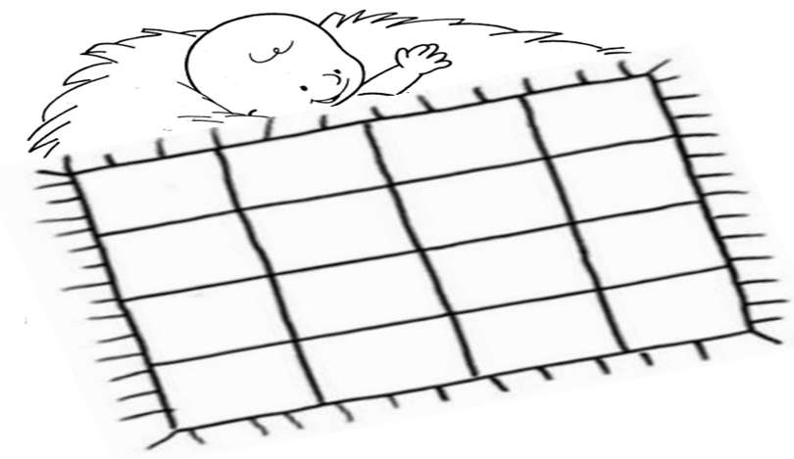
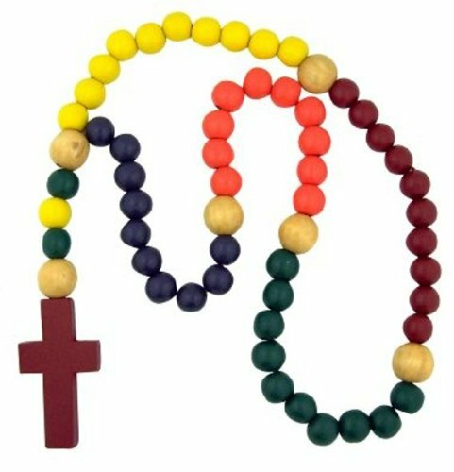
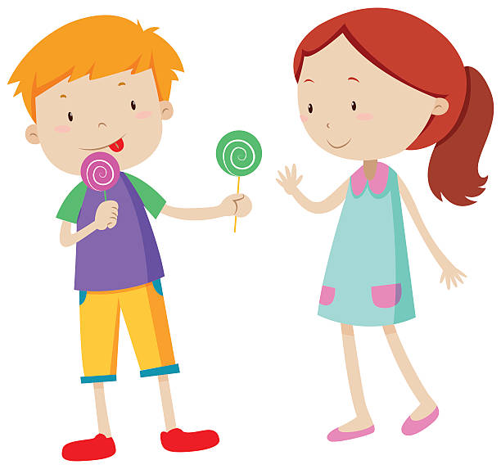
FORGIVE
PREPARE YOUR HEART TO RECEIVE BABY JESUS.
Write or draw in some of the rectangles on the blanket the good works, sacrifices, and prayers you plan to do to prepare your heart so it’s warm and comfortable for baby Jesus’ birth on Christmas Day. Color.
OBEY
LOVE
HELP
SHARE
SACRIFICE

Slide 18
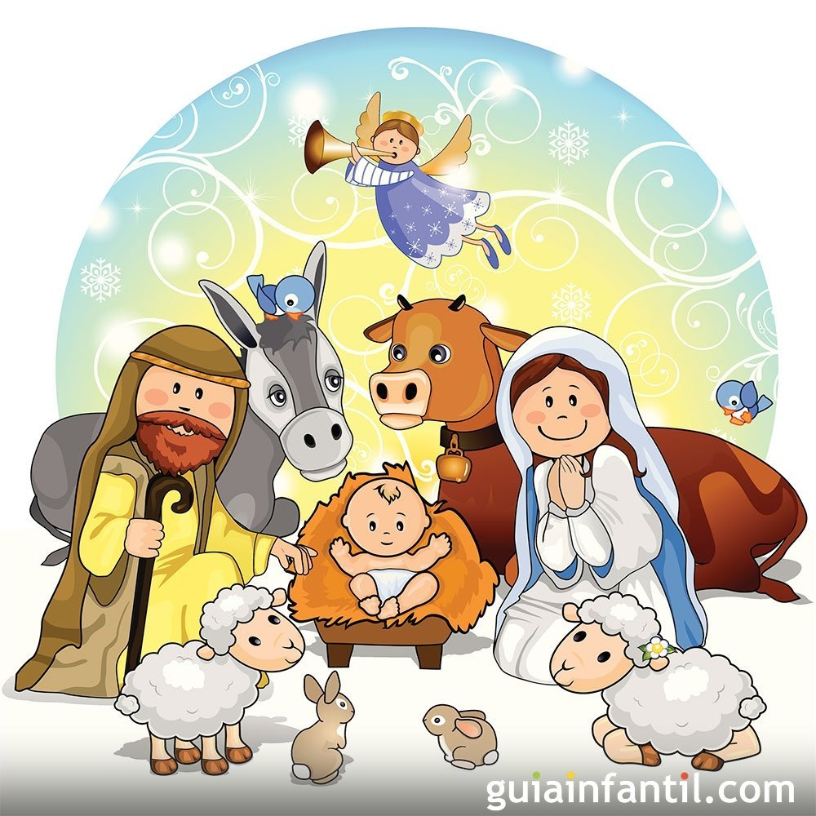
PRAYER
Lord, I am waiting for you. Help me so when you arrive you may find I have grown in love and respect of my family, and in honesty, sincerity and love for others.
Amen.

Slide 19
The Advent Song for Kids, Catholicicing, (Ctrl Click), https://youtu.be/HZCtyhOU2gw (3-6)

Slide 20
Prepare the Way, Marie Antoinette Lacson, (Ctrl Click), https://youtu.be/IOMyJ0IoVjw (7+ years)

