Slide 1
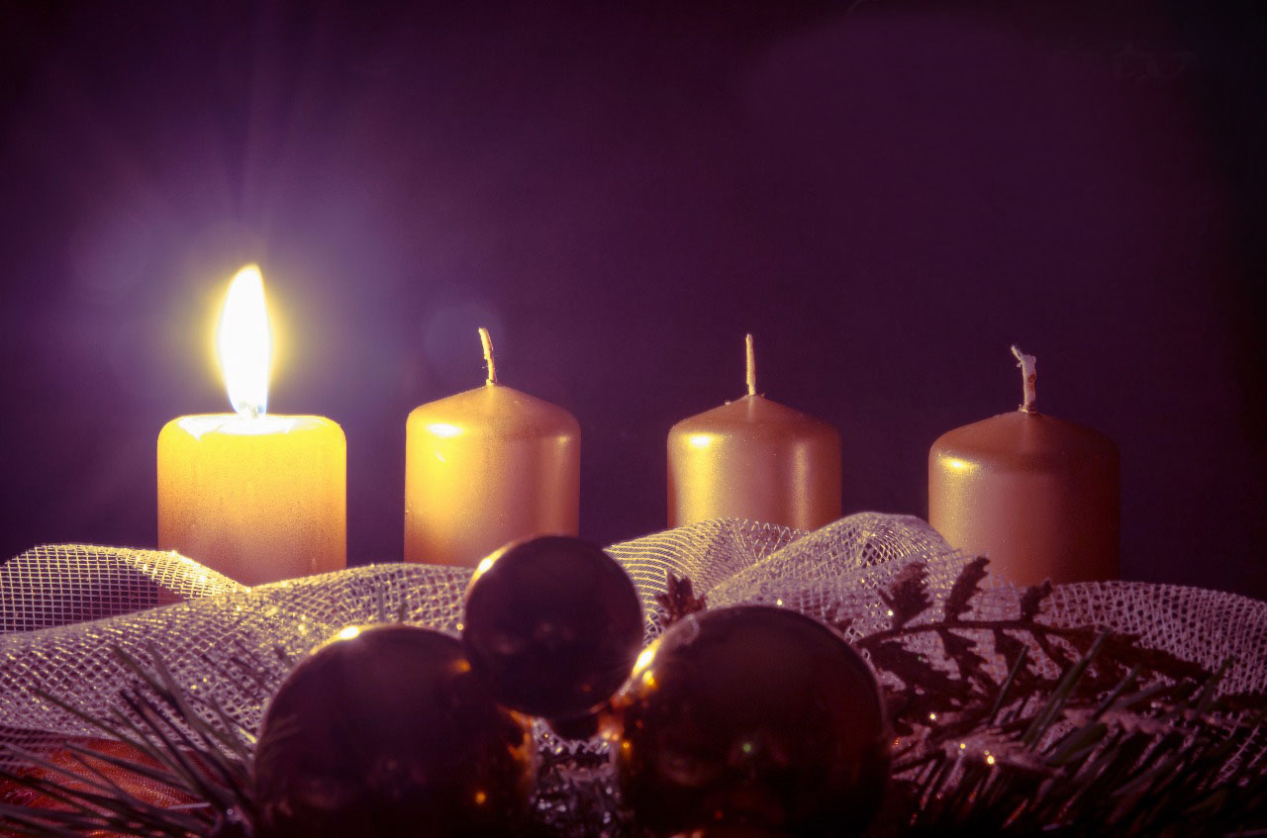
Friends of Jesus and Mary
I Sunday of Advent
Be Alert…
Luke 21, 25-28,34-36

Slide 2
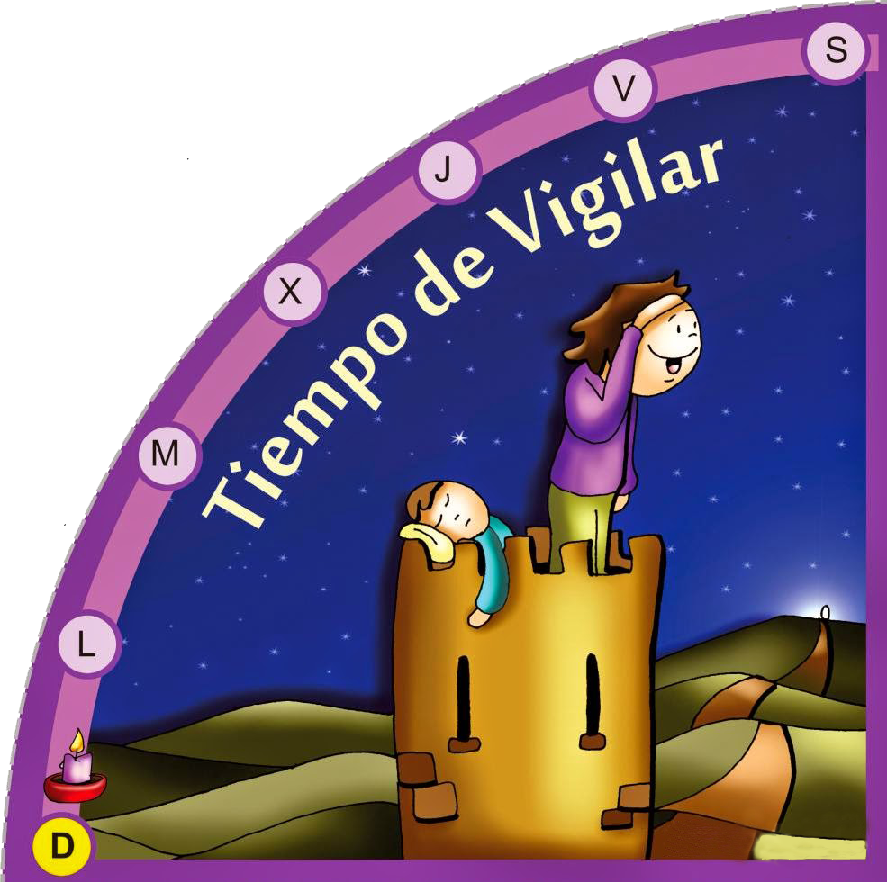
Be Alert…
Luke 21, 25-28,34-36
Jesus said to his disciples: “There will be signs in the sun, the moon, and the stars, and on earth nations will be in dismay, perplexed by the roaring of the sea and the waves. People will die of fright
in anticipation of what is coming upon the world, for the powers of the heavens will be shaken.

Slide 3

And then they will see the Son of Man coming in a cloud with power and great glory. But when these signs begin to happen, stand erect and raise your heads because your redemption is at hand.
“Beware that your hearts do not become drowsy from carousing and drunkenness and the anxieties of daily life, and that day catch you by surprise like a trap. For that day will assault everyone who lives on the face of the earth. Be vigilant at all times and pray that you have the strength to escape the tribulations that are imminent and to stand before the Son of Man.”
BE
WATCHFUL
Let His LIGHT
Turn on your
soul

Slide 4
REFLECTION

Slide 5
The gospel speaks of the second coming of Jesus and the signs that will happen before. They are described, not to scare us, but so we may be prepared and protected by Jesus because we do not know when they will happen.
What does the gospel say we should do continuously?

Slide 6
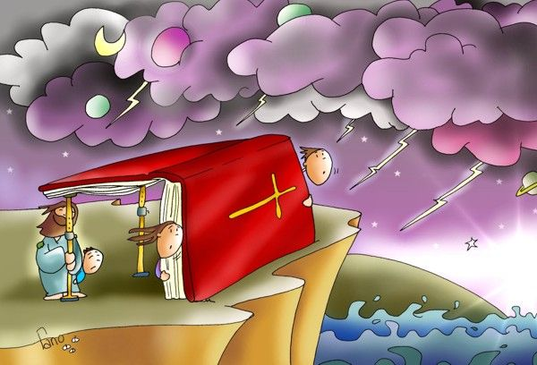
Avoid vices and pray.
Prayer brings us close to God so He can guide us on the right path.

Slide 7
Every year at Christmas time, we celebrate the first time Jesus came to earth, when He was born in a stable in Bethlehem. Every year He is born in our heart.
What are the signs that show Christmas is approaching?

Slide 8
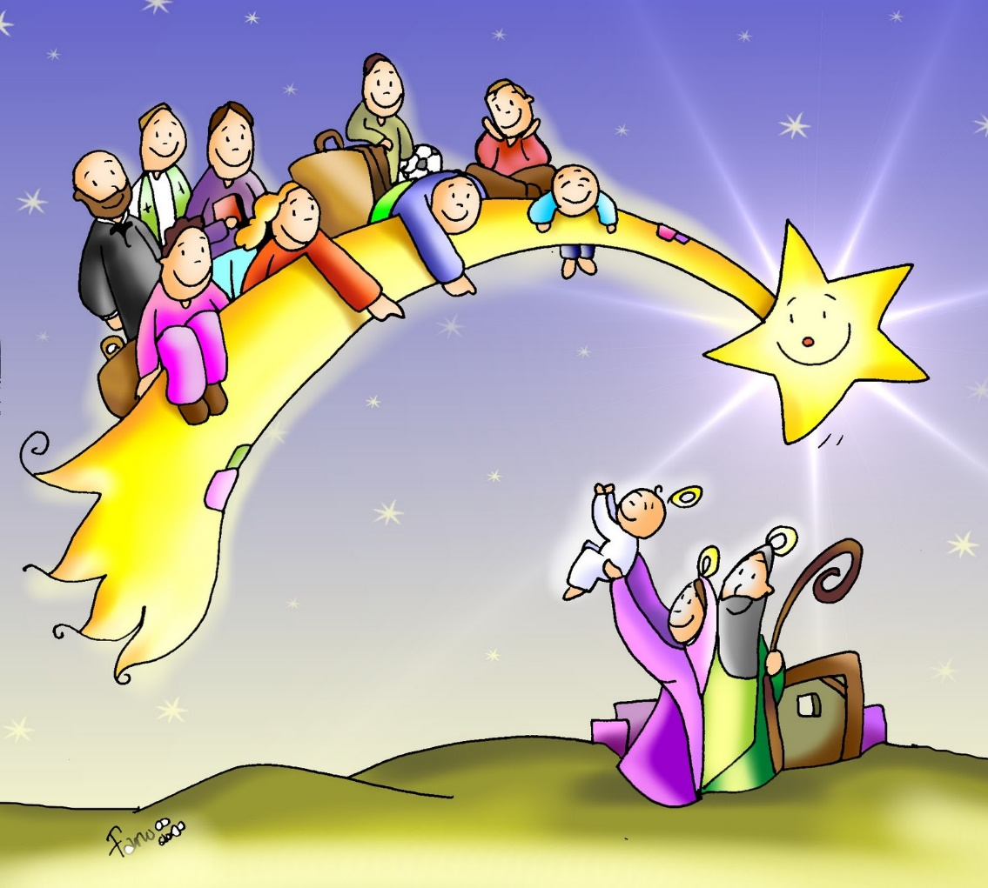
Christmas decorations in the stores and in houses, Christmas songs on the radio, Christmas cards arrived and written…

Slide 9
How should we prepare our heart so it’s ready for Jesus on Christmas Day?

Slide 10


Also avoiding vices, praying often, sharing with and helping others, offering small sacrifices to Jesus... This pleases Him greatly.
Are you off?
Much to do!
Wake up!
Dare to
light up the world in
ADVENT

Slide 11
ACTIVITIES

Slide 12
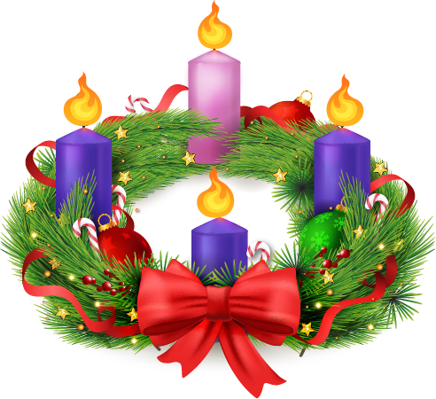
The Symbols of the Advent Wreath
The wreath is formed by many symbols.
The candles of the 1st, 2nd, and 4th weeks are purple symbolizing a time of preparation and sacrifice. The 3rd is pink for the joy we feel that soon Jesus arrives.
The circular shape
Is a sign of God’s eternal love, without a beginning or end. Also, it symbolizes our love for God and neighbor that should never end.
3
The green branches
Represent the color of life and hope.
4
1
The red ribbon
The four candles
Represents our love for God and God’s love that envelops us.
2
Represents Christ’s light that illuminates the darkness caused by sin which separates us from God.

Slide 13
THE ADVENT CALENDAR
Sunday
of
Hope
FIRST SUNDAY OF ADVENT
PRAYER:
To you, Lord, I lift up my soul. I trust in you.
Friday
of
Hope
Mary and Joseph ate very simple food on the trip.
I Will eat healthy today. I Will thank God for the food I have and I Will pray for the hungry.
Saturday
of
Hope
After a day of travel, Mary prepared a meal for Joseph. He found her a place to rest.
I Will do something special to give joy to my parents and my family today.
Monday
of
Hope
Jesus and Mary lived in Nazareth doing with joy their daily chores.
I Will do my work today well and with joy, for love of God.
Tuesday
of
Hope
Joseph received the order from the Roman emperor to go to Bethlehem to register his family. He obeyed and prepared to go.
I Will obey my parents, teachers and all in charge of me.
Wednesday
of
Hope
Mary fixed her house and packed for the trip without complaining
I Will not complain today, even if I have to do things I don’t like.
Thursday
of
Hope
Mary and Joseph travelled on a donkey.
I Will be happy with what I have and won’t ask my family for more or better things.

Slide 14
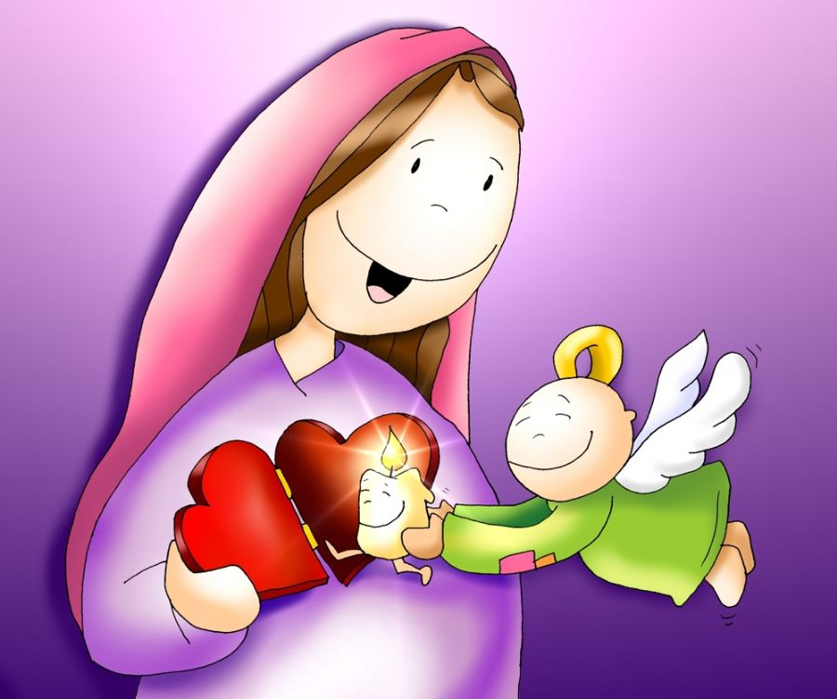
Therefore, the Lord himself will give you a sign: The virgin will conceive and give birth to a son, and will call him Immanuel.” (God with us.) Isaiah 7:14

Slide 15
Sunday
of Peace
SECOND
SUNDAY OF
ADVENT
PRAYER:
Come Lord Jesus and save all the nations.
Friday
of Peace
Joseph went from door to door, but in every place, he heard “No room!”
I will make room in my heart for others and will try to show special love for someone who seems lonely or unhappy.
Saturday
of Peace
Mary felt sorry for those who had no room. She knew they would like to have helped.
I will ask Mary to help me make room for Jesus in my heart by doing what he wants me to do.
Monday
of Peace
Mary and Joseph travelled with many people to Bethlehem; they were kind to all.
I Will be kind to all today, especially those I don’t like.
Tuesday
of Peace
Mary and Joseph were very tired at the end of the day because travel was uncomfortable and hard.
I will help my parents with some chores to give them time to rest after a difficult day at work.
Wednesday
of Peace
When Mary and Joseph reached Bethlehem, they were pressed by the crowd, but they stayed calm.
I will keep calm and not lose my temper when I am pushed or treated rudely.
Thursday
of Peace
Joseph tried for, Mary‘s sake, to find a clean, comfortable place to stay.
I will honor Mary in a special way today by being cheerful. I will pray the Joyful Mysteries of the Rosary.

Slide 16
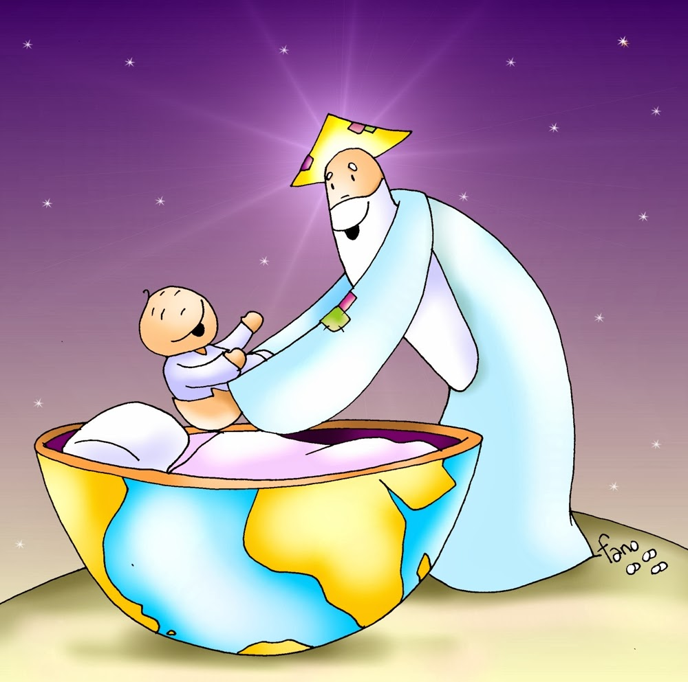
He Will be a descendent of David and will bring Reconciliation.
Isaiah 11,1-9

Slide 17
Sunday
of Joy
THIRD SUNDAY OF ADVENT
PRAYER
I WILL BE HAPPY OH LORD FOR YOU ARE NEAR!
Friday
of Joy
Joseph made a bed of clean straw for Mary to sleep on during the night.
I will secretly do a kind act for someone who is not very friendly toward me.
Saturday
of Joy
Mary unpacked the swaddling clothes that would keep baby Jesus warm.
I will warm my heart with love for Jesus by doing a kind act for each person in my family.
Monday
of Joy
Mary and Joseph were offered only a poor stable to stay in and they accepted gratefully.
I will excuse others when they are thoughtless, and I will try to be more thoughtful of others today.
Tuesday
of Joy
The animals helped to warm the stable by being there.
I will share the warmth of my friendship with others, especially with someone I do not like.
Wednesday
of Joy
Joseph cleaned the stable for Mary and for Jesus, who would soon be born.
I will keep my heart pure today by thinking and doing only pure things and by saying only kind things about others.
Thursday
of Joy
Mary put fresh straw in the manger to make a bed for the Christ Child.
I will brighten the day for others by smiling and showing how happy I am that Jesus is coming.

Slide 18
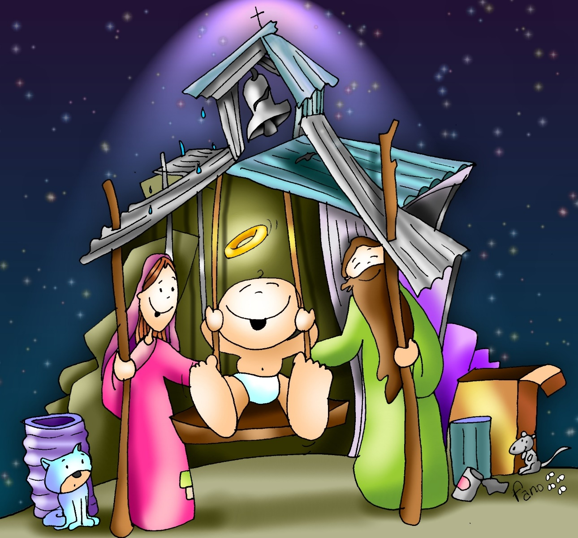
The Messiah Will be born in Bethlehem.
(House of Bread)
Micah 5,1-4

Slide 19
Sunday
of Love
FOURTH
SUNDAY
OF ADVENT
PRAYER:
Oh Come,
Oh Come Emmanuel
Friday
of Love
Mary and Joseph welcomed Jesus with great love!
I will be helpful at home these last days before Jesus’ birthday.
CHRISTMAS
Love is Born
Mary and Joseph welcomed Jesus with great love!
I will welcome Jesus with great love also and offer him all my good acts and prayers during the weeks of Advent.
Monday
of Love
Mary and Joseph waited patiently for the coming of Jesus.
I will try to be patient today, especially when others keep me waiting or do things that bother me.
Tuesday
of Love
Mary and Joseph thanked God for taking care of them.
I will thank God for all he gives me. I will show my parents I am grateful for all they do for me.
Wednesday
of Love
Mary and Joseph were at peace because they trusted God to care for them.
I will trust God to help me today to be a peacemaker in school and at home.
Thursday
of Love
A beautiful, bright star shone in the night sky over the stable.
I will bring the brightness of joy to everyone I meet today.

Slide 20
Instrucciones:
Instructions:
Cut the calendar and the items (www.fcpeace.org).
Cut 4 strips of brown construction paper (8x3.5”). Cut lines from the bottom towards the top, 1 and 1/8” apart and leaving 1/8” above to glue to the calendar.
Cut a triangle on brown paper. (Base 9”, height 4”, sides 6”)
Glue the calendar onto a paper (11x17”), starting with the 2nd page of the calendar on the bottom border.
Glue the strips to the top of each week.
Glue the roof (triangle) to the top.
Cut and color Mary and Joseph and the message: “Lets accompany…” and glue to the roof.
Cut the symbols and glue to the week to which they correspond.
Glue the prophesies to the top corners.
Let’s accompany Mary and Joseph in preparing for the coming of baby Jesus.

Slide 21
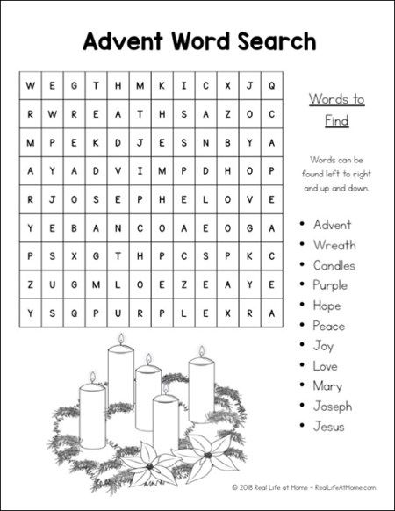

Slide 22


PRAYER
Dear Jesus,
You are true God and true man.
We thank you for coming to live amongst us. Teach us to share your peace and love with our families and friends. Help us to prepare well to receive you on Christmas Day.
Amen.

Slide 23

The King is on the Way - https://youtu.be/V6kIuetbQdY

