Slide 1

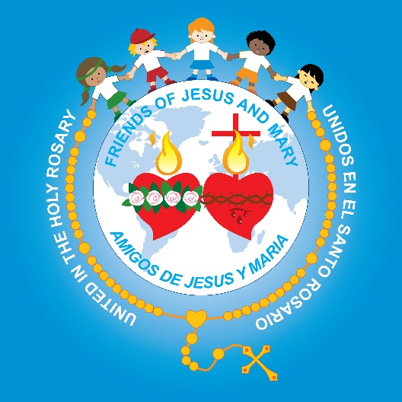
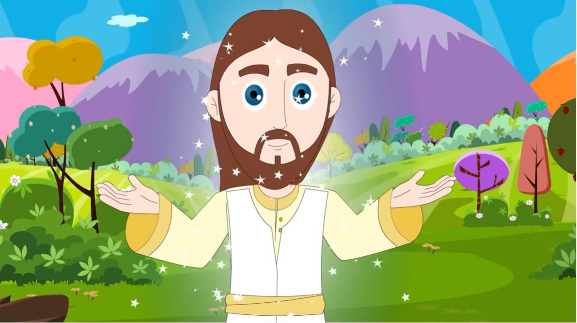
I Sunday of Easter - Cycle C
The Resurrection of Jesus (John 20, 1-9)
Ministry Friends of Jesus and Mary
Easter Triduum
and

Slide 2
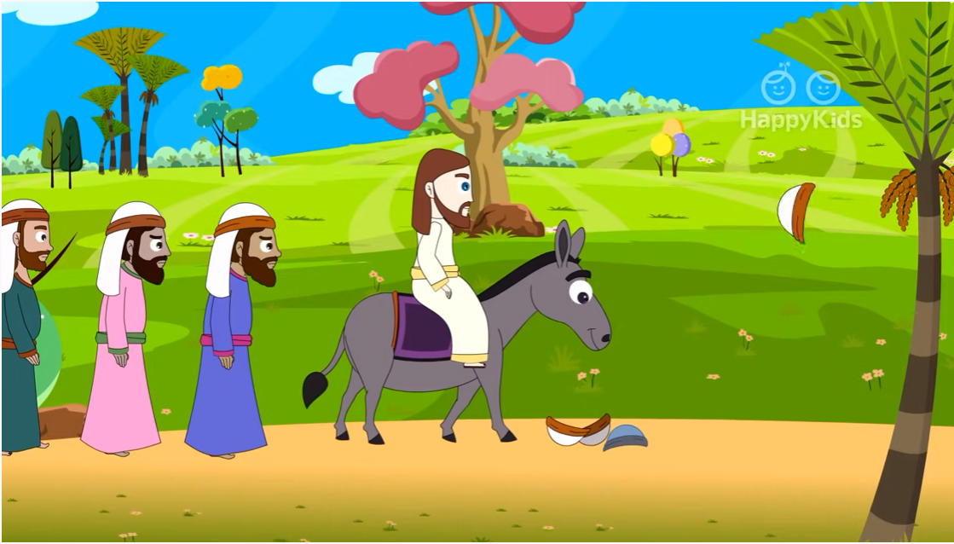
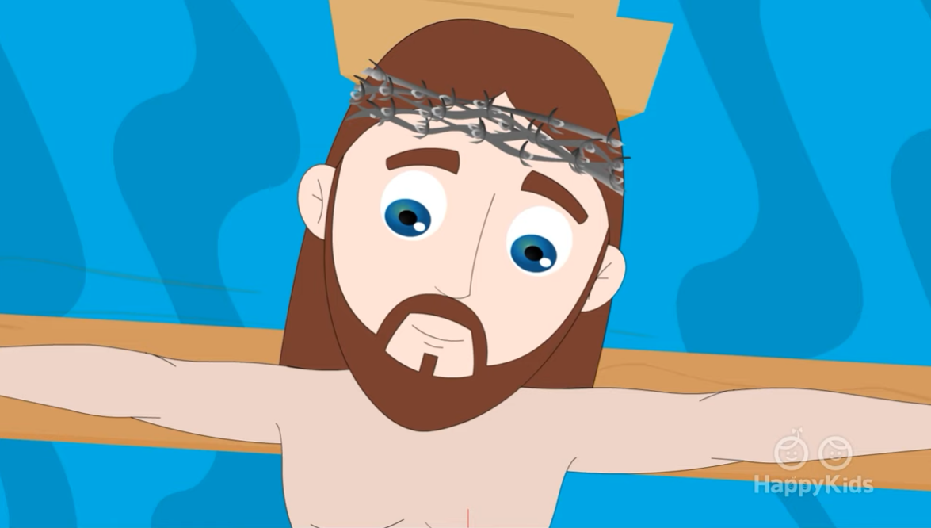
HOLY WEEK STARTS ON PALM SUNDAY, CONTINUES WITH THE EASTER TRIDUUM AND ENDS WITH EASTER SUNDAY.
Palm Sunday:
Jesus enters Jerusalem and is
proclaimed King.
-Last Sunday of Lent-
Easter Triduum:
Passion, death, and resurrection of Jesus.
-Thursday, Friday, and eve of Easter Sunday.-
Easter Sunday:
We celebrate the resurrection of Jesus.-
-I Sunday of Easter-

Slide 3
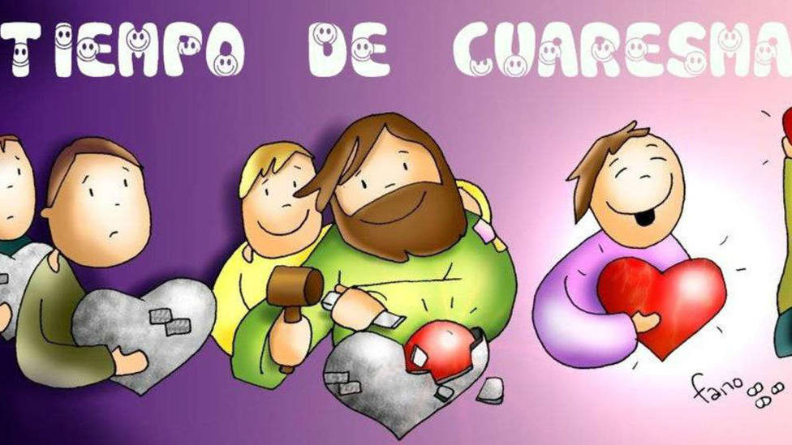
LENT ENDS ON HOLY THURSDAY WHEN
THE EASTER TRIDUUM BEGINS.
LENTEN TIME

Slide 4
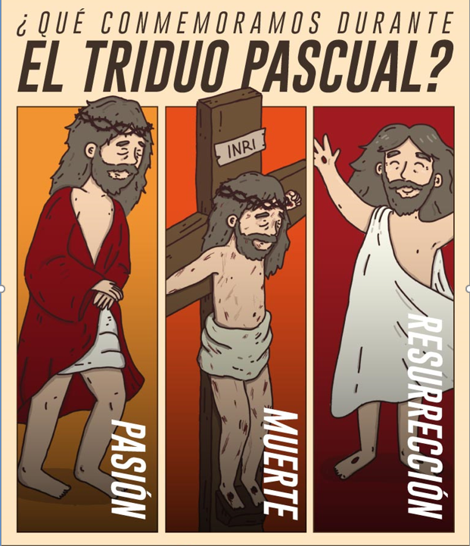
EASTER
TRIDUUM
WHAT DO WE REMEMBER ON THE
EASTER TRIDUUM?
THREE DAYS WHEN THE CHURCH REMEMBERS:
THE PASSION
DEATH AND
RESURRECTION OF JESUS
It begins at sunset on Thursday (the Last Supper Mass) and ends on Saturday night (Easter Vigil).
R
E
S
U
R
R
E
C
T
I
ON
PASS
I
ON
DEATH

Slide 5
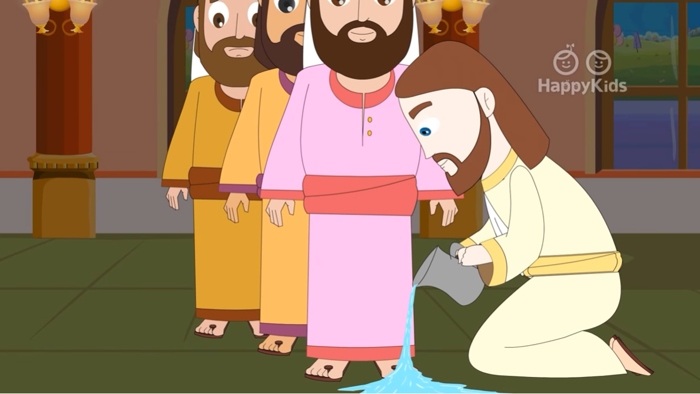
1ST DAY OF EASTER TRIDUUM: HOLY THURSDAY
Washing of the feet.
This day, Jesus celebrates with His apostles the LAST SUPPER (Passover). But before, Jesus washes the 12 apostle’s feet to show that He came TO SERVE. ( Love of neighbor)

Slide 6
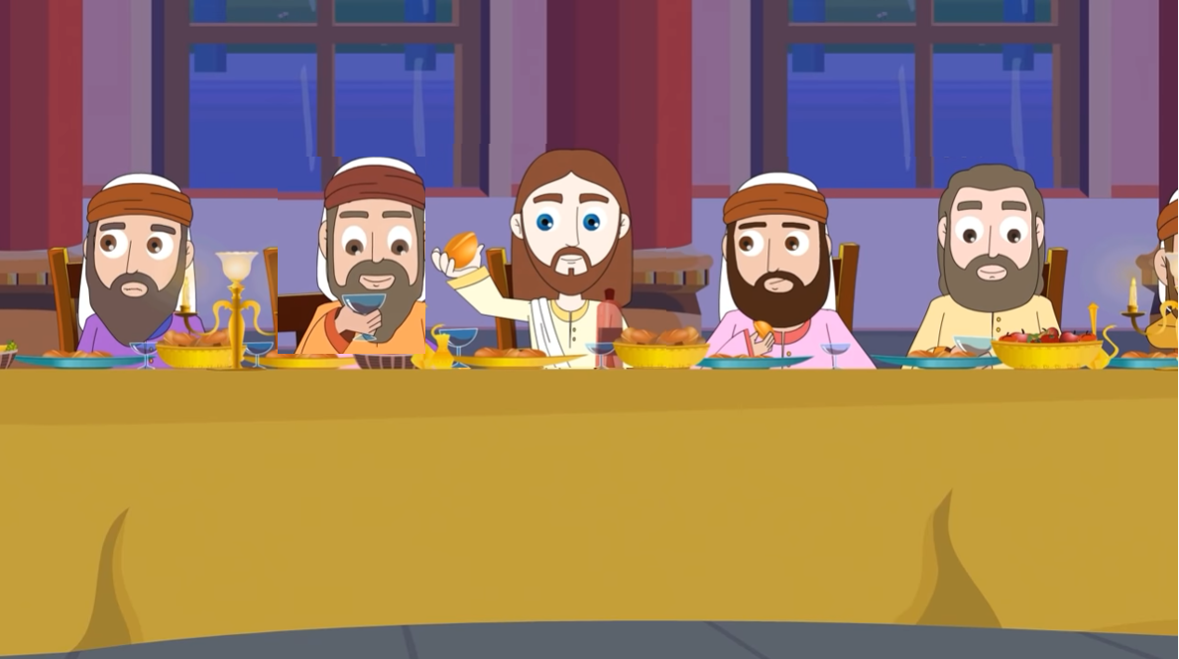
1ST DAY OF EASTER TRIDUUM: HOLY THURSDAY
JESUS INSTITUTES THE EUCHARIST AND THE PRIESTHOOD
At the LAST SUPPER, Jesus takes the BREAD and blesses it saying: “Take this bread and eat it; this is MY BODY which will be given up for you”.

Slide 7
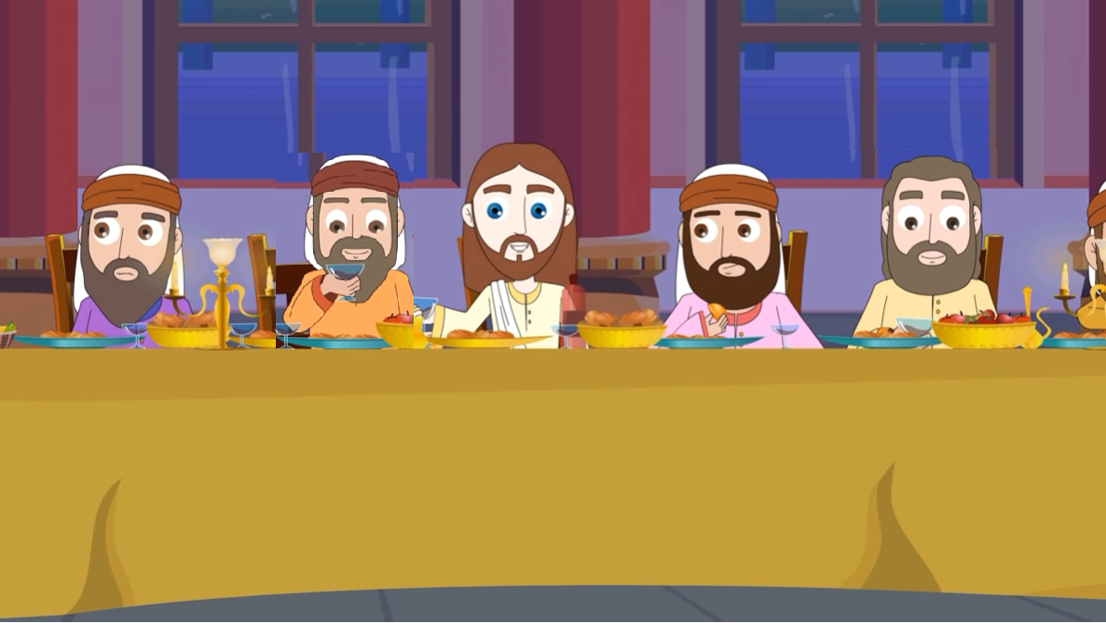
1ST DAY OF EASTER TRIDUUM: HOLY THURSDAY
JESUS INSTITUTES THE EUCARIST AND THE PRIESTHOOD.
Then Jesus took the CHALICE and blessed it saying: “Take this all of you and drink from it, for this is MY BLOOD that will be shed for you and for all men so that sins may be forgiven”.
Then He said, “ Do this in memory of me”. With these words, He makes the apostles priests and gives them a great mission.

Slide 8
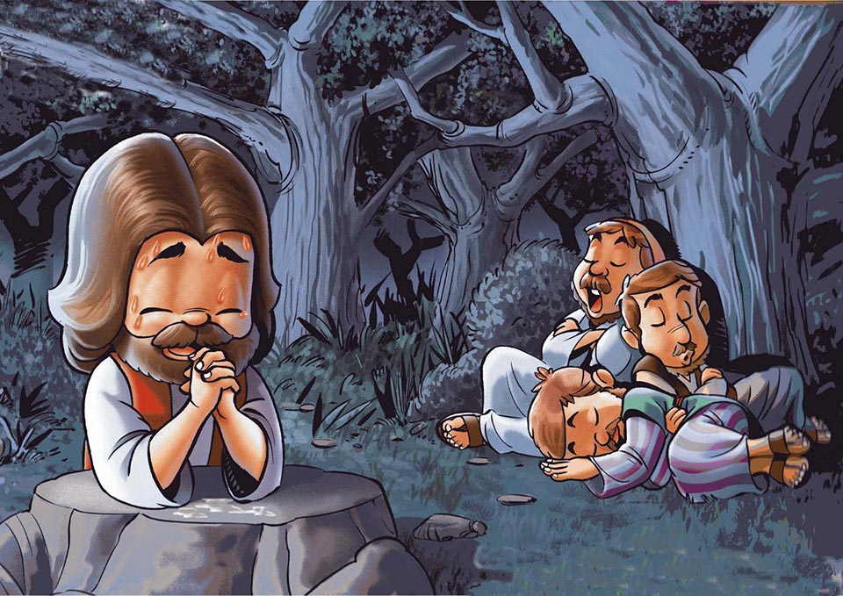
1ST DAY OF EASTER TRIDUUM: HOLY THURSDAY
JESUS PRAYS IN THE GARDEN OF GETHSEMANE.
After the Last Supper, Jesus retires with James, Peter, and John to pray. His pain for what was about to happen was so great that He was sweating large drops of blood.

Slide 9
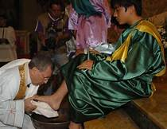
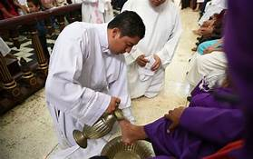
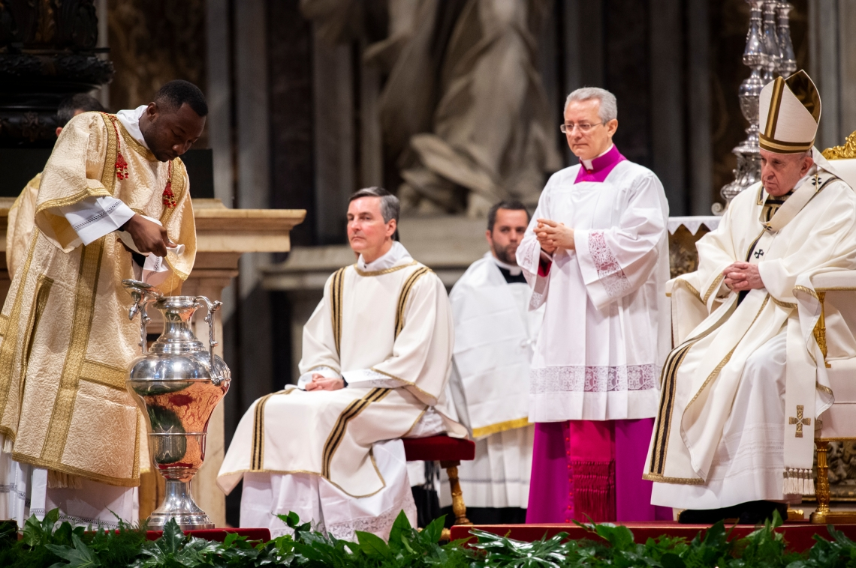
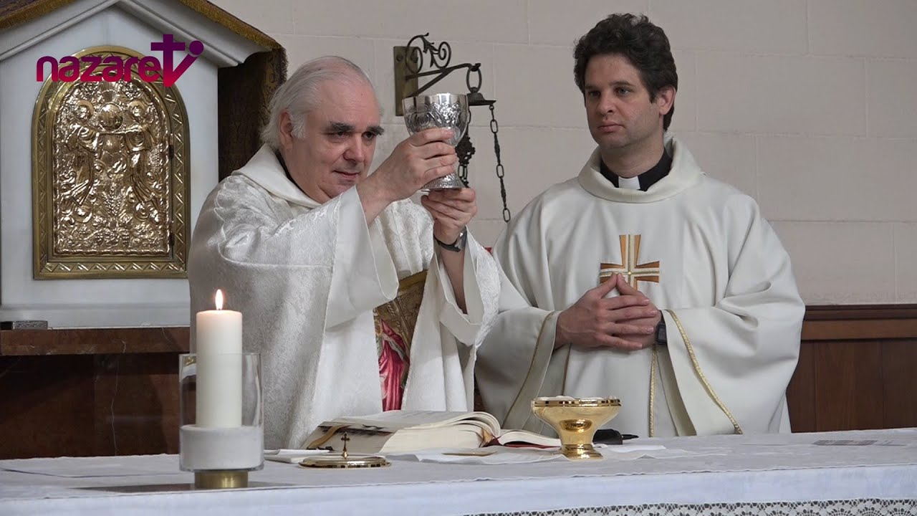
HOLY THURSDAY MASS
What happens during Holy Thursday Mass?
The priest washes the feet of 12 persons, remembering what Jesus did...
The priest blesses the holy oils, or holy chrisms, which will be used in the Sacraments throughout the year.
We celebrate the Eucharist consecrating enough hosts for Good Friday, since there is no consecration until Saturday’s Easter Vigil.

Slide 10
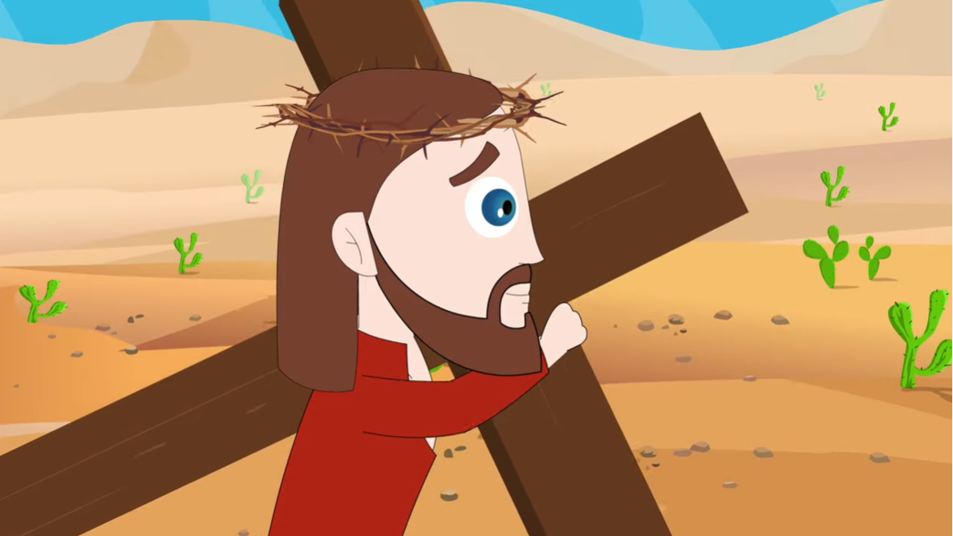
2ND DAY OF EASTER TRIDUUM: GOOD FRIDAY
This day we remember the Pasion and Death of Jesus Christ.
We pray the Stations of the Cross, accompanying Jesus while He carries His cross to Calvary where He is crucified.

Slide 11
2ND DAY OF EASTER TRIDUUM: GOOD FRIDAY
THE SEVEN WORDS
1.- “Father forgive them; they know not what they do.”
4.- “ My God, My God! Why have you abandoned me?
2.- “I assure you that today you will be with me in Paradise.”
5.- “ I Thirst!”
6.- “It is finished.”
3.- “Woman, there is your son. There is your Mother.”
7.- “Father, into your hands, I commend my spirit”.
This day, there is no Mass, only the Liturgy of the Word.
We Venerate the Cross by kissing it.
We meditate on the 7 last words that Jesus said on the Cross.
The Tabernacles are left open to show Jesus is not there.

Slide 12
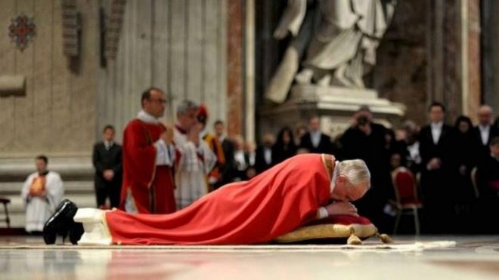
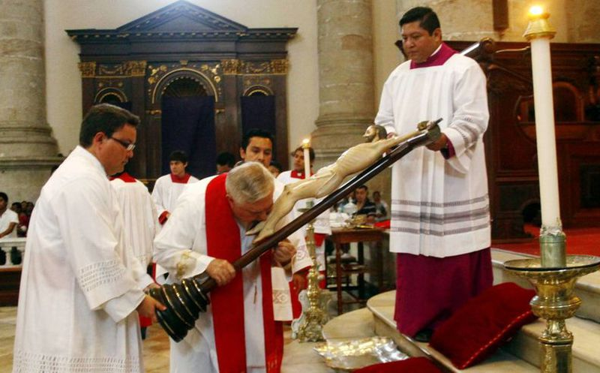
GOOD FRIDAY LITURGY
The priest wears RED.
There is no entrance hymn.
The priest enters in silence and prostrates himself on the floor expressing his pain for Jesus’ agony.
Veneration of the Holy Cross: We kiss the cross and recognize that by the Holy Cross we are saved from our sins.
We receive the Eucharist, (consecrated on Holy Thursday).
Day of fasting (for those at least 18 yrs. old) and abstinence (at least 14 yrs). It is a way of purifying our bodies and opening ourselves up to prayer. Children are also invited to offer up small sacrifices.

Slide 13

3RD DAY OF EASTER VIGIL: HOLY SATURDAY
It is a day of prayer close to the tomb, waiting for Jesus’ resurrection. We accompany the Virgin Mary in her pain; they have taken her only Son.
On Saturday night, we celebrate the Easter Vigil.

Slide 14
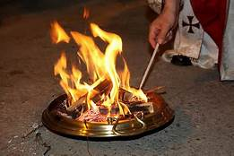
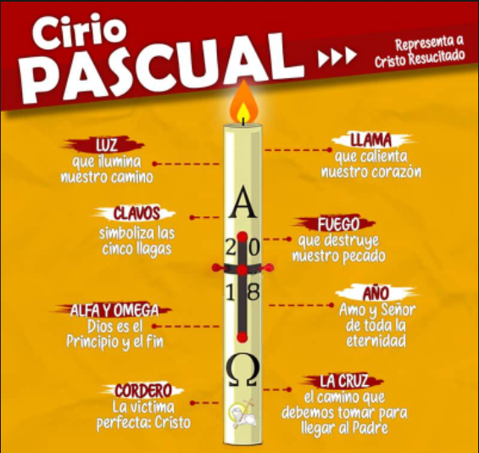
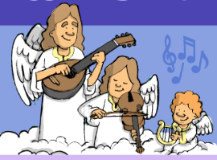
HOLY SATURDAY MASS (Easter Vigil)
1.- The Easter Vigil begins with the Blessing of the Fire.
Everything begins in darkness, the New fire is lit, the Paschal candle is blessed and lit with that fire.
The Paschal Candle symbolizes the resurrected Christ.
Jesus is the LIGHT of the world; He lights our path to Heaven. Jesus is the Alfa and the Omega, the 1st and last letters in the Greek alphabet. (He is the beginning and the end of everything.)
The Paschal Candle will be lit in all the celebrations during the Easter Season.
(For 50 days until Pentecost)
2.- We read the Liturgy of the Word, where we read various stories from scripture beginning with Creation and ending with Jesus’ Resurrection.
We pray the GLORIA again.
(stopped throughout Lent)
The priest wears white.

Slide 15
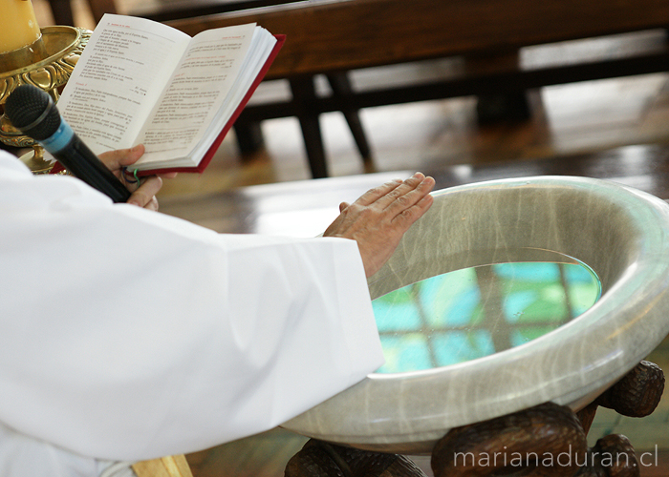
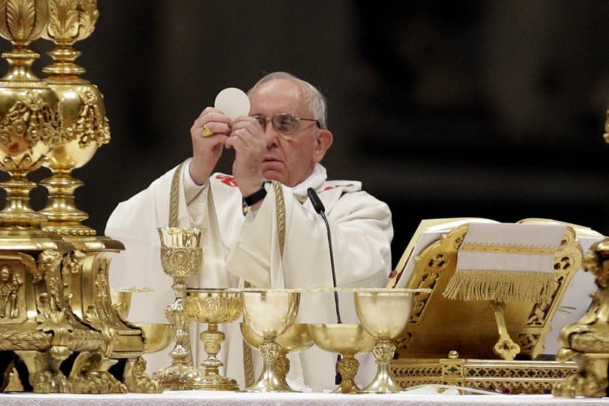
HOLY SATURDAY MASS (Easter Vigil)
3.- The priest continues with the Baptismal Liturgy, where they bless the Baptismal Font and the water. The Catechumens are baptized and the already baptized renew the baptismal vows made by their parents at the time of their Baptism.
4.- The priest continues with the Liturgy of the Eucharist. He celebrates the Consecration again and we share the resurrected Jesus in the Eucharist.

Slide 16
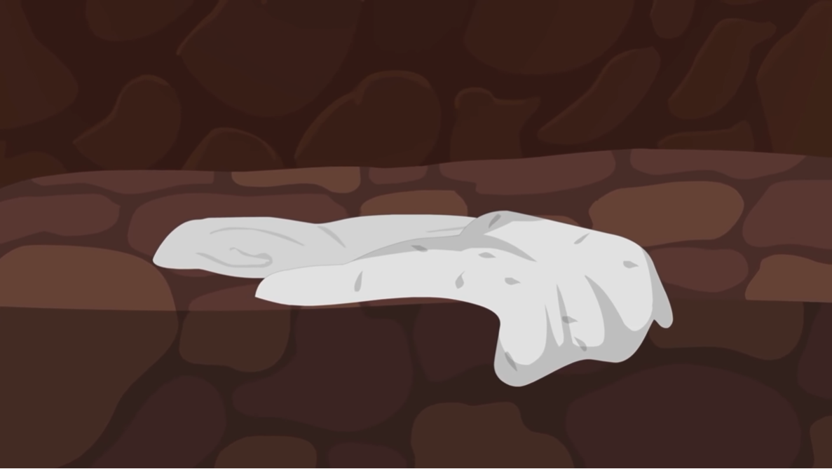
EASTER SUNDAY
JESUS IS RESURRECTED!
On Sunday morning, they went to the tomb and found that the stone had been moved and that the Lord was not there. Only the burial cloths remained.
JESUS IS VICTORIOUS OVER DEATH AND IS RESURRECTED!

Slide 17
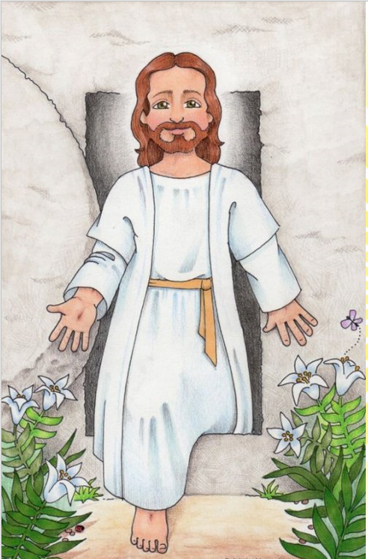
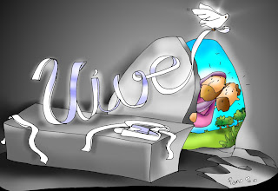
EASTER SUNDAY
THE RESURRECTION OF JESUS
Easter Sunday is the most important feast of the Church because we celebrate that Jesus has resurrected!
Jesus is victorious over death which SAVES HUMANITY. Jesus offered to His Father His painful Pasion and Death for our sins and thus gave us the opportunity to enter Heaven.
Thank You! ALELUYA!
HE LIVES

Slide 18
I Sunday of Easter-Cycle C
The Resurrection of Jesus (John 20, 1-9)
GOSPEL

Slide 19
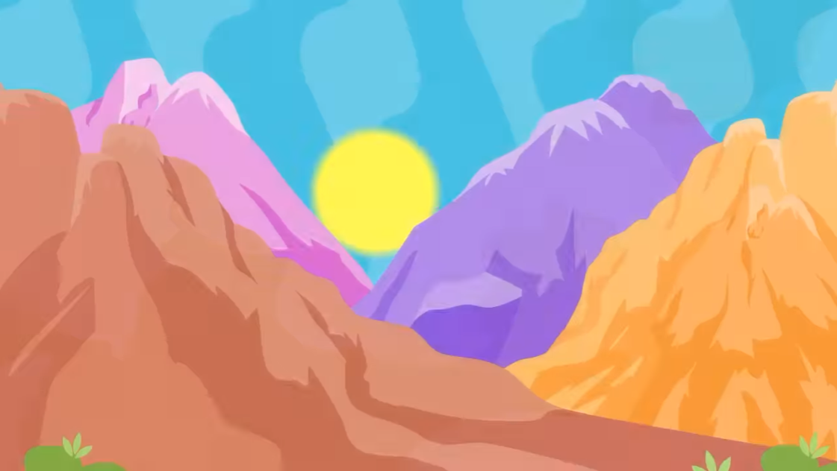
On the first day of the week, while it was still dark ,

Slide 20
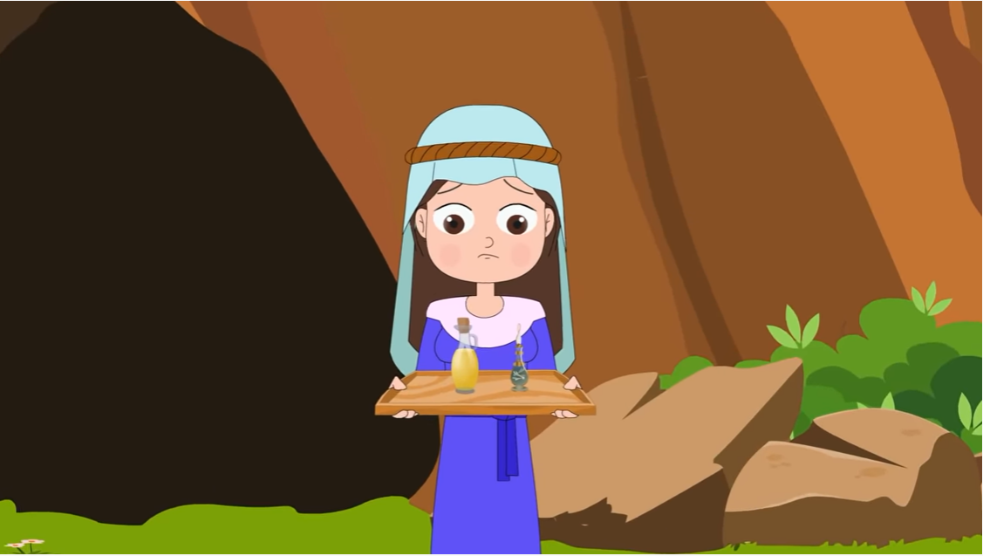
Mary of Magdala came to the tomb early in the morning...

Slide 21
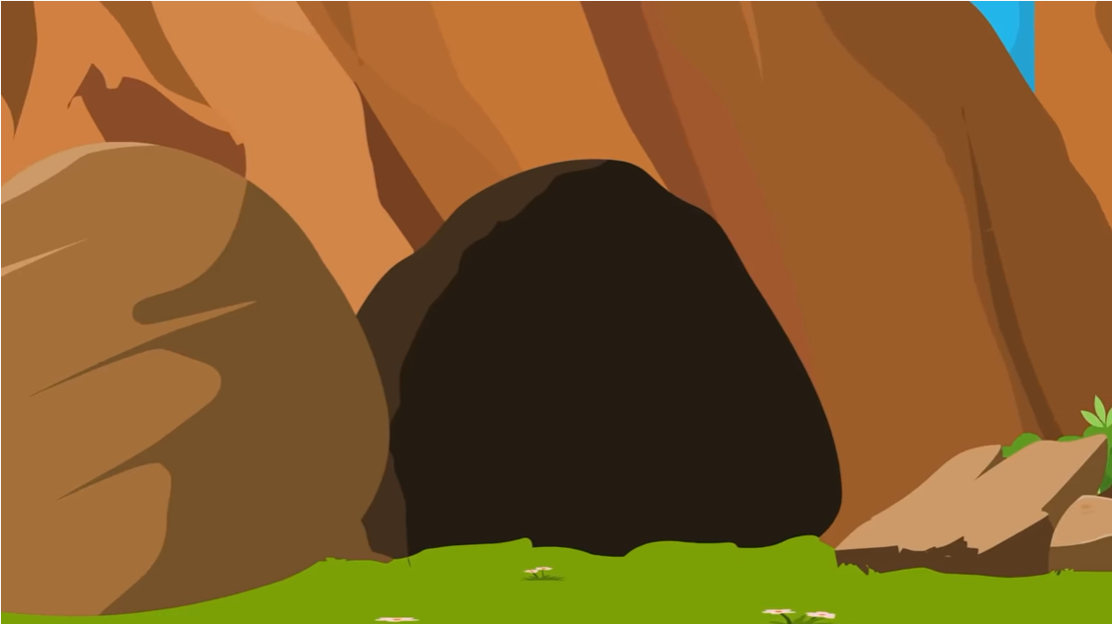
…and saw the stone removed from the tomb.

Slide 22
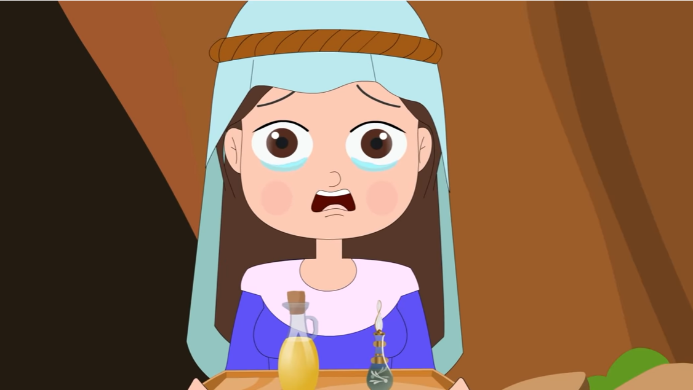
So she ran and went to Simon Peter and to the other disciple whom Jesus loved, and told them,

Slide 23
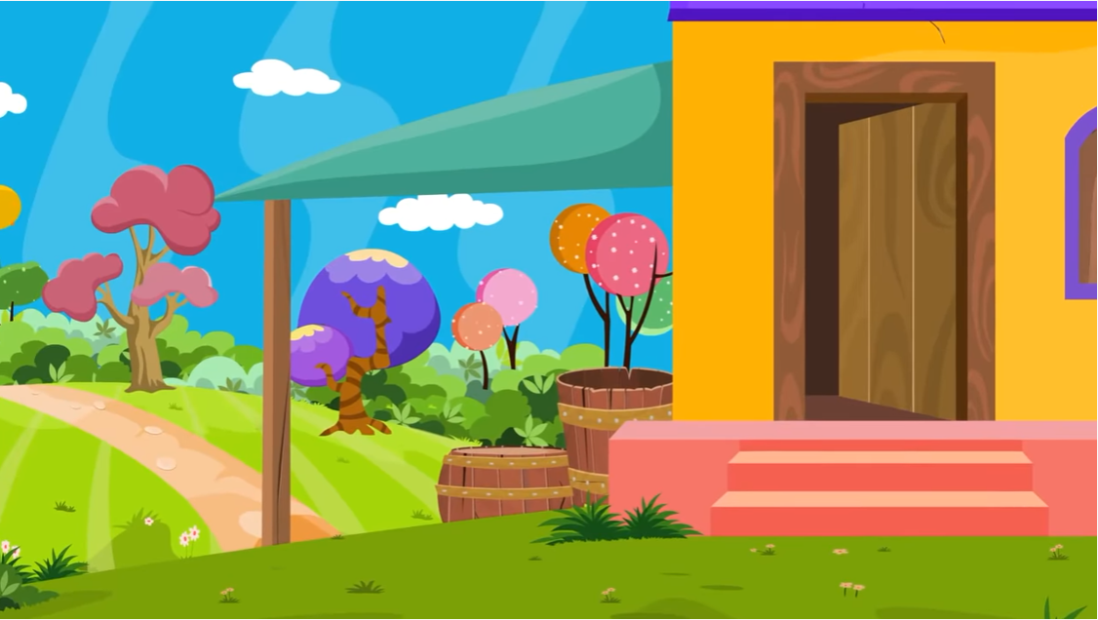
“They have taken the Lord from the tomb, and we don’t know where they put him.”

Slide 24
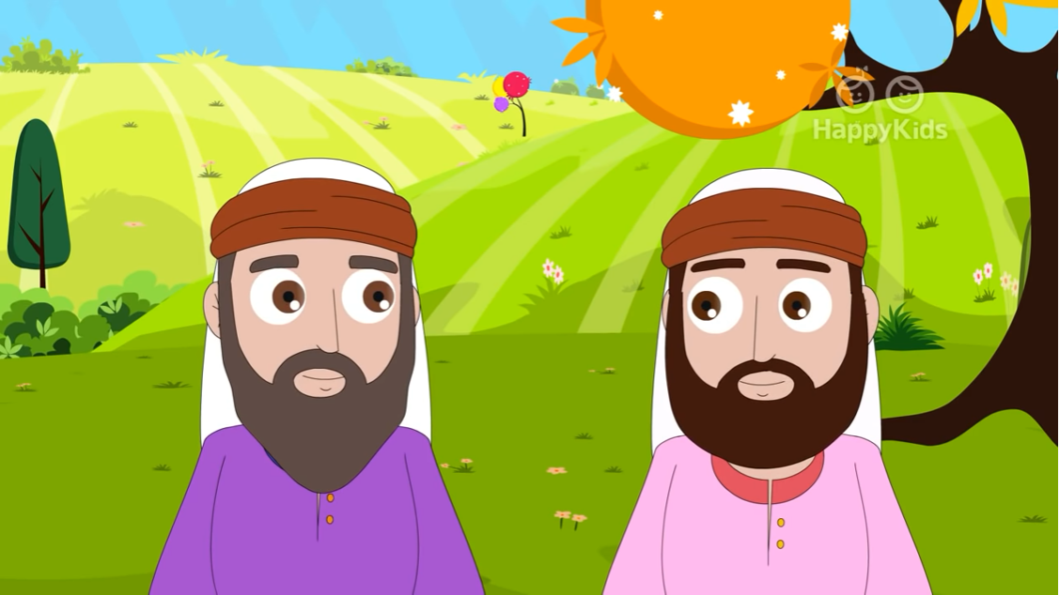
So Peter and the other disciple went out and came to the tomb. They both ran,

Slide 25
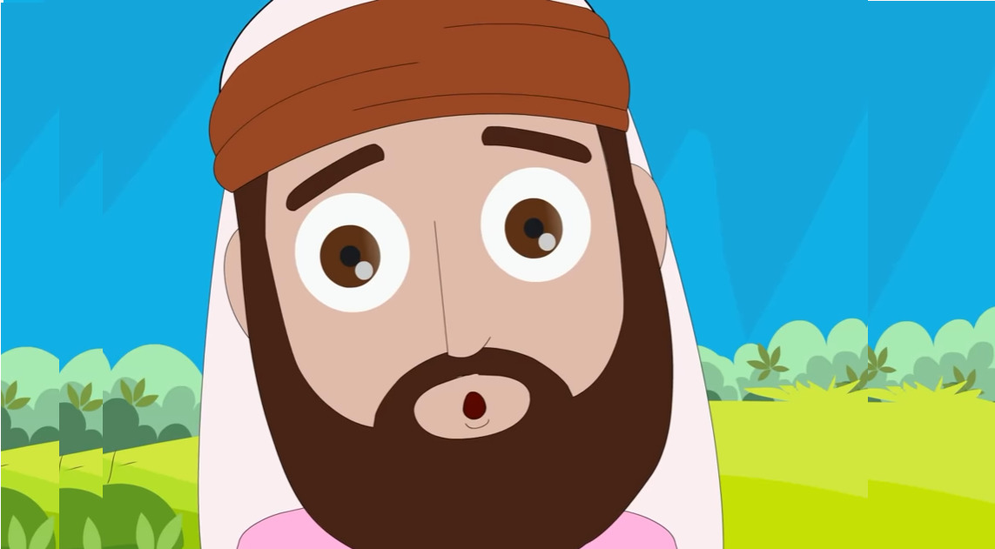
…but the other disciple ran faster than Peter and arrived at the tomb first; he bent down,

Slide 26
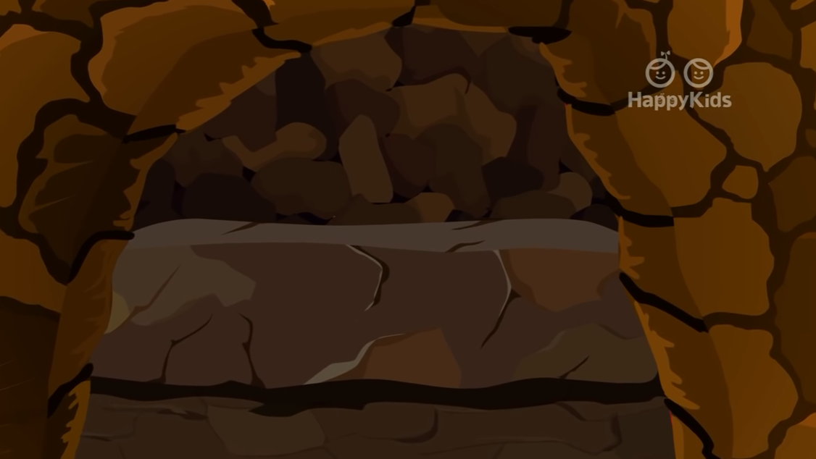
…and saw the burial cloths there, but did not go in. When Simon Peter arrived after him, he went into the tomb…

Slide 27
and saw the burial cloths there, and the cloth that had covered his head,

Slide 28
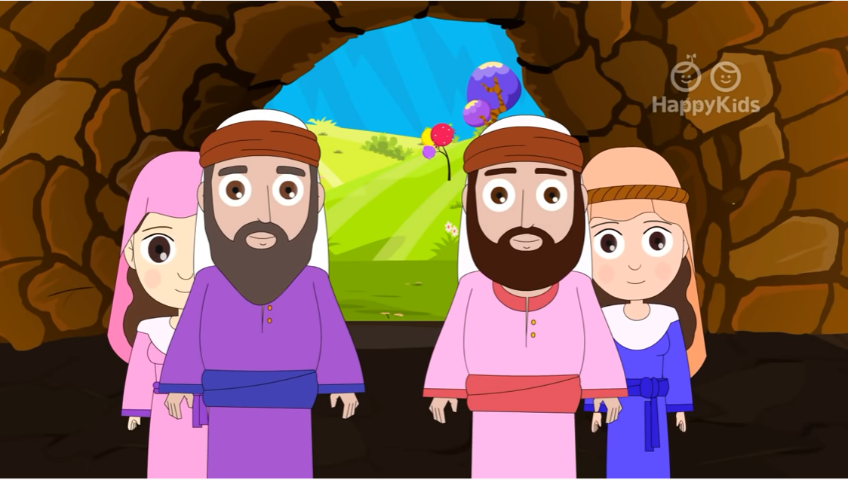
…not with the burial cloths but rolled up in a separate place. Then the other disciple also went in,

Slide 29
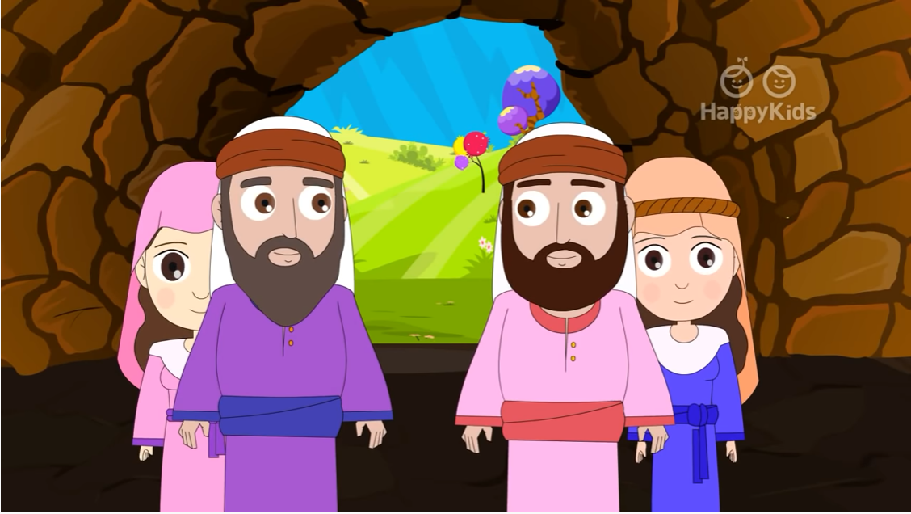
…the one who had arrived at the tomb first, and he saw and believed.

Slide 30
For they did not yet understand the Scripture that he had to rise from the dead.
The Gospel of the Lord. Praise to You Lord Jesus Christ.

Slide 31
REFLECTION
What is the first day of the week?
Sunday
What did Mary Magdalene see when she arrived at the tomb?
The stone that closed the tomb was removed.

Slide 32
REFLEXION
What did she do?
She ran to tell Peter and John that someone had taken Jesus’ body.
Do you know the name of the other apostle who accompanied Peter?
John, the beloved disciple
What did Peter and John do?
They ran to the tomb to see for themselves.

Slide 33
What did they see when they arrived?
The burial cloths, and the cloth that had covered his head, rolled up in a separate place.
What would you think if you saw the empty tomb? SHARE
The Gospel says that they saw and believed. For they did not yet understand the Scripture that he had to rise from the dead.
Jesus is alive after they saw Him die! What does this mean?
Jesus is God and He has power over death. If we believe and follow Jesus, death can have no power over us;
we have eternal life.
THIS IS THE GOOD NEWS

Slide 34

ACTIVITY

Slide 35
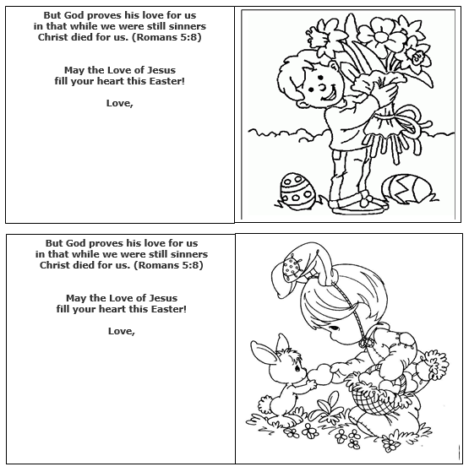
Activity 1:
Make Easter cards!!
Color and cut the attached cards. Write a nice message for your loved ones.
Also make a card for someone who you think may need love on Easter.
Give it to them on Easter Sunday!!!

Slide 36

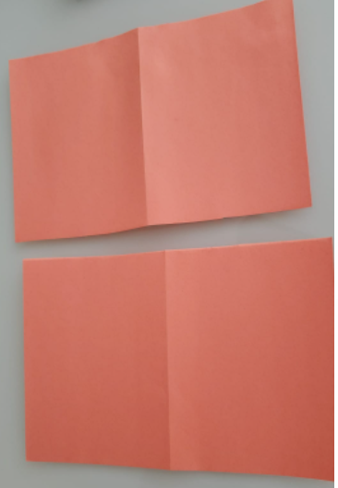

ACTIVITY 2: Make a Holy Week Book.
1.- Fold a piece of construction paper in 4. (4.5”x5.5” each)
2.- Cut the paper in half (on the horizontal fold)
3.- Place each side over the other and staple at the fold.
4.- Color and cut the four following pages and glue to the inside pages of the book, on the left and on the right sides. Place the pictures of the crosses on the front with the name “Holy Week”.

Slide 37
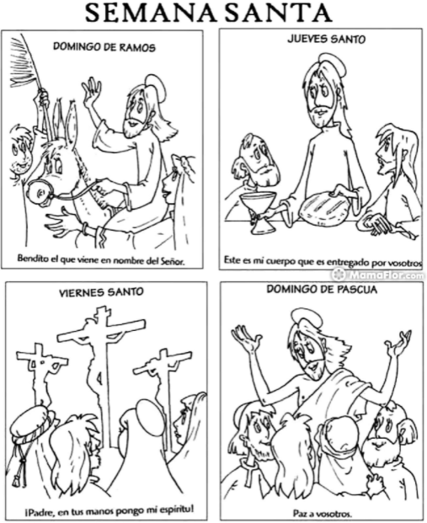
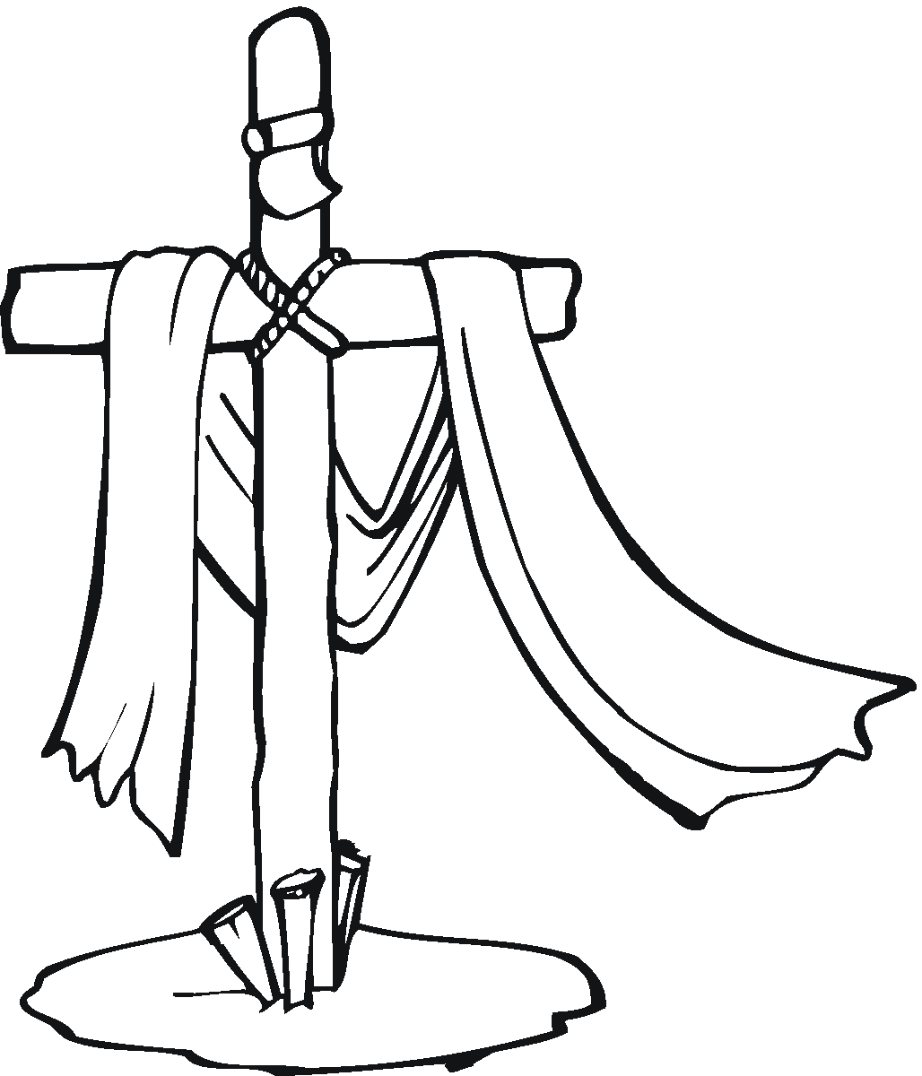
PALM SUNDAY
HOLY THURSDAY
HOLY WEEK
Blessed is He who comes in the name of the Lord.
This is my body that will be given up for you.
GOOD FRIDAY
EASTER SUNDAY
Father, into your hands I commend my Spirit.
Peace be with you.

Slide 38
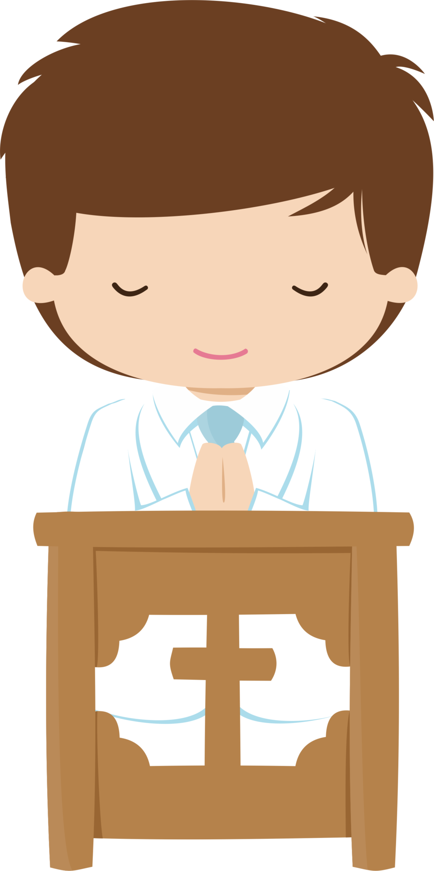
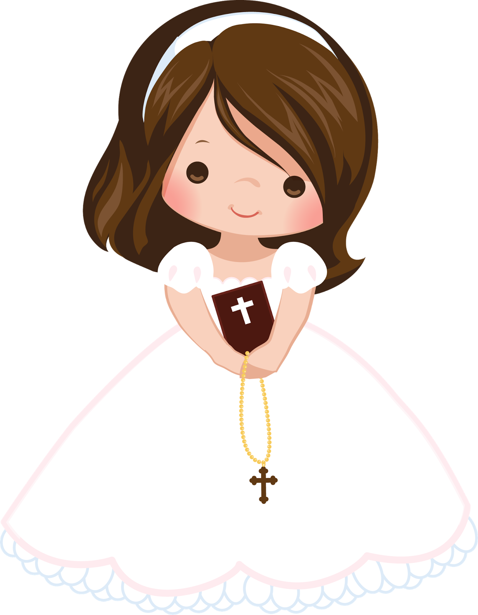
PRAYER
Lord Jesus, you gave your life for me and you defeated death. And despite all our errors and sins, you always offer us new life and happiness. Help us to be a reason for hope and happiness in this world. Amen

Slide 39
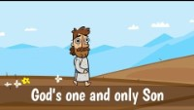
SONG: Jesus Song, Saddlebag Kids, (3-8 yrs.) https://youtu.be/Rn84AYtFUSM

Slide 40
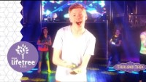
Song: Jesus is Alive, Lifetree Kids, (9+ yrs.) https://youtu.be/JpZJ-39IT1k

