Slide 1
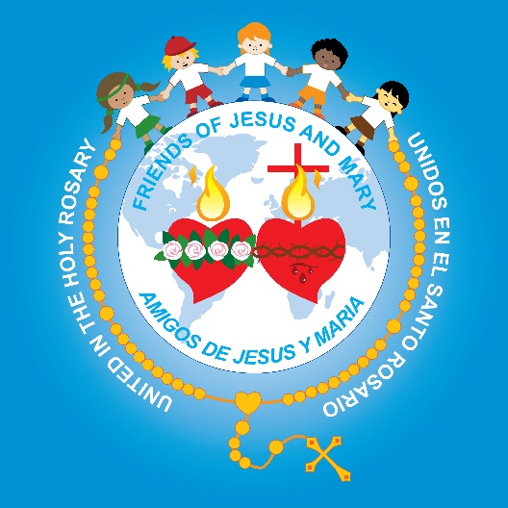
Friends of Jesus and Mary
Prayer Group for Children
Cycle C – I Sunday in Lent
Jesus is Tempted in the Desert– Luke 4, 1-13

Slide 2
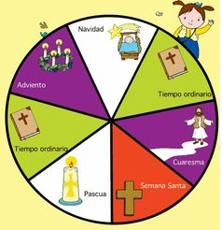
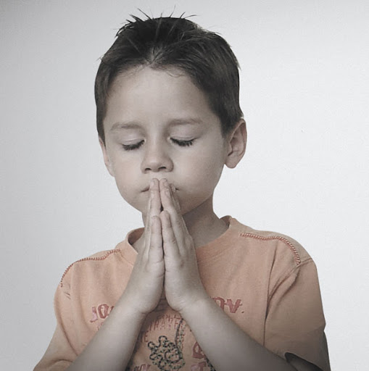
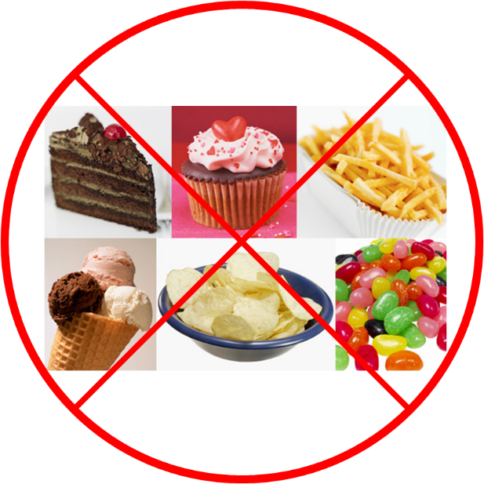
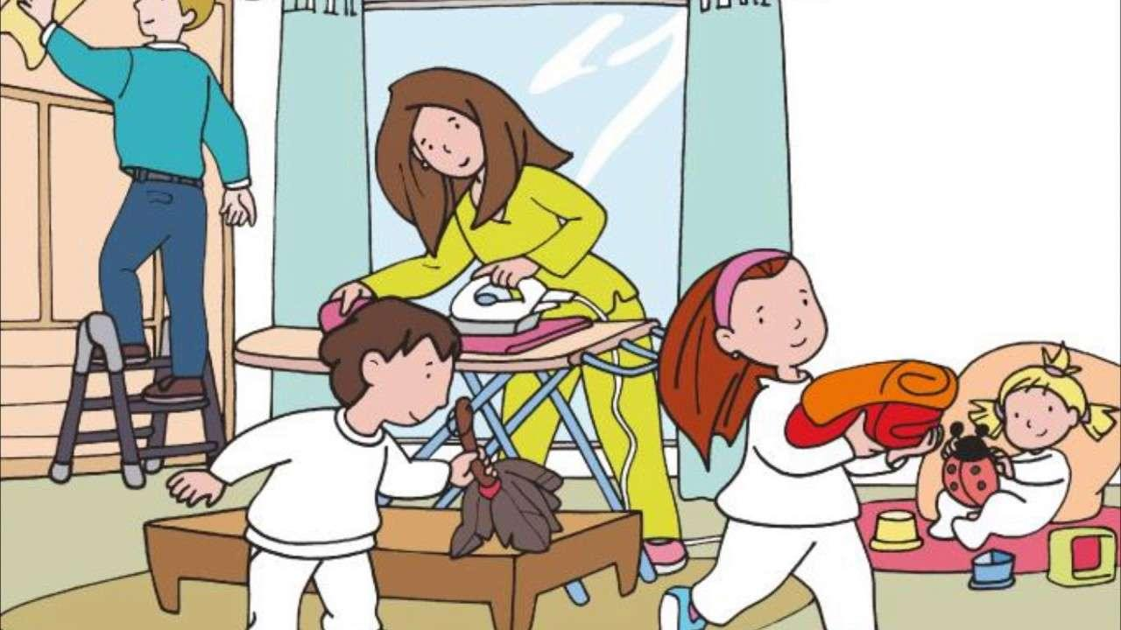
We begin the season of Lent, a time of preparation.
Throughout the 40 days of Lent, we prepare our hearts with:
Prayer,
Sacrifices,
and Acts
of Love,

Slide 3

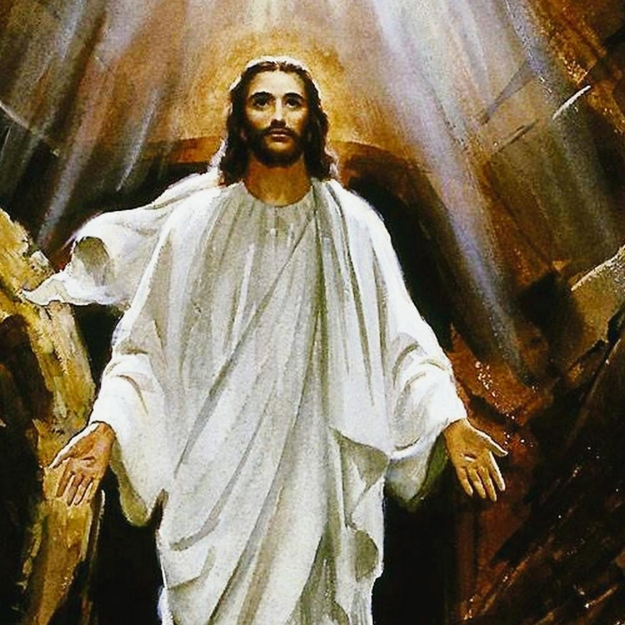
…To receive the Resurrected Christ
into our hearts on Easter Sunday.

Slide 4
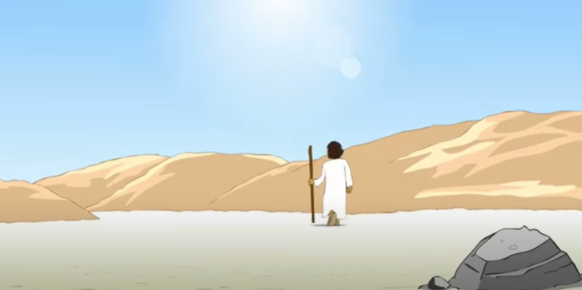
Filled with the Holy Spirit, Jesus returned from the Jordan and was led by the Spirit into the desert…

Slide 5
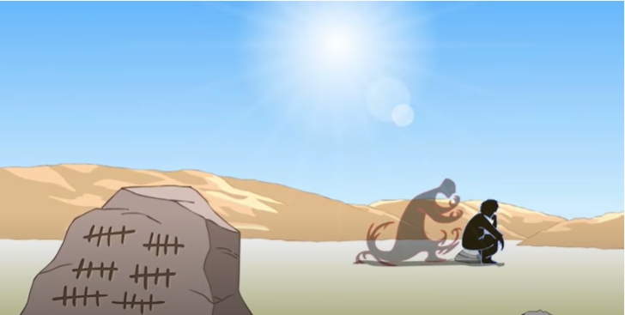
…for forty 40 days, to be tempted by the devil.

Slide 6
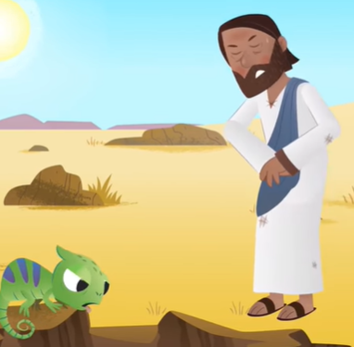
He ate nothing during those days, and when they were over, he was hungry.

Slide 7
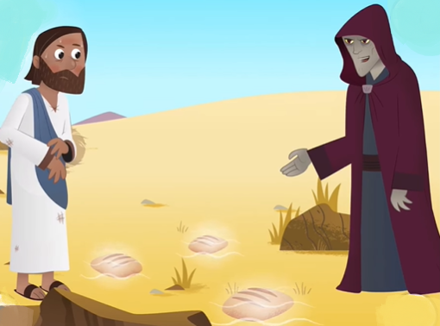
The devil said to him, "If you are the Son of God, command this stone to become bread."

Slide 8
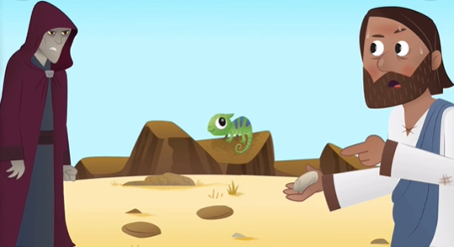
Jesus answered him, "It is written, One does not live on bread alone."

Slide 9
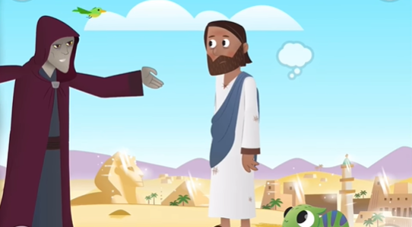
Then he took him up and showed him all the kingdoms of the world in a single instant. The devil said to him,
"I shall give to you all this power and glory; for it has been handed over to me, and I may give it to whomever I wish. All this will be yours, if you worship me."

Slide 10
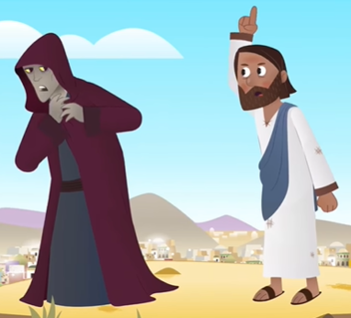
Jesus said to him in reply, "It is written: You shall worship the Lord, your God, and him alone shall you serve."

Slide 11
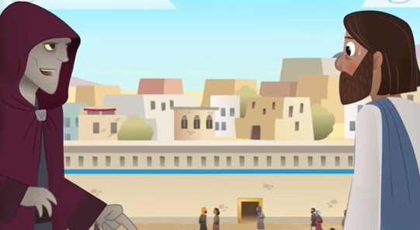
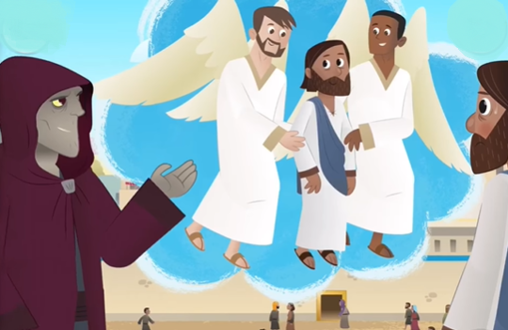
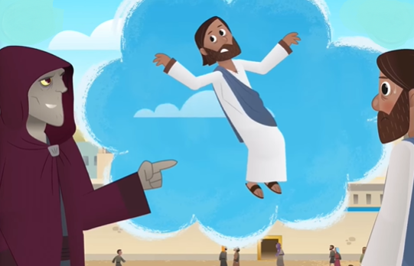
Then he led him to Jerusalem, made him stand on the parapet of the temple, and said to him, "If you are the Son of God, throw yourself down from here,
… for it is written: He will command his angels concerning you, to guard you, and: With their hands they will support you, lest you dash your foot against a stone."

Slide 12
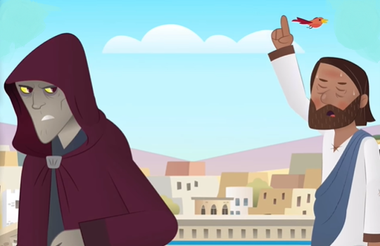
Jesus said to him in reply, "It also says, You shall not put the Lord, your God, to the test."

Slide 13
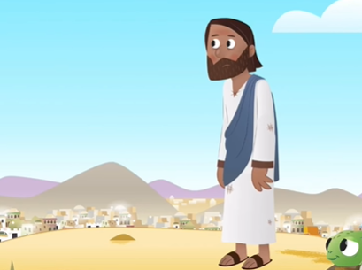
When the devil had finished every temptation, he departed from him for a time.
The Gospel of the Lord, Praise to You Lord Jesus Christ.

Slide 14
REFLECTION

Slide 15
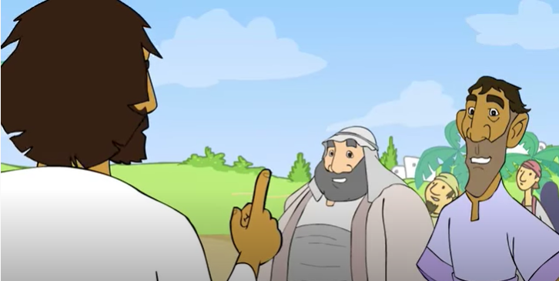
After Jesus was baptized, the Holy Spirit led Him out to the desert for 40 days to prepare for His mission.
In the bible, the number 40 signifies a time of preparation.
For what was Jesus preparing?
Soon He would begin His public ministry, where He would teach all about God’s love. He would also save us by suffering and dying for our sins.

Slide 16
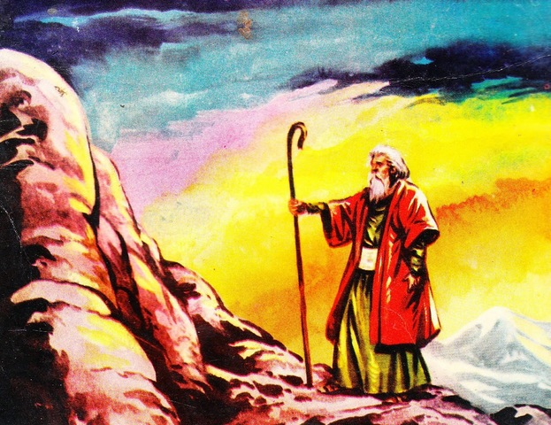
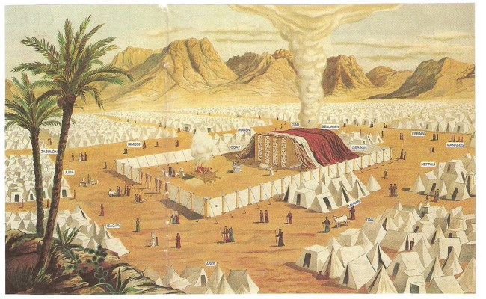
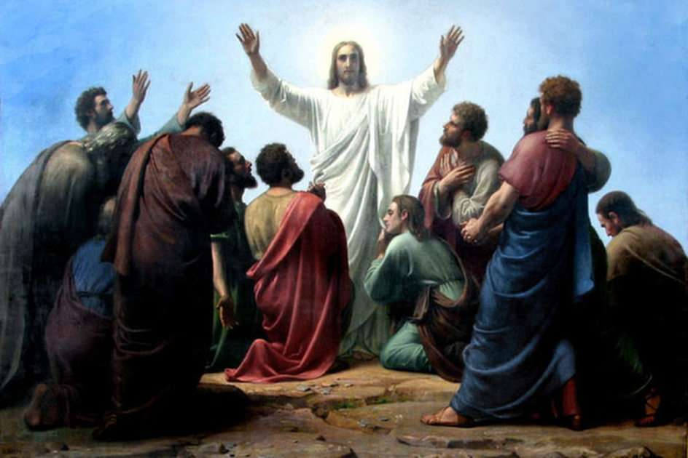
Do you know of other important times when the number 40 occured in the bible?
After God saved His people from slavery in Egypt, Moses went up to Mount Sinai and received the 10 Commandments from God, to make a Covenant with His people. Moses first fasted and prayed for 40 days.
After Jesus resurrected, He stayed with the apostles for 40 days before ascending into Heaven to prepare them for their mission to spread the Gospel.
Then God’s people remained in the desert for 40 years preparing to enter the Promised Land of Canaan.

Slide 17
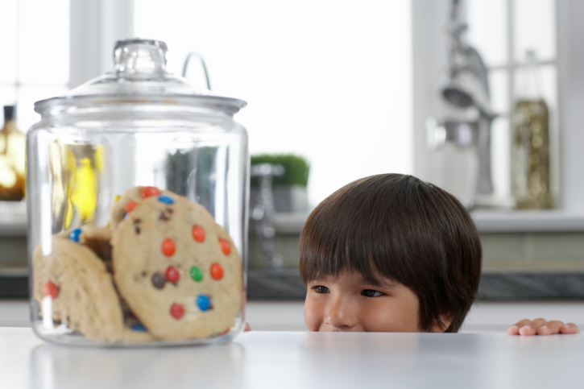
In the desert Satan tempted Jesus, trying to destroy God’s plan to save us.
What does temptation mean?
When we want to do something we know we shouldn’t.

Slide 18

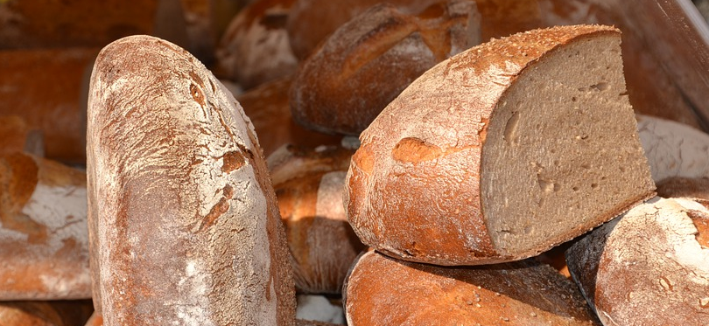
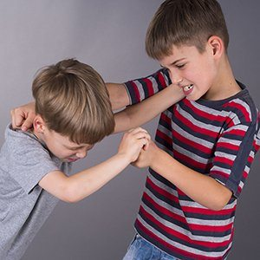
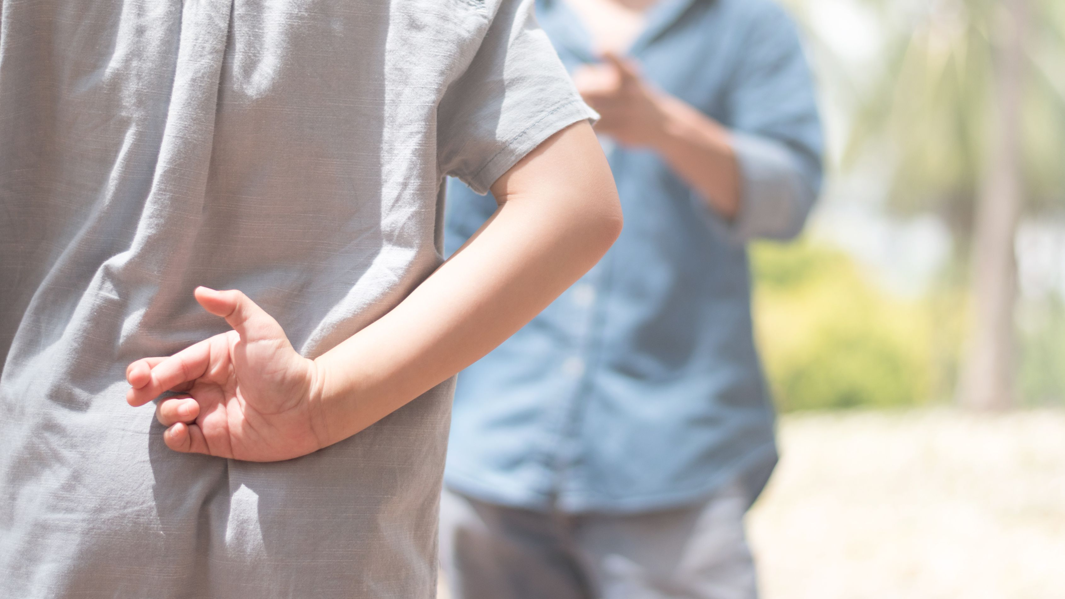
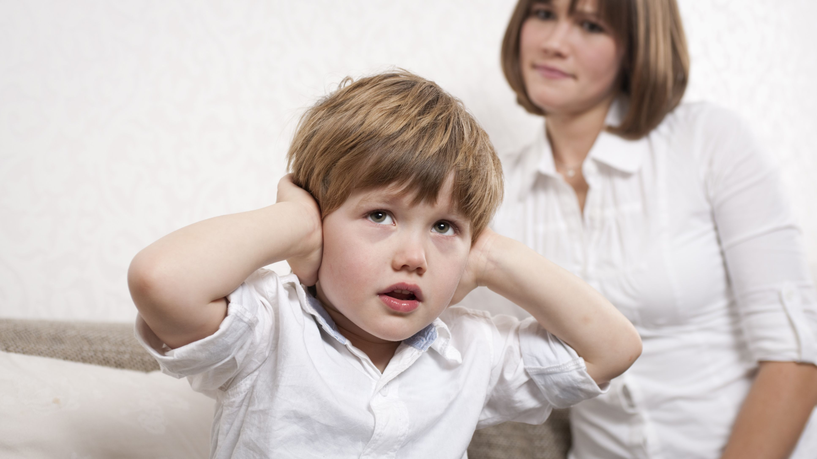
The 1st temptation is to change the stones to bread and give up fasting, something the Holy Spirit had requested to help Him obey.
Have you ever been tempted to disobey God?

Slide 19
What does Jesus respond?
"It is written, One does not live on bread alone."

Slide 20
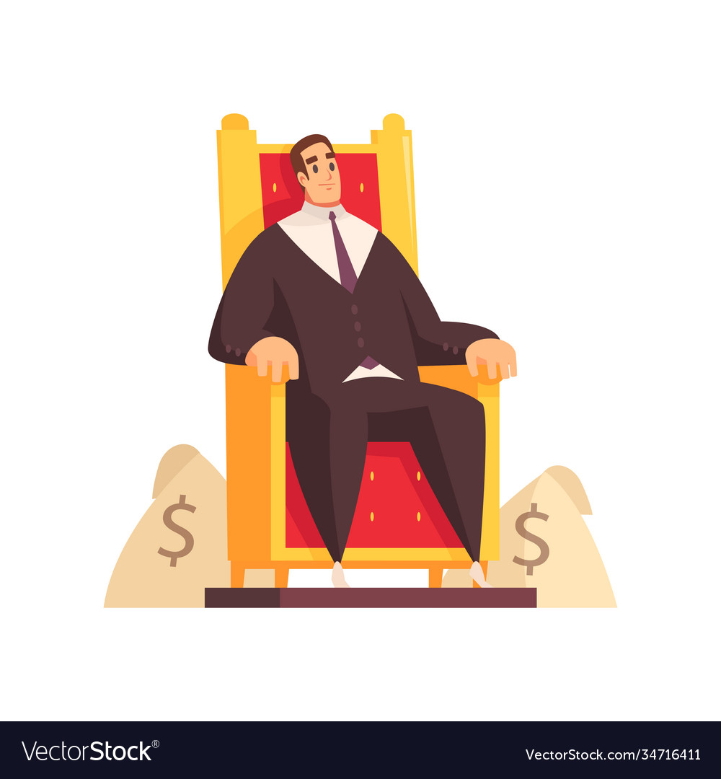



The 2nd temptation is to choose power and riches instead of serving God.
Have you ever been tempted to choose comfort and pleasure instead of doing homework or going to Mass?

Slide 21
What does Jesus respond?
"It is written: You shall worship the Lord, your God, and him alone shall you serve."

Slide 22
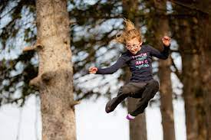
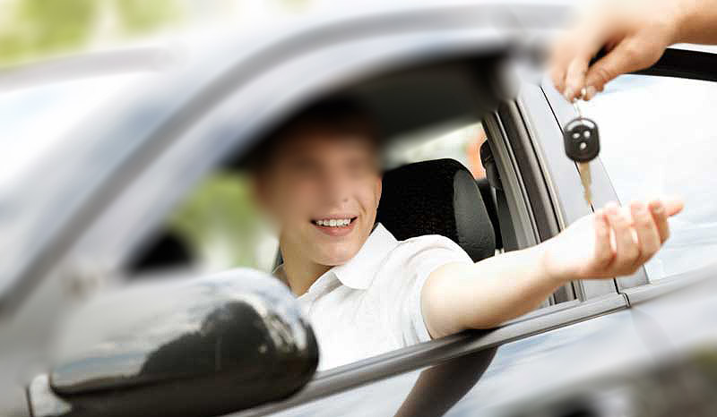
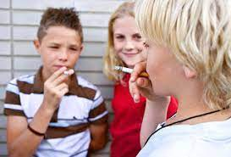
The 3rd temptation is to prove He is God by throwing Himself off of the temple, something very dangerous, to see if the angels will save Him.
Has a friend ever pressured you to do something dangerous?

Slide 23
How did Jesus respond?
“It also says, You shall not put the Lord, your God, to the test."

Slide 24
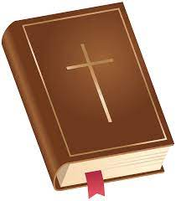
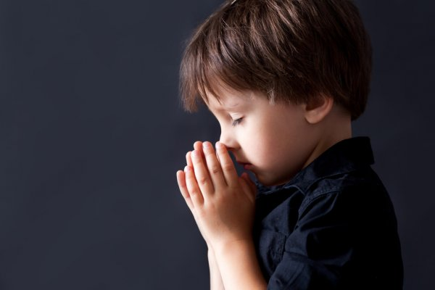
Jesus always resisted temptation because He knew what God asked us in the scriptures and He always wanted to obey.
Jesus shows us that God’s Word, prayer, and fasting or sacrifices, help us to resist temptation and fulfill our mission as children of God to love and serve God and others.

Slide 25

Activity

Slide 26
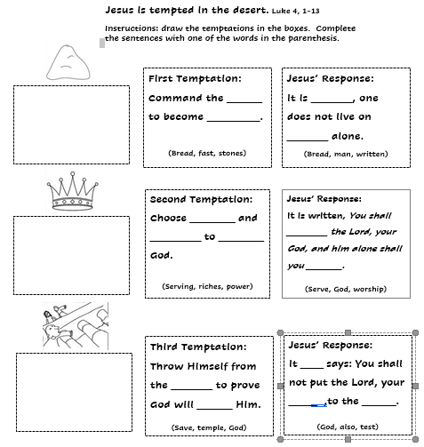
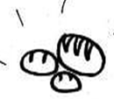

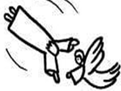
stones
written
bread
bread
riches
power
serving
worship
serve
also
temple
save
God
test

Slide 27
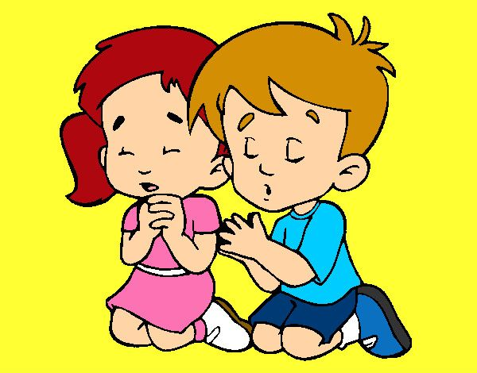
PRAYER
Help me Lord to resist temptations and to focus on the greatness of Your love for us. I want to be better each day. Help me to distinguish between good and evil and to always serve you by sharing your love with others. Amen.

Slide 28
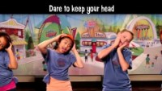
Stand Strong, ccw vbs, https://youtu.be/52GHF_8v-kw

