Slide 1
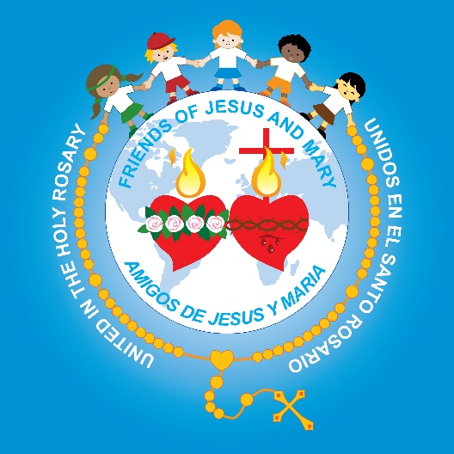
Friends of Jesus and Mary
Prayer Group for Children
Cycle C-I Sunday in Ordinary Time
The Baptism of the Lord, Luke 3, 15-16, 21-22

Slide 2
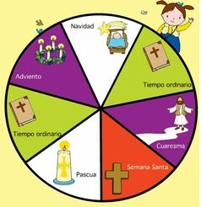
We begin Ordinary Time.
During Ordinary Time, Jesus teaches us of God’s great love and how we should love.

Slide 3
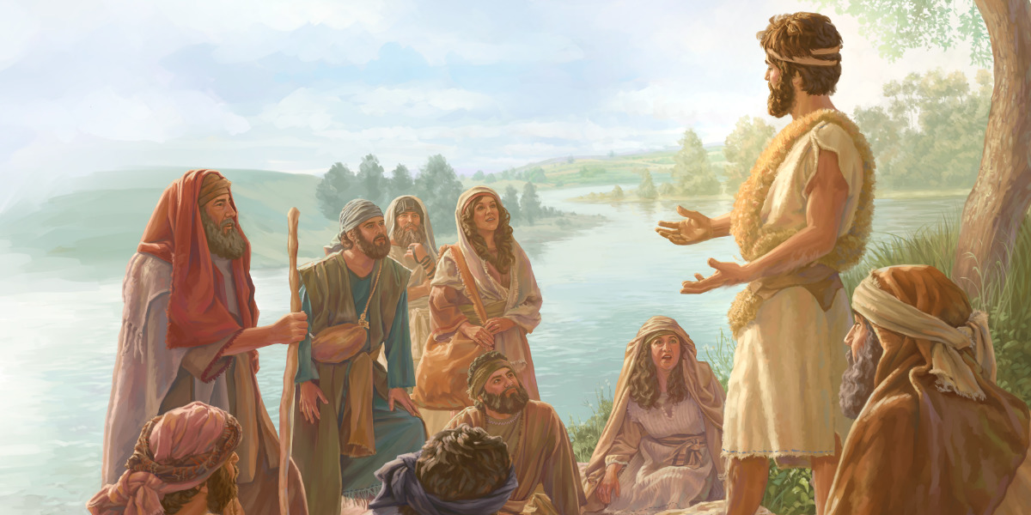
The people were filled with expectation, and all were asking in their hearts whether John might be the Christ.
John answered them all, saying, "I am baptizing you with water, but one mightier than I is coming. I am not worthy to loosen the thongs of his sandals.

Slide 4

He will baptize you with the Holy Spirit and fire.

Slide 5
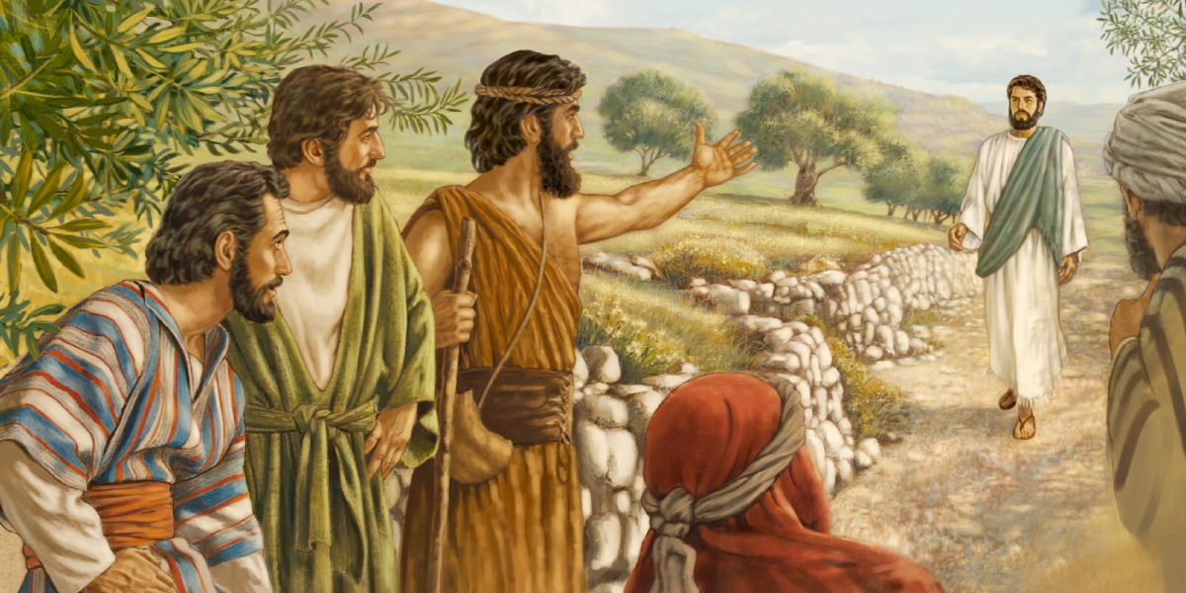
After all the people had been baptized and Jesus also had been baptized…

Slide 6
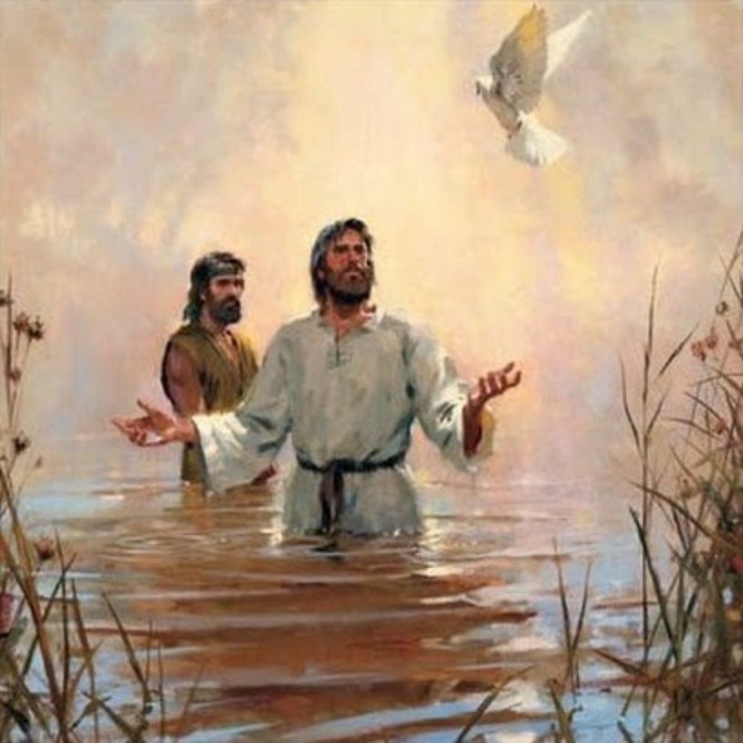
and was praying, heaven was opened, and the Holy Spirit descended upon him in bodily form like a dove.
And a voice came from heaven,
"You are my beloved Son; with you I am well pleased.”
The Gospel of the Lord,
Praise to You Lord Jesus Christ

Slide 7
REFLECTION

Slide 8
Imagine the scene: the light, the voice, the dove.
Whose is speaking?
Together with Jesus, God the Son, who is present?
God the Father
Who does the Dove represent?
The
Holy Trinity
God the
Holy Spirit

Slide 9
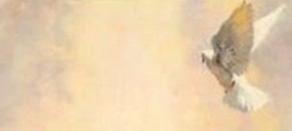
God’s says that He is His beloved Son.
How must they have felt hearing this? Share.

Slide 10
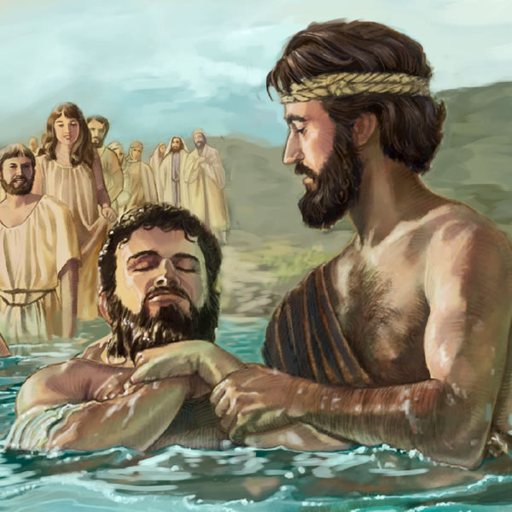

John baptizes with water.
St. John says his baptism is different from Jesus’ baptism.
How are they different?
His baptism is only symbolic of being sorry for your sins. It does not have spiritual power.

Slide 11

…But Jesus baptizes with fire.
His baptism forgives our sins,
Makes us members of God’s family,
It has spiritual power!
And gives us the Holy Spirit.

Slide 12
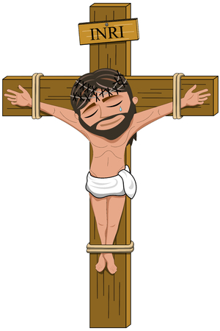
Why did Jesus accept being baptized even though He did not have sins?
He wanted to be an example of doing God’s will. God wants everyone to be baptized.
Also, Jesus was accepting our sins as His own. His mission was to pay for our sins with His cross, death, and resurrection.

Slide 13
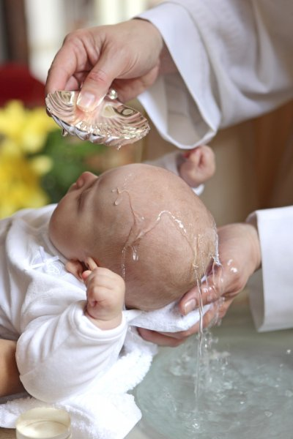
What happens when we are baptized?

Slide 14


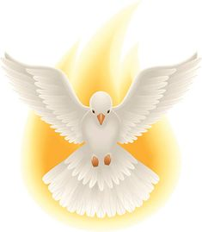
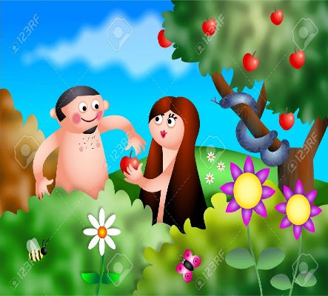


God erases from our heart original sin, the sin of Adam and Eve which we are born with and gifts us the Holy Spirit.

Slide 15
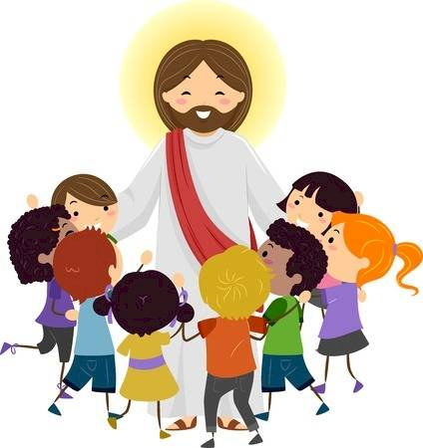
And we become part of God’s family.

Slide 16
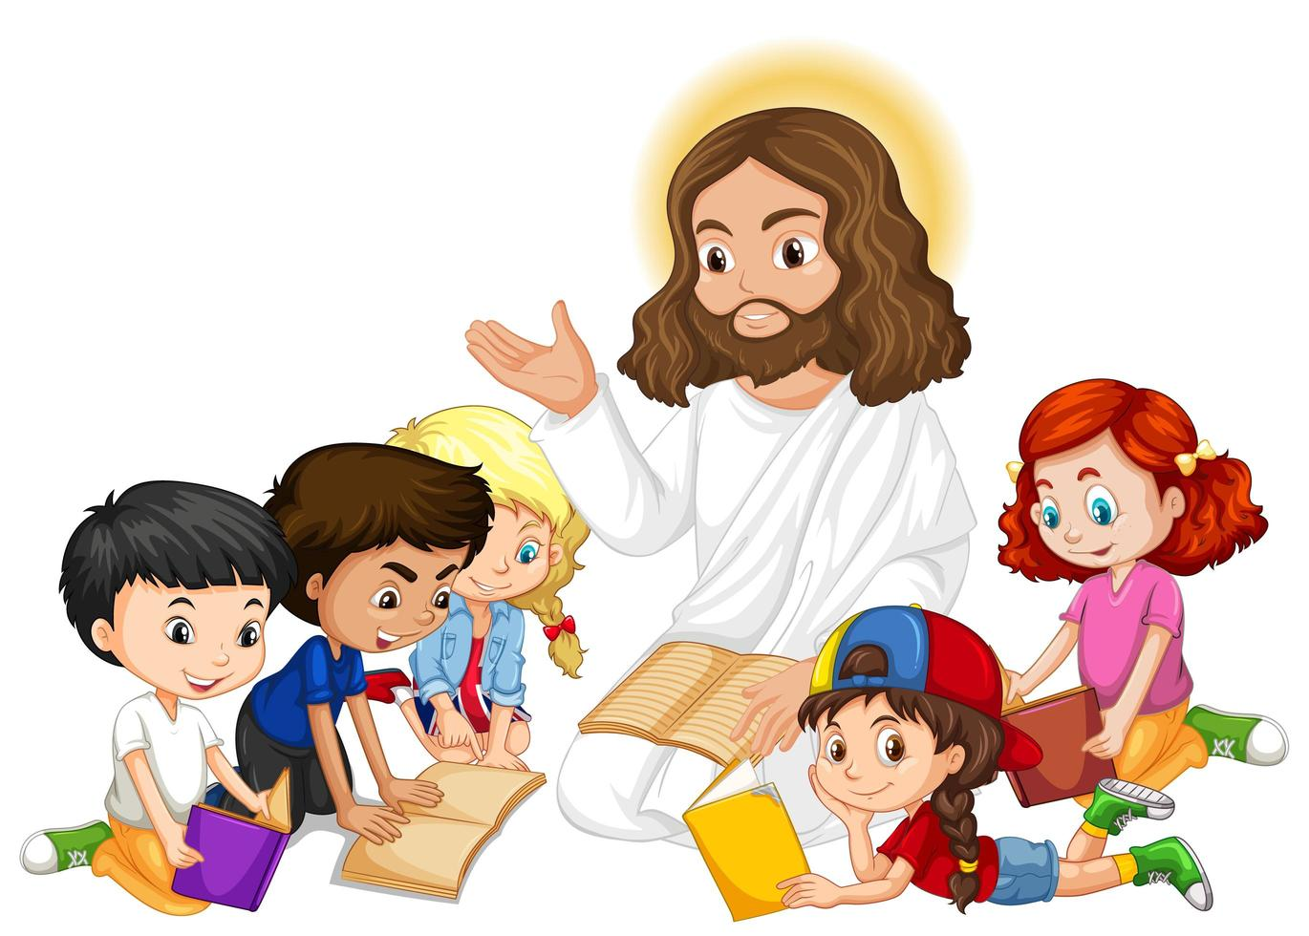
And we receive Jesus’ mission for the world.

Slide 17
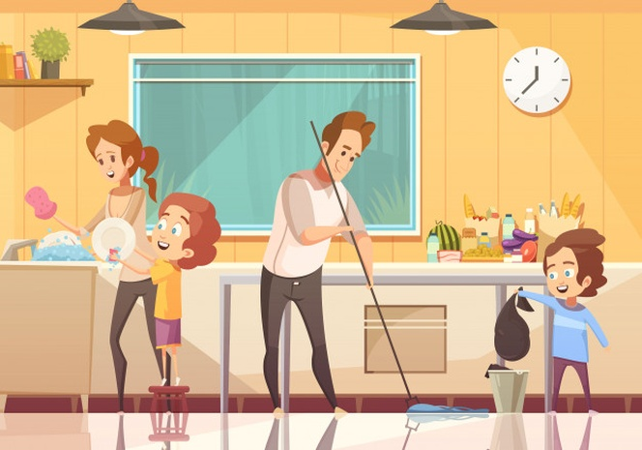
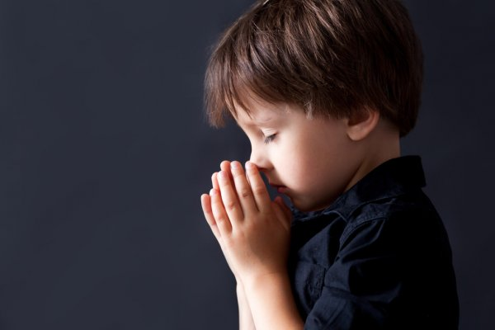

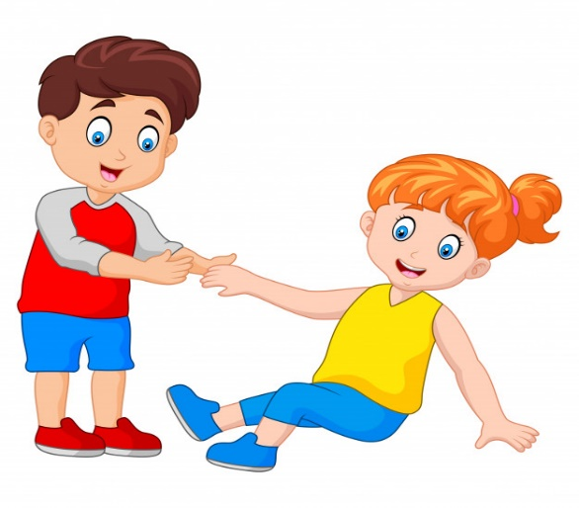
What is Jesus’ mission and our mission?
To listen to, obey, and love God and our parents.
To take that love to everyone so they too may love God.

Slide 18

Activity

Slide 19
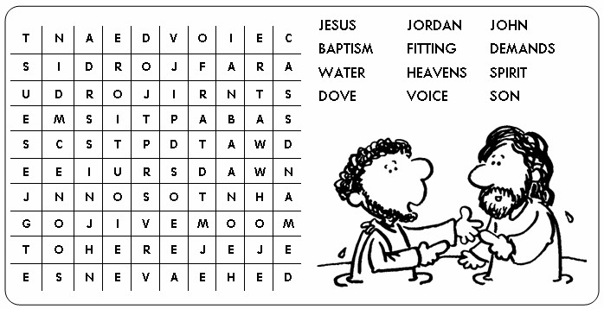
C
E
S
U

Slide 20
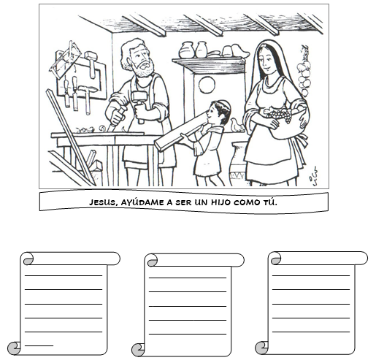
As children, a mission that God gives us through the 10 Commandments is to honor our parents like Jesus honored His. Share how we can love and honor them better.
Choose the words that honor our parents. Make a card writing 3 ways you will try to be a better child using these words.
JESUS, HELP ME TO BE A BETTER CHILD LIKE YOU.
RESPECT
OBEDIENCE
IGNORE
HATE
GRATITUDE
LOVE
FORGIVENESS
FIGHTS
HELP

Slide 21
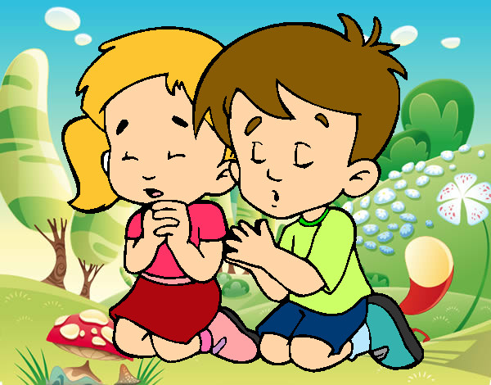

Prayer
Lord Jesus, You came to make us part of your family and you freed us from sin and death. Help us to take your message of love to all our family and friends.
Amen.

Slide 22
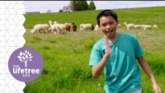
All that is Good, Lifetree Kids (Ctrl Click) https://youtu.be/bV5usNv4WEo

