Slide 1
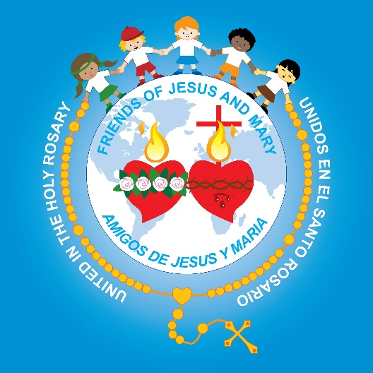
Friends of Jesus and Mary
Children’s Prayer Group
Cycle C - II Sunday of Christmas
Solemnity of the
Epiphany of the Lord
Matthew 2, 1-12

Slide 2
The Gospel of Matthew 2:1-12, https://youtu.be/rK8_hoDBJlg

Slide 3
REFLECTION

Slide 4
The Word Epiphany means revelation. How is the Three Kings visit a revelation?
The Three Kings knew the Jewish scripture that a Savior King would be born, preceded by a star.
So, when they saw the star, they followed the inspiration of the Holy Spirit and set out to find the newborn King.

Slide 5
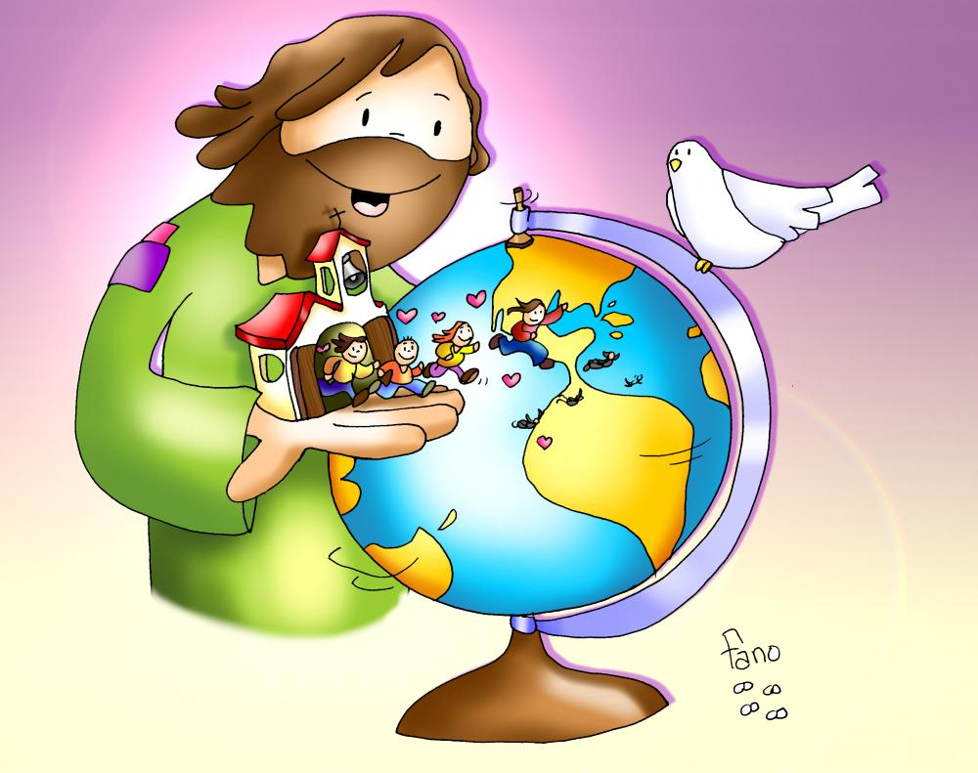
The Three Kings were not Jewish like Joseph and Mary; they were from foreign lands. What does God reveal to us by this?
Jesus’ message is for the whole world.

Slide 6
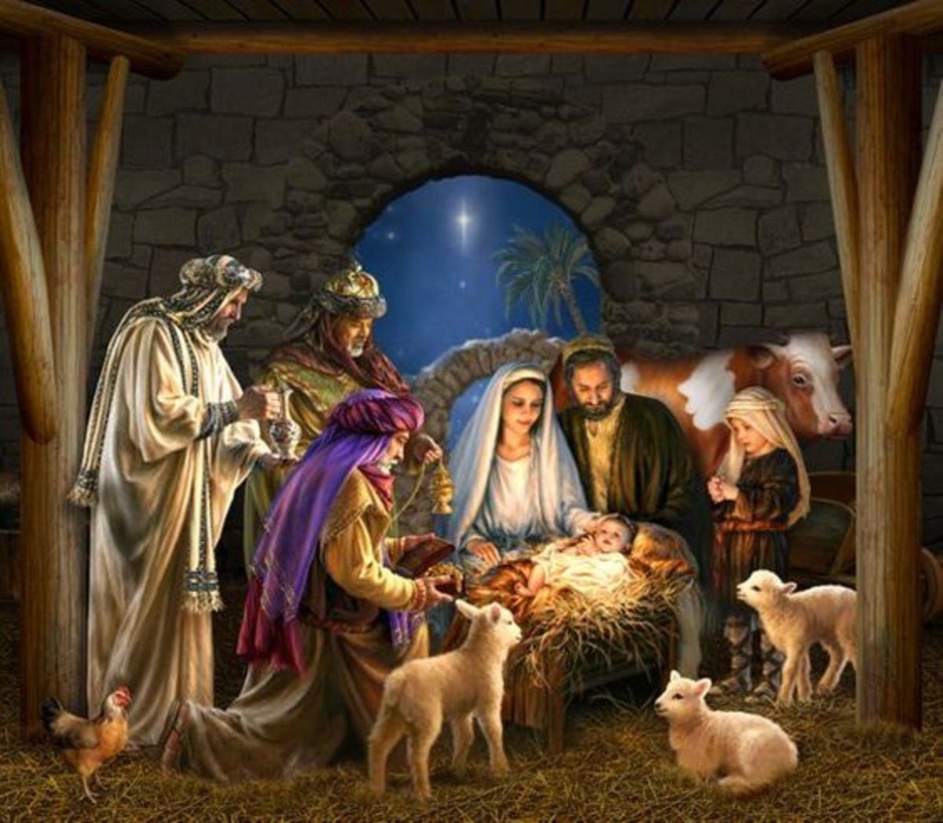
God is humble and loves poverty.
Traveling a long way bearing gifts for a newborn King reveals that a very special King would be born. What must they have thought when they found the baby in a stable?

Slide 7
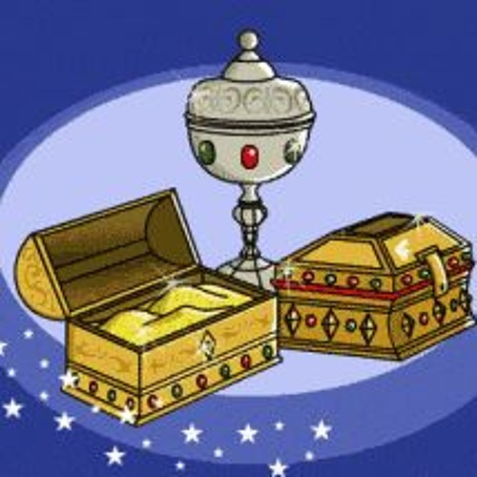
They took gold, incense, and myrrh as gifts. What did this reveal?
Myrrh was used to bury people and Jesus is human and would suffer and die for us.
Gold is offered to kings and Jesus is a King.
Incense is offered up to God and Jesus is God.

Slide 8
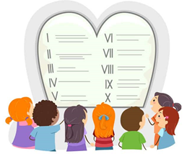
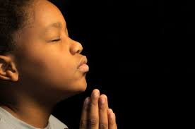
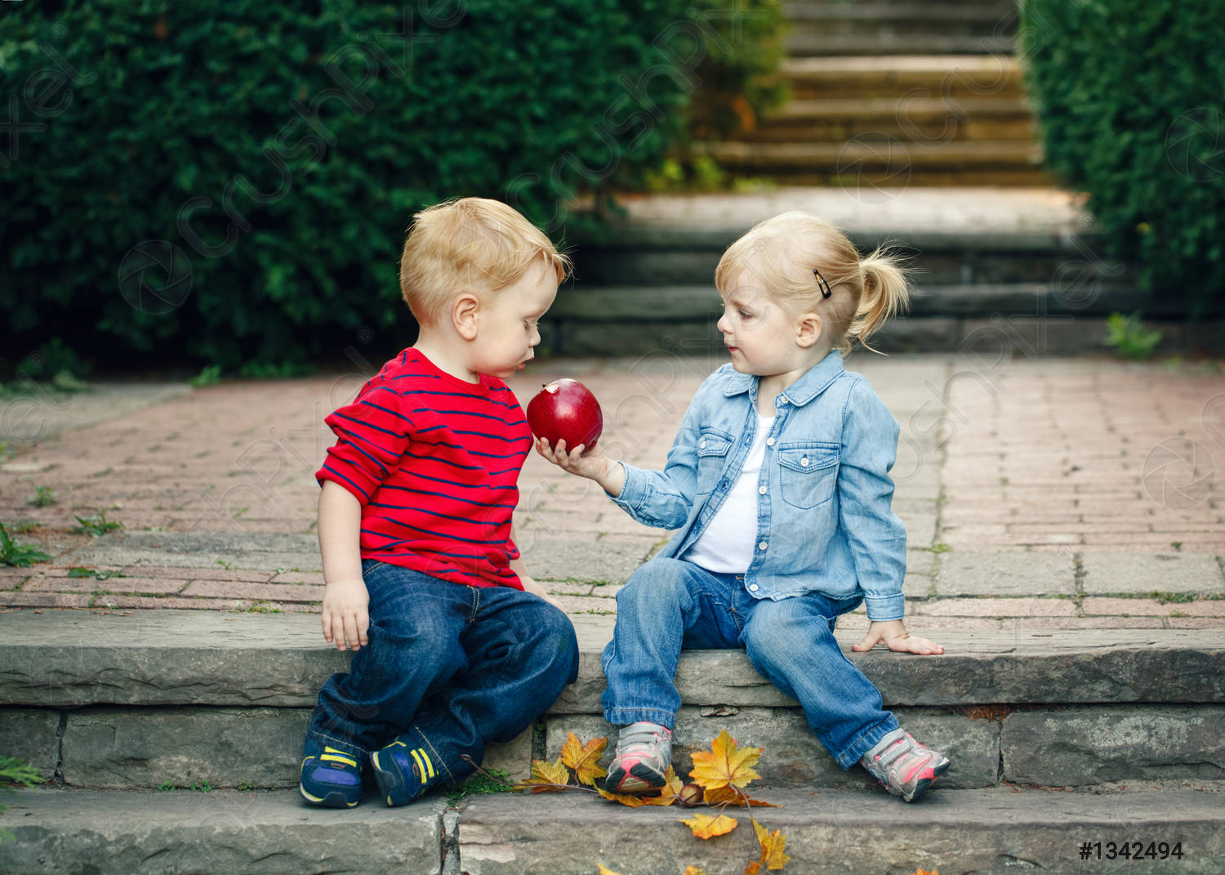
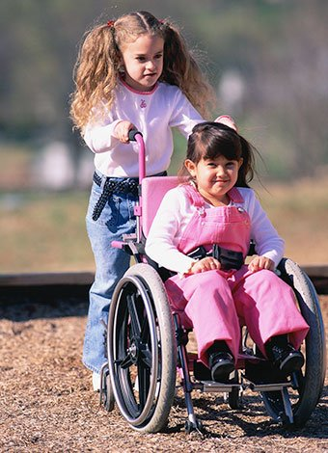
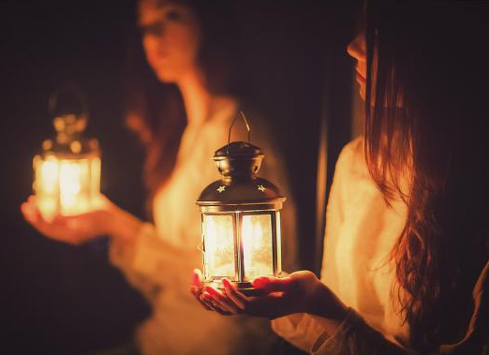
For them, the star was the presence of God. How can we be God’s light for others?
Helping
Others
Sharing
Praying
a lot
Obeying God
and our Parents

Slide 9
ACTIVITY

Slide 10
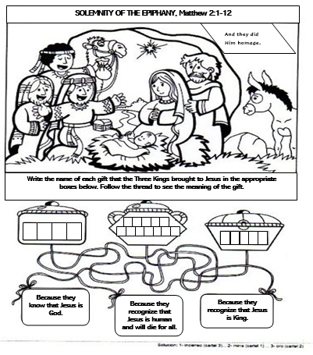
F R A N K-
G O L D
I N C E N S E
M Y R R H

Slide 11
What gift would you like to give to Baby Jesus?

Slide 12
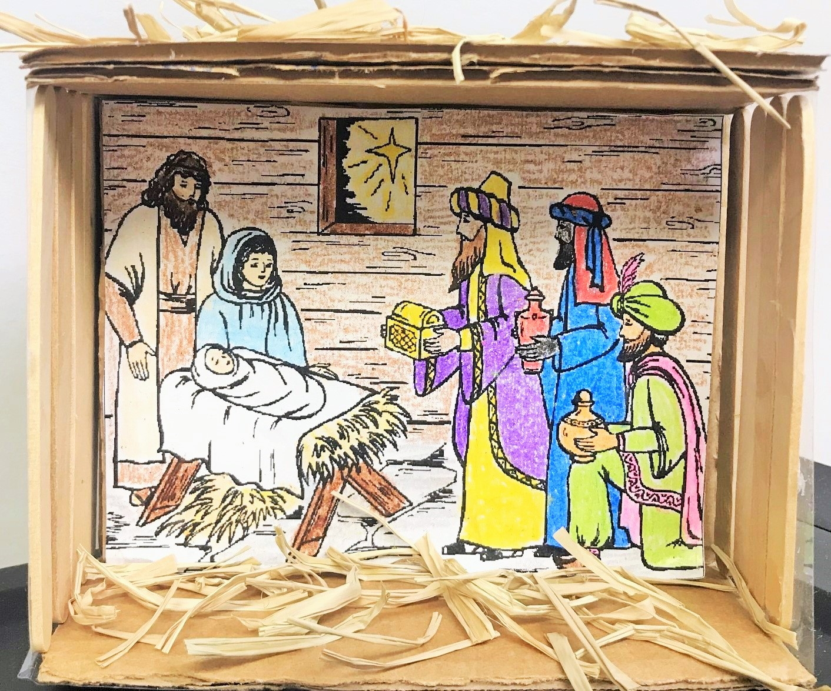
Make a Nativity Scene with the Three Kings. See www.fcpeace.org, Friends of Jesus and Mary Cycle C – II Sunday of Christmas

Slide 13
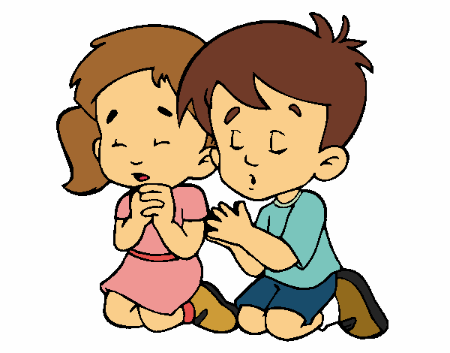
Jesus, you are the light of the world. Sometimes I get lost because I am interested in things that lead me away from you. Teach me to follow your light always so I may lead others to you. Amen.
PRAYER

Slide 14
O Come all Ye Faithful, Lifetree Kids (Ctrl Click) https://youtu.be/1Yl3Kaxx2gk

