Slide 1

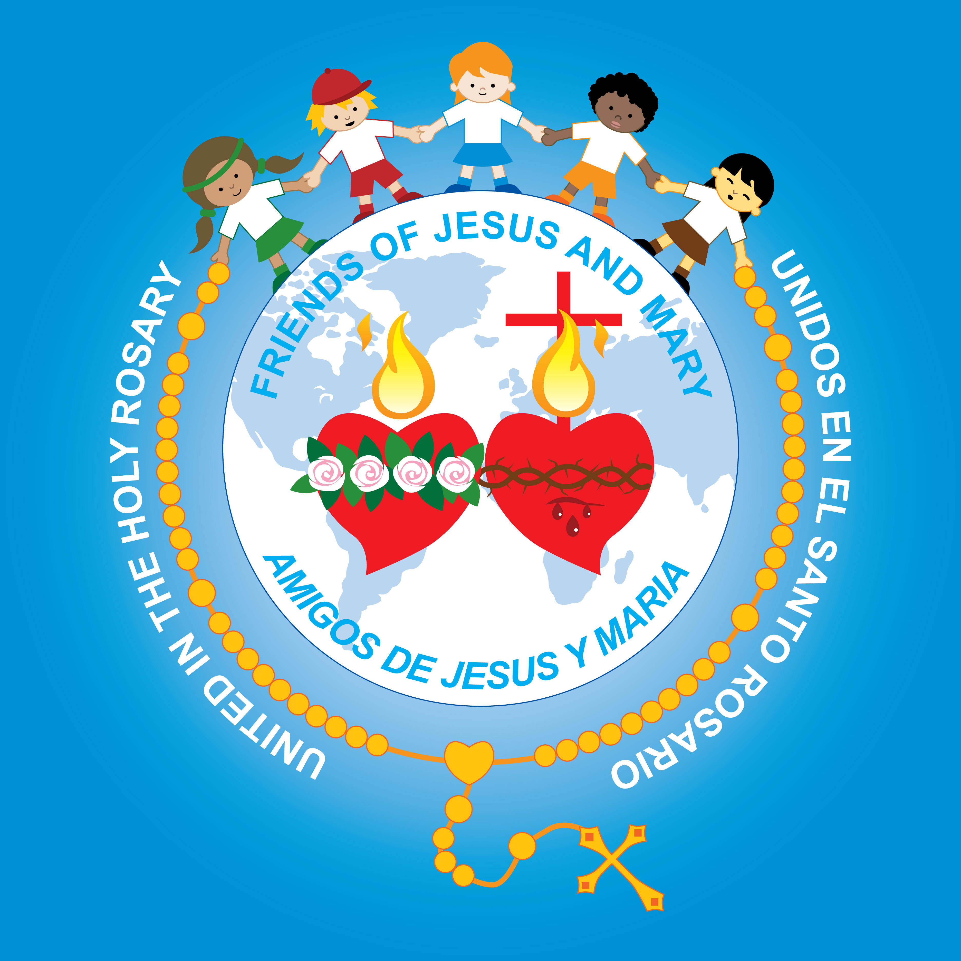
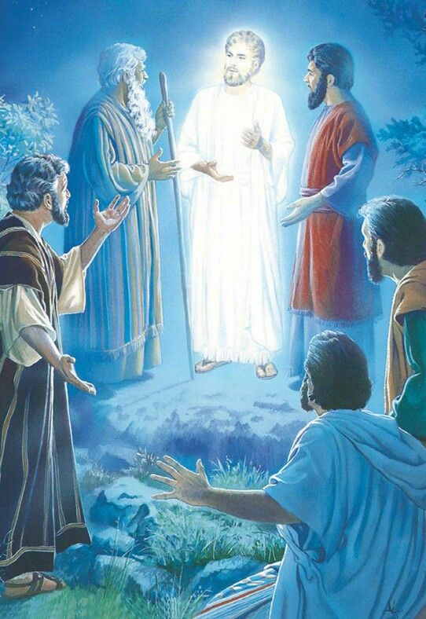
MINISTRY FRIENDS OF JESUS AND MARY
THE TRANSFIGURATION
CYCLE C – II SUNDAY OF LENT
LuKE 9, 28b-36

Slide 2
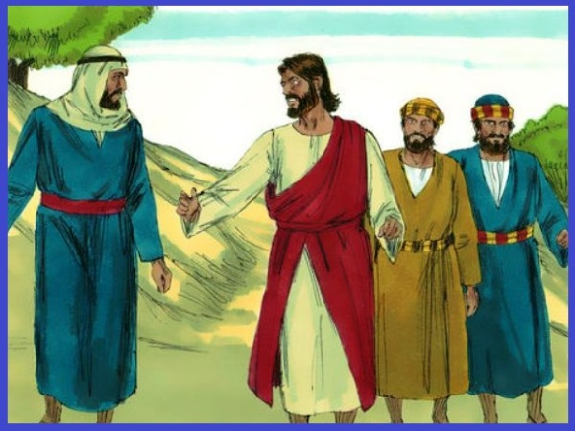
THE TRANSFIGURATION
Jesus took Peter, John, and James and went up the mountain to pray.

Slide 3
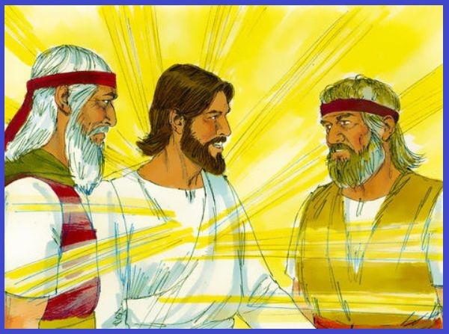
While he was praying his face changed in appearance and his clothing became dazzling white. And behold, two men were conversing with him, Moses and Elijah, who appeared in glory and spoke of his exodus that he was going to accomplish in Jerusalem.

Slide 4
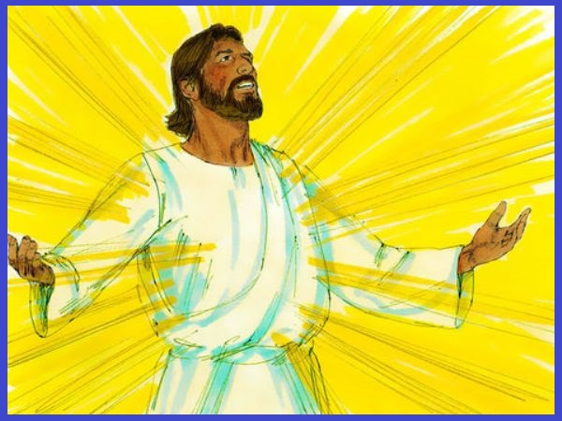
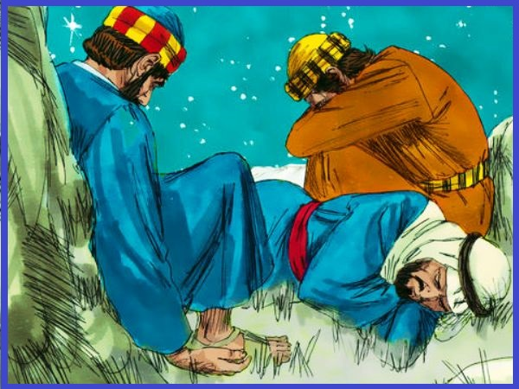
Peter and his companions had been overcome by sleep, but becoming fully awake, they saw his glory and the two men standing with him.

Slide 5
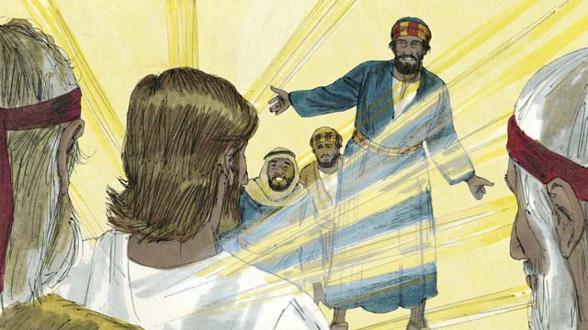
As they were about to part from him, Peter said to Jesus, "Master, it is good that we are here; let us make three tents, one for you, one for Moses, and one for Elijah." But he did not know what he was saying.

Slide 6
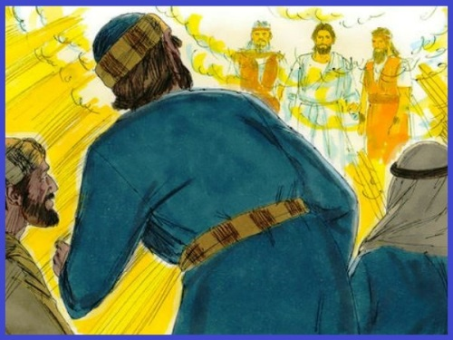
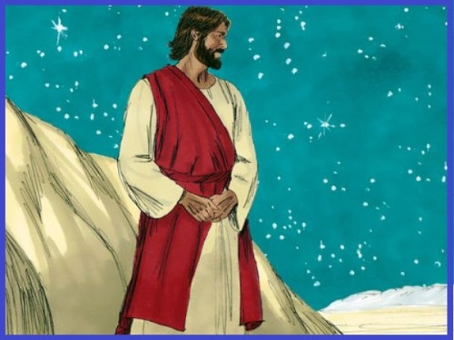
While he was still speaking, a cloud came and cast a shadow over them, and they became frightened when they entered the cloud. Then from the cloud came a voice that said, "This is my chosen Son; listen to him." After the voice had spoken, Jesus was found alone. They fell silent and did not at that time tell anyone what they had seen.
THE GOSPEL OF THE LORD, PRAISE TO YOU LORD JESUS CHRIST.

Slide 7
RefleCTIOn

Slide 8
Before entering Jerusalem for the last time, when Jesus would suffer and die, He went up a mountain with the apostles James, Peter, and John to pray. There, His appearance transformed and His face and clothes became dazzling white as if He were in Heaven.
How do you think the apostles felt upon seeing this?
Surprised, happy…
How would this vision help them during Jesus’ passion?
They would know it was part of God’s plan.
What hope does it give us for the future?
Heaven is a glorious and happy place.

Slide 9
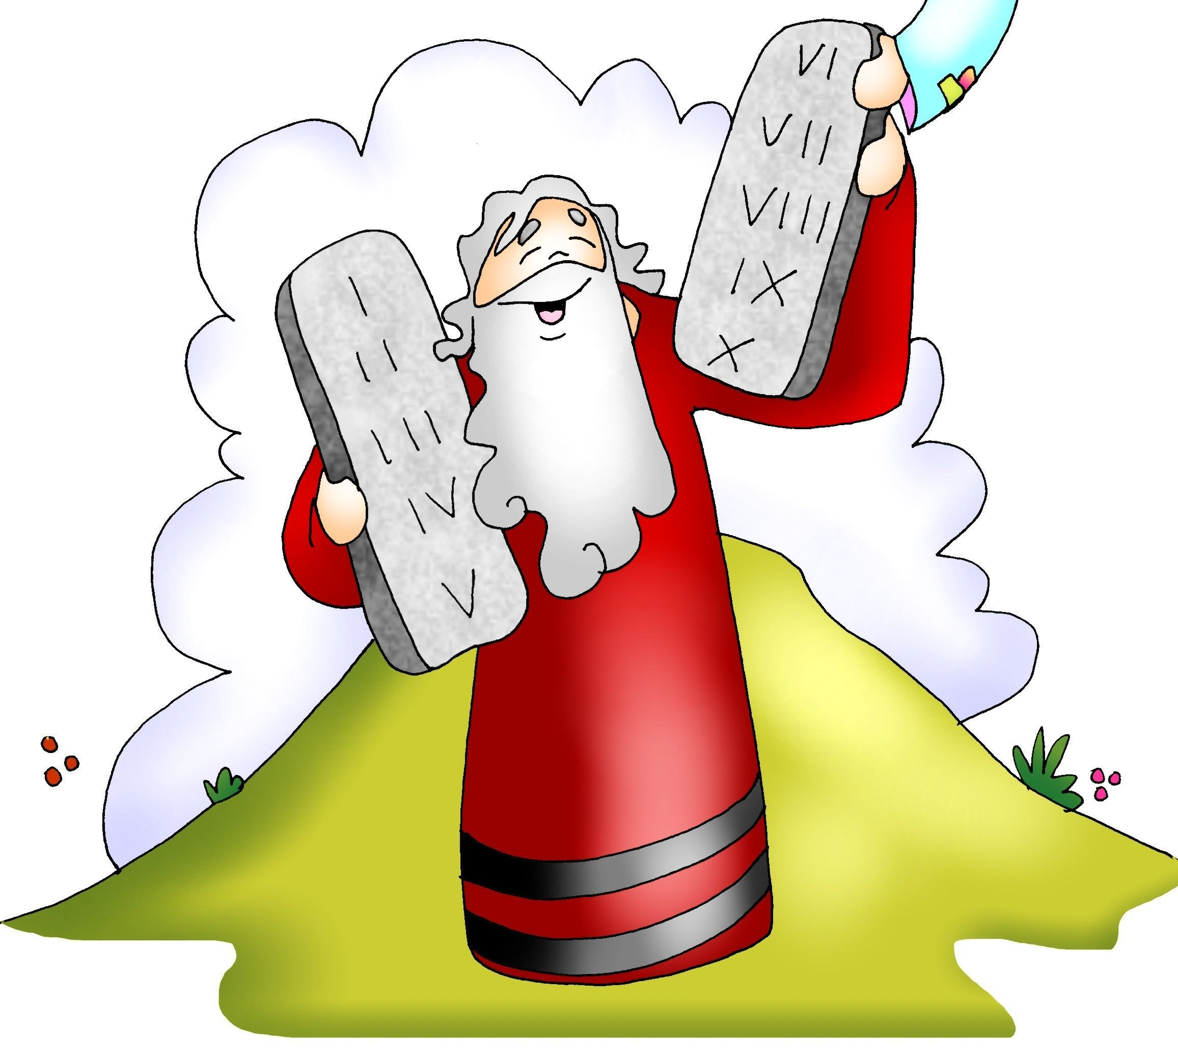
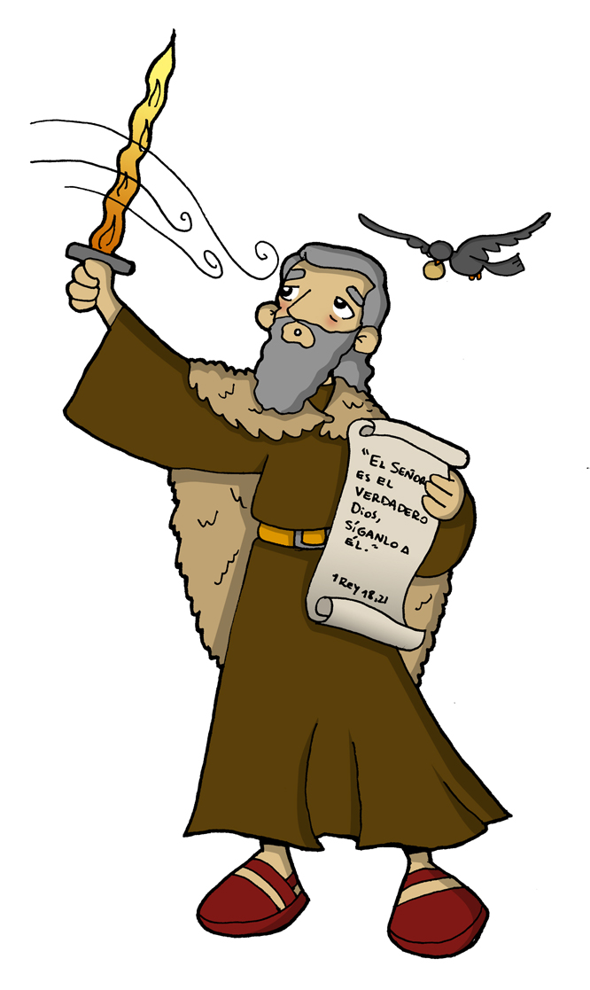
Moses and Elijah from the old testament appeared talking with Jesus.
Why was Moses important?
Moses received the 10 commandments from God after he freed the Israelites from slavery in Egypt; then he led them to the promised land. Likewise, Jesus, with His passion, death, and resurrection freed us from the slavery of our sins so we may live forever with God in Heaven.
Why was elijah important?
He represents the prophets of the Old Testament which asked for conversion and faithfulness to God to prepare for the coming of the Messiah. Their presence reveals that Jesus is the Messiah God’s people awaited.

Slide 10
Why does Peter want to stay on the mountain?
He feels happy seeing the glory of God.
Why does god speak to them?
He wants to confirm that Jesus is His Son, the promised Savior, and we must listen to Him.

Slide 11
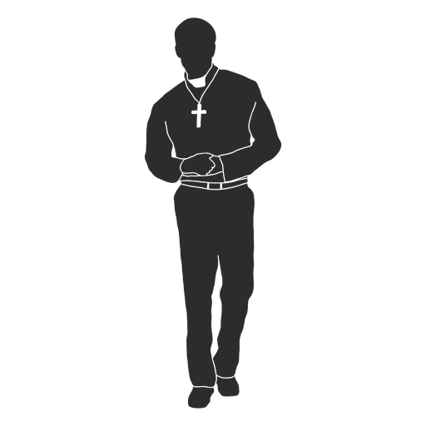

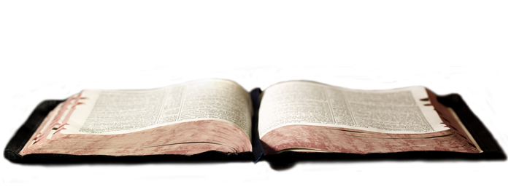



How do we listen to jesus?
in the Gospel;
priests,
In prayer;
in nature…
through our parents,
teachers;

Slide 12
activities

Slide 13
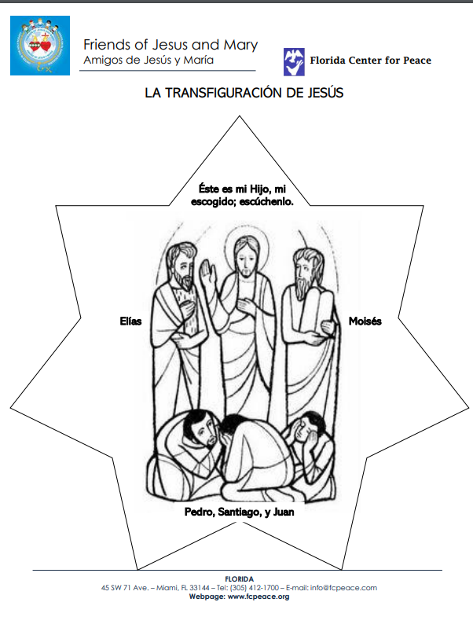
Cut, color, and glue the picture to colored construction paper. Glue shiny paper or glitter around the people and on Jesus’ tunic.

Slide 14

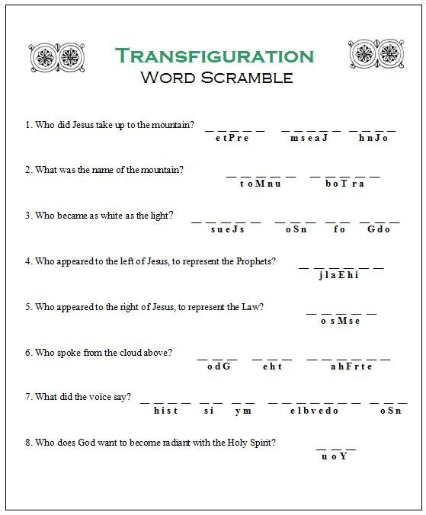
Peter
James
John
Mount
Tabor
Jesus
of
God
Son
Elijah
Moses
God
the
Father
This
is
my
beloved
Son
You

Slide 15
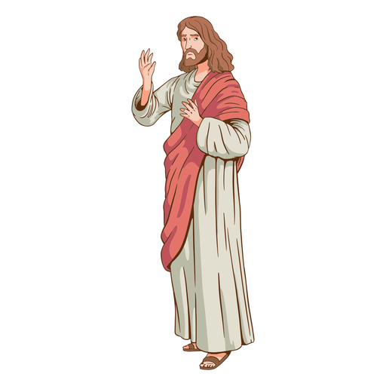
Prayer
Lord, help me to always listen to and follow Jesus. Help me to always have hope in in the happiness of Heaven, despite difficulties and sadness in this world. Amen.

Slide 16
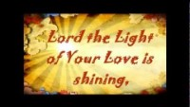
Shine, Jesus, Shine, vbtyree, https://youtu.be/cVnMrCIAeMw (3-7yrs.)

Slide 17

I can only Imagine, Brentwood Benson: https://youtu.be/rUYj_duHMoA

Slide 18
See you next week.
Don’t forget to pray every day.

