Slide 1
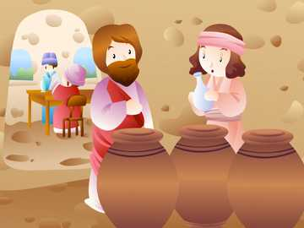
Ministry Friends of Jesus and Mary
Cycle “C” - II Sunday in Ordinary Time
John 2: 1-11
The Wedding at Cana

Slide 2
The Wedding at Cana, https://youtu.be/ZYLUTdB9l1g

Slide 3
Reflection

Slide 4
Jesus did His first public miracle in a wedding in Cana.
Who was with Him?
His mother, the Virgin Mary, and the apostles
Who realizes that they ran out of wine?
His Mother Mary

Slide 5
What does she do?
She asks Jesus to do something because she knows He is God and can perform miracles.
Maybe in His home in Nazareth, He had done miracles when things were scarce.

Slide 6
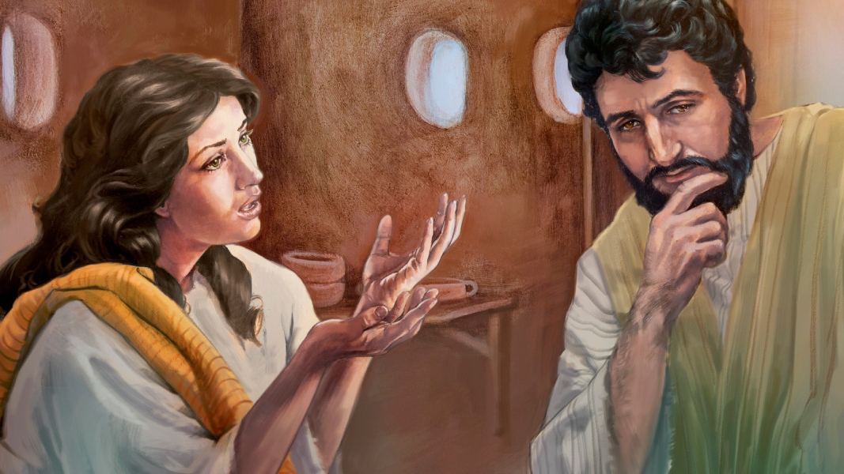
What does Jesus say?
My hour has not yet come.

Slide 7
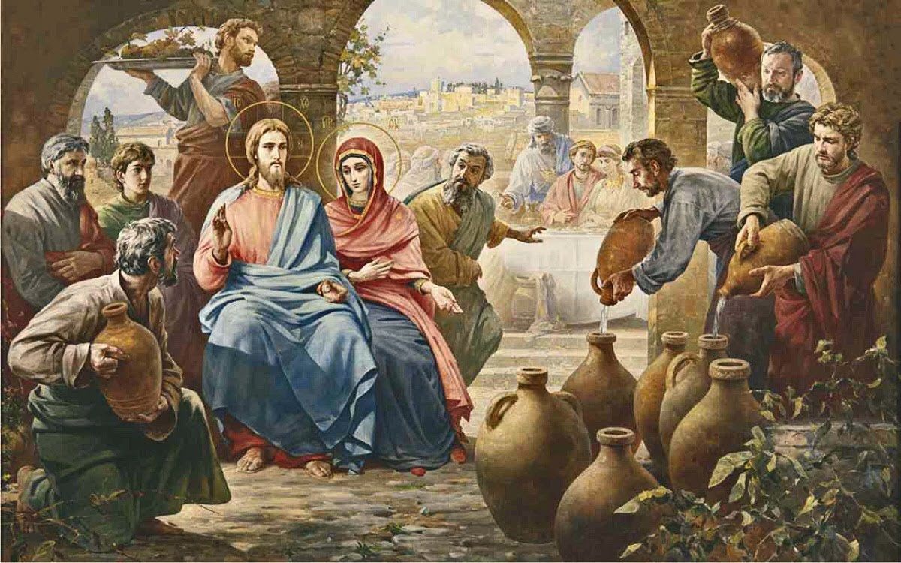
But later he obeys His mother because He loves her very much and does not want to sadden her.

Slide 8
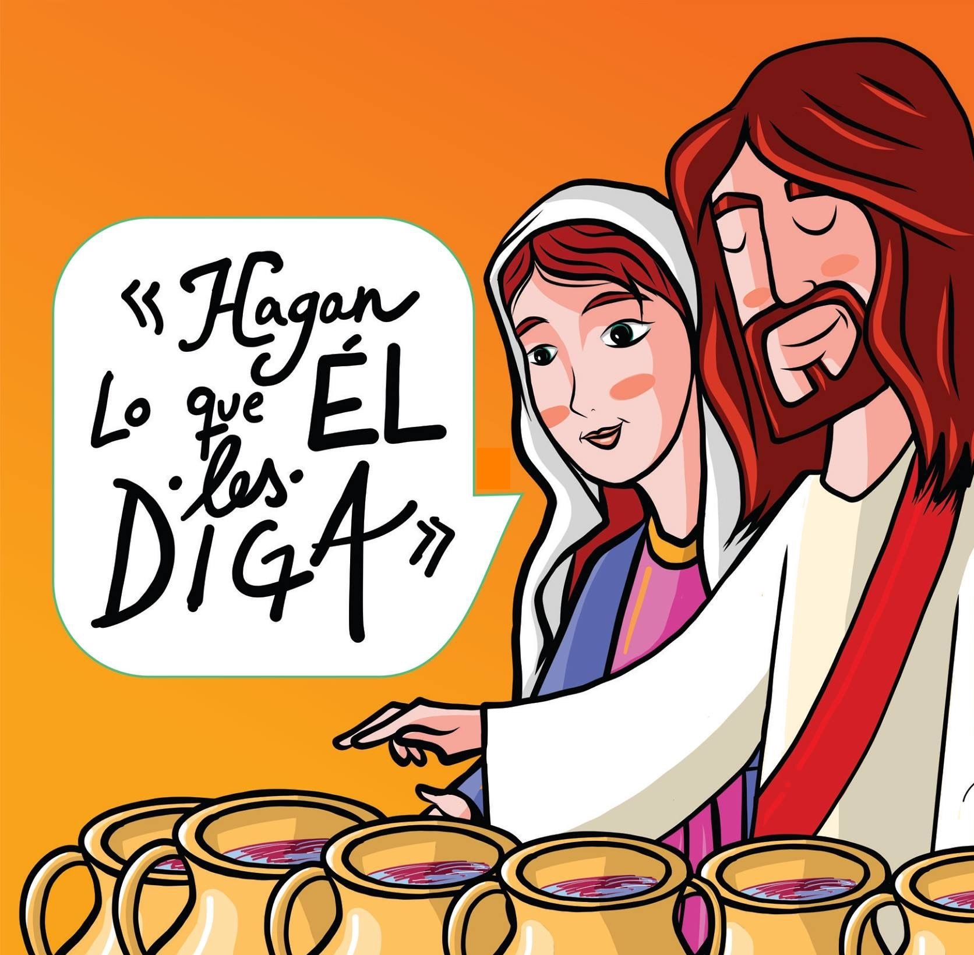
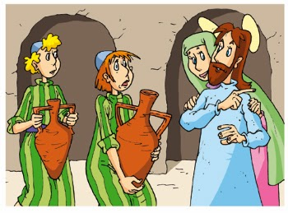
Mary knows that Jesus is a good son and always obeys.
What does she tell the servants?
Do What He tells you!

Slide 9
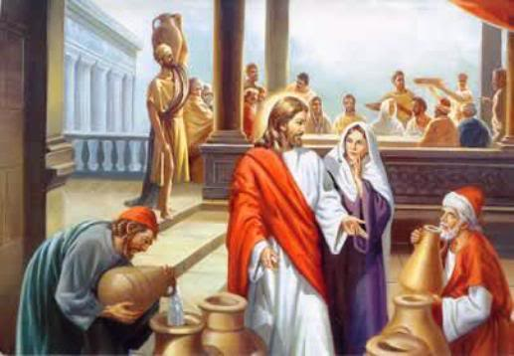
What does Jesus ask them to do?
Fill six jars with water and take a little to the headwaiter to taste, because Jesus had changed the water to wine.

Slide 10
What does the headwaiter say?
He told the groom happily that he had saved the best wine for last.

Slide 11
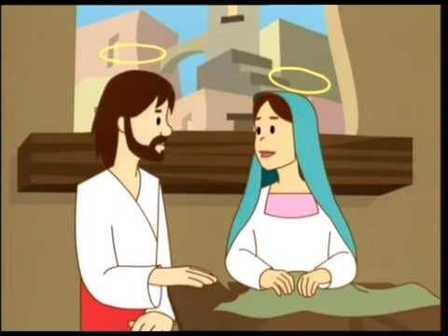
In the same way, our Blessed Mother intercedes for our needs to her loving Son and Jesus cannot say no to His Mother. The Virgen Mary only asks one thing of us.
What is it?
Do what He tells you!

Slide 12
If we do God’s will, He can do miracles in our lives.

Slide 13
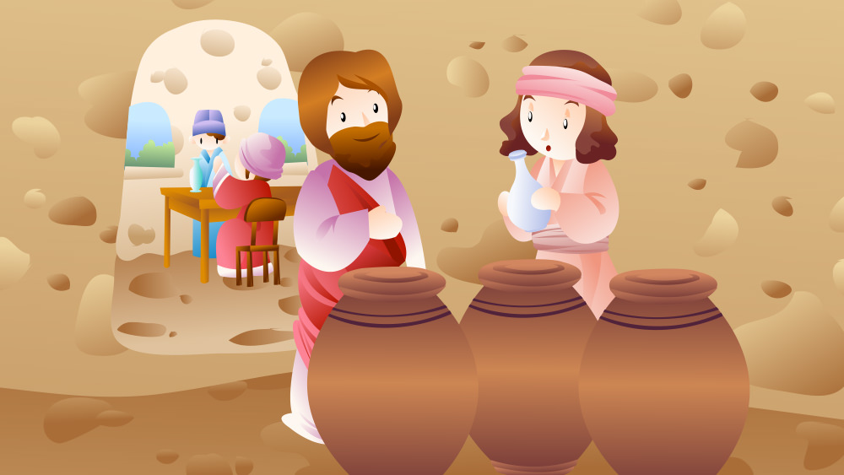
And the wine that Jesus made was the best.
In the same way, Jesus’ presence in our lives makes everything better, filling it with more happiness, love, and holiness.

Slide 14
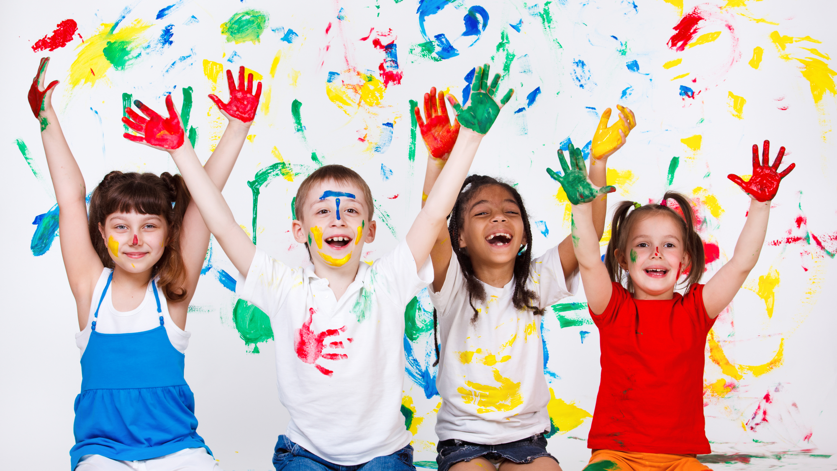
ACTIVITY

Slide 15
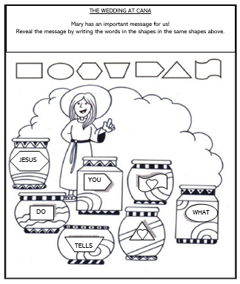
DO
WHAT
JESUS
TELLS
YOU
Mary has an important message for us!
Reveal the message by writing the words in the shapes below in the same shapes above.

Slide 16
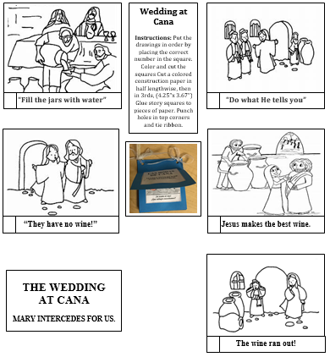
4
3
PUT THE PICTURES IN THE CORRECT ORDER THEN MAKE A BOOK WITH THE STORY YOU JUST LEARNED.
2
5
1

Slide 17
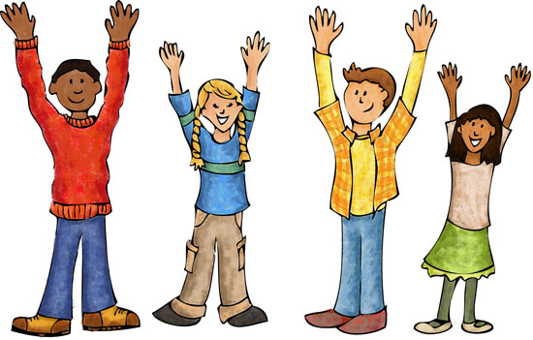
GAME: JESUS SAYS (SIMON SAYS)…
The leader gives instructions such as “Jesus says clap”. The children must do what the leader says but only if the command is preceded by “Jesus says”. If the leader gives instructions without saying this and the child follows, the child must sit down. The last child standing, wins.

Slide 18
SONGS Mama Mary, NCMC (3-6 yrs.) https://youtu.be/v0kcAWZ9qOA Be With Us Mary Along the Way, Tony Diaz (7+yrs.) https://youtu.be/O0FpDV9ozBA

Slide 19
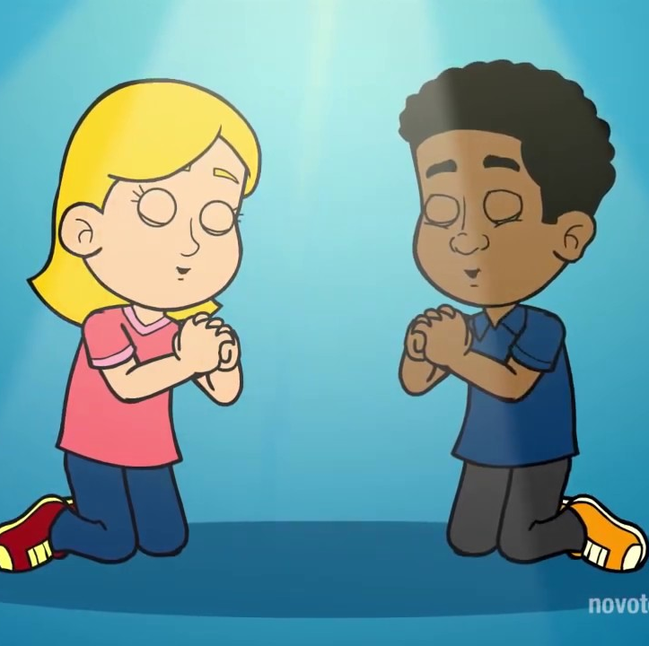
PRAYER
Lord, we want to change the water to wine with you. We want to change sadness to joy, hunger to satisfaction, loneliness to smiles and friendship. Come to our feast, Jesus, and fulfill our needs with your wine of joy and love.
Amen.

