Slide 1
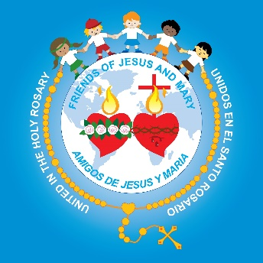
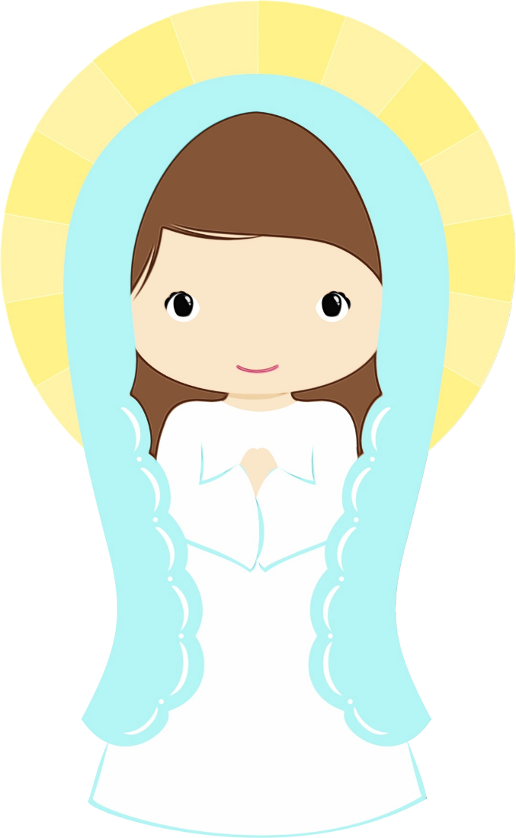
Ministry Friends of Jesus and Mary
Cycle C – III Sunday of Advent
He will baptize with the Holy Spirit.
Feast of the Immaculate Conception

Slide 2
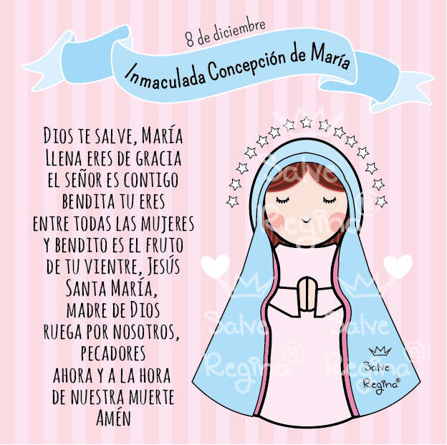
December 8th
The Immaculate Conception
Hail Mary,
Full of Grace
The Lord is With You
Blessed are You Amongst Women,
And Blessed is the Fruit of Your Womb, Jesus
Holy Mary,
Mother of God
Pray for us Sinners,
Now and at the Hour of Our Death.
Amen

Slide 3
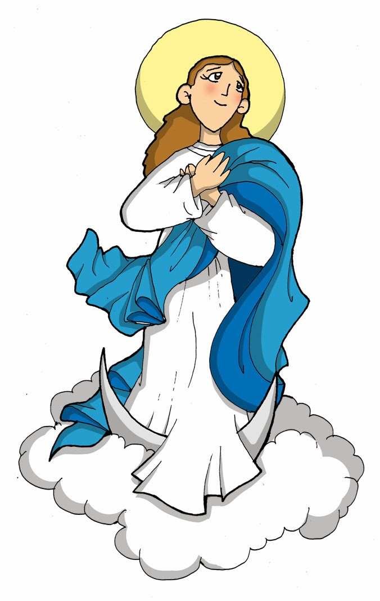
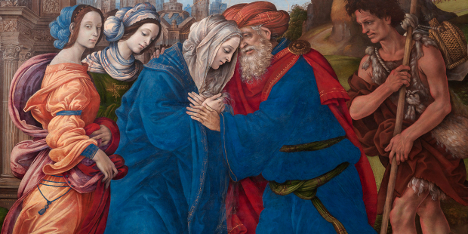
The Solemnity of the Immaculate Conception of Mary
Celebrated December 8th
What does the word “Conception” mean?
Conception is the moment when God creates the soul. It is the moment that human life begins.
St. Joaquín and St. Anne, were the Virgen Mary’s parents. St. Anne was already old and could not have children, something the Jewish people looked down upon. Joaquín and Anne, prayed with much faith and offered sacrifices to God. One day, an angel appeared to Anne and told her that God took pity on her sadness and she would be a mother.

Slide 4
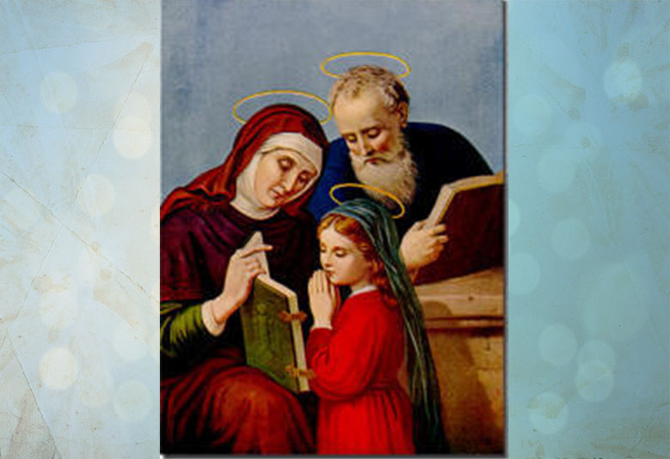
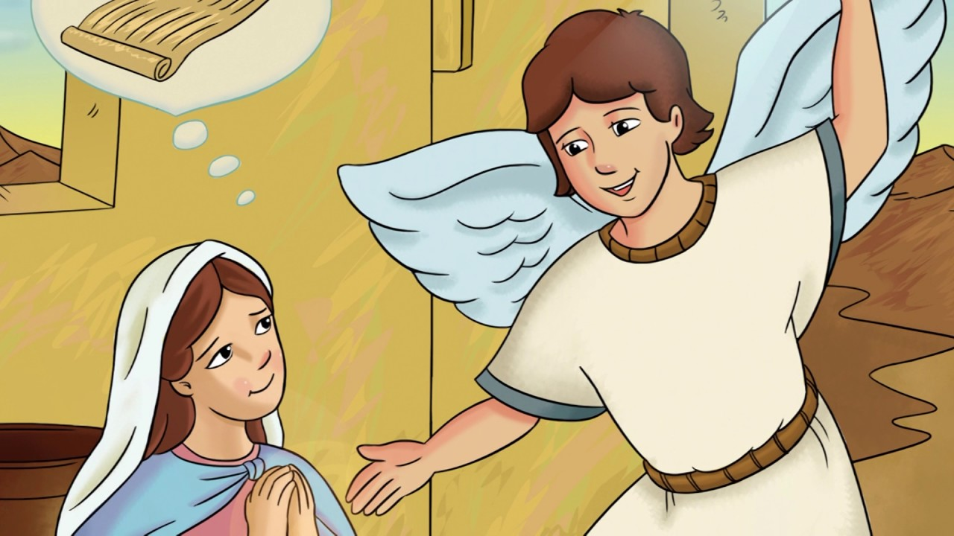
The Immaculate Conception of Mary
St. Anne gave birth to a beautiful daughter which she named Mary.
She was born unique. She lacked the stain of original sin on her soul. She was pure and immaculate since her conception: since the moment she was first formed in her mother’s womb.
Years later, when the angel Gabriel appeared to Mary to announce she would be the Mother of Jesus, he calls her “full of Grace” ( Full of God’s life).

Slide 5
The Immaculate Conception of Mary
The Church proclaimed that Mary was free from all sin since her Conception and December 8th the Solemnity of the Immaculate Conception.
“The Immaculate Conception”
Accompany us always, Our Mother
The Immaculate Conception, Catholic Central, https://youtu.be/SModVTYA1Ow

Slide 6
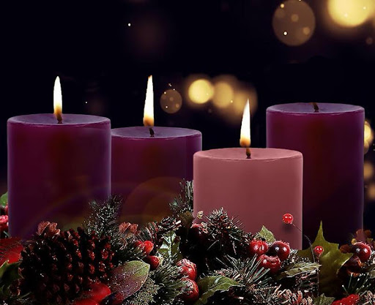
Gospel of St. Luke 3, 10-18
III Sunday of Advent

Slide 7
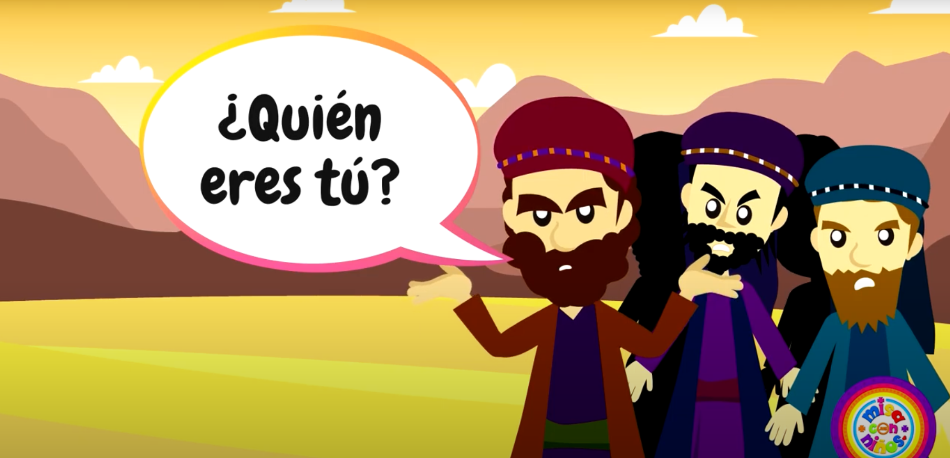
The crowds asked John the Baptist,
What should we do?

Slide 8
He responded:
“Whoever has two cloaks should share with the person who has none. And whoever has food should do likewise.”

Slide 9
Even tax collectors came to be baptized and they said to him, “Teacher, what should we do?” He answered them,
“Stop collecting more than what is prescribed.”

Slide 10
Soldiers also asked him, “And what is it that we should do?” He told them,
“Do not practice extortion, do not falsely accuse anyone, and be satisfied with your wages.”

Slide 11
Now the people were filled with expectation, and all were asking in their hearts whether John might be the Christ. John answered them all, saying,
“I am baptizing you with water, but one mightier than I is coming. I am not worthy to loosen the thongs of his sandals.”

Slide 12
“He will baptize you with the Holy Spirit and fire. His winnowing fan is in his hand to clear his threshing floor and to gather the wheat into his barn, but the chaff he will burn with unquenchable fire.”
Exhorting them in many other ways, he preached good news to the people.
The Gospel of the Lord: Praise to You Lord Jesus Christ.

Slide 13
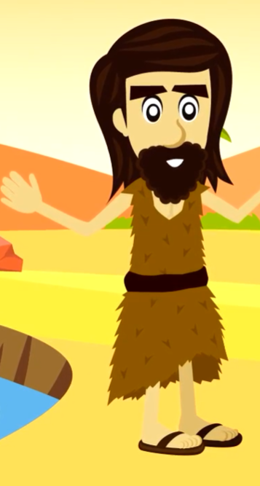
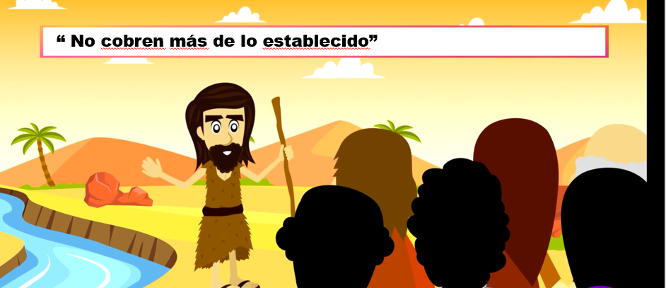
The people felt that John was a man of God and possibly the Messiah. Who was John?
He was a prophet that prepared the way for Jesus. Also, he was Jesus’ cousin.
What did they ask him?
What should we do?
What did John answer?
This means we must
Share with others!
“Stop collecting more than what is prescribed.”
“Whoever has two cloaks should share with the person who has none. And whoever has food should do likewise.”
What does this mean?
Do not steal.

Slide 14
“Do not practice extortion, do not falsely accuse anyone, and be satisfied with your wages.”
John tells the soldiers to not practice extortion.
This means do not force and threaten people to pay more than they should.
Do not steal.
He also says, do not falsely accuse anyone. What does this mean?
Do not lie and accuse someone of something they didn’t do.
How did John clear up that he was not the Messiah?
“I am baptizing you with water, but one mightier than I is coming. I am not worthy to loosen the thongs of his sandals.”
He said that one mightier than he was coming. He was not worthy to loosen the thongs of his sandals.

Slide 15
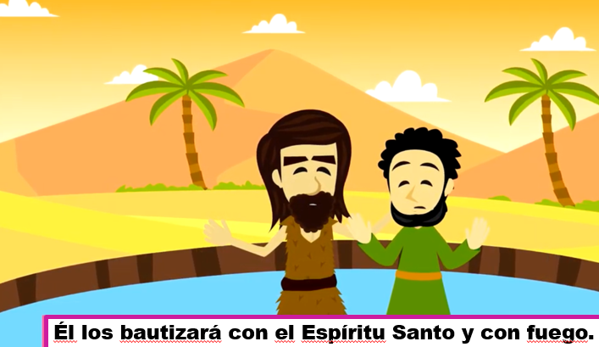
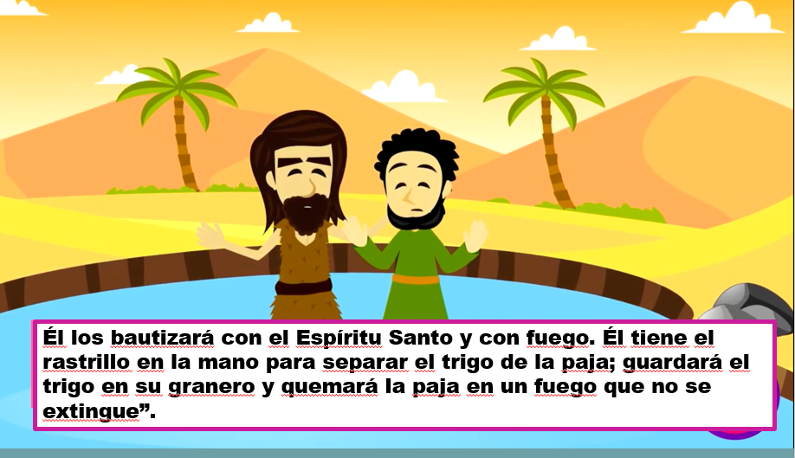
How did John baptize?
He baptized with only water.
How would the Messiah baptize?
He would baptize with the Holy Spirit and with fire.
He will baptize with the Holy Spirit and with fire.
The baptism of John symbolized conversion, but the baptism of the Messiah has the power to forgive sins and to send the Holy Spirit.
What else would the Messiah do?
Separate the wheat from the chaff.
Who represents the wheat?
The just.
Who represents the chaff?
The unjust
His winnowing fan is in his hand to clear his threshing floor and to gather the wheat into his barn, but the chaff he will burn with unquenchable fire.”
What is the Barn?
Heaven where the just will be.

Slide 16
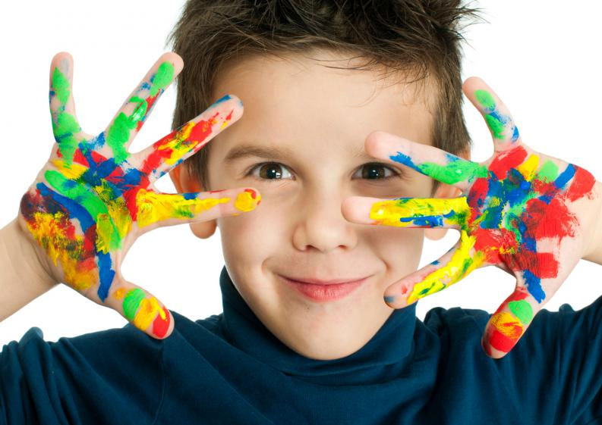
ACTIVITY

Slide 17
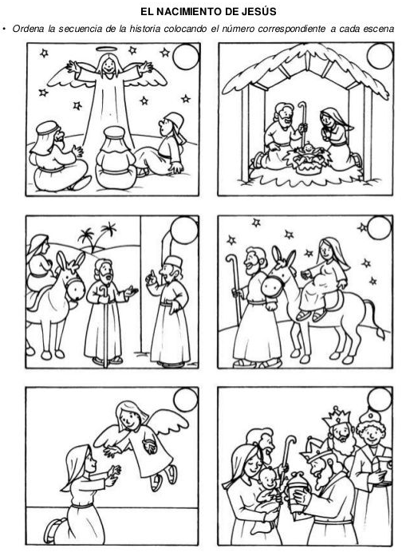
5
4
The Christmas Story, JJohn, https://youtu.be/Dbp24wZQa3Y
See the movie and put the pictures in chronological order by writing the appropriate numbers in the circle.
3
2
1
6

Slide 18
Prayer
Lord, although you are King of the Universe, you came into the world small and helpless. Teach me to always be humble like You so I may always hear your voice and follow you. Never let your light stop shining in my heart. I love you.
Amen.
Song:
The Little Drummer Boy, Everythinglearnlove, https://youtu.be/_6p5icEYBus

