Slide 1
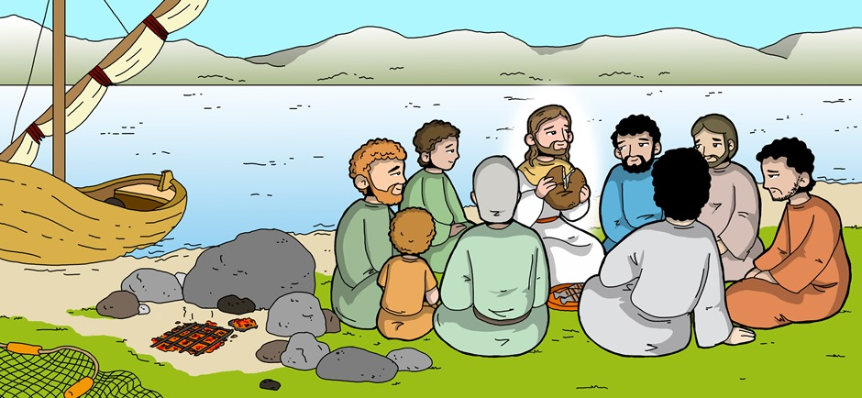
Friends of Jesus and Mary
III Sunday of Easter- Jesus Appears the Third Time
John 21, 1-19

Slide 2
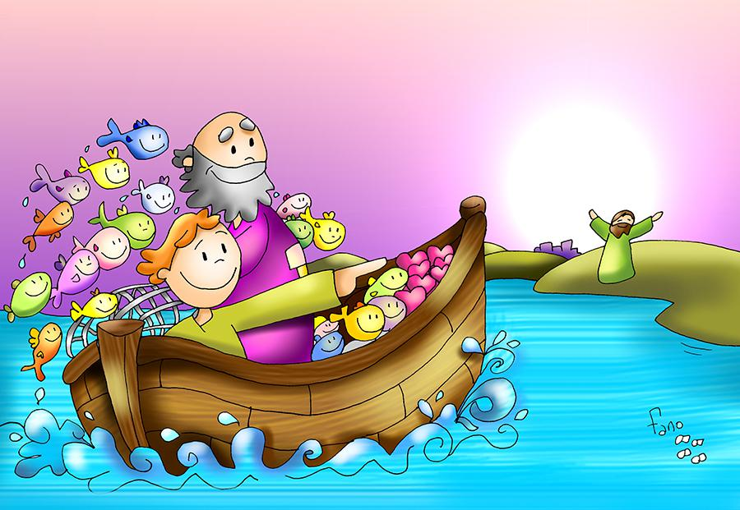
Jesus appears the third time
John 21, 1-19
At that time, Jesus revealed himself again to his disciples at the Sea of Tiberias. He revealed himself in this way. Together were Simon Peter, Thomas called Didymus, Nathanael from Cana in Galilee, Zebedee's sons, and two others of his disciples. Simon Peter said to them, "I am going fishing." They said to him, "We also will come with you."

Slide 3
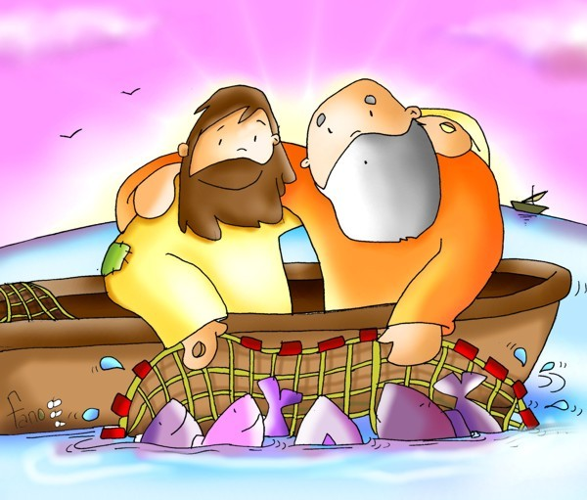
So they went out and got into the boat, but that night they caught nothing. When it was already dawn, Jesus was standing on the shore; but the disciples did not realize that it was Jesus. Jesus said to them, "Children, have you caught anything to eat?" They answered him, "No." So he said to them, "Cast the net over the right side of the boat and you will find something." So they cast it, and were not able to pull it in because of the number of fish.

Slide 4
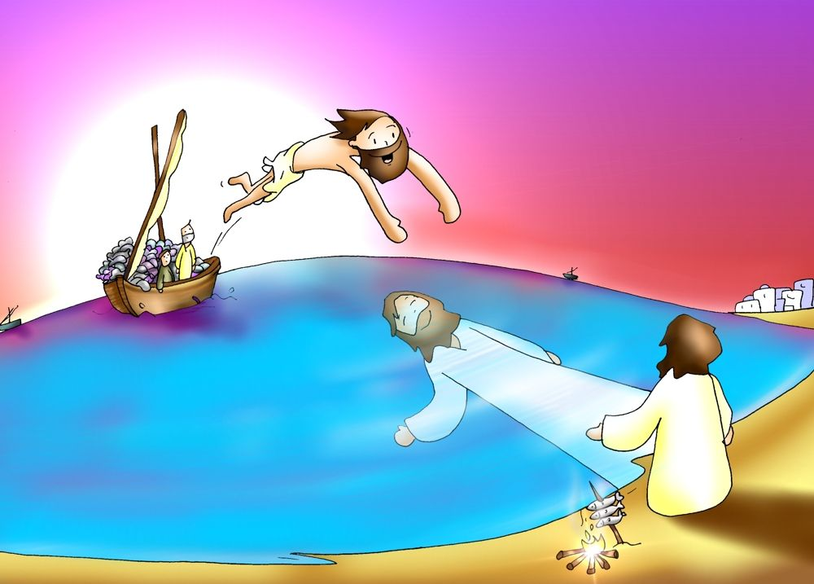
So the disciple whom Jesus loved said to Peter, "It is the Lord." When Simon Peter heard that it was the Lord, he tucked in his garment, for he was lightly clad, and jumped into the sea. The other disciples came in the boat, for they were not far from shore, only about a hundred yards, dragging the net with the fish. When they climbed out on shore, they saw a charcoal fire with fish on it and bread.

Slide 5
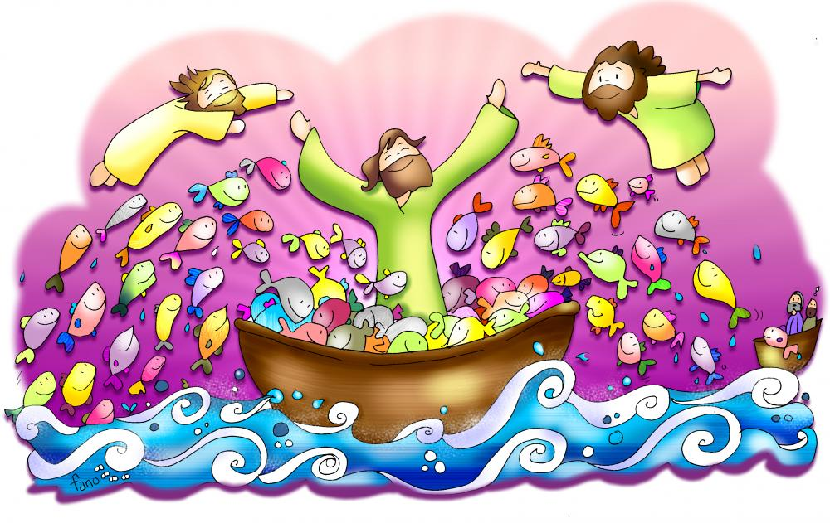
Jesus said to them, "Bring some of the fish you just caught." So Simon Peter went over and dragged the net ashore full of one hundred fifty-three large fish. Even though there were so many, the net was not torn. Jesus said to them, "Come, have breakfast." And none of the disciples dared to ask him, "Who are you?" because they realized it was the Lord.

Slide 6
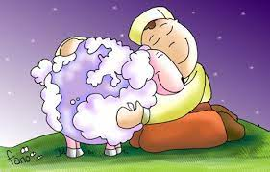
Jesus came over and took the bread and gave it to them, and in like manner the fish. This was now the third time Jesus was revealed to his disciples after being raised from the dead. When they had finished breakfast, Jesus said to Simon Peter, "Simon, son of John, do you love me more than these?" Simon Peter answered him, "Yes, Lord, you know that I love you." Jesus said to him, "Feed my lambs."

Slide 7
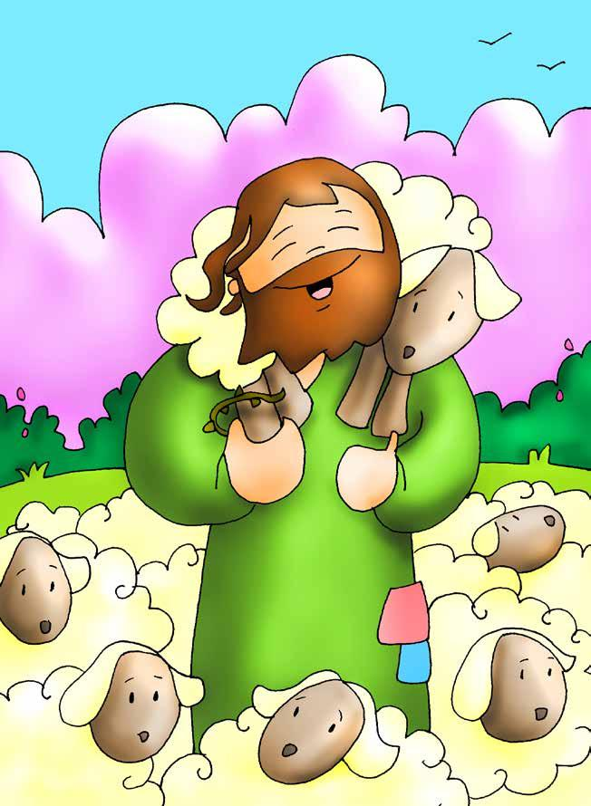
He then said to Simon Peter a second time, "Simon, son of John, do you love me?" Simon Peter answered him, "Yes, Lord, you know that I love you." Jesus said to him, "Tend my sheep." Jesus said to him the third time, "Simon, son of John, do you love me?" Peter was distressed that Jesus had said to him a third time, "Do you love me?" and he said to him, "Lord, you know everything; you know that I love you." Jesus said to him, "Feed my sheep… Follow me."

Slide 8
REFLECTION

Slide 9
The resurrected Christ appears to the disciples a 3rd time but they don’t recognize Him. Why don’t they recognize Him?
Jesus is God and wants to appear differently to help strengthen their faith: He wants to help them to believe without seeing.

Slide 10
They were fishing and had fished nothing. John realized it was Jesus at the shore and tells Peter.
How did John know?
Because of the sudden miraculous catch of fish after following the stranger’s directions.

Slide 11
When did this happen before?
The first time they met Jesus and followed Him.

Slide 12
How did Peter react?
He dove into the water to reach Jesus quickly.

Slide 13
How did the other disciples react?
They arrived dragging the nets full of fish.

Slide 14
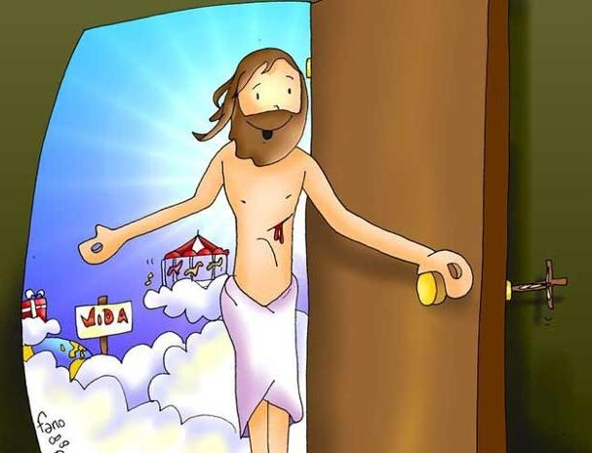
When someone you love a lot arrives at your house, what do you do?
Share.

Slide 15
What did Jesus do when they all arrived?
He gave them bread and fish to eat. Jesus still feeds us with the Eucharist.

Slide 16
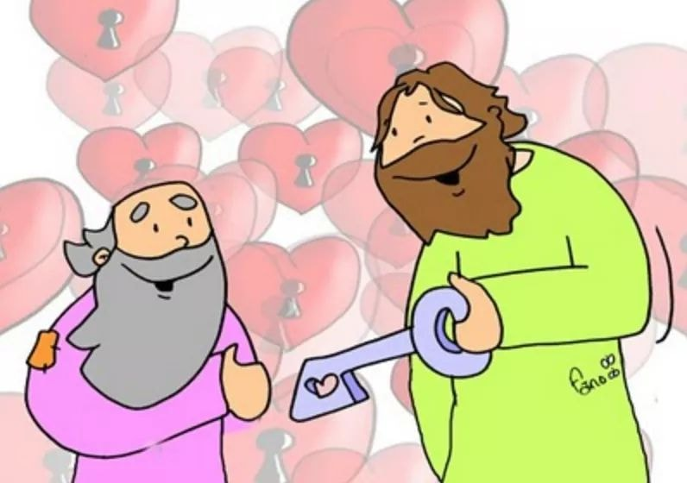
Later, what does Jesus ask Peter 3 times?
Do you love me?

Slide 17
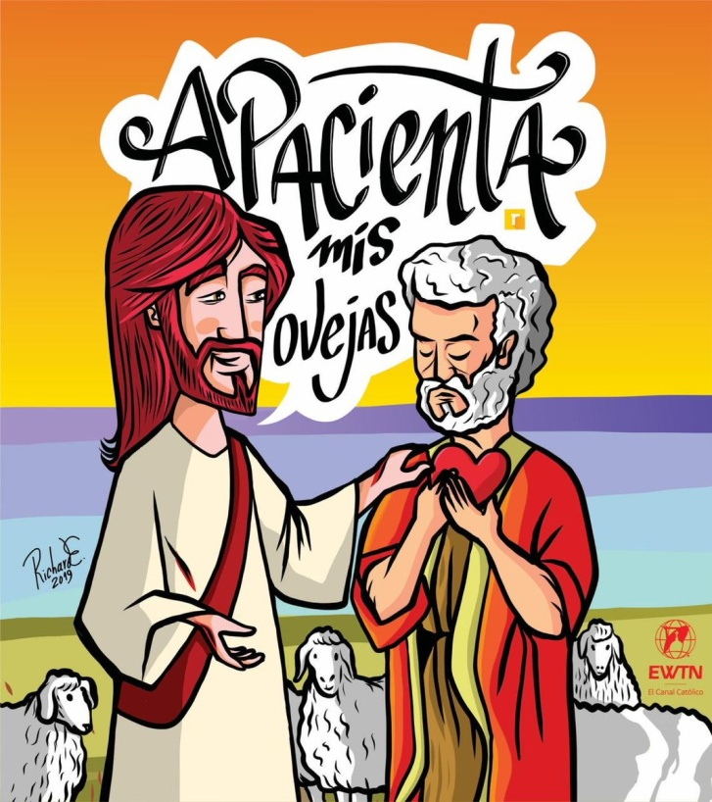
What does Jesus ask of Peter 3 times?
Feed my lambs.

Slide 18
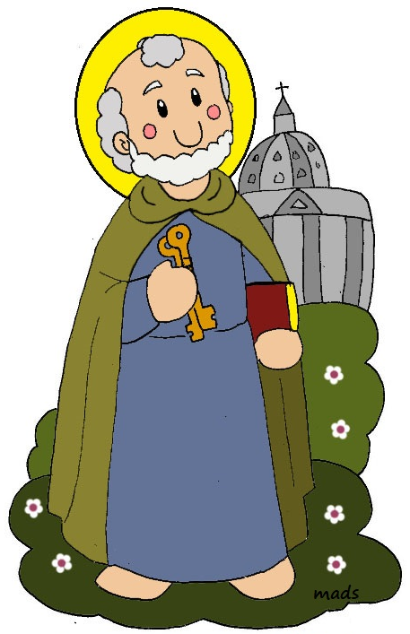
What does this mean?
He wanted Peter to pastor His people: directing, instructing, protecting them... Peter was the first Pope because of His great love for Jesus.

Slide 19
Jesus tells him, “Follow me.” When did He say this before?
At the first miraculous catch of fish when He told them they would be fishers of men. Again, He gives them this mission.

Slide 20
Jesus demonstrates again that He is alive.
What does Jesus want most of all from us?
That we love Him and follow Him, being another Jesus on earth.

Slide 21
ACTIVITIES

Slide 22
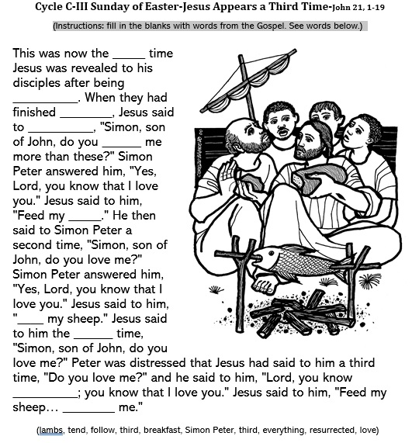
third
resurrected
breakfast
Simon Peter
love
lambs
Feed
third
everything
Follow

Slide 23
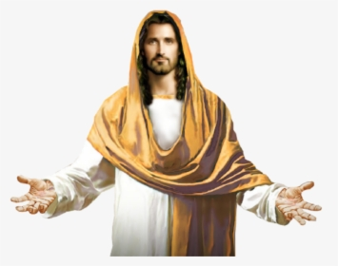
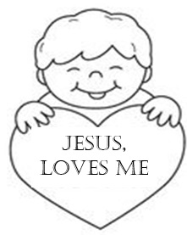
Cut, color, and write your name on the back of the pictures below. Then place one at a time around a picture of Jesus and pray: Jesus, I Love You very much.

Slide 24
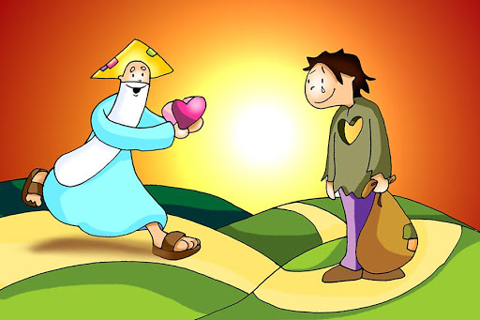
PRAYER
Lord, sometimes you have to repeat yourself many times so we understand. Help us to understand the Immense Love you have for us. Give us the Grace to love you intensely, to love each other, and to always follow you. Amen.

Slide 25
I love you Jesus, MAPI (Ctrl Click) https://youtu.be/llLR5q9C1KU (3-6 yrs. old)

Slide 26
Forever God, Forever Love, Lifetree Kids (Ctrl Click) https://youtu.be/knqrk-1XXaU (7+ years)

