Slide 1
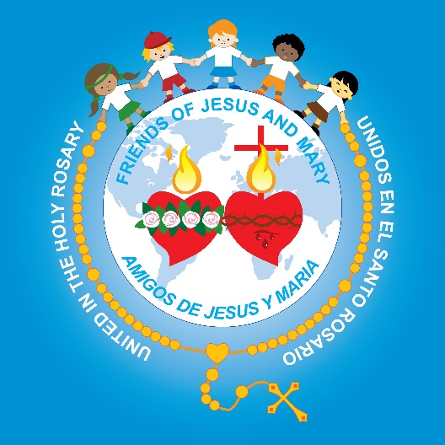
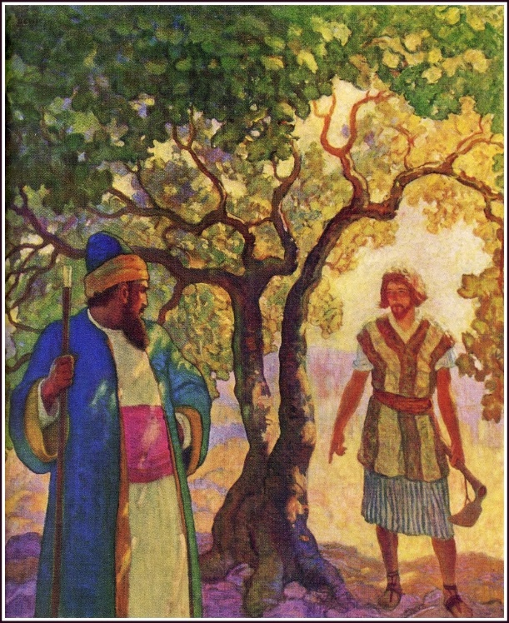
Ministry Friends of Jesus and Mary
Prayer Group for Children
Cycle C - III Sunday of Lent
The Barren Fig Tree– Luke 13: 1-9
www.fcpeace.org

Slide 2
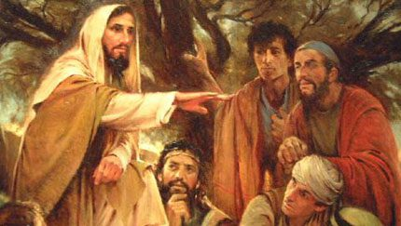
Some people told Jesus about the Galileans whose blood Pilate had mingled with the blood of their sacrifices. Jesus said to them in reply,
“Do you think that because these Galileans suffered in this way, they were greater sinners than all other Galileans?
By no means! But I tell you, if you do not repent, you will all perish as they did!”

Slide 3
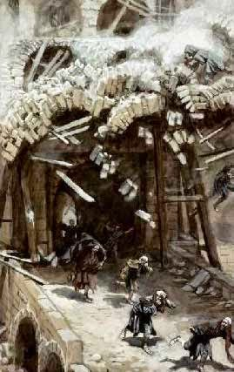
Or those eighteen people who were killed when the tower at Siloam fell on them—do you think they were more guilty than everyone else who lived in Jerusalem? By no means! But I tell you, if you do not repent, you will all perish as they did!"

Slide 4
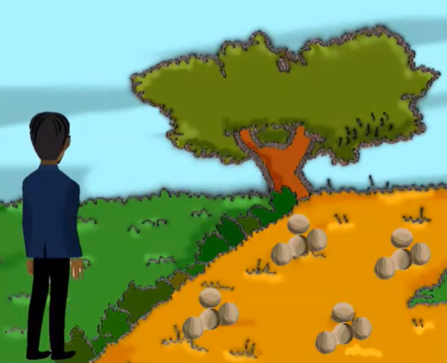
And he told them this parable:
There once was a person who had a fig tree planted in his orchard, and when he came in search of fruit on it but found none, he said to the gardener,

Slide 5
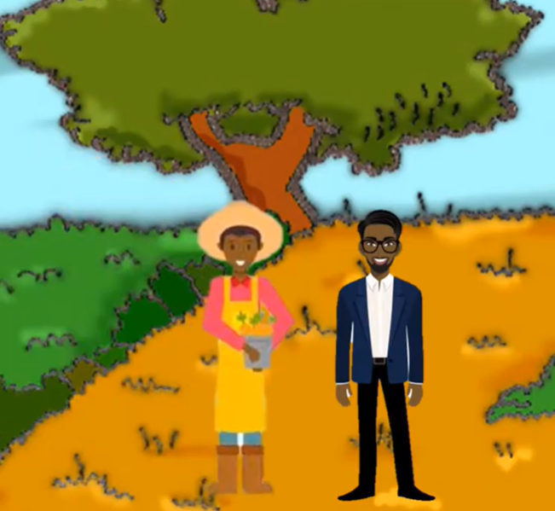
'For three years now I have come in search of fruit on this fig tree but have found none. So cut it down. Why should it exhaust the soil?'

Slide 6
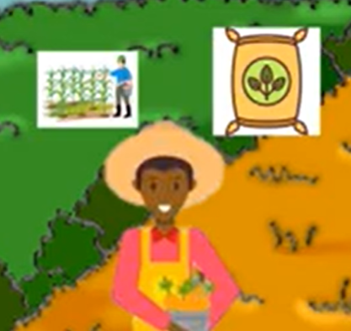
He said to him in reply, 'Sir, leave it for this year also, and I shall cultivate the ground around it and fertilize it; it may bear fruit in the future. If not, you can cut it down.'
Praise to You Lord Jesus Christ
The Gospel of the Lord

Slide 7
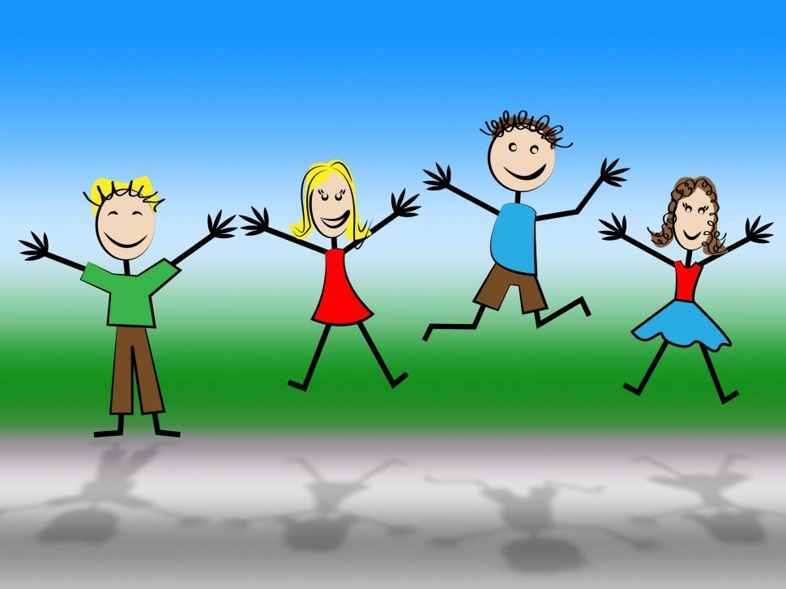
REFLECTION

Slide 8
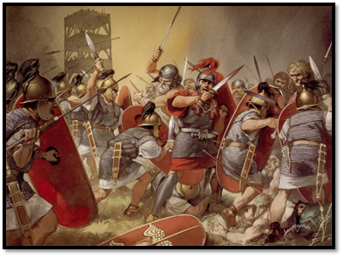
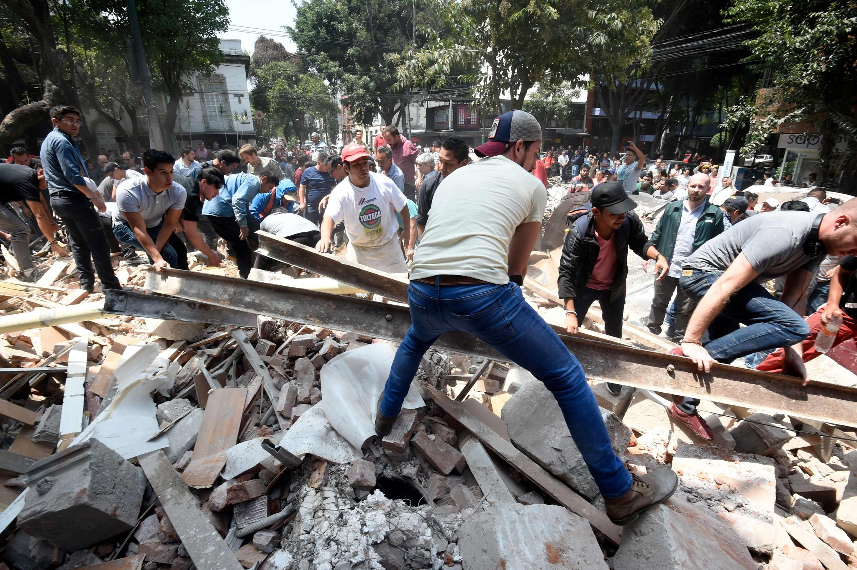
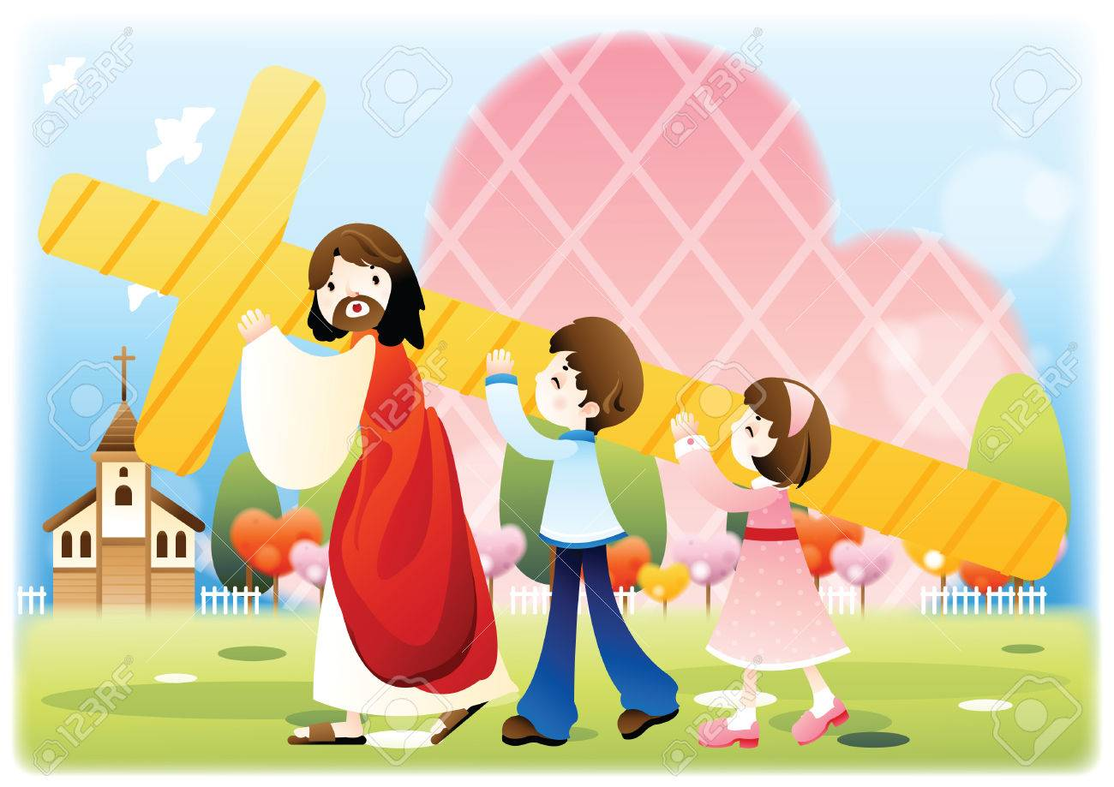
The gospel speaks of some Galileans that Pilate killed unjustifiably. Did this happen because they were big sinners?
Jesus says no. Suffering exists in the world because some people choose evil, like Pilate.
Other times we don’t understand why, like in natural disasters, or in sickness, but we trust in God and join our suffering to Jesus’ cross so He can save more souls.

Slide 9
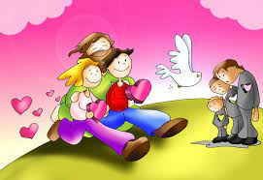
But Jesus wants our hearts to always be prepared to enter Heaven.

Slide 10
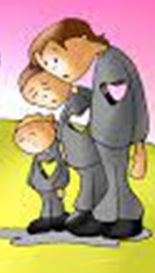
He tells a parable (a story with a lesson) about a barren fig tree. What does the tree without fruit which the owner wants to cut down symbolize?
A sinner who does not repent of his sins and is in danger of dying to an eternity without Jesus.

Slide 11
Who is the owner of the tree in the parable?
Who is the gardener who asks the owner for one more year to work the soil to see if the tree will give fruit?
The man represents God who gives us life.
The gardener represents Jesus who intercedes for us before God.

Slide 12
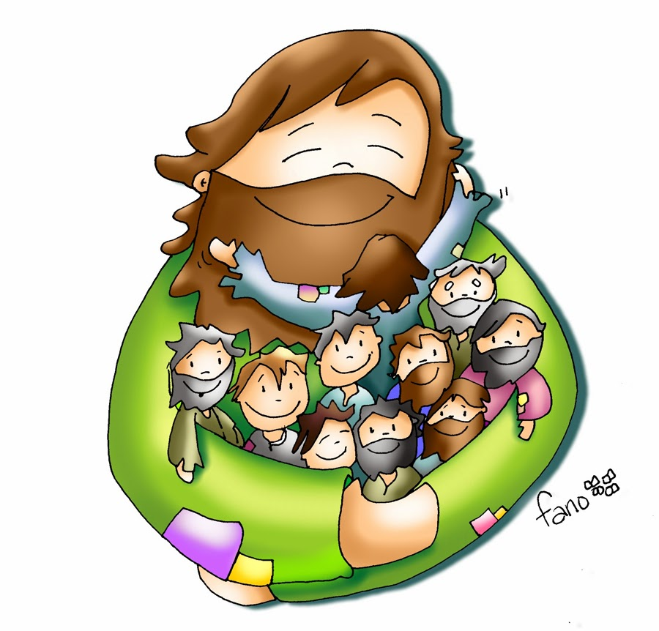
Jesus loves us and wants to spend eternity with us. What happens when we repent of our sins?
Our heart is filled with the Holy Spirit

Slide 13
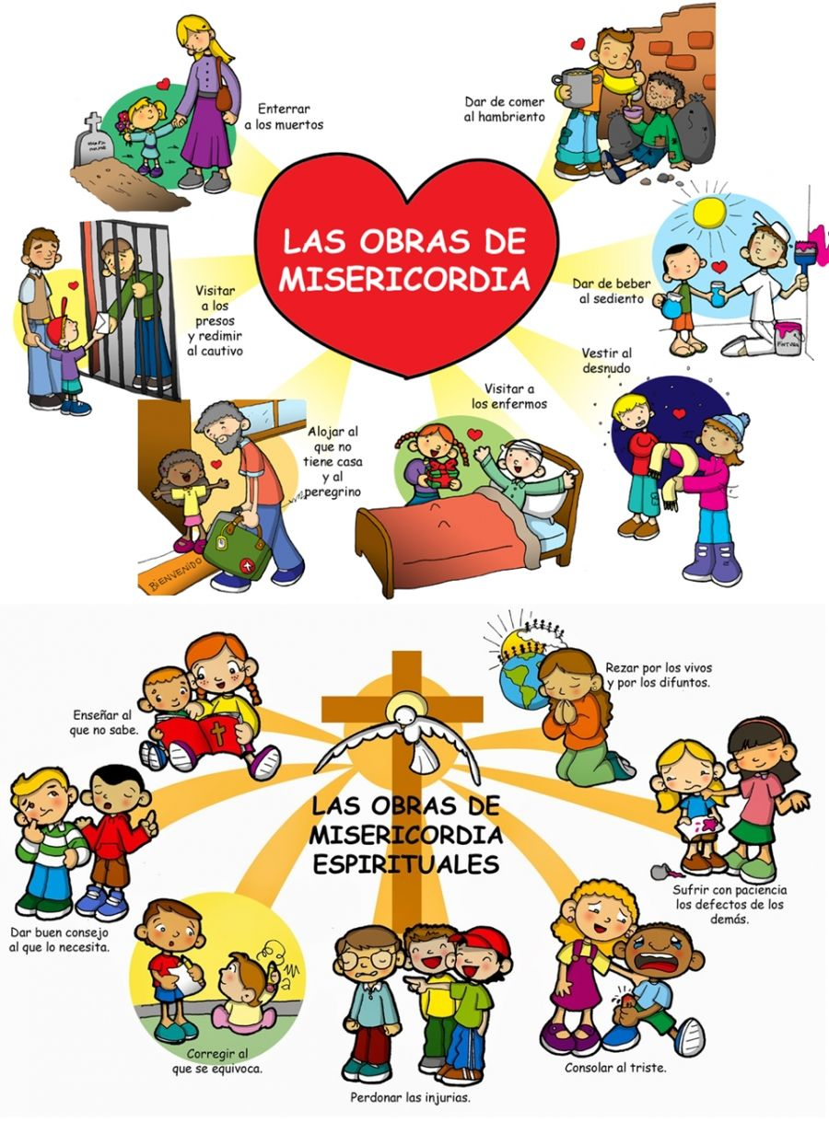
…and we can give fruits of good works, charity and mercy. (Review the works of mercy)
Bury the dead
Feed the Hungry
THE CORPORAL WORKS
OF MERCY
Give drink to the thirsty
Visit those in prison
CORPORALES
Clothe the naked
Visit the sick
Shelter the homeless
Instruct the ignorant
Pray for the living and the dead
THE SPIRITUAL WORKS OF MERCY
Suffer patiently other’s defects
Counsel the doubtful
Correct sinners
Console the sad
Forgive offenses

Slide 14
Activity

Slide 15
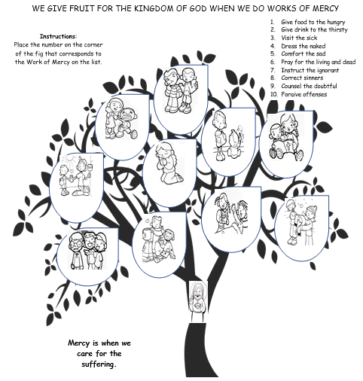
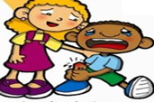
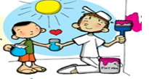
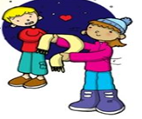
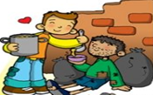
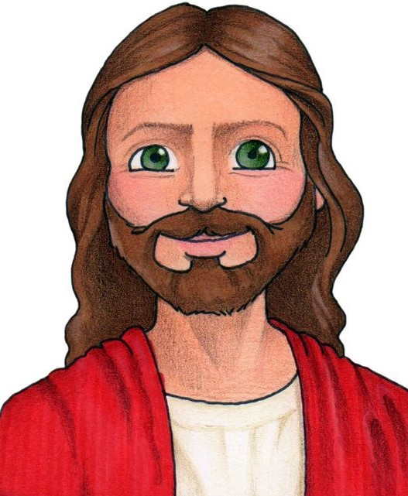
9
5
8
7
6
2
3
4
1
10

Slide 16
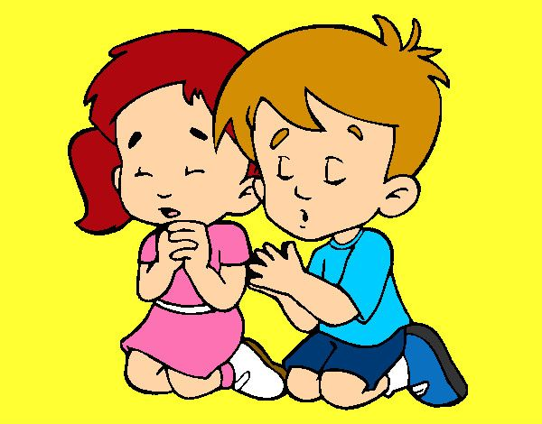
Prayer Jesus, give me the humility to repent of my sins. Fill my heart with your Holy Spirit of Love and Goodness. Make me sensitive to the needs of those around me that I may give witness of Your presence in the world. Amen

Slide 17
Corporal Works of Mercy Song, Catholic Conundrum, https://youtu.be/_8QGtMEv82k

Slide 18
Spiritual Works of Mercy, Christine in Action, https://youtu.be/TYXng71uDXQ

