Slide 1

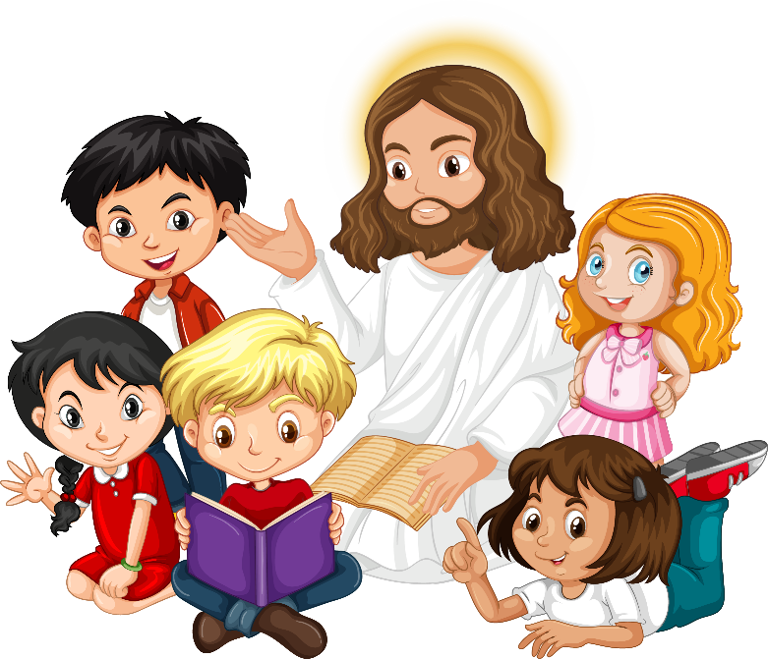
Friends of Jesus and Mary
Cycle C - III Sunday in Ordinary Time
“Today this scripture passage is fullfilled…”
Luke 1, 1-4; 4, 14-21

Slide 2
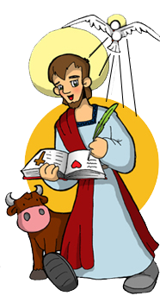
“Today this scripture passage is fullfilled…”
Since many people have written about the events that have occurred among us, just as the eyewitnesses have told them to us, I have also decided, after investigating everything, to write it down for you, most excellent Theophilus, so that you may realize the teachings you have received are true.

Slide 3
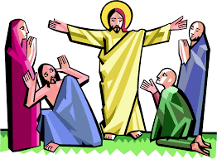
“Today this scripture passage is fullfilled…”
Jesus returned to Galilee in the power of the Spirit, and news of him spread throughout the whole region. He taught in their synagogues and was praised by all.

Slide 4
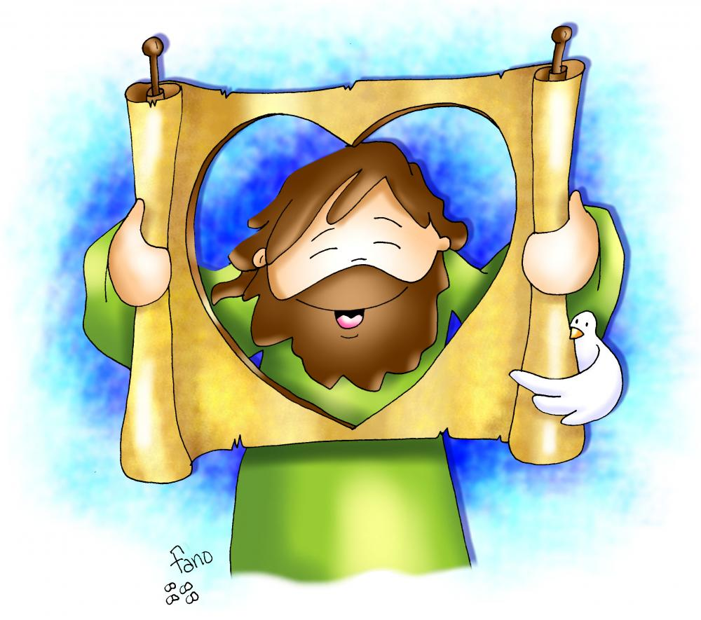
He came to Nazareth, where he had grown up, and went according to his custom into the synagogue on the Sabbath day. He stood up to read and was handed a scroll of the prophet Isaiah. He unrolled the scroll and found the passage where it was written:
The Spirit of the Lord is upon me, because he has anointed me to bring glad tidings to the poor. He has sent me to proclaim liberty to captives and recovery of sight to the blind, to let the oppressed go free, and to proclaim a year acceptable to the Lord.
Rolling up the scroll, he handed it back to the attendant and sat down, and the eyes of all in the synagogue looked intently at him. He said to them,
“Today this Scripture passage is fulfilled in your hearing."

Slide 5
REFLECTION

Slide 6
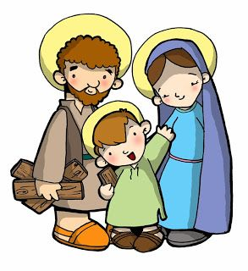
This Gospel passage starts when Jesus is 30 years old and starts his public ministry; He starts preaching to everyone about God’s love.
St. Luke, who wrote this Gospel, starts writing to Theophilus, a distinguished person to whom he dedicates this Gospel.
Before this, He lived quietly with Joseph and Mary in Nazareth, hiding His divinity.

Slide 7
How does Luke say Jesus’ public ministry begins?

Slide 8
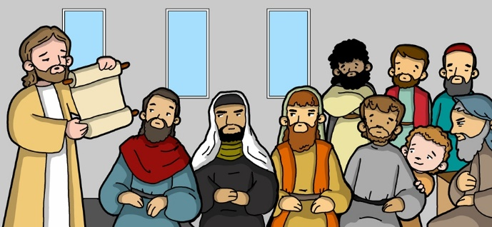
Inspired by the Holy Spirit, He returned to Galilee, teaching in the synagogues and was praised by all.

Slide 9
Then Jesus returns to Nazareth where He was raised, where everyone knew Him as the son of the carpenter Joseph and of Mary. He enters the synagogue on the Sabbath and reads from scripture as was customary.
What was the reading?

Slide 10
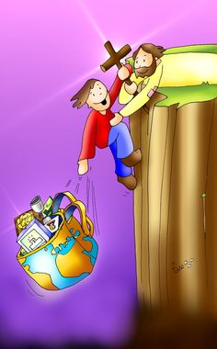
He read from a scroll of the prophet Isaiah about the coming Messiah.

Slide 11
What did it say?

Slide 12
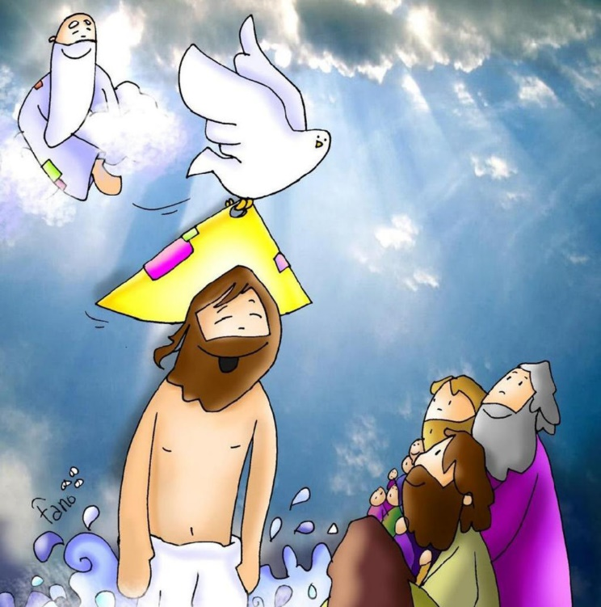
The Spirit of the Lord is upon me, because he has anointed me to bring glad tidings to the poor…

Slide 13
What did Jesus mean when He said, “Today this Scripture passage is fulfilled in your hearing…”?

Slide 14
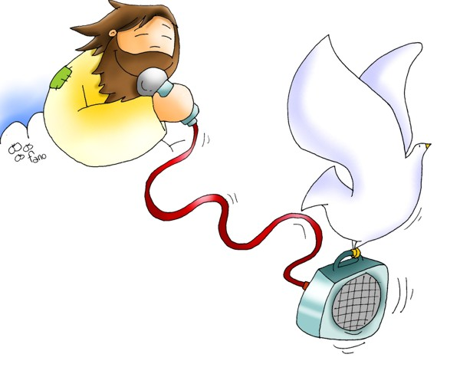
He is the one anointed to take the Good News to the poor…, the awaited Messiah, the Savior.

Slide 15
What is the Good News that the Messiah brings?

Slide 16
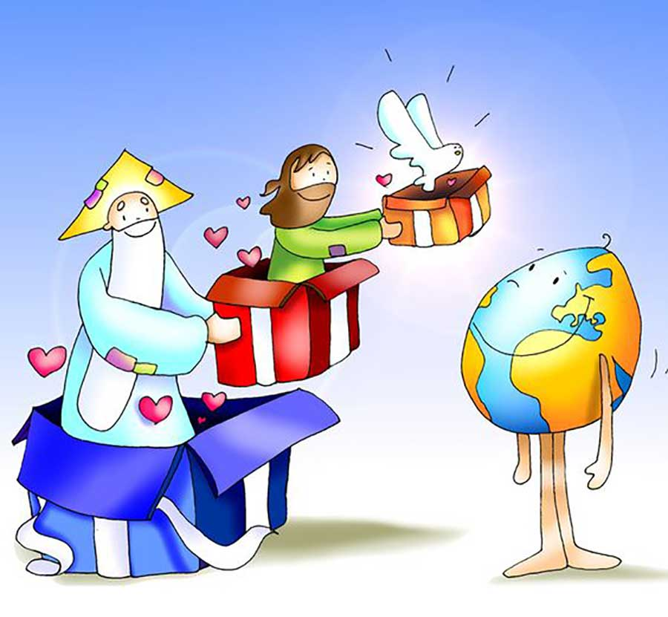
God sent His only son, to be God’s Word, to show us how much He loves us and how to love others.
He also came to pay for our sins on the cross, thus opening the gates of Heaven for us.
He then sends the Holy Spirit to live in us, guiding, healing, protecting, and loving us…

Slide 17
What does Gospel mean?
Good News

Slide 18
The Four Evangelists
The word “Gospel” means “Good News”
And what is the Good News?
Everything that Jesus did and taught, sent by the Father.
Four disciples of Jesus wrote the Gospels…

Slide 19
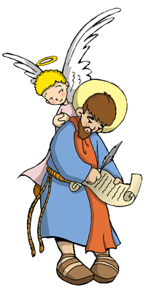
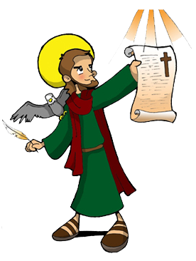
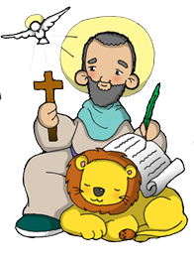
St. Matthew
(The Angel)
*He was one of the 12 apostles.
*He was a tax collector.
*He left his job to follow Jesus.
*He writes everything Jesus did and said, especially His teachings.
*He wrote his Gospel around the year 80.
St. Luke
(The Bull)
*He was a disciple and secretary to St. Peter.
*He wrote everything Peter taught about Jesus.
*This is the shortest and oldest Gospel.
*It was written around the year 70.
St. John
(The Eagle)
*He was one of the 12 apostles.
*This Gospel is a little different from the others and so is called “the spiritual gospel”.
*He finished writing his gospel around the year 100.
St. Mark
(The Lion)
*He did not know Jesus personally.
*He accompanied St. Paul and collected Jesus teaches by talking to those who lived with Him.
*He speaks about the Virgin Mary and the infancy of Jesus.
*He wrote his Gospel around 50 years after Jesus died.

Slide 20
How can you take the Good News to your family and friends?
Share

Slide 21
ACTIVITIES

Slide 22

Fill in the blanks with the words below.
Spirit
Lord
anointed
The ______ of the _____is upon me, because he has ________ me to bring glad ______ to the ____. He has sent me to proclaim ______ to captives and recovery of sight to the _____, to let the oppressed go ____, and to proclaim a year __________ to
the Lord.
tidings
poor
liberty
blind
free
acceptable
Choose from the following words: Tidings Anointed Acceptable
Blind Spirit Free Poor Liberty Lord

Slide 23
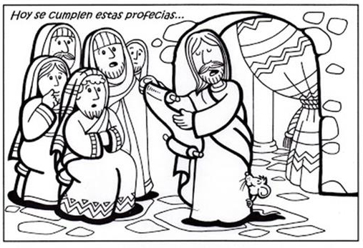
Today this scripture passage is fulfilled…

Slide 24
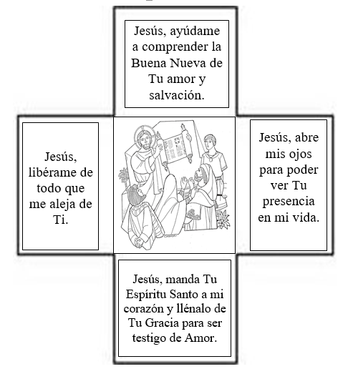
Instructions: Color and cut cross onto brown paper cut in the form of a larger cross. Can use brown paper bag. Punch a whole on top and tie ribbon for hanging. Write behind how we can be witnesses of the Good News.
Jesus, help me to understand the Good News of your love and salvation.
Jesus, free me from all that separates me from you.
Jesus, open my eyes so I may see Your presence in my life.
Jesus, send your Holy Spirit into my heart and fill it
with the graces I need to be a witness of your Love.

Slide 25
Play telephone with the phrases of the prophesy. One child whispers a phrase into the ear of another child. The 2nd child must whisper the same phrase to a 3rd child… After everyone has listened to the phrase, the last child states the phrase out loud to see how the phrase has changed.

Slide 26
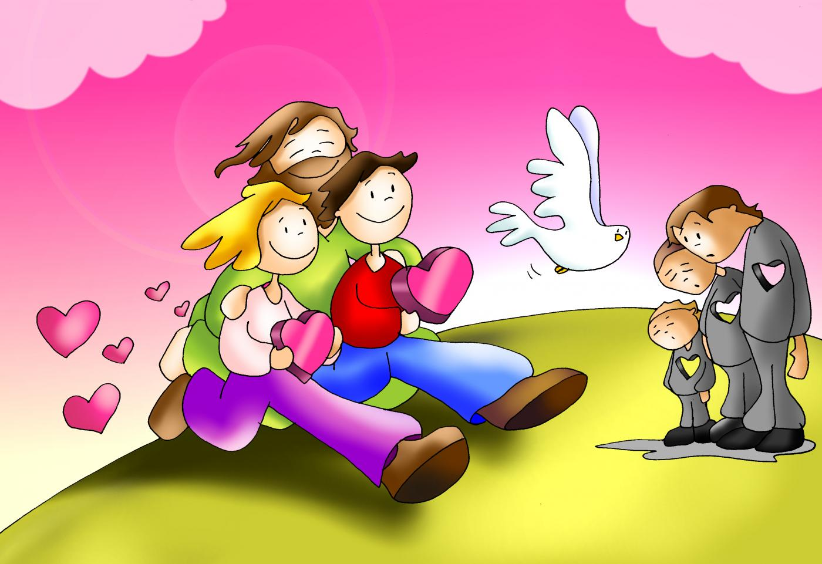
PRAYER
Lord, help me to take the Good News to others. In times of sadness, help me to be compassionate. In times of division, help me to be a bridge. In times of disillusion, give me words of encouragement. Amen.

Slide 27
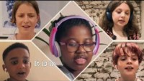
Make Me a Channel of your Peace, Best Kids Worship Songs, https://youtu.be/qasGlAN399o

