Slide 1
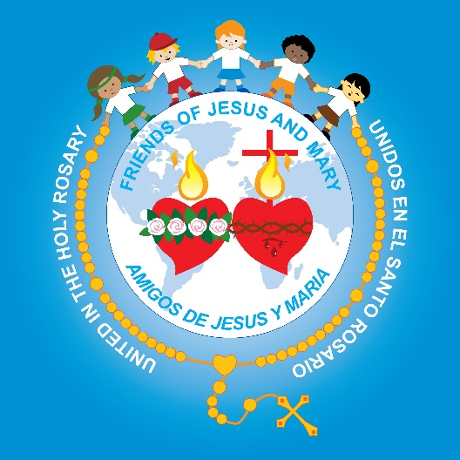
Friends of Jesus and Mary
PRAY FAST GIVE
Prayer Group for Children
Cycle C – IV Sunday of Lent
The Prodigal Son– Luke 15, 1-3. 11-32
biblia

Slide 2
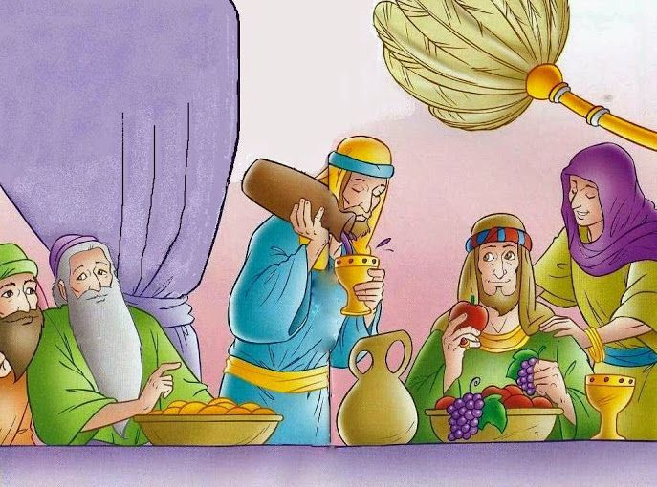
Tax collectors and sinners were all drawing near to listen to Jesus, but the Pharisees and scribes began to complain, saying, “This man welcomes sinners and eats with them.” So to them Jesus addressed this parable:
THE PRODIGAL SON

Slide 3
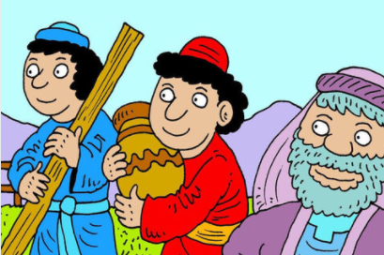
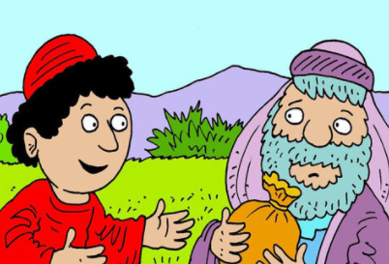
“A man had two sons, and the younger son said to his father, ‘Father give me the share of your estate that should come to me.’ So the father divided the property between them.

Slide 4
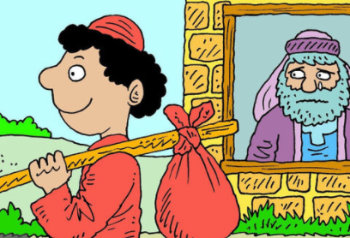
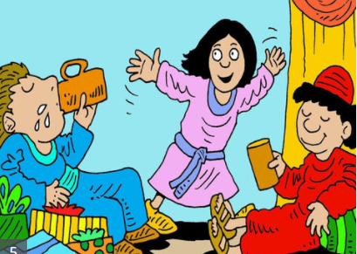
After a few days, the younger son collected all his belongings and set off to a distant country where he squandered his inheritance on a life of dissipation.

Slide 5
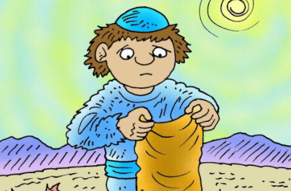
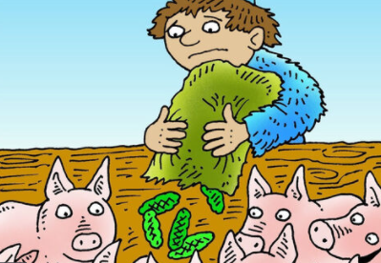
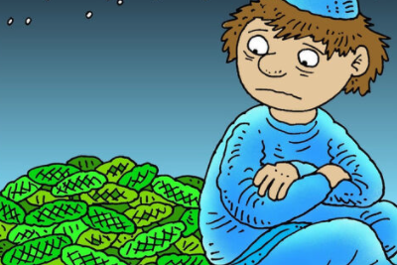
When he had freely spent everything, a severe famine struck that country, and he found himself in dire need. So he hired himself out to one of the local citizens who sent him to his farm to tend the swine. And he longed to eat his fill of the pods on which the swine fed, but nobody gave him any.

Slide 6
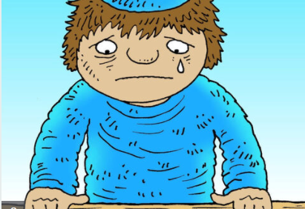
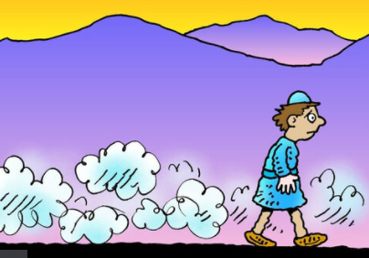
Coming to his senses he thought, ‘How many of my father’s hired workers have more than enough food to eat, but here am I, dying from hunger. I shall get up and go to my father and I shall say to him, “Father, I have sinned against heaven and against you. I no longer deserve to be called your son; treat me as you would treat one of your hired workers.”’ So he got up and went back to his father.

Slide 7
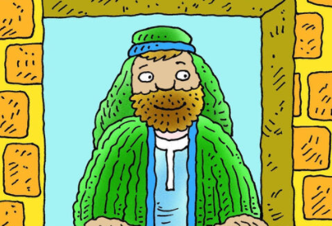
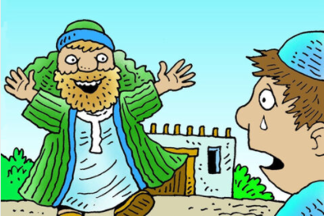
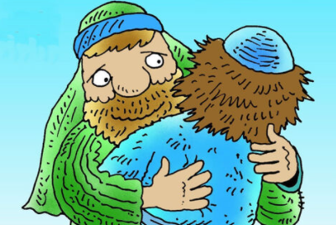
While he was still a long way off, his father caught sight of him, and was filled with compassion. He ran to his son, embraced him and kissed him.

Slide 8
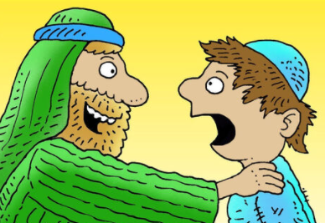
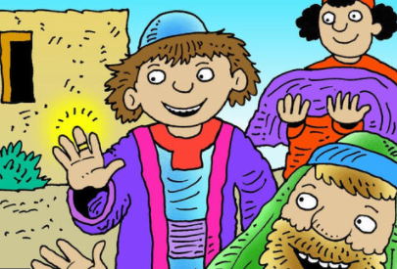
His son said to him, ‘Father, I have sinned against heaven and against you; I no longer deserve to be called your son.’ But his father ordered his servants, ‘Quickly bring the finest robe and put it on him; put a ring on his finger and sandals on his feet. Take the fattened calf and slaughter it. Then let us celebrate with a feast, because this son of mine was dead, and has come to life again; he was lost, and has been found.’ Then the celebration began.

Slide 9
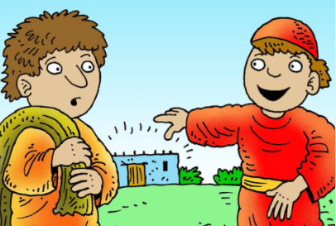
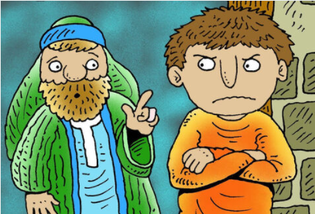
Now the older son had been out in the field and, on his way back, as he neared the house, he heard the sound of music and dancing. He called one of the servants and asked what this might mean. The servant said to him, ‘Your brother has returned and your father has slaughtered the fattened calf because he has him back safe and sound.’ He became angry, and when he refused to enter the house, his father came out and pleaded with him.

Slide 10
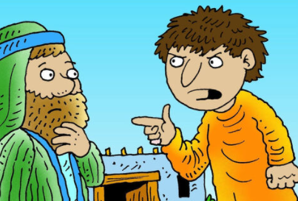
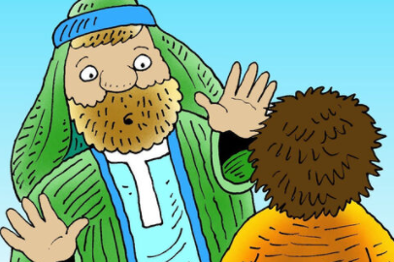
He said to his father in reply, ‘Look, all these years I served you and not once did I disobey your orders; yet you never gave me even a young goat to feast on with my friends. But when your son returns who swallowed up your property with prostitutes, for him you slaughter the fattened calf.’ He said to him, ‘My son, you are here with me always; everything I have is yours. But now we must celebrate and rejoice, because your brother was dead and has come to life again; he was lost and has been found.’”
The Gospel of the Lord, Praise to You Lord Jesus Christ.

Slide 11
REFLECTION

Slide 12
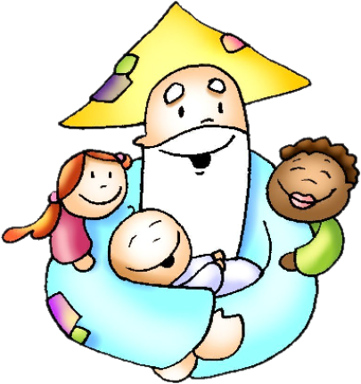
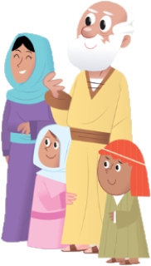
Jesus tells a parable to explain God’s great love for us.
Who does the father represent?
GOD
Who does the son represent?
Us when we sin and distance ourselves from God.

Slide 13
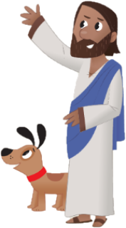
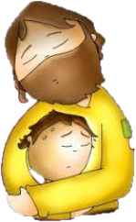
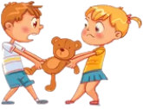
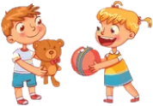
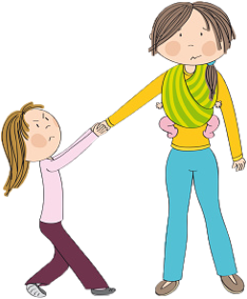
What does Jesus want to teach us?
God always forgives us joyfully when we repent and return to Him.
Why is the brother jealous?
His brother had behaved badly and his Father gives him a great feast; he had always behaved well and never had received one.

Slide 14
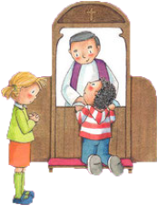
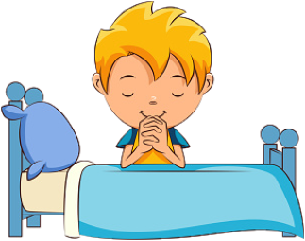
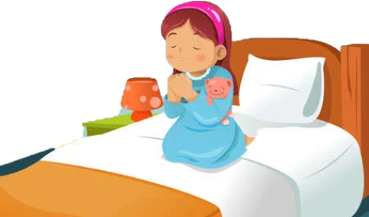
What does his father say to him?
Everything I have is yours. But now we must celebrate and rejoice, because your brother was dead and has come to life again; he was lost and has been found.
In the same way, God celebrates in Heaven when we repent and return to Him.

Slide 15
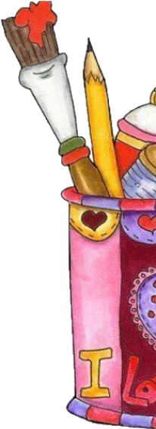
ACTIVITIES

Slide 16
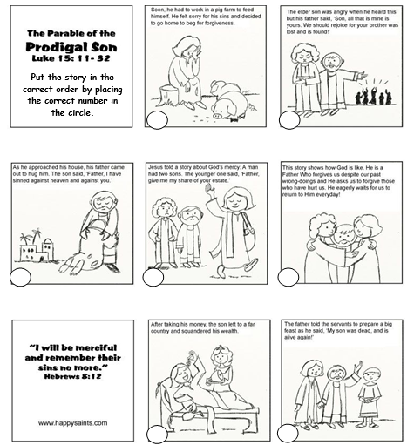
Soon he had to work in a pig farm to feed himself. He felt sorry for his sins and decided to go home to beg for forgiveness.
The elder son was angry when he heard this but his father said, “Son, all that is mine is yours. We should rejoice for your brother was lost and is found.
3
6
As he approached the house, his father came out to hug him. The son said, “Father, I have sinned against heaven and against you.”
Jesus told a story about God’s mercy. A man had two sons. The younger one said, “Father give me my share of your estate.”
This story shows how God is a Father who forgives us despite our past wrong-doings and He asks us to forgive those who have hurt us. He eagerly waits for us to return to Him everyday.
4
1
7
After taking his money, the son left to a far country and squandered his wealth.
The father told the servants to prepare a big feast as he said, “My son was dead, and is alive again!”
2
5

Slide 17
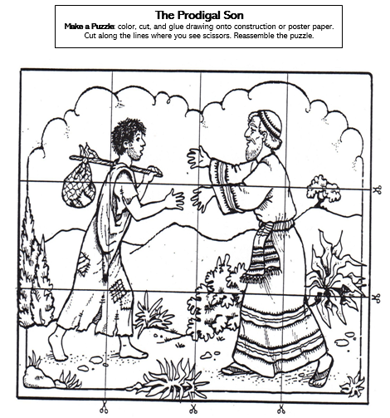

Slide 18
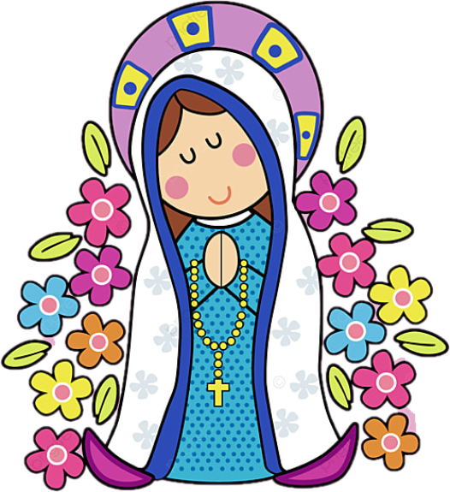
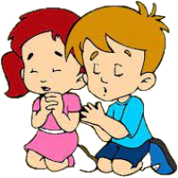
PRAYER
My God,
thank you for having mercy on me. Help me to always be grateful for the great inheritance of being called your son/daughter and of having your great Love in my life. Help me to always forgive those who hurt me.
Amen.

Slide 19
—Goodbye! Blessings…
The Prodigal Son Children’s Song, https://youtu.be/Sc15l8VdwfI (3-6yrs)

Slide 20
—Goodbye! Blessings…
The Lord is Merciful and Compassionate, https://youtu.be/3YBIka9ngKI (7yrs.+)

