Slide 1
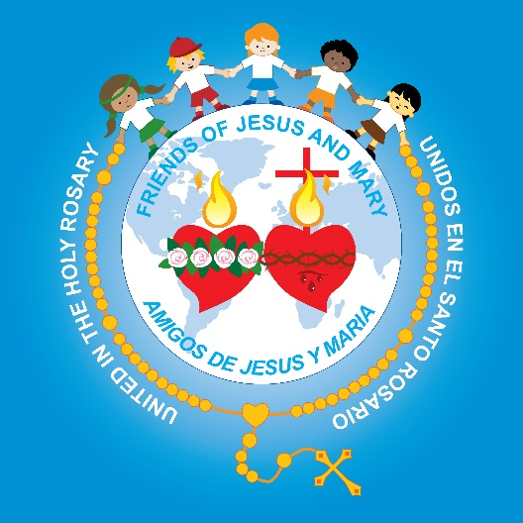
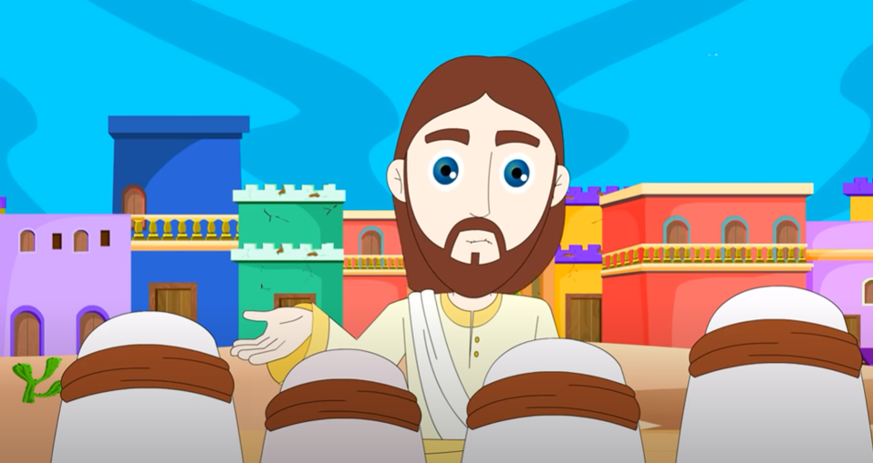
Cycle C- IV Sunday in Ordinary Time No prophet is accepted in his native land. (Luke 4, 21-30)
Ministry Friends of Jesus and Mary

Slide 2
St. Henry of Ossó
January 27
PATRON SAINT OF
FRIENDS OF JESUS AND MARY

Slide 3
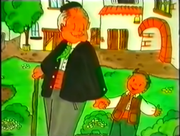
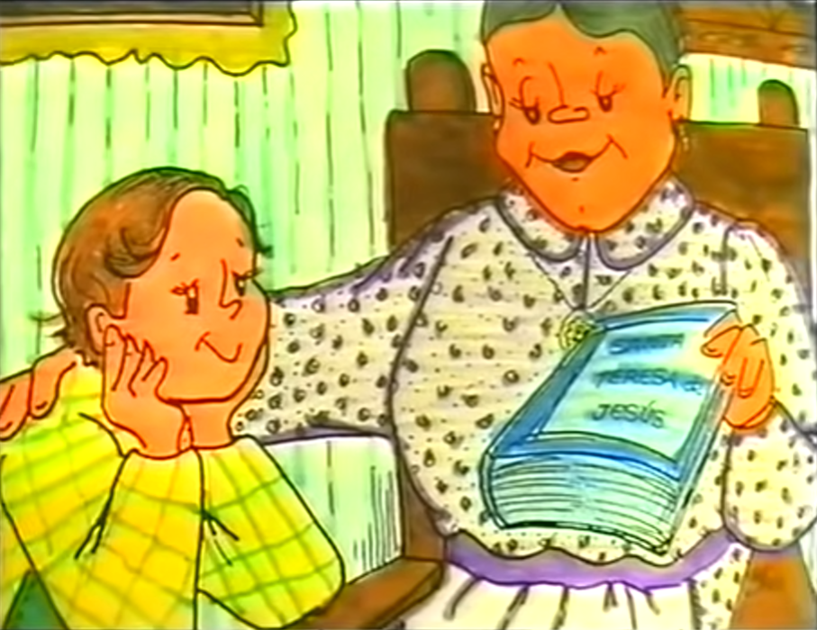
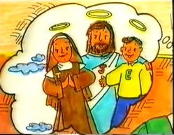
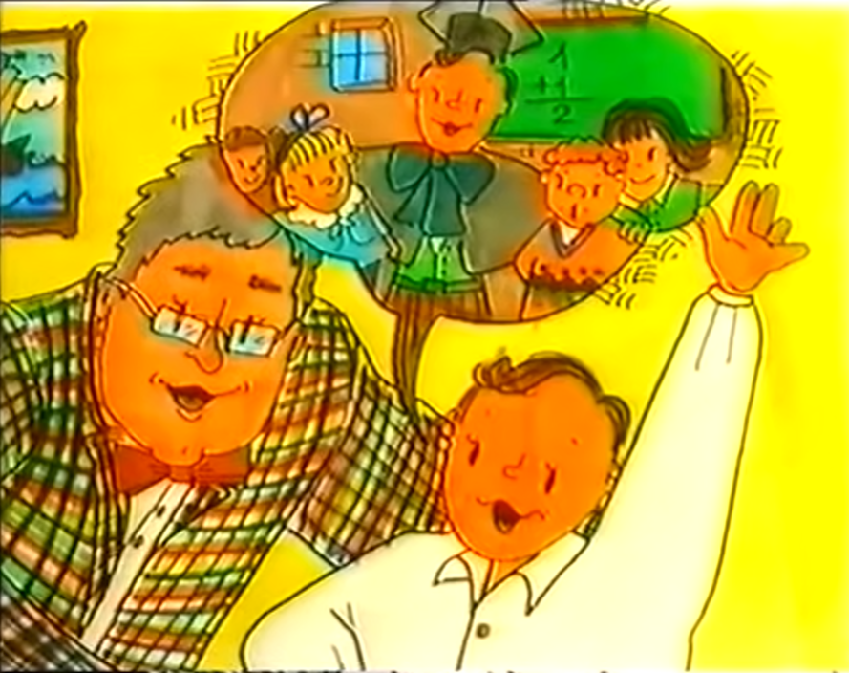
St. Henry of Ossó was born in Vinebre, a small town in Catalonia – Spain.
His parents were: Jaime y Micaela.
He had two older siblings: Jaime and Dolores.
Henry’s grandfather, Don Antonio, took him on walks through the town and told him many stories about the lives of the saints.
His aunt, Mariana, gave him a book on St. Theresa of Avila which greatly interested him in her life.
Henry thought that like St. Theresa, he too wanted be a great friend of Jesus.
He was a great student and dreamed of being a teacher when he grew up so he could help others.

Slide 4
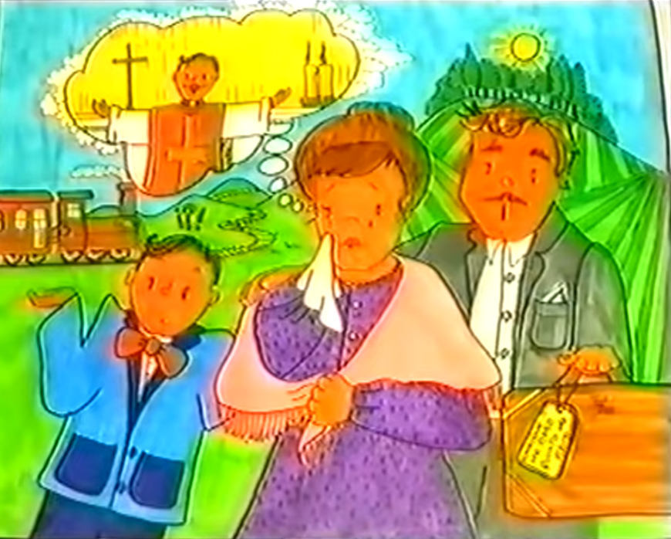
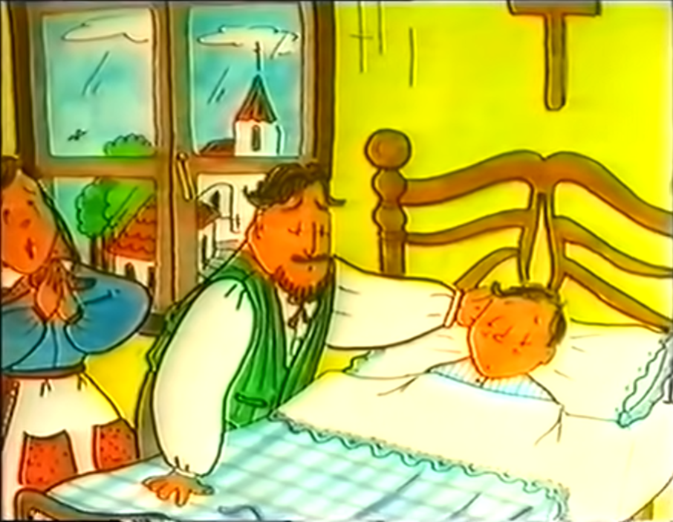
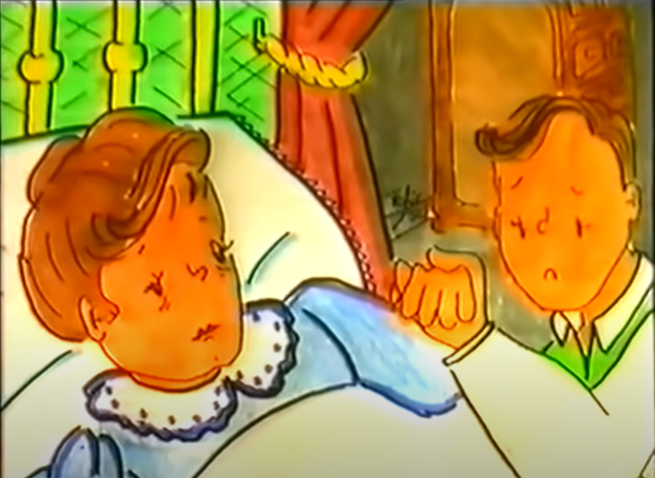
Don Jaime, Henry’s father, wanted his son to be a merchant so he decides to send him to his uncle’s house to work at his store.
Henry has to leave and sees how his mother cries because she did not want him to leave. Also, she wanted him to be a priest instead of a merchant.
After a few month’s at his uncle’s, Henry becomes seriously ill. His uncle promises to take him to Our Lady of the Pilar if he gets better.
Everything Passes; God Alone Suffices.
Ever since his grandfather had told him about Our Lady of the Pilar, Henry wanted to know her. When he was well, he went and thanked her because she had never left his side.
Henry returned to his home to rest. But he soon had to return to the big city to work. He continued to read St. Theresa’s book.
Some time later, his mother became sick and she repeated to him her desire that he become a priest. She died and Henry thought of St. Theresa who also lost her mother when she was young.

Slide 5
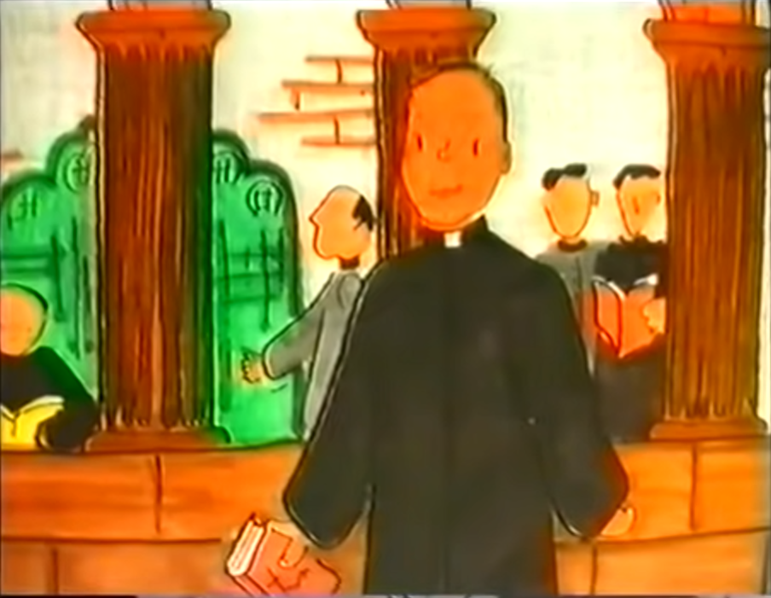
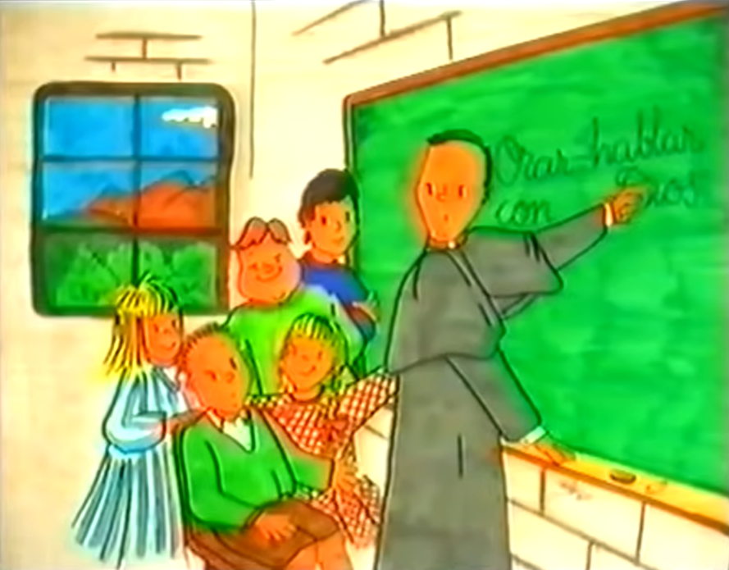
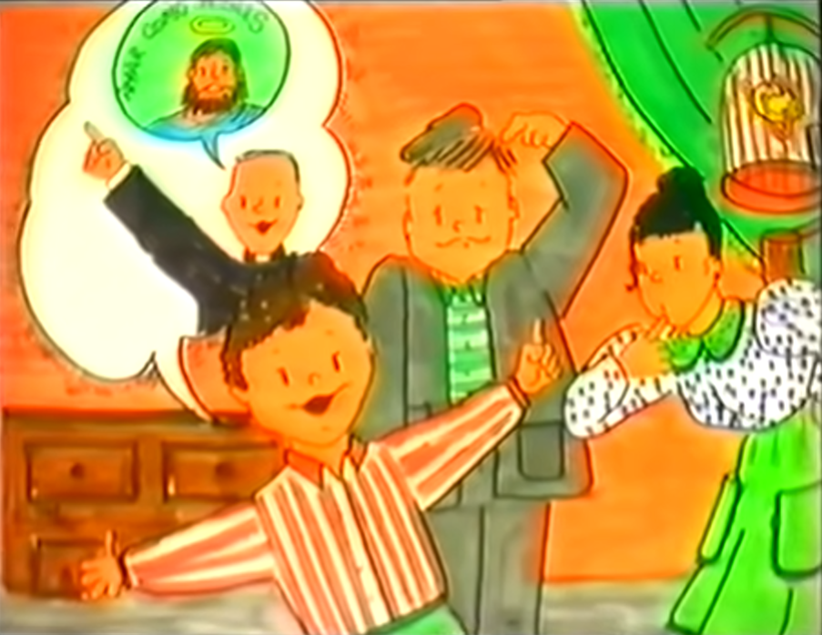
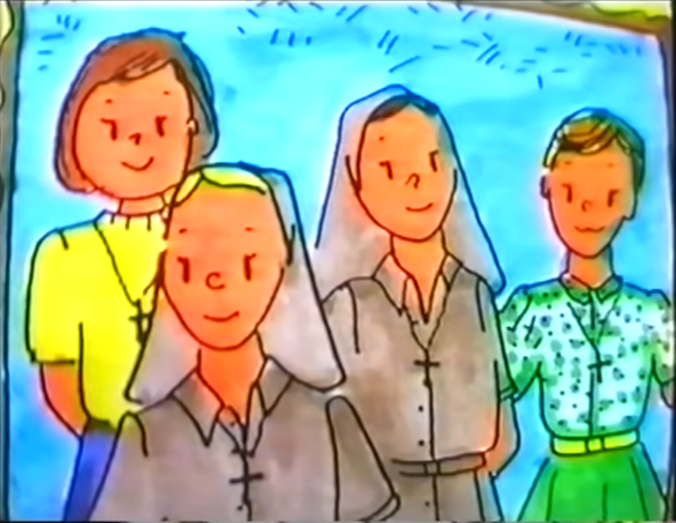
Henry decides to go to Montserrat to visit the Virgin Mary and tell her of his desire to be a priest.
He soon entered the seminary and prepares to become a priest.
He spent much time with the children and never tired of teaching them about Jesus and the importance of praying.
Seeing that so many children wanted to be Friends of Jesus, Henry forms the Company of St. Theresa of Jesus, with sisters that teach children about Jesus, their great friend.
St. Henry was Another Jesus on Earth. He teaches us that we too can be Another Jesus on Earth if we think, live, and love like Jesus did. Friends of Jesus and Mary love you!!!
Each day more children wanted to be Friends of Jesus. The children spoke of Jesus in their homes and wanted to pray with their families

Slide 6
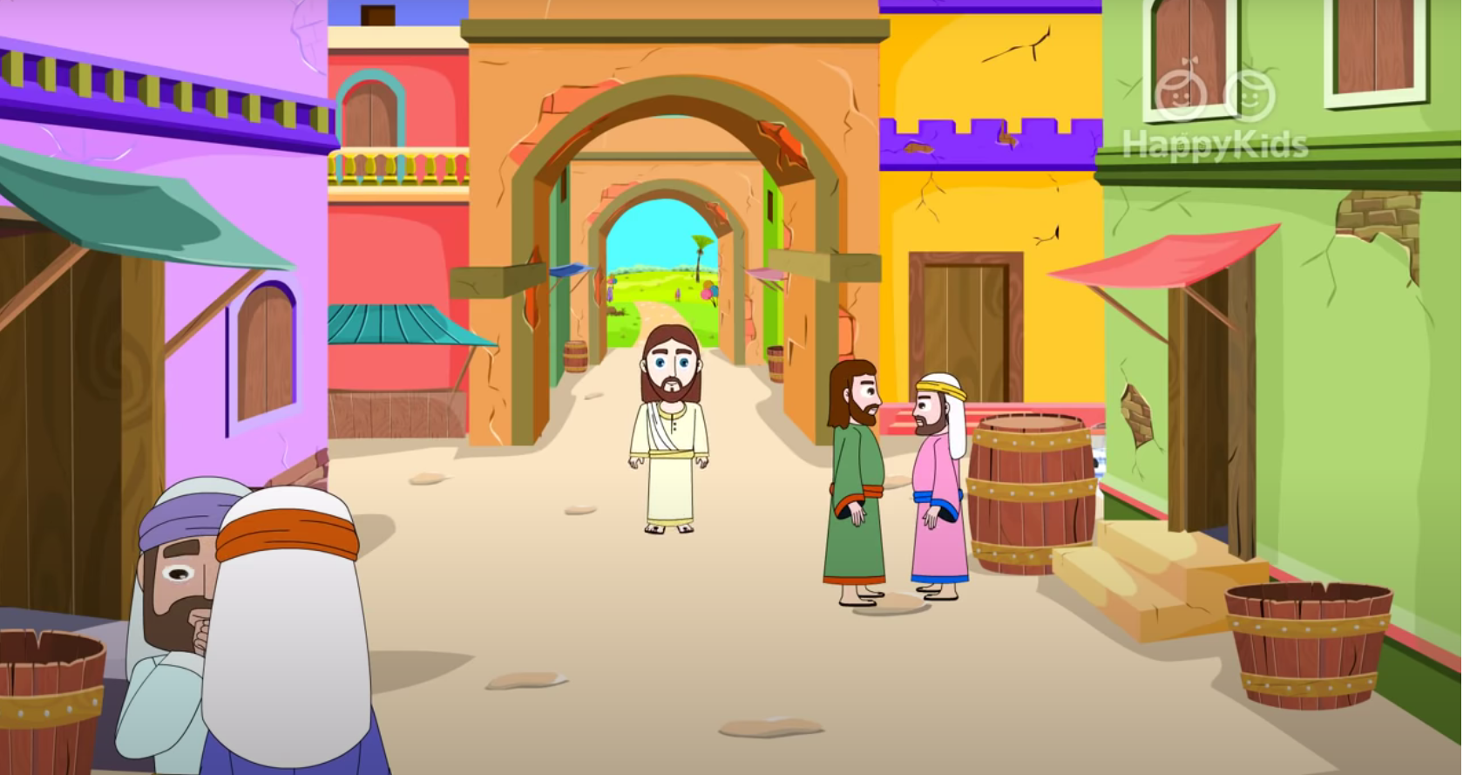
Gospel
“No Prophet is Accepted in his Native Land”
Luke 4, 21-30

Slide 7
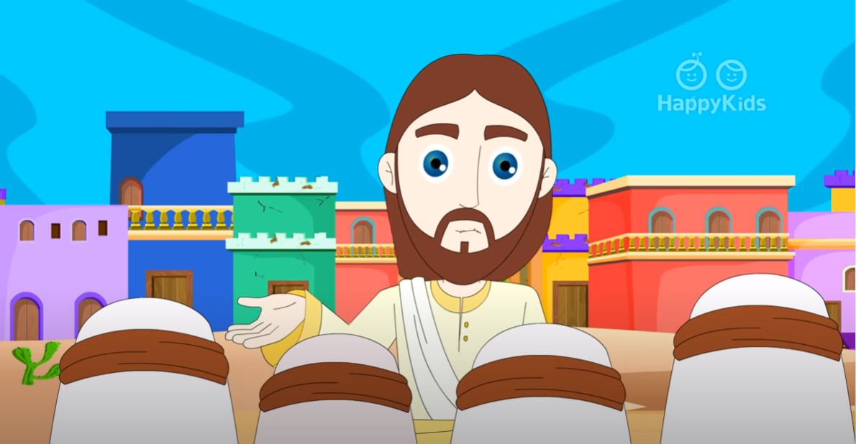
Jesus began speaking in the synagogue, saying: "Today this Scripture passage is fulfilled in your hearing."

Slide 8
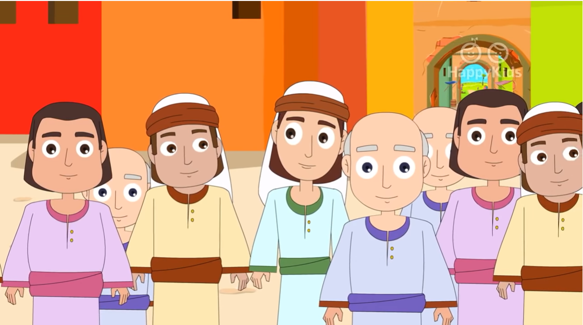
And all spoke highly of him and were amazed at the gracious words that came from his mouth.

Slide 9
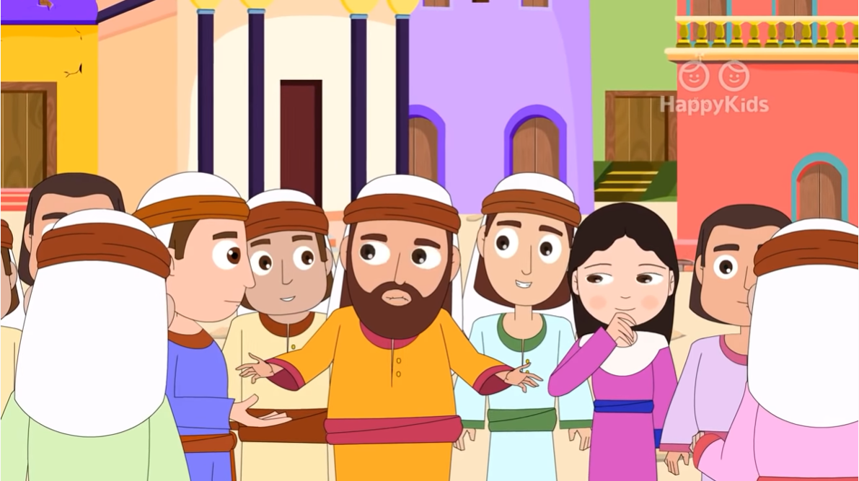
They also asked,
"Isn't this the son of Joseph?"

Slide 10
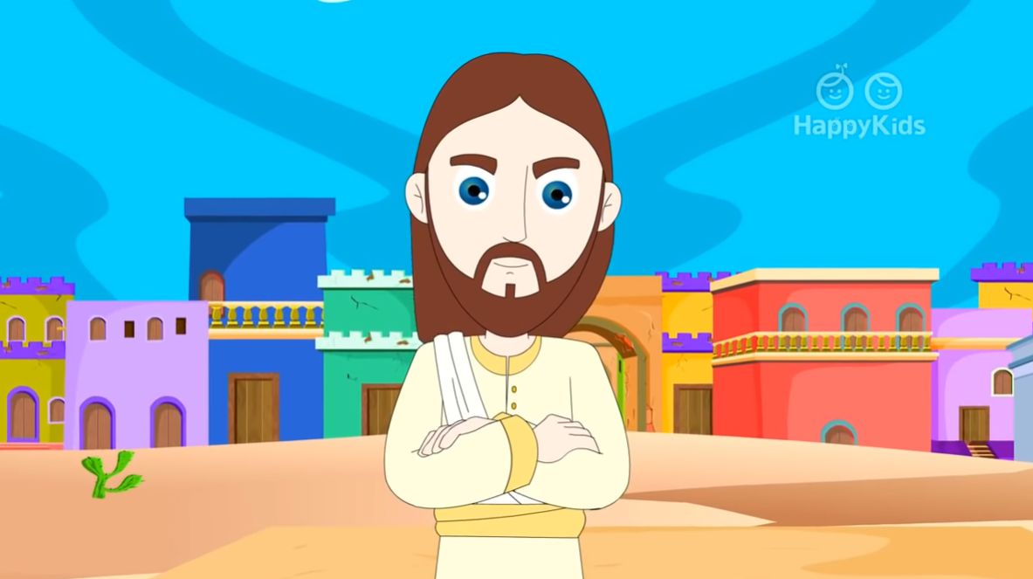
He said to them, "Surely you will quote me this proverb, 'Physician, cure yourself,' and say, 'Do here in your native place the things that we heard were done in Capernaum.'"

Slide 11
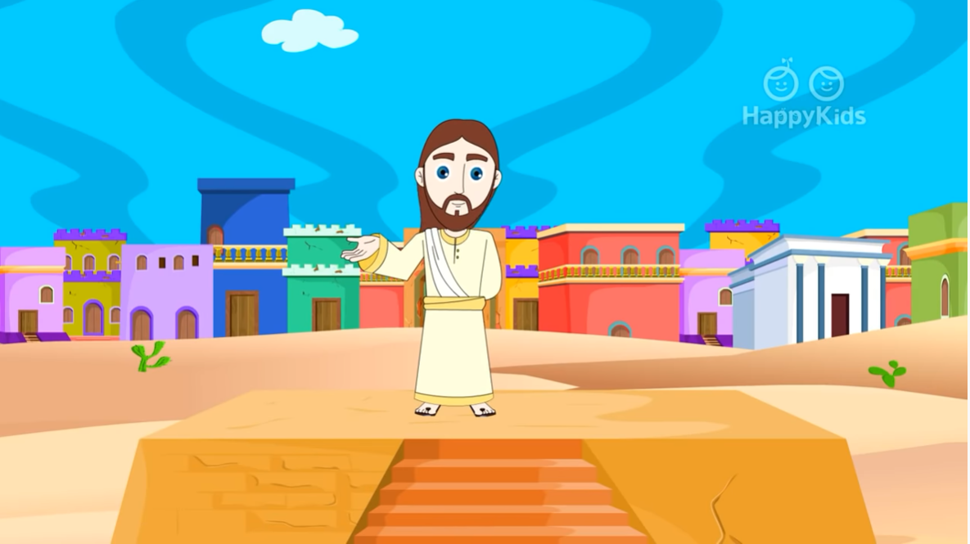
And he said, "Amen, I say to you, no prophet is accepted in his own native place. Indeed, I tell you, there were many widows in Israel in the days of Elijah when the sky was closed for three and a half years and a severe famine spread over the entire land.”

Slide 12
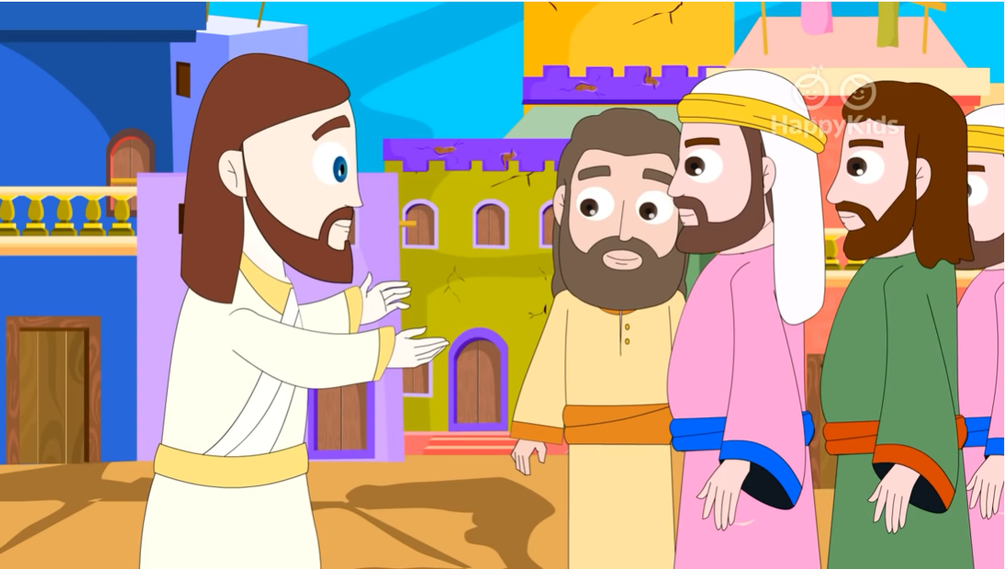
“It was to none of these that Elijah was sent, but only to a widow in Zarephath in the land of Sidon.”

Slide 13
“Again, there were many lepers in Israel during the time of Elisha the prophet; yet not one of them was cleansed, but only Naaman the Syrian."

Slide 14
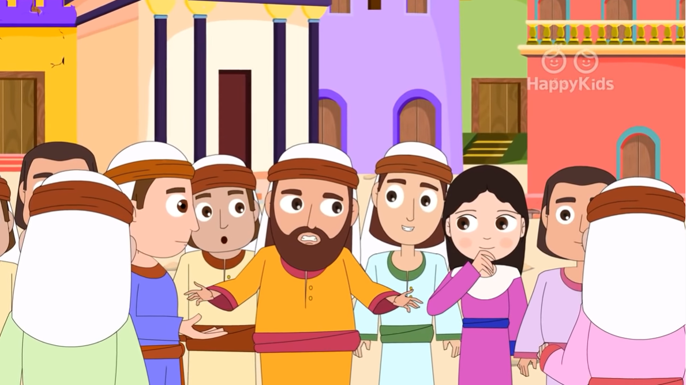
When the people in the synagogue heard this, they were all filled with fury. They rose up, drove him out of the town.

Slide 15
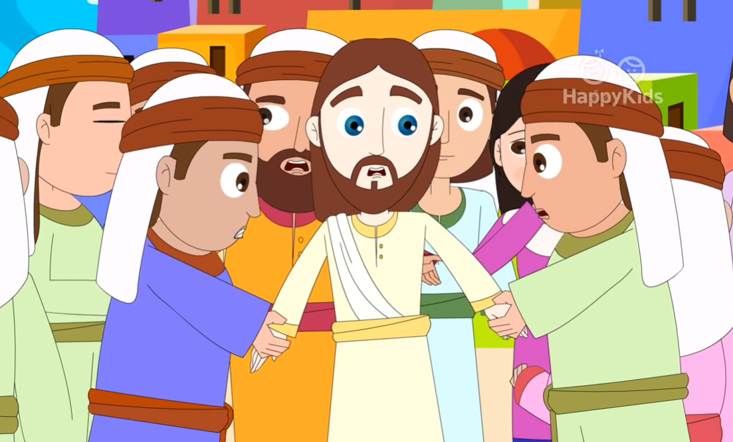
They led him to the brow of the hill on which their town had been built, to hurl him down headlong. But Jesus passed through the midst of them and went away.
THE GOSPEL OF THE LORD. PRAISE TO YOU LORD JESUS CHRIST.

Slide 16
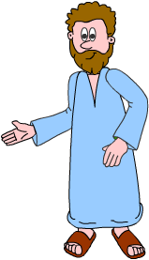
REFLECTION
Jesus read in the synagogue in Nazareth from the book of Isaiah.
Who was Isaiah?
A prophet who lived 765 years before Jesus and who spoke of Him.
What is a prophet?
A person who speaks about God to other people. He can see things that are going to happen in the future, and guide people to God.
After reading, Jesus said, “Today this Scripture passage is fulfilled in your hearing.” What did He mean?
Isaiah’s prophesy was speaking about Jesus, himself.

Slide 17
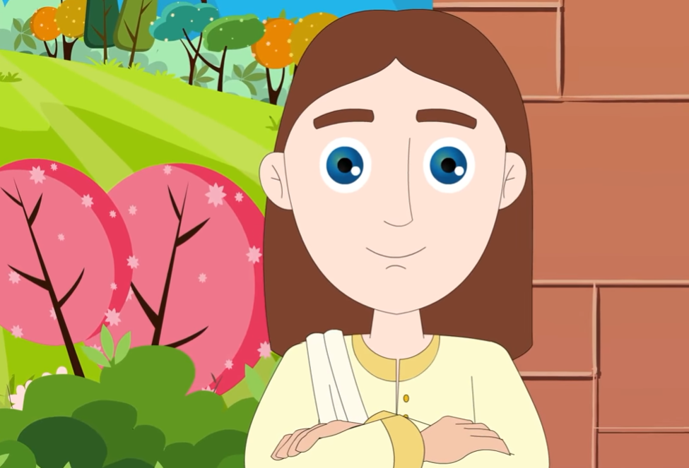
REFLECTION
Jesus was raised in Nazareth. What were the people who knew Him His whole life saying?
Isn't this the son of Joseph? They did not understand how He could be the Messiah.
Jesus, who is God and knows what is in the hearts of everyone, saw that they did not believe Him. What does Jesus say to them?
Amen, I say to you, no prophet is accepted in his own native place.
They saw Him as one of themselves, and not a prophet.

Slide 18
REFLECTION
Then Jesus gives them examples of people in scripture of other nationalities, not Jewish, which were saved by God instead, like the widow of Zarephath and the lepers from Syria.
What was Jesus saying to them?
Sometimes foreigners have more faith than God’s chosen people.
.
This made them very upset and they tried to get rid of Him.

Slide 19
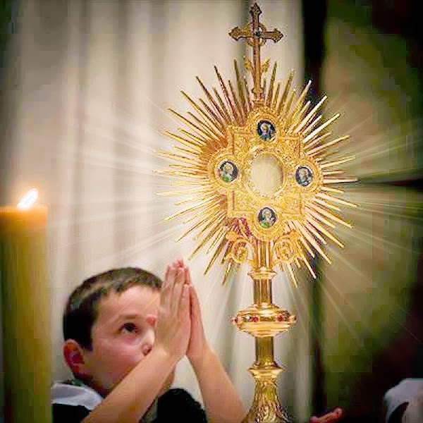
REFLECTION
They saw and heard Jesus and did not believe Him. Do you believe that Jesus is God, who loves and saves you?
How can we increase our faith in Jesus our Savior, our King, our Pastor, our Friend?
We can seek His presence in the 7 Sacraments.
…Especially the Eucharist, where He becomes physically present during the Mass.

Slide 20
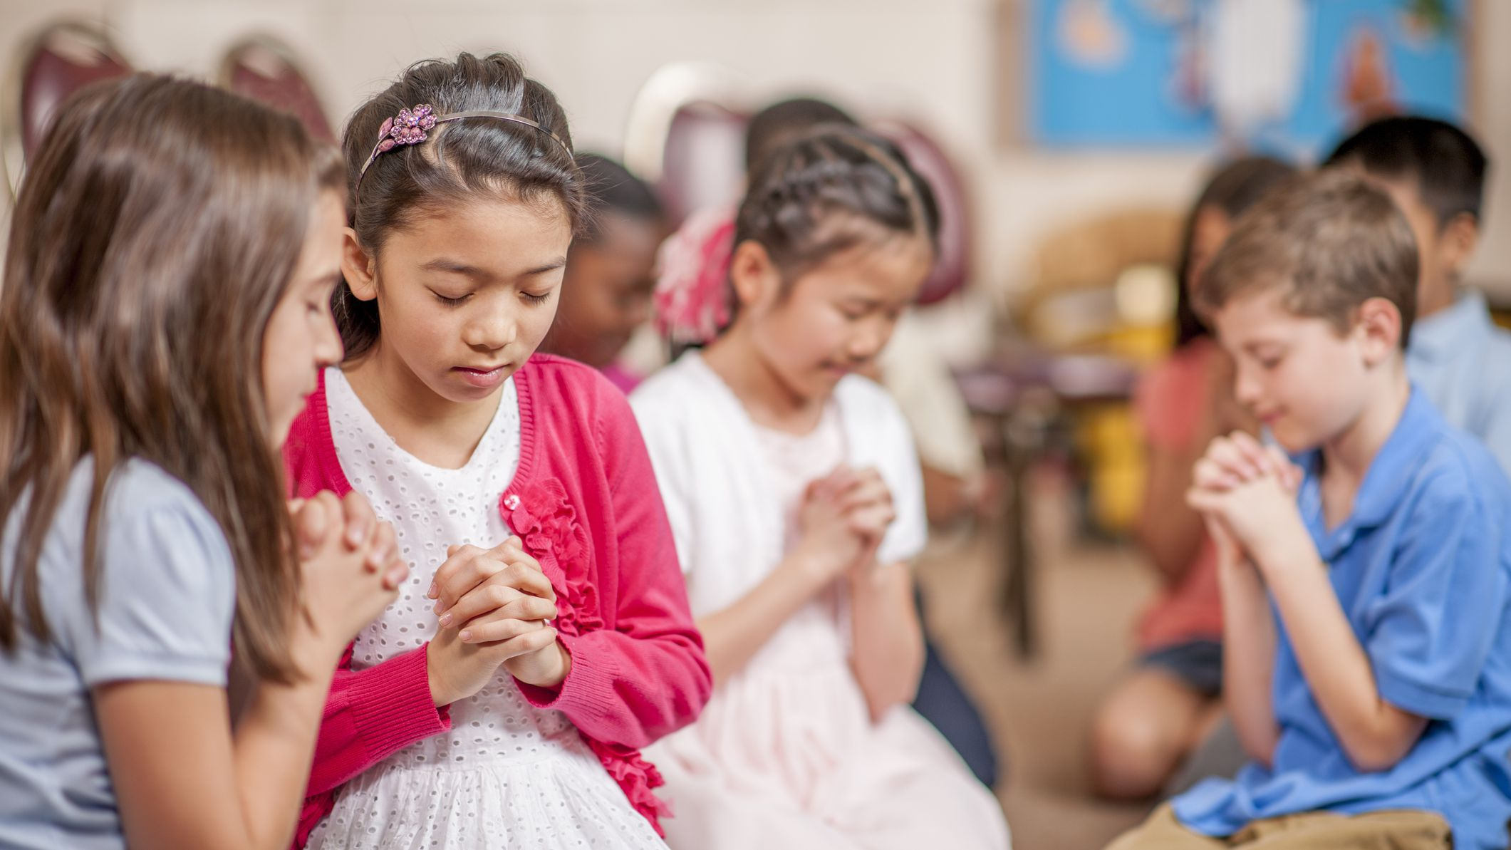
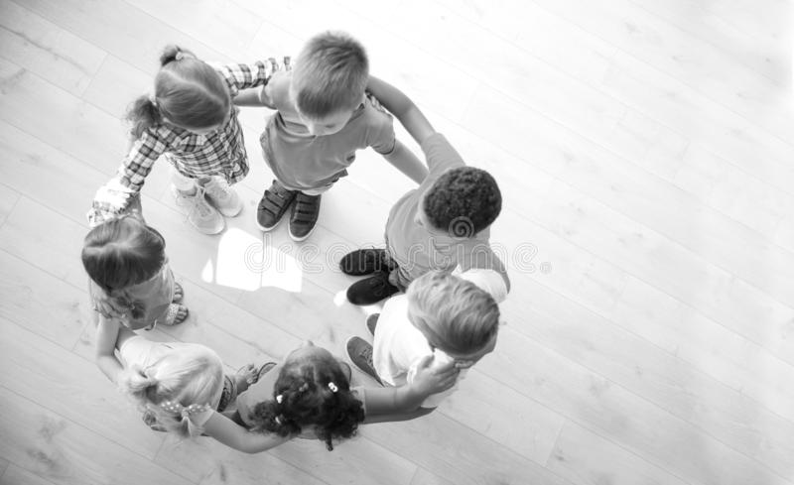
REFLECTION
We can open our hearts and listen to Him…
In prayer,
In Scripture,
In nature,
In our neighbor.

Slide 21
ACTIVITIES

Slide 22
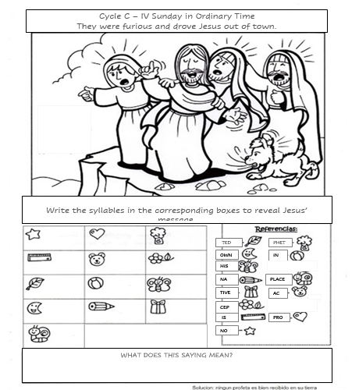
NO
PRO
PHET
IS
AC
CEP
TED
IN
HIS
OWN
NA
TIVE
PLACE

Slide 23
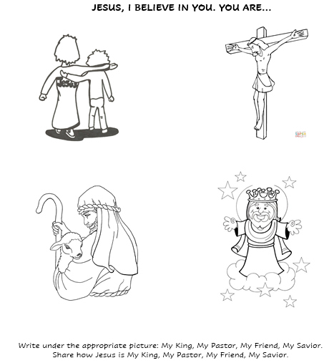
MY FRIEND
MY SAVIOR
MY PASTOR
MY KING

Slide 24
PRAYER
Lord, help me to grow in faith every day. Teach me to see You in all those around me and those that I meet in this life. Help me to be a witness of your presence and Love in this world. Amen
SONG:
I Believe in Jesus, Saddleback Kids,
https://youtu.be/AIKj_Afv-hs

