Slide 1
FRIENDS OF JESUS AND MARY
Cycle C - V Sunday of Easter
John 13,31-33.34-35
JESUS
GIVES US A NEWCOMMANDMENT
OF LOVE

Slide 2
Jesus said, "Now is the Son of Man glorified, and God is glorified in him. If God is glorified in him, God will also glorify him in himself, and God will glorify him at once.”

Slide 3
My children, I will be with you only a little while longer.

Slide 4
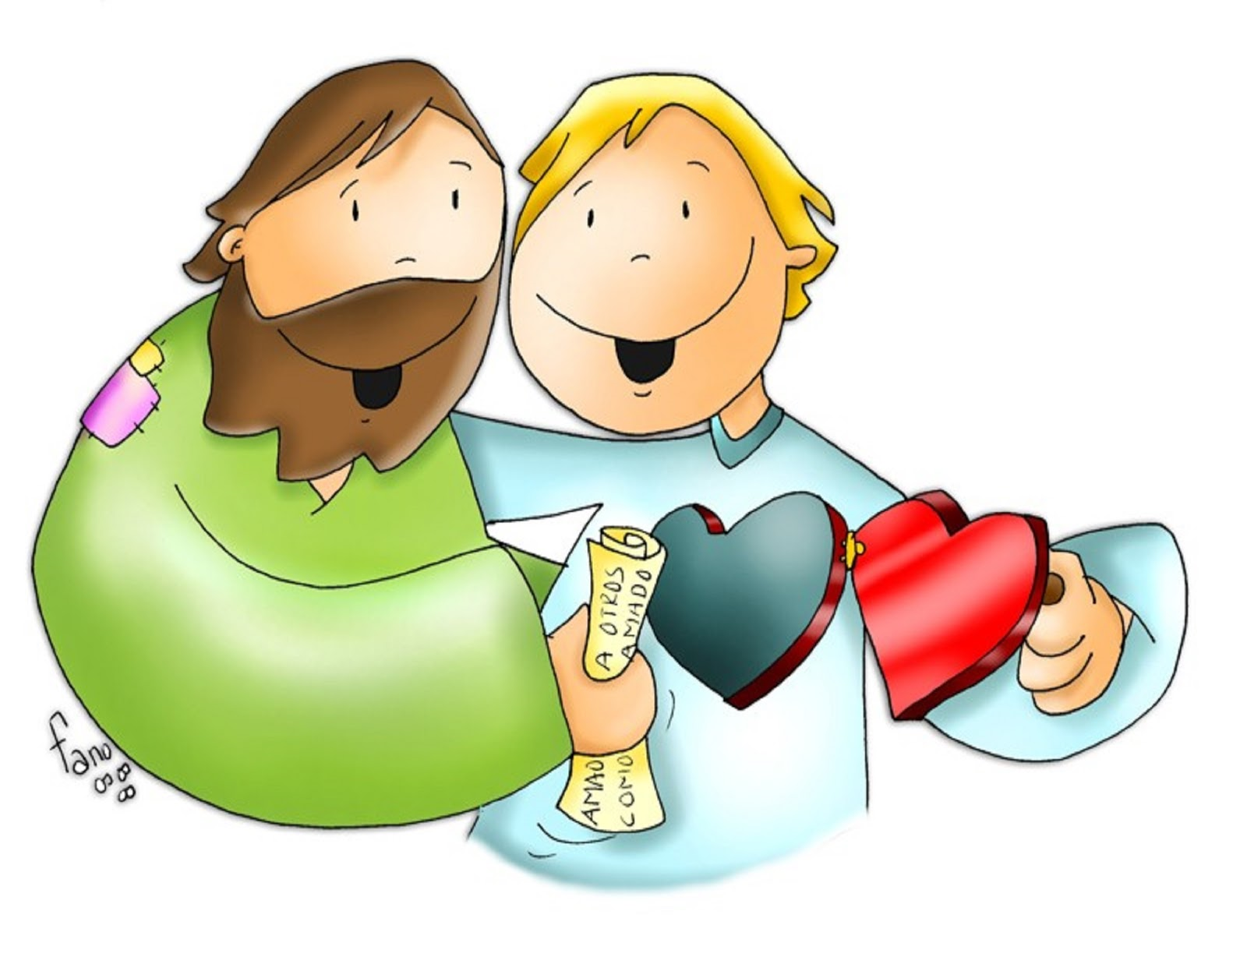
I give you a new commandment:
“As I have loved you, so you also should love one another.”

Slide 5
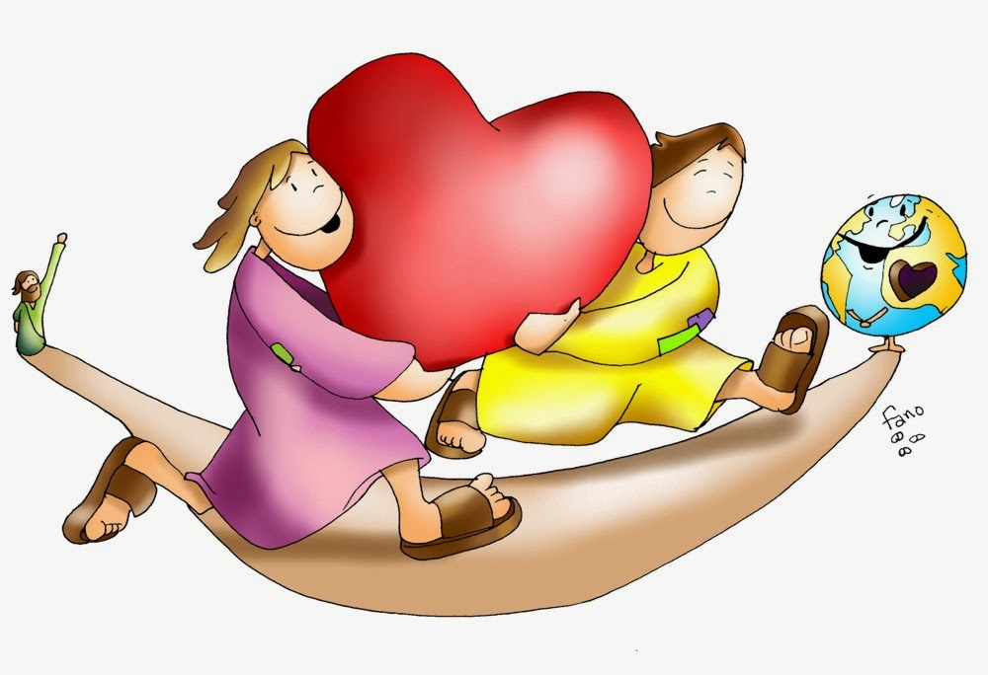
“This is how all will know that
you are my disciples, if you
have love for one another."
The Gospel of the Lord, Praise to you Lord Jesus Christ.

Slide 6
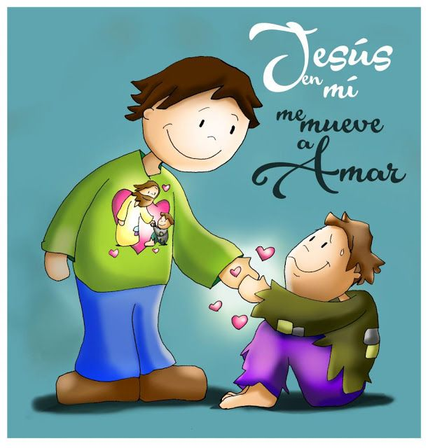
Reflection
JESUS IN ME, MOVES ME TO LOVE

Slide 7
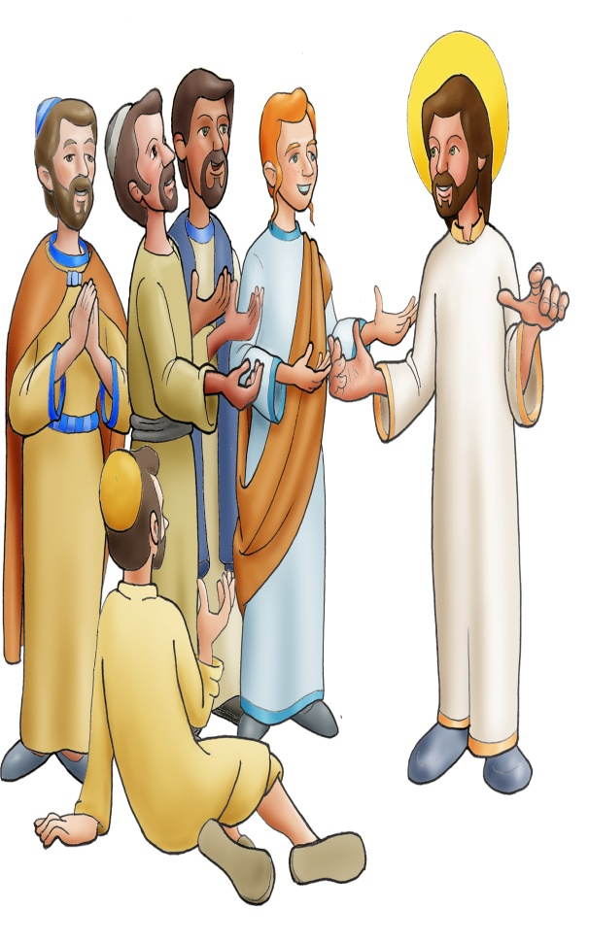
Jesus talks with His disciples and tells them that soon He will be glorified. And His Father will be glorified because they are one.

Slide 8
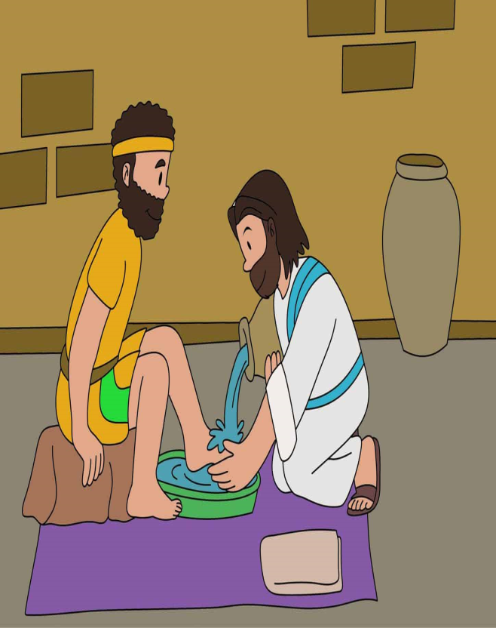
He leaves a new commandment.
«Love one another as I have loved you».

Slide 9
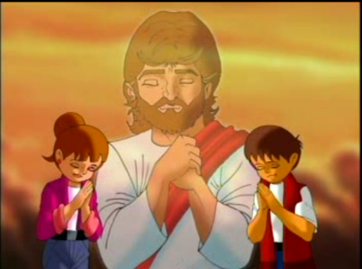
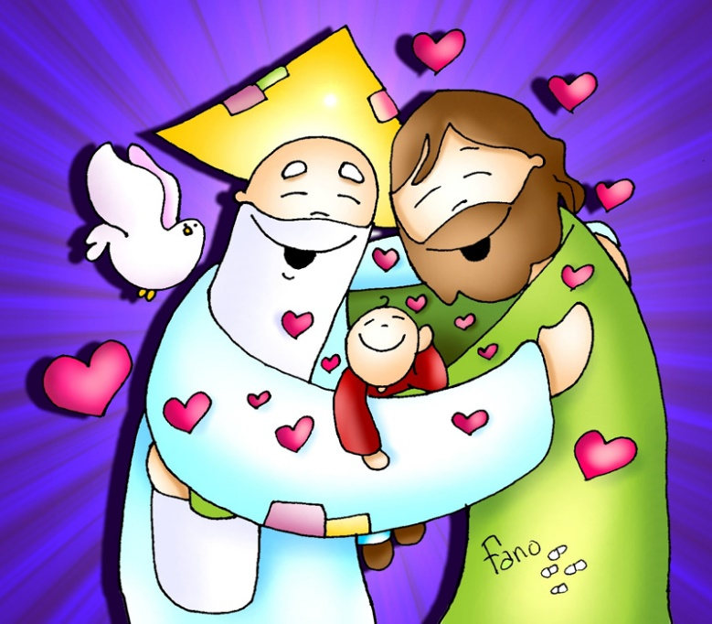
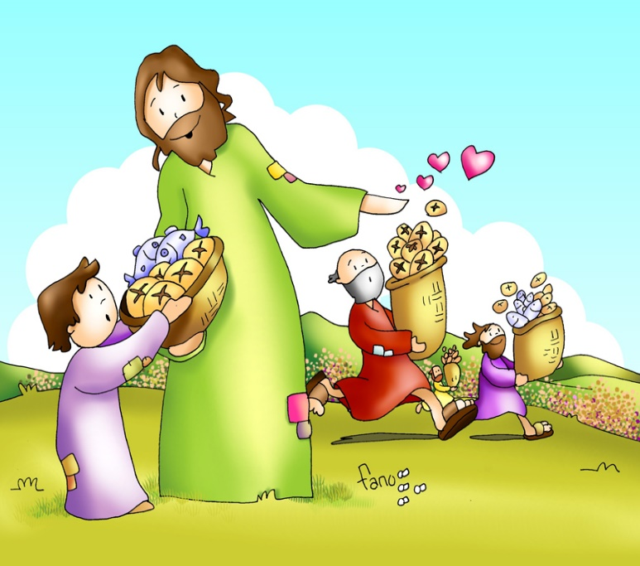
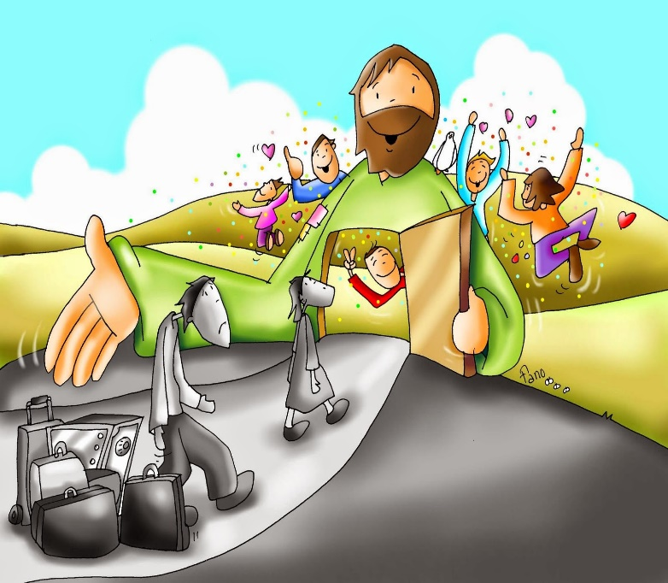
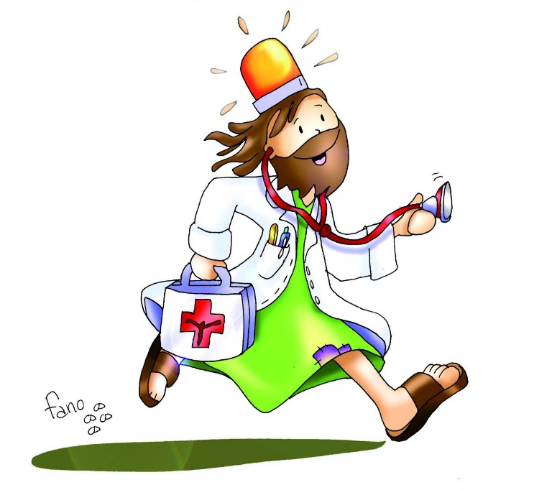
How did Jesus love?
Jesus prayed for them.
Jesus taught about God’s love.
Jesus cured them.
Jesus gave them to eat and drink.
Jesus forgave sins.

Slide 10
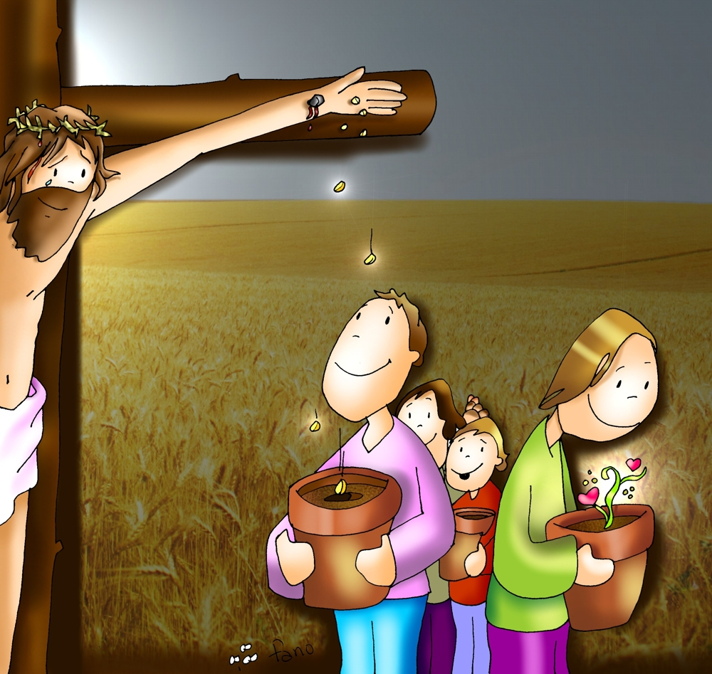
Jesus suffered and died so all may have eternal life…

Slide 11
«Love one another as I have loved you».
Jesus calls us to a heroic love. However, we must know we are first loved by Him. Sharing that love is how we show others that we feel His love in our lives.

Slide 12
How can we love as Jesus did?
Sharing our food with the hungry.
Giving a glass of water to the thirsty
Caring for the sick.

Slide 13
Forgiving
Praying for others,
Sharing our clothes with those that have none.
Being patient with others
Helping Others Learn about God’s Love.

Slide 14
ACTIVITY

Slide 15
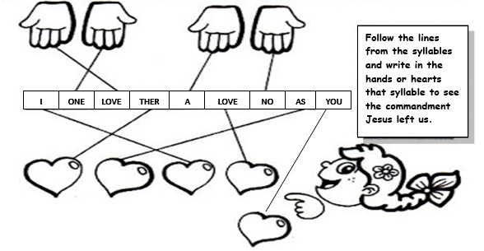
LOVE
ONE
A
NO
THER
AS
I
LOVE
YOU

Slide 16
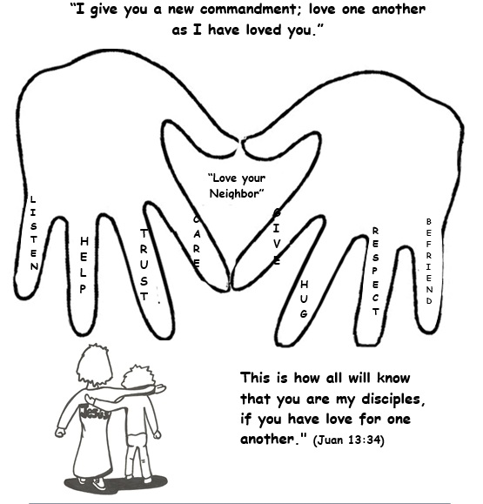
Instructions:
Print these or trace your hands. Draw on each hand a way that you can love your neighbor. Talk about each word in the fingers and how you can love one another using each word.

Slide 17
PRAYER
LOVE ONE ANOTHER
Jesus, you are my best friend. Help me to glorify you by loving my neighbor, especially the one that is most difficult to love. Send your Holy Spirit into my heart and fill it with love. Amen

Slide 18
Love One Another, Dakota Pyle https://youtu.be/LYlkcoAfLU4 (3-7yrs.)

Slide 19
Love One Another, Orange Kids Music https://youtu.be/JysQNwalyIQ (7+ yrs.)

