Slide 1
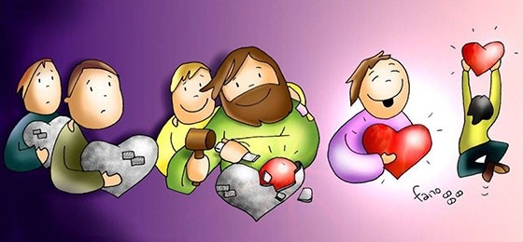
FRIENDS OF JESUS AND MARY
Prayer Group for Children
Cycle C - V Sunday in Lent - The Adulterous Woman
(John 8: 1-11)
www.fcpeace.org
Notes:
1

Slide 2
Jesus went to the Mount of Olives. But early in the morning he arrived again in the temple area, and all the people started coming to him, and he sat down and taught them.

Slide 3
Then the scribes and the Pharisees brought a woman who had been caught in adultery and made her stand in the middle. They said to him, “Teacher, this woman was caught in the very act of committing adultery.

Slide 4
Now in the law, Moses commanded us to stone such women. So what do you say?” They said this to test him, so that they could have some charge to bring against him.

Slide 5
Jesus bent down and began to write on the ground with his finger. But when they continued asking him, he straightened up and said to them, “Let the one among you who is without sin be the first to throw a stone at her.” Again he bent down and wrote on the ground.

Slide 6
And in response, they went away one by one, beginning with the elders. So he was left alone with the woman before him.

Slide 7
Then Jesus straightened up and said to her, “Woman, where are they? Has no one condemned you?” She replied, “No one, sir.” Then Jesus said, “Neither do I condemn you. Go, and from now on do not sin anymore.”
The Gospel of the Lord. Praise to you Lord Jesus Christ..

Slide 8
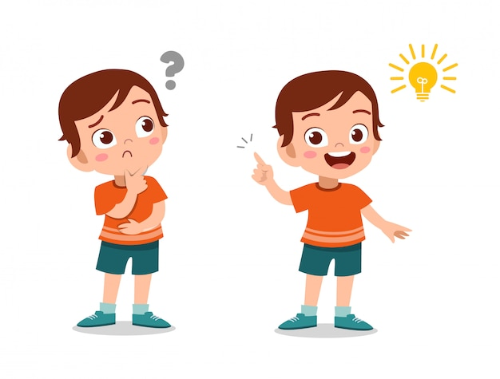
REFLECTION

Slide 9
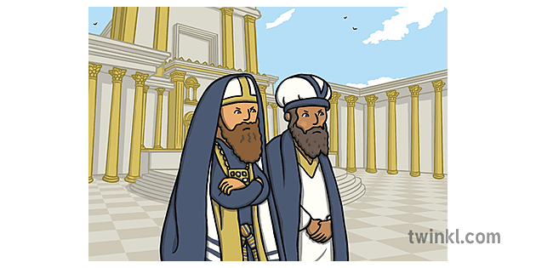
Jesus taught the people in the temple area when the scribes and the Pharisees brought a woman who had been caught in adultery. They were the heads of the Jewish religion. Their intention was to trick Jesus so they could accuse Him, since they did not accept that He is the Messiah.

Slide 10
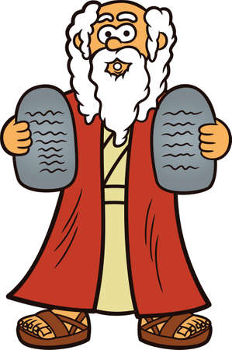
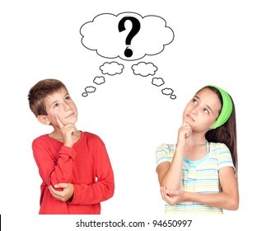
What do they ask Jesus?
Now in the law, Moses commanded us to stone such women. So what do you say?”
If Jesus said yes, they would stone her, something Jesus did not want; if He said no, Jesus would be against the law of Moses and they could accuse Him.

Slide 11
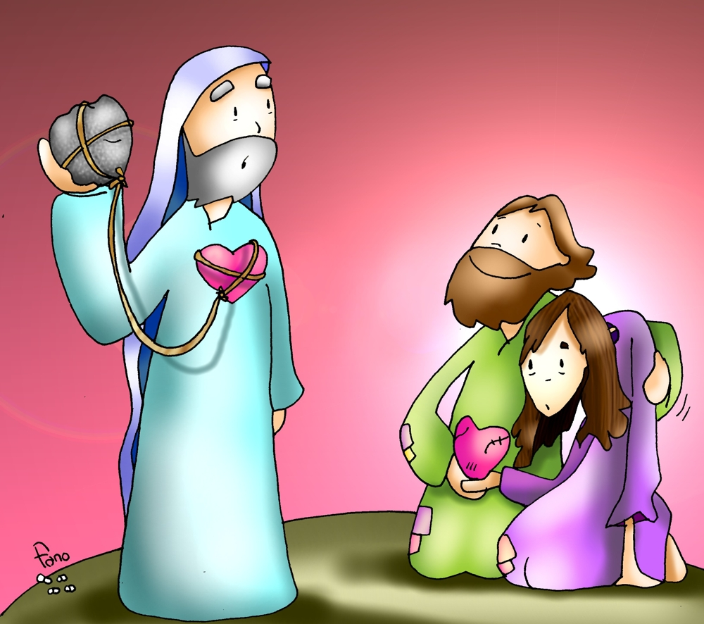
How does Jesus Respond?
Jesus bent down and wrote on the ground. Then He said, “Let the one among you who is without sin be the first to throw a stone at her.”

Slide 12
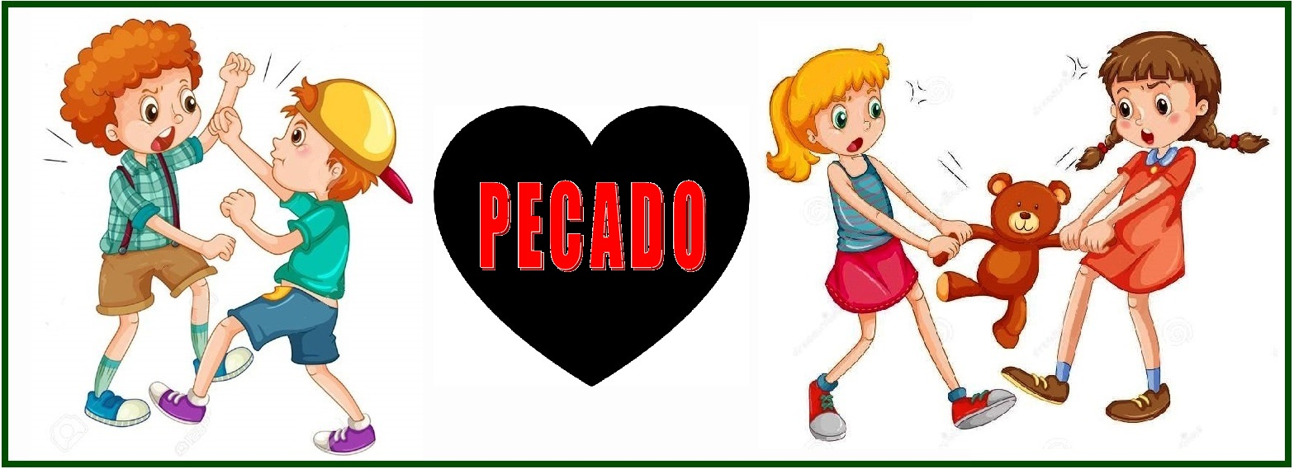
What do the scribes and the Pharisees do?
They left because all of them had sinned. Jesus let them know that we all sin and so only God can judge the sins of others.
SIN

Slide 13
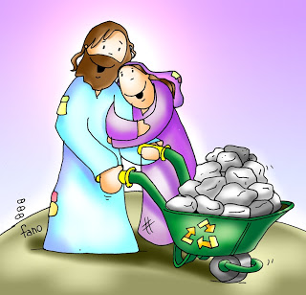
What does Jesus say to the adulterous woman?
“Woman, where are they? Has no one condemned you?” … “Neither do I condemn you. Go, and from now on do not sin anymore.”

Slide 14
We see how Jesus, because He loves us, wants to forgive sinners and that they sin no more so they may feel God’s great love and joy in their hearts.
JESUS FORGIVES US WITH THE POWER OF GOD.

Slide 15
ACTIVITIES

Slide 16
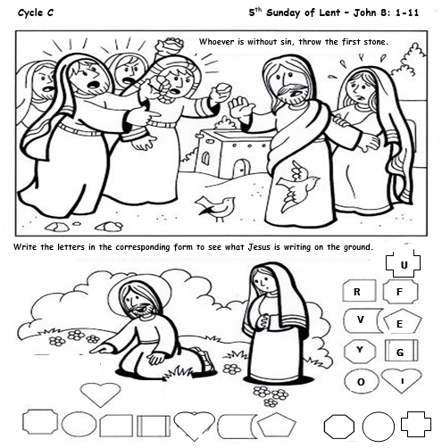
Color the picture and write the letters in the corresponding form to see Jesus’ message.
I
F
O
R
G
I
V
E
Y
O
U

Slide 17
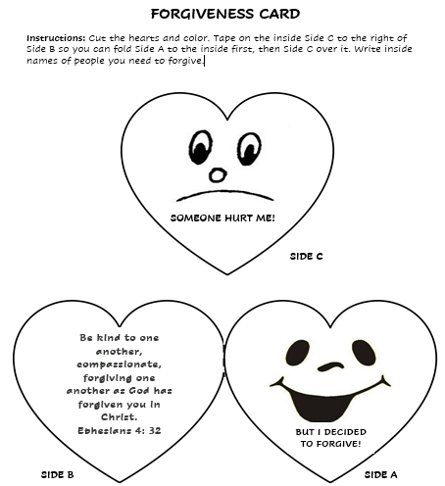
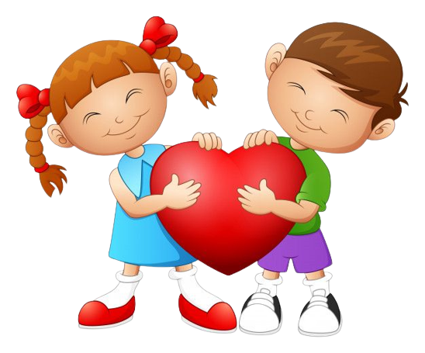
Notes:
17

Slide 18
Lord, sometimes we judge others harshly, yet we cannot see our own errors. You want to forgive us but want us to forgive each other. Help me to always repent and to always forgive those who hurt me. Amen.
PRAYER

Slide 19
You Forgive Me, Lifetree Kids
https://youtu.be/LO-2fm7IKcU

