Slide 1
Friends of Jesus and Mary
Prayer Group for Children
Cycle C-V Sunday in Ordinary Time
The Miraculous Catch – Luke 5, 1-11

Slide 2
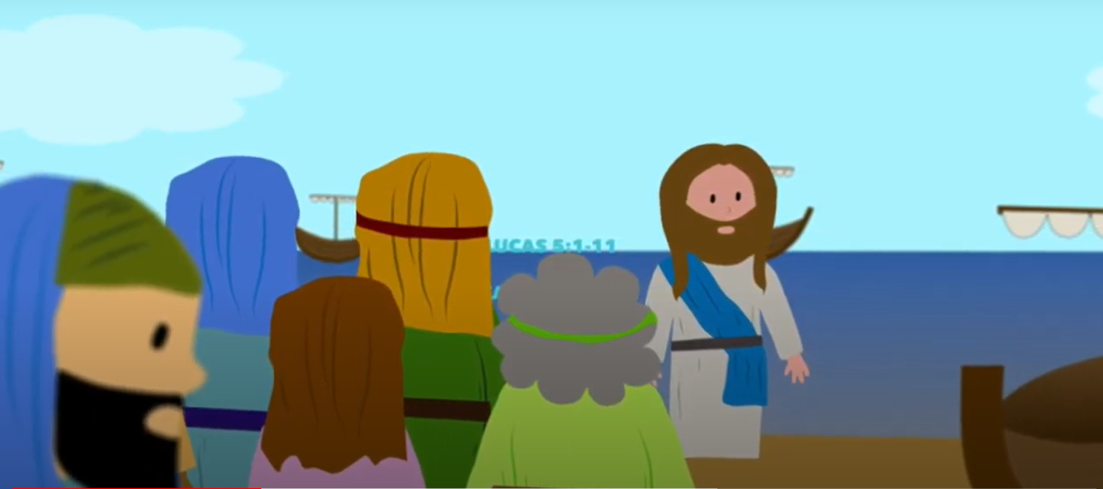
While the crowd was pressing in on Jesus and listening to the word of God,

Slide 3
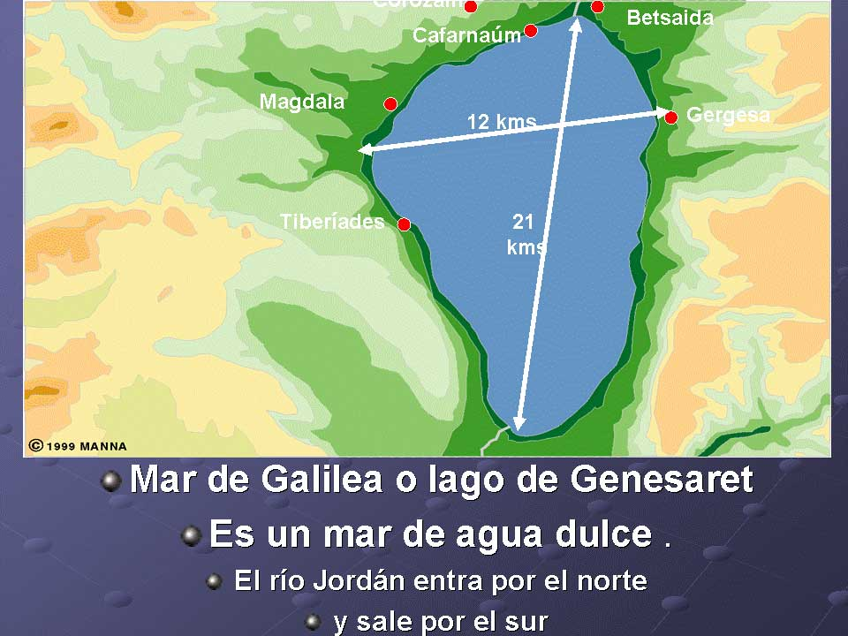
…He was standing by the Lake of Gennesaret.
The Sea of Galilee or the Lake of Gennesaret
Is a fresh water lake.
The Jordan River flows in from the North and out through the South.

Slide 4
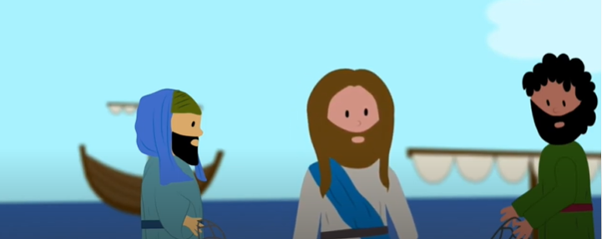
Jesus saw two boats there alongside the lake; the fishermen had disembarked and were washing their nets.

Slide 5
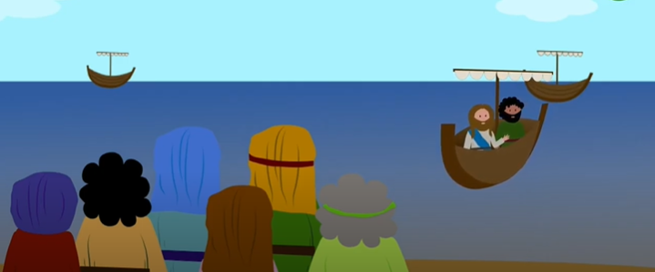
Getting into one of the boats, the one belonging to Simon, he asked him to put out a short distance from the shore. Then he sat down and taught the crowds from the boat.

Slide 6
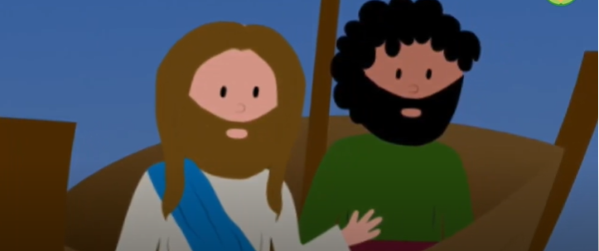
After he had finished speaking, he said to Simon, "Put out into deep water and lower your nets for a catch."
Simon said in reply, "Master, we have worked hard all night and have caught nothing, but at your command I will lower the nets."

Slide 7
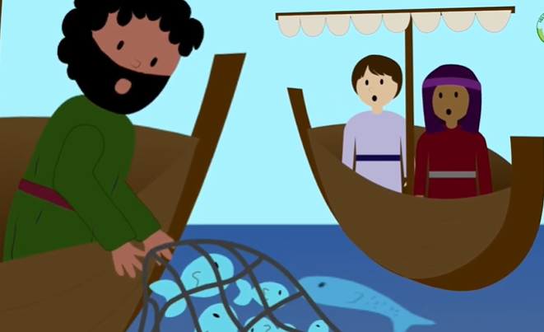
When they had done this, they caught a great number of fish and their nets were tearing. They signaled to their partners in the other boat to come to help them.

Slide 8
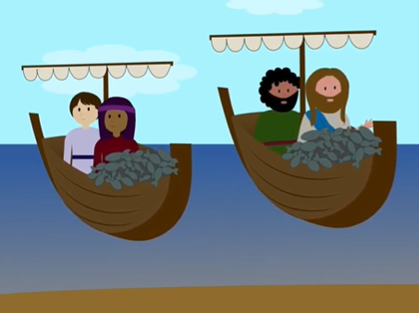
They came and filled both boats so that the boats were in danger of sinking.

Slide 9
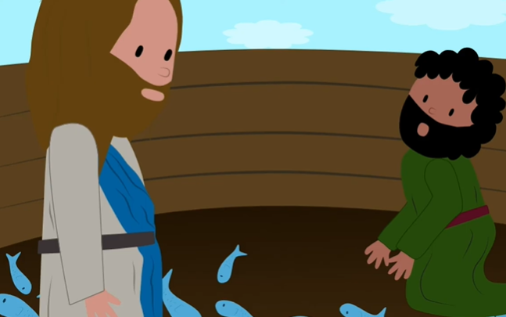
When Simon Peter saw this, he fell at the knees of Jesus and said, "Depart from me, Lord, for I am a sinful man."
For astonishment at the catch of fish they had made seized him and all those with him, and likewise James and John, the sons of Zebedee, who were partners of Simon.

Slide 10
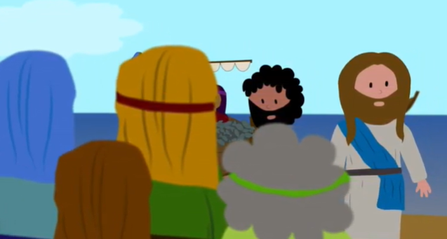
Jesus said to Simon, "Do not be afraid; from now on you will be catching men." When they brought their boats to the shore, they left everything and followed him.
The Gospel of the Lord. Praise to You Lord Jesus Christ.

Slide 11
REFLECTON

Slide 12
Jesus was preaching on the shore of Lake Gennesaret. How did the people react?
The crowd pressed in on Jesus to hear the Word of God because He touched their hearts.

Slide 13
What does Jesus do so they can hear Him better?
He gets on Simon the fisherman’s boat and asks him to push offshore a short distance and He continued preaching.

Slide 14
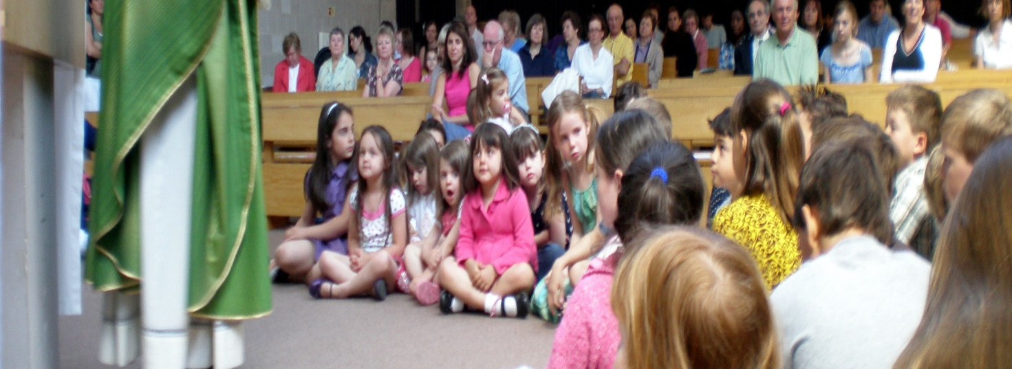
When He finished, Jesus asks Simon to set out to fish again. What does Simon answer?
“Master, we have worked hard all night and have caught nothing, but at your command I will lower the nets”.
Listening to Jesus speak, Simon came to believe in Him.
We also can grow in faith by listening to Jesus speak in the Gospel.

Slide 15
What happened when they went out again?
They caught so many fish that the nets were breaking and the boat was sinking.

Slide 16
How does Simon react to this miracle?
He says, "Depart from me, Lord, for I am a sinful man!"
Why does he say this?
Simon and the other fishermen see that Jesus has the power of God and they feel small and sinful faced with His power and purity.

Slide 17
What does Jesus say to Simon?
"Do not be afraid; from now on you will be catching men."
What does this mean?
Jesus is asking them to leave their work, and to follow Him to save souls.

Slide 18
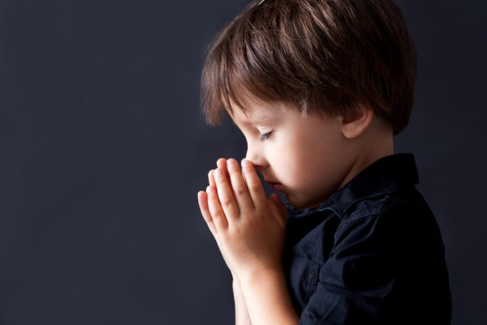
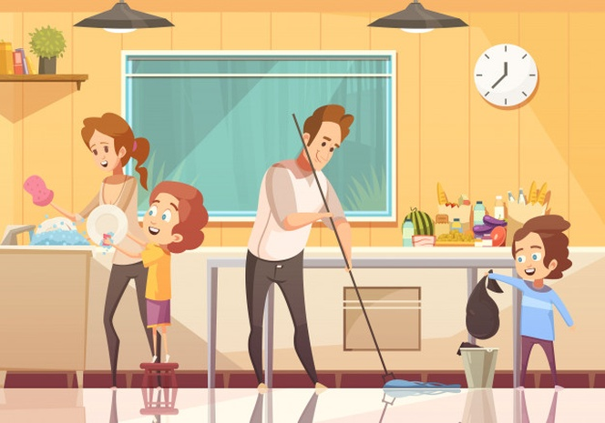
Jesus also calls us to be fishers of men. With Jesus in our boat, how can we help Him save souls?
Praying
For
Others
Sharing the Gospel with them
Helping
Others
Inviting them to Mass

Slide 19
Activity

Slide 20
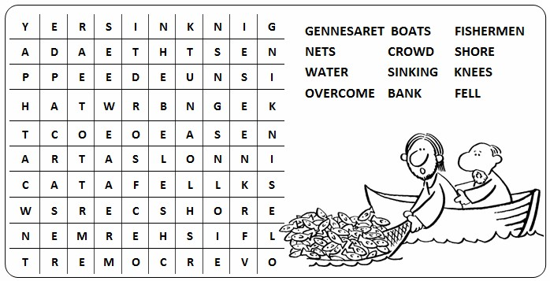

Slide 21
YOU WILL BE CATCHING MEN (Luke 5, 1-11) Cut and color the fish. Write on the blank line groups of people or a person that we need to catch for Jesus: those that don’t believe in God, those that are separated from the Church, those that don’t know God’s love, those that are depressed or disillusioned, a friend or family member…
JESUS, I GIVE YOU ______________________
SO YOU WILL SAVE THEM.

Slide 22
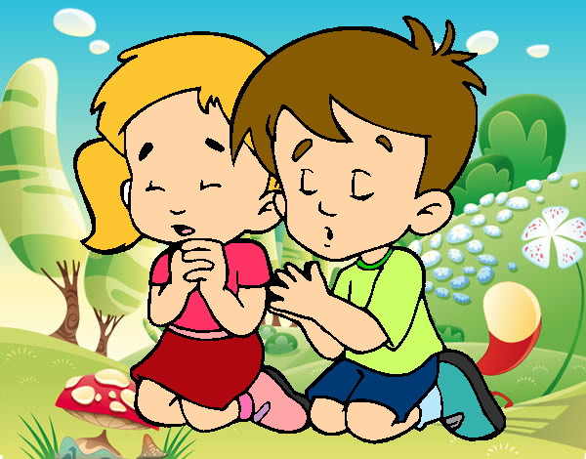
Prayer Jesus, help us to always have faith in you. Help us to always follow you and help in your mission of saving souls. Help us to grow in love every day. Amen.

Slide 23
Song: Come Follow Me, Lifetree Kids https://youtu.be/68IFTA9kwTM

