Slide 1
FRIENDS OF JESUS AND MARY
www.fcpeace.org
YOUR WORD GIVES ME LIFE
Cycle C
VI Sunday
of Easter
John 14, 23-29

Slide 2
INITIAL PRAYER
HOLY SPIRIT, ILUMINATE OUR UNDERSTANDING TO LEARN WHAT YOU WANT TO TEACH US.
MARY OUR MOTHER, HELP US TO BE LIKE YOU TO LISTEN TO THE VOICE OF THE LORD IN OUR HEART.
AMEN

Slide 3
Evangelio según San Juan
GOSPEL ACCORDING TO JOHN
Jesus said to his disciples: "Whoever loves me will keep my word, and my Father will love him, and we will come to him and make our dwelling with him. Whoever does not love me does not keep my words; yet the word you hear is not mine but that of the Father who sent me. "I have told you this while I am with you. The Advocate, the Holy Spirit, whom the Father will send in my name, will teach you everything and remind you of all that I told you.

Slide 4
Evangeli según San Juan
Peace I leave with you; my peace I give to you. Not as the world gives do I give it to you. Do not let your hearts be troubled or afraid. You heard me tell you, 'I am going away and I will come back to you.' If you loved me, you would rejoice that I am going to the Father; for the Father is greater than I. And now I have told you this before it happens, so that when it happens you may believe."

Slide 5
THE GOSPEL OF THE LORD
PRAISE TO YOU LORD JESUS CHRIST

Slide 6
REFLEXIONEMOS
REFLECTION

Slide 7
Jesus says, if we love Him, we will keep His word and the Father and He will make their dwelling in us.
Do we do what Jesus tells us?

Slide 8
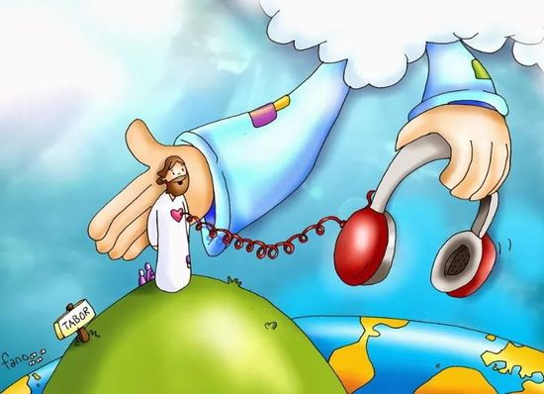
He also says that what He tells us comes from the Father who sent Him because they are One.
Why do God the Father and Jesus want us to keep their word?

Slide 9
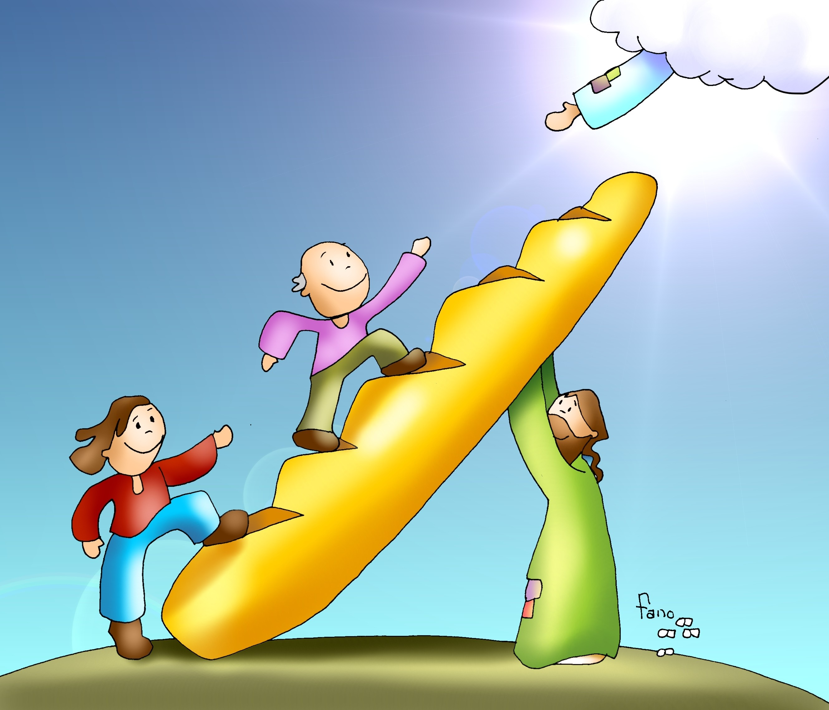
They know if we keep their Word (obey their commandments), God can help us get to Heaven where we will have eternal happiness.

Slide 10
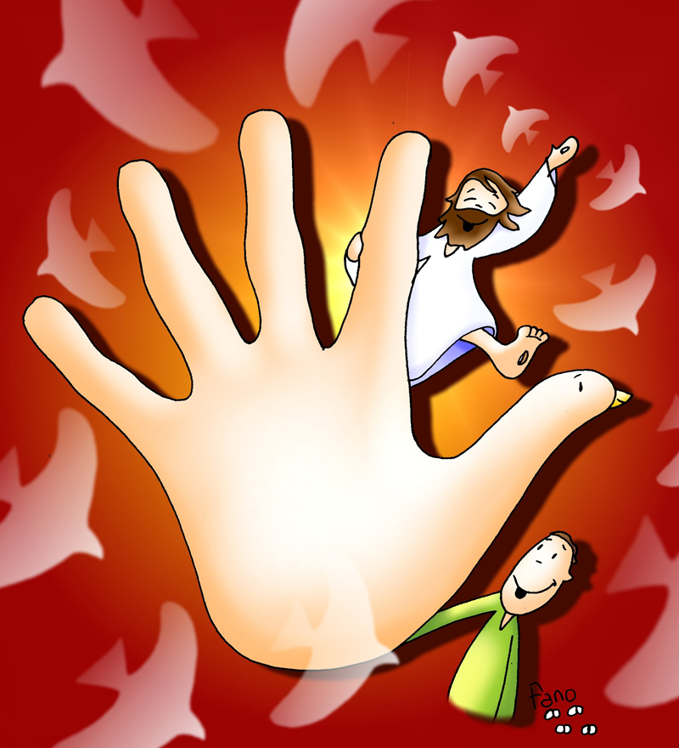
What gift does Jesus give us when we keep His word?
“MY PEACE I GIVE YOU.”

Slide 11
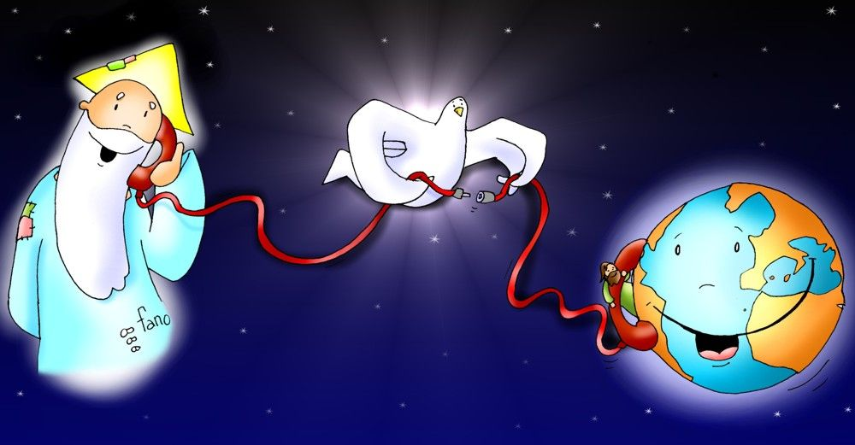
Jesus says the Father will send the Paraclete (the Holy Spirit). What does Jesus say the Holy Spirit will do?
He teaches us all things and reminds us of Jesus’ words.

Slide 12
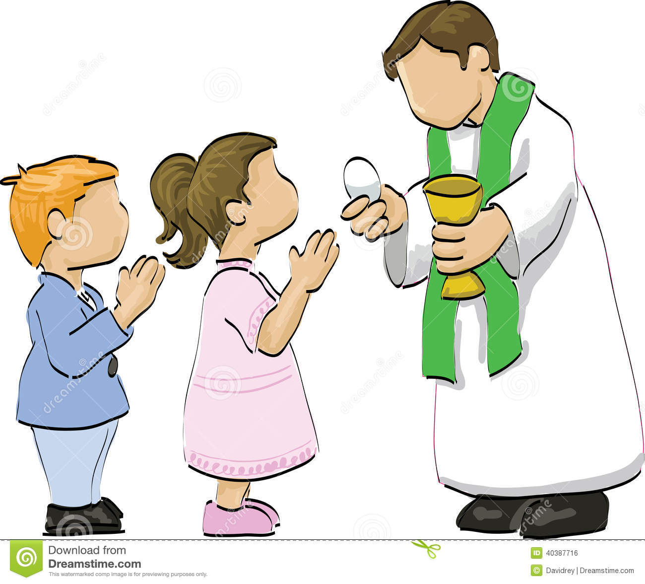
How can the Holy Spirit guide us?
When we pray,
When we read
the bible,
When we go to Church,
When we obey,

Slide 13
The Holy Spirit puts words and thoughts in our heart.

Slide 14
Jesus teaches us that God the Father, God the Son, and God the Holy Spirit tell us the same thing because they are One: One God in three persons. What do we call our One God in three persons?
THE HOLY TRINITY
The Trinity is Love that Saves the World.

Slide 15
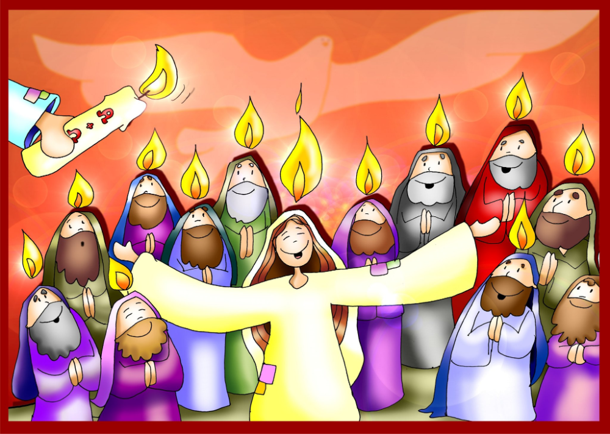
Jesus later promises that He will return to be with them. Jesus is preparing them for the coming of the Holy Spirit on Pentecost (50 days after Easter). He and the holy spirit are one.

Slide 16
ACTIVITY

Slide 17
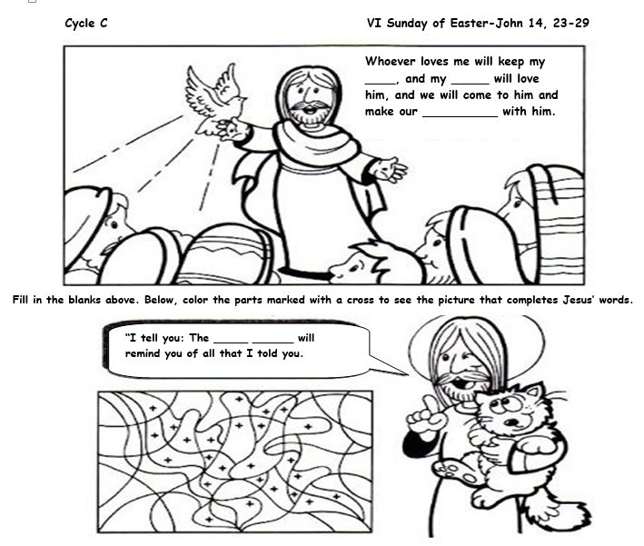
WORD
FATHER
DWELLING
HOLY SPIRIT

Slide 18
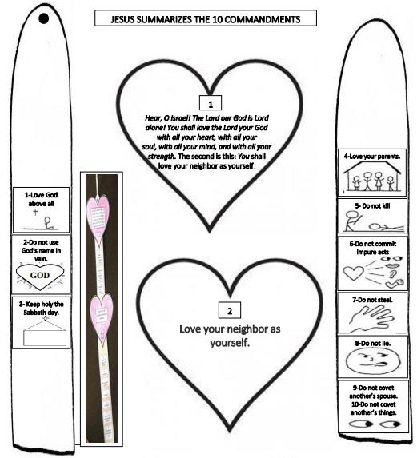
Review god’s commandments

Slide 19
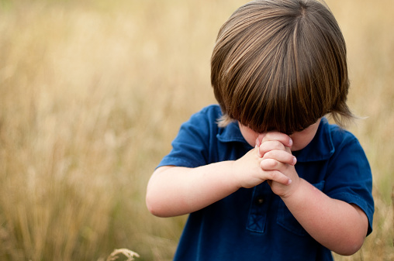
PRAYER
God the Father, God the Son, and God the Holy Spirit,
Thank you for loving me so much. Help me to grow in faith and to accept the mysteries that I cannot understand. Help me to love you more every day and to be obedient so my heart is a place where You will feel welcome and happy. Amen.

Slide 20
Trinity Song, Ryan Folken https://youtu.be/GnUVjLJ6Kas (3-7 years)

Slide 21
Trinity, Song by Pillar Youth Team https://youtu.be/aF_M0WWIU7U (8+ years)

