Slide 1
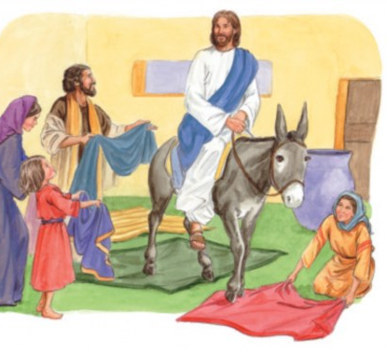
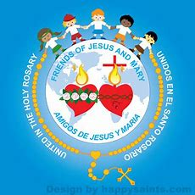
Ministry Friends of Jesus and Mary
Prayer Group for Children
Holy Week and
Cycle C – VI Sunday of Lent
Palm Sunday
“Jesus Enters Jerusalem"
Luke 19, 28-40 y 22, 14-23, 56
www.fcpeace.org

Slide 2
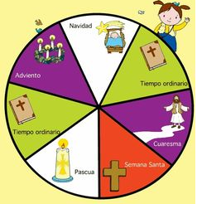
Holy Week begins with Palm Sunday and ends the following Sunday when Easter begins. JESUS RESURRECTS!
Christmas
Advent
Ordinary Time
Ordinary Time
Lent
Holy Week
Easter

Slide 3
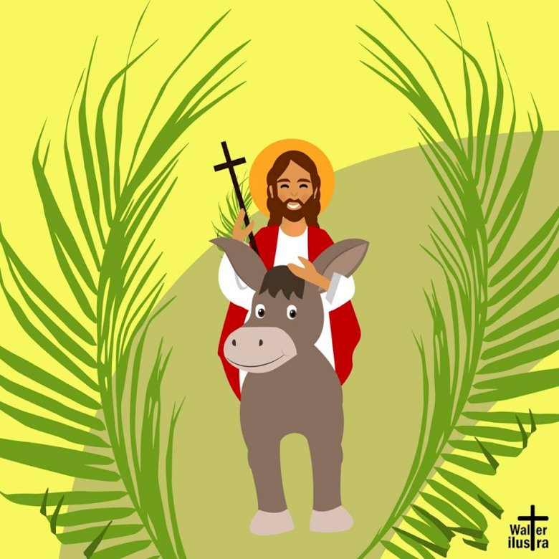
Palm Sunday Jesus’ teachings on prayer and love made even the smallest of his children follow Him. They honored Him as King and Savior when He entered Jerusalem for the last time by waving palm branches. But He knew some did not accept Him. We begin Mass on Palm Sunday with a procession with palms because we also believe Jesus is King and Savior of the world.
HOLY WEEK

Slide 4
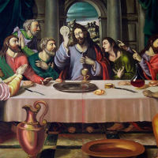
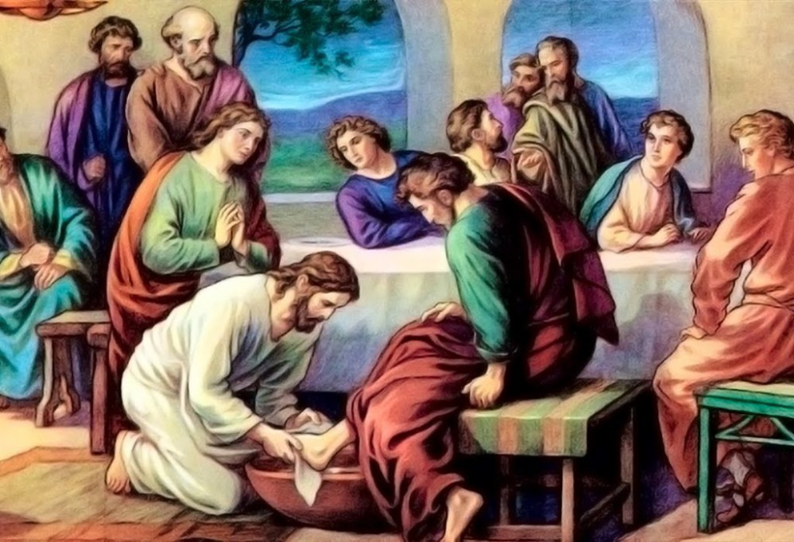
HOLY WEEK
Holy Thursday
Jesus went to Jerusalem to celebrate Passover with His Friends.
…and He washed their feet to show them the importance of serving others.
On Holy Thursday, during Mass, the priest washes certain people’s feet.
He shared the first Eucharist with them…

Slide 5
HOLY WEEK
Good Friday
We remember Jesus’ death on the cross. We come together as a family and honor the cross because our faith teaches us that the cross is truly the “Tree of Salvation” that offers us new life.
On Good Friday, we do the Stations of the Cross in church. During Mass there is no Consecration and at the end Jesus is removed from the tabernacle. It is the only day of the year He is not present in church.
Good Friday
From the Cross you turn on LIFE.

Slide 6
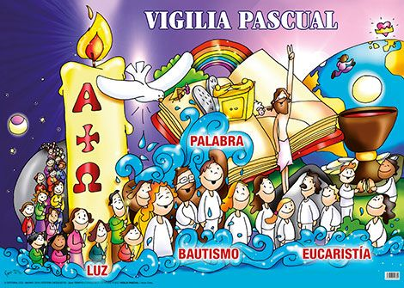
HOLY WEEK
Holy Saturday
(Easter Vigil)
The promise of new life is celebrated with Baptisms on the Easter Vigil. On Holy Saturday, new members of the Christian family are baptized and receive a white robe to symbolize new life in Christ.
Easter Vigil
WORD
BAPTISM
EUCHARIST
LIGHT

Slide 7
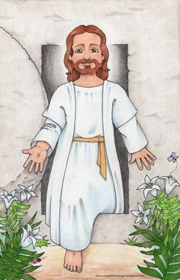
Resurrection Sunday
HOLY WEEK
We celebrate that Jesus rose from the dead, victorious over death and opened the gates of Heaven for us!
Alleluia!

Slide 8
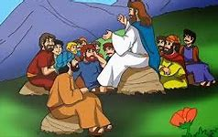
Gospel for Palm Sunday
“Jesus Enters Jerusalem"
Jesus proceeded on his journey up to Jerusalem. As he drew near to Bethphage and Bethany at the place called the Mount of Olives, he sent two of his disciples. He said, "Go into the village opposite you, and as you enter it you will find a colt tethered on which no one has ever sat. Untie it and bring it here. And if anyone should ask you, 'Why are you untying it?' you will answer, 'The Master has need of it.'"

Slide 9
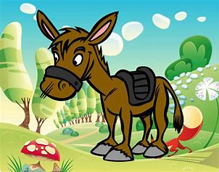
So those who had been sent went off and found everything just as he had told them. And as they were untying the colt, its owners said to them, "Why are you untying this colt?" They answered, "The Master has need of it." So they brought it to Jesus, threw their cloaks over the colt, and helped Jesus to mount.

Slide 10
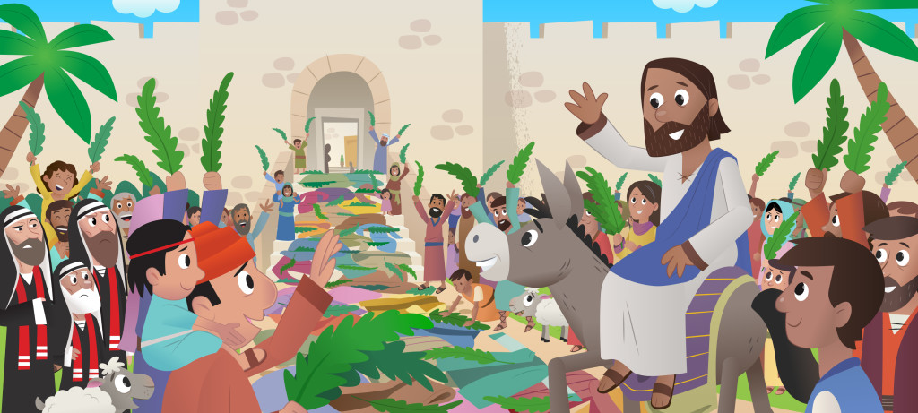
As he rode along, the people were spreading their cloaks on the road; and now as he was approaching the slope of the Mount of Olives, the whole multitude of his disciples began to praise God aloud with joy for all the mighty deeds they had seen. They proclaimed: "Blessed is the king who comes in the name of the Lord. Peace in heaven and glory in the highest." Some of the Pharisees in the crowd said to him, "Teacher, rebuke your disciples." He said in reply, "I tell you, if they keep silent, the stones will cry out!"

Slide 11
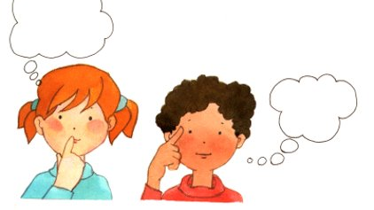
Reflection

Slide 12
The Gospel talks about Jesus’ entrance into Jerusalem.
Let’s reflect...
Jesus entered Jerusalem to celebrate Passover, and to complete His mission to suffer and die on the cross for the forgiveness of our sins. In Passover, the Jews celebrate when God freed them from slavery in Egypt.
How did Jesus know a donkey was waiting for Him and his Master would gladly lend him?
He is God and knows everything.
Why did Jesus enter on a donkey?
This animal is used as a symbol of peace, of gentleness, of humility. Jesus teaches us to be humble! How lucky this donkey which served as the throne for Jesus, our King!

Slide 13
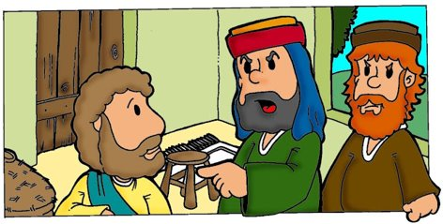
How did they receive Him in Jerusalem?
The people spread their cloaks on the road and praised Him as King for all the mighty deeds He had done.
What did they shout?
"Blessed is the king who comes in the name of the Lord. Peace in heaven and glory in the highest."
Why did the Pharisees want to quiet the crowd?
The people were praising the coming of the Messiah, the King who comes in the name of the Lord. But the Pharisees did not accept that Jesus was the Messiah.

Slide 14
Jesus is always waiting for us with open arms.
What does Jesus answer them?
He confirms that He is the Messiah come from God by saying: "I tell you, if they keep silent, the stones will cry out!"
Only God can make the stones cry out.

Slide 15
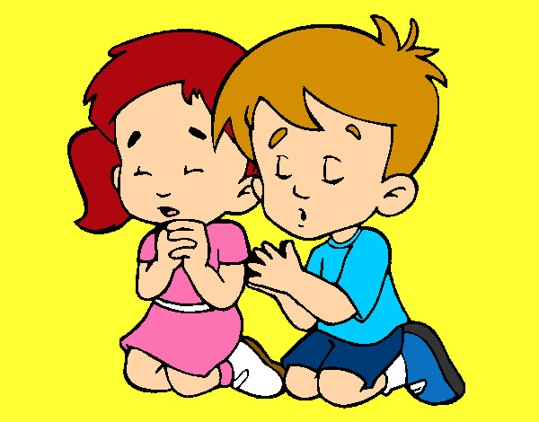
How do we show Jesus every day that He is the King of our heart?
Praying
Being obedient
Loving others

Slide 16
Activity

Slide 17
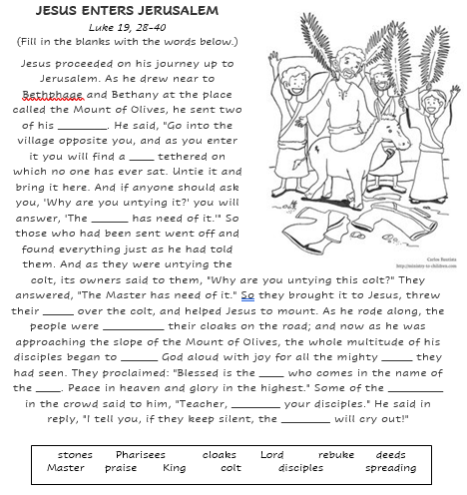
disciples
colt
Master
cloaks
spreading
praise
deeds
King
Lord
Pharisees
rebuke
stones

Slide 18
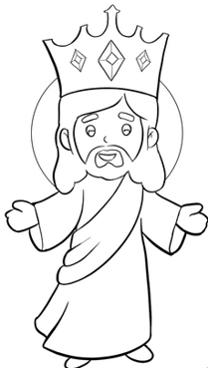
PALM SUNDAY JESUS ENTERS JERUSALEM
The people praised Jesus by waving palms and shouting: Blessed the King who comes in the name of the Lord! We can praise Jesus daily with our words and actions. Write in the palm branch ways that we can honor Jesus with our lives every day.
BLESSED THE KING
Thank you
God for my
family!
I pray for…
I will ask my Mom to take me to mass today.
I forgive … for
hurting me.
Examples:
Thanking God for everything
Attending Mass
Respecting and obeying our parents
Being happy
Forgiving someone who hurts me
Praying often
Visiting a sick person
Sharing my things and time
I will call ... who is sick
to see how they are.
Today I
will do all my parents say.
I will donate some of my toys.

Slide 19
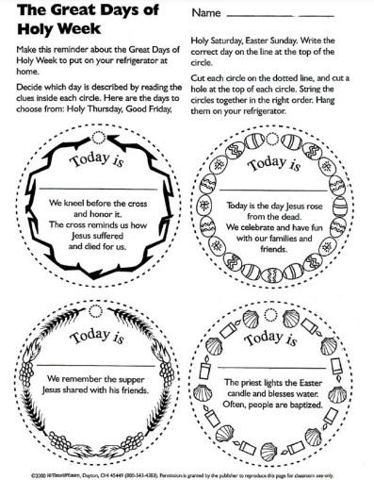
Good Friday
Easter
Holy Thursday
Holy Saturday

Slide 20
Prayer Lord, thank you for loving me so much! Being King of the universe, you humbled yourself unto death on the cross for me. Help me to honor you always as King of my heart and of the world. May my words and actions always give you glory. Amen

Slide 21
Shout Hosanna, TheRealDonutMan https://youtu.be/rem79QoAwtY (3-6 yrs.)

Slide 22
Hosanna, Praise is Rising, Curtis Swallow, https://youtu.be/NSBR-r9B_94 (7+ years)

